Slide 1
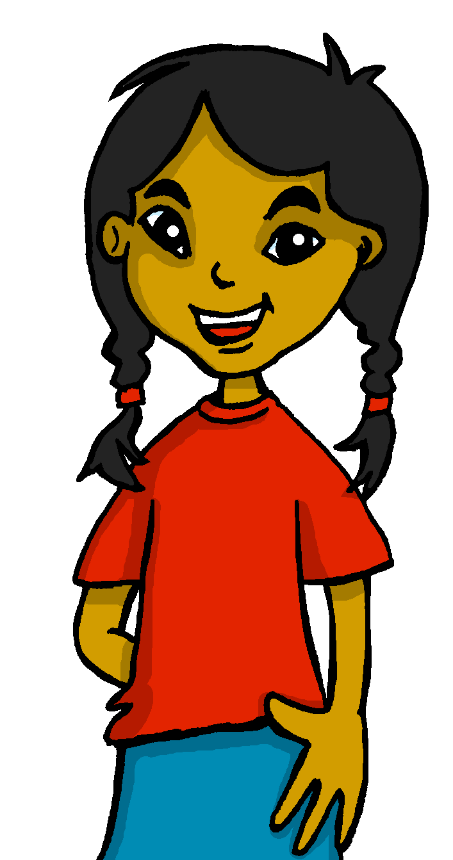
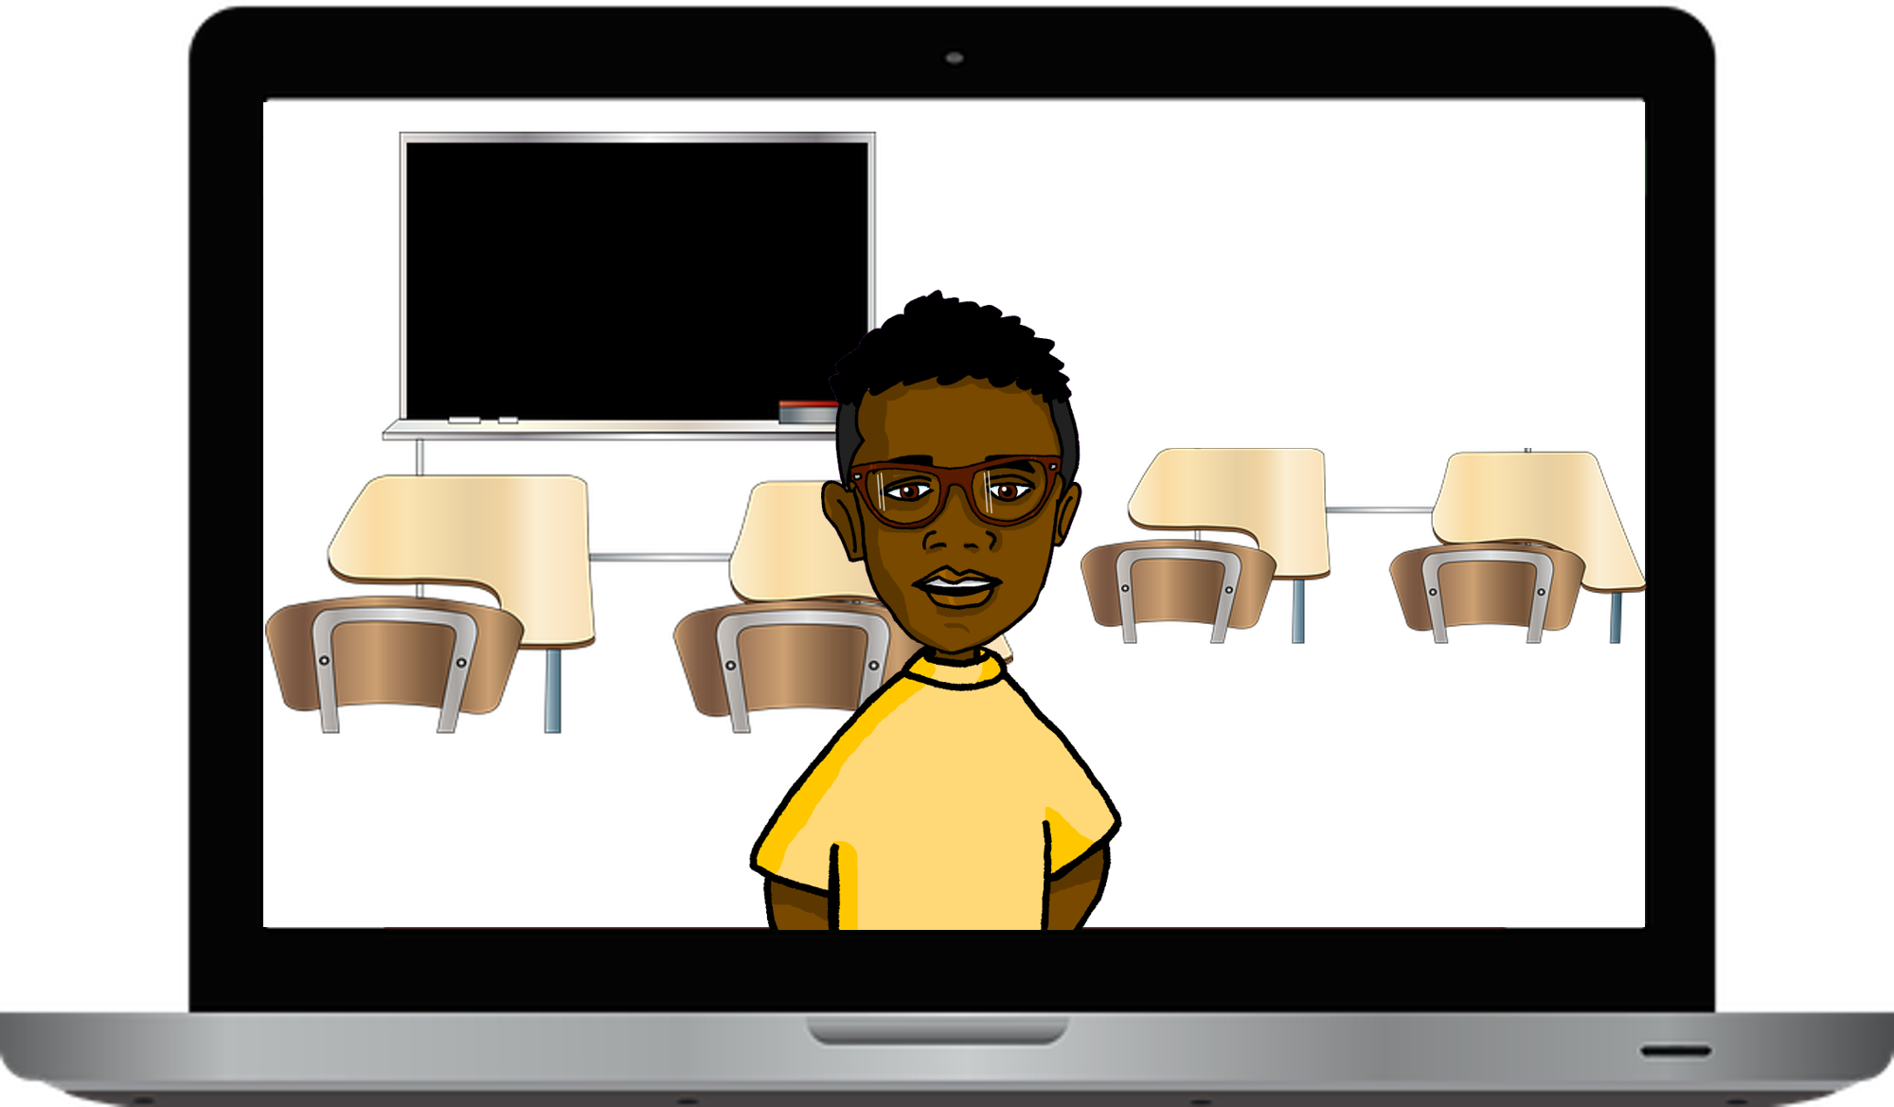
Saying what I and others like/dislike, and have to do
Puedo hacer muchas cosas
📝
🔊
💬
🎶
verde
Follow ups 1-5
Notes:
Artwork by Steve Clarke. All additional pictures selected are available under a Creative Commons license, no attribution required.
The frequency rankings for words that occur in this PowerPoint which have been previously introduced in the resources are given in the SOW (excel document) and in the resources that first introduced and formally re-visited those words.
Phonics: SSC revision 2
Vocabulary (new words in bold): poder, puedo, puedes, puede [32] tren [1488]
Revisit 1: persona [108] gente [137] dinero [364] tráfico [>5000]
Revisit 2: primo [1451] voy [ir 33] vas [ir 33] va [ir 33] estoy [estar 21] está [estar 21] estás [estar 21] calle [269] cine [952] estadio [2581] parque [1354] playa [1475] plaza [806] teatro [605] a [8] el [1] la [1]
Frequency of unknown words:
empezar [175] encuesta [2077] sobre [62] Source: Davies, M. & Davies, K. (2018). A frequency dictionary of Spanish: Core vocabulary for learners (2nd ed.). Routledge: London
For any other words that occur incidentally in this PowerPoint, frequency rankings will be provided in the notes field wherever possible.

Slide 2
Follow up 1:
[A] Escucha y canta 🎤.
Monto en un tren, por primera vez
Va muy veloz*. Todo esto en nuevo
Suena el silbato*, pero no tengo miedo.
¡Yo sí puedo!
[chorus]
Monto en bicicleta, por primera vez
Pedaleo* fuerte*. Todo esto en nuevo
Viene* una colina 🏔 , pero no tengo miedo.
¡Yo sí puedo!
hablar
escuchar
[
Run, run esto es nuevo y diferente
Run, run pero voy a ser* valiente*
Run, run, yo no tengo miedo, yo sí puedo.
Monto en camión, por primera vez*
El camión 🚌 es grande. Todo esto en nuevo
Suena* la bocina*, pero no tengo miedo.
¡Yo sí puedo!
Monto en avión 🛫, por primera vez*
Se mueve* en el aire. Todo esto en nuevo
Suena* el motor*, pero no tengo miedo.
¡Yo sí puedo!
[chorus x2]
No hay dada que temer lo vas a hacer
chorus
Notes:
Timing: 5 minutes
Aim: to revisit several SSC .
Procedure:
Read and clarify the instruction.
Listen once for pupils to appreciate and become familiar with the rhythm
Listen one more time and encourage pupils to sing along
Video source:
https://www.youtube.com/watch?v=jHGgI3aI9hI&ab_channel=123Andr%C3%A9s
voy a ser = I’m going to be
valiente = brave
por primera vez = first time
Suena = it rings / sounds
(la) bocina = horn
veloz = fast
(el) silbato = whistle
Pedaleo = I pedal
fuerte = hard
(el) motor = engine

Slide 3
Follow up 2 [a]:
1
c
7
e
6
_
_
_
¿Qué palabra es?
v
o
y
_
l
8
_
vocabulario
_
e
c
m
_
p
l
Abajo ⬇
1. to understand
3. To talk, talking
7. cinema
8. theatre
Horizontal ➡
2. people
4. To go, going
5. To write, writing
6. I go
i
3
_
_
t
h
_
r
n
2
_
g
_
_
e
_
l
a
e
n
t
e
b
_
a
n
d
_
_
t
l
_
_
b
_
_
_
c
r
r
_
s
_
5
e
_
i
i
a
4
_
_
i
r
o
_
r
Notes:
Timing: 5 minutes
Aim: to revisit vocabulary from previous weeks.
[Part 1]
Procedure: 1.Teachers model the task by drawing pupils’ attention to the clues on the left-hand side of the slide.
NB. All these words have been introduced and practised before.
2. Ensure the meaning of ‘abajo’ and ‘horizontal’ is clear. 3. Pupils can work in pairs and try to translate as many as they can.
4. Elicit meaning from pupils and click on the numbers to bring up the answers.
NB. Further rounds of learning can be facilitated by one pupil turning away from the board, and his/her partner asking him/her the meanings (‘Cómo se dice X en español?’). This activity can work from L2 → L1 or L1 → L2.

Slide 4
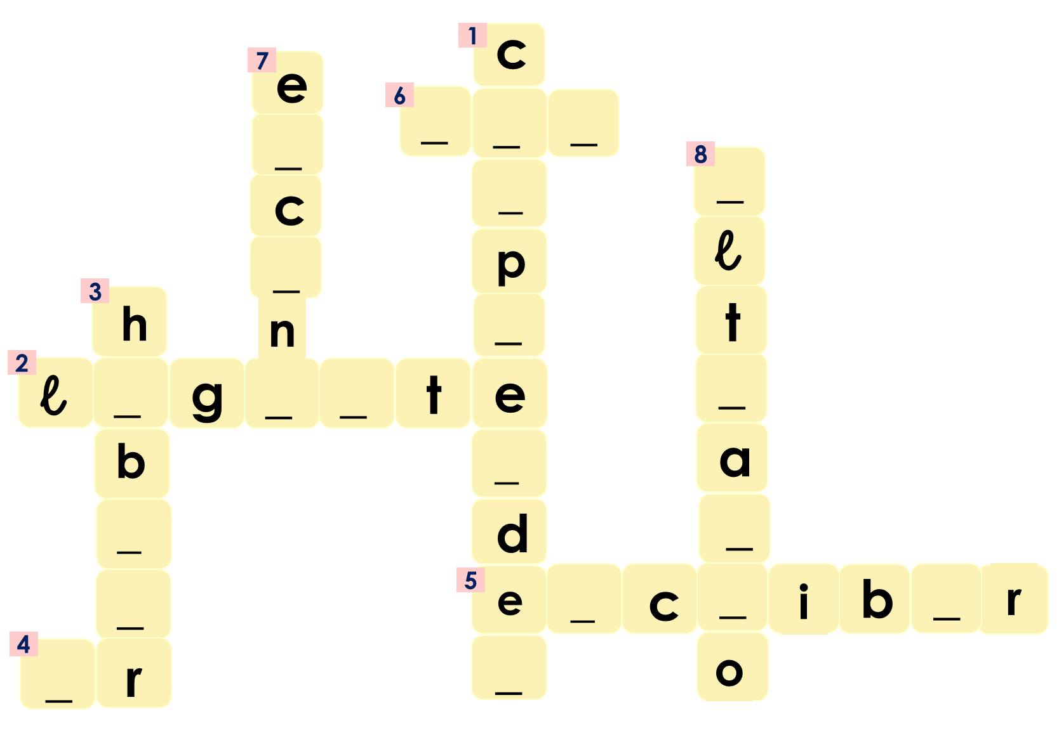
Follow up 2 [b]:
empieza = it starts
vocabulario
¿Qué ves?
¿Qué cosita es?
Abajo ⬇
1. to understand
3. To talk, talking
7. cinema
8. theatre
Horizontal ➡
2. people
4. To go, going
5. To write, writing
6. I go
¿Qué es, qué es, qué es?
Una cosita
Veo veo
Empieza con la letra…
Notes:
Aim: to practise key vocabulary (newly introduced this week and from previous weeks).
Procedure: [Part 2]
Tell students they need to guess the word the teacher is thinking of (s/he might write it down unseen on a mini whiteboard as part of the process)
Teacher models the game by reading the first (pink) speech bubble and pupils respond (green speech bubble).
Pupils suggest different words in Spanish (from the prompts shown on the left) until they guess the word and the teacher reveals it.
Do a couple of rounds, then pupils can work in pairs to guess each other’s word.
Note: this is the ‘I spy’ game; the meaning of the spoken routine is as follows: - Veo, veo. (I see, I see or I spy, I spy) - ¿Qué ves? (What do you see?) - Una cosita (a little thing)
- ¿Qué cosita es? (what little thing is it?)
- Empieza con la letra… (it starts with the letter…)
Frequency of unknown words: empezar [175] Source: Davies, M. & Davies, K. (2018). A frequency dictionary of Spanish: Core vocabulary for learners (2nd ed.). Routledge: London

Slide 5
Saying what you can do
[Poder: to be able to, can]
In Spanish, the verb ‘poder’ is followed by a 2nd verb in infinitive.
Puedo comprender información.
The verb ending tells you who the sentence refers to.
I can understand information.
Puedes hablar rápido.
¿Puedes hablar lento, por favor?
You can speak fast.
¿Can you speak slowly, please?
Puede hablar en español.
S/he can speak in Spanish.
Notes:
Timing: 3 minutes
Aim: to introduce poder (2-verb structure) in 1st and 3rd person singular; revisit negatives
Procedure:
Click through the animations to present the information.
Elicit English translations for the Spanish examples provided.

Slide 6
Follow up 3:
¡Es verano! 🌞 What can they do?
Escucha. ¿Quién es? ¿Qué puede hacer?
escuchar
A Escribe 📝
B Marca
 | A | B | C
 | a person ☐ | a language ☐ | a place ☐
 | a question word ☐ | an animal ☐ | a place ☐
 | a person ☐ | a day of the week ☐ | food ☐
 | a frequency phrase ☐ | a place ☐ | a person ☐
 | an animal ☐ | a vehicle ☐ | a place ☐
 | a place ☐ | a day ☐ | an object ☐
I | you | s/he can ________.
I | you | s/he can ________.
I | you | s/he can ________.
I | you | s/he can ________.
I | you | s/he can ________.
I | you | s/he can ________.
E
learn
E
español
1
swim
el mar
1
2
eat
2
fruta
3
drink
todos los días
3
4
go
4
tren
5
visit
5
el teatro
Notes:
Timing: 10 minutes
Aim: to practise aural comprehension of singular persons singular person of poder and vocabulary; Connecting sound with meaning.
Procedure:
(Part A)
Read the instruction in Spanish & click to bring further instruction.
Do [E] with them. Click to listen. Pupils circle the correct person (I, you, s/he) and write down the infinitive verb.
Click for answers
(Part B)
1. Pupils listen to 1-5 and write the sentences, selecting from the options given For each question, they put a cross (x) under the type of word you hear.
Click for answers
Transcript 1:
E. Puedo aprender español.
Puedes nadar en el mar.
Puedes comer fruta.
Puede beber a todos los días.
Puedo ir en tren.
Puede visitar el teatro.

Slide 7
Follow up 4
(la) encuesta = a survey
sobre = about
Pregunta y completa la encuesta* sobre* el verano.
hablar
A: ¿Puedes hablar español?
B: Sí, puedo hablar español 😊.
speak Spanish | speak English | learn new words | go to the cinema | sleep | swim in the sea | swim in the swimming pool | rest | read | write
B: Sí, puedo hablar inglés 😊.
A: ¿Puedes hablar inglés?
Notes:
Timing: 8 minutes
Aim: to practise oral production and comprehension of puedo & puedes with a range of infinitives.
Read the title.
Tell students they are going to conduct a survey in the class to figure how the most popular birthday months.
Click to bring key speech bubbles to model the dialogue. A ¿Puedes hablar español? & click to bring B’s sample answer and follow up question. Click to model how to use the survey sheet.
Tell students they have 5 minutes to ask as many students in the class. Teachers should monitor pupils are answer in full sentences.
NB. Some pupils might benefit from writing their response beforehand. Techers can give a couple of minutes to do this after modelling the exchange.
Frequency of unknown words and cognates:
encuesta [2077] sobre [62]
Source: Davies, M. & Davies, K. (2018). A frequency dictionary of Spanish: Core vocabulary for learners (2nd ed.). Routledge: London

Slide 8
Follow up 5 [a]:
Escribe en inglés 📝: Can you get at least 15 points?
 | el cine | vas | la plaza
 | va | el estadio | el teatro
 | la persona | la gente | estoy
 | el primo | el dinero | el tráfico
 | poder | puedo | puedes
 | puede | ir | el tren
vocabulario
(the) cinema
you go
(the) square
x3
s/he goes
(the) stadium
(the) theatre
(the) person
(the) people
I am (location, state)
x2
(the) cousin (m)
(the) money
(the) traffic
to be able to (can)
I can
you can
x1
s/he can
to go, going
(the) train
Notes:
Timing: 7 minutes
Aim: to practise written comprehension of vocabulary from this week and this week’s revisited sets.
Procedure:
1. Give pupils a blank grid. They fill in the English meanings of any of the words they know, trying to reach 15 points in total.
Note: The most recently learnt and practised words are pink, words from the first revisit are green and those from the second revisit are blue, thus more points are awarded for them, to recognise that memories fade and more effort (heavy lifting!) is needed to retrieve them.

Slide 9
Follow up 5 [b]:
Escribe en español 📝: Can you get at least 15 points?
 | you go | (the) cinema | (the) theatre
 | (the) stadium | s/he goes | (the) square
 | (the) people | (the) money | (the) traffic
 | (the) person | (the) cousin (m.) | I am (loc., state)
 | I can | to be able to | to go, going
 | you can | (the) train | s/he can
vas
vocabulario
el cine
el teatro
x3
el estadio
va
la plaza
la gente
el dinero
el tráfico
x2
la persona
el primo
estoy
puedo
poder
ir
x1
puedes
el tren
puede
Notes:
Timing: 5 minutes
Aim: to practise written production of vocabulary from this week and this week’s revisited sets.
Procedure: 1. Give pupils a blank grid. They fill in the Spanish meanings of any of the words they know, trying to reach 15 points in total.
Note: The most recently learnt and practised words are pink, words from the first revisit are green and those from the second revisit are blue, thus more points are awarded for them, to recognise that memories fade and more effort (heavy lifting!) is needed to retrieve them.

Slide 10
¡adiós!
verde

Slide 11
Handout: Follow up extra [a]
Escribe en inglés 📝: Can you get at least 15 points?
 | el cine | vas | la plaza
 | va | el estadio | el teatro
 | la persona | la gente | estoy
 | el primo | el dinero | el tráfico
 | poder | puedo | puedes
 | puede | ir | el tren
vocabulario
x3
x2
x1
Notes:
Timing: 5 minutes
Aim: to practise written comprehension of vocabulary from this week and this week’s revisited sets.
Procedure: 1. Give pupils a blank grid. They fill in the English meanings of any of the words they know, trying to reach 15 points in total.
Note: The most recently learnt and practised words are pink, words from the first revisit are green and those from the second revisit are blue, thus more points are awarded for them, to recognise that memories fade and more effort (heavy lifting!) is needed to retrieve them.

Slide 12
Handout: Follow up extra [b]
Escribe en español 📝: Can you get at least 15 points?
vocabulario
 | you go | (the) cinema | (the) theatre
 | (the) stadium | s/he goes | (the)square
 | (the) people | (the) money | (the) traffic
 | (the) person | (the) cousin (m.) | I am (loc., state)
 | I can | to be able to | to go, going
 | you can | (the) train | s/he can
x3
x2
x1
Notes:
Timing: 5 minutes
Aim: to practise written production of vocabulary from this week and this week’s revisited sets.
Procedure: 1. Give pupils a blank grid. They fill in the Spanish meanings of any of the words they know, trying to reach 15 points in total.
Note: The most recently learnt and practised words are pink, words from the first revisit are green and those from the second revisit are blue, thus more points are awarded for them, to recognise that memories fade and more effort (heavy lifting!) is needed to retrieve them.

