Slide 1
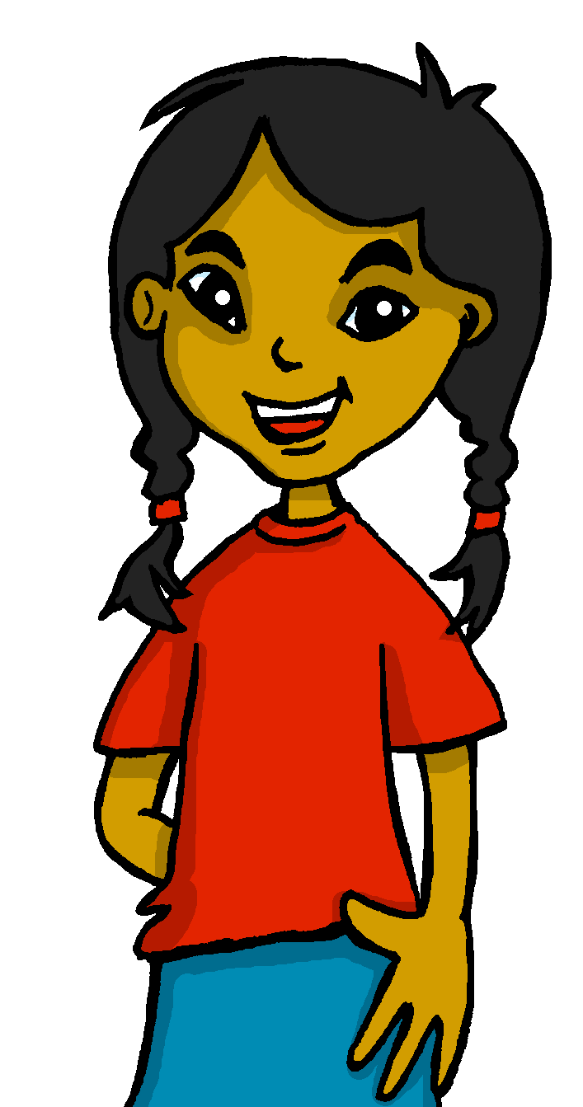
español, con Sofía

Slide 2
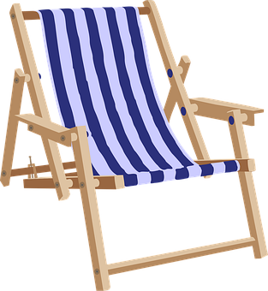
Saying what I and others want to do
De vacaciones
verde
2-verb structure: querer
SSC repaso 2
Notes:
Artwork by Steve Clarke. All additional pictures selected are available under a Creative Commons license, no attribution required.
The frequency rankings for words that occur in this PowerPoint which have been previously introduced in the resources are given in the SOW (excel document) and in the resources that first introduced and formally re-visited those words.
Phonics: SSC revision 2
Vocabulary (new words in bold): querer, quiero, quieres, quiere [58] dormir [403] lavar [1676] Revisit 1: desfile [4514] flor [739] fuego [884] luz [278] mucho [41] todo12 [472] todo el mundo [n/a]
Revisit 2: voy [ir 33] vas [ir 33] va [ir 33] bosque [1444] campo [342] isla [810] lago [2151] montaña [1464] playa [1475] río [496] a [8] el [1] la [1]
Frequency of unknown words:
opinar [1547] reaccionar [2284] helado [3024] muro [1874] aburrido [3917]
Source: Davies, M. & Davies, K. (2018). A frequency dictionary of Spanish: Core vocabulary for learners (2nd ed.). Routledge: London
For any other words that occur incidentally in this PowerPoint, frequency rankings will be provided in the notes field wherever possible.

Slide 3
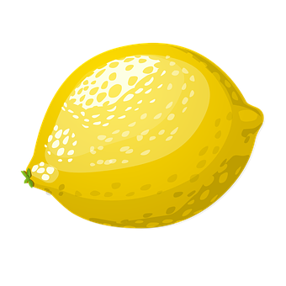
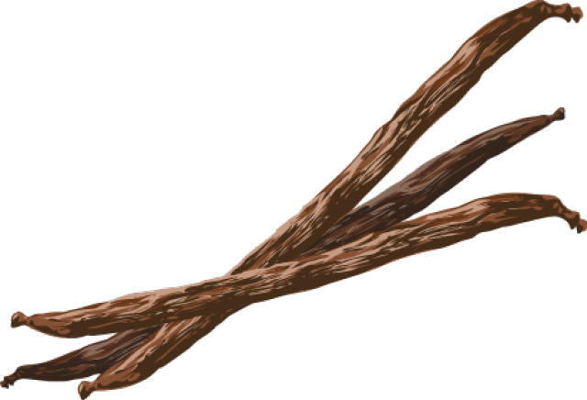
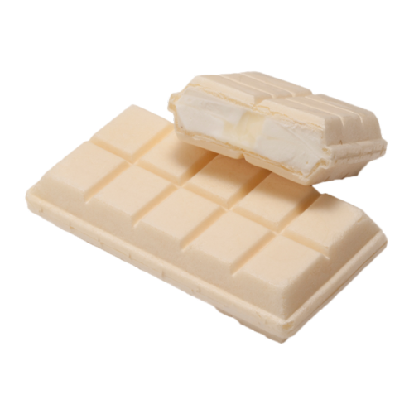
pronunciar
Lee el menú.
SSC Repaso
fresa
limón
cereza
plátano
vainilla
chocolate
chocolate blanco
tarta de queso
avellana
pronunciar
he
la
dos
Notes:
Timing: 3 minutes
Aim: to practise several SSC
Procedure:
Read the instruction
Allow pupils to read the text aloud menu in pairs
Read the text aloud, so pupils can follow. (Click on the individual pictures to hear the audio, if preferred).
Elicit pupils’ understanding.
Frequency of unknown words and cognates:
avellana [>5000] cereza [>5000] chocolate [3408] fresa [>5000] limón [4420] plátano [>5000] queso [3187] vainilla [>5000]
Image source:
<a href="https://www.flaticon.com/free-icons/cheesecake" title="cheesecake icons">Cheesecake icons created by LAFS - Flaticon</a>

Slide 4
vocabulario
Un muro de palabras
¿Cómo se dice en inglés?
¿Cómo se dice en español?
dormir 😴
el río
hacer
el restaurante
to sleep, sleeping
restaurant
river
to do, make
la playa
nadar
lavar 🧼
gafas
to swim, swimming
beach
to wash
glasses
la calle
el cine
el mar
el baloncesto
street
cinema
sea
basketball
el campo
cada
tocar
a
to play, playing
to
countryside
each
la piscina
descansar
por
al
swimming pool
through, around, along
to relax
to the (m.)
Notes:
Timing: 5 minutes
Aim: this slide practises read aloud, meaning and spoken production of 18 revisited words that we will use this week with timed spoken comprehension. 2 words are newly introduced here (dormir & lavar).
Procedure:
The activity is designed like a scratch card. On clicks, the English translation appears following the horizontal (left to right) order of the display.
Click to select a word (the word will change colour). Pupils read the word aloud.
Ask ‘¿Cómo se dice en inglés?’ and click again to trigger a 6-second ‘scratch’ animation, which slowly reveals the English equivalent. Pupils turn to their partner and say the word meaning before it is revealed.
Ask ‘¿Cómo se dice en español?’ to elicit the Spanish meaning again.
When all English meanings are displayed, if time allows, ask ¿Cómo se dice [to visit, visiting] en español? etc. to elicit oral recall of a few of the Spanish meanings again.
Frequency of unknown words and cognates: muro [1874]

Slide 5
Saying what you want to do
[querer: to want, wanting]
In Spanish, the verb ‘querer’ is followed by a 2nd verb in infinitive.
‘Querer’ does not follow the general rules.
‘quer changes to ‘quier’
Quiero nadar en el mar.
As usual, the verb endings change to match the person of the verb.
I want to swim in the sea.
Quieres ir a la playa.
Quiere ir al campo.
You want to go to the beach.
S/he wants to go to the countryside.
☺ Same endings as for all –er verbs
Notes:
Timing: 3 minutes
Aim: to introduce querer (2-verb structure) in 1st , 2nd and 3rd person singular.
Procedure:
Click through the animations to present the information.
Elicit English translations for the Spanish examples provided.

Slide 6
escuchar y escribir
Escucha y escribe.
[Ejemplo]
Quiero
1. _________ ir a la playa.
I
you
s/he
3
a
b
c
to go
to visit
to read
2
1
¿Qué es en inglés?
¡escribe!
I want to go to the beach.
Notes:
Timing: 8 minutes (6 slides)
Aim: to practise listening out for the verbs ‘quiero’, ‘quieres’ and ‘quiere’ and process the person of the verb they refer to. To then practise processing the meaning of both the newly introduced and revisited vocabulary
Slide 1/6
Procedure:
Read the instructions in Spanish. The following instructions apply to the next 5 slides.
Tell students this is a delayed dictation activity. You will play a sentence twice and they will have to retain that sentence in their working memory (picturing it in their heads!) for 3 seconds.
(NB. They can choose to use the help on the board or without looking – encourage students to choose their own level of challenge).
Click to start timer once you’ve played / read the sentence x2. Once the time is up, the instruction ‘escribe’ will come up and they need to write the whole sentence (or just the verb if they are facing the board for more support)
4. Click to reveal the missing verb. Pupils who were facing away turn back to check their answers.
5. Click again to bring up the different prompts and elicit answers from pupils.
Transcript:
E. Quiero ir a la playa.
1. Quiere descansar en casa.
2. Quieres pasear por la montaña.
3. Quiere jugar en la piscina.
4. Quiero dormir mucho.
5. Quieres montar en bici.

Slide 7
escuchar y escribir
[1/5]
Escucha y escribe.
Quiere
1. _________ descansar en casa.
I
you
s/he
3
a
b
c
to speak
to relax
to watch
2
1
¿Qué es en inglés?
¡escribe!
S/he wants to relax at home.
Notes:
Transcript:
E. Quiero ir a la playa.
1. Quiere descansar en casa.
2. Quieres pasear por la montaña.
3. Quiere jugar en la piscina.
4. Quiero dormir mucho.
5. Quieres montar en bici.

Slide 8
escuchar y escribir
[2/5]
Escucha y escribe.
Escucha y escribe.
Quieres
1. _________ pasear por la montaña.
I
you
s/he
3
a
b
c
to talk
to arrive
to go for a walk
2
1
¿Qué es en inglés?
¡escribe!
You want to go for a walk in the mountains.
Notes:
Transcript:
E. Quiero ir a la playa.
1. Quiere descansar en casa.
2. Quieres pasear por la montaña.
3. Quiere jugar en la piscina.
4. Quiero dormir mucho.
5. Quieres montar en bici.

Slide 9
escuchar y escribir
[3/5]
Escucha y escribe.
Escucha y escribe.
Escucha y escribe.
Escucha y escribe.
Escucha y escribe.
Quiere
1. _________ jugar en la piscina.
I
you
s/he
3
a
b
c
to eat
to play
to do
2
1
¿Qué es en inglés?
¡escribe!
S/he wants to play in the swimming pool.
Notes:
Transcript:
E. Quiero ir a la playa.
1. Quiere descansar en casa.
2. Quieres pasear por la montaña.
3. Quiere jugar en la piscina.
4. Quiero dormir mucho.
5. Quieres montar en bici.

Slide 10
escuchar y escribir
[4/5]
Escucha y escribe.
Escucha y escribe.
Quiero
1. _________ dormir mucho.
I
you
s/he
3
a
b
c
to sleep
to sing
to dance
2
1
¿Qué es en inglés?
¡escribe!
I want to sleep a lot.
Notes:
Transcript:
E. Quiero ir a la playa.
1. Quiere descansar en casa.
2. Quieres pasear por la montaña.
3. Quiere jugar en la piscina.
4. Quiero dormir mucho.
5. Quieres montar en bici.

Slide 11
escuchar y escribir
[5/5]
Escucha y escribe.
Quieres
1. _________ montar en bici.
I
you
s/he
3
a
b
c
to learn
to ride
to go
2
1
¿Qué es en inglés?
¡escribe!
You want to ride your bike.
Notes:
Transcript:
E. Quiero ir a la playa.
1. Quiere descansar en casa.
2. Quieres pasear por la montaña.
3. Quiere jugar en la piscina.
4. Quiero dormir mucho.
5. Quieres montar en bici.

Slide 12
leer
De vacaciones. Sofía habla con Quique.
Lee las frases. ¿Quién quiere hacer qué?
 | Quieres nadar en la playa.
 | Quiero jugar al baloncesto.
 | Quiere lavar el coche.
 | Quiere comer helados.
 | Quieres pasear por la montaña.
 | Quiero comer en el restaurante.
 | Quieres ir al museo.
 | Quiero usar gafas de sol.
Escribe el número y el verbo en inglés.
E
(el) helado – ice-cream
1
2
3
Quique [I] | Sofía [you] | Papá Pedro [he]
4
1
to play
E
to swim
2
to wash
5
4
3
to eat
5
to eat
to stroll
6
6
to go
7
to use
7
Notes:
Timing: 7 minutes
Aim: reading to differentiate between 1st, 2nd and 3rd person singulaof querer; written comprehension of key vocabulary introduced this week.
Procedure:
Read the context and click to bring up instructions.
Read the first sentence. Ask pupils to identify de if it’s Quique (I), Sofía (you) or mum (she) and write the correct verb in English.
Continue with items 1 – 7.
Transcript: Ejemplo. Quieres nadar en la playa. 1. Quiero jugar al baloncesto. 2. Quiere lavar el coche. 3. Quiere comer helados. 4. Quieres pasear por la montaña. 5. Quiero comer el el restauarnte. 6. Quieres ir al museo. 7. Quiero usar gafas de sol.
Frequency of unknown words:
helado [3024]
Source: Davies, M. & Davies, K. (2018). A frequency dictionary of Spanish: Core vocabulary for learners (2nd ed.). Routledge: London

Slide 13
leer
Lee las frases. ¿Qué opinas?
¡Reacciona! 😃😟
Quiero…
hablar
la playa
(el) campo
la ciudad
(el)cine
la calle
(el) mar
la montaña
(el) río
… ir
… descansar
… pasear
… nadar
… montar en bici
por
en
a
al
opinas – you think
reacciona – react
aburrido – boring
A
B
Quiero ir al cine.
¡Es divertido!
😃 bonito | fantástico | divertido |importante | diferente | tranquilo
😟 tranquilo | terrible | aburrido*
Notes:
Timing: 4 minutes
Aim: to practise reading comprehension of both newly introduced and revisited vocabulary & apply logic to the statements.
Procedure:
Click x2 to bring up speech bubbles and model the conversation.
Pupil take turns to read statements 1-6 and react to them according to their own opinion.
Frequency of unknown words:
opinar [1547] reaccionar [2284] aburrido [3917]
Source: Davies, M. & Davies, K. (2018). A frequency dictionary of Spanish: Core vocabulary for learners (2nd ed.). Routledge: London

Slide 14
¡adiós!
verde

