Slide 1
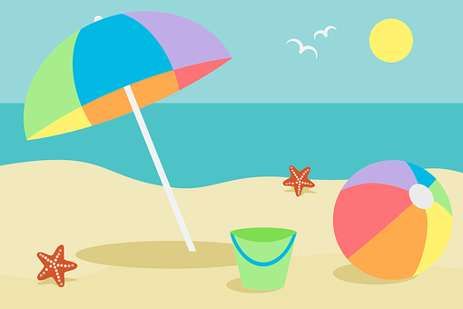
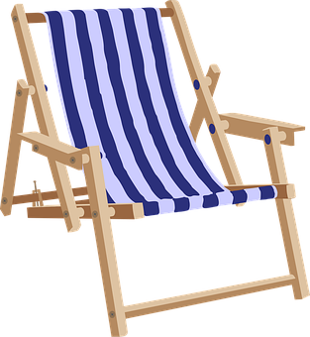
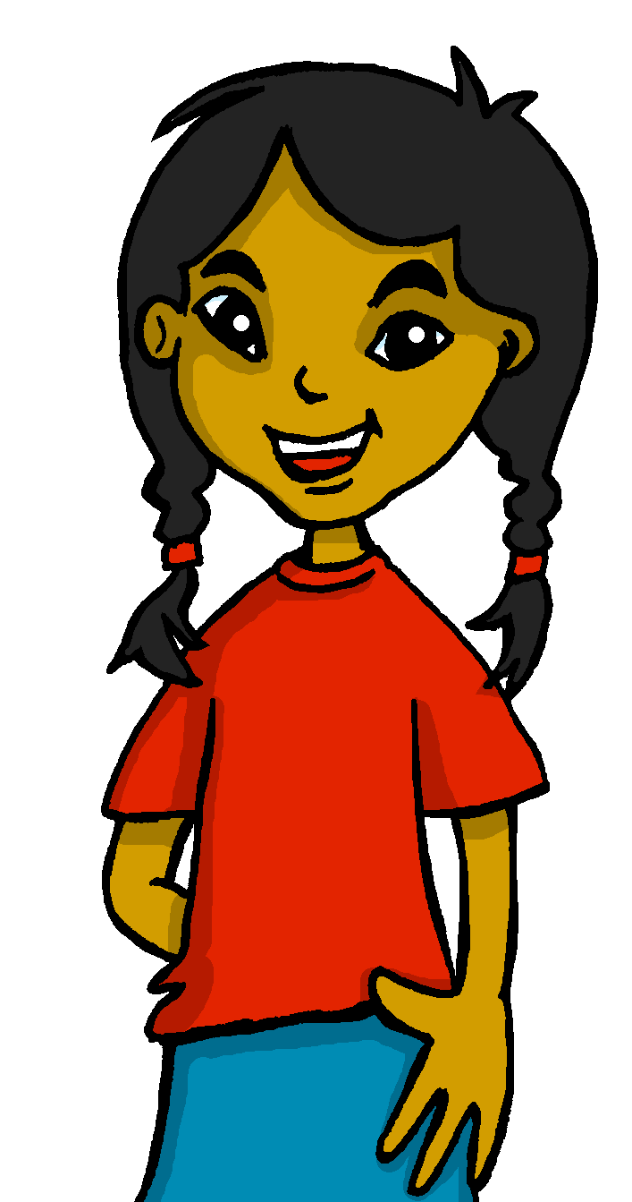
Saying what I and others want to do
De vacaciones
verde
Follow ups 1-5
Notes:
Artwork by Steve Clarke. All additional pictures selected are available under a Creative Commons license, no attribution required.
The frequency rankings for words that occur in this PowerPoint which have been previously introduced in the resources are given in the SOW (excel document) and in the resources that first introduced and formally re-visited those words.
Phonics: SSC revision 2
Vocabulary (new words in bold): querer, quiero, quieres, quiere [58] dormir [403] lavar [1676]
Revisit 1: desfile [4514] flor [739] fuego [884] luz [278] mucho [41] todo12 [472] todo el mundo [n/a]
Revisit 2: voy [ir 33] vas [ir 33] va [ir 33] bosque [1444] campo [342] isla [810] lago [2151] montaña [1464] playa [1475] río [496] a [8] el [1] la [1]
Frequency of unknown words:
encuesta [2077]
Source: Davies, M. & Davies, K. (2018). A frequency dictionary of Spanish: Core vocabulary for learners (2nd ed.). Routledge: London
For any other words that occur incidentally in this PowerPoint, frequency rankings will be provided in the notes field wherever possible.

Slide 2
Follow up 1:
SSC Repaso
Escucha y practica.
pronunciar
Notes:
Timing: 5 minutes
Aim: to revisit several SSCs and develop phonological confidence
Procedure: 1. Pupils read the texts aloud in pairs
2. Click on the play button to listen to each line
https://www.youtube.com/watch?v=7p4AxvnYDbA&ab_channel=123Andr%C3%A9s

Slide 3
Follow up 2
Escribe nueve palabras en inglés.
¡Bingo!
¿Tienes 9? Responde ‘¡Bingo!’
¿Tienes 3? Responde ‘línea’
palabras
quiero | quiere
quieres | la montaña
la playa | la calle
dormir | el campo
lavar | hacer
la ciudad | ir
línea
bingo
Notes:
Timing: 5 minutes
Aim: to practise written comprehension of this week’s new language.
Procedure: 1. Pupils choose any 9 of the words from the Spanish table and write them into their grid in English..
2. Teacher then calls out the Spanish for any of the 12 words in the table in whichever order.
3. Pupils call ‘línea’ when they have any three in a row (vertical, horizontal, or diagonal) and then ‘bingo’ again for the first full house.

Slide 4
Follow up 3:
Adjectives following the noun
We have learned that many adjectives follow the noun:
noun
adjective
Quiero ir a una playa bonita.
adjective
noun
I want to go to a beautiful beach.
They also agree (match) in gender (masculine or feminine)and number (singular or plural) with the noun they are describing.
When we describe more than one person or animal, we add an ‘s’ after‘o’, ‘a’ and ‘e’.
Quieres ver montañas bonitas.
Quiero comer fruta deliciosa.
I want to eat delicious fruit.
You want to see pretty mountains.
Quiero ir a museos interesantes.
Quiero nadar en un río tranquilo.
I want to swim in a calm river.
I want to go to interesting museums.
Notes:
Timing: 6-8 minutes (grammar reminder + translation practice, 6 slides).
Aim: to revisit post-nominal adjective agreement.
Procedure:
Read the grammar explanation on post-nominal adjective agreement.
Elicit English translations for the Spanish examples provided.

Slide 5
Follow up 3:
[1/5]
Traduce la frase al español.
escribir
Quiero visitar un estadio importante.
30
I want to visit an important stadium.
visitar
importante
importantes
un estadio
quiero
quiere
0
⚠ You do not need all of the words!
INICIO
Notes:
Time: 6-8 minutes (5 slides)
Aim: to practise guided writing sentence building. Targeted features: postnominal regular gender agreement | revisit quiero | quiere | quieres Procedure:
1. Click for English sentence and Spanish prompt words. 2. Click inicio to start the timer.
3. Pupils select from the words given to create and write the sentence before the time elapses. 4. Click for the Spanish sentence to appear.

Slide 6
Follow up 3:
[2/5]
Traduce la frase al español.
escribir
Quieres ver a tus abuelos.
30
You want to see your grandparents.
tus
a
abuelos
visitar
ver
quiero
quieres
una película
0
⚠ You do not need all of the words!
INICIO
Notes:
[2/5]

Slide 7
Follow up 3:
[3/5]
Traduce la frase al español.
escribir
Quiere leer libros divertidos.
30
S/he wants to read fun books
pasar
quiero
libros
divertidas
leer
divertido
divertidos
quiere
0
⚠ You do not need all of the words!
INICIO
Notes:
[3/5]

Slide 8
Follow up 3:
[4/5]
Traduce la frase al español.
escribir
Quiero ir a una playa bonita.
30
I want to go to a beautiful beach.
ir
quiero
a
una
bonito
bonita
querer
quiere
0
⚠ You do not need all of the words!
INICIO
Notes:
[4/5]

Slide 9
Follow up 3:
[5/5]
Traduce la frase al español.
escribir
Quieres visitar una montaña tranquila.
30
You want to visit a quiet mountain.
tranquilas
tranquila
una
quiere
probar
quieres
montaña
visitar
0
⚠ You do not need all of the words!
INICIO
Notes:
[5/5]

Slide 10
Follow up 4:
Saying what you want to do
[querer: to want, wanting]
In Spanish, the verb ‘querer’ is followed by a 2nd verb in infinitive.
‘Querer’ does not follow the general rules.
‘quer changes to ‘quier’
Quiero nadar en el mar.
As usual, the verb endings change to match the person of the verb.
I want to swim in the sea.
Quieres ir al campo.
Quiere ir a la montaña.
You want to go to the country.
S/he wants to go to the mountains.
☺ Same endings as for all –er verbs
Notes:
Timing: 5 minutes (grammar reminder + translation practice, 6 slides).
Aim: to revisit post-nominal adjective agreement.
Procedure:
Read the grammar explanation on post-nominal adjective agreement.
Elicit English translations for the Spanish examples provided.

Slide 11
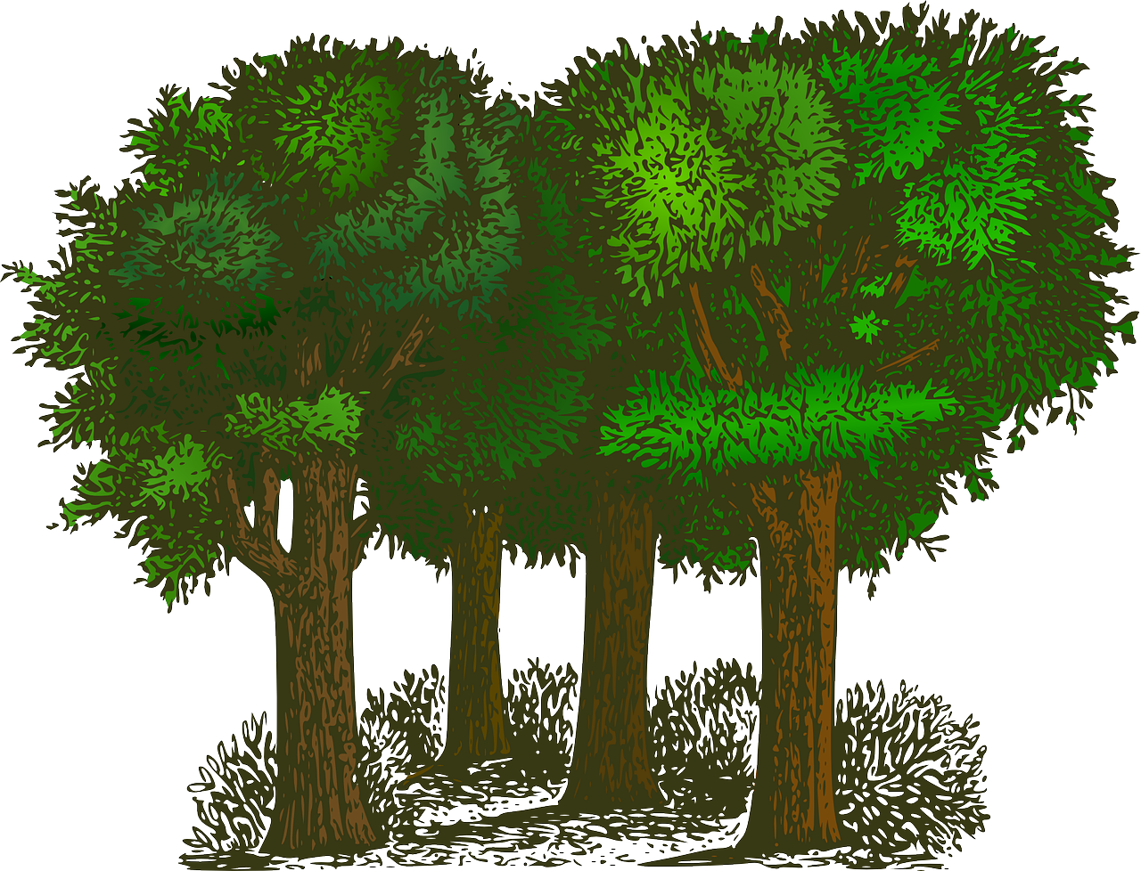
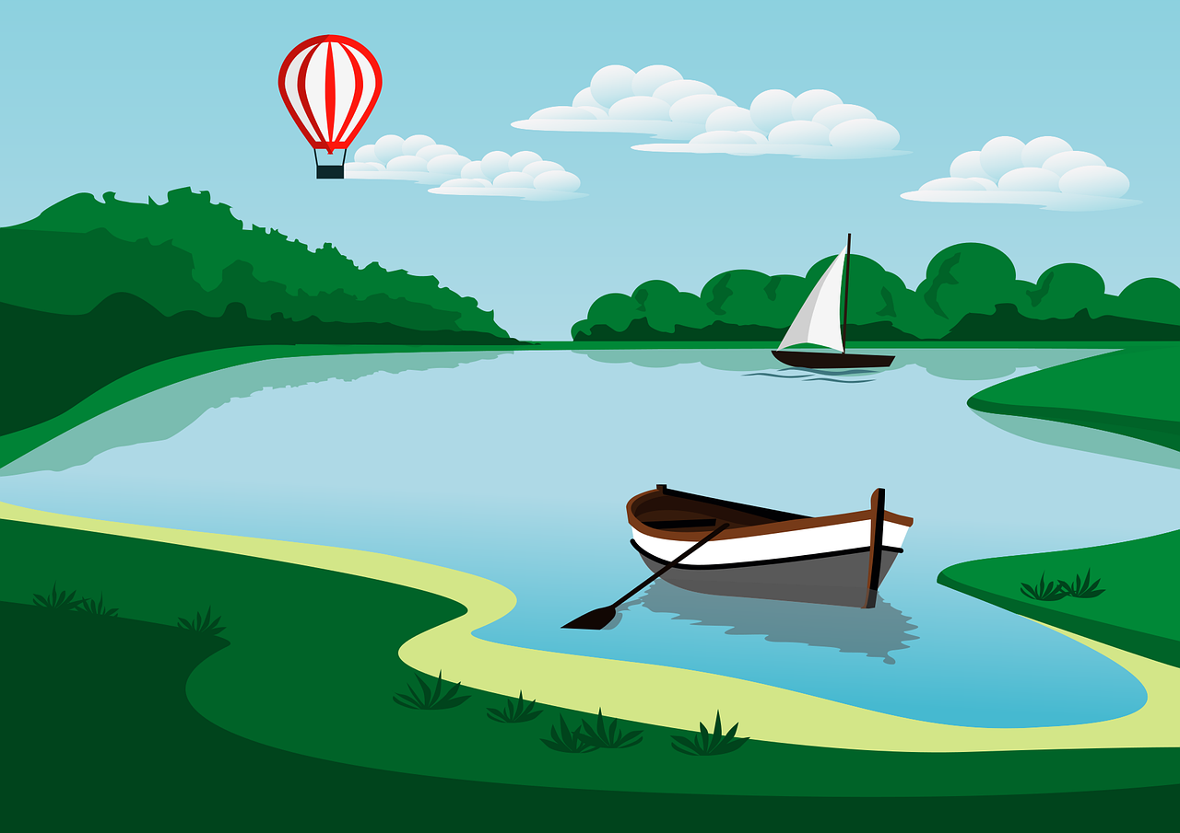
Follow up 4
(la) encuesta = a survey
Pregunta y completa la encuesta*.
hablar
A: ¿Quieres ir a la playa?
B: Sí, quiero ir a la playa.
to go to the | to go to the | to visit a | to sleep | to clean | to swim in the sea | to swim in the pool | to rest | to play tennis | to play football
B: No, no quiero ir al bosque.
A: ¿Quieres ir al bosque?
Notes:
Timing: 8 minutes
Aim: to practise oral production and comprehension of quiero & quieres with a range of infinitives.
Read the title.
Tell students they are going to conduct a survey in the class to figure out the most popular activities.
Click to bring key speech bubbles to model the dialogue. A ¿Quieres ir a la playa? & click to bring B’s sample answer and follow up question. Click to model how to use the survey sheet.
Tell students they have 5 minutes to ask as many students in the class. Teachers should monitor pupils are answer in full sentences.
NB. Some pupils might benefit from writing their response beforehand. Techers can give them a couple of minutes to do this after modelling the exchange.
Frequency of unknown words and cognates:
encuesta [2077]
Source: Davies, M. & Davies, K. (2018). A frequency dictionary of Spanish: Core vocabulary for learners (2nd ed.). Routledge: London

Slide 12
Follow up 5a:
Escribe en inglés 📝: Can you get at least 15 points?
 | la isla | vas | to
 | va | el río | el bosque
 | la flor | la luz | todo
 | mucho | todo el mundo | el fuego
 | lavar | dormir | quiero
 | quiere | ir | quieres
vocabulario
(the) island
you go
a
x3
s/he goes
(the) river
(the) forest
(the) flower
(the) light
all
x2
a lot
everybody
(the) fire
to wash, washing
to sleep, sleeping
I want
x1
s/he wants
to go, goind
you want
Notes:
Timing: 7 minutes
Aim: to practise written comprehension of vocabulary from this week and this week’s revisited sets.
Procedure:
1. Give pupils a blank grid. They fill in the English meanings of any of the words they know, trying to reach 15 points in total.
Note: The most recently learnt and practised words are pink, words from the first revisit are green and those from the second revisit are blue, thus more points are awarded for them, to recognise that memories fade and more effort (heavy lifting!) is needed to retrieve them.

Slide 13
Follow up 5b:
Escribe en español 📝: Can you get at least 15 points?
 | you go | to | (the) island
 | (the) forest | (the) river | s/he goes
 | all | everybody | (the) flower
 | (the) light | (the) fire | a lot
 | you want | to go, going | s/he wants
 | I want | to wash | to sleep
vas
a
la isla
vocabulario
x3
el bosque
el río
va
todo el mundo
la flor
todo
x2
la luz
el fuego
mucho
quieres
ir
quiere
x1
quiero
lavar
dormir
Notes:
Timing: 5 minutes
Aim: to practise written production of vocabulary from this week and this week’s revisited sets.
Procedure: 1. Give pupils a blank grid. They fill in the Spanish meanings of any of the words they know, trying to reach 15 points in total.
Note: The most recently learnt and practised words are pink, words from the first revisit are green and those from the second revisit are blue, thus more points are awarded for them, to recognise that memories fade and more effort (heavy lifting!) is needed to retrieve them.

Slide 14
¡adiós!
verde

Slide 15
Follow up 4
hablar
(la) encuesta = a survey
to go to the | to go to the | to visit a | to sleep | to clean | to swim in the sea | to swim in the pool | to rest | to play tennis | to play football
Notes:
HANDOUT

Slide 16
Handout: Follow up 5a
Escribe en inglés 📝: Can you get at least 15 points?
 | la isla | vas | to
 | va | el río | el bosque
 | la flor | la luz | todo
 | mucho | todo el mundo | el fuego
 | lavar | dormir | quiero
 | quiere | ir | quieres
vocabulario
x3
x2
x1
Notes:
Timing: 5 minutes
Aim: to practise written comprehension of vocabulary from this week and this week’s revisited sets.
Procedure: 1. Give pupils a blank grid. They fill in the English meanings of any of the words they know, trying to reach 15 points in total.
Note: The most recently learnt and practised words are pink, words from the first revisit are green and those from the second revisit are blue, thus more points are awarded for them, to recognise that memories fade and more effort (heavy lifting!) is needed to retrieve them.

Slide 17
Handout: Follow up 5b
Escribe en español 📝: Can you get at least 15 points?
 | you go | to | (the) island
 | (the) forest | (the) river | s/he goes
 | all | everybody | (the) flower
 | (the) light | (the) fire | a lot
 | you want | to go, going | s/he wants
 | I want | to wash, washing | to sleep, sleeping
vocabulario
x3
x2
x1
Notes:
Timing: 5 minutes
Aim: to practise written production of vocabulary from this week and this week’s revisited sets.
Procedure: 1. Give pupils a blank grid. They fill in the Spanish meanings of any of the words they know, trying to reach 15 points in total.
Note: The most recently learnt and practised words are pink, words from the first revisit are green and those from the second revisit are blue, thus more points are awarded for them, to recognise that memories fade and more effort (heavy lifting!) is needed to retrieve them.

