Slide 1


español, con Sofía

Slide 2



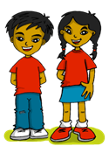
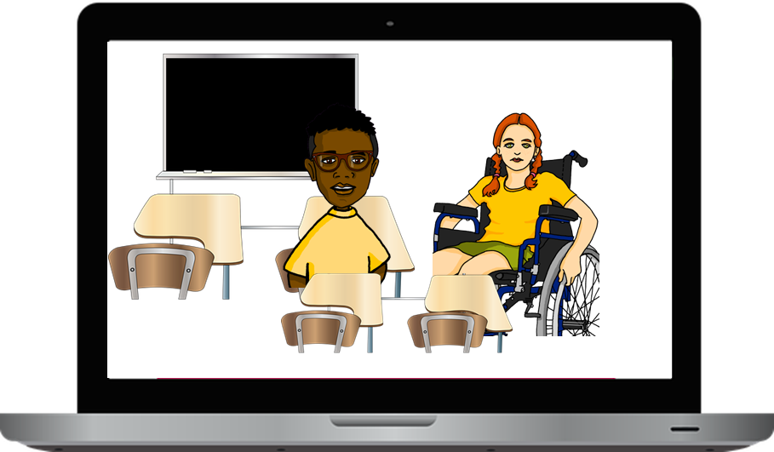

Saying what
I and others like/dislike doing
Aprender idiomas
💗
verde
- -AR & -ER verbs: we & they
- 2-verb structures:
amar, odiar
- SSC repaso
Notes:
Artwork by Steve Clarke. All additional pictures selected are available under a Creative Commons license, no attribution required.
The frequency rankings for words that occur in this PowerPoint which have been previously introduced in the resources are given in the SOW (excel document) and in the resources that first introduced and formally re-visited those words.
Phonics: SSC revision 1
Vocabulary (new words in bold): amar [700] aprender [428] escribir [198] hablar [90] odiar [2211] idioma [1159]
Revisit 1: bailar [1323] cantar [717] pasear [1741] llevar [101] caballo [907] flor [739] coche [1190] gente [137] luz [278] puerta [274] traje [1689]
Revisit 2: hay [13] dos [64] tres [134] cuatro [241] cinco [284] seis [438] siete [603] ocho [641] nueve [991] diez [449] once [1701] doce [1138] trece [2700] catorce [2411] quince[1215] dieciséis [3373] diecisiete [3400] dieciocho [2730] diecinueve [4232] veinte [819] veintiuno [819/425] veintidós, veintitrés, veinticuatro, veinticinco, veintiséis, veintisiete, veintiocho, veintinueve, treinta [830] treinta y uno [830/4/425]
Frequency of unknown words:
continente [1950] lengua [586] materna [3634] millón [248] como [20] porque [40]
Source: Davies, M. & Davies, K. (2018). A frequency dictionary of Spanish: Core vocabulary for learners (2nd ed.). Routledge: London
For any other words that occur incidentally in this PowerPoint, frequency rankings will be provided in the notes field wherever possible.

Slide 3




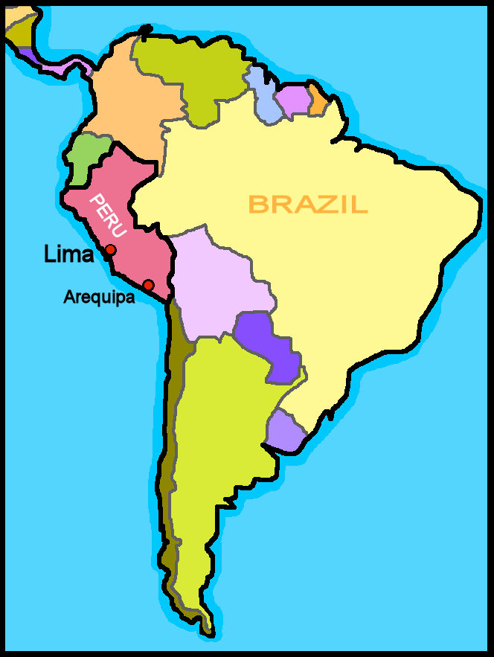
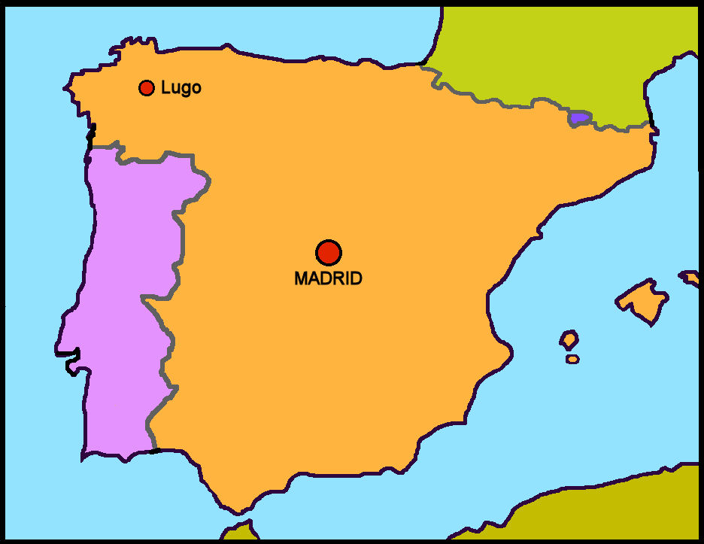
leer
Lee la información sobre el español en el mundo 🌍
Cerca de quinientos (500) millones* de
personas hablan español como* lengua* materna*. ¡Es mucha gente! El español es la lengua oficial en veintiún países, en dos continentes* diferentes: América y Europa.
En América
Argentina
México
Colombia
Venezuela
Honduras
En Europa
Perú
Ecuador
Paraguay
Bolivia
El Salvador
Uruguay
Costa
Rica
Chile
Nicaragua
Guatemala
como – as
lengua materna – mother tongue
Ahora lee los países donde hablan español en Lationamérica.
Notes:
Timing: 5 minutes
Aim: to set the scene for this week’s lesson; to revisit several SSC.
Procedure:
Pupils read the text aloud with teacher support, as needed.
Click on the audio button to hear an audio version of the text, if desired.
3. Click to bring further instruction and give pupils time to practise pronouncing the names for the Latin-American countries where Spanish is spoken. Click on each country name to hear it pronounced, if desired.
Frequency of unknown words and cognates:
continente [1950] lengua [586] materna [3634] millón [248] como [20]
Source: Davies, M. & Davies, K. (2018). A frequency dictionary of Spanish: Core vocabulary for learners (2nd ed.). Routledge: London

Slide 4


vocabulario
Un muro de palabras
¿Cómo se dice en inglés?
¿Cómo se dice en español?
visitar
leer
hacer
palabras
to read, reading
words
to visit, visiting
to do, make
la clase
inglés
la ciudad
la casa
the classroom, lesson
the house (home)
English (m)
the city
mandar
una visita
nuevos
la tarjeta
to send, sending
new (m., pl.)
a visit
the card
celebrar
divertidas
el idioma
escribir
to celebrate, celebrating
to write, writing
fun (f., pl.)
the language
aprender
en
llevar
una fiesta
to learn, learning
to wear, wearing
in, at
a festival
Notes:
Timing: 5 minutes
Aim: this slide practises read aloud, meaning and spoken production of 20 revisited words that we will use this week with timed spoken comprehension.
Procedure: the activity is designed like a scratch card. On clicks, the English translation appears following the horizontal (left to right) order of the display.
Click to select a word (the word will change colour). Pupils read the word aloud.
Ask ‘¿Cómo se dice en inglés?’ and click again to trigger a 6-second ‘scratch’ animation, which slowly reveals the English equivalent. Pupils turn to their partner and say the word meaning before it is revealed.
Ask ‘¿Cómo se dice en español?’ to elicit the Spanish meaning again.
When all English meanings are displayed, if time allows, ask ¿Cómo se dice [to visit, visiting] en español? etc. to elicit oral recall of a few of the Spanish meanings again.
Frequency of unknown words and cognates:
muro [1874]

Slide 5

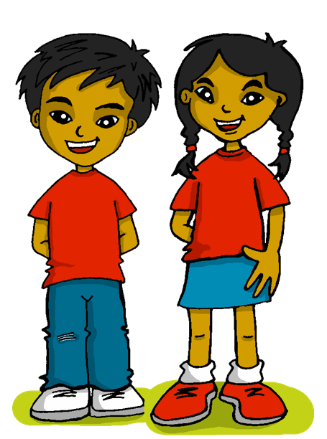

Knowing who does what
[‘we’ vs. ‘they’]
Remember: to mean ‘we’ with an -ar verb, remove –ar and add –amos.
To mean ‘they’ with a verb, we remove –ar and add –an.
Hablamos español en casa.
Hablan inglés en casa.
We speak Spanish at home.
They speak English at home.
To mean ‘S/he, it’ with an –er verb, remove –er and add -emos.
To mean ‘they’ with a verb, we remove –er and add –en.
Hacemos amigos.
Aprenden palabras nuevas.
We make friends.
They learn new words.
Notes:
Timing: 4 minutes
Aim: to revisit 1st and 3rd persons plural for–ar and –er verbs (hacer, jugar).
Procedure:
Click through the animations to present the new information.
Elicit English translations for the Spanish examples provided.

Slide 6


escuchar
Quique & Sofía have learned a lot about Max and Krina’s life in the UK.
Escucha. ¿Es Quique y Sofía o Krina y Max?
Marca
Escribe el verbo 📝.
 | we | they | VERBO
E
llevan
1
comemos
2
aprendemos
3
mandan
4
tienen
5
celebramos
Notes:
Timing: 7 minutes
Aim: to practise connection of the 1st and 3rd person plural and aural recognition of vocabulary.
Procedure:
Pupils listen to each phrase.
Attending to the verb ending, pupils decide if it’s ‘we’ or ‘they’. Encourage them to write the verb.
Click to reveal answers.
On the 2nd time of listening (NEXT SLIDE), pupils write the English meaning of the sentences. Teachers can click on the blue box to provide support if required.
Transcript:
E. llevan uniforme en clase.
1. comemos en casa los lunes.
2. aprendemos palabras en inglés.
3. mandan muchas tarjetas.
4. tienen clase en julio.
5. celebramos muchas fiestas divertidas.

Slide 7


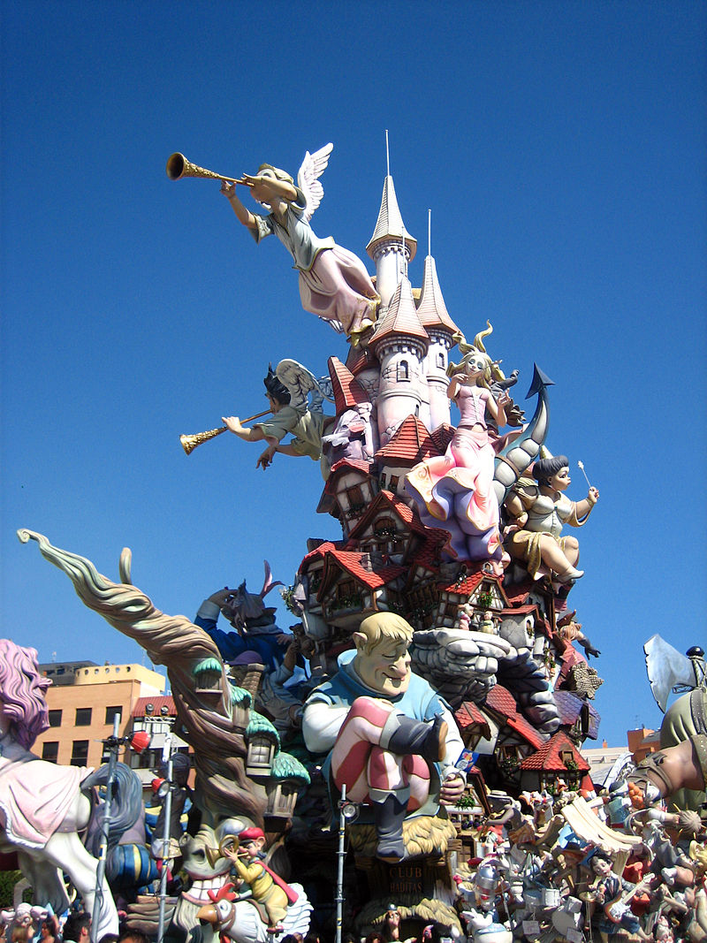




escuchar
Inglaterra y España
Escucha y escribe en inglés.
 | VERBO | frase en inglés
 | llevan
 | comemos
 | aprendemos
 | mandan
 | tienen
 | celebramos
E
They wear uniform in class.
Fallas
1
We eat at home on Mondays.
2
We learn words in English.
3
They send many cards.
4
They have lessons in July.
5
We celebrate many festivals.
Notes:
On the 2nd time of listening, pupils write the English meaning of the sentences. Teachers can click on the blue box to provide some visual cues, if required.
Transcript:
E. llevan uniforme en clase.
1. comemos en casa los lunes.
2. aprendemos palabras en inglés.
3. mandan muchas tarjetas.
4. tienen clase en julio.
5. celebramos muchas fiestas divertidas.

Slide 8


Saying you love doing something
[amar|odiar]
Change the ending of amar|odiar to say who loves or hates.
To say ‘love/hate to do’ or ‘love/hate doing’ in Spanish, the verbs ‘amar’ and ‘odiar’ are followed by the infinitive verb:
In English, we usually use the gerund
(-ing form).
Amo hablar español.
Amamos aprender inglés.
I love to speak Spanish.
We love to learn English.
speaking
learning
Amas hacer una visita a España.
You love to do a visit to Spain.
doing
Aman aprender español.
They love to learn Spanish.
learning
Ama visitar ciudades nuevas.
S/he loves to visit new cities.
visiting
Notes:
Timing: 4 minutes
Aim: to introduce 2-verb structures with 2 opinion verbs (amar, odiar).
Procedure:
Click through the animations to present the information.
Elicit English translations for the Spanish examples provided.

Slide 9


leer
Lee los mensajes de Sofía y Quique.
¿Es una opinión? o ¿es solo una actividad?
Es una opinión.
We usually say ‘we love learning new words’.
E
Amamos aprender palabras nuevas.
✉
🅰
_______
to do
to play
to learn
nine
new
nice
games
words
activities
We love
Notes:
Timing: 7 minutes (6 slides)
Aim: to differentiate between the meaning and form of single and 2-verb structures; to practise written comprehension of key vocabulary introduced this week.
Procedure:
Read the context. Tell students Quique is receiving messages from different friends.
Read the first message. Ask pupils to identify amar if it’s an opinion or a task (¿Es una opinión o una actividad?). Click to model TL response from pupils.
Click to bring part 2 (support for pupils to translate the message) and elicit oral response.
Continue with items 1 – 5.

Slide 10
leer
[1/6]
1
Hacemos actividades divertidas cada día.
Es una actividad.
🅰
✉
_______
do
celebrate
send
parties
activities
tasks
every night
every morning
every day
We
______
fun
Notes:
Slide 2/6

Slide 11
leer
[2/6]
2
Es una opinión.
Odiamos jugar a juegos aburridos.
🅰
✉
_______
to clean
to play
to see
slow
serious
boring
We hate
games
books
magazines
OR playing
Notes:
Slide 3/6

Slide 12
leer
[3/6]
3
Es una opinión.
Odian tener clases en verano. ¡Es normal!
🅰
✉
_______
They hate
to do
to have
to go
______
___
______
lessons
of
in
to
winter.
Friday.
summer.
It is
normal.
OR having,
Notes:
Slide 3/6

Slide 13
leer
[4/6]
4
Es una actividad
Leemos
libros en inglés en clase.
🅰
✉
read
buy
have
clothes
books
chairs
_______
We
__
English
Spanish
in
__
_______.
in
class
Notes:
Slide 4/6

Slide 14
leer
[5/6]
5
Es una opinión.
Amamos celebrar fiestas importantes cada año.
🅰
✉
_______
to visit
to see
to celebrate
_________
photos
festivals
days
_____
Monday.
year.
week.
We love
important
every
OR celebrating
Notes:
Slide 5/6

Slide 15
leer
[6/6]
porque – because
6
Es una y una actividad.
Aman escribir mensajes en español porque* aprenden vocabulario.
🅰
✉
_______
to read
to send
to write
letters
messages
magazines
learn
understand.
reply to
They love
___
because
they
OR writing
_________.
vocabulary
Notes:
Slide 6/6
Frequency of unknown words:
porque [40]
Source: Davies, M. & Davies, K. (2018). A frequency dictionary of Spanish: Core vocabulary for learners (2nd ed.). Routledge: London

Slide 16
¡adiós!
verde

