Slide 1
español, con Sofía

Slide 2
Saying what others and I do
Geografía física
verde
muchos / as
hay
[ge, gi | ga, go, gu | gue, gui]
Notes:
Artwork by Steve Clarke. All additional pictures selected are available under a Creative Commons license, no attribution required.
The frequency rankings for words that occur in this PowerPoint which have been previously introduced in the resources are given in the SOW (excel document) and in the resources that first introduced and formally re-visited those words.
Phonics: [ge] [gi] [ga] [go] [gu] [gue] [gui]
Vocabulary (new words in bold): persona [108] gente [137] dinero [364] tráfico [>5000]
Revisit 1: hacer [26] hago, haces; jugar [356] juego [jugar 356] juegas [jugar 356] baloncesto [>5000] esquí [>5000] fútbol [1471] tenis [4856] tiempo2 [80] bueno [103] malo [360] a [8] el [1] la [2] + revisit months + time phrases
Revisit 2: bicicleta [3684] cama [609] camisa [1873]cuaderno [3301] cuarto [653] gato [1728] habitación [1069] hermano [333] hermana [3409] idea [247] libro [230] mochila [>5000] oso [4449] perro [888] tía [1205] tío [988] vestido [1697]dónde [161] qué [50]
Source: Davies, M. & Davies, K. (2018). A frequency dictionary of Spanish: Core vocabulary for learners (2nd ed.). Routledge: London
For any other words that occur incidentally in this PowerPoint, frequency rankings will be provided in the notes field wherever possible.

Slide 3
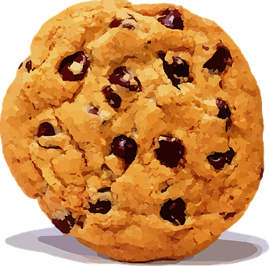
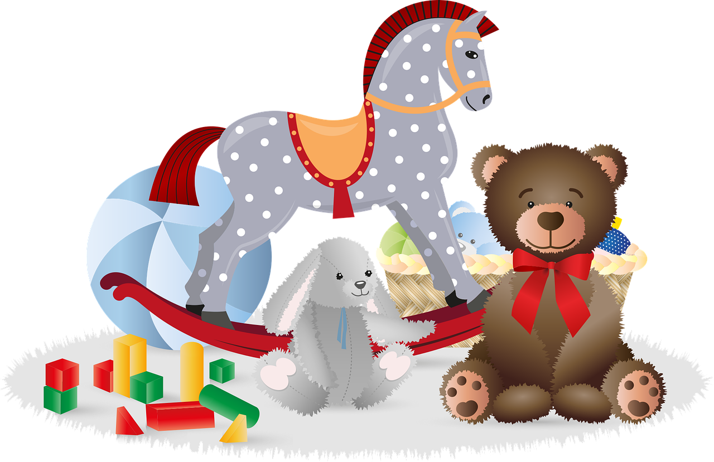
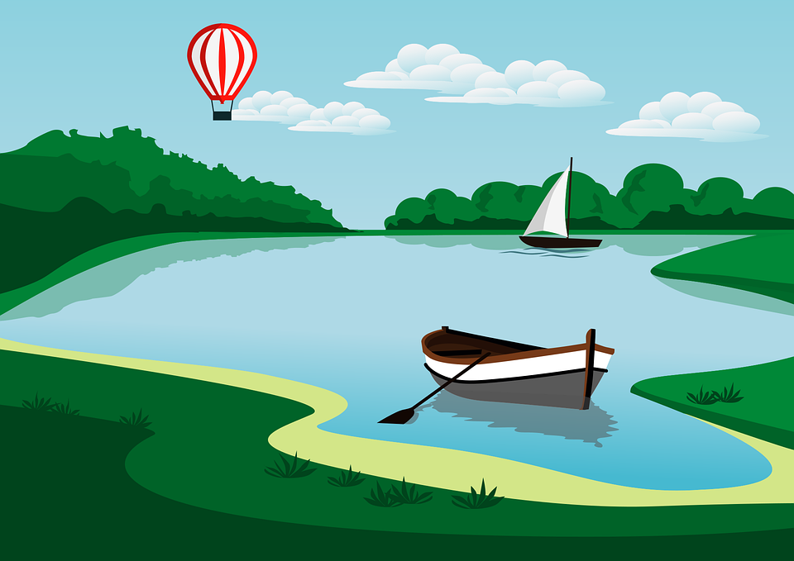
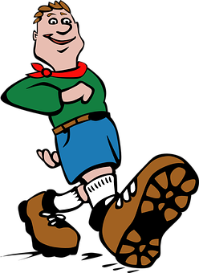
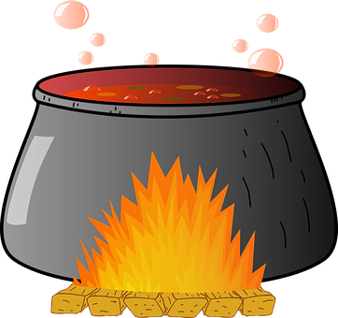
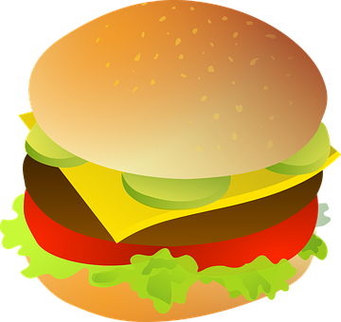
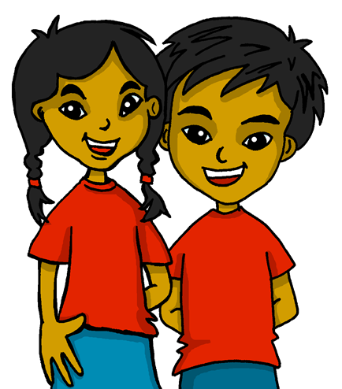
Repaso
[ge, gi | ga, go, gu | gue, gui]
pronunciar
galleta
[biscuit]
lago
[lake]
gafas
[glasses]
juego
[game]
galleta |  | lago | gafas | juego
guisantes |  | hamburguesa |  | seguir |  | guiso
gemelos | corregir | gente |  | igual | agenda | guerra
60
guisante
[pea]
seguir
[to continue]
S
hamburguesa
[hamburguer]
guiso
[stew]
gemelos
[twins]
corregir
[to correct]
igual
[equal]
agenda
[diary]
gente
[people]
guerra
[war]
0
START
Notes:
Timing: 5 minutes
Aim: to practise applying knowledge of ge | gi | ga | go | gu | gue | gui to known and unknown words.
Procedure: 1. Start the timer. Pupil A tries to read aloud all of the words pronouncing the SSC correctly, within the 60 seconds allowed.
2. Pupil B listens. If Pupil A mispronounces the SSC by mistake, Pupil B can direct him/her to start again from the beginning. 3. They swap roles and repeat the task.
4. Finally, teacher clicks to bring up each white word/arrow separately and elicits choral pronunciation of each word, again.
Frequency of unknown words and cognates:
seguir [99] corregir [2351] galleta [>5000] guerra [283] guisante [>5000] guiso [>5000] hamburguesa [>5000] igual [263]
Source: Davies, M. & Davies, K. (2018). A frequency dictionary of Spanish: Core vocabulary for learners (2nd ed.). Routledge: London

Slide 4
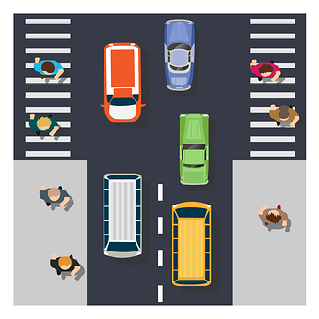
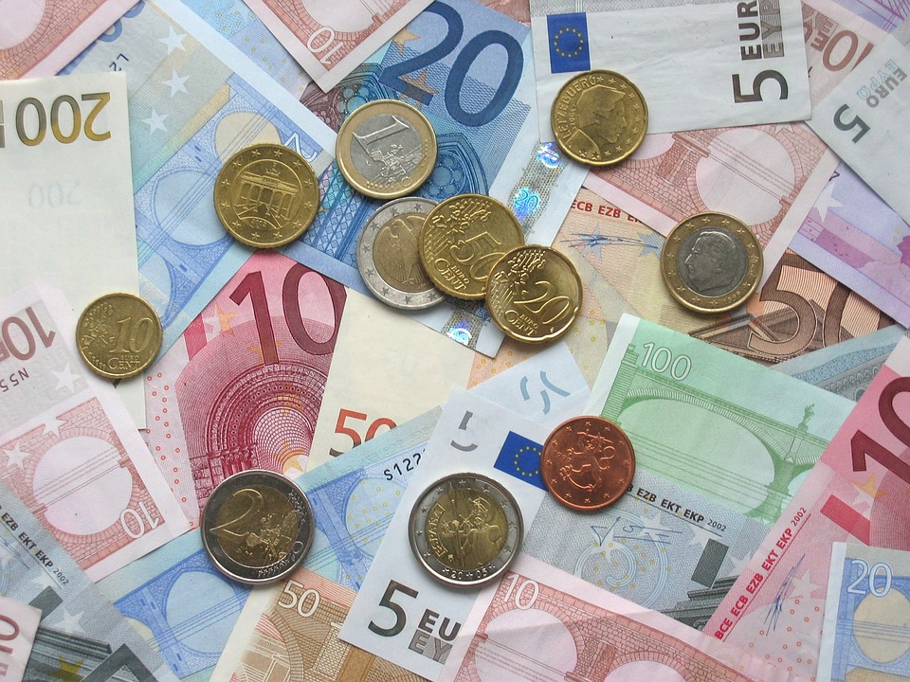
vocabulario
Escucha y pronuncia bien.
la persona
el tráfico
la gente
el dinero
Notes:
Timing: 7 minutes (two slides)
Aim: to present and practise written comprehension and read aloud of previously taught vocabulary and the three new words for this week.
Procedure:
Click to bring up the Spanish word and say the word together with the pupils.

Slide 5
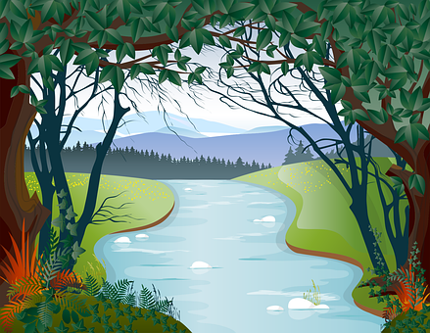
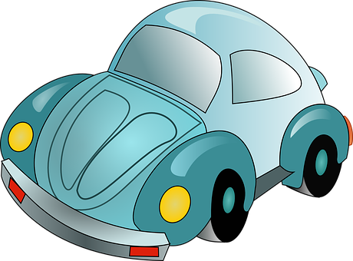
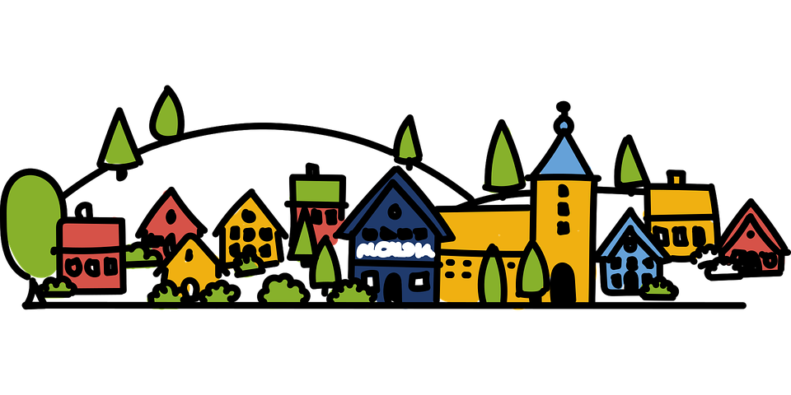
vocabulario
¿Qué palabra es?
¡Atención! ¿Qué palabra no está? 👀
4
1
3
9
2
6
5
10
8
7
la montaña el tráfico la gente el edificio el coche
el bosque la playa la ciudad el río la isla
Notes:
Timing: 5 minutes
Aim: to present and practise written comprehension and read aloud of six items of previously taught vocabulary that we revisit this week and the four new words.
Procedure: 1. Elicit the Spanish for 1-10 from pupils.
2. Click to make the words disappear and bring up further instructions.
3. On click, one word will disappear. Elicit word from pupils.
[NB] For additional support, click on the support icon (bottom left-hand side of the slide). Spanish words will appear again.

Slide 6
muchos, muchas
[many, a lot of, lots of]
Muchos, muchas means many, a lot of, lots of.
We use muchos, muchas before plural nouns. The spelling changes to match gender and number:
masculine
feminine
muchos coches
muchas personas
many cars
many people
Notes:
Timing: 3 minutes
Aim: to introduce muchos,as and how to use it with masculine and feminine plural nouns.
Procedure:
Click through the animations to present the new information.
Elicit English translations for the Spanish examples provided.

Slide 7
escuchar
México
Escucha. ¿Qué hay en México?
Ahora, marca.✅
 | muchos | muchas
 |  |  | animales | playas
 |  |  | casas | ríos
 |  |  | ríos | montañas
 |  |  | museos | personas
 |  |  | bosques | montañas
 |  |  | iglesias | parques
E
E
1
1
2
2
3
3
4
4
5
5
Notes:
Timing: 7 minutes
Aim: to practise aural transcription of plural nouns and their connection to the correct determiner – muchos or muchas.
Procedure:
Pupils write 1-5 in their books.
Click to listen to the example. Pupils listen out for the place that is mentioned and transcribe the noun. (The article is beeped out).
Click to correct.
Pupils now decide whether it should say ‘muchos’ or ‘muchas’.
Click to bring up a new set of audio buttons. Listen to the full sentences (Transcript 2) to check, and reveal written answers.
Elicit what the sentences say that México has lots of, in English.
Transcript 1:
Ej. En México hay muchas [playas].
1. En México hay muchos [ríos].
2. En México hay muchas [montañas].
3. En México hay muchas [personas].
4. En México hay muchos [bosques].
5. En México hay muchas [Iglesias].
Transcript 2:
Ej. En México hay muchas playas.
1. En México hay muchos ríos.
2. En México hay muchas montañas.
3. En México hay muchas personas.
4. En México hay muchos bosques.
5. En México hay muchas iglesias.

Slide 8
hablar
[1/5]
¿Qué hay en México?
Con tu compañero/a, habla 📢.
En México hay…
a river
two rivers
many rivers
un río
dos ríos
muchos ríos
Notes:
Time: 5 minutes
(Slide 1/5)
Aim: to practise oral sentence building. Targeted features: agreement of many, plural marking
Procedure:
1. Use this slide to model the activity. Elicit Spanish from volunteers and click through the animations to bring up answers.
2. For slide 2-5, pupils work in pairs to produce the full sentence for each picture. Click on inicio to allow pupils to work in pairs for 30 seconds.
3. Click for the Spanish sentence to appear.

Slide 9
hablar
[2/5]
¿Qué hay en México?
Con tu compañero/a, habla 📢.
En México hay…
30
S
a forest
two forests
many forests
un bosque
dos bosques
muchos bosques
0
INICIO
Notes:
[2/5]

Slide 10
hablar
[3/5]
¿Qué hay en México?
Con tu compañero/a, habla 📢.
En México hay…
30
S
S
a beach
two beaches
many beaches
una playa
dos playas
muchas playas
0
INICIO
Notes:
[3/5]

Slide 11
hablar
[4/5]
¿Qué hay en México?
Con tu compañero/a, habla 📢.
En la ciuda de México hay…
30
S
En ciudad de México hay muchas personas: ¡21.8 millones de personas! También hay mucho tráfico.
a car
un coche
many cars
two cars
muchos coches
0
dos coches
INICIO
Notes:
[4/5]

Slide 12
hablar
[5/5]
¿Qué hay en México?
Con tu compañero/a, habla 📢.
30
S
an island
two islands
many islands
una isla
dos islas
muchas islas
0
INICIO
Notes:
[5/5]

Slide 13
¡adiós!
verde

