Slide 1
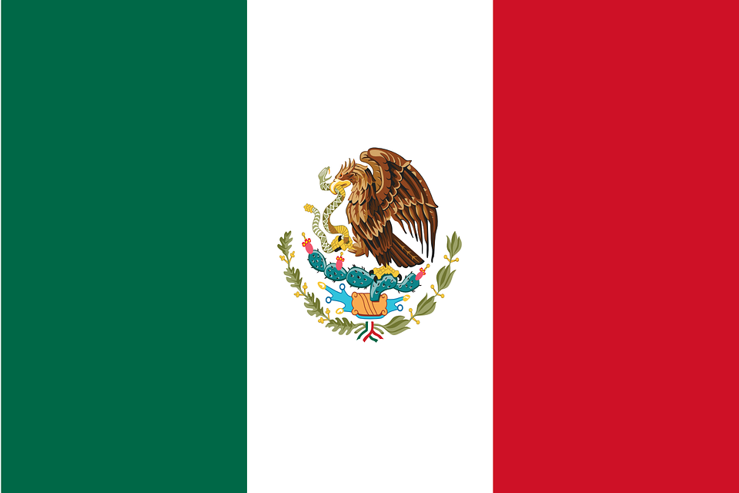
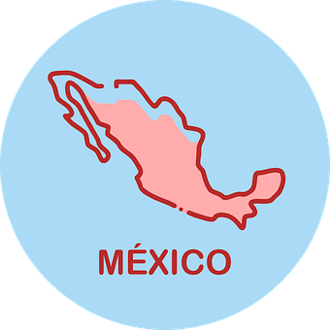
Saying what I and others do
Geografía física
verde
Follow ups 1-5
Notes:
Artwork by Steve Clarke. All additional pictures selected are available under a Creative Commons license, no attribution required.
The frequency rankings for words that occur in this PowerPoint which have been previously introduced in the resources are given in the SOW (excel document) and in the resources that first introduced and formally re-visited those words.
Phonics: Revisit 1
Vocabulary (new words in bold): persona [108] gente [137] dinero [364] tráfico [>5000]
Revisit 1: hacer [26] hago, haces; jugar [356] juego [jugar 356] juegas [jugar 356] baloncesto [>5000] esquí [>5000] fútbol [1471] tenis [4856] tiempo2 [80] bueno [103] malo [360] a [8] el [1] la [2] + revisit months + time phrases
Revisit 2: bicicleta [3684] cama [609] camisa [1873]cuaderno [3301] cuarto [653] gato [1728] habitación [1069] hermano [333] hermana [3409] idea [247] libro [230] mochila [>5000] oso [4449] perro [888] tía [1205] tío [988] vestido [1697]dónde [161] qué [50]
Frequency of unknown words and cognates: artículo [458]
Source: Davies, M. & Davies, K. (2018). A frequency dictionary of Spanish: Core vocabulary for learners (2nd ed.). Routledge: London
For any other words that occur incidentally in this PowerPoint, frequency rankings will be provided in the notes field wherever possible.

Slide 2
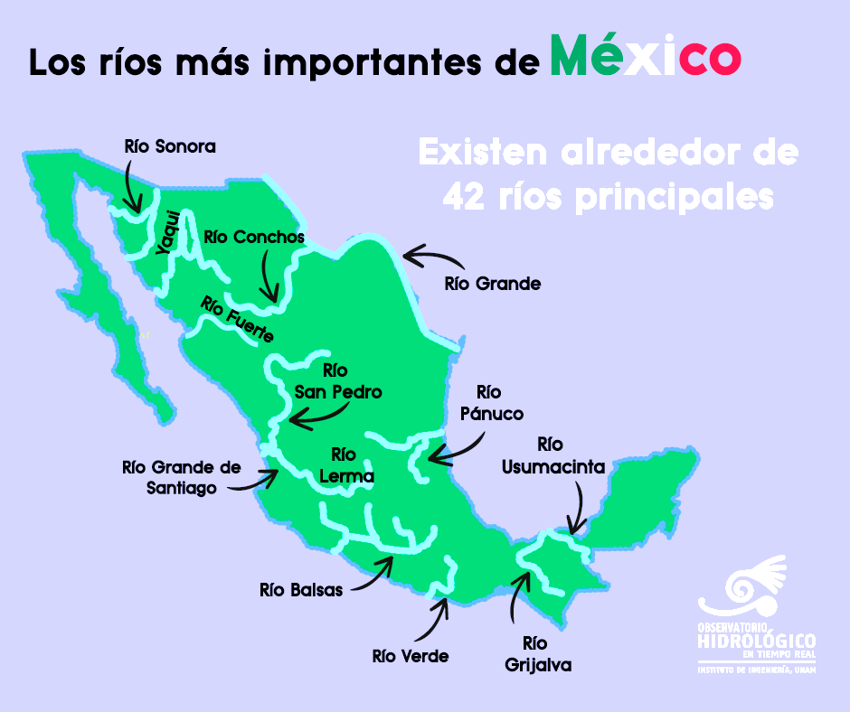
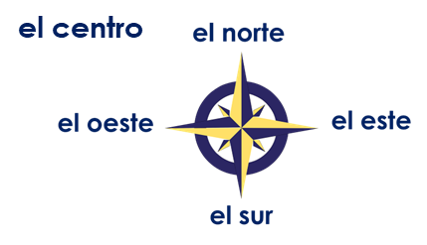
Follow up 2:
Escucha y comprueba las respuestas.
Observa el mapa y completa las frases.
pronunciar
Sonora
Yaqui
Los ríos ____________ y ________________ están en el norte de México.
Río ____________ está en el este de México y llega hasta* el sur de Estados Unidos.
El río _________________________ está en el oeste de México.
Los ríos ____________, __________ y ______________ están en el sur de México.
Grande
Grande de Santiago
Balsas
Verde
Grijalva
hasta – until, up to
Notes:
Audio for instruction 1 coming. Timing: 5 minutes
Aim: to practise a range of SSC.
Procedure: 1. Pupils read the texts in pairs, filling the gaps with the names of the rivers in the map.
2. They then read the shorts texts aloud.
2. Click on the play button for pupils to listen to the texts and check their answers.
Frequency of unknown words and cognates: hasta [60]
Source: Davies, M. and Davies, K. (2018). A frequency dictionary of Spanish: Core vocabulary for learners (2nd ed.). Routledge: London

Slide 3
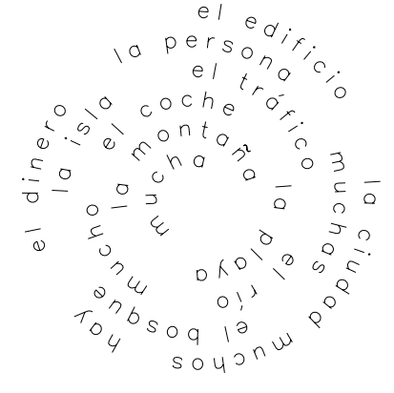
Follow up 2:
la
montaña
 | mountain
 | many (f, pl.)
 | there is / are
 | city
 | money
 | a lot (of), much (m)
 | car
 | traffic
 | many (m, pl.)
 | a lot (of), much (m)
 | person
 | beach
 | island
 | forest
 | river
 | building
muchas
Escribe el vocabulario.
hay
vocabulario
¿Qué artículo es? (el/la)
la
ciudad
el
dinero
mucho
escribir
el
coche
el
tráfico
mucha
muchos
la
persona
la
playa
la
isla
el
bosque
el
río
el
edificio
🆘 ¡Las palabras están en la espiral!
Notes:
Timing: 5 minutes
Aim: to practise guided written production of vocabulary of this week and previous weeks, and key grammar features: mucho (mucha, muchos, muchas).
Procedure:
NB. Some pupils will be doing this from memory whereas other might want to use the spiral to find the appropriate word, or a combination of both.
Teacher models the task with word 1:
¿Como se dice ‘mountain/ en español? Montaña, muy bien ☺.
Click to bring up word
¿Qué artículo es? ‘la’, excelente (and click to bring up ‘la’ and make the ink disappear).
¿Dónde está en la espiral? Click to highlight the word.
2. Pupils work individually or in pairs, then teacher elicits answers from individuals.
Frequency of unknown words and cognates: artículo [458]
Source: Davies, M. & Davies, K. (2018). A frequency dictionary of Spanish: Core vocabulary for learners (2nd ed.). Routledge: London

Slide 4
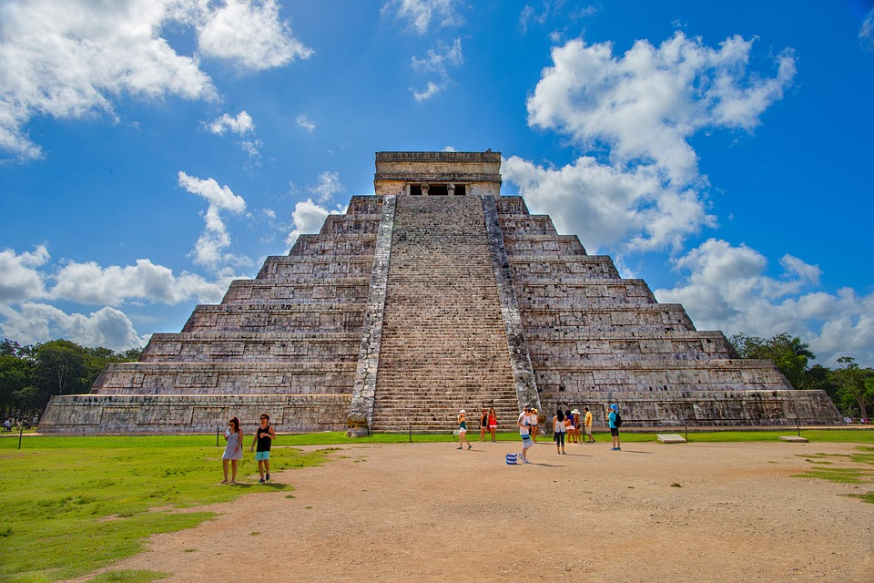
Follow up 3:
Lee el texto. Completa con la palabra correcta.
leer
En México la gente habla normalmente español pero también hablan lenguas* indígenas. Por ejemplo, el Náhuatl. Hay mucha gente - 126 millones de habitantes*. México es muy grande – casi* 2 millones de km².(Inglaterra es menos* grande - 245 000 km².). En México hay muchos bosques y muchas montañas. El país es famoso por las playas bonitas y los edificios de la cultura Maya.
_______
1
_______
Templo Chichén Itzá, en Yucatán, México.
2
_______
3
_______
4
_______
____
5
7
_______
6
The word chocolate 🍫 originates from Náhuatl (xocoatl). It means ‘food made from cacao seeds’.
_______
8
muchas
playas
mucha
la gente
la lengua - language
casi - almost el/la habitante – inhabitant
menos – less, fewer
muchos
grande
país
hablan
Notes:
Timing: 6 minutes
Aim: to practise use of the correct forms of mucho to match the noun that follows; to practise written comprehension of previously taught vocabulary and most of this week’s new words.
Procedure:
Pupils first look at the words that follow the gaps. For each one (1-7) they decide which word is needed from the options below and write it down.
Teacher elicits the responses and clicks to reveal the answers.
Pupils then read the text aloud with teacher support, as needed.
Click on the play button to hear an audio version of the text, if desired.
Teachers elicit an oral translation of the text from the class to consolidate meaning of the text.
Frequency of unknown words and cognates: habitante [1121] lengua [586] menos [117]
Source: Davies, M. & Davies, K. (2018). A frequency dictionary of Spanish: Core vocabulary for learners (2nd ed.). Routledge: London

Slide 5
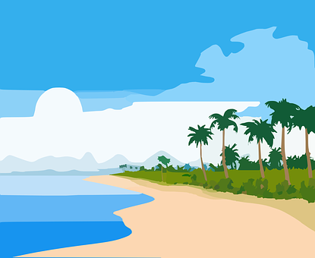
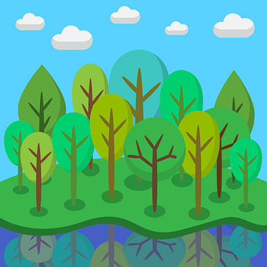
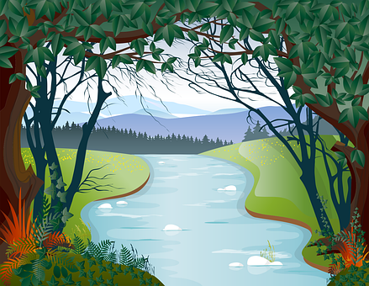
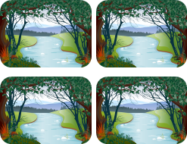
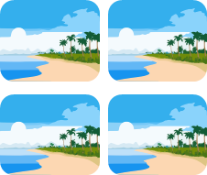
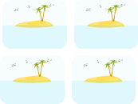
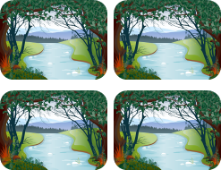
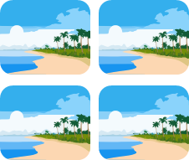
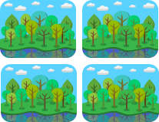
Follow up 4 [1/4]
Escucha y usa tus tarjetas. ¿Cuál es la tarjeta extra?
escuchar
uno / una
o
unos, muchos / unas, muchas
1
1 | 2 | 3
4 | 5 | 6
7 | 8 | 9
La tarjeta extra es…
Notes:
Timing: 5 minutes (four slides)
Note: we differentiate here only between singular (a/an) and plural (some, many). Aim: to practise aural comprehension of taught vocabulary
Procedure:
Give out the cards and ‘bingo’ cards to pupils before explaining the instructions.
Pupils are going to listen and put their cards in the order they hear the sentences, working from left to right and ending up with a 9-picture 3x3 formation. (NB. Pupils can work in pairs or individually).
Pupils might find it helpful for put their cards more or less as they appear on the right hand side of the slide, in singular and plural groups, just to help them find them more easily, as they listen.
Click the audio icon to listen. The audio is continuous, but at a reasonably slow pace with a pause after each word to allow process. Subsequent rounds of listening reduce the pauses to after each set of three words and increase the pace a little.
Click to allow pupils to check their answers and move on to the next round.
Transcript:
Hay una isla.
Hay un bosque.
Hay muchos ríos.
Hay muchas playas.
Hay un río.
Hay unas islas.
Hay unos bosques.
Hay una persona.
Hay una playa.

Slide 6
Follow up 3 [2/4]
2
escuchar
1 | 2 | 3
4 | 5 | 6
7 | 8 | 9
La tarjeta extra es…
Notes:
Transcript:
Hay una playa.
Hay muchas playas.
Hay muchas islas.
Hay muchos ríos.
Hay un bosque.
Hay un río.
Hay una isla.
Hay unas personas.
Hay una persona.

Slide 7
Follow up 3 [3/4] Más rápido
3
escuchar
1 | 2 | 3
4 | 5 | 6
7 | 8 | 9
La tarjeta extra es…
Notes:
Transcript:
Hay una persona.
Hay muchas islas.
Hay una playa.
Hay muchas personas.
Hay una isla.
Hay muchos ríos.
Hay muchos bosques.
Hay un río.
Hay un bosque.

Slide 8
Follow up 3 [4/4] Súper rápido
escuchar
4
1 | 2 | 3
4 | 5 | 6
7 | 8 | 9
La tarjeta extra es…
Notes:
Transcript:
Hay una personas.
Hay muchos bosques.
Hay unas islas.
Hay una playa.
Hay un bosque.
Hay muchas personas.
Hay una isla.
Hay muchas playas.
Hay un río.

Slide 9
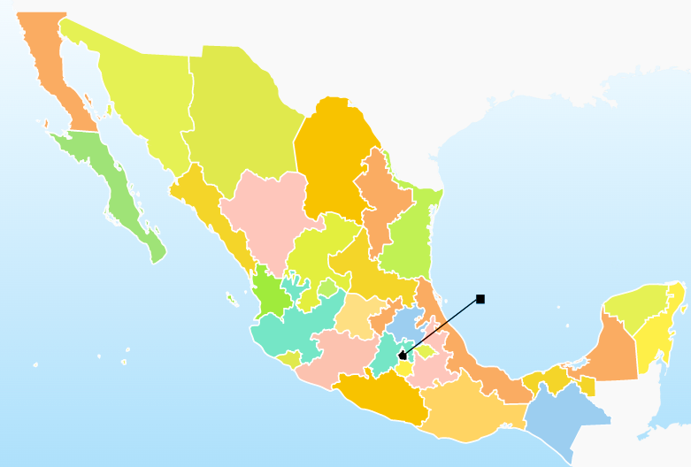
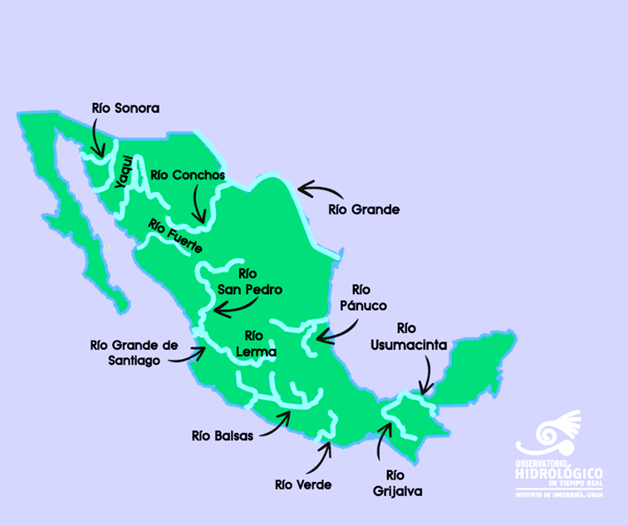
Follow up 4:
¿Qué hay en México?
En México hay muchos | muchas ______, Por ejemplo: ________. También hay un |una ________ famoso | famosa , _______. Su nombre es ________.
hablar
Ciudad de México es la capital del país.
Isla Pérez
Playa Tortugas
Cofre de Perote
Isla María Madre
Playa Cozumel
Bosque el Manto
Pico de Orizaba
Playa la India
Notes:
Timing: 5 minutes
Aim: to use this week’s vocabulary with the correct form of muchos / muchas in a guided oral activity.
Procedure:
1. Click to play one example of a description. Note that there are multiple possible descriptions.
2. Pupils work in pairs to describe the map.

Slide 10
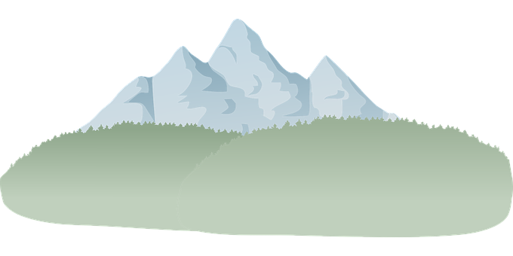
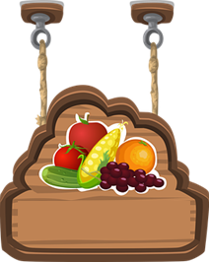
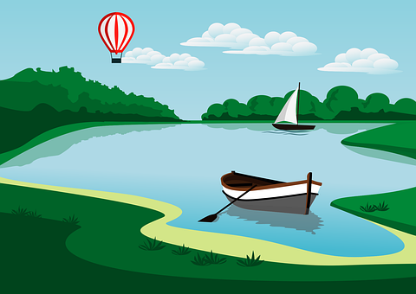
Follow up 5:
Escribe 5 frases y describe México.
⚠ Remember: when using mucho before a noun, the spelling changes to match gender and number.
escribir
Examples
In Mexico there is a lake.
In Mexico there are many beaches.
In Mexico there is an island.
In Mexico there are many forests.
In Mexico there are many mountains.
1
2
3
4
5
Find the name and location in Mexico of a famous example of each of these:
Beach 3 forest 5 Lake
River 4 Mountain 6 Island
Write the name of it and where it is in Mexico.
Notes:
Timing: 10 minutes
Aim: written production of key vocabulary and the correct form of the article (a/an/many).
Procedure:
Teacher to read the instruction and ensure this is clear.
Click to bring up speech bubble and remind pupils about using the correct form of muchos/as.
Click to bring up examples in English to support pupils who might need help. Encourage more linguistically able pupils to come up with their own sentences.
Click to bring up part two of the task. Pupils can conduct their own independent research. This would provide an extra opportunity to apply their SSC knowledge when pronouncing the names of the different places they research.

Slide 11
Follow up Extra 1:
Escribe en inglés 📝: Can you get at least 15 points?
 | la mochila | ¿Dónde? | la cama
 | el vesitdo | la habitación | ¿Qué?
 | hago | bueno | el baloncesto
 | haces | el tiempo | malo
 | muchas | muchos | la gente
 | el dinero | la persona | el tráfico
vocabulario
(the) school bag
Where?
(the) bed
x3
(the) dress
(the) room
What?
I do, make
good
(the) basketball
x2
You do, make
(the) weather, time
bad
many (fpl)
many (mpl)
(the) people
x1
(the) money
(the) person
(the) traffic
Notes:
Timing: 7 minutes
Aim: to practise written comprehension of vocabulary from this week and this week’s revisited sets.
Procedure:
1. Give pupils a blank grid. They fill in the English meanings of any of the words they know, trying to reach 15 points in total.
Note: The most recently learnt and practised words are pink, words from the first revisit are green and those from the second revisit are blue, thus more points are awarded for them, to recognise that memories fade and more effort (heavy lifting!) is needed to retrieve them.

Slide 12
Follow up 5b:
Escribe en español 📝: can you get at least 15 points?
 | (the) room | What? | (the) dress
 | (the) bed | (the) (school) bag | Where?
 | good | (the) basketball | you do, make
 | I do, make | (the) weather, time | bad
 | many (f, pl.) | many (m, pl.) | (the) person
 | (the) traffic | (the) people | (the) money
la habitación
¿Qué?
el vestido
vocabulario
x3
la cama
la mochila
¿Dónde?
bueno
el baloncesto
haces
x2
hago
el tiempo
malo
muchas
muchos
la persona
x1
el tráfico
la gente
el dinero
Notes:
Timing: 5 minutes
Aim: to practise written production of vocabulary from this week and this week’s revisited sets.
Procedure: 1. Give pupils a blank grid. They fill in the Spanish meanings of any of the words they know, trying to reach 15 points in total.
Note: The most recently learnt and practised words are pink, words from the first revisit are green and those from the second revisit are blue, thus more points are awarded for them, to recognise that memories fade and more effort (heavy lifting!) is needed to retrieve them.

Slide 13
¡adiós!
verde

Slide 14
Handout: Follow up extra 1
Escribe en inglés 📝: Can you get at least 15 points?
 | la mochila | ¿Dónde? | la cama
 | el vesitdo | la habitación | ¿Qué?
 | hago | bueno | el baloncesto
 | haces | el tiempo | malo
 | muchas | muchos | la gente
 | el dinero | la persona | el tráfico
vocabulario
x3
x2
x1
Notes:
Timing: 5 minutes
Aim: to practise written comprehension of vocabulary from this week and this week’s revisited sets.
Procedure: 1. Give pupils a blank grid. They fill in the English meanings of any of the words they know, trying to reach 15 points in total.
Note: The most recently learnt and practised words are pink, words from the first revisit are green and those from the second revisit are blue, thus more points are awarded for them, to recognise that memories fade and more effort (heavy lifting!) is needed to retrieve them.

Slide 15
Handout: Follow up 5b
Escribe en español 📝: Can you get at least 15 points?
 | (the) room | What? | (the) dress
 | (the) bed | (the) (school) bag | Where?
 | good | (the) basketball | you do, make
 | I do, make | (the) weather, time | bad
 | many (f, pl.) | many (m, pl.) | (the) person
 | (the) traffic | (the) people | (the) money
vocabulario
x3
x2
x1
Notes:
Timing: 5 minutes
Aim: to practise written production of vocabulary from this week and this week’s revisited sets.
Procedure: 1. Give pupils a blank grid. They fill in the Spanish meanings of any of the words they know, trying to reach 15 points in total.
Note: The most recently learnt and practised words are pink, words from the first revisit are green and those from the second revisit are blue, thus more points are awarded for them, to recognise that memories fade and more effort (heavy lifting!) is needed to retrieve them.

Slide 16
Handout: follow up 3
|
|
|
|
|
|
|
|
|
|
|
|
|
|
|
|
|
|
|
|
|
|
|
|
|
|
|
|
|
|
|
|
|
|
|
|

Slide 17
Handout: follow up 3
1 | 2 | 3
4 | 5 | 6
7 | 8 | 9
1 | 2 | 3
4 | 5 | 6
7 | 8 | 9

