Slide 1
español, con Sofía

Slide 2
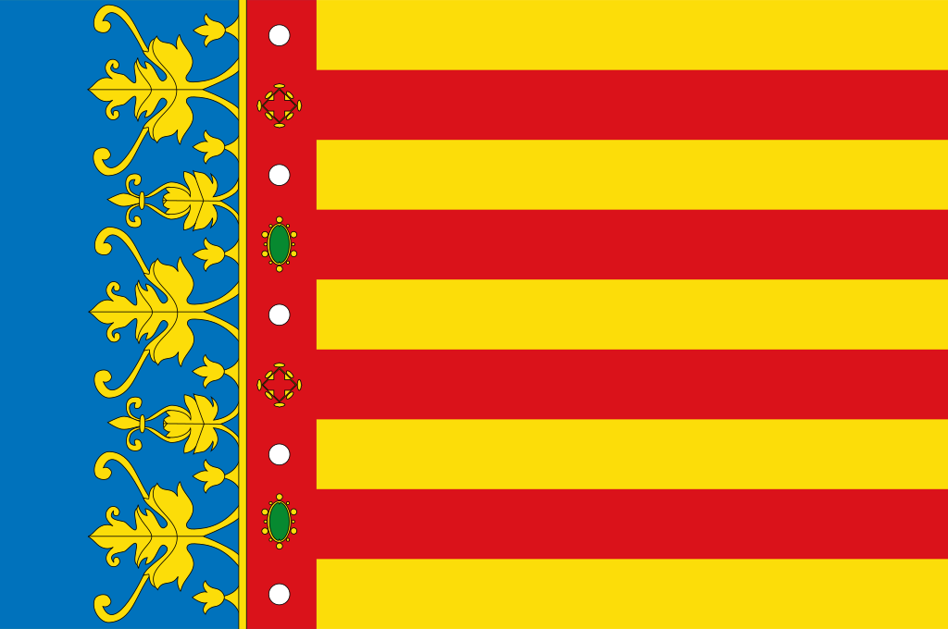
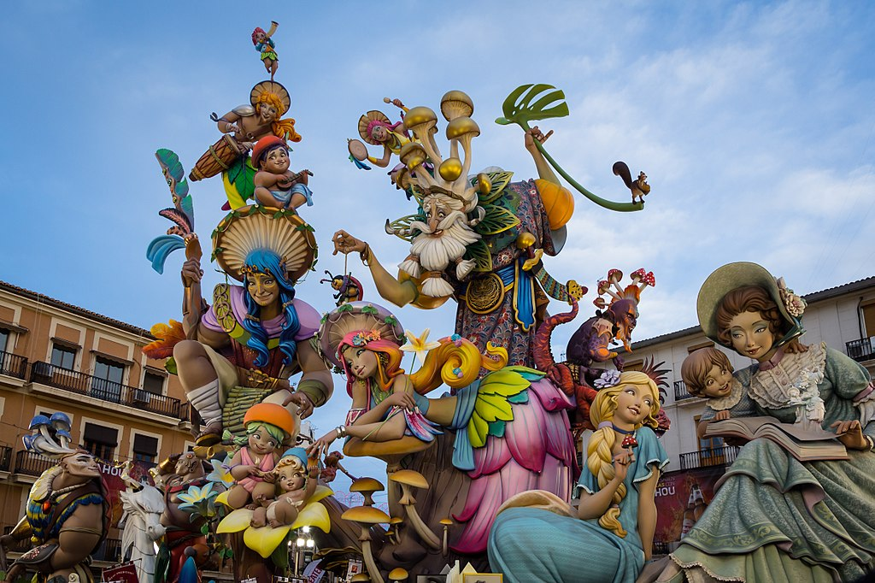
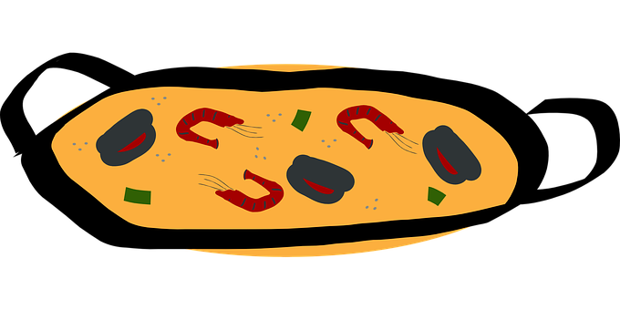
Saying what others and I do
Las fallas
verde
todo, mucho
-AR / -ER verbs: they, s/he
revisit several SSC
Notes:
Artwork by Steve Clarke. All additional pictures selected are available under a Creative Commons license, no attribution required.
The frequency rankings for words that occur in this PowerPoint which have been previously introduced in the resources are given in the SOW (excel document) and in the resources that first introduced and formally re-visited those words.
Phonics: Revisit accents rules 1-3
Vocabulary (new words in bold): desfile [4514] flor [739] fuego [884] luz [278] mucho [41] todo¹² [472] todo el mundo [n/a] traje [1689
Revisit 1: hacer [26] hago, haces, hace baile [2040] ciclismo [>5000] deporte [1489] dibujo [1726] natación [>5000] pastel [>5000] prueba [651] tarjeta [1958]
Revisit 2: jugar [356] amigo [210] amiga [1172] ajedrez [4970] carta [627] cuerda [2116] escondite [>5000] fútbol [1471] habitación [1069] hermano [333] hermana [3409] línea [476] tenis [4856] pelota [2270] solo [181] con [14] en [5]
Frequency of unknown words and cognates: dulce [3450] visitante [2428] colegio [628]
Source: Davies, M. & Davies, K. (2018). A frequency dictionary of Spanish: Core vocabulary for learners (2nd ed.). Routledge: London
For any other words that occur incidentally in this PowerPoint, frequency rankings will be provided in the notes field wherever possible.
By Rafa Esteve - Own work, CC BY-SA 4.0, https://commons.wikimedia.org/w/index.php?curid=67753089

Slide 3
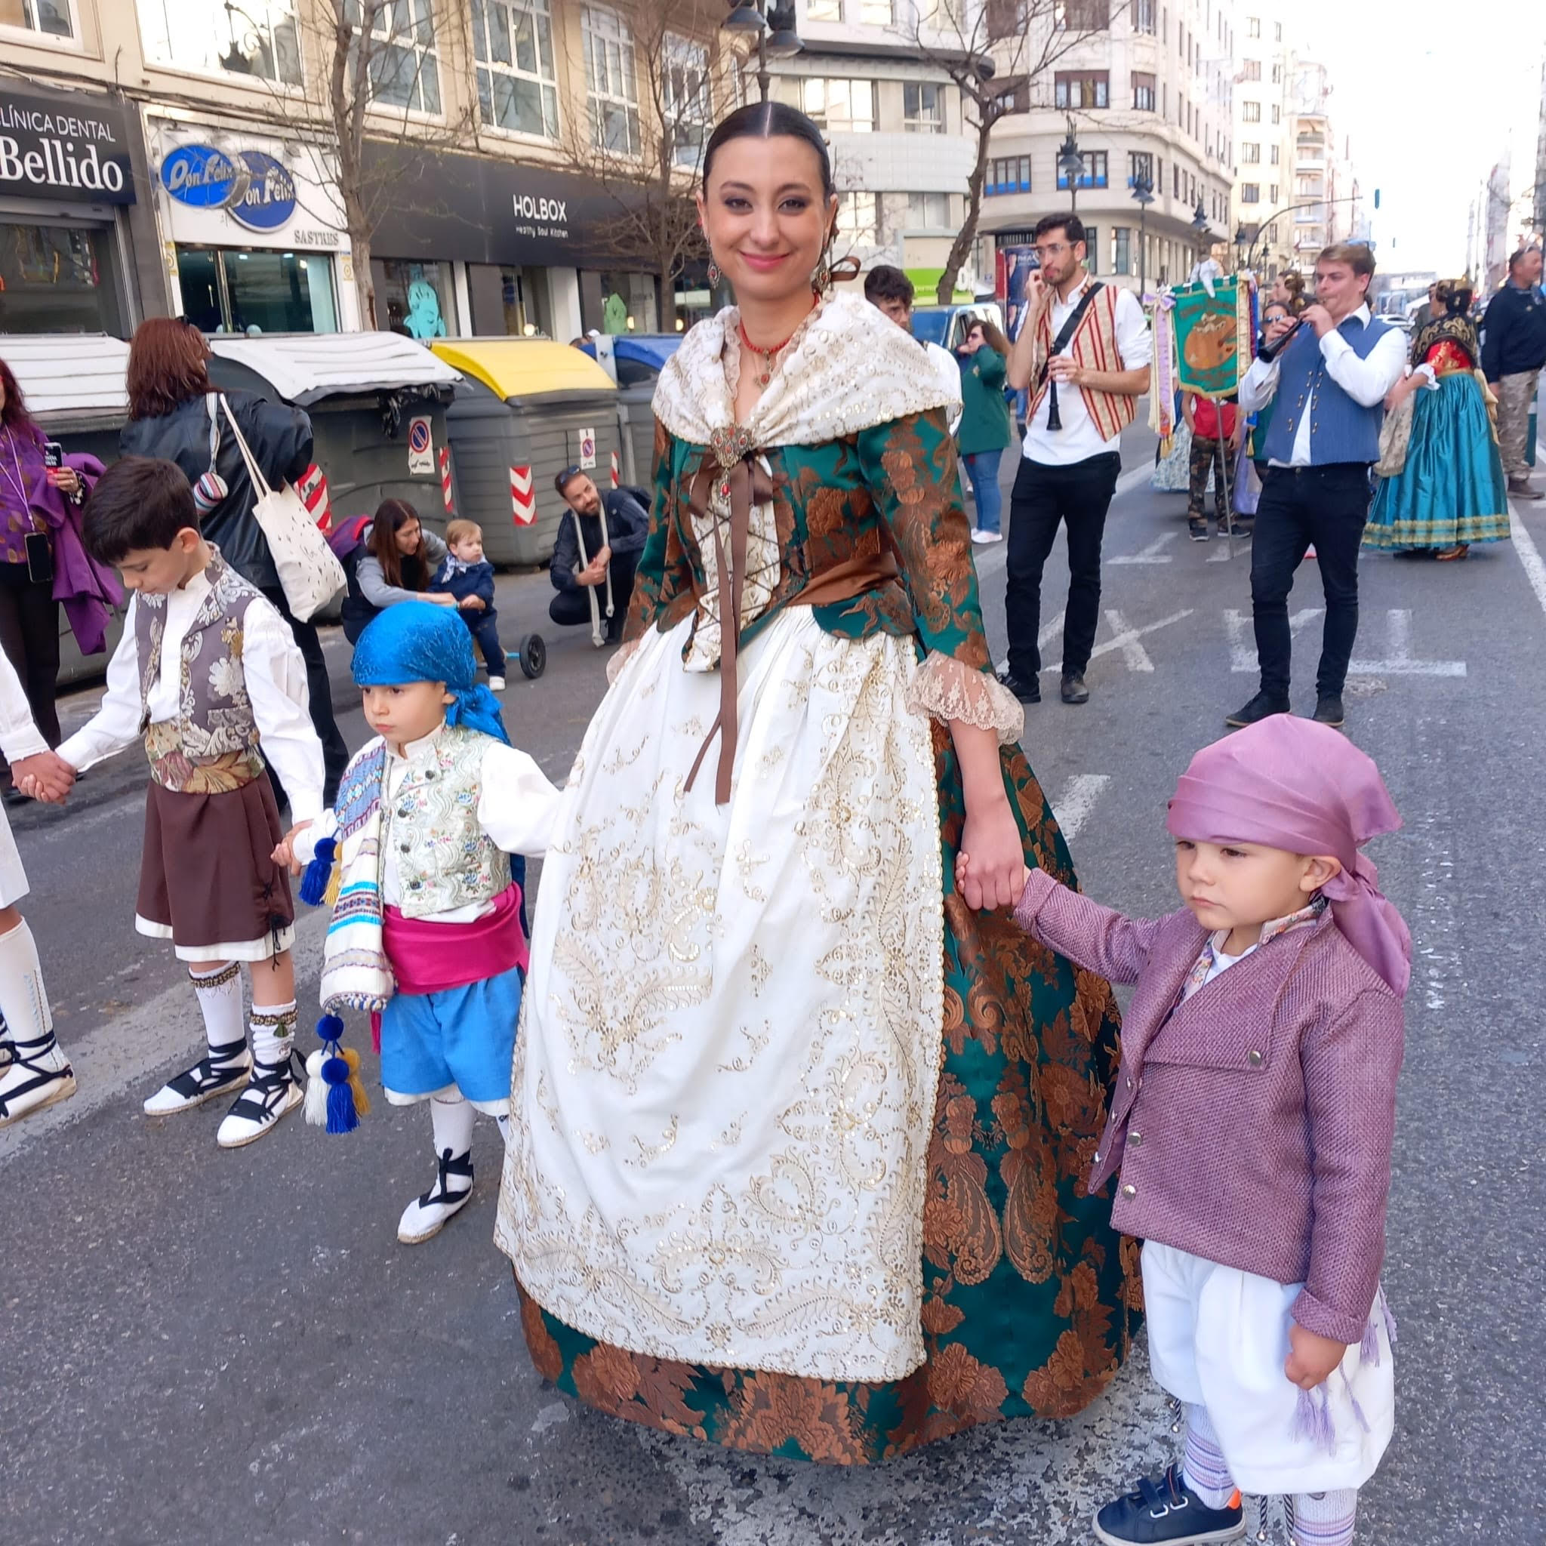
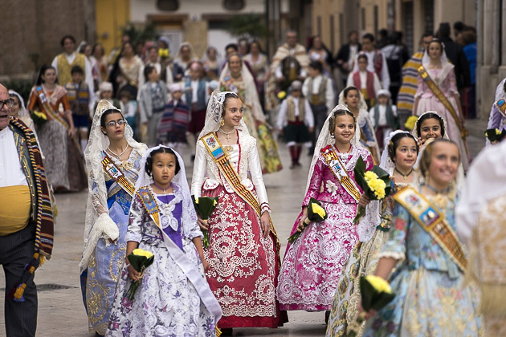
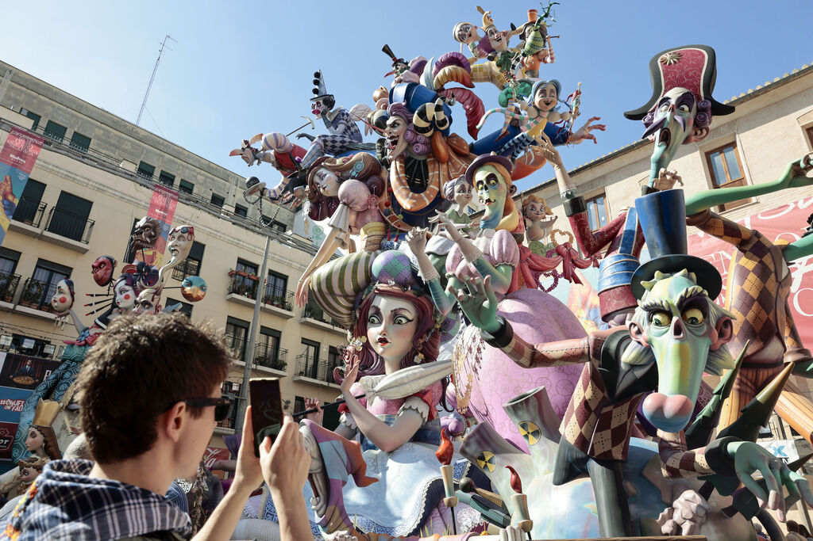
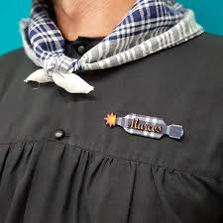
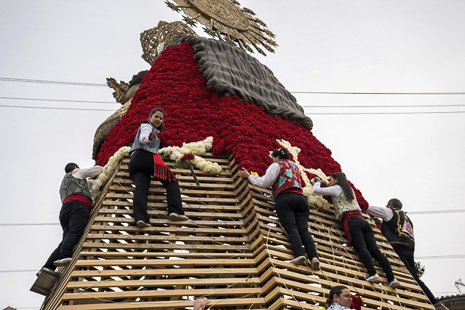
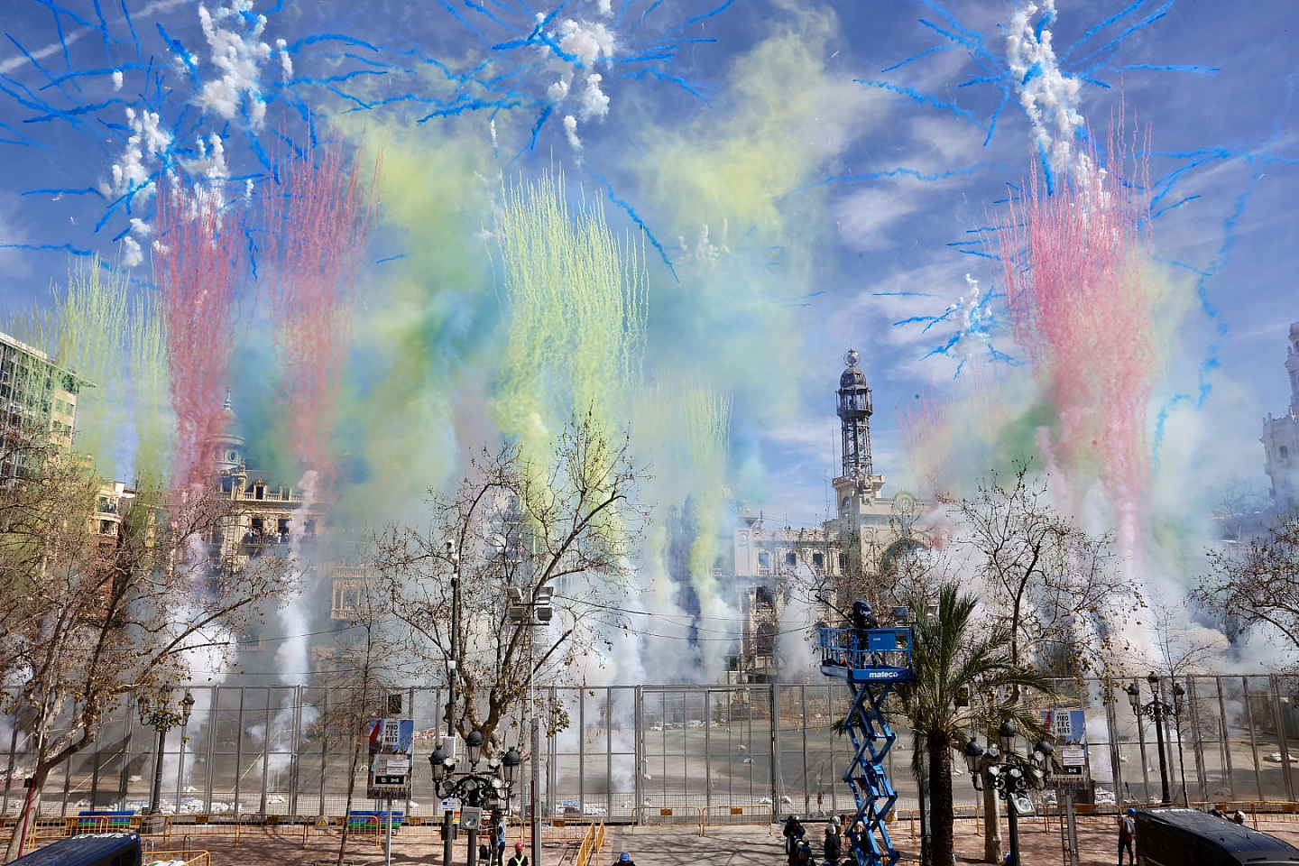
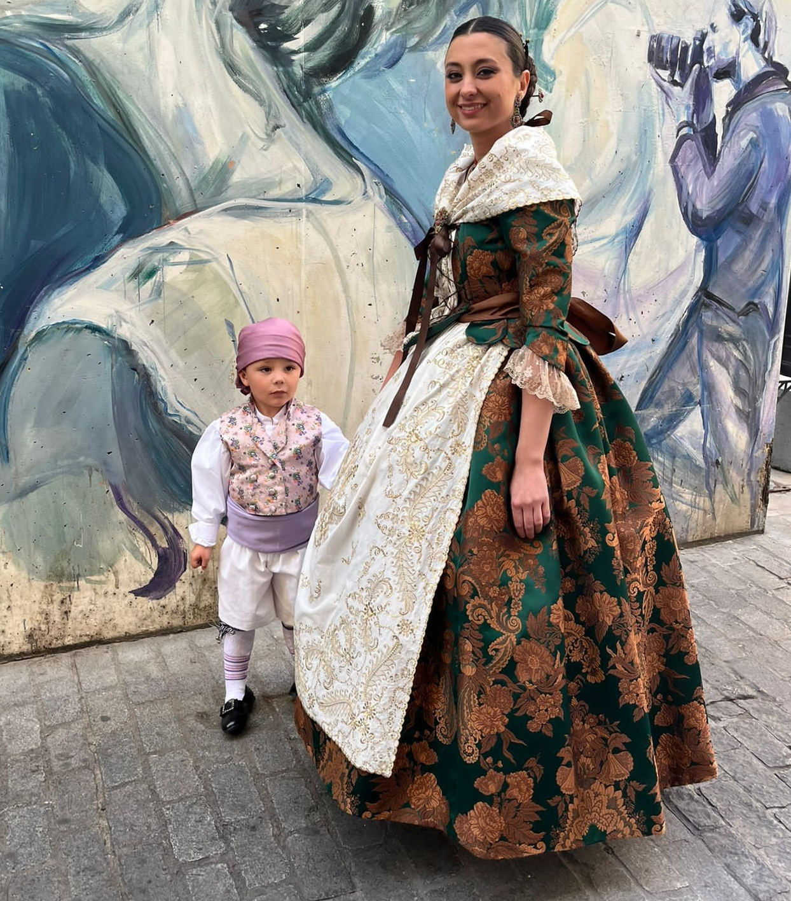
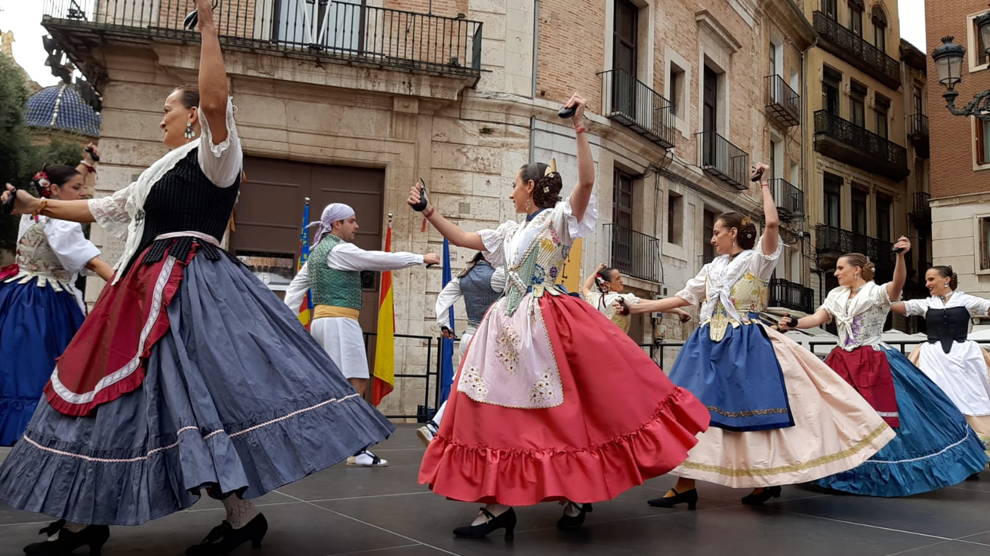
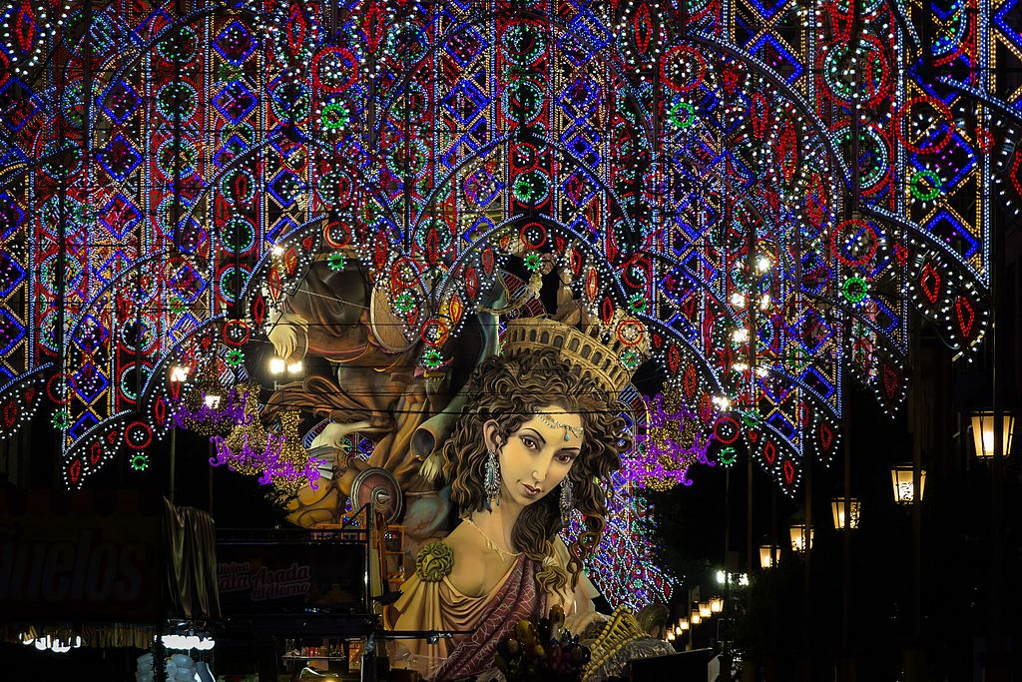
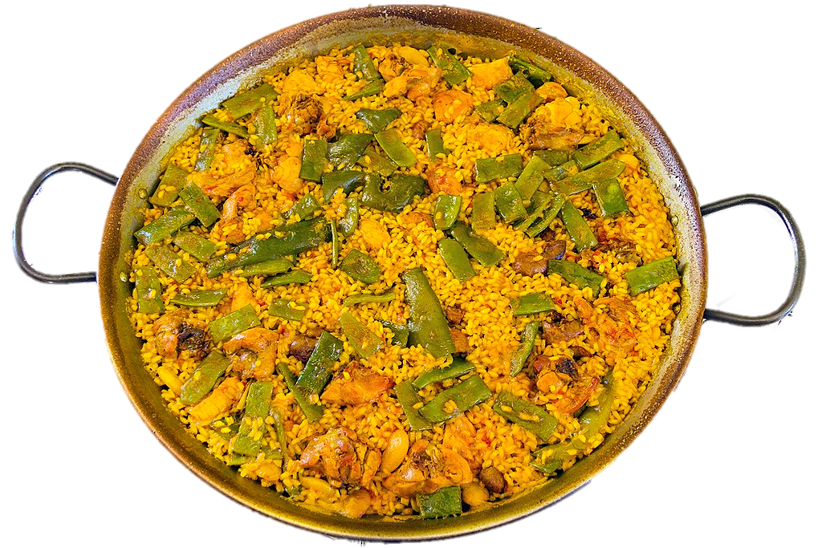
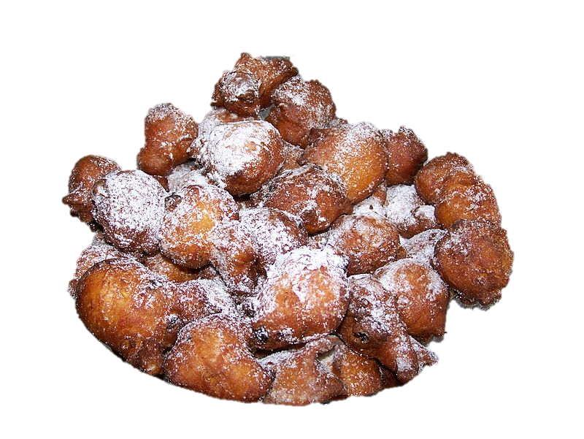
Las Fallas
de Valencia
(el) traje = garment
Lee la información y pronuncia.
pronunciar
1 | 2 | 3 | 4
5 | 6 | 7 | 8
9 | 10 | 11 | 12
Volunteers sort the bouquets by colours and by the end of the 2nd day of the offering, the dress is complete.
ver el desfile por la mañana
60 s
llevar
flores a la Virgen
hacer
muchas fotos
llevar un pañuelo fallero
From 16th to 19th every morning there are parades (desfiles) of men and women wearing traditional garments.
During a two-day parade, tens of thousands of falleros and falleras march through the streets to take bouquets for the massive wooden figure of Our Lady of the Forsaken.
On 19th March, the festival culminates at midnight with the "Cremà“, by burning all the Fallas, turning them to ashes amidst music and fireworks.
llevar
trajes
típicos
escuchar música tradicional
ver la ‘mascletà'
bailar en la calle
comer paella
A’ Macletà’ is a concert of explosions of gunpowder with a unique sound that takes place daily at 2.00 p.m.
ver la ‘Cremà’
cantar
el himno
de Valencia
0
pasear por las calles con luces
y buñuelos
INICIO
Notes:
Timing: 6 minutes
Aim: to practise read aloud of a mixture of familiar and unfamiliar words; to give an introduction to this week’s theme: las fallas in Valencia, Spain.
Procedure:
Tell pupils that this week they are going to learn about the festival of ‘las Fallas’ in Valencia and that these are pictures of the festival.
Pupils work in pairs to practise pronouncing activities that are part of this festival.
Teacher elicits pronunciation from pupils and clicks on each picture (as necessary) to hear the phrase pronounced.
Teacher to clarify the meaning of unknown words and cultural references by clicking to bring up callouts.
Transcript:
ver el desfile por la mañana
llevar flores a la Virgen
hacer muchas fotos
llevar un pañuelo fallero
ver la mascletà
llevar trajes típicos
escuchar música tradicional
bailar en la calle
pasear por las calles con luces
ver la Cremà
cantar el himno de Valencia
comer paella y buñuelos
Picture attributions: 1. Ver el desfile por la mañana 2. Llevar flores a la Virgen - https://valencia.for91days.com/la-ofrenda-flowers-for-the-virgin/
3. Hacer muchas fotos. https://www.distritofallas.com/2015/03/22/la-moda-del-selfie-dentro-y-fuera-de-las-fallas/
4. Llevar un pañuelo fallero. https://mercedesalfonso.com/producto/broche-petardo/
5. Ver la mascletà: https://fallas.com/index.php/main-galeria-va/event/140323mascleta
6.
7. Esuchar música tradicional - 8. bailar en la calle - https://fallas.com/index.php/main-noticies-va/11632-junta-central-fallera-celebra-el-xxv-aniversari-dels-balls-al-carrer-amb-una-gran-festa-de-folklore-valencia-a-la-placa-de-l-ajuntament 9. Pasear por las calles con luces - De Rafa Esteve - Trabajo propio, CC BY-SA 4.0, https://commons.wikimedia.org/w/index.php?curid=57607041
10. Ver la ‘Cremà’ - https://www.20minutos.es/imagenes/comunidad-valenciana/valencia/5111154-crema-pone-fin-fallas-2023/
11. Cantar el himno de Valencia - De Mutxamel - https://commons.wikimedia.org/w/index.php?curid=3250078
12. Comer paella - De Jan Harenburg - Trabajo propio, CC BY-SA 4.0, https://commons.wikimedia.org/w/index.php?curid=62140363
y buñuelos - De Klenje - Trabajo propio, CC BY-SA 3.0, https://commons.wikimedia.org/w/index.php?curid=9479100
The cremà (Valencian for "burning") is the act of setting fire to a falla monument,

Slide 4
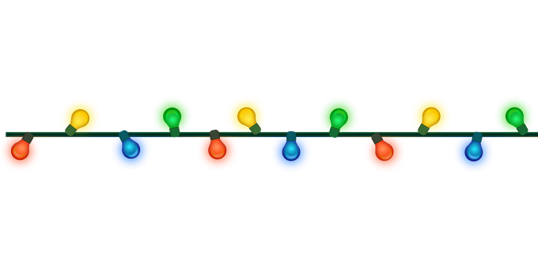
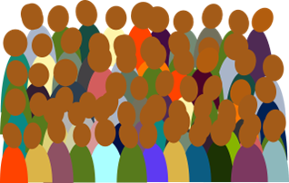
vocabulario
¿Cómo es en español?
⚠ The plural form of ‘luz’ is ‘luces’.
la luz
todo
la gente
el desfile
todo el mundo
el fuego
mucho
la calle
parade
much, a lot of
people
everything,
all (of)
everybody
fire
street
light
Notes:
Timing: 3 minutes
Aim: to present and practise written comprehension and read aloud of previously taught vocabulary and new words for this week.
Procedure: 1. Elicit pronunciation from pupils for the Spanish words
2. Click for an English prompt.
3. Elicit the Spanish word from pupils. 4. Continue until all 8 items have been seen and heard.

Slide 5
todo
⚠ We also just use todos with a plural verb to mean all/everyone: Todos hablan español. All speak/Everyone speaks Spanish.
[everything | all (of)]
Todo means everything.
Veo todo.
I see everything.
We also use todo before a noun to mean all (of). The spelling changes to match gender and number:
singular
plural
todo el día
all day
todos los desfiles
all (of) the parades
toda la gente
all (of) the people
todas las personas
all (of) the people
⚠ la gente is singular in Spanish: Toda la gente habla español. All the people speak / Everyone speaks Spanish.
⚠ Todas las personas hablan español. All the people speak Spanish.
Notes:
Timing: 3 minutes
Aim: to introduce todo and how to use it with masculine and feminine singular and plural nouns.
Procedure:
Click through the animations to present the new information.
Elicit English translations for the Spanish examples provided.

Slide 6
escuchar
Sofía visita las Fallas.
¿Qué hacen las personas? Escribe en inglés.
(el) dulce - sweet
Los churros y los buñuelos son dulces*
típicos. Es común comerlos
con chocolate caliente.
 | Todo el mundo (everyone) | todos (all - they)
1
2
3
4
5
6
7
8
1
1
… celebrates the Fallas.
2
2
… eat churros or buñuelos.
3
3
… see the parades in the morning.
4
4
… dance.
5
5
… sees the lights around the city.
6
6
… visits the monuments, ‘las Fallas’.
7
7
… take flowers to the Virgin.
8
8
… sing the hymn of Valencia.
Notes:
Timing: 8 minutes
Aim: to practise aural recognition of verbs in the 3rd persons singular and plural; to understand new information about Peru’s national days.
Procedure:
Pupils listen to each phrase.
First, they decide if the missing words must be ‘todo el mundo’ (singular verb) or ‘todos’ (plural verb).
Click to check the answers.
Click to listen again. On the 2nd time of listening, pupils write the rest of the phrase (i.e., the part following todo el mundo/todos) in English.
Click to reveal answers.
Transcript:
1 El 16 de marzo [todo el mundo] celebra las Fallas
2 [Todos] comen churros o buñuelos
3 [Todos] ven los desfiles por la mañana.
4 [Todo el mundo] baila.
5 [Todo el mundo ] ve las luces.
6 [Todo el mundo ] visita los monumentos, ‘las Fallas’. 7 [Todos] llevan flores a la virgen.
8 [Todos] cantan el himno de Valencia.
Frequency of unknown words and cognates: dulce [3450]
Source: Davies, M. & Davies, K. (2018). A frequency dictionary of Spanish: Core vocabulary for learners (2nd ed.). Routledge: London
Picture attribution: Churros: https://www.freepik.es/vector-gratis/coleccion-comida-mejicana_850772.htm#query=churros&position=0&from_view=search&track=sph">Freepik</a>
Buñuelos - De Klenje - Trabajo propio, CC BY-SA 3.0, https://commons.wikimedia.org/w/index.php?curid=9479100

Slide 7
mucho
[much | a lot of]
Mucho means much, a lot (of).
Veo mucho.
I see a lot.
We also use mucho before a noun. The spelling changes to match gender and number:
singular
plural
a lot of sun
muchos desfiles
a lot of parades
mucho sol
mucha gente
a lot of people
muchas personas
a lot of people
Notes:
Timing: 2 minutes
Aim: to introduce mucho and how to use it with masculine and feminine singular and plural nouns.
Procedure:
Click through the animations to present the new information.
Elicit English translations for the Spanish examples provided.

Slide 8
leer
¡Es 19 de marzo! Sofía está en Valencia y manda un mensaje a Krina y Max.
por todas partes - everywhere
Lee el texto. Escribe mucho, mucha, muchos o muchas.
people
parade
visitor
sun
la gente
el desfile
el/la visitante
el sol
¡Hola Krina y Max! ¡Felices Fallas! Hoy hace mucho sol y hay mucha gente en las calles. Todo el mundo está muy contento porque ¡no hay colegio! Veo muchas personas por todas partes. Muchos visitantes son de fuera – de muchos países del mundo - pero también hay muchas personas de Valencia. Quique y yo estamos en el desfile. Hay muchos niños con trajes típicos y mucha música.
1
_______
2
_______
3
_______
4
_______
5
_______
6
_______
7
_______
8
A marching band always accompanies each ‘casal faller’ (a group of people from a neighbourhood).
_______
outfit
school
everybody
country
el traje
el colegio
todo el mundo
el país
Notes:
Timing: 6 minutes
Aim: to practise use of the correct forms of mucho to match the noun that follows; to practise written comprehension of previously taught vocabulary and most of this week’s new words.
Procedure:
Pupils first look at the words that follow the gaps. For each one (1-8) they decide which form of mucho is needed and write it down.
Teacher elicits the responses and clicks to reveal the answers.
Pupils then read the text aloud with teacher support, as needed.
Click on the image of Sofía to hear an audio version of the text, if desired.
Pupils focus on the eight English words and identify the Spanish words from the text.
Pupils can volunteer answers in any order – teacher clicks on the English word and the Spanish translation appears.
4. Teachers elicit an oral translation of the text from the class to consolidate meaning of the text.
5. Teacher can play the video to show a parade.
Note: Fallas is a UNESCO heritage festival since 2016. For more information: https://en.wikipedia.org/wiki/Valencia_Fallas
Frequency of unknown words and cognates: visitante [2428] colegio [628] traje []
Source: Davies, M. & Davies, K. (2018). A frequency dictionary of Spanish: Core vocabulary for learners (2nd ed.). Routledge: London

Slide 9
¡adiós!
verde

