Slide 1

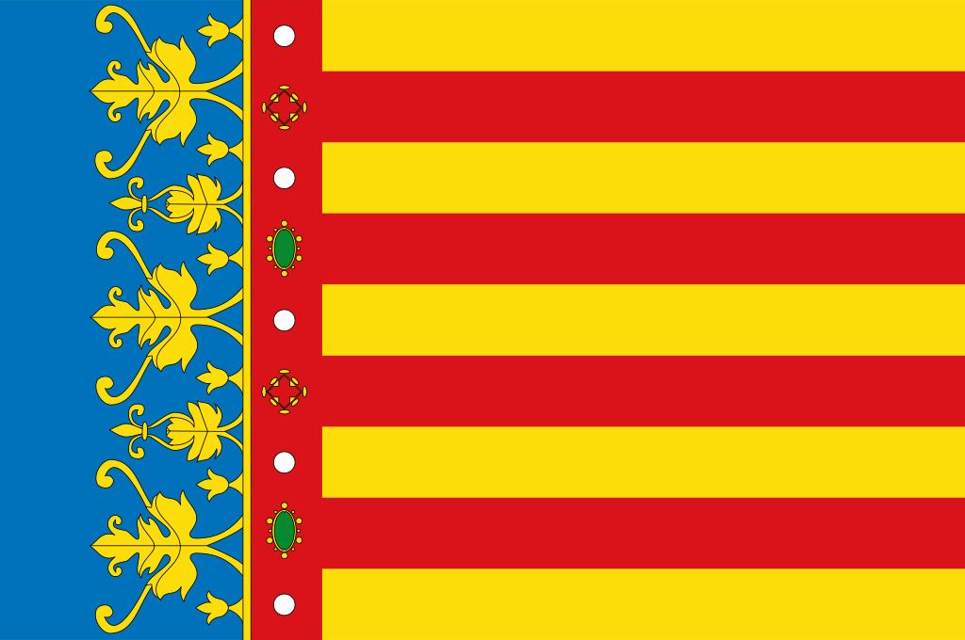
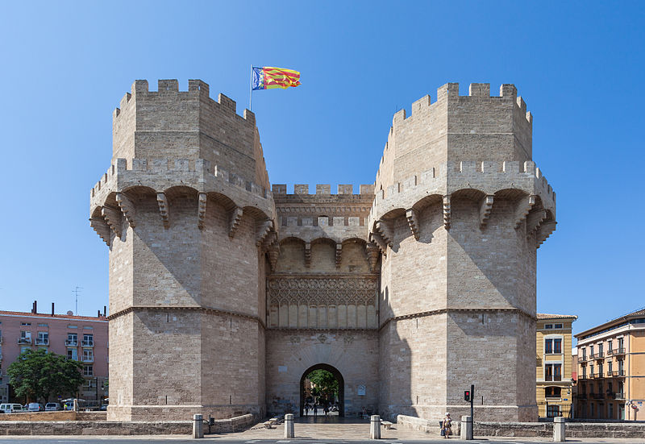
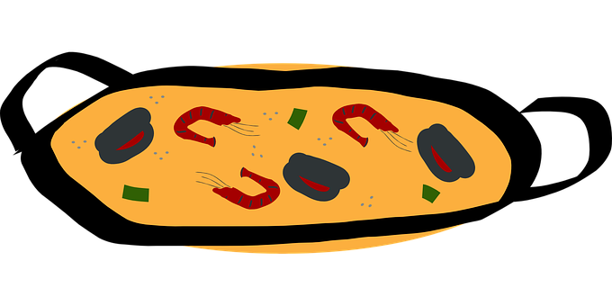
Saying what I and others do
Valencia
verde
Follow ups 1-5
Notes:
Artwork by Steve Clarke. All additional pictures selected are available under a Creative Commons license, no attribution required.
The frequency rankings for words that occur in this PowerPoint which have been previously introduced in the resources are given in the SOW (excel document) and in the resources that first introduced and formally re-visited those words.
Phonics: Revisit of SSC (ch-cu-ce-ci-z-qui-ll-ñ-j-r-rr-h)
Vocabulary (new words in bold): desfile [4514] flor [739] fuego [884] luz [278] mucho [41] todo12 [472] todo el mundo [n/a]
Revisit 1: hacer [26] hago, haces, hace baile [2040] ciclismo [>5000] deporte [1489] dibujo [1726] natación [>5000] pastel [>5000] prueba [651] tarjeta [1958]
Revisit 2: jugar [356] amigo [210] amiga [1172] ajedrez [4970] carta [627] cuerda [2116] escondite [>5000] fútbol [1471] habitación [1069] hermano [333] hermana [3409] línea [476] tenis [4856] pelota [2270] solo [181] con [14] en [5]
Frequency of unknown words and cognates:
dulce [3450] visitante [2428] colegio [628] traje []
Frequency of unknown words and cognates:
antiguo [446]
Source: Davies, M. & Davies, K. (2018). A frequency dictionary of Spanish: Core vocabulary for learners (2nd ed.). Routledge: London
For any other words that occur incidentally in this PowerPoint, frequency rankings will be provided in the notes field wherever possible.
By Rafa Esteve - Own work, CC BY-SA 4.0, https://commons.wikimedia.org/w/index.php?curid=67753089

Slide 2



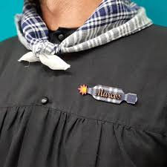
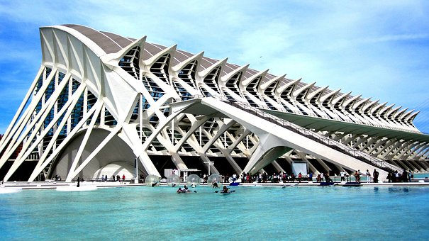
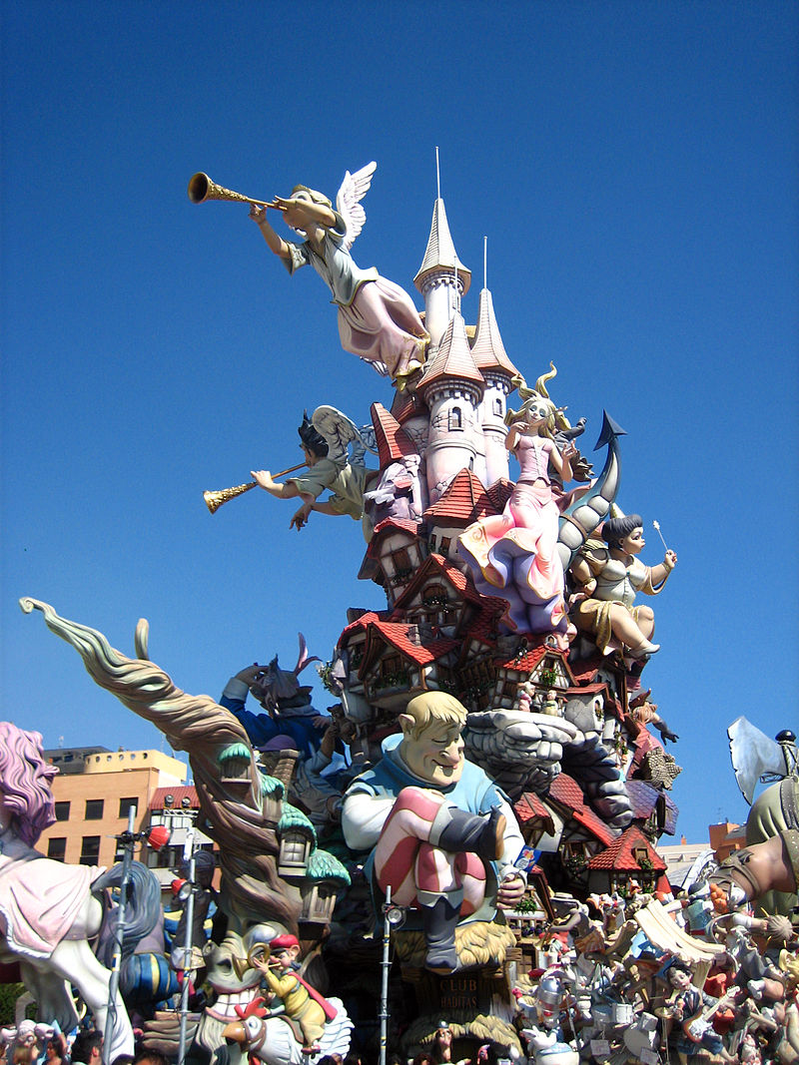
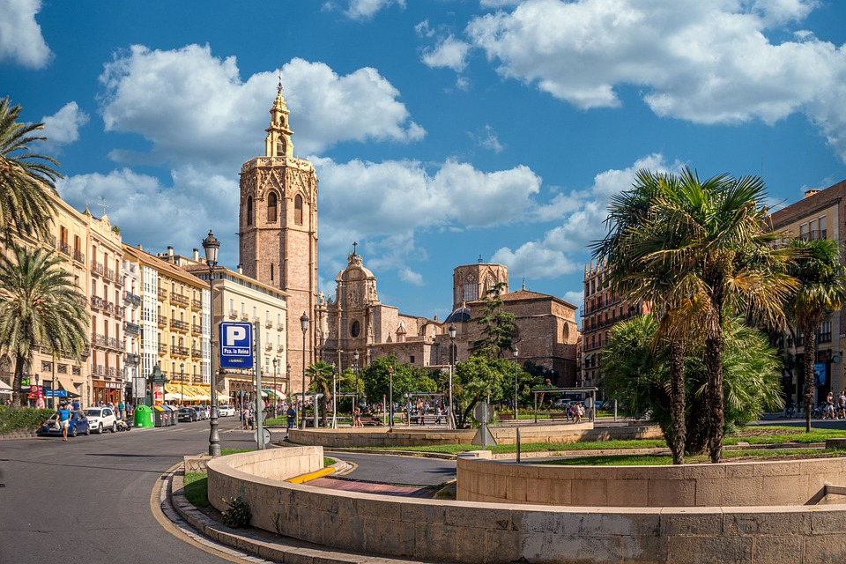
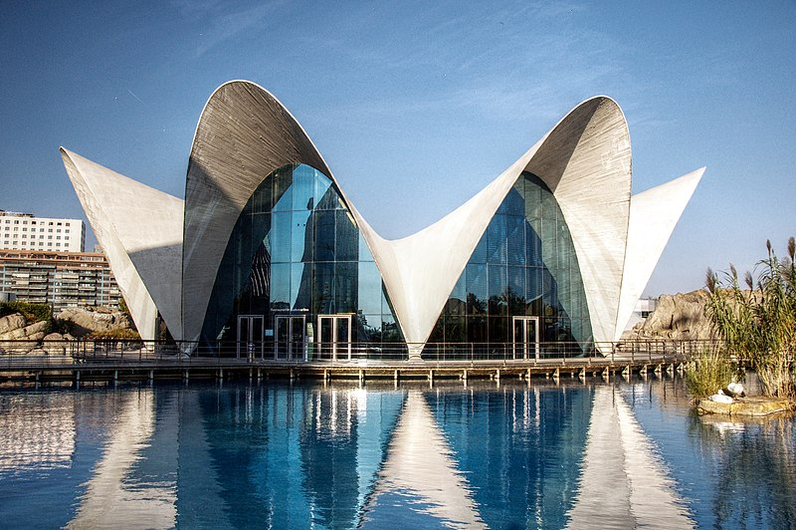
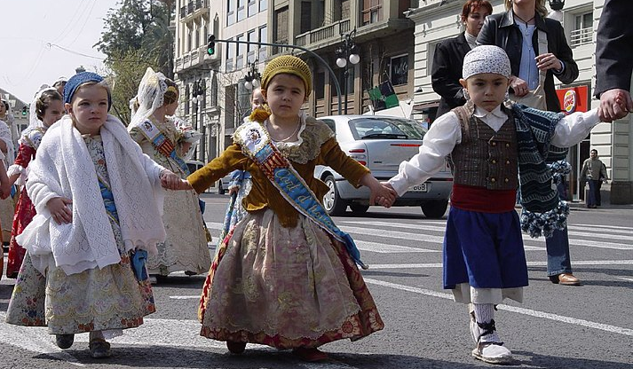
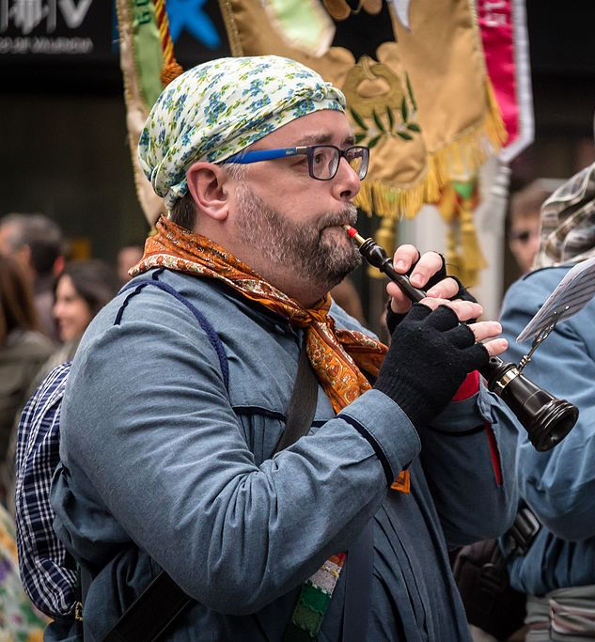
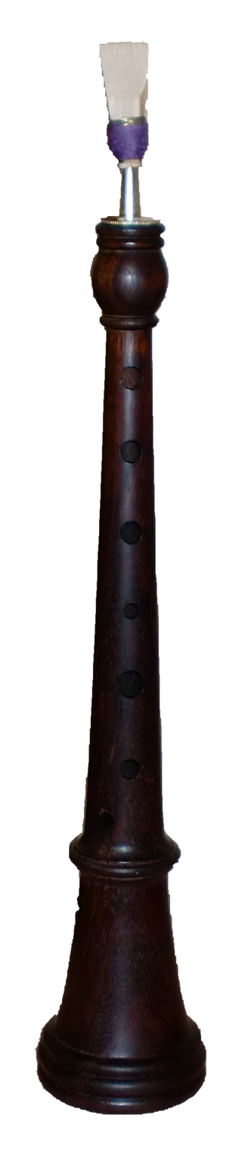
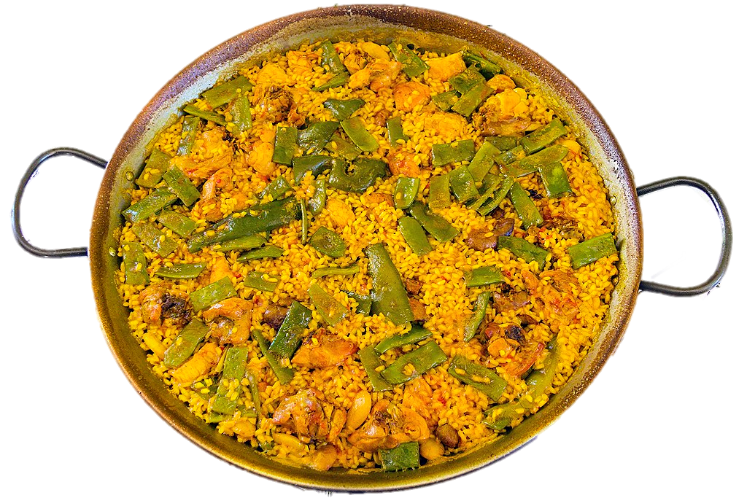
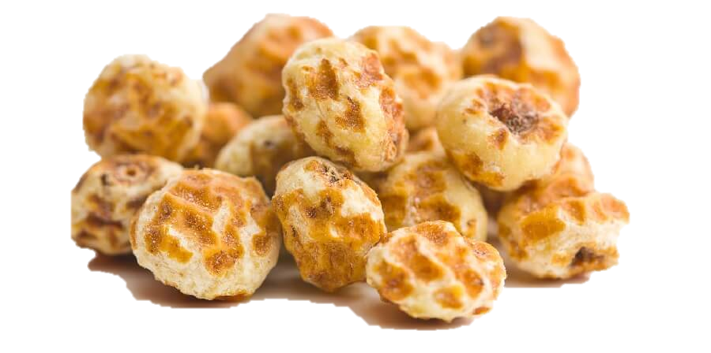
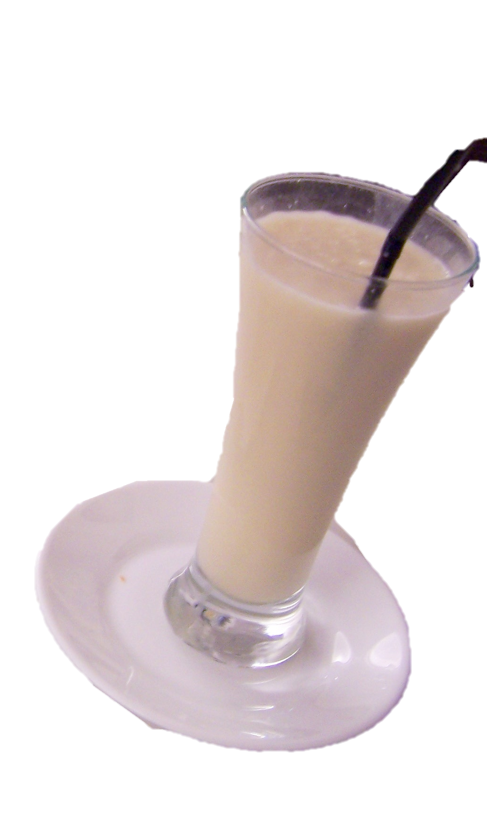
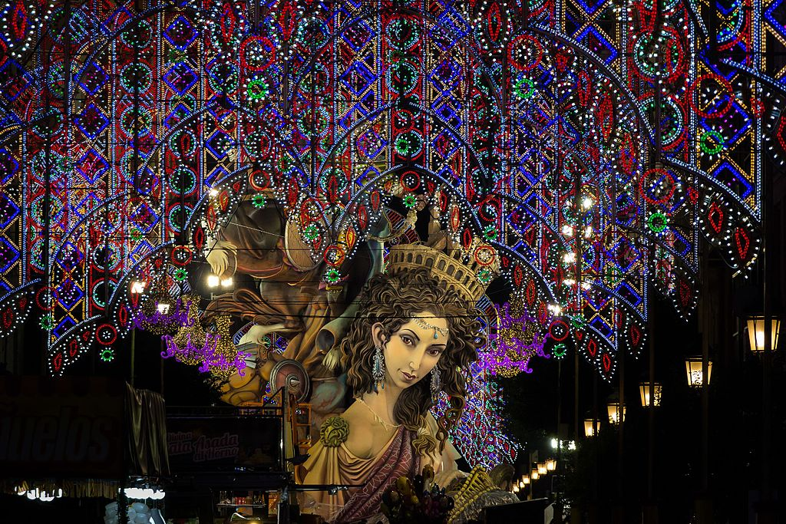
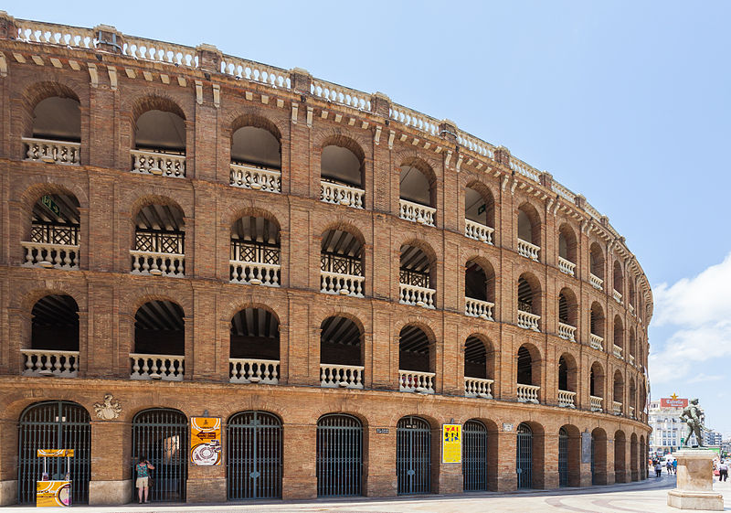
pronunciar
Follow up 1:
Pronuncia las palabras.
1 | 2 | 3 | 4
5 | 6 | 7 | 8
9 | 10 | 11 | 12
Valencia
un
pañuelo fallero
una
falla
la arquitectura moderna
1
minuto
la paella
It’s a plant-based drink made with soaked and sweetened tiger nuts, similar to rice milk. Horchata
slushes are very popular
in summer!
el
traje tradicional
el acuario
la dulzaina
las
torres
de Serranos
la horchata
la
plaza de toros
las luces
INICIO
Notes:
Timing: 5-8 minutes
Aim: to consolidate knowledge of SSC (ch-cu-ce-ci-z-qui-ll-ñ-j-r-rr-h) in a read aloud task using mainly unknown words and cognates; to provide an introduction to the city of the festival of this week, las Fallas.
Procedure:
1. Teacher gives the instruction.
2. Pupils practise pronouncing the words in pairs.
3. Teacher to elicit words chorally. (Click on the picture to hear native audio, if required).
4. Teachers can decide if to bring up the information explaining more about all of the words. (Alternatively, the teacher can read these beforehand in advance and decide which details to give.)
5. Pupils work in pairs to pronounce words again, for 1 minute.
Transcript:
1 Un pañuelo fallero
2 Valencia
3 arquitectura moderna
4 una falla
5 el acuario
6 la paella
7 el traje tradicional
8 la dulzaina
9 las luces
10 la horchata
11 la plaza de toros
12 las torres de Serranos
Picture attribution:
Dulzaina: By Rafa Esteve - Own work, CC BY-SA 4.0, https://commons.wikimedia.org/w/index.php?curid=53867860; By Ferbr1 - Own work, CC BY-SA 4.0, https://commons.wikimedia.org/w/index.php?curid=9763792
Oceanografic: By Felipe Gabaldón, CC BY 2.0, https://commons.wikimedia.org/w/index.php?curid=12532971
Torres de Serranos: By Diego Delso, CC BY-SA 4.0, https://commons.wikimedia.org/w/index.php?curid=35074193
El traje tradicional: By inferis - Flickr, CC BY-SA 2.0, https://commons.wikimedia.org/w/index.php?curid=599224
Una falla: By Sento - originally posted to Flickr as Falla Nou Campanar, CC BY-SA 2.0, https://commons.wikimedia.org/w/index.php?curid=9654823
Pañuelo:
Luces: De Rafa Esteve - Trabajo propio, CC BY-SA 4.0, https://commons.wikimedia.org/w/index.php?curid=57607041
Horchata: By Photocapy - http://commons.wikimedia.org/wiki/File:Horchata_de_chufa.jpg, CC BY-SA 2.0, https://commons.wikimedia.org/w/index.php?curid=9440367
Paella: De Jan Harenburg - Trabajo propio, CC BY-SA 4.0, https://commons.wikimedia.org/w/index.php?curid=62140363
Tiger nuts: https://www.bulkeez.com/products/organic-peeled-tiger-nuts
2

Slide 3


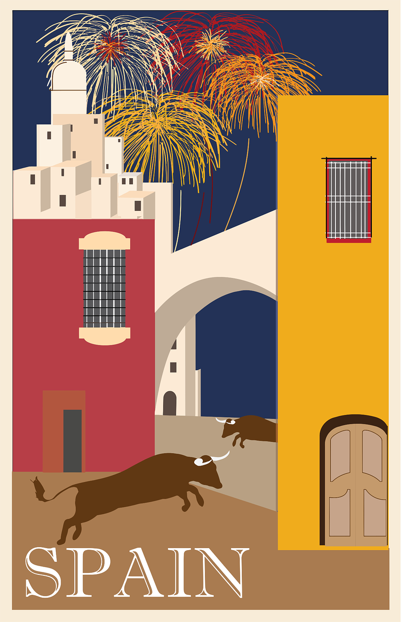

Follow up 2: Sofía describe Valencia.
Combina las frases.
leer
antiguo - old
 | En Valencia …
 | La ciudad está …
 | Valencia tiene …
 | Mucha…
 | Todo el mundo…
 | en la costa de España. [A]
 | un museo de ciencias muy famoso: la Ciudad de las Ciencias. [B]
 | hay edificios antiguos* y modernos. ¡Es una ciudad muy bonita! [C]
 | celebra en las calles durante* las Fallas. [D]
 | gente bebe horchata cuando hace calor. [E]
1
E
2
1
E
2
4
3
*during
3
4
Notes:
Timing: 5 minutes
Aim: to practise reading comprehension of vocabulary of this week and previous weeks, and key grammar features: mucho (mucha, muchos, muchas) and todo (toda, todos, todas)
Procedure:
Teacher models the task with sentence 1, using a ‘think aloud’ to consider which one of the sentences on the right is the correct one. Start from the top one and elicit English from pupils so that they can judge by themselves whether it makes sense or not. (En Valencia en la costa este de España = In Valencia on the East coast of Spain]. Elicit suggestions from pupils as to a suitable combinations.
Pupils can work then in pairs, reading aloud possible combinations.
Teachers can elicit answers and click to bring answers back or click on the buttons (E-4) to hear individual sentences and get pupils to check their answers.
Click on the image of Sofía to hear an audio version of the full text, if desired.
NB. When translating English to Spanish, pupils might consider E-E (In Valencia people drink horchata when it’s hot), however, it is not grammatically correct as the definite article before ‘gente’ would be needed as Spanish uses the article when talking about things / people in general.
Frequency of unknown words and cognates:
antiguo [446] durante [139]
Source: Davies, M. & Davies, K. (2018). A frequency dictionary of Spanish: Core vocabulary for learners (2nd ed.). Routledge: London

Slide 4
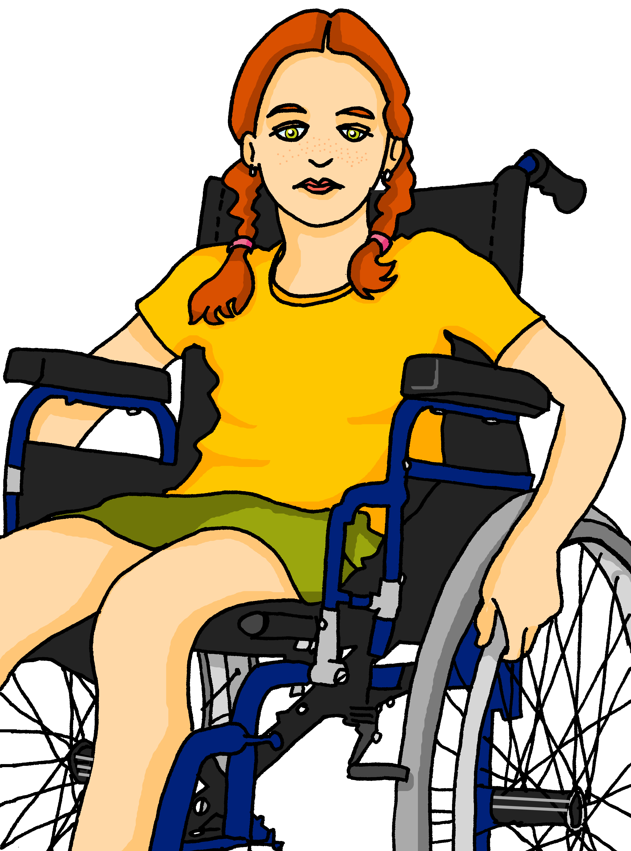


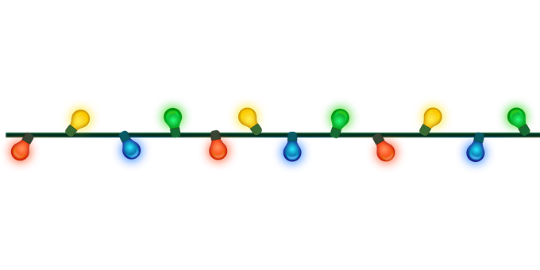

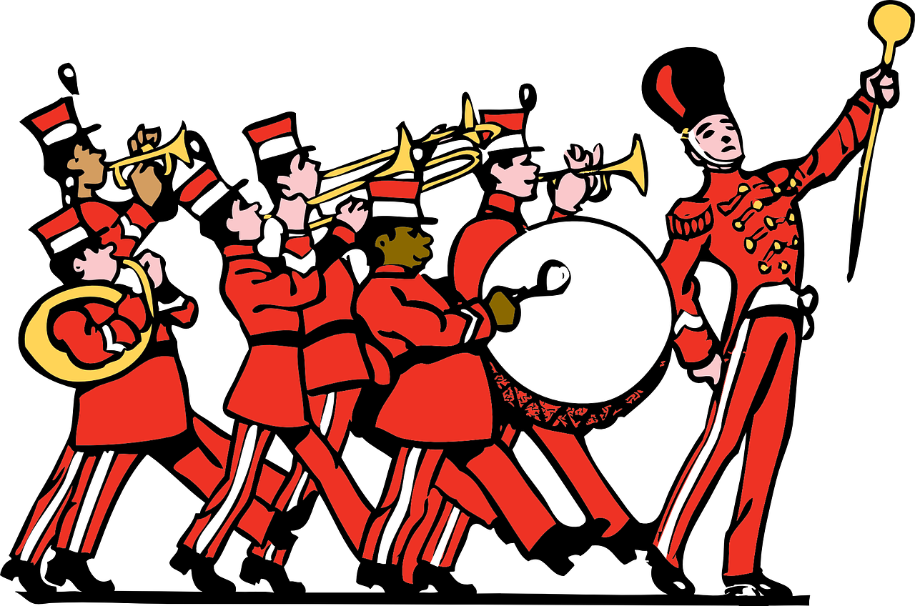

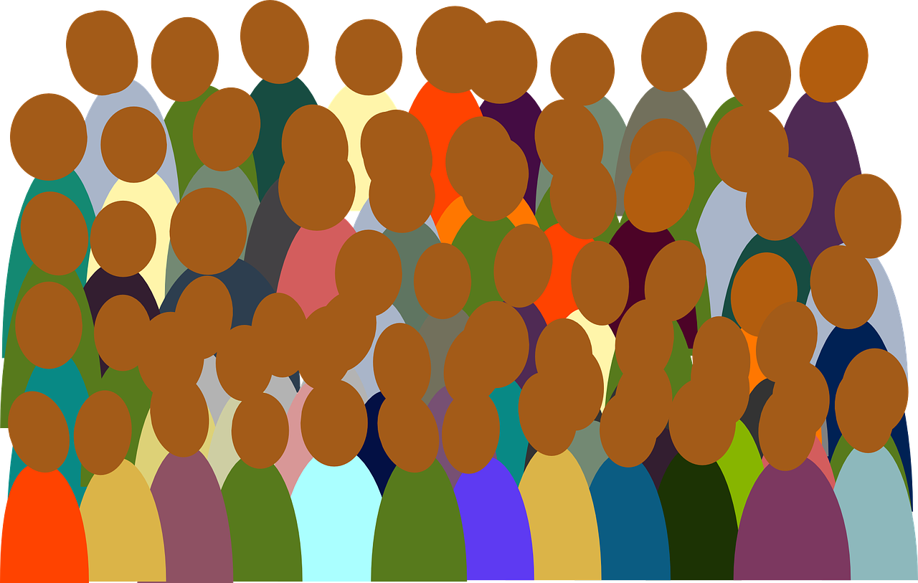

Follow up 3: Krina busca información sobre Valencia y las Fallas.
Escribe las frases en español.
escribir
 | In March there is a very famous festival/celebration in Valencia.
 | There is 🎶 and in the streets.
 | and takes (makes) .
 | visit Valencia and the weather is always good.
 | take/carry flowers to ‘la Vírgen’ and watch the parades.
En marzo hay un festival muy famoso en Valencia.
E
Hay mucha música y muchas luces en las calles.
1
a lot
of
much,
a lot (of)
Todo el mundo ve el desfile y hace muchas fotos.
2
much,
a lot (of)
Mucha gente visita Valencia y siempre hace buen tiempo.
3
much,
a lot (of)
4
Muchos llevan flores a ‘la Virgen’ y ven los desfiles.
everyone (they)
Notes:
Timing: 5 minutes
Aim: to practise written production of mucho (mucha, muchos, muchas) and todo (toda, todos, todas) and other vocabulary from this and previous weeks.
Procedure:
Teacher models the task with sentence 1, using a ‘think aloud’ to interpret the picture, and eliciting suggestions from pupils as to a suitable sentence (perhaps initially in English and then Spanish, or just in Spanish).
Pupils write the sentences.
Click to correct.
Note: Teachers can differentiate the task, providing more support to lower proficiency learners by:
i. providing the initial letters of each word as prompts.
iii. enabling pupils to look at the vocabulary first (e.g. do Follow up 5 before this one).

Slide 5


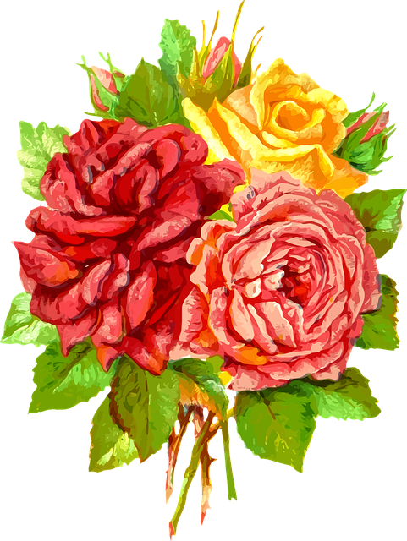

Follow up 4:
Habla con tu compañero/a. ¿Qué número es?
hablar
Persona A elige* una imagen.
Persona B identifica la imagen correcta.
Persona A
Persona B
arriba
1
2
a la izquierda
a la derecha
abajo
Arriba a la derecha hay muchas flores.
Abajo a la izquierda hay muchos desfiles.
¡Es el número 1!
No.
Sí.
B
A
Notes:
Timing: 5 minutes
Aim: to practise productive use of muchos, muchas and this week’s vocabulary; to practise use of previously taught vocabulary for positions/locations.
Procedure:
1. Use this slide to model the task.
2. Pupil A chooses a picture. (Note: there are only two pictures here which makes the task very easy – this is just to model it. In the task itself, there are 9 pictures, so more questions are usually needed).
3. Pupil B identifies the correct picture by giving statements about where the many items are.
4. Note: pupils may need reminding at this state about muchos + mpl nouns and muchas + fpl nouns.
In this task there are:
mucho fuego muchas flores , muchas luces, muchos desfiles.
Teachers can elicit these first from students, as needed.
5. Go to the next slide to play the game. Pupils can take it in turns and it can be played multiple times, taking around 30-45 seconds each time.

Slide 6
Habla con tu compaero/a. ¿Qué número es?
1 | 2 | 3
4 | 5 | 6
7 | 8 | 9
hablar
Notes:
Display during the speaking activity – no need to print anything out.

Slide 7




Follow up 5a:
Escribe en inglés 📝: Can you get at least 15 points?
 | la hermana | solo | jugar
 | la pelota | la habitación | con
 | hago | el deporte | hacer
 | la natación | el dibujo | haces
 | todo | mucho | todo el mundo
 | el desfile | la flor | el fuego
vocabulario
(the) sister
alone
to play, playing
x3
(the) ball
(the) room
with
to do, make; doing, making
I do, make
(the) sport
x2
(the) swimming
(the) drawing
s/he does/makes
all; everything
much; a lot (of)
everybody
x1
(the) parade
(the) flower
(the) fire
Notes:
Timing: 7 minutes
Aim: to practise written comprehension of vocabulary from this week and this week’s revisited sets.
Procedure:
1. Give pupils a blank grid. They fill in the English meanings of any of the words they know, trying to reach 15 points in total.
Note:
The most recently learnt and practised words are pink, words from the first revisit are green and those from the second revisit are blue, thus more points are awarded for them, to recognise that memories fade and more effort (heavy lifting!) is needed to retrieve them.

Slide 8
Follow up 5b:
Escribe en español 📝: can you get at least 15 points?
 | (the) room | only | with
 | (the) ball | to play, playing | (the) sister
 | you do, make | (the) swimming | (the) drawing
 | (the) sport | to do, make | I do, make
 | much; a lot of | (the) flower | (the) fire
 | (the) parade | all, everything | everybody
la habitación
vocabulario
solo
con
x3
la pelota
jugar
la hermana
haces
la natación
el dibujo
x2
el deporte
hacer
hago
mucho
la flor
el fuego
x1
el desfile
todo
todo el mundo
Notes:
Timing: 5 minutes
Aim: to practise written production of vocabulary from this week and this week’s revisited sets.
Procedure:
1. Give pupils a blank grid. They fill in the Spanish meanings of any of the words they know, trying to reach 15 points in total.
Note:
The most recently learnt and practised words are pink, words from the first revisit are green and those from the second revisit are blue, thus more points are awarded for them, to recognise that memories fade and more effort (heavy lifting!) is needed to retrieve them.

Slide 9
¡adiós!
verde

Slide 10
Handout: Follow up 5a
Escribe en inglés 📝: Can you get at least 15 points?
 | la hermana | solo | jugar
 | la pelota | la habitación | con
 | hago | el deporte | hacer
 | la natación | el dibujo | haces
 | todo | mucho | todo el mundo
 | el desfile | la flor | el fuego
vocabulario
x3
x2
x1
Notes:
Timing: 5 minutes
Aim: to practise written comprehension of vocabulary from this week and this week’s revisited sets.
Procedure:
1. Give pupils a blank grid. They fill in the English meanings of any of the words they know, trying to reach 15 points in total.
Note:
The most recently learnt and practised words are pink, words from the first revisit are green and those from the second revisit are blue, thus more points are awarded for them, to recognise that memories fade and more effort (heavy lifting!) is needed to retrieve them.

Slide 11
Handout: Follow up 5b
Escribe en español 📝: Can you get at least 15 points?
vocabulario
 | room | only | with
 | ball | to play, playing | sister
 | you do, make | swimming | drawing
 | sport | to do, make | I do, make
 | much; a lot of | flower | fire
 | parade | all, everything | everybody
x3
x2
x1
Notes:
Timing: 5 minutes
Aim: to practise written production of vocabulary from this week and this week’s revisited sets.
Procedure:
1. Give pupils a blank grid. They fill in the Spanish meanings of any of the words they know, trying to reach 15 points in total.
Note:
The most recently learnt and practised words are pink, words from the first revisit are green and those from the second revisit are blue, thus more points are awarded for them, to recognise that memories fade and more effort (heavy lifting!) is needed to retrieve them.

