Slide 1


español, con Sofía

Slide 2


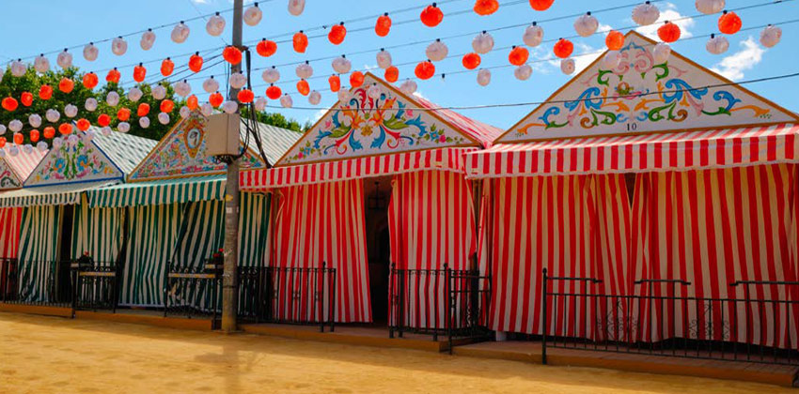
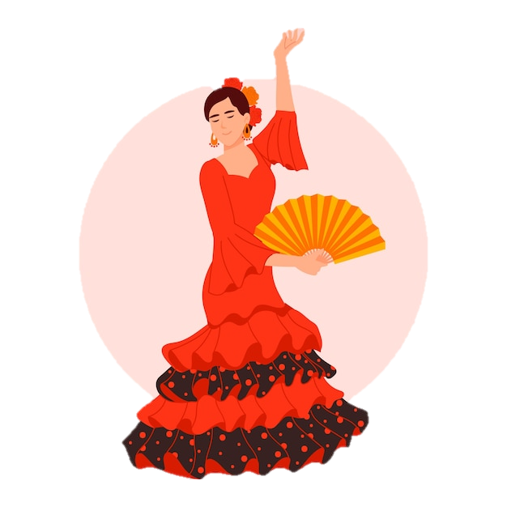
Saying what others and I do
La feria de abril
verde
-AR / -ER verbs:
they, s/he
revisit accents 1- 3
Notes:
Artwork by Steve Clarke. All additional pictures selected are available under a Creative Commons license, no attribution required.
The frequency rankings for words that occur in this PowerPoint which have been previously introduced in the resources are given in the SOW (excel document) and in the resources that first introduced and formally re-visited those words.
Phonics: Revisit accents rules 1-3
Vocabulary (new words in bold): bailar [1323] cantar [717] pasear [1741] llevar [101] caballo [907] flor [739] coche [1190] gente [137] luz [278] puerta [274] traje [1689]
Revisit 1: llegar [75] centro [316] iglesia [437] mercado [487] piscina [4604] playa [1475] plaza [806] río [496] teatro [605] de1 [2] cerca [1042] lejos [833]
Revisit 2: fin [182] restaurante [2636] ruido [1034] nunca [158]: aprender [428] beber [1085] comer [37] comprender [434] hacer [26] leer [209] responder (a) [464] ver [38] a menudo [958] a veces [vez 59] normalmente [1696] siempre [96]
Frequency of unknown words and cognates:
avenida [1931] atracciones [>5000] festival [3194] limonada [>5000] región [545] traje [1689] sur [661] colorido [>5000]
Source: Davies, M. & Davies, K. (2018). A frequency dictionary of Spanish: Core vocabulary for learners (2nd ed.). Routledge: London
For any other words that occur incidentally in this PowerPoint, frequency rankings will be provided in the notes field wherever possible.

Slide 3

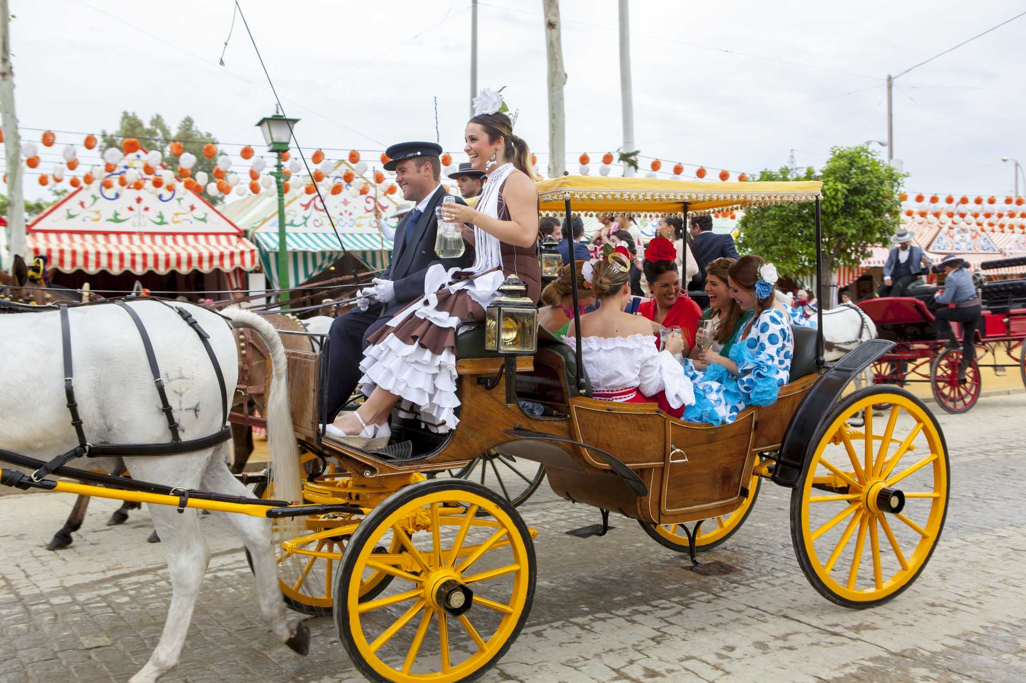
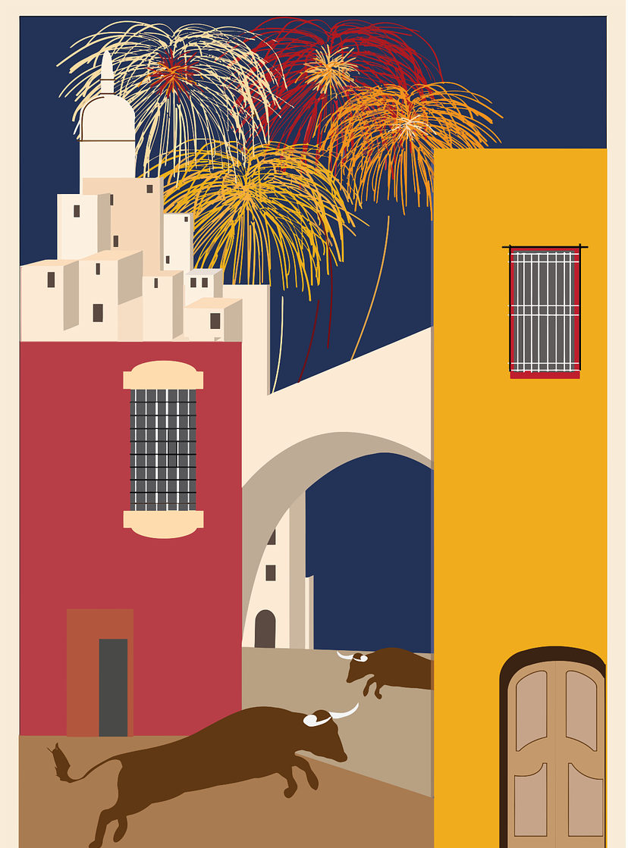

leer
outfit, dress
people
during
head
a flower
la gente
durante
la cabeza
una flor
el traje
La Feria de Abril es una fiesta muy colorida.
La gente celebra el festival en primavera en Sevilla, una ciudad muy bonita en la región de Andalucía, en el sur de España.
Durante la fiesta, la gente baila y canta y lleva trajes de flamenca con una flor en la cabeza.
También es típico pasear en coche de caballos.
⚠ ‘coche’ means ‘car’. What do you think ‘coche de caballos’ means?
colorido = colourful
Carriage ☺
La feria de abril
a city
celebration
spring
to go for a walk
South
una ciudad
la fiesta
la primavera
pasear
el sur
Notes:
Timing: 5 minutes
Aim: to set the scene for this week’s lesson – La feria de abril / feria de Sevilla; to practise written comprehension of previously taught vocabulary and this week’s four new words, el traje, la gente, el coche, la flor.
Procedure:
Pupils read the text aloud with teacher support, as needed.
Click on each section of the text to hear an audio version of the text, if desired.
3. Pupils focus on the English words and identify the Spanish words from the bold words in the text. Pupils can volunteer answers in any click – teacher clicks on the English word and the Spanish translation appears.
4. Teachers elicit an oral translation of the text from the class to establish the context of this week’s lesson.
Frequency of unknown words and cognates:
festival [3194] región [545] sur [661] colorido [>5000]
Source: Davies, M. & Davies, K. (2018). A frequency dictionary of Spanish: Core vocabulary for learners (2nd ed.). Routledge: London
Picture attributions:
Carriage: https://www.andalucia.org/es/feria-de-abril/un-dia-en-la-feria
Casetas: https://www.sevillaconlospeques.com/feria-de-sevilla-con-ninos/
Flamenca: https://www.freepik.es/vector-gratis/ilustracion-mujer-flamenca-dibujada-mano_35003754.htm#query=vestido%20sevillana&position=19&from_view=search&track=ais">Freepik</a>

Slide 4



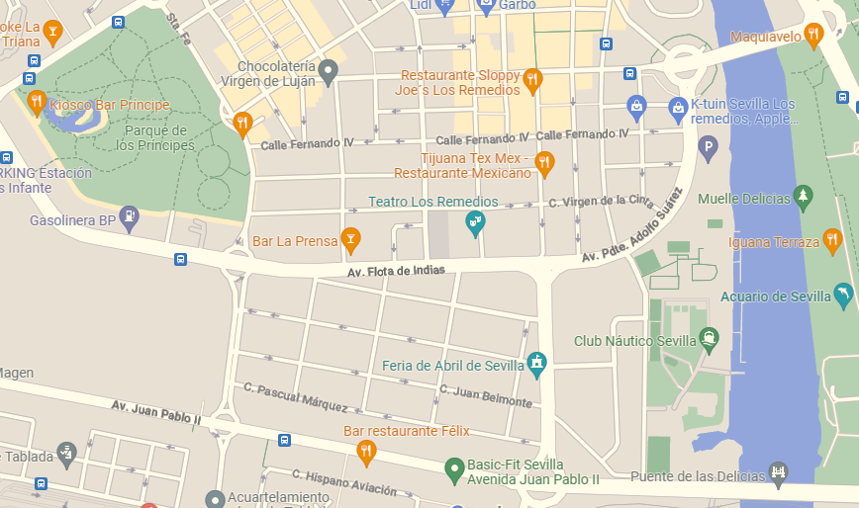
Sevilla
Pronuncia las calles de Sevilla.
1. Avenida Ramón de Carranza.
Rule 1: All words with stress on the 3rd last syllable have an accent.
pronunciar
2. Calle Virgen de África
60
Sevilla,
España
3. Calle Pepe Luis Vázquez
Rule 2: Words ending in any consonant except –n or –s with stress on the penultimate syllable need an accent.
4. Calle Alfonso de Borbón
S
5. Calle Pascual Márquez
Rule 3: Words ending in a vowel or –n or –s need an accent if the stress is on the last syllable.
6. Calle Asunción
7. Calle Manuel Jiménez Chicuelo
8. Avenida Aeródromo de Tablada
0
9. Calle Béjar
la avenida = avenue
INICIO
Notes:
AUDIO for no. 5 to be added.
Timing: 3 minutes
Aim: to practise read aloud of unfamiliar words with and without accents.
Procedure:
Clarify the word avenida and its pronunciation (remind pupils that ‘v’ = ‘b’ sound).
Pupils work in pairs to practise pronouncing some street names in Sevilla (the location of the La feria de abril festival which is the theme of this lesson).
Teacher elicits pronunciation from pupils and click on each street name (as necessary) to hear it pronounced.
Click to bring up each rule and ask pupils if they can suggest any words which match the rule. Continue with the other two rules. Colour-coding is used for those that find this helpful but it is not essential to understanding the information.
Note: the most important knowledge is for pupils to know that when they read aloud they stress the accented syllable. Teachers may want to remove the reference to the rules and the 2nd part of this task at this stage, which is absolutely fine.
Frequency of unknown words and cognates:
avenida [1931]
Source: Davies, M. & Davies, K. (2018). A frequency dictionary of Spanish: Core vocabulary for learners (2nd ed.). Routledge: London

Slide 5
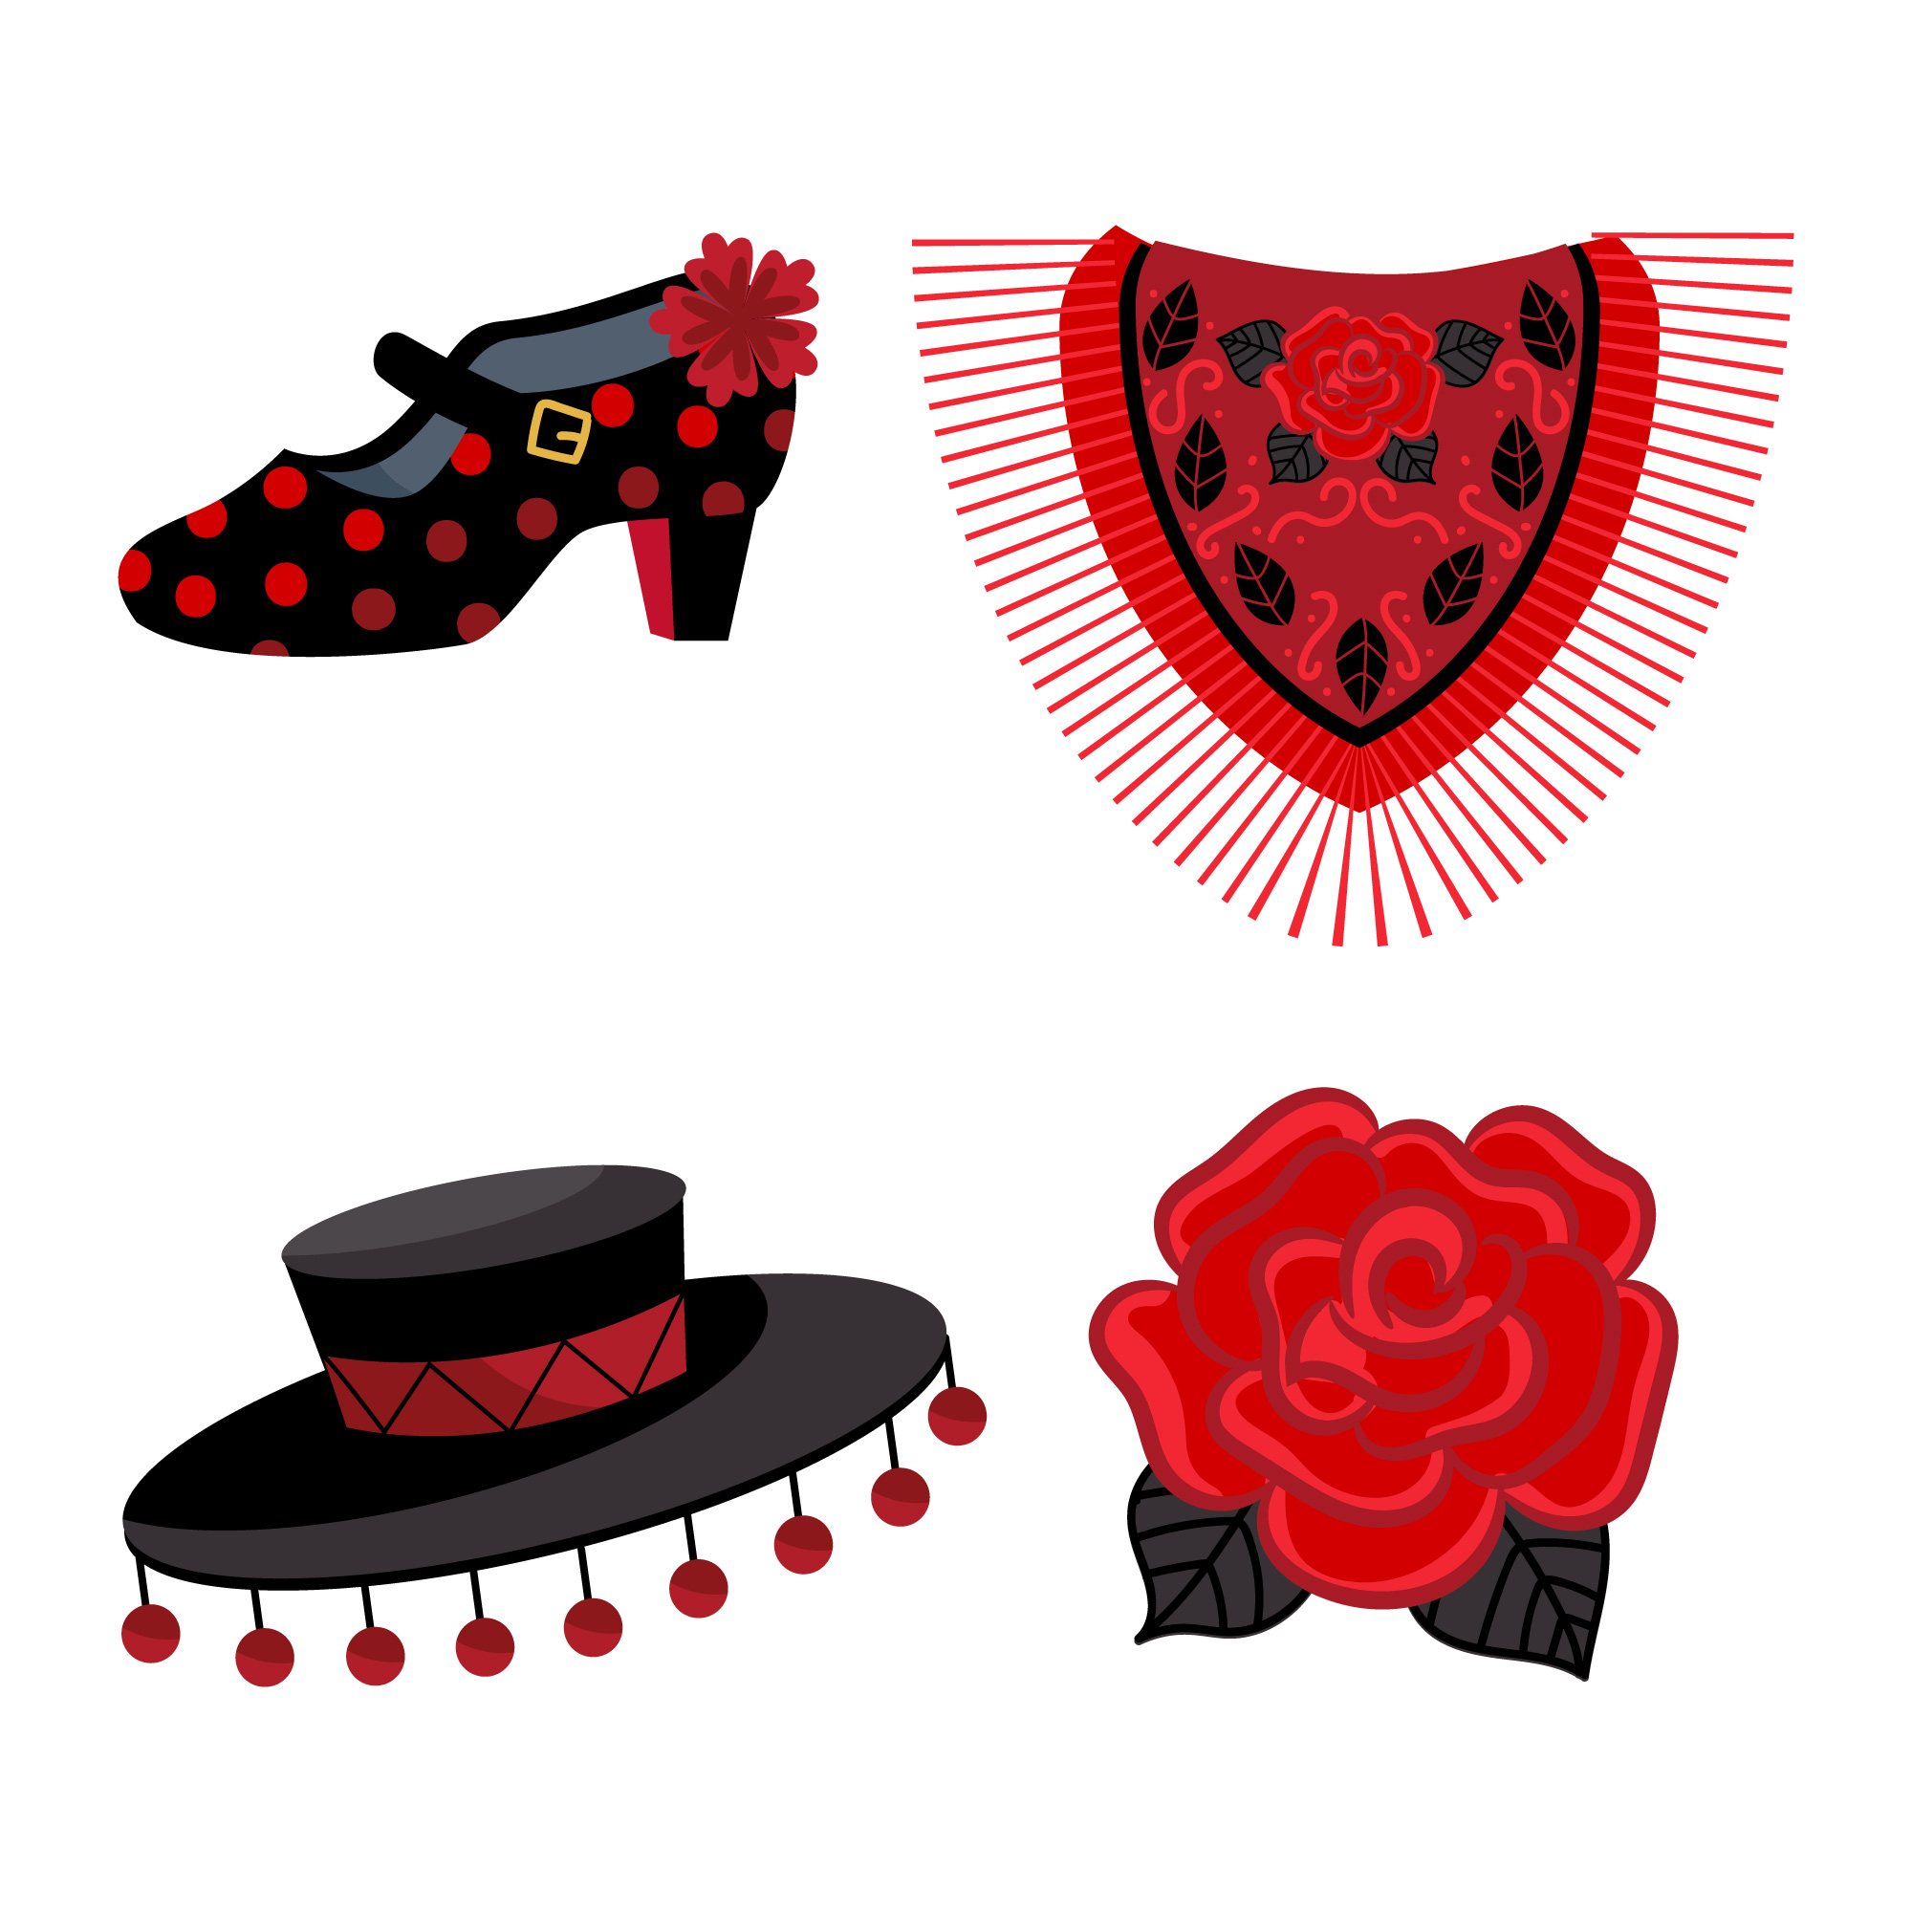

Knowing who does what
[–ar verbs: ‘S/he,it’ vs. ‘they’]
Remember: to mean ‘S/he, it’ with an -ar verb, remove –ar and add -a.
To mean ‘they’ with a verb, we remove –ar and add –an.
Lleva una flor.
Llevan un sombrero.
S/he wears a flower.
They wear hats.
To mean ‘S/he, it’ with an –er verb, remove –er and add -e.
To mean ‘they’ with a verb, we remove –er and add –en.
Bebe agua.
Beben agua.
S/he drinks water.
They drink water.
Notes:
Timing: 2 minutes
Aim: to revisit 3rd persons singular and plural for–ar and –er verbs.
Procedure:
Click through the animations to present the new information.
Elicit English translations for the Spanish examples provided.
Imagen de <a href="https://www.freepik.es/vector-gratis/coleccion-elementos-baile-flamenco-dibujados-mano_34916092.htm#query=traje%20flamenca&position=31&from_view=search&track=ais">Freepik</a>

Slide 6
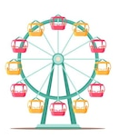
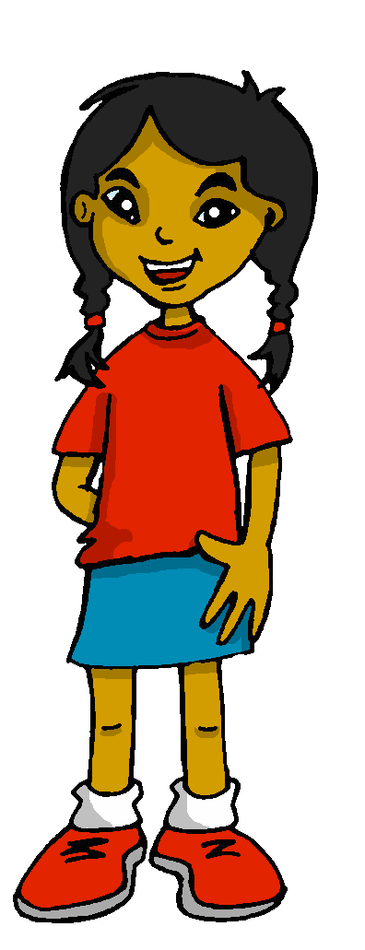
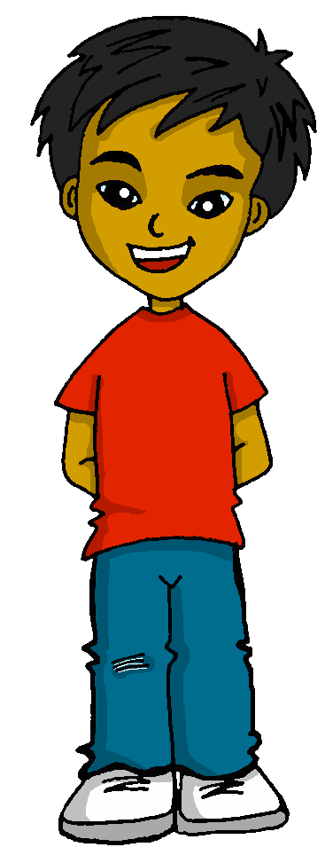


leer
En la feria de abril
En la ‘Calle del Infierno’ hay
atracciones* para niños y adultos.
Es muy típico comer churros con chocolate. ¡ñam ñam! 😋
atracciones = rides
(la) limonada = lemonade
 |  | Sofía y Quique (they) | Quique (he)
1 | ¡…están en Sevilla para La feria de abril!
2 | …come churros.
3 | …baila flamenco.
4 | …beben limonada*.
5 | …ven los coches de caballos.
6 | …pasean por la ‘Calle del Infierno’.
7 | …lleva un sombrero.
8 | ¡…aprenden a hacer palmas flamencas!
¿Qué hacen Sofía y Quique? ¿Qué hace Quique?
1
2
3
4
5
6
7
8
Notes:
Timing: 12 minutes (two slides)
Aim: to practise written comprehension of present tense –ar/-er verbs in 3rd persons singular and plural; to understand sentences containing a range of previously taught language in the new context.
Procedure:
Teachers set the scene by reading the introductory text about La Feria de abril: extra info regarding a very famous part of it – ‘la calle del infierno’, which is a very busy area with rides and food trucks. ‘infierno’ means hell!
Click on the text to hear an audio version of the text, if desired.
Ensure that pupils know that Sofía and Quique are in Sevilla and the sentences describe what they both do and what they do.
First pupils write 1-8 and they/she for each of the sentences, paying close attention to the verb endings.
Teachers elicit responses (time allowing, ask pupils to read each sentence aloud for additional practice), and click to reveal answers.
Move to the next slide for a comprehension task.
Frequency of unknown words and cognates:
Atracciones [>5000] limonada [>5000]
Source: Davies, M. & Davies, K. (2018). A frequency dictionary of Spanish: Core vocabulary for learners (2nd ed.). Routledge: London
Picture attributions:
Ferris Wheel: https://www.freepik.es/vector-gratis/conjunto-ilustraciones-atracciones-parque-atracciones-merry-go-round-vintage-carrusel-montanas-rusas-rueda-fortuna-columpios-feria-carnaval-festival-cliparts-pack_28849561.htm#page=3&query=noria&position=21&from_view=search&track=sph">Imagen de studio4rt</a> en Freepik
Churros: https://www.freepik.es/vector-gratis/coleccion-comida-mejicana_850772.htm#query=churros&position=0&from_view=search&track=sph">Freepik</a>

Slide 7
leer
En la feria de abril
En la ‘Calle del Infierno’ hay
atracciones* para niños y adultos.
Es muy típico comer churros con chocolate. ¡ñam ñam! 😋
atracciones = rides
(la) limonada = lemonade
1 | ¡…están en Sevilla para La feria de abril!
2 | …come churros.
3 | …baila flamenco.
4 | …beben limonada*.
5 | …ven los coches de caballos.
6 | …pasean por la ‘Calle del Infierno’
7 | …lleva un sombrero.
8 | ¡…aprenden a hacer palmas flamencas!
¿Qué significan las frases en inglés?
1
They are in Sevilla for La Feria de abril.
2
He eats churros.
3
He dances flamenco.
4
They drink lemonade.
5
They see the carriages.
6
They go for a walk in the ‘Calle del Infierno’
7
He wears a hat.
8
They learn (how to) do flamenco clapping.
Notes:
Aim: to practise written comprehension of a range of singular and plural –-AR/-ER verbs and vocabulary initially learnt in different lessons and contexts.
Procedure:
Pupils volunteer English meanings of each sentence.
Teacher clicks to reveal written answers.
If desired, click the buttons to play full sentence audio.
Frequency of unknown words and cognates:
Atracciones [>5000] limonada [>5000]
Source: Davies, M. & Davies, K. (2018). A frequency dictionary of Spanish: Core vocabulary for learners (2nd ed.). Routledge: London
Picture attributions:
Ferris Wheel: https://www.freepik.es/vector-gratis/conjunto-ilustraciones-atracciones-parque-atracciones-merry-go-round-vintage-carrusel-montanas-rusas-rueda-fortuna-columpios-feria-carnaval-festival-cliparts-pack_28849561.htm#page=3&query=noria&position=21&from_view=search&track=sph">Imagen de studio4rt</a> en Freepik
Churros: https://www.freepik.es/vector-gratis/coleccion-comida-mejicana_850772.htm#query=churros&position=0&from_view=search&track=sph">Freepik</a>

Slide 8

escuchar
¿Qué hacen Sofía y Quique? ¿Qué hace Quique?
Escucha.
 | Sofía y Quique (they) | Quique (he)
1
2
3
4
5
6
7
8
Who…
goes for a walk in the streets?
sends lots of photos to grandma?
is very tired afterwards?
learns (how) to dance flamenco?
arrives in the afternoon?
drinks hot chocolate?
sings songs?
wears a flower?
is really happy?
1
S & Q
2
Q
3
Q
4
Q
5
S & Q
6
S & Q
7
Q
8
Q & S
9
Q & S
Notes:
Timing: 8 minutes
Aim: to practise aural recognition of vocabulary and understanding of 3rd person singular and plural present tense –AR-/-ER verbs.
Procedure:
Pupils listen to each phrase.
First, they decide if both Sofía y Quique are doing the action or just Quique.
Click to check the answers.
Click to bring up the table of questions. On the 2nd time of listening, work out who does each activity. (Note: the events are not in order 1-9 or pupils would have the answers from part 1).
Click to reveal answers.
Transcript:
1. Llegan por la tarde.
2 Están muy felices.
2 Llevan una flor.
4 Canta canciones.
5 Aprende a bailar flamenco.
6 Pasean por las calles.
7 Beben chocolate caliente.
8 Manda muchas fotos a la abuela.
9 Está muy cansado después.

Slide 9
¡adiós!
verde

