Slide 1
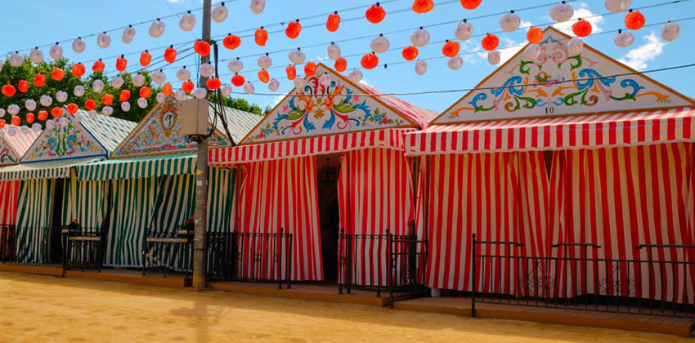
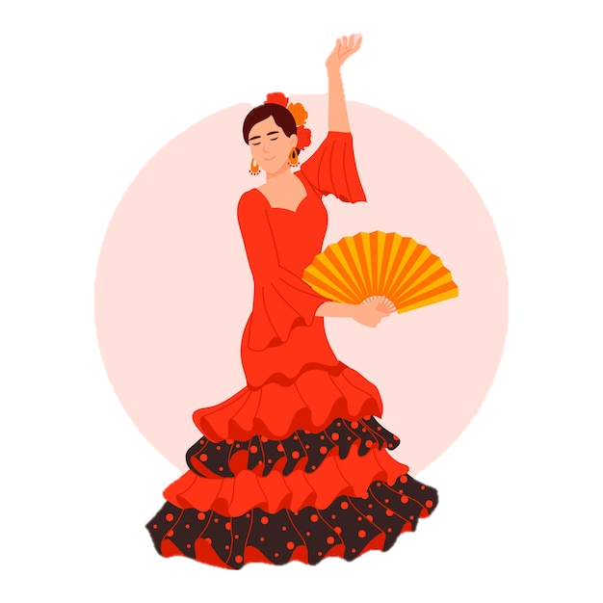
Saying what I and others do
La feria de abril
verde
Follow ups 1-5
Notes:
Artwork by Steve Clarke. All additional pictures selected are available under a Creative Commons license, no attribution required.
The frequency rankings for words that occur in this PowerPoint which have been previously introduced in the resources are given in the SOW (excel document) and in the resources that first introduced and formally re-visited those words.
Phonics: Revisit accents rules 1-3
Vocabulary (new words in bold): bailar [1323] cantar [717] pasear [1741] llevar [101] caballo [907] flor [739] coche [1190] gente [137] luz [278] puerta [274] traje [1689]
Revisit 1: llegar [75] centro [316] iglesia [437] mercado [487] piscina [4604] playa [1475] plaza [806] río [496] teatro [605] de1 [2] cerca [1042] lejos [833]
Revisit 2: fin [182] restaurante [2636] ruido [1034] nunca [158]: aprender [428] beber [1085] comer [37] comprender [434] hacer [26] leer [209] responder (a) [464] ver [38] a menudo [958] a veces [vez 59] normalmente [1696] siempre [96]
Frequency of unknown words and cognates:
avenida [1931] atracciones [>5000] festival [3194] limonada [>5000] región [545] traje [1689] sur [661] colorido [>5000]
Source: Davies, M. & Davies, K. (2018). A frequency dictionary of Spanish: Core vocabulary for learners (2nd ed.). Routledge: London
For any other words that occur incidentally in this PowerPoint, frequency rankings will be provided in the notes field wherever possible.

Slide 2
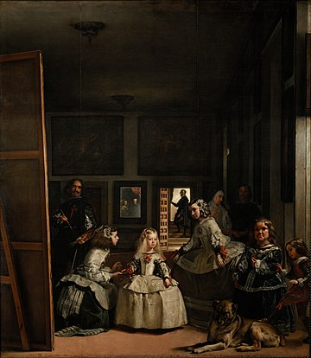
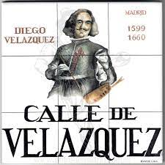
pronunciar
Follow up 1
¿Dónde tiene acento?
(la) avenida – avenue
Escucha y escribe las palabras. ✍
(el) pintor – painter
(el) cuadro - painting
 | calles de Sevilla
 | Calle V _ _ _ _ I _ _ _ _ _
 | Avenida Isabel la _ _ _ _ _ _ _
 | Calle V _ _ _ z _ _ _ _
 | Calle San Pedro _ _ _ _ _ r
 | Calle _ _ _ _ _
 | Calle J _ _ _ _ _ _
‘
E
alle
nclan
‘
Catolica
1 minuto
1
‘
2
ela quez
‘
3
Marti
‘
4
‘
Colon
5
upiter
Muchas calles en España tienen nombre de personas famosas. Por ejemplo, Diego Velázquez, el pintor*, es famoso por el cuadro* ‘Las Meninas’.
INICIO
Notes:
Timing: 5 minutes
Aim: to develop understanding of the three accent rules.
Procedure:
Teacher gives the instruction
Pupils listen out and transcribe the words (ensure they understand these are all unknown words for them). They may need to listen to each one several times. Encourage them!
3. Click to bring up answers.
4. Now teacher clicks to ask pupils where the accents are. Each of the words has an accent.
5. Pupil apply the rule and write an accent if necessary.
4. Teacher brings up the information about Spanish street names and Cervantes.
5. Pupils work in pairs to pronounce the street names for 1 minute.
Transcript:
E Calle Valle Inclán
1 Avenida Isabel la Católica
2 Calle Velázquez
3 Can San Pedro Mártir
4 Calle Colón
5 Calle Júpiter
Picture attribution: By Diego Velázquez - Galería online, Museo del Prado., Public Domain, https://commons.wikimedia.org/w/index.php?curid=15474596
http://www.gritosdemadrid.es/15x15-calle-de-velazquez-cartel-calle-azulejo/
2

Slide 3
Follow up 2
Escribe en inglés 📝: Can you get at least 15 points?
 | aprender | a menudo | el ruido
 | beber | ver | a veces
 | el río | de | llegar
 | el centro | la plaza | lejos
 | pasear | llevar | bailar
 | la gente | la flor | el coche
vocabulario
to learn, learning
often
noise
x3
to drink, drinking
to see, seeing
sometimes
river
of, from
to arrive, arriving
x2
centre
square
far
to go on a walk
to wear, wearing
to dance, dancing
x1
people
flower
car
Notes:
Timing: 7 minutes
Aim: to practise written comprehension of vocabulary from this week and this week’s revisited sets.
Procedure:
1. Give pupils a blank grid. They fill in the English meanings of any of the words they know, trying to reach 15 points in total.
Note: The most recently learnt and practised words are pink, words from the first revisit are green and those from the second revisit are blue, thus more points are awarded for them, to recognise that memories fade and more effort (heavy lifting!) is needed to retrieve them.

Slide 4
Follow up 3: Escucha. ¿Una persona o 2+ personas?
Escucha y escribe A o B y la frase en español. ✍.
escuchar
E
Ejemplo
A
B
Llevan una flor.
Notes:
Timing: 5 minutes [Ejemplo] (9 slides in total but it is fine to do fewer)
Aim: to practise aural comprehension of 3rd person singular and plural verbs in the present tense; to practise transcription of previously taught vocabulary.
Procedure:
Explain the task, using the instructions.
Click to listen to the sentence.
Pupils write the sentence in Spanish and the correct letter A or B.
Click to reveal both.
Repeat for the following 6 sentences.
Differentiation: For more challenge in terms of comprehension ask pupils to translate the setence into English after transcribing it, and before they see the picture cues. Note that for this option, teachers will need to adjust the slides so that the singular options are always A. Transcription: Llevan una flor.

Slide 5
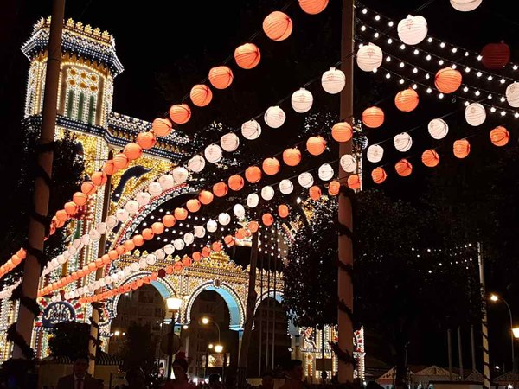
Follow up 3: [1/8]
Escucha y escribe A o B y la frase en español. ✍.
escuchar
1
A
B
Ve las luces con papá.
Notes:
[1/8] Transcription: Ve las luces con papá.
Picture attribution:
https://www.sevilla.org/fiestas-de-la-ciudad/feria-de-sevilla/cuando-es-la-feria

Slide 6
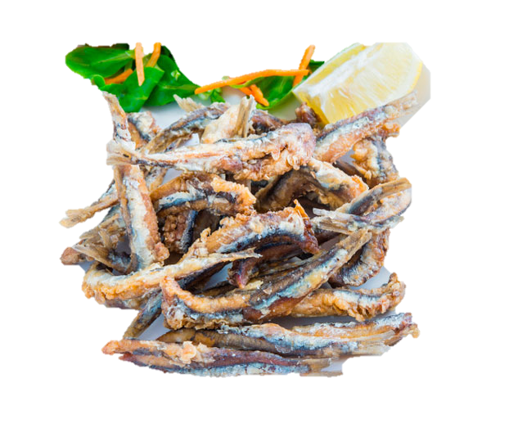
Follow up 3: [2/8]
Escucha y escribe A o B y la frase en español. ✍.
escuchar
2
A
B
Come pescado. ¡Es muy típico!
Notes:
[1/8] Transcription: Come pescado. ¡Es muy típico!
Picture attribution:
https://asgt.es/feria-de-abril-y-tendencias-gastronomicas/

Slide 7
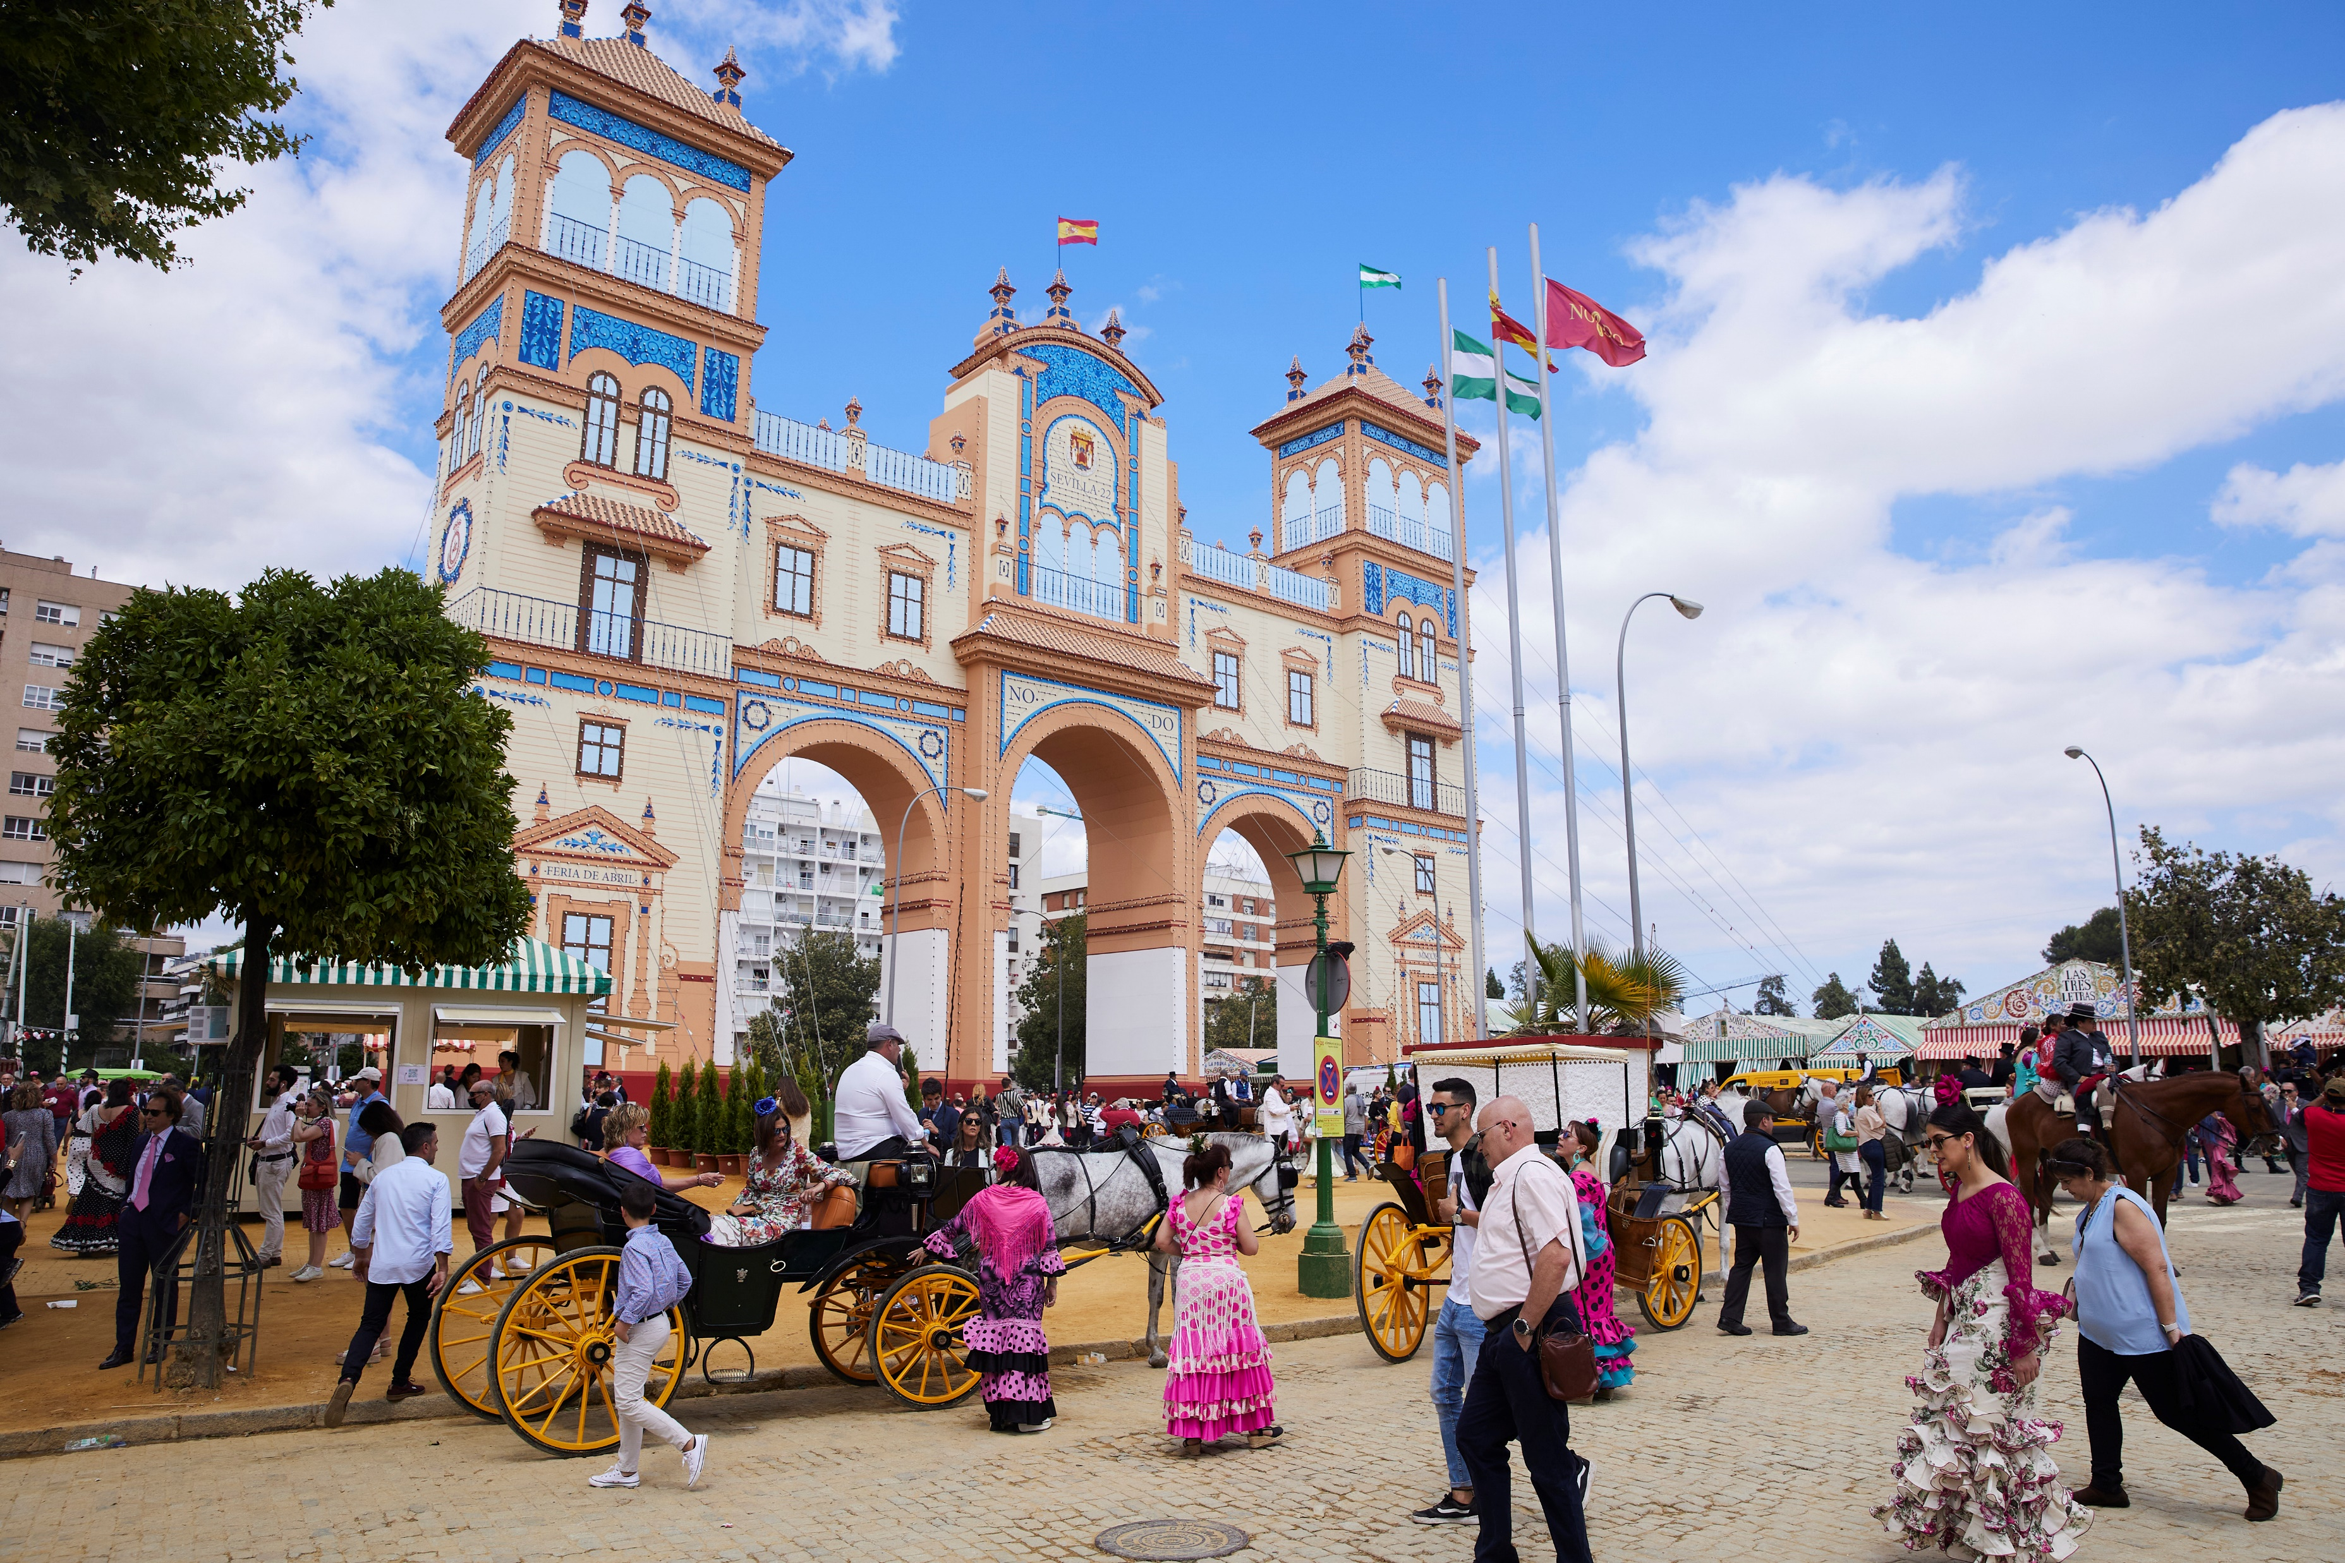
Follow up 3: [3/8]
Escucha y escribe A o B y la frase en español. ✍.
escuchar
A
B
3
Están delante de la puerta grande.
Notes:
[3/8] Transcription: Están delante de la puerta grande.
Picture attribution:
https://www.sevilla.org/fiestas-de-la-ciudad/feria-de-sevilla/cuando-es-la-feria

Slide 8
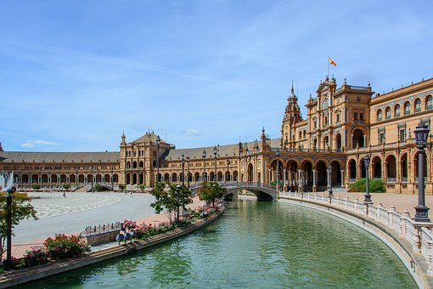
Follow up 3: [4/8]
Escucha y escribe A o B y la frase en español. ✍.
escuchar
A
B
4
Visita una plaza muy famosa: la plaza de España.
Notes:
[4/8] Transcription: Visita una plaza muy famosa: la plaza de España.

Slide 9
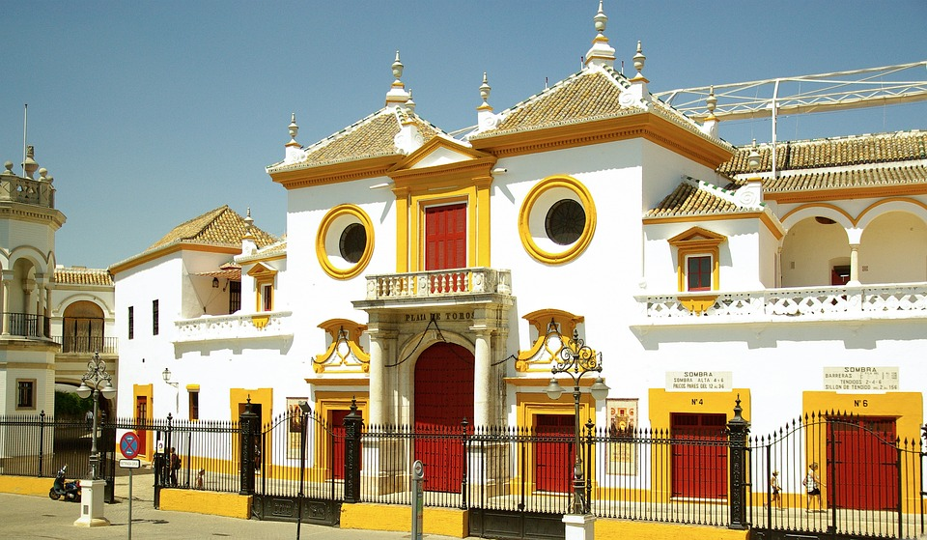
Follow up 3: [5/8]
Escucha y escribe A o B y la frase en español. ✍.
escuchar
A
B
5
Pasean por el centro de la ciudad.
Notes:
[5/8] Transcription: Pasean por el centro de la ciudad.

Slide 10
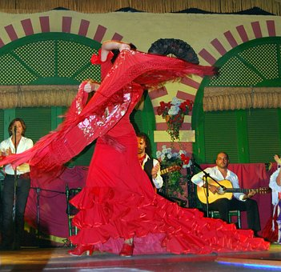
Follow up 3: [6/8]
Escucha y escribe A o B y la frase en español. ✍.
escuchar
A
B
6
Ven un espectáculo de flamenco.
Notes:
[6/8] Transcription: Ven un espectáculo de flamenco.

Slide 11
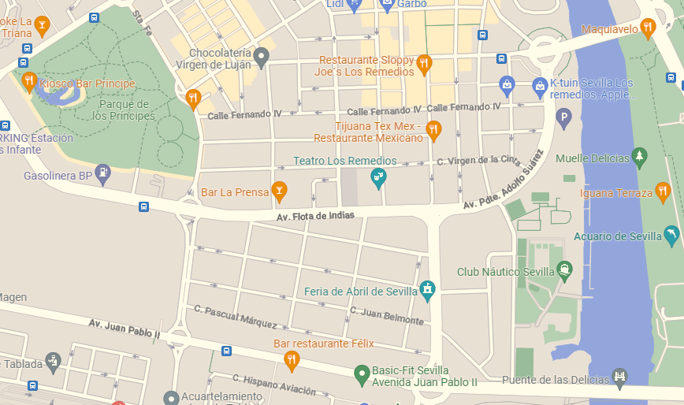
Follow up 3: [7/8]
Escucha y escribe A o B y la frase en español. ✍.
escuchar
A
B
7
Lee el mapa de la ciudad.
Notes:
[7/8] Transcription: Lee el mapa de la ciudad.

Slide 12
Follow up 3: [8/8]
Escucha y escribe A o B y la frase en español. ✍.
escuchar
A
B
8
Hace muchas fotos.
Notes:
[8/8] Transcription: Hace muchas fotos.

Slide 13
Follow up 4:
Describe la visita a Sevilla de Sofía y Quique.
Escribe seis frases 📝.
escribir
👍
👎
streets
😀
👀🐴
in Seville
centre
los coches de caballos = carriages
Notes:
Aim: to practise more independent written production of third person singular and plural sentences, drawing on a variety of previously taught vocabulary.
Procedure:
Pupils write sentences using the third person singular and plural of –AR and –ER verbs to describe (with 6 sentences) any of the activities that Sofía and Quique do at La Feria de Abril.
The Venn diagram shows what Quique and Sofía do together, and what each does on his/her own.
Remind learners that the weather expressions use ‘hace’
Note: Teachers can add a list of verbs to the slide to help pupils, if needed. E.g. hacer, comer, ver, pasear, llevar, leer, comer, estar, bailar
Picture attributions:
Ferris Wheel: https://www.freepik.es/vector-gratis/conjunto-ilustraciones-atracciones-parque-atracciones-merry-go-round-vintage-carrusel-montanas-rusas-rueda-fortuna-columpios-feria-carnaval-festival-cliparts-pack_28849561.htm#page=3&query=noria&position=21&from_view=search&track=sph">Imagen de studio4rt</a> en Freepik
Churros: https://www.freepik.es/vector-gratis/coleccion-comida-mejicana_850772.htm#query=churros&position=0&from_view=search&track=sph">Freepik</a>

Slide 14
Follow up 5:
Escribe en español 📝: can you get at least 15 points?
 | to drink, drinking | (the) noise | to see, seeing
 | to learn, learning | sometimes | often
 | far (from) | (the) river | to arrive, arriving
 | (the) square | of, from | (the) centre
 | (the) outfit, dress | (the) people | (the) flower
 | to go for a walk | to wear, wearing | (the) car
vocabulario
beber
el ruido
ver
x3
aprender
a veces
a menudo
lejos (de)
el río
llegar
x2
la plaza
de
el centro
el traje
la gente
la flor
x1
pasear
llevar
el coche
Notes:
Timing: 5 minutes
Aim: to practise written production of vocabulary from this week and this week’s revisited sets.
Procedure: 1. Give pupils a blank grid. They fill in the Spanish meanings of any of the words they know, trying to reach 15 points in total.
Note: The most recently learnt and practised words are pink, words from the first revisit are green and those from the second revisit are blue, thus more points are awarded for them, to recognise that memories fade and more effort (heavy lifting!) is needed to retrieve them.

Slide 15
Follow up [extra]
¡Practica el ritmograma!
🔑
el chasquido 🤞 – snapping
la palma 👏 – clapping
el puño 👊– knocking on table
los pies 🦶 – feet
Las palmas en los muslos – clapping on legs
1, 2, 3, 4
The stress falls on number 2 😉
Notes:
Timing: 5 minutes
Aim: to explore sound and rhythm in order to develop cultural awareness and appreciation of Spanish music.
Procedure: 1. Tell pupils you are going to learn the basics of flamenco rhythms and clarify the key terms. They do not need to recognise these words in the video as pictures are provided.
2. Play the video and encourage pupils to join. Teachers can pause after ‘ahora tú’ and give pupils time to practise before moving on to the next sequence.

Slide 16
¡adiós!
verde

Slide 17
Handout: Follow up 2
Escribe en inglés 📝: Can you get at least 15 points?
 | aprender | a menudo | el ruido
 | beber | ver | a veces
 | el río | de | llegar
 | el centro | la plaza | lejos
 | pasear | llevar | bailar
 | la gente | la flor | el coche
 | aprender | a menudo | el ruido
vocabulario
x3
x2
x1
Notes:
Timing: 5 minutes
Aim: to practise written comprehension of vocabulary from this week and this week’s revisited sets.
Procedure: 1. Give pupils a blank grid. They fill in the English meanings of any of the words they know, trying to reach 15 points in total.
Note: The most recently learnt and practised words are pink, words from the first revisit are green and those from the second revisit are blue, thus more points are awarded for them, to recognise that memories fade and more effort (heavy lifting!) is needed to retrieve them.

Slide 18
Handout: Follow up 5
Escribe en español 📝: Can you get at least 15 points?
 | to drink, drinking | noise | to see, seeing
 | To learn, learning | sometimes | often
 | far | river | to arrive
 | square | of, from | centre
 | to dance, dancing | people | flower
 | To go for a walk | to wear, wearing | car
 | to drink, drinking | noise | to see, seeing
vocabulario
x3
x2
x1
Notes:
Timing: 5 minutes
Aim: to practise written production of vocabulary from this week and this week’s revisited sets.
Procedure: 1. Give pupils a blank grid. They fill in the Spanish meanings of any of the words they know, trying to reach 15 points in total.
Note: The most recently learnt and practised words are pink, words from the first revisit are green and those from the second revisit are blue, thus more points are awarded for them, to recognise that memories fade and more effort (heavy lifting!) is needed to retrieve them.

