Slide 1
español, con Sofía

Slide 2
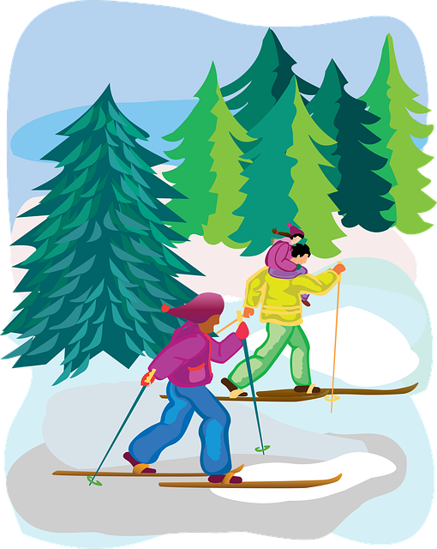
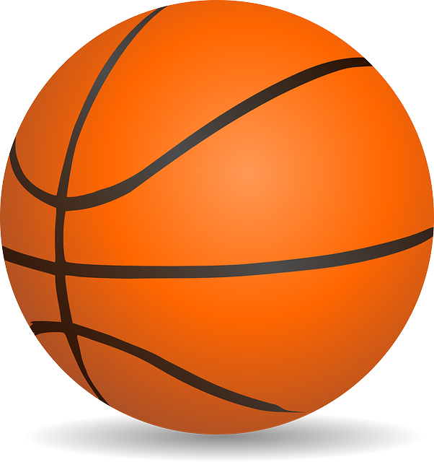
Saying what others and I do
👍
👎
verde
hacer & jugar
(hace) for weather
accents 3
Notes:
Artwork by Steve Clarke. All additional pictures selected are available under a Creative Commons license, no attribution required.
The frequency rankings for words that occur in this PowerPoint which have been previously introduced in the resources are given in the SOW (excel document) and in the resources that first introduced and formally re-visited those words.
Phonics: López [N/A] Héctor [N/A] Félix [N/A]
Vocabulary (new words in bold): hacer [26] hago, haces; jugar [356] juego [jugar 356] juegas [jugar 356] baloncesto [>5000] esquí [>5000] fútbol [1471] tenis [4856] tiempo2 [80] bueno [103] malo [360] a [8] el [1] la [2] + revisit months + time phrases
Revisit 1:
hay [13] dos [64] tres [134] cuatro [241] cinco [284] seis [438] siete [603] ocho [641] nueve [991] diez [449] once [1701] doce [1138] trece [2700] catorce [2411] quince[1215] dieciséis [3373] diecisiete [3400] dieciocho [2730] diecinueve [4232] veinte [819] veintiuno [819/425] veintidós, veintitrés, veinticuatro, veinticinco, veintiséis, veintisiete, veintiocho, veintinueve, treinta [830] treinta y uno [830/4/425]
Revisit 2: a menudo [958] aprender [428] beber [1085] comer [347] [347] correr [343] hacer [26] leer [209]
Frequency of unknown words and cognates:
adivinar [2077] azúcar [2007] clímax [>5000] dátil [>5000] lluvia [986] récord [4902]
resumen [3298]
Source: Davies, M. & Davies, K. (2018). A frequency dictionary of Spanish: Core vocabulary for learners (2nd ed.). Routledge: London
Source: Davies, M. & Davies, K. (2018). A frequency dictionary of Spanish: Core vocabulary for learners (2nd ed.). Routledge: London
For any other words that occur incidentally in this PowerPoint, frequency rankings will be provided in the notes field wherever possible.

Slide 3
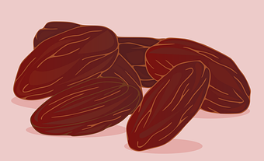
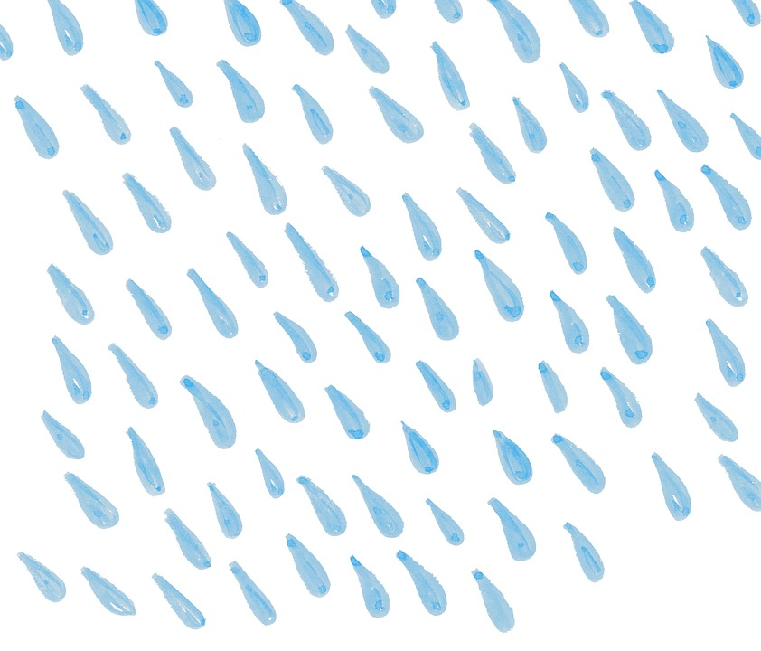
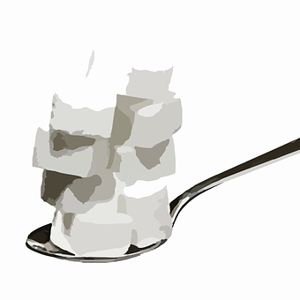
Accents 3
Words with penultimate (second-last) syllable stress that end in any consonants other than ‘n’ or ‘s’ need an accent.
pronunciar
Vázquez
¿Tiene acento?
clímax
climax
lluvia
azucar
dátil
Éric
datil
resumen
record
Ángel
[summary]
azúcar
récord
Óscar
Notes:
Timing: 3 minutes
Aim: to explain the 3rd rule of written accents.
Procedure:
Read the explanation.
Introduce the example words to exemplify the rule.
Frequency of unknown words and cognates:
clímax [>5000] lluvia [986] azúcar [2007] dátil [>5000] resumen [3298] récord [4902]
Source: Davies, M. & Davies, K. (2018). A frequency dictionary of Spanish: Core vocabulary for learners (2nd ed.). Routledge: London

Slide 4
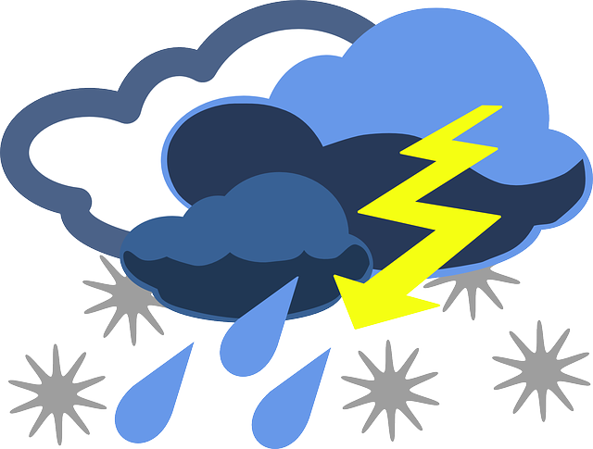
palabras
¿Cómo es en español?
el esquí
el baloncesto
👍
el tiempo
bueno
👎
malo
Notes:
Timing: 5 minutes [1/2]
Aim: to present and practise new vocabulary for this week.
Procedure:
Click for each word to appear, and click again for picture/English to appear. As this is useful classroom language, you may want to use gestures or demonstrate the actions yourself too and continue to use these in future.
Practise pronunciation of each word as it appears.
Once all 6 pieces of vocabulary are on the board practise repeating again, varying volume and voice.
If you have chosen to use actions, now practise first giving the Spanish words (in random order) one by one and pupils doing the actions. Then you do the actions and pupils say the correct Spanish word chorally.
Possible actions: el esquí; pretending to move ski poles left and right; el baloncesto; bounce the ball twice, pretend to throw it and put arms in the air to celebrate the score; bueno; thumbs up; malo; thumb down; el tiempo; open hands wave towards face (This is the sign in BSL).

Slide 5
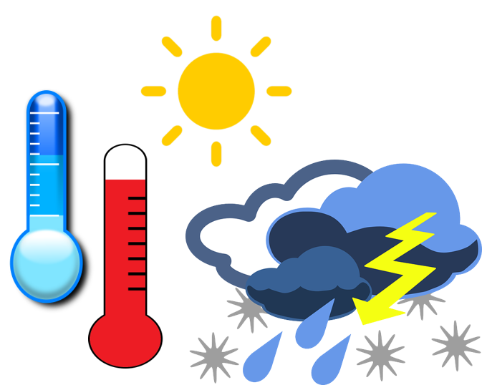
palabras
¿Cómo es en español?
el esquí
el baloncesto
malo
el tiempo
bueno
1
2
3
5
👎
👍
4
Notes:
[2/2]
Timing: 5 minutes (including previous slide) Aim: to provide production (speaking) practice with the new vocabulary.
Procedure: 1. Pupils match the Spanish words to the pictures in their heads.
2. The teacher gives the pupils a number and the pupils must say the correct word in Spanish. The number prompts are the trigger (i.e. wait for the hand and then click on the number) for the lines to connect the correct word to the picture.
3. Click to make each Spanish word disappear in turn. Encourage pupils to use the actions you used if relevant as each word disappears, and then to recall the Spanish word.
Note: if required, click on the pictures to hear audio again.

Slide 6
Jugar + al
[to play, playing]
Remember that the verb ‘jugar’ is always followed by the preposition ‘a’ (‘to’).
When the noun is singular and masculine, a + el becomes al.
Juego al baloncesto.
Juegas al fútbol.
I play basketball.
You play football.
Note that ‘al’ (to the) is not needed in English, but it is necessary in Spanish!
Most ball sports are masculine in Spanish (el fútbol, el baloncesto, el tenis),therefore you need to use ‘jugar al’ with them.
Notes:
Timing: 2 minutes
Aim: to remind pupils about the contraction ‘al’.
Procedure:
Read the grammar explanation on ‘to the’.
Elicit English translation for the Spanish examples provided.

Slide 7
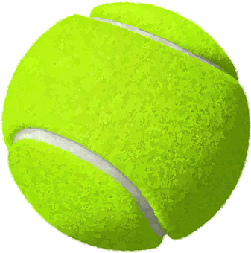
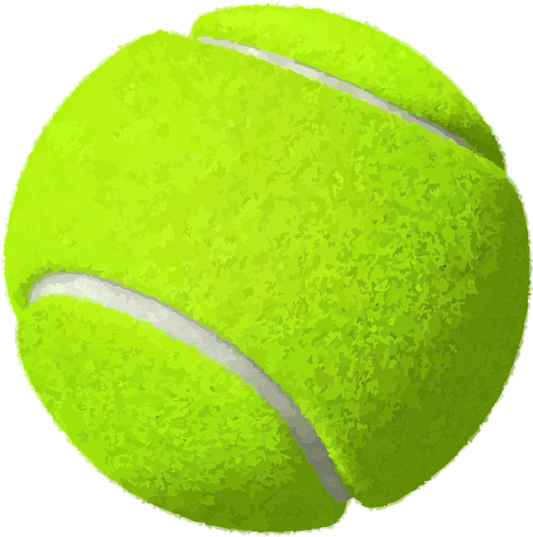
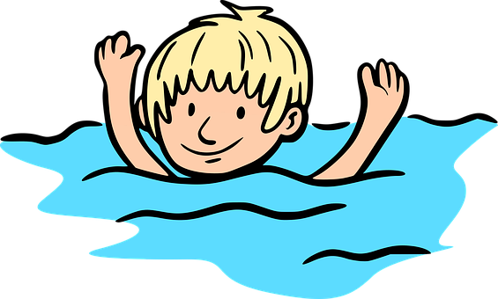
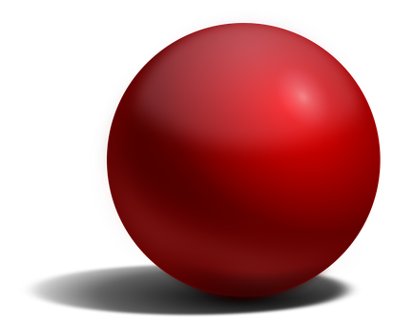
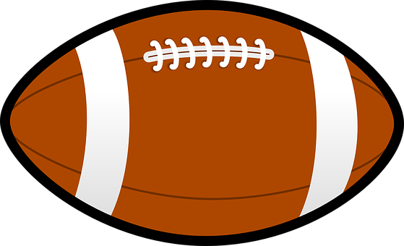
palabras
⚠ How would we translate ‘hacer’ here?
⚠ Remember that we translate hacer as ‘to go’ with ‘natación’, ‘ciclismo’and ‘esquí’.
⚠ We use the verb hacer to mean to do and to make. How would we translate it here?
Clasifica las actividades.
⚠ Is it ‘to make’ or ‘to do’?
leer
hacer
jugar al
dibujos
tenis
ciclismo
baloncesto
natación
fútbol
esquí
deporte
Notes:
Timing: 4 minutes
Aim: to revisit key vocabulary together with jugar and hacer, including the multiple translations of hacer before introducing another possible meaning (weather).
Procedure:
Introduce the task.
Animation appear on click, left to right.
Say the first word aloud and ask pupils to think whether we would use it in combination with hacer or jugar al.
Elicit response from pupils.
Callout 1: Remider anbout multiple translations of hacer (make vs do). Elicit answer from pupils – hacer dibujos – to make drawings
Callout 2: Reminder about additional translation of hacer (to go).
Callout 3: Elicit answer from pupils – hacer esquí = to go skiing
Callout 4: Elicit answer from pupils – hacer deporte – to do
There are 5 sentences in total, including the example.

Slide 8
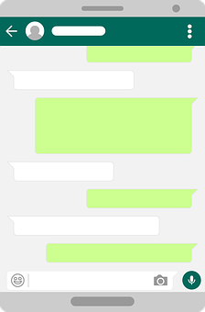
leer
Luis manda mensajes a Sofía. ¿Quién es?
Ahora escribe la información en inglés 📝.
Consider carefully the right translation for hacer (to do, to make, to go).
E
__
A menudo juego al fútbol
Luis (I) or Sofía (you) | Activity | Extra ⚡
__
1
Hago deporte por la mañana.
I
play football
often
2
Haces esquí en febrero.
__
I
do sport
in the morning
3
__
Juego al baloncesto
con mi madre.
you
go skiing
in February
4
__
Juegas al tenis en junio.
I
play basketball
with my mother
__
5
Hago una tarta para
tu cumpleaños.
you
play tennis
in June
I
make a cake
for your birthday
Notes:
Timing: 8 minutes
Aim: to practise written comprehension of jugar and hacer in the 1st and second person singular, in combination with vocabulary introduced this week and previously.
Procedure:
Read the title and click to explain the context of the task. Whom does the message refer to?
Do [E] with them to model the task, drawing their attention to the verb (hago). Is it Luis or Sofía?
Pupils complete 1-5.
Elicit answers from pupils, click to bring up answers.
Click to bring up part two of the task which check comprehension further.
NB., Callout before answer for #1 reminds puils to consider the different translations of ‘hacer’.
Teachers can play the texts for further listening practice, if they wish, or pupils can read the texts aloud in pairs.
Elicit answers from pupils, click to bring up answers.

Slide 9
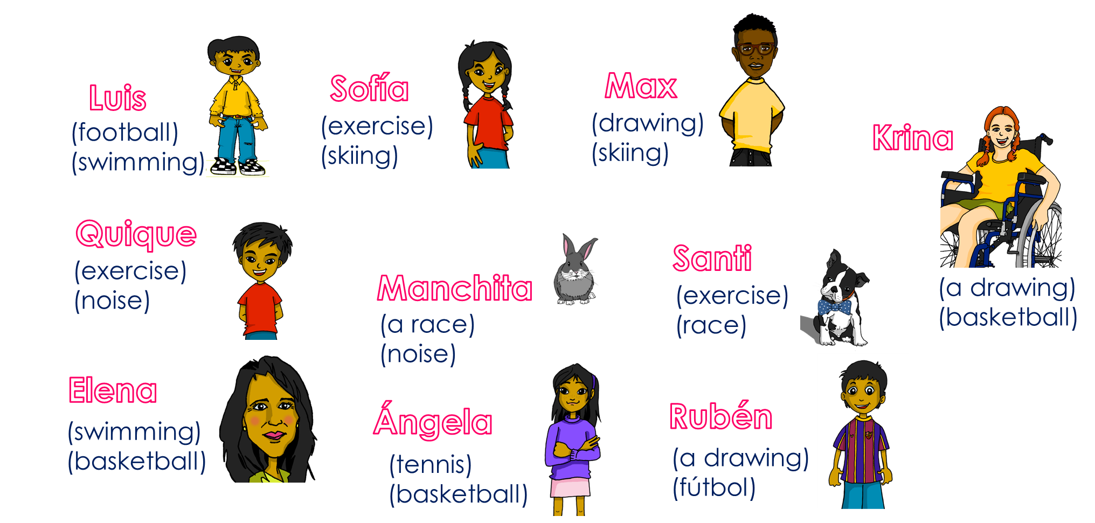
hablar
Pregunta y adivina*.
adivina* = guess
Ask your partner questions to guess their secret character.
A: ¿Haces un dibujo?
Remember to raise your voice at the end when asking questions ☺.
B: No.
B: No.
B: ¡Sí…!
B: ¡Sí…!
A: ¿Juegas al fútbol?
deporte
natación
una carrera
fútbol
un dibujo
baloncesto
ejercicio
tenis
ruido
esquí
A: ¿Haces ejercicio?
A: ¿Haces ruido?
Notes:
Time: 8-10 minutes
Aim: To use haces and juegas al with vocabulary introduced and revisited this week.
Read the title in Spanish and click to bring a brief explanation of the instructions.
Tell students they are going to work in pairs. Partners take it in turns to ask yes/no questions to try to figure out the other player’s character. The partner guessing needs to use raised question intonation and the correct verb (juegas, haces) in combination with vocabulario to narrow down their options correctly!
Click x3 to bring the speech bubbles to make sure students are clear about what the exchange should look like (¿Haces un dibujo? / No). There is a callout to reminder them to use raised intonation.
Animation appears on click to allow teachers to narrow down the options together with the whole class. Who does a drawing? Krina, Rubén and Max. Click to bring up crosses.
Click x2 to model another example (“¿Juegas al fútbol?” / ¡No!). Show students on the board how that means Luis is not the secret character & click to bring X shape to cover him.
Click x2 to trigger the next question ¿Haces ejercicio?’. The response is “Yes” so we it can only be Quique or Santi.
7. Click x2 to bring further question ‘¿haces ruido?’ and the answer ‘yes’. This means Quique is the secret character.
Teachers can model another round with the whole class (getting students to ask the questions) before getting them started in pairs.
3. Give students 30 seconds to write down 4 names (mixture of male/female).
4. The aim is to work with your partner, to identify all 8 people as quickly as possible.
NB. Print the template slide (slide 12) in A5 so that students can cross out as they play.
Frequency of unknown words and cognates:
adivinar [2077]
Source: Davies, M. & Davies, K. (2018). A frequency dictionary of Spanish: Core vocabulary for learners (2nd ed.). Routledge: London

Slide 10
¡adiós!
verde

Slide 11
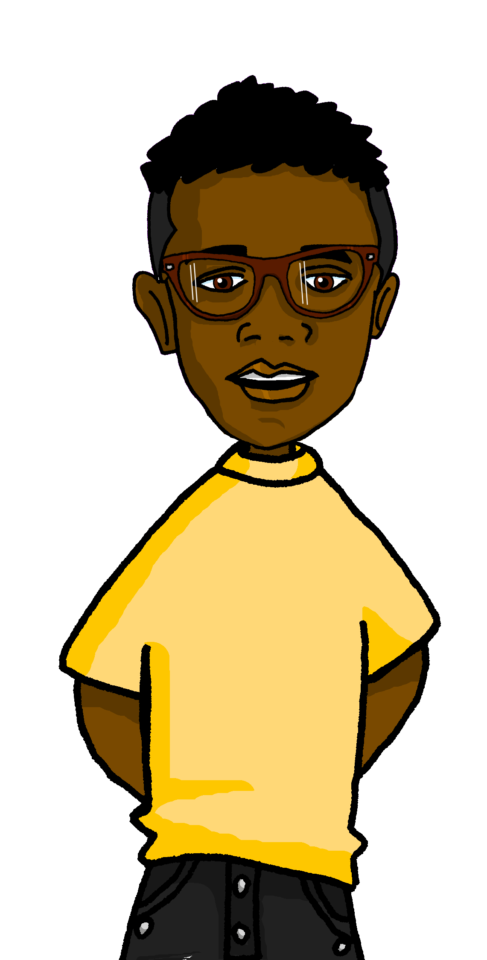
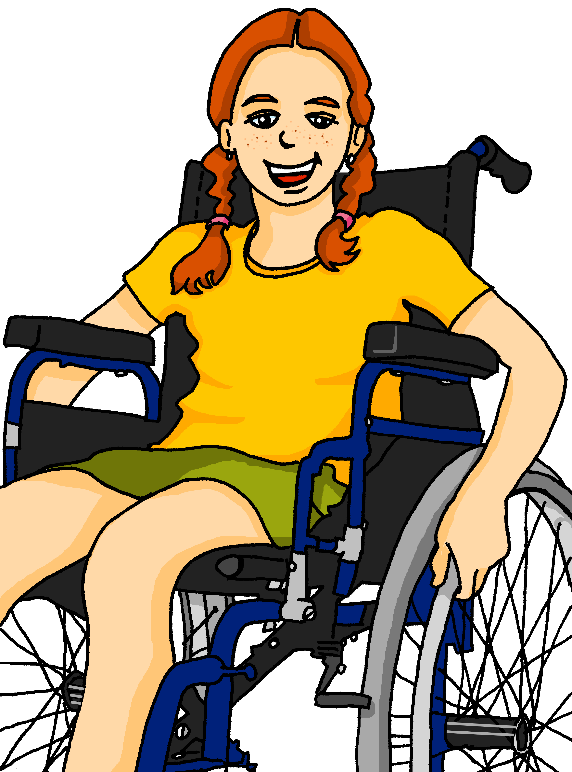
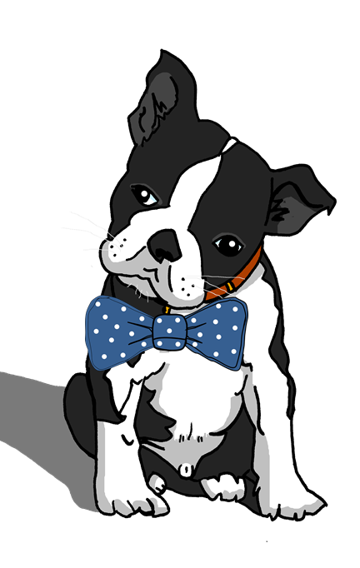
hablar
Pregunta y adivina*.
Sofía
Max
Luis
Krina
(football)
(swimming)
(exercise)
(skiing)
(drawing)
(skiing)
(a drawing)
(basketball)
Quique
Santi
(exercise)
(noise)
Manchita
(exercise)
(race)
deporte
natación
una carrera
fútbol
un dibujo
baloncesto
ejercicio
tenis
ruido
esquí
(a race)
(noise)
Elena
Ángela
Rubén
(swimming)
(basketball)
(tennis)
(basketball)
(a drawing)
(fútbol)
Notes:
Master slide for guess who game. Print the template slide in A5 so that students can cross out as they play.

