Slide 1
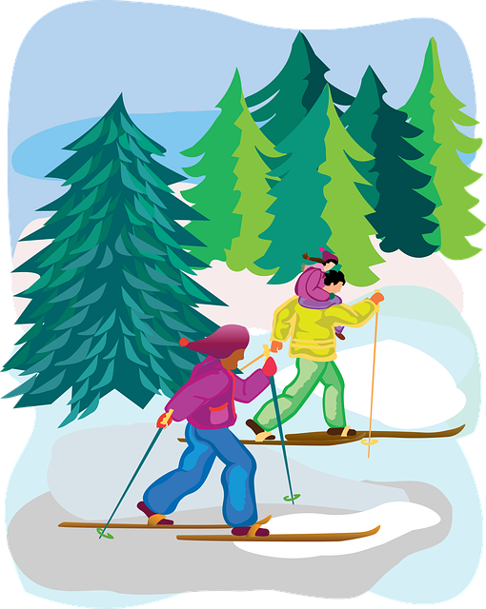
Saying what I and others do
👍
👎
verde
Follow ups 1-5
Notes:
Artwork by Steve Clarke. All additional pictures selected are available under a Creative Commons license, no attribution required.
The frequency rankings for words that occur in this PowerPoint which have been previously introduced in the resources are given in the SOW (excel document) and in the resources that first introduced and formally re-visited those words.
Phonics: López [N/A] Héctor [N/A] Félix [N/A]
Vocabulary (new words in bold): hacer [26] hago, haces; jugar [356] juego [jugar 356] juegas [jugar 356] baloncesto [>5000] esquí [>5000] fútbol [1471] tenis [4856] tiempo2 [80] bueno [103] malo [360] a [8] el [1] la [2] + revisit months + time phrases
Revisit 1:
hay [13] dos [64] tres [134] cuatro [241] cinco [284] seis [438] siete [603] ocho [641] nueve [991] diez [449] once [1701] doce [1138] trece [2700] catorce [2411] quince[1215] dieciséis [3373] diecisiete [3400] dieciocho [2730] diecinueve [4232] veinte [819] veintiuno [819/425] veintidós, veintitrés, veinticuatro, veinticinco, veintiséis, veintisiete, veintiocho, veintinueve, treinta [830] treinta y uno [830/4/425]
Revisit 2: a menudo [958] aprender [428] beber [1085] comer [347] [347] correr [343] hacer [26] leer [209]
Frequency of unknown words and cognates:
apellido [2576] nombre [215]
Source: Davies, M. & Davies, K. (2018). A frequency dictionary of Spanish: Core vocabulary for learners (2nd ed.). Routledge: London
Source: Davies, M. & Davies, K. (2018). A frequency dictionary of Spanish: Core vocabulary for learners (2nd ed.). Routledge: London
For any other words that occur incidentally in this PowerPoint, frequency rankings will be provided in the notes field wherever possible.

Slide 2
pronunciar
Follow up 1
el apellido – surname el nombre – first name
¿Tiene acento?
[A] Escucha y escribe la palabra 📝
 | palabra
 | _ _ _ _
 | _ _ _ _
 | _ _ _ _ _ _
 | _ _ _ _
 | _ _ _ _ _
 | _ _ _ _ _
 | _ _ _ _
 | _ _ _ _ _
acento
Son apellidos* y nombres* españoles.
‘
a
Remember that words with penultimate (second-last) syllable stress that end in any consonants other than ‘n’ or ‘s’ need an accent.
E
Lopez
1 minuto
a
1
Mora
[B] Practica combinaciones con tu compañero/a.
a
2
Llanos
n
3
Hugo
‘
a
Ejemplo: Félix Llanos Mora
4
‘
Nuñez
n
5
Felix
n
6
Cora
The tradition in is for a child
to take on the surname of their father and mother, usually in that order.
‘
a
7
Perez
INICIO
Notes:
Timing: 5 minutes
Aim: to develop understanding of rule for accents 3.
Procedure:
Teacher gives the instruction
Pupils listen out and transcribe the words (ensure they understand these are all unknown words for them).
3. Click to bring up answers.
4. Now teacher clicks to ask pupils whether these words need an accent or not, and bring up the speech bubble with a reminder of the rule.
5. Pupil apply the rule and write an accent if necessary.
6. Part B
4. Teacher clarifies these are all names or surnames & brings up reminder about Spanish surnames.
5. Pupils work in pairs to create combinations of names + surnames.
Transcript:
E López
1 Mora
2 Llanos
3 Hugo
4 Núñez
5 Félix
6 Cora
7 Pérez
Frequency of unknown words and cognates:
apellido [2576] nombre [215]
Source: Davies, M. & Davies, K. (2018). A frequency dictionary of Spanish: Core vocabulary for learners (2nd ed.). Routledge: London
2

Slide 3
Follow up 2:
hacer (for weather)
You know to use ‘hace’ to mean ‘he does/is doing’:
Hace esquí.
He goes/is going skiing.
Hace deporte.
He does/is doing sport.
Hace una tarjeta.
He makes/is making a card.
⚠ This is a new meaning of ‘hace’.
Also use ‘hace’ to mean ‘it is’ with weather:
Hace buen tiempo.
It is good weather / the weather is good.
Hace mal tiempo.
It is bad weather / the weather is bad.
⚠ Do not use the article ‘el’ in weather expressions.
⚠ ‘buen’ and ‘mal’ are placed before the noun ‘tiempo’.
Notes:
Timing: 2 minutes
Aim: to introduce hace meaning ‘he does, is doing’ and introduce it to mean ‘it is’ for weather.
Procedure:
Click through the animations to present the information.
Elicit English translations for the Spanish examples provided.

Slide 4
Follow up 2:
Lee las frases e identifica la imagen correcta.
leer
1 | Hace buen tiempo.
2 | Hace la cama.
3 | Haces una tarta.
4 | Hace mal tiempo.
5 | Hago ciclismo.
6 | Hace deporte.
7 | Hace natación.
8 | Haces una tarjeta.
E
A
A | B | C
D |  | E
F | G | H
1
H
👍
2
G
3
F
4
D
5
E
6
C
👎
7
B
Notes:
Timing: 5 minutes
Aim: to practise written recognition of the singular forms of ‘hacer’ and connect these with meaning.
Procedure:
1. Read the rubric and ensure that pupils understand the task.
2. Pupils read the sentences and note down the letter of the picture. (1=A etc.)
3. Answers revealed on clicks.
4. Optional – click the numbered buttons to hear the full sentences.
5. Ask additional questions to assess comprehension of the singular forms of hacer – e.g., who is doing the shopping?

Slide 5
Follow up 3:
Escribe las frases en inglés.
escribir
leer
1 | Hace buen tiempo.
2 | Hace la cama.
3 | Haces una tarta.
4 | Hace mal tiempo.
5 | Hago ciclismo.
6 | Hace deporte.
7 | Hace natación.
8 | Haces una tarjeta.
E
It is good weather.
1
S/he makes |is making the bed.
2
You make | are making a cake.
3
It is bad weather.
4
I go | am going cycling.
5
S/he does | is doing sport.
6
S/he goes | is going swimming.
7
You make | are making a card.
Notes:
Timing: 5 minutes
Aim: to check more complete understanding of the new vocabulary and of the person of the verb used in each sentence, engaging the pupils again with the grammar feature from the past 2-3 weeks (singular persons of the verb hacer).
Procedure:
1. Pupils translate each sentence into English. This could be orally, on mini whiteboards or in exercise books.
2. Answers are revealed on a mouse click.
Note that is time is short, teachers can elicit answers orally or omit this activity.

Slide 6
Follow up 4:
Find your partner’s weekly activities to sink their ships!
Ejemplo
Persona A
hablar
lunes | martes | miércoles | jueves | viernes | sábado | domingo | hoy
A: ¿Juegas al fútbol el sábado?
B: No. Es incorrecto.
A: ¡Sí, es correcto! Hago ciclismo el viernes.
B: ¿Haces ciclismo el viernes?
lunes | martes | miércoles | jueves | viernes | sábado | domingo | hoy
Draw your pictures on any day of the week in the top table. This is just an example. Keep your drawings hidden from your partner!
football x
A: ¿Juegas al tenis el sábado?
B: ¡Sí,correcto! Juego al tenis el sábado.
Notes:
Handout at end of presentation
Timing: 10 minutes
Aim: to practise oral production of second and first person weak verbs with time adverbs in the context of weekly activities.
Procedure:
Give pupils a copy of the handout and explain that the top table is for them to draw/note down an activity for each day, and the bottom table is for them to keep track of their partner’s activities/ships. It is important that pupils use the verbs/activities on the board, not their own, as otherwise their partner has no chance of guessing, and may not have the German to do so.
Click through the animations on this slide to show pupils a) to draw their pictures (if this takes too long they can just write one word e.g. photos, tennis) b) how to conduct the conversation, reminding them of ‘du’ forms of the verb for questions and c) how to keep track of what they have asked their partner. If they ‘sink’ their partner’s ship by guessing the correct activity on the correct day, they can tick/cross/draw a ship in that box.
NOTE: 1) This game has the potential to last a long time, so it could be the first to sink X number of ships! 2) Infinitive Sp verbs are given on the handout to help pupils, but they still need to conjugate them.
Additional Activities:
Pupils could make sentences in the 3rd person to tell another pair what they have found out about their partner. E.g. Sammy spielt mittwochs Tennis.
Alternatively, pupils might like to have real conversations now about themselves using these and other verbs/activities of their choice. This could be done as a survey around the class: ‘Spielst du sonntags Spiele?’

Slide 7
Follow up 5:
Escribe las frases en español.
escribir
1 | I play basketball in the morning.
2 | I go skiing in the mountains.
3 | You often play tennis.
4 | The weather is good.
5 | You make a list with the teacher (f).
Juego al baloncesto por la mañana.
Hago esquí en las montañas.
Remember to use ‘al’ after ‘jugar’ with masculine nouns (i.e. ‘baloncesto’ and ‘tenis’)
A menudo juegas al tenis.
Hace buen tiempo.
⚠ you can place the adverb a menudo (often) either at the beginning or the end of the sentence ☺.
Haces una lista con la profesora.
juego | buen tiempo | hago | haces
hace | al (x2) | por la mañana | una lista
juegas | baloncesto | con | esquí
en las montañas | a menudo | tenis | la profesora
Notes:
Timing: 6-8 minutes
Aim: to correctly use ‘juego’ & ‘juegas’ (+ al) and ‘hago’, ‘haces’ and’ ‘hace’ in written production; retrieval of vocabulary
Procedure:
Tell pupils to translate the sentences using the vocabulary from the lesson. They can use the words in the frame to support their writing if needed.
Click to bring up reminder about a / an
Click to bring up reminder about punctuation and capital letters.

Slide 8
¡adiós!
verde

Slide 9
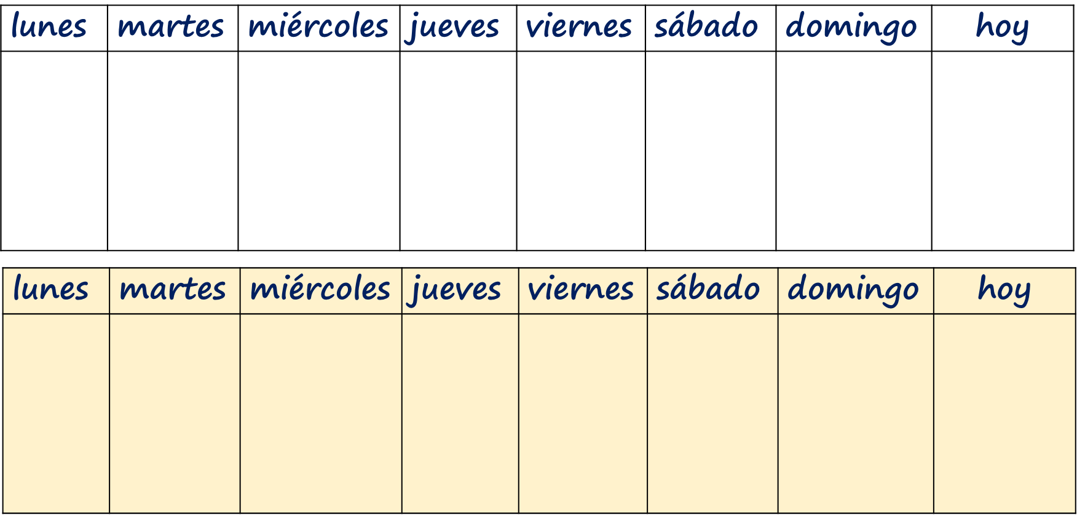
Follow up 4:
Draw your activities in the first table.
Use the second table to keep track of which of your partner’s
ships you have sunk and what you have already asked.
hablar
ciclismo
una carrera
fútbol
una tarjeta
baloncesto
una tarta
tenis
esquí
Notes:
HANDOUT

