Slide 1


español, con Sofía

Slide 2

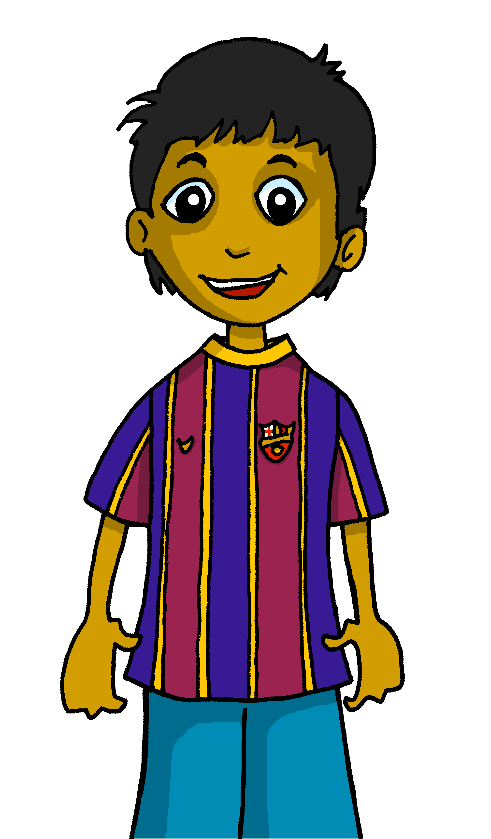
Saying what others and I do
verde
hacer [to do]:
hago, haces, hace
accents 2
Notes:
Artwork by Steve Clarke. All additional pictures selected are available under a Creative Commons license, no attribution required.
The frequency rankings for words that occur in this PowerPoint which have been previously introduced in the resources are given in the SOW (excel document) and in the resources that first introduced and formally re-visited those words.
Phonics: Medellín [N/A] Alcalá [N/A] Málaga [N/A]
Vocabulary (new words in bold): hacer [26] hago, haces, hace baile [2040] ciclismo [>5000] deporte [1489] dibujo [1726] natación [>5000] pastel [>5000] prueba [651] tarjeta [1958]
Revisit 1: primo [1451] voy [ir 33] vas [ir 33] va [ir 33] estoy [estar 21] está [estar 21] estás [estar 21] calle [269] cine [952] estadio [2581] mercado [487] parque [1354] playa [1475] plaza [806] teatro [605] a [8] el [1] la [1]
Revisit 2: beber [1085] aula [3501] bocadillo [>5000] chocolate [3408] comida [906] compañero / compañera [551] ejercicio [1162] español [262] patio [1197] profesor / profesora [501] salón [1722] tarea [995] caliente [1810] en [5] previously revisited –er verbs: aprender [428] comer [347] hacer [26] leer [209]
Frequency of unknown words and cognates:
jardín [1195] libre [473] conmigo [1256]
Source: Davies, M. & Davies, K. (2018). A frequency dictionary of Spanish: Core vocabulary for learners (2nd ed.). Routledge: London
For any other words that occur incidentally in this PowerPoint, frequency rankings will be provided in the notes field wherever possible.

Slide 3
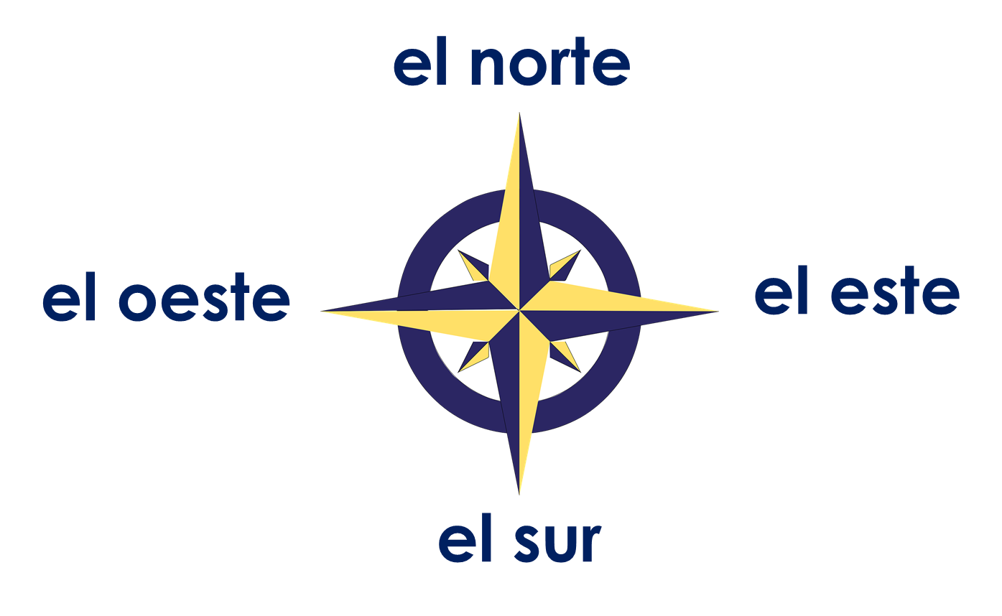


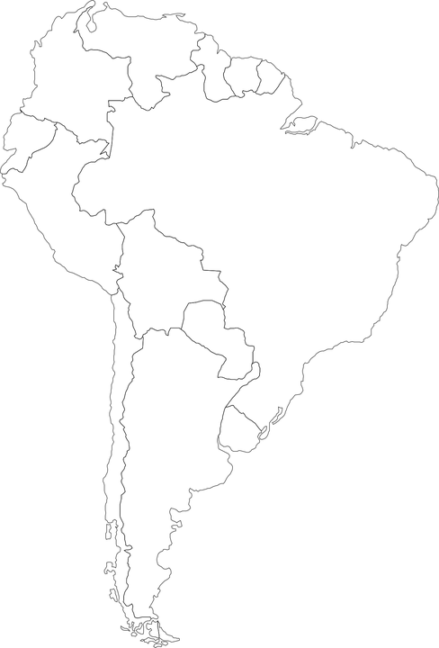
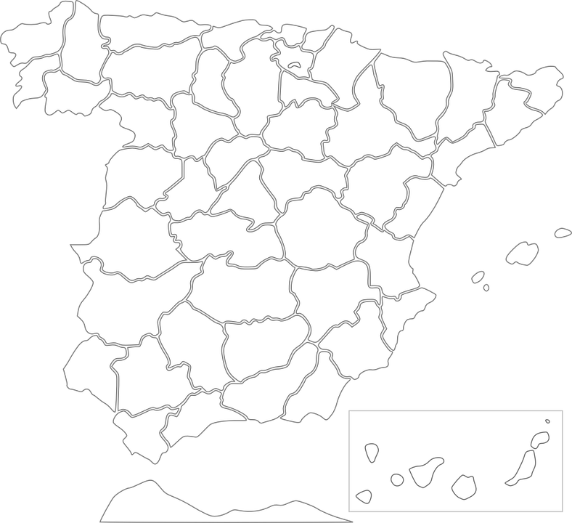
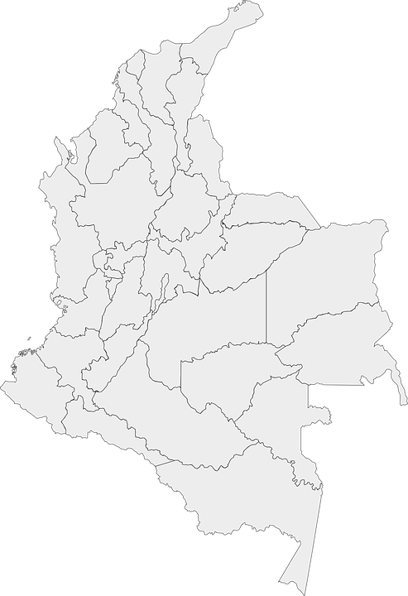



Accents 2
el centro
In Spanish, all words with last syllable stress that end in –n, -s or a vowel have an accent.
pronunciar
Cadaqués
Medellín
Alcalá de Henares
¿Dónde está Alcalá de Henares?
¿Dónde está Cadaqués?
¿Dónde está Medellín?
norte
este
España
centro
Está en el _______ de __________.
Colombia
España
Está en el ______ de _________.
Está en el ______ de _________.
Notes:
Timing: 3 minutes
Aim: to explain the rule of written accents 1
Procedure:
Read the explanation.
Introduce the example words to exemplify the rule.
Click further to bring questions on location of the cities used as example and elicit answer from pupils (encourage them to answer in full sentences).
NB. For Cadaqués, pupils could also answer ‘Cadaqués está en el norte de España.’

Slide 4




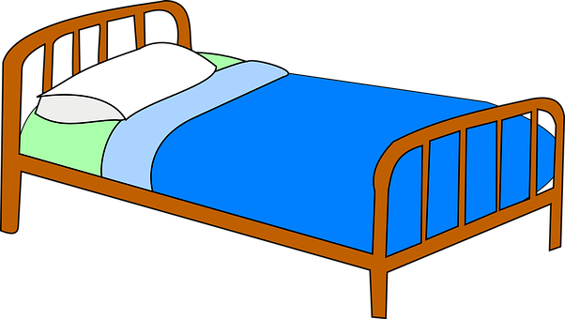
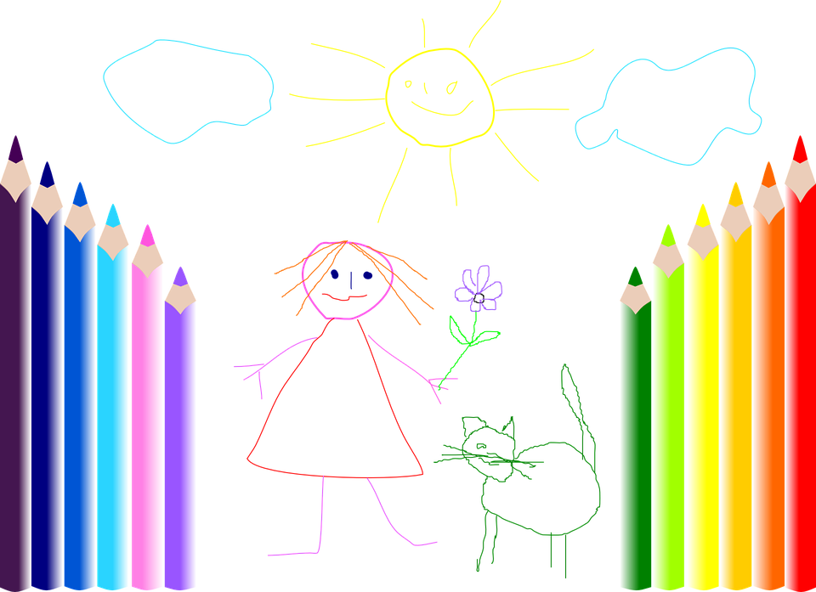
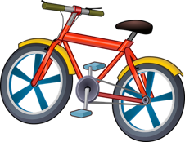









vocabulario
Vocabulario
¿Cómo es en español?
➜ hacer…
a test
una lista
una tarta
la cama
una prueba
a drawing
bed
a list
un dibujo
cycling
swimming
a race
ciclismo
to do/go cycling
to make a card
to do sport
to do a test
a card
to make a list
to make the bed
to make a cake
to do a race
to do/go swimming
to do a drawing
a cake
a test
sport
natación
una tarjeta
una carrera
deporte
Notes:
Timing: 5 minutes
Aim: to present and practise written comprehension and read aloud of previously taught vocabulary and two new words for this week.
Procedure:
1. Click for an English item. Elicit pronunciation of the Spanish from pupils, the full phrase, i.e., hacer la cama.
2. Click to cover the Spanish word with a picture.
3. Continue with the remaining items.
4. Elicit the Spanish from pupils; full phrase English prompts reappear on each mouse click this time without written Spanish support.

Slide 5

Using the verb ‘hacer’
[to do: I do & s/he, it does]
Remember that the verb ‘hacer’ is irregular and does not follow the general rules:
⚠ Use the verb hacer to mean to do and to make.
⚠ With sport(s), don’t use an article.
s/he, it
you
I
Hago un dibujo.
Hace una tarta.
Haces natación.
I do a drawing.
S/he makes a cake.
You do/go swimming.
Quique hace una tarta.
⚠ Hacer can also mean ‘to go’.
Quique makes a cake.
Notes:
Timing: 3 minutes
Aim: to introduce 2nd person singular of ;hacer’; to revisit 1st and 3rd person singular of ‘hacer’
Procedure:
Read the grammar explanation on irregular verb hacer.
Elicit English translation for the Spanish examples provided.

Slide 6



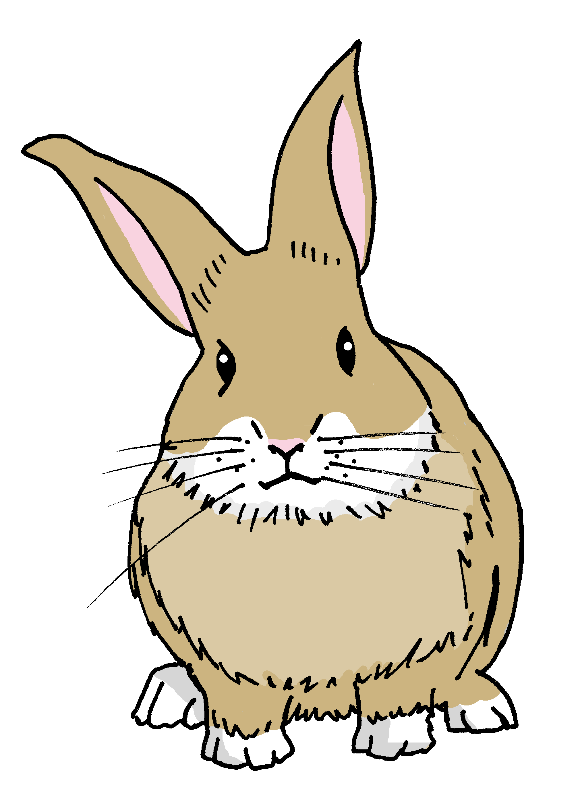


leer
El sábado es un día especial. Rubén pasa el día con Sofía y Quique.
Sofía escribe una lista con las actividades, pero ¡Pancho tiene hambre!
¿Quién hace qué? ¿Es Quique (you) o Rubén (he)?
conmigo – with me
(el) jardín – garden
Haces un dibujo para mamá.
4
Hace una tarjeta de cumpleaños para su abuelo.
E
tú (you)
él (he)
Haces la cama por la mañana.
5
1
Haces natacion en la piscina por la tarde.
E
1
2
3
4
5
6
6
Haces ejercicio en el jardín.
2
Hace una tarta de chocolate conmigo.
Hace una prueba de vocabulario en el ordenador.
3
Notes:
Timing: 6 minutes
Aim: to practise written recognition of the second and third person singular forms of ‘hacer’ and connect these with meaning.
Procedure:
1. Read the rubric and ensure that pupils understand the context.
2. Pupils read the parts of sentences they can see and tick who they think it applies to. They should use their knowledge of verb forms to decide.
3. Answers revealed on clicks.
4. Optional – click the numbered buttons to hear the full sentences.
5. Ask additional questions to assess comprehension – e.g., who is doing the swimming? When? Who is doing the drawing? Who for?
Frequency of unknown words and cognates:
jardín [1195] conmigo [1256]
Source: Davies, M. & Davies, K. (2018). A frequency dictionary of Spanish: Core vocabulary for learners (2nd ed.). Routledge: London

Slide 7

escuchar
Sofía habla con Rubén sobre el tiempo libre.
¿Qué actividad hace?
¿Es una pregunta [?] o una frase [.]?
¿Quién es?
Escribe. 📝
Escribe en inglés. 📝
 | [?] [.] | [I] or [you] | activity | extra ⚡
🎶
?
you
E
swimming
normally
1
.
I
a drawing
never
.
I
with my mum
2
sport
3
.
you
Sunday morning
a cake
4
?
you
always
cycling
in the park
⚠ Two activities are not mentioned!
(el) tiempo libre – free time
Notes:
Timing: 8 minutes
Aim: to practise aural differentiation of statements and intonation questions, and to recognise vocabulary aurally.
Procedure:
Pupils listen to each phrase.
Pupils note: 1. the person (I or you), as well as if it is a question or a statement. They may need to listen more than once to get all the information.
Click to reveal the answers (person, statement or question).
Now pupils note what each person does. Not all the activities in the speech bubble are mentioned. Encourage pupils to also listen out for any extra pieces of information.
Transcript:
E ¿Haces natación normalmente?
1 Nunca hago un dibujo.
2 Hago deporte con mi madre.
3 Haces un pastel el domingo por la mañana.
4 ¿Siempre haces ciclismo en el parque?
Frequency of unknown words and cognates:
libre [473]
Source: Davies, M. & Davies, K. (2018). A frequency dictionary of Spanish: Core vocabulary for learners (2nd ed.). Routledge: London

Slide 8
¡adiós!
verde

