Slide 1
Saying what I and others do
verde
Follow ups 1-5
Notes:
Artwork by Steve Clarke. All additional pictures selected are available under a Creative Commons license, no attribution required.
The frequency rankings for words that occur in this PowerPoint which have been previously introduced in the resources are given in the SOW (excel document) and in the resources that first introduced and formally re-visited those words.
Phonics: Medellín [N/A] Alcalá [N/A] Málaga [N/A] Vocabulary (new words in bold): hacer [26] hago, haces, hace baile [2040] ciclismo [>5000] deporte [1489] dibujo [1726] natación [>5000] pastel [>5000] prueba [651] tarjeta [1958]
Revisit 1: primo [1451] voy [ir 33] vas [ir 33] va [ir 33] estoy [estar 21] está [estar 21] estás [estar 21] calle [269] cine [952] estadio [2581] mercado [487] parque [1354] playa [1475] plaza [806] teatro [605] a [8] el [1] la [1]
Revisit 2: beber [1085] aula [3501] bocadillo [>5000] chocolate [3408] comida [906] compañero / compañera [551] ejercicio [1162] español [262] patio [1197] profesor / profesora [501] salón [1722] tarea [995] caliente [1810] en [5] previously revisited –er verbs: aprender [428] comer [347] hacer [26] leer [209]
Frequency of unknown words and cognates:
corregir [2351] ciudad [178] pueblo [244]
Source: Davies, M. & Davies, K. (2018). A frequency dictionary of Spanish: Core vocabulary for learners (2nd ed.). Routledge: London
For any other words that occur incidentally in this PowerPoint, frequency rankings will be provided in the notes field wherever possible.

Slide 2
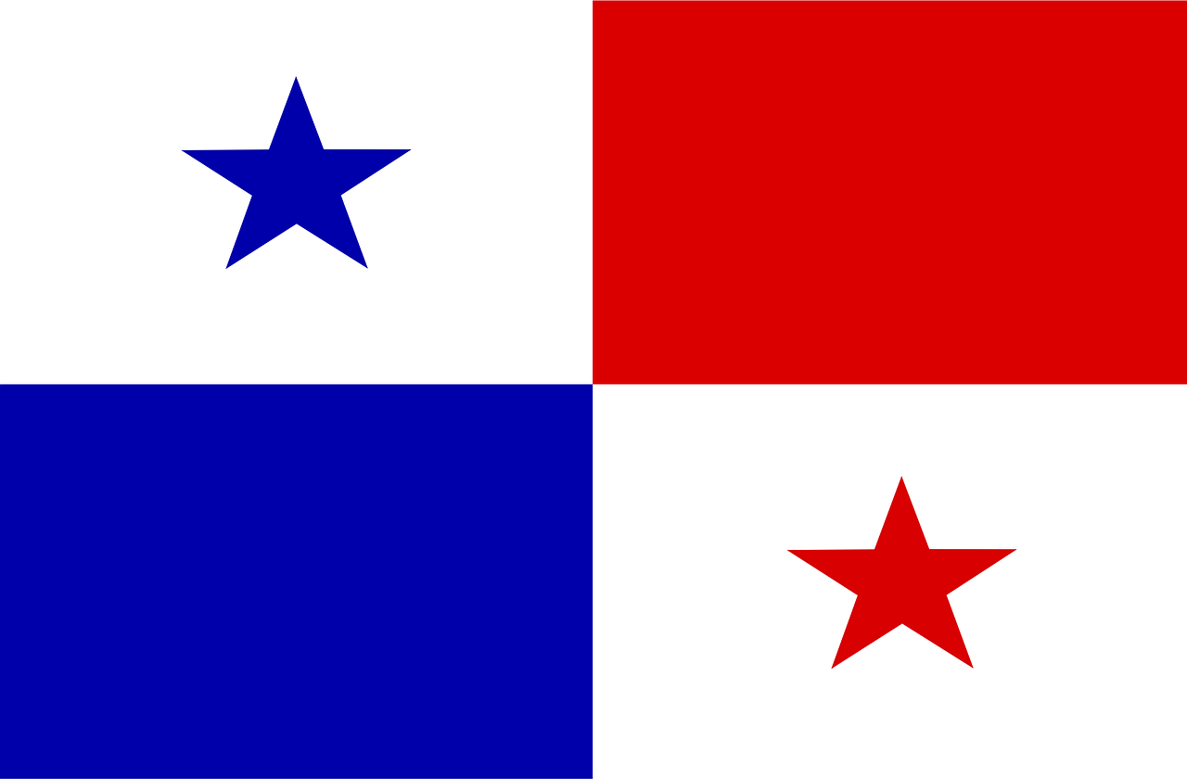
pronunciar
Follow up 1
¿Tiene acento?
[A] Escucha y escribe la palabra ✍
 | Palabra
 | _ _ _ _ _ _
 | _ _ _ _ _ _ _
 | _ _ _ _ _ _ _
 | _ _ _ _ _
 | _ _ _ _ _ _
 | _ _ _ _ _ _
 | El _ _ _ _ _ _ _ _
 | _ _ _ _ _ _ _
Remember that in Spanish, all words with last syllable stress that end in –n, -s or a vowel have an accent.
‘
E
Panama
1
Ademuz
2
pensar
‘
avion
Los dos países en Sudamérica son ______ y _________ .
3
‘
ingles
Panamá
El Salvador
4
‘
Padrón
padron
Los dos ciudades de España son ___________ y ___________.
5
Ademuz
6
Salvador
‘
7
corazon
el pueblo = village, town
la ciudad = city
Notes:
Timing: 5 minutes (two slides)
Aim: to develop pupil’s awareness of word stress with unknown words (Spanish surnames)/
Procedure:
1. Teacher gives the instruction and clarifies ‘acento’.
2. Pupils listen out for identifying the number of syllables in each word (ensure they understand these are all unknown words for them).
3. Click to bring up answers.
4. Listen one more time to focus on where the stress falls in the word – most linguistically may want to try to write the whole word.
5. Elicit the answers in the two gapped sentences. Click to reveal the answers. Click on each sentence to hear it pronounced.
Transcript:
E Panamá
1 Ademúz
2 pensar
3 avión
4 inglés
5 Padrón
6 Salvador
7 corazón
Frequency of unknown words and cognates:
ciudad [178] pueblo [244]
Source: Davies, M. & Davies, K. (2018). A frequency dictionary of Spanish: Core vocabulary for learners (2nd ed.). Routledge: London
2

Slide 3
Follow up 2:
Escribe en inglés 📝: Can you get at least 15 points?
 | aprender | el aula | la comida
 | beber | comer | el compañero
 | el primo | vas | ir
 | voy | la calle | el teatro
 | haces | la natación | la prueba
 | hago | hacer | el ciclismo
vocabulario
to learn, learning
classroom
food
x3
to drink, drinking
to eat, eating
(male) partner
male cousin
you go
to go, going
x2
I go
street
theatre
you do, make
swimming
test
x1
I do, make
to do, make
cycling
Notes:
Timing: 7 minutes
Aim: to practise written comprehension of vocabulary from this week and this week’s revisited sets (next slide).
Procedure:
Part 2 [7 minutes] 1. Give pupils a blank grid. They fill in the English meanings of any of the words they know, trying to reach 15 points in total.
Note: The most recently learnt and practised words are pink, words from the first revisit are green and those from the second revisit are blue, thus more points are awarded for them, to recognise that memories fade and more effort (heavy lifting!) is needed to retrieve them.

Slide 4
Follow up 3:
Lee las frases y corrige*.
 | Sofía does exercise in the morning .
 | Sofía hace ejercicio por la tarde.
 | She often does a race.
 | Hago una carrera a menudo.
 | I go swimming with friends.
 | Haces natación con amigos.
 | I never make my bed.
 | Siempre hago mi cama.
 | Do you do drawings on Saturday morning?
 | ¿Haces ciclismo el sábado por la mañana?
afternoon.
leer
E
I
do
‘a menudo’ is an adverb. Use it at the start or end of a sentence.
1
You go
2
⚠ We translate hacer as ‘to go’ with ‘natación’ and ‘ciclismo’.
always
3
go
cycling
4
corrige = correct
Notes:
Timing: 5 minutes
Aim: written comprehension of hacer + positions
Procedure:
Tell pupils that there are mistakes in the ENGLISH sentences.
Pupils read the Spanish and write the corrections for the English sentence. They can just write the corrections rather than the full sentences.
Click to correct.
If desired, click on the numbers to hear the Spanish sentences.
Frequency of unknown words and cognates:
corregir [2351]
Source: Davies, M. & Davies, K. (2018). A frequency dictionary of Spanish: Core vocabulary for learners (2nd ed.). Routledge: London

Slide 5
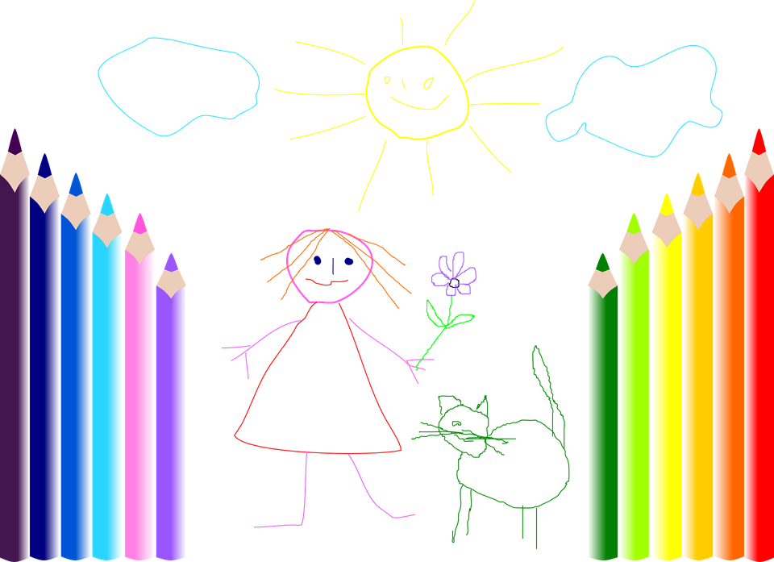
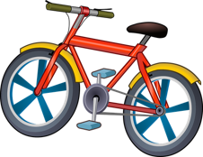
Follow up 4:
Find your partner’s weekly activities to sink their ships!
Ejemplo
Persona A
hablar
lunes | martes | miércoles | jueves | viernes | sábado | domingo | hoy
exercise
a test
A: ¿Haces dibujos el miércoles ?
B: No. Es incorrecto.
A: ¡Sí,correcto! Hago natación el sábado. ☹
B: ¿Haces natación el sábado?
lunes | martes | miércoles | jueves | viernes | sábado | domingo | hoy
Draw your pictures on any day of the week in the top table. This is just an example. Keep your drawings hidden from your partner!
drawing x
A: ¿Haces deporte el jueves?
B: ¡Sí,correcto! Hago deporte el jueves.
Notes:
Handout at end of presentation
Timing: 10 minutes
Aim: to practise oral production of second and first person weak verbs with time adverbs in the context of weekly activities.
Procedure:
Give pupils a copy of the handout and explain that the top table is for them to draw/note down an activity for each day, and the bottom table is for them to keep track of their partner’s activities/ships. So this example is just Persona A’s sheet. It is important that pupils use the verbs/activities on the board, not their own, as otherwise their partner has no chance of guessing, and may not have the Spanish to do so.
Click through the animations on this slide to show pupils a) to draw their pictures (if this takes too long they can just write one word e.g. card, cycling) b) how to conduct the conversation, reminding them of ‘you’ forms of the verb for questions and c) how to keep track of what they have asked their partner. If they ‘sink’ their partner’s ship by guessing the correct activity on the correct day, they can tick/cross/draw a ship in that box.
NOTE: 1) This game has the potential to last a long time, so it could be the first to sink X number of ships! 2) Infinitive Spanish verbs are given on the handout to help pupils, but they still need to conjugate them.
Additional Activities:
Pupils could make sentences in the 3rd person to tell another pair what they have found out about their partner. E.g. Sammy hace deporte el domingo.
Alternatively, pupils might like to have real conversations now about themselves using these and other verbs/activities of their choice. This could be done as a survey around the class: ‘Haces deporte el domingo?’

Slide 6
Follow up 5:
Escribe en español 📝: can you get at least 15 points?
 | to drink, drinking | (the) classroom | (the) food
 | to learn, learning | to eat, eating | (the) partner (f)
 | (the) cousin (m) | (the) street | s/he goes
 | you go | (the) beach | (the) market
 | you do, make | (the) cycling | (the) swimming
 | to do, make; doing, making | I do, make | (the) test, exam
beber
el aula
la comida
vocabulario
x3
aprender
comer
la compañera
el primo
la calle
va
x2
vas
la playa
el mercado
haces
el ciclismo
la natación
x1
hacer
hago
la prueba
Notes:
Timing: 5 minutes
Aim: to practise written production of vocabulary from this week and this week’s revisited sets.
Procedure: 1. Give pupils a blank grid. They fill in the Spanish meanings of any of the words they know, trying to reach 15 points in total.
Note: The most recently learnt and practised words are pink, words from the first revisit are green and those from the second revisit are blue, thus more points are awarded for them, to recognise that memories fade and more effort (heavy lifting!) is needed to retrieve them.

Slide 7
¡adiós!
verde

Slide 8
Handout: Follow up 2a
Escribe en inglés 📝: Can you get at least 15 points?
 | aprender | el aula | la comida
 | beber | comer | el compañero
 | el primo | vas | ir
 | voy | la calle | el teatro
 | haces | la natación | la prueba
 | hago | hacer | el ciclismo
 | aprender | el aula | la comida
vocabulario
x3
x2
x1
Notes:
Timing: 5 minutes
Aim: to practise written comprehension (this slide) and production (next slide) of vocabulary from this week and this week’s revisited sets.
Procedure: 1. Give pupils a blank grid. They fill in the English meanings of any of the words they know, trying to reach 15 points in total.
Note: The most recently learnt and practised words are pink, words from the first revisit are green and those from the second revisit are blue, thus more points are awarded for them, to recognise that memories fade and more effort (heavy lifting!) is needed to retrieve them.

Slide 9
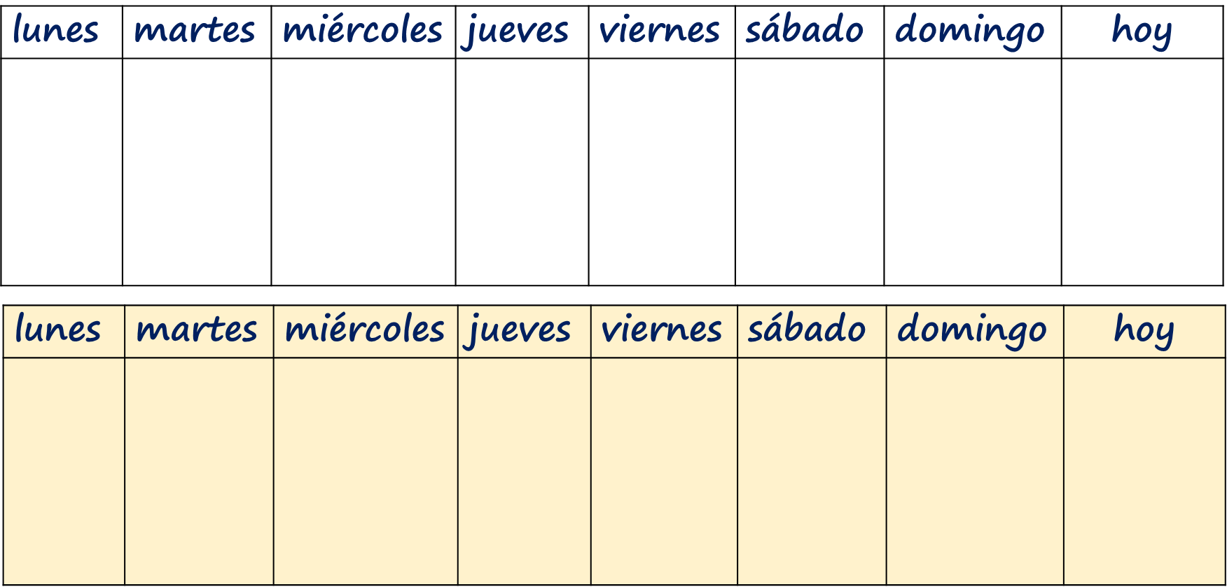
Follow up 4:
Draw your activities in the first table.
Use the second table to keep track of which of your partner’s
ships you have sunk and what you have already asked.
hablar
deporte
natación
una prueba
un pastel
un dibujo
una tarjeta
la cama
ciclismo
canciones 🎶
comida
Notes:
HANDOUT

Slide 10
Handout: Follow up 2b
Escribe en español 📝: Can you get at least 15 points?
 | to drink, drinking | (the) classroom | (the) food
 | to learn, learning | to eat, eating | (the) partner (f)
 | (the) cousin (m) | (the) street | s/he goes
 | you go | (the) beach | (the) market
 | you do, make | (the) cycling | (the) swimming
 | to do, make; doing, making | I do, make | (the) test, exam
vocabulario
x3
x2
x1
Notes:
HANDOUT

