Slide 1
español, con Sofía

Slide 2
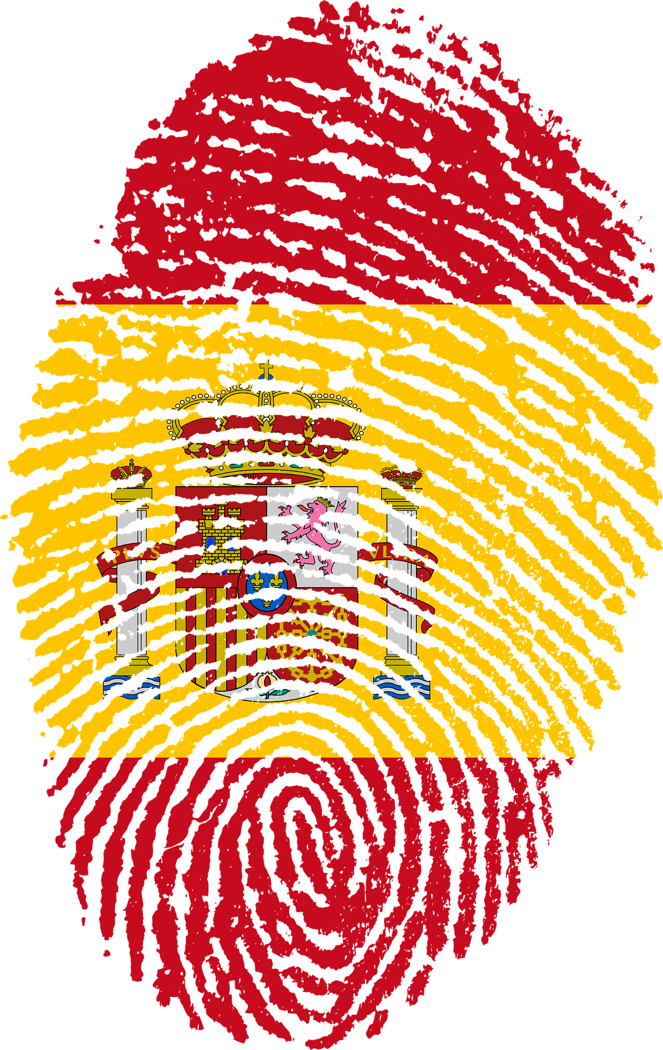
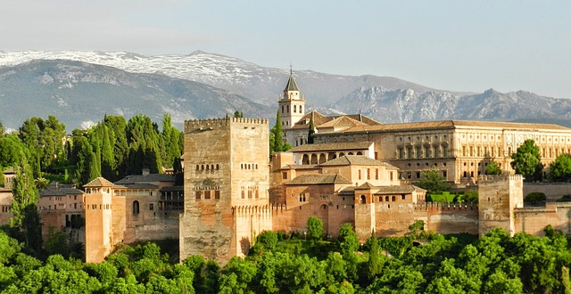
Saying what I and others do
hacer [to do/make]: hago vs. hace
contractions (del vs. de la)
SSC: [r] [rr]
verde
Notes:
Artwork by Steve Clarke. All additional pictures selected are available under a Creative Commons license, no attribution required.
The frequency rankings for words that occur in this PowerPoint which have been previously introduced in the resources are given in the SOW (excel document) and in the resources that first introduced and formally re-visited those words.
Phonics: Accents 1
Vocabulary (new words in bold): centro [316] iglesia [437] piscina [4604] playa [1475] plaza [806] río [496] teatro [605] de1 [2] visita [911] cerca [1042] lejos [833]
Revisit 1: voy [ir 33] vas [ir 33] va [ir 33] bosque [1444] campo [342] isla [810] lago [2151] montaña [1464] playa [1475] río [496] a [8] el [1] la [1]
Revisit 2: celebrar [886] mandar [588] carrera [481] España [N/A] tarjeta [1958] villancico [>5000] común [742] especial [436] tipíco [1934] pero [30] en1 [5] Revisit other –ar verbs: cantar [717] comprar [361] escuchar [281] preparar [570]
Glossed: arquitectura [1627] mercado [487] palacio [1705] viaje [519] artesanal [>5000] islámico [>5000]
Source: Davies, M. & Davies, K. (2018). A frequency dictionary of Spanish: Core vocabulary for learners (2nd ed.). Routledge: London
For any other words that occur incidentally in this PowerPoint, frequency rankings will be provided in the notes field wherever possible.

Slide 3
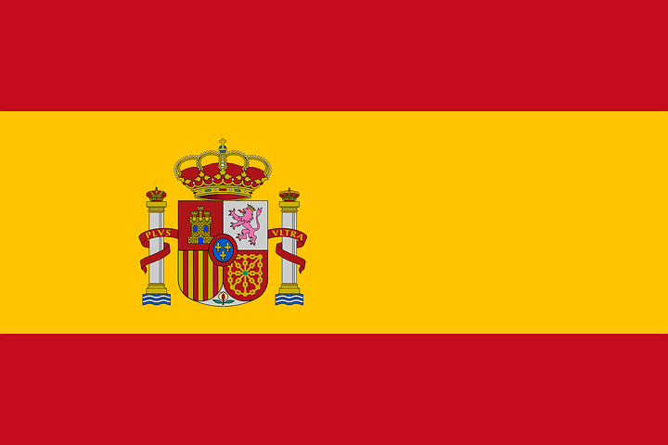
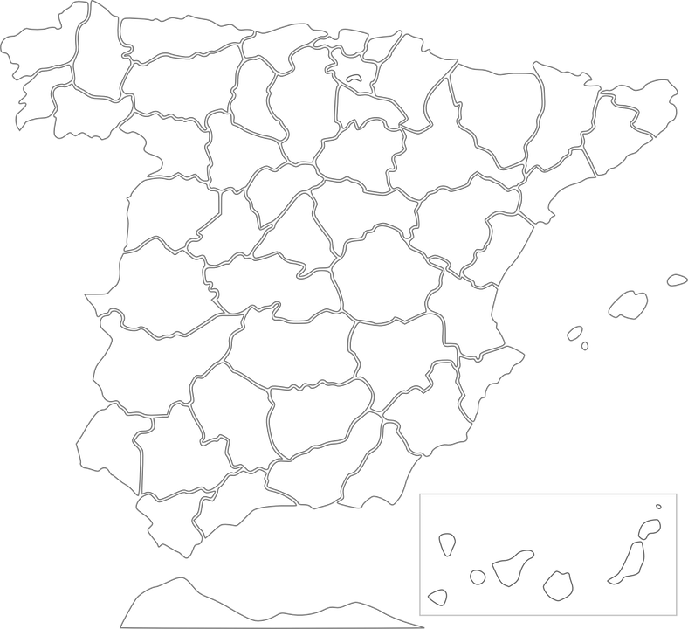
Accents 1
In Spanish, all words with antepenultimate (third-last) syllable stress have an accent.
pronunciar
Lérida
Cáceres
Mérida
Úbeda
Málaga
Notes:
Timing: 3 minutes
Aim: to explain the 1st rule of written accents.
Procedure:
Read the explanation.
Introduce the example words to exemplify the rule.

Slide 4
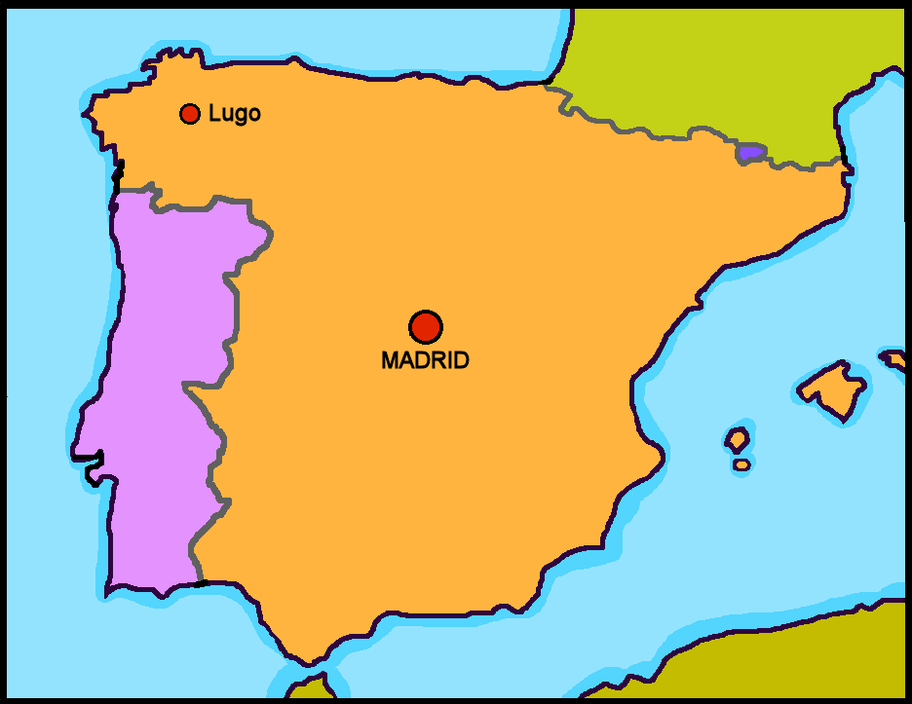
Leer y hablar
Granada
el viaje = trip / journey
el palacio = palace
El viaje* a ______________
escuchar
leer
1
Voy a una __________ histórica con mi familia.
No tiene ____________ pero tiene montañas.
Está en el sur y ________ un palacio muy famoso*: El Palacio de la Alhambra.
ciudad
2
playa
hay
3
El Palacio de la Alhambra
Barcelona 🏟
Mérida 🎭
Granada 🏯
Cádiz
¿Qué ciudad es?
Notes:
Timing: 3 minutes
Aim: to introduce the context of the lesson (Córdoba) through transcription of 3 key items of vocabulary introduced in week 8.
Procedure: 1. Pupils write 1-3.
2. Click to listen to each sentence. Pupils write in the missing word.
3. Click to correct answers.
4. Click to bring up question ¿Qué ciudad es? Teachers can refer back to the sentences and the map… Está en el oeste ¿Es Mérido? No! No es Mérida. Está en el sur…. Etc.
5. Click to bring up ‘Granada’ in the title.
Frequency of unknown words and cognates:
palacio [1705] viaje [519]
Source: Davies, M. & Davies, K. (2018). A frequency dictionary of Spanish: Core vocabulary for learners (2nd ed.). Routledge: London

Slide 5
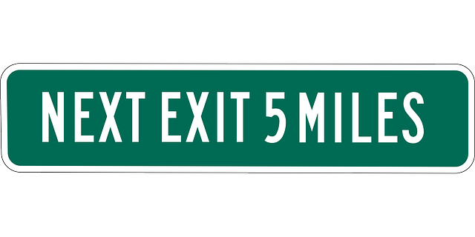
vocabulario
Escucha y repite 🗣
100 metros
cerca
c _ _ _ _ a
cerca
el centro
el c_ _ _ _ o
el centro
[near]
[centre]
100 kilómetros
lejos
l _ _ _ s
lejos
[visit]
[far]
l_ v_ _ _ _ a
la visita
la visita
Notes:
Timing: 5 minutes
Aim: to introduce the four new items of vocabulary for this week.
Procedure: 1.Teacher introduces items one by one (word, picture & English) and pupils practise pronunciation aloud.
Alternatively, pupils work in pairs, reading the Spanish words out loud and looking at the English meanings (1 minute). 2. Then the teacher removes the English words or pictures, and pupils try to recall the English orally (chorally), looking at the Spanish (1 minute). 3. Teacher brings up hints – pupils work in pairs trying to recall the Spanish.
4. Elicit answers from pupils (from top left to bottom right).
NB. Further rounds of learning can be facilitated by one pupil turning away from the board, and his/her partner asking him/her the meanings (‘Cómo se dice X en español?’). This activity can work from L2 → L1 or L1 → L2.

Slide 6
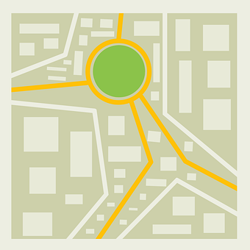
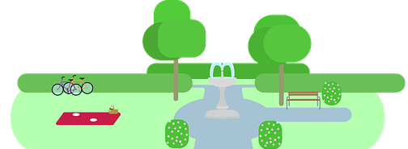
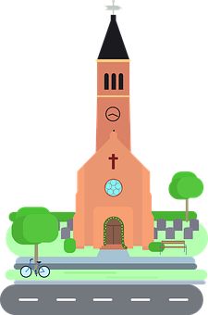
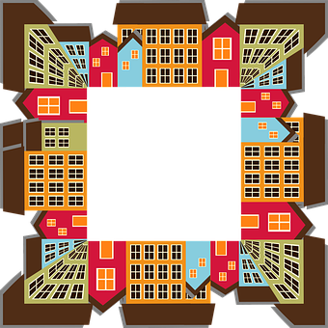
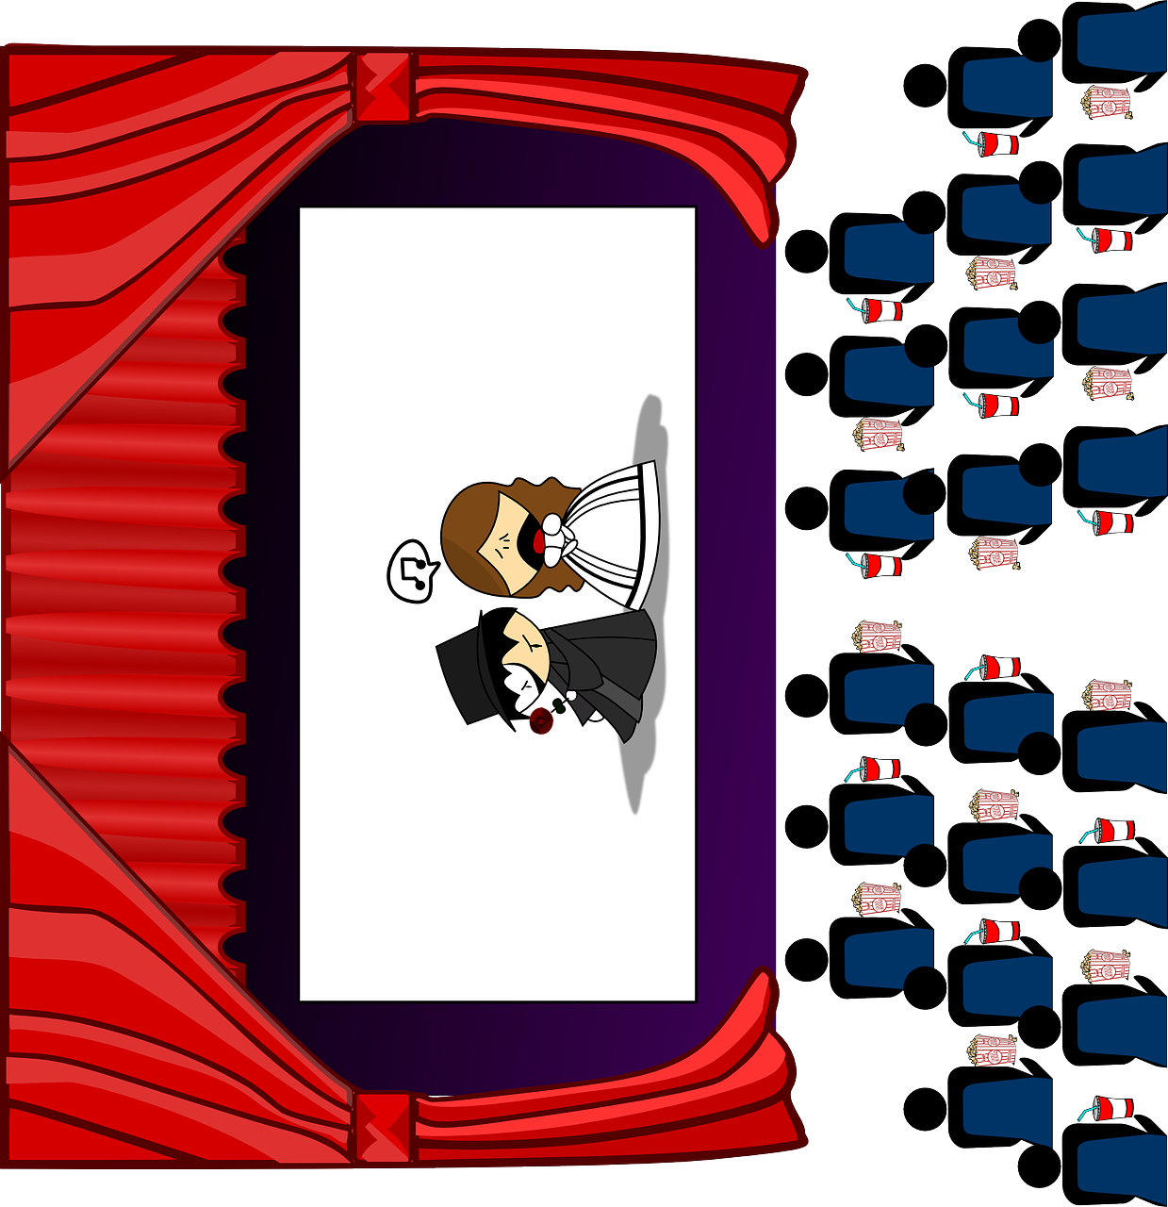
Cerca |
lejos
Note: we use de after cerca and lejos but we don’t say of in English.
[near, far]
To say something is near to, use cerca de:
cerca
[near]
[to]
El parque está cerca de la iglesia.
To say something is far from, use lejos de:
lejos
[from]
[far]
El museo está lejos de la iglesia.
Notes:
Timing: 4 minutes
Aim: to introduce two new adverbs of position.
Procedure:
Click to present the information.
Elicit English translations for the Spanish examples provided.

Slide 7
Using ‘del’ & ‘de la’
This just makes it easier to say!
[of the]
To mean ‘near to the / far from the’ before a singular feminine noun, use ‘de la’.
To mean ‘near to the / far from the’ before a singular masculine noun, use de + el → del.
cerca de la playa
cerca del bosque
near (to) the beach
near (to) the forest
lejos de la isla
lejos del lago
far from the island
far from the lake
Notes:
Timing: 3 minutes
Aim: to introduce contraction ‘del’.
Procedure:
Read the grammar explanation on ‘(to) the/from the’.
Elicit English translation for the Spanish examples provided.

Slide 8
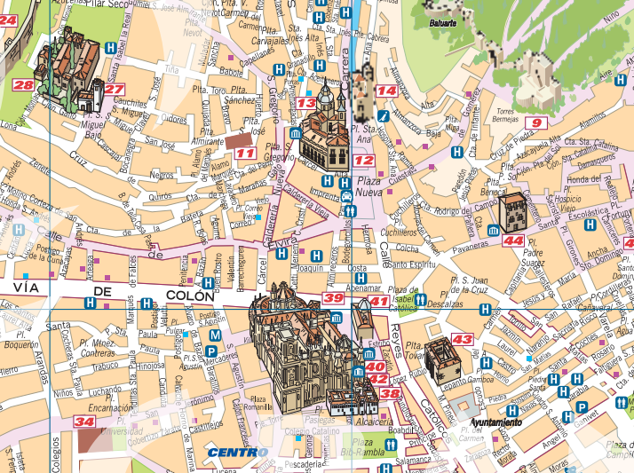
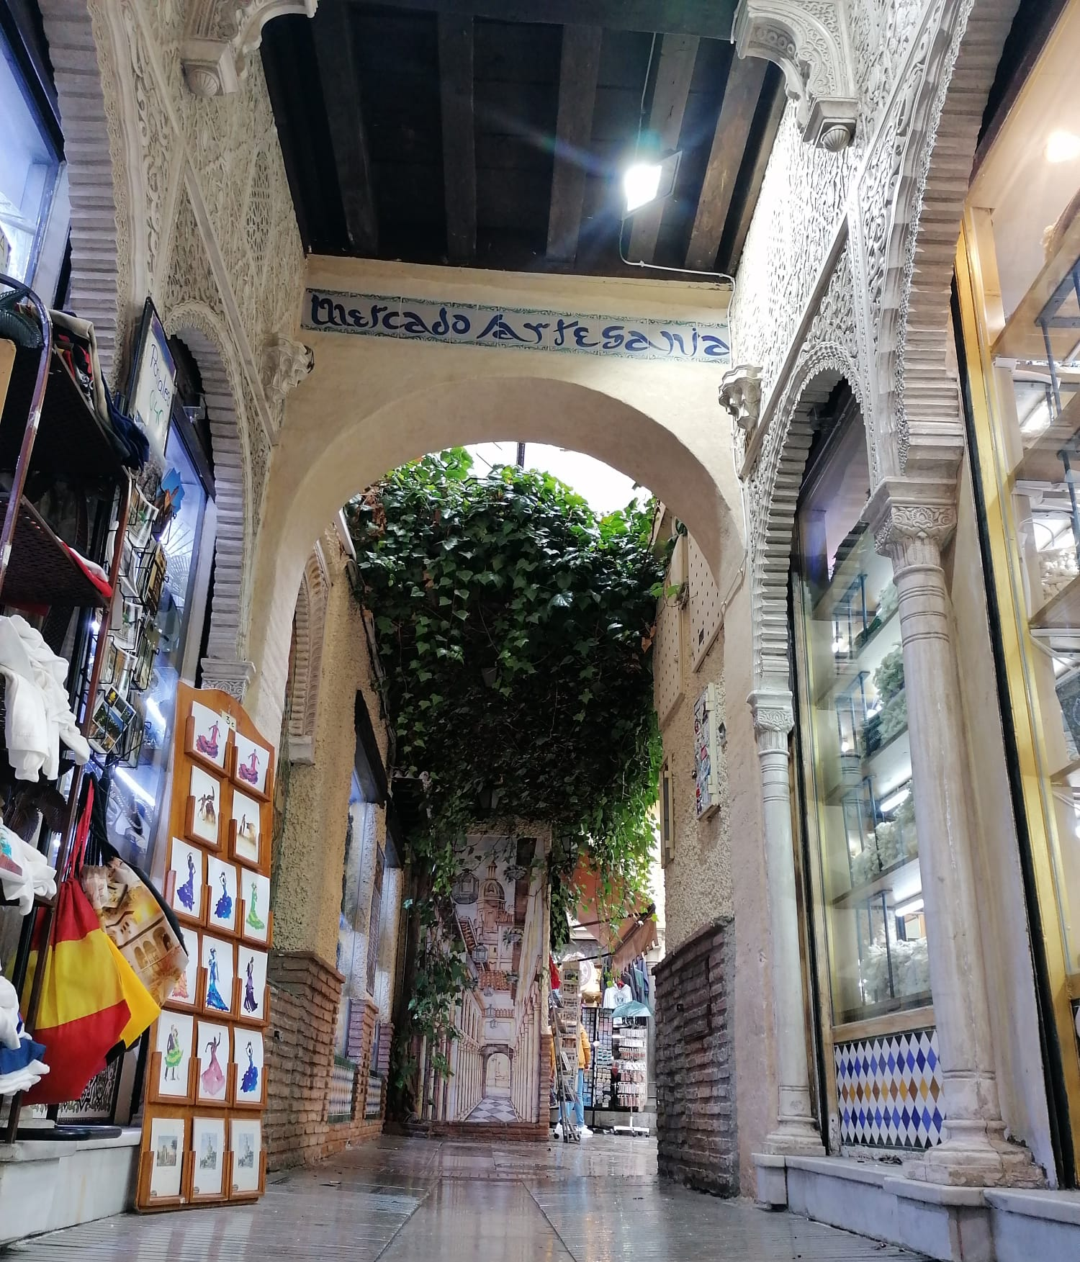
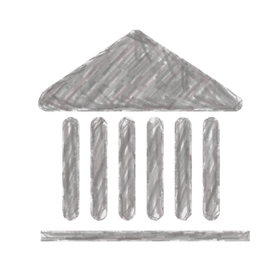
leer
Lee la frase. ¿Es del o de la?
[1/6]
El mercado = market
artesanal = craft
💬 La Alcaicería está lejos del | de la plaza Isabel la Católica.
En la Alcaicería hay un mercado* artesanal*.
Museo San Juan de Dios
La Alcaicería
Notes:
Timing: 5 minutes
Aim: to identify the correct preposition and article or contraction.
Procedure:
Introduce the task.
Draw pupils’ attention to gender of the noun (plaza = feminine).
Give pupils 20-30 seconds to read the sentence aloud in pairs and decide on the preposition + article combination.
Elicit response from pupils.
There are 6 sentences in total, including the example.
Frequency of unknown words and cognates:
mercado [487] artesanal [>5000]
Source: Davies, M. & Davies, K. (2018). A frequency dictionary of Spanish: Core vocabulary for learners (2nd ed.). Routledge: London
Map source: https://www.turgranada.es/wp-content/blogs.dir/2/files_mf/1393956800callejero.pdf

Slide 9
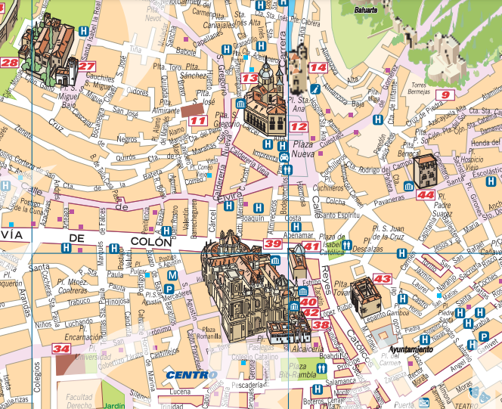
leer
Lee la frase. ¿Es del o de la?
[2/6]
💬 La Alcacería está cerca del | de la teatro Isabel la Católica.
Museo San Juan de Dios
La Alcacería
🎭 Teatro Isabel la Católica
Notes:
[2/6]
Frequency of unknown words and cognates:
artesanal [>5000]
Source: Davies, M. & Davies, K. (2018). A frequency dictionary of Spanish: Core vocabulary for learners (2nd ed.). Routledge: London
Map source: https://www.turgranada.es/wp-content/blogs.dir/2/files_mf/1393956800callejero.pdf

Slide 10
leer
Lee la frase. ¿Es del o de la?
[3/6]
💬 El teatro está lejos del | de la museo.
Museo San Juan de Dios
La Alcacería
🎭 Teatro Isabel la Católica
Notes:
[3/6]
Frequency of unknown words and cognates:
artesanal [>5000]
Source: Davies, M. & Davies, K. (2018). A frequency dictionary of Spanish: Core vocabulary for learners (2nd ed.). Routledge: London
Map source: https://www.turgranada.es/wp-content/blogs.dir/2/files_mf/1393956800callejero.pdf

Slide 11
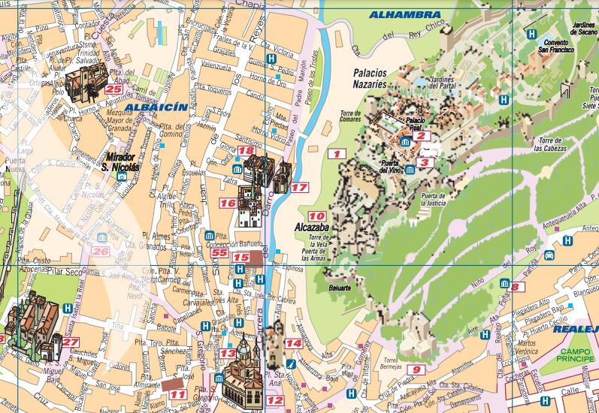
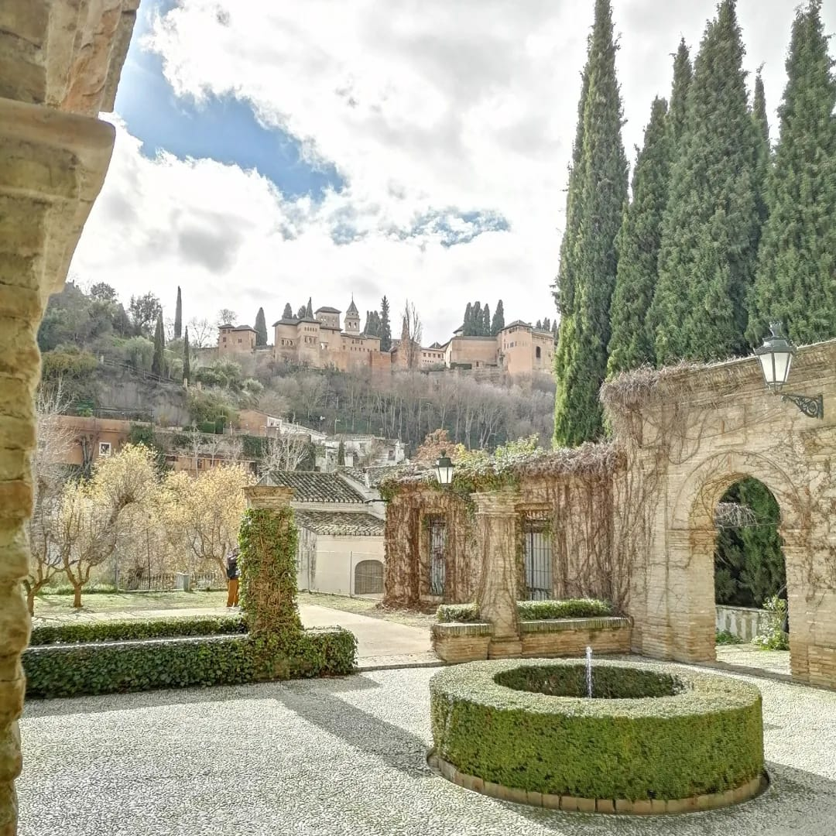
leer
Lee la frase. ¿Es del o de la?
[4/6]
💬 La Alhambra está cerca del | de la iglesia.
La Alhambra
La Alhambra es un palacio* famoso por su arquitectura* islámica*.
⛪ Iglesia de San Pedro y San Pablo
Museo San Juan de Dios
el palacio = palace
la arquitectura = architecture
islámica = Islamic
Notes:
[4/6]
Frequency of unknown words and cognates:
palacio [1705] arquitectura [1627] islámico [>5000]
Source: Davies, M. & Davies, K. (2018). A frequency dictionary of Spanish: Core vocabulary for learners (2nd ed.). Routledge: London
Map source: https://www.turgranada.es/wp-content/blogs.dir/2/files_mf/1393956800callejero.pdf

Slide 12
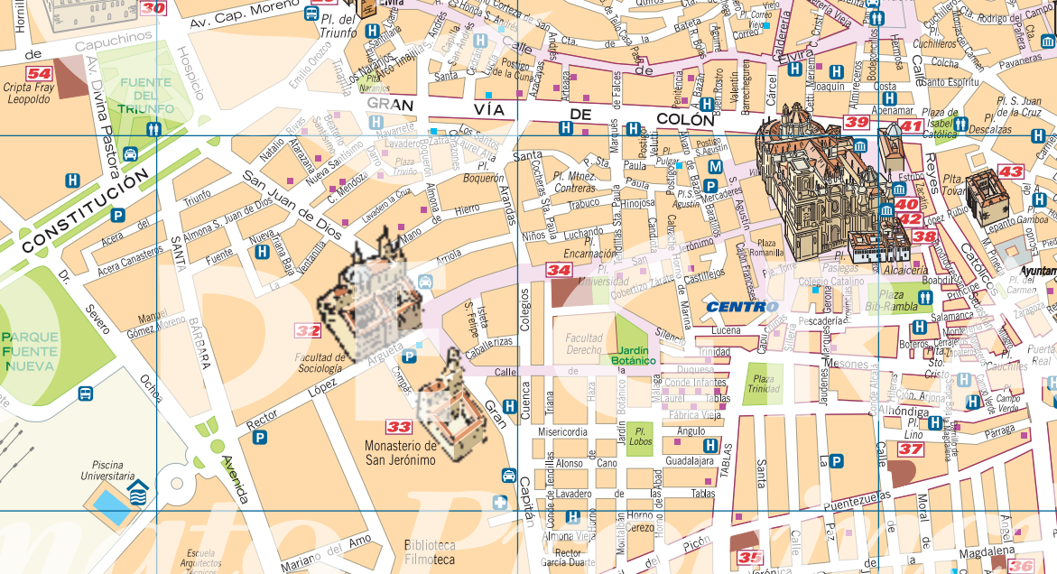
leer
Lee la frase. ¿Es del o de la?
[5/6]
💬 La Alcacería está lejos del | de la piscina.
La Alcacería
Notes:
[5/6]
Map source: https://www.turgranada.es/wp-content/blogs.dir/2/files_mf/1393956800callejero.pdf

Slide 13
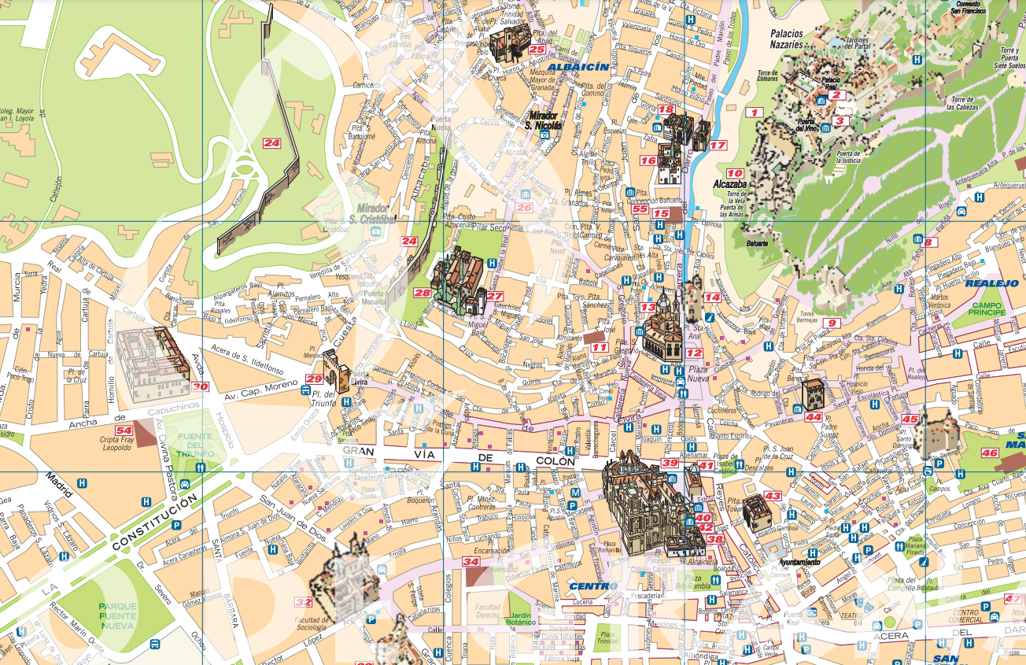
leer
Lee la frase. ¿Es del o de la?
[6/6]
💬 La Alhambra está muy lejos del | de la parque Fuente Nueva.
🌳 Parque Fuente Nueva
Notes:
[6/6]
Map source: https://www.turgranada.es/wp-content/blogs.dir/2/files_mf/1393956800callejero.pdf

Slide 14
Using the verb ‘hacer’
[to do, make: I do/make & s/he, it does, makes]
Some verbs do not follow the general rules.
The verb ‘hacer’ is an example of this.
We use the verb ‘hacer’ to mean to do and to make.
I
s/he, it
Hago ruido.
Hace una carrera.
I make noise.
S/he does a race.
Sofía hace una carrera.
Sofía does a race.
Notes:
Timing: 3 minutes
Aim: to introduce 1st and 3rd person singular of ‘hacer’
Procedure:
Read the grammar explanation on irregular verb hacer.
Elicit English translation for the Spanish examples provided.

Slide 15
leer
En Granada
¿Quién hace qué? ¿Es Quique o Sofía?
el palacio = palace
To emphasise the contrast, we sometimes use pronouns (e.g., yo (I)) in Spanish.
 | (yo) | (ella)
Yo hago una visita a un museo lejos del parque.
Ella hace una fiesta cerca de la plaza.
Ella hace una carrera cerca del centro.
Yo hago una actividad divertida lejos de la montaña.
Ella hace ejercicio lejos de la plaza.
Yo hago una visita a un palacio* cerca del río.
E
1
2
3
4
5
Notes:
Timing: 5 minutes
Aim: to practise written recognition of the first and third person singular forms of ‘hacer’ and connect these with meaning.
Procedure:
1. Pupils read the parts of sentences they can see and tick who they think it applies to. They should use their knowledge of verb forms to decide.
2. Answers revealed on clicks.
3. Optional – click the numbered buttons to hear the full sentences.
4. Elicit the English meanings of each sentence. What does Quique say? 5. Finally, bring up the callout to explain one use of Spanish pronouns – to emphasise a contrast e.g., between two people (I do X, she does Y).

Slide 16
¡adiós!
verde

