Slide 1





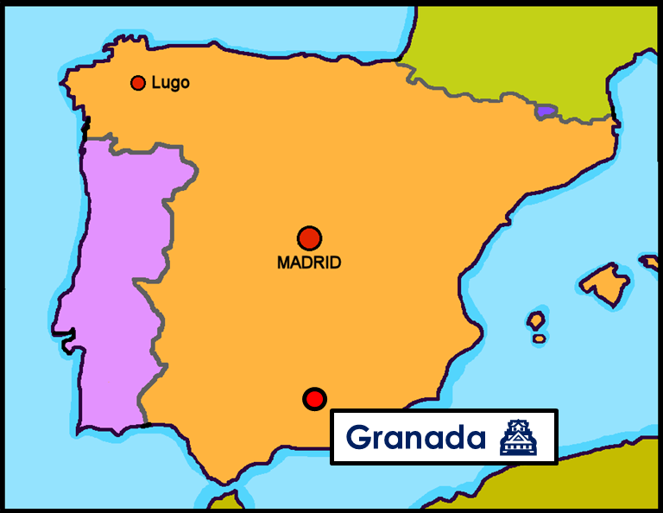
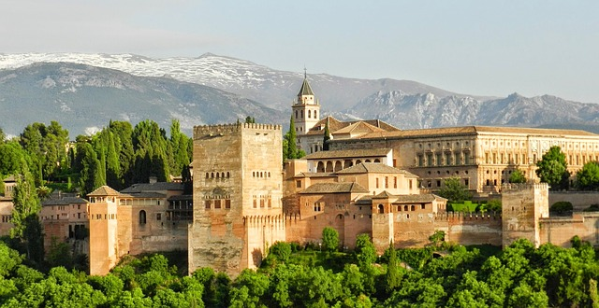
Saying what I and others do
verde
Follow ups 1-5
Notes:
Artwork by Steve Clarke. All additional pictures selected are available under a Creative Commons license, no attribution required.
The frequency rankings for words that occur in this PowerPoint which have been previously introduced in the resources are given in the SOW (excel document) and in the resources that first introduced and formally re-visited those words.
Phonics: Accents 1
Vocabulary (new words in bold): centro [316] iglesia [437] visita [911] piscina [4604] playa [1475] plaza [806] río [496] teatro [605] de1 [2] cerca [1042] lejos [833]
Revisit 1: voy [ir 33] vas [ir 33] va [ir 33] bosque [1444] campo [342] isla [810] lago [2151] montaña [1464] playa [1475] río [496] a [8] el [1] la [1]
Revisit 2: celebrar [886] mandar [588] carrera [481] España [N/A] tarjeta [1958] villancico [>5000] común [742] especial [436] tipíco [1934] pero [30] en1 [5]
Revisit other –ar verbs: cantar [717] comprar [361] escuchar [281] preparar [570]
Source: Davies, M. & Davies, K. (2018). A frequency dictionary of Spanish: Core vocabulary for learners (2nd ed.). Routledge: London
For any other words that occur incidentally in this PowerPoint, frequency rankings will be provided in the notes field wherever possible.

Slide 2
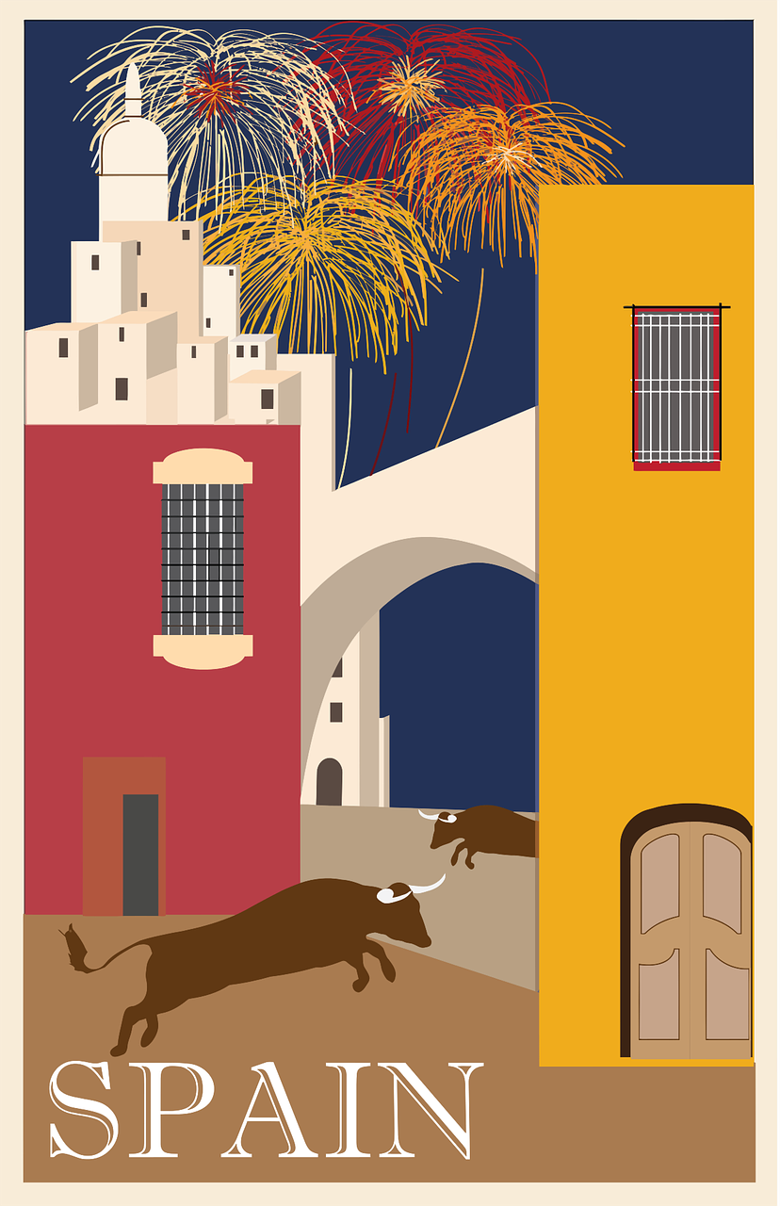

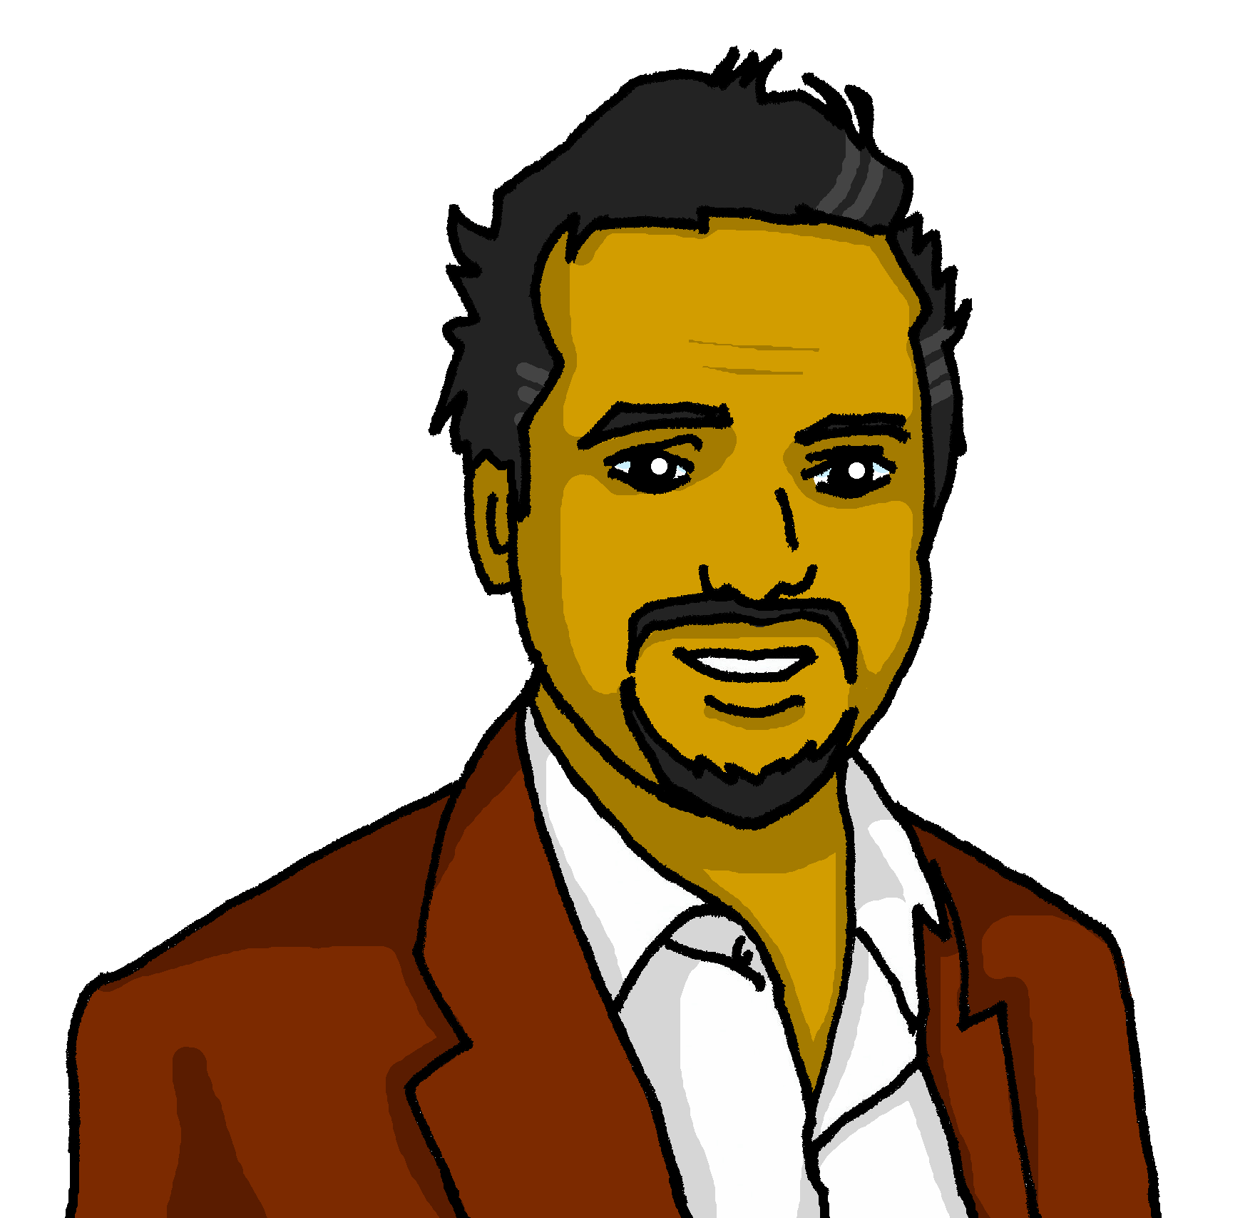
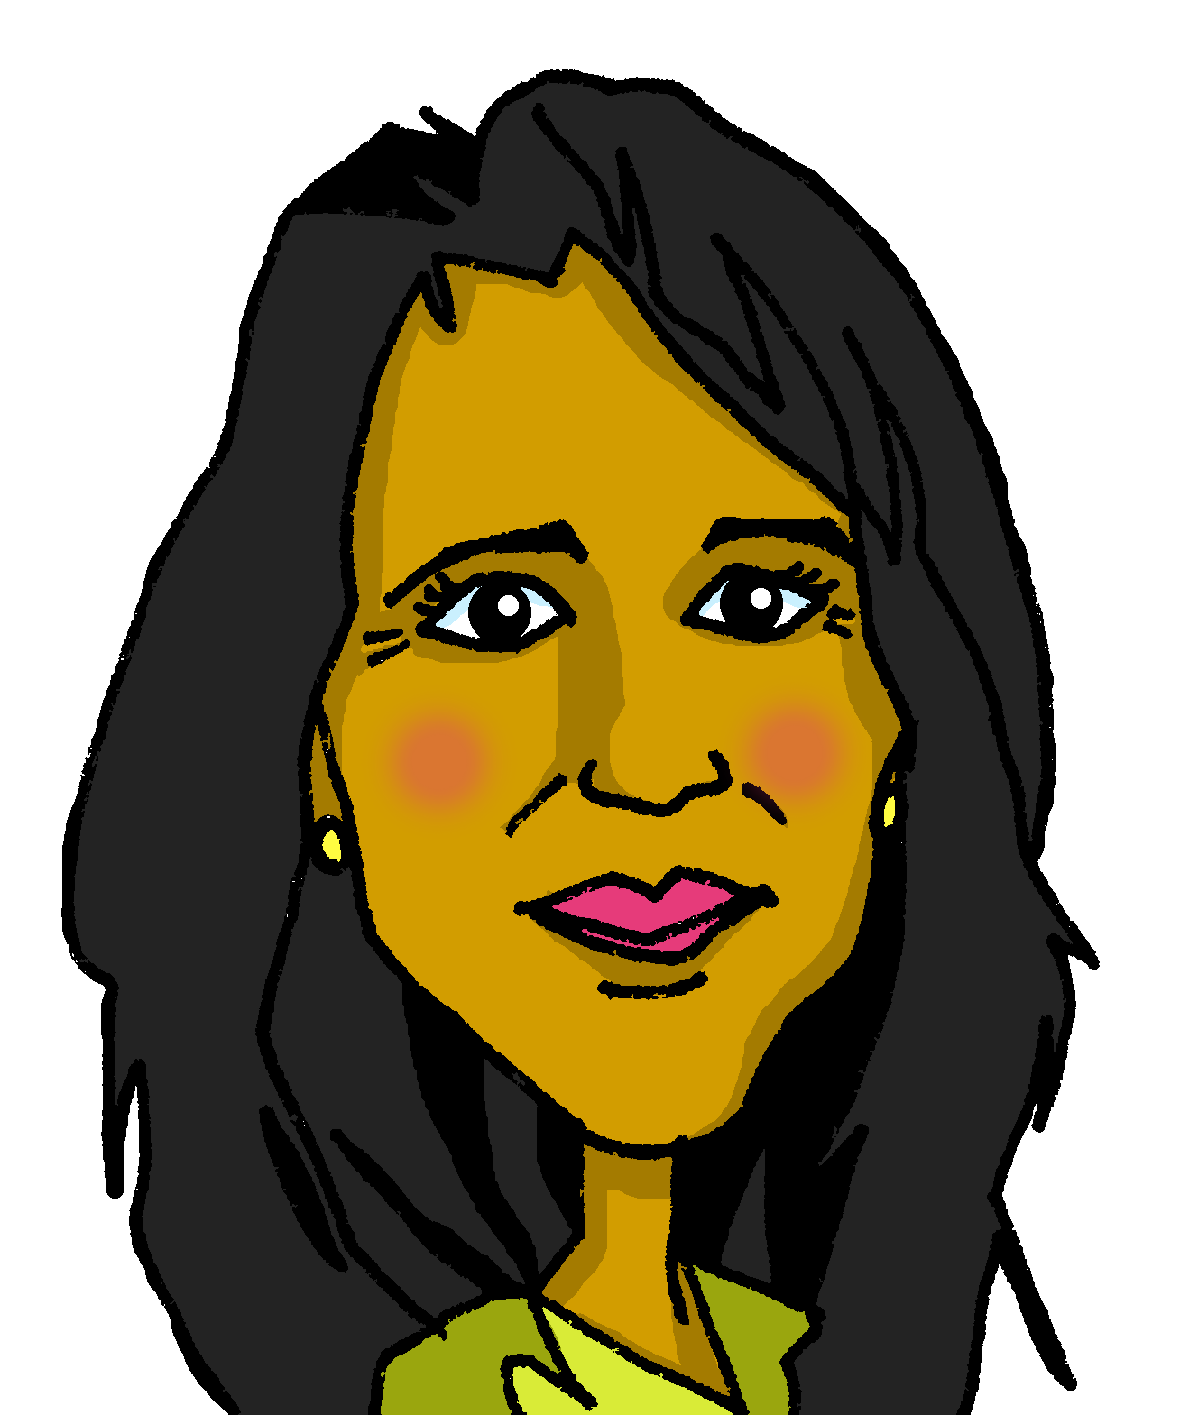
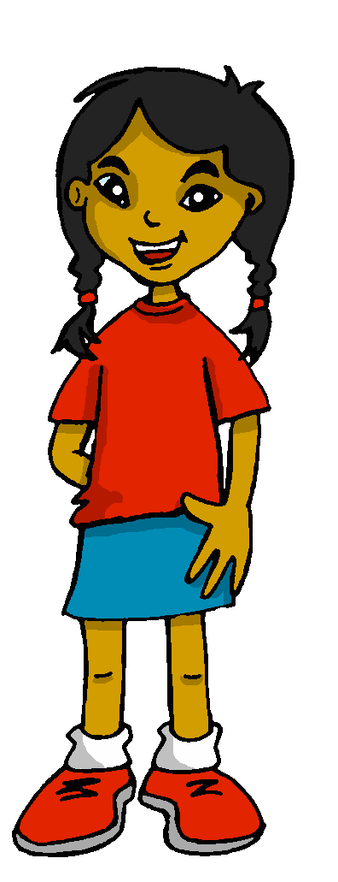

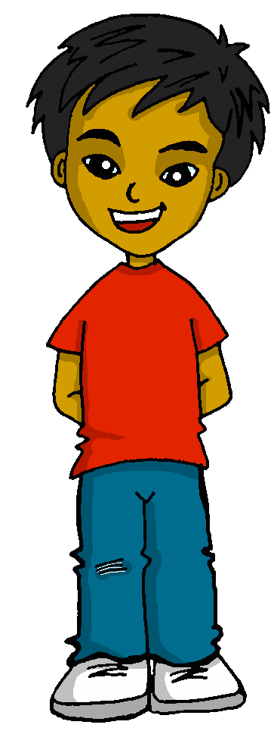
cultura
Los apellidos
Follow up 1
En España y Latinoamérica, las personas tienen dos apellidos.
Ejemplo: Quique Mamani Flores
The tradition in is for a child to take on the surname of their father and mother, usually in that order.
¿Cuál es el apellido de Pedro, el papá de Quique?
Notes:
Timing: 2 minutes
Aim: to introduce the tradition in Spain and Latin America for people to have two surnames, taking the surname of their father and their mother.
Procedure:
Click to present the information.
Ask pupils what they think of this idea.
2

Slide 3




pronunciar
Follow up 1
¿Dónde está el estrés?
¿Cuántas sílabas tiene?
Marca
 | número
1st | 2nd | 3rd
Escribe la palabra.
E
3
Amador
1
4
González
2
3
Zambrano
3
2
Quispe
4
3
Lúcida
5
2
López
Notes:
Timing: 5 minutes (two slides)
Aim: to develop pupil’s awareness of word stress with unknown words (Spanish surnames)
Procedure:
1. Teacher gives the instruction and clarifies ‘estrés’.
2. Pupils listen out for the number of syllables in each word (ensure they understand these are all unknown words for them).
3. Click to bring up answers.
4. Listen one more time to focus on where the stress falls in the word – some pupils may want to try to write the whole word.
5. Move onto the next slide.
E Amador
1 González
2 Zambrano
3 Quispe
4 Lúcida
5 López
3

Slide 4




Follow up 2a:
Escribe en inglés 📝: Can you get at least 15 points?
 | mandar | la tarjeta | especial
 | celebrar | común | la carrera
 | el bosque | el campo | a
 | vas | la playa | va
 | el centro | cerca | hago
 | la visita | hace | lejos
vocabulario
to send, sending
(the) card
special
x3
to celebrate, celebrating
common
(the) race
(the) forest
(the) countryside
to
x2
you (s) go
(the) beach
s/he, it goes
(the) centre
near (to)
I do, make
x1
(the) visit
s/he does, makes
far (from)
Notes:
Timing: 10 minutes (two slides)
Aim: to practise written comprehension (this slide) and production (next slide) of vocabulary from this week and this week’s revisited sets.
Procedure:
Give pupils a blank grid. They fill in the English meanings of any of the words they know, trying to reach 15 points in total.
Note:
The most recently learnt and practised words are pink, words from the first revisit are green and those from the second revisit are blue, thus more points are awarded for them, to recognise that memories fade and more effort (heavy lifting!) is needed to retrieve them.

Slide 5
follow up 2b:
Escribe en español 📝: Can you get at least 15 points?
 | common | to celebrate, celebrating | to send, sending
 | (the) race | (the) card | special
 | to | you go | (the) beach
 | s/he goes | (the) countryside | (the) forest
 | far (from) | s/he,it does, makes | (the) centre
 | (the) visit | near (to) | I do, make
común
celebrar
mandar
vocabulario
x3
la carrera
la tarjeta
especial
a
vas
la playa
x2
va
el campo
el bosque
lejos (de)
hace
el centro
x1
la visita
cerca (de)
hago
Notes:
Timing: 5 minutes
Aim: to practise written production of vocabulary from this week and this week’s revisited sets.
Procedure:
1. Give pupils a blank grid. They fill in the Spanish meanings of any of the words they know, trying to reach 15 points in total.
Note:
The most recently learnt and practised words are pink, words from the first revisit are green and those from the second revisit are blue, thus more points are awarded for them, to recognise that memories fade and more effort (heavy lifting!) is needed to retrieve them.

Slide 6





Making sentences negative
[negative ‘no’]
⚠
Remember that in English…
However, in Spanish…
I do a trip.
I don’t do a trip.
Hago un viaje.
No hago un viaje.
…we add don’t before the verb to make the sentence negative.
…add no before the verb and to make the sentence negative.
Notes:
Timing: 1 minute
Aim: Recap negation with single-verb structures and draw attention to differences between Spanish and English negation structure. (Pupils were introduced to this last term – T2 Week 7).
Procedure:
Click through the animations to present the information.
Elicit English translations for the French examples provided.

Slide 7




Follow up 3:
What do Quique and Sofía do during their visit?
Lee la lista de Quique. ¿Quién es? ¿La frase es positiva o negativa?
leer
Write ? if the activity isn’t mentioned.
1) …………………………………
2) …………………………………
3) …………………………………
4) …………………………………
5) …………………………………
6) …………………………………
7)………………………………….
8)………………………………….
Hago una actividad divertida.
Hace ejercicio en la habitación.
[I]
[she]
?
a visit
exercise
a card
noise
an activity
a race
things
1
No hago una visita del museo.
2
?
Hace una tarjeta para la abuela.
?
3
No hace una carrera por el parque.
?
4
No hace ruido por la mañana.
5
?
No hago cosas típicas con mamá.
6
7
?
Hago una carrera por el río.
Notes:
Timing: 5 minutes
Aim: to practise written comprehension of negative and 1st and 3rd person singular of ‘hacer’, together with vocabulary from this and previous weeks.
Note: the answers are not in the order of the text.
Procedure:
1. Pupils can write 1-6 and Quique (I) | Sofía (she) as two column headers.
2. Pupils read the sentences and tick if either or both characters do the activity, cross if they don’t and put ? if there is no mention of the activity for one or both of them.
3. For feedback of answers click to complete the table and to highlight the answer in the text itself.
4. Click the audio button to hear the full sentences, if desired.

Slide 8

Follow up 4:
Escucha. ¿Dónde hace qué?
escuchar
Sofía | Actividad | Where [1] | Where [2]
 |  | near (to) far (from) in
 |  | of near (to) far (from) in
 |  | near (to) in far (from)
[1]
do exercise
the park
🔉
make a sandwich
the room
[2]
do a visit
the church
🔉
do typical things
the river
[3]
activities
(historic) centre
🔉
deporte
the university
Notes:
Timing: 5 minutes
Aim: to practise aural comprehension of this week’s vocabulary (nouns with hacer, prepositions and places in town).
Procedure:
Pupils listen to each phrase.
Pupils note what Sofía says she does as well as any extra information they hear (where 1 and 2).
Click first to reveal what they do and then to reveal the extra information.
Transcript:
Por la mañana, hago ejercicio cerca del parque y hago un bocadillo en la habitación.
Luego hago una visita de la iglesia y también hago cosas típicas cerca del río.
Por la tarde hago actividades lejos del centro histórico. Hago deportes cerca de la universidad.

Slide 9

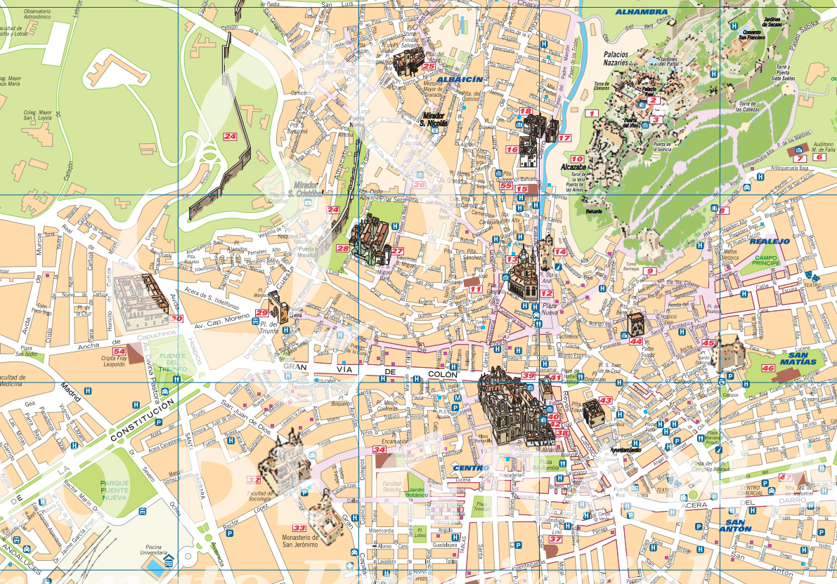


Follow up 5
Remember you can make your sentences negative, too.
Escribe 5 mensajes.
Vas a Granada. ¿Qué haces?
escribir
[I do / make]
Palacio de la Alhambra
del with masculine nouns
de la with feminine nouns
🌊 r _ _ Genil
[a visit]
[exercise]
[a sandwich]
[a card]
[things]
[a race]
[an activity]
[noise]
⛪ [ig_ _ _ _ _ ] de San Pedro y San Pablo
near [to]
far [from]
[m_ s_ _] San Juan de Dios
[church]
[park]
[museum]
[swimming pool]
[square]
[river]
[centre]
[countryside]
Mercado La Alcacería
🌳 [P_ _ q_ _] Fuente Nueva
C_ _ t_ _ histórico
🎭 [t_ _t_ _ ] Isabel la Católica
🎓 [u_ _ _ v_ _ s_ _ _d ] de Granada
Ejemplo: Hago una carrera cerca del río Genil
Notes:
Timing: 5-10 minutes
Aim: to practise written production affirmative / negative sentences with 1st person of hacer, and vocabulary from this week.
Procedure:
Pupils to write 5 sentences to plan their visit to Granada.
Click through animations to bring up each part they should include in their sentence, including the reminder of the contraction del/de la.
Click to bring up the example.

Slide 10
¡adiós!
verde

Slide 11
Handout: Follow up 2a
Escribe en inglés 📝: Can you get at least 15 points?
 | mandar | la tarjeta | especial
 | celebrar | común | la carrera
 | el bosque | el campo | a
 | vas | la playa | va
 | el centro | cerca | hago
 | la visita | hace | lejos
 | mandar | la tarjeta | especial
vocabulario
x3
x2
x1
Notes:
HANDOUT

Slide 12
Handout: Follow up 2b
Escribe en español 📝: Can you get at least 15 points?
 | common | to celebrate, celebrating | to send, sending
 | (the) race | (the) card | special
 | to | you go | (the) beach
 | s/he goes | (the) countryside | (the) forest
 | far (from) | s/he,it does, makes | (the) centre
 | (the) visit | near (to) | I do, make
vocabulario
x3
x2
x1
Notes:
HANDOUT

