Slide 1
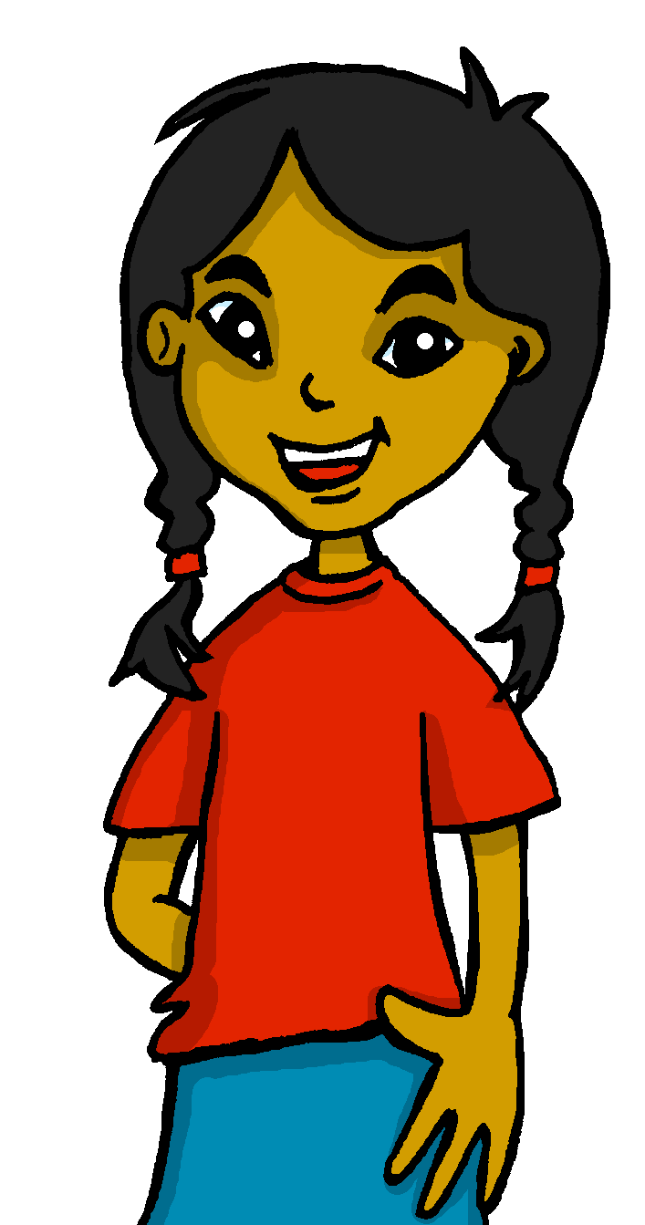
español, con Sofía

Slide 2
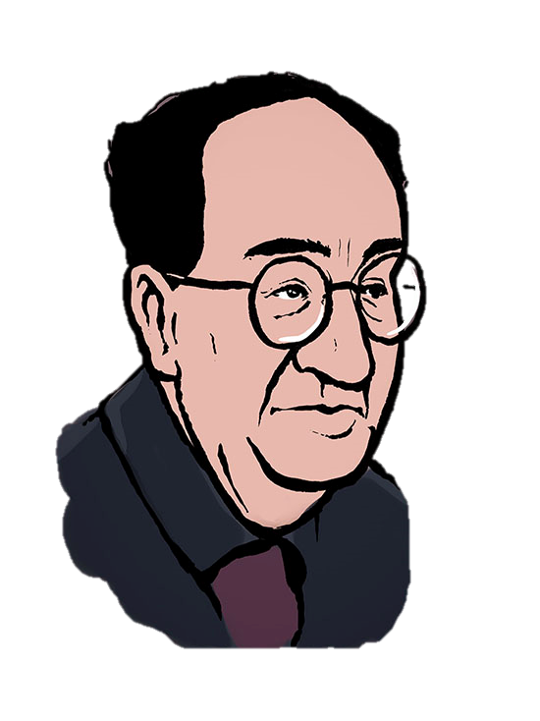
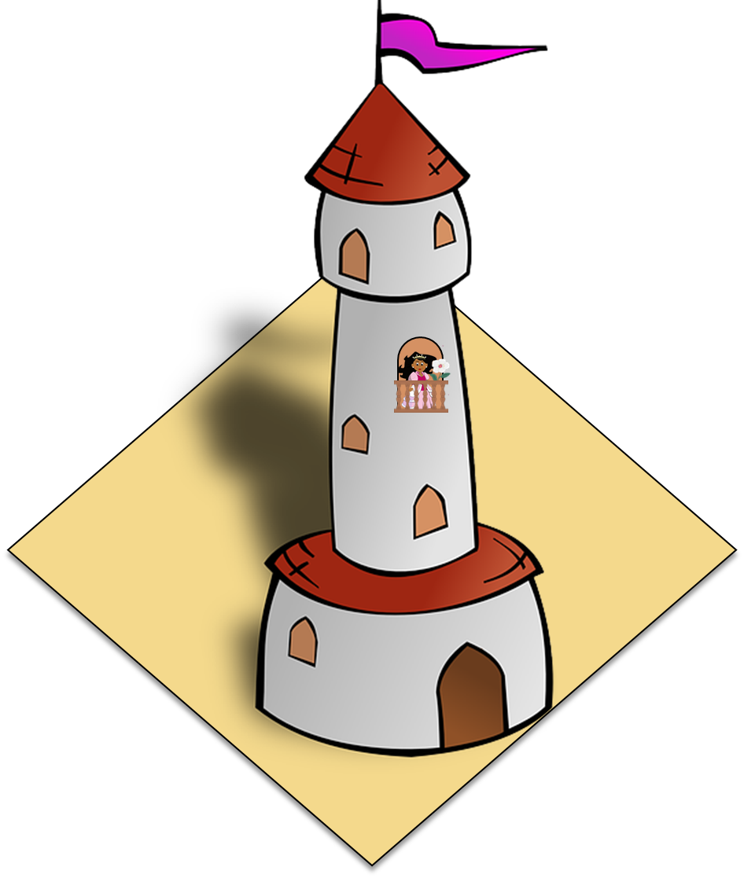
La plaza tiene una torre
Antonio Machado
verde
Notes:
Artwork by Steve Clarke. All additional pictures selected are available under a Creative Commons license, no attribution required.
The frequency rankings for words that occur in this PowerPoint which have been previously introduced in the resources are given in the SOW (excel document) and in the resources that first introduced and formally re-visited those words.
Phonics: SSC revision 3
Vocabulary (new words in bold): N/A
Revisit 1: persona [108] gente [137] dinero [364] tráfico [>5000]
Revisit 2: primo [1451] voy [ir 33] vas [ir 33] va [ir 33] estoy [estar 21] está [estar 21] estás [estar 21] calle [269] cine [952] estadio [2581] parque [1354] playa [1475] plaza [806] teatro [605] a [8] el [1] la [1]
Frequency of unknown words and cognates:
ha (haber) [13] balcón [3133] caballero [2056] torre [2138] voz [252] alegre [2081]
Source: Davies, M. & Davies, K. (2018). A frequency dictionary of Spanish: Core vocabulary for learners (2nd ed.). Routledge: London
For any other words that occur incidentally in this PowerPoint, frequency rankings will be provided in the notes field wherever possible.

Slide 3
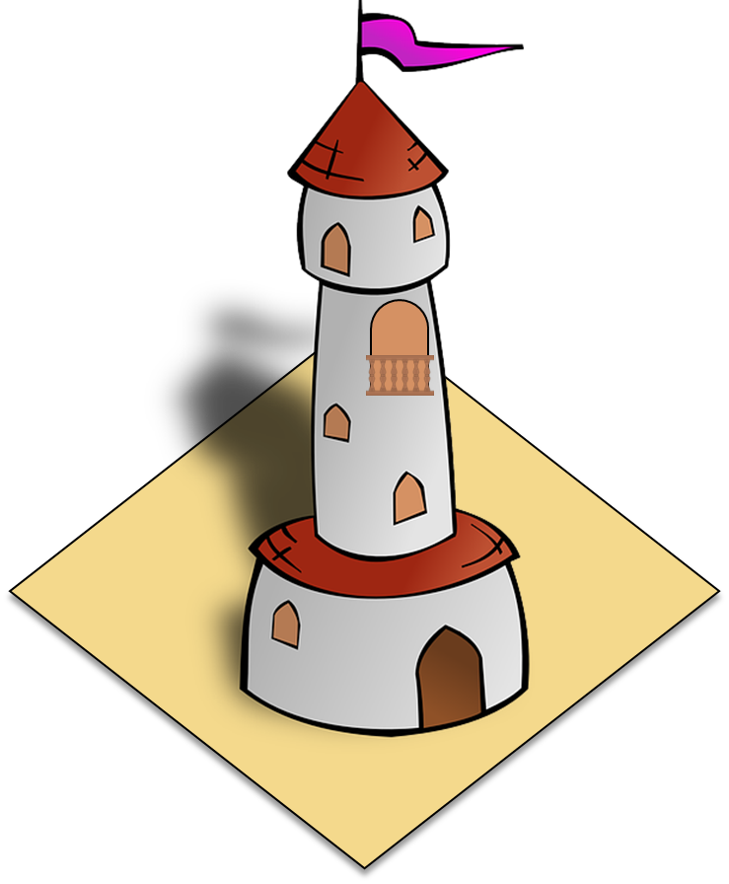
leer
Lee. ¿Qué artículo es?
hablar
La plaza tiene ____ torre, ____ torre tiene un balcón,
una
[15 segundos]
[a - fem.]
la
[the – fem. ]
INICIO
Notes:
Timing: 5 minutes (five slides 3-7)
Aim: Recap of meaning of definite and indefinite articles.
Procedure:
Teachers draw out and make explicit the difference in meaning between the definite and indefinite article ‘la’ and ‘una’, eliciting an English translation of each of the lines from this and the next two slides. Answers are revealed by clicking.
Repeat the procedure on slides 5 and 6.
An active choice between the definite and indefinite articles is needed in each instance. We have separated parts of the poem to ask for a choice between definite and indefinite (rather than between masculine and feminine) so that pupils only have to focus on article usage.

Slide 4
leer
Lee. ¿Qué artículo es?
hablar
La torre tiene ___ balcón, ___ balcón tiene una dama,
un
[15 segundos]
[a - masc.]
el
[the – masc. ]
INICIO
Notes:
[2/5]

Slide 5
leer
Lee. ¿Qué artículo es?
hablar
el balcón tiene ____ dama, ____ dama una blanca flor.
una
[15 segundos]
[a - fem.]
la
[the – fem. ]
INICIO
Notes:
[3/5]

Slide 6
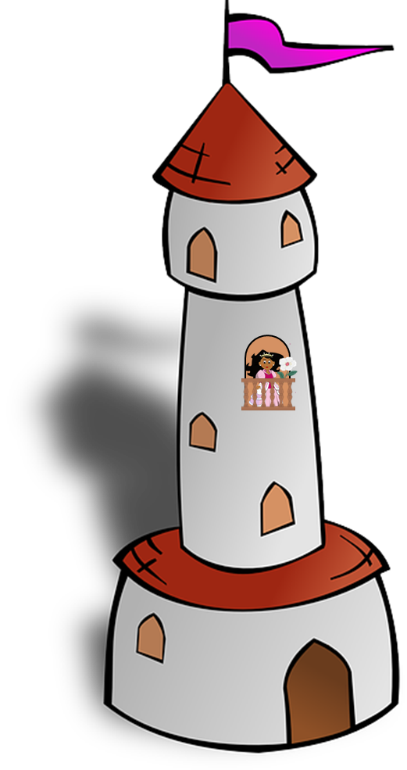
leer
Lee. ¿Qué artículo es?
hablar
ha pasado _____ caballero
y se ha llevado ____ plaza,
un
[15 segundos]
[a - masc.]
la
[the – fem. ]
ha pasado – has passed
se ha llevado – has taken
INICIO
Notes:
[4/5]

Slide 7
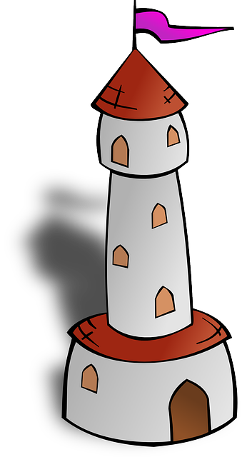
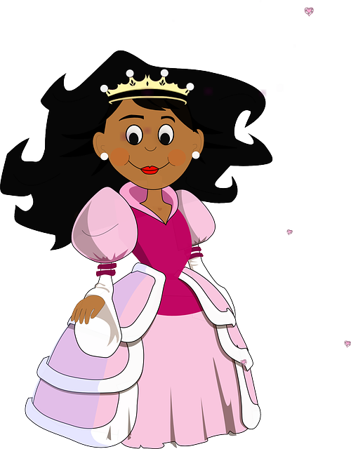
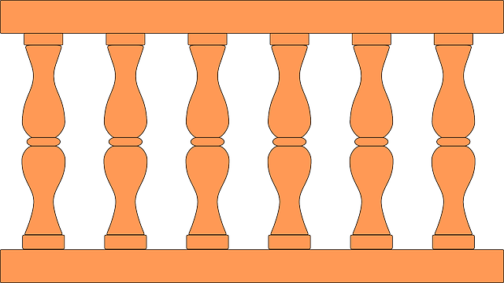
leer
Lee. ¿Qué artículo es?
con _____ torre y _____ balcón,
con _____ dama y _____ flor.
hablar
la
el
[15 segundos]
[the - fem.]
[the - masc.]
la
la
[the – fem..]
[the – fem.]
ha pasado – has passed
se ha llevado – has taken
INICIO
Notes:
[5/5]

Slide 8
leer
Con tu compañero/a, lee
hablar
un h_ _ _ _
a hotel
un hotel
Hay una p_____ , una t____ y…
un e_ t _ d_ _
a stadium
[15]
laza
un estadio
orre
un teatro
a theatre
un t_ _ _ _ _
un p_ _ _ _ _. Está c_ _ _
un puente. Está cerca.
a bridge. It’s near.
un museo
un m_ _ _ _
a museum
una u_ _ v_ _ s_ _ _d
una universidad
a university
una iglesia
a church
una i_ _ _ _ _ _
una e_ _ _ _ _ _. Está l_ _ _ s.
una escuela. Está lejos.
a school. It’s far.
INICIO
Notes:
Timing: 5 minutes
Aim: to practise spoken recall of previously taught vocabulary [places in town].
Procedure:
Teachers ask pupils for the missing words. A choral response can be sought, or teachers could ask pupils to work in pairs first to remember the vocabulary.
Teachers click to reveal the answers.
Additional practice can be done by encouraging pupils to challenge each other to see who can say the longest sentence in 15 seconds using ‘y’ and ‘y también’.

Slide 9
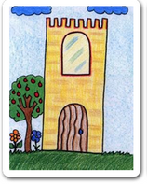
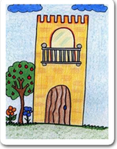
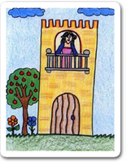
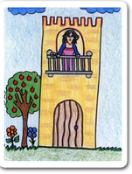
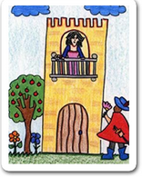
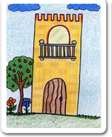
leer
Ordena los dibujos.
1
e
2
a
3
b
[1] La p______ tiene u__ t____e, [2] l__ t____e tiene u__ b____n, [3] e_ b_____ tiene u__ d___,
[4] l__ d____ u__ blanca f___. [5] ha pasado un caballero [6] y se ha llevado l__ p____, [7] con su t____ y su b_____, [8] con su d_____ y su b__ f__.
4
d
5
c
6
f
hablar
7
a
8
d
a
b
c
d
e
f
Notes:
Timing: 5 minutes
Aim: to practise written recall and comprehension of the poem’s meaning with only partial written prompts.
Procedure: 1. Pupils read each line and identify the matching picture, writing 1-8 and a-f. 2. Click to reveal the answers.
3. Teachers may try to elicit the full lines of the poem from pupils as they proceed.
4. Click on the audio buttons as required to hear each line of the poem spoken.

Slide 10
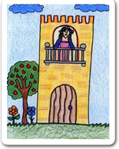
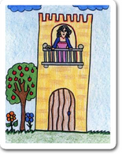
escribir
Practica el poema. ¡De memoria!
__ ______ tiene ____ ____, __ _____ tiene ___ _______, __ ______ tiene ____ ______, __ _____ ____ blanca ____. ha pasado un caballero y se ha llevado __ _____, con su _____ y su ________, con su _______ y su _______
su _______ y su _______ ___.
escribir
Notes:
Timing: 8 minutes (two slides)
Aim: Writing exercise using pictures to practise articles and nouns.
Procedure:
1. Pupils complete the text with both definite and indefinite articles, plus the nouns. 2. Move to the next slide to elicit answers and provide feedback.
Image attribution: Images by Colegio de Educación Infantil y Primaria Vista Alegre
Licensed under CC BY-SA 4.0
http://literaturalunalunera.blogspot.com/2014/03/la-plaza-tiene-una-torre.html

Slide 11
respuestas
Las respuestas
__ ______ tiene ____ ____, __ _____ tiene ___ _______, __ ______ tiene ____ ______, __ _____ ____ blanca ____. ha pasado un caballero y se ha llevado __ _____, con su _____ y su ________, con su _______ y su _______
su _______ y su _______ ___.
La plaza
una torre
hablar
la torre
un balcón
el balcón
una dama
escribir
La dama una
flor
la plaza
torre
balcón
balcón
dama
dama
blanca flor
Notes:
Procedure: Elicit pupil responses chorally and click to confirm the answers at the end of each line (so that pupils can retain the rhythm of the poem, saying each line of it at a time).

Slide 12
¡adiós!
verde

