Slide 1
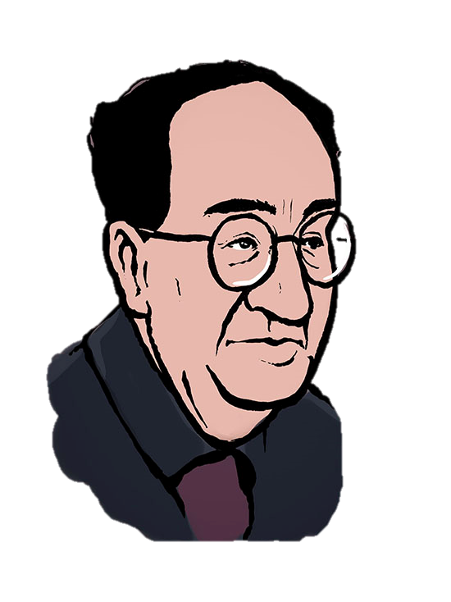
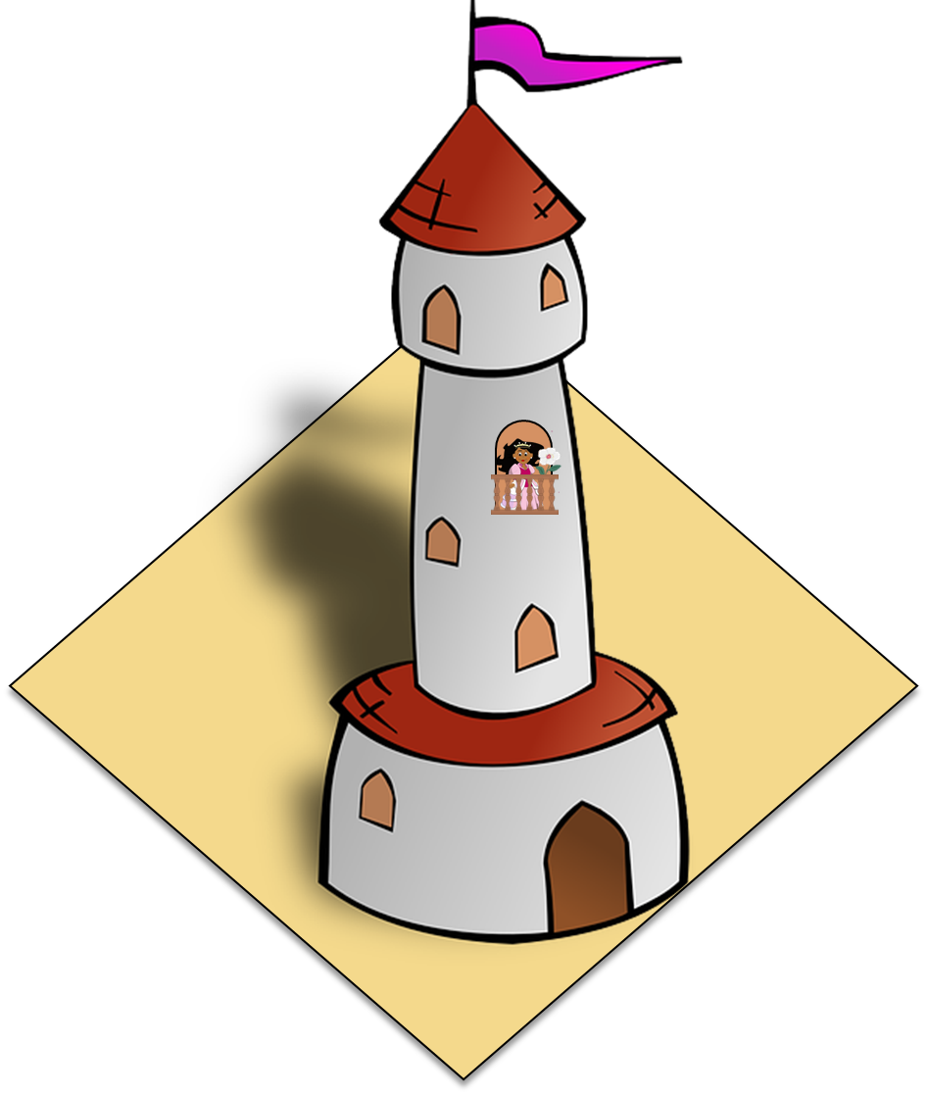
Saying what I and others like/dislike, and have to do
Antonio Machado
verde
Follow ups 1-5
Notes:
Artwork by Steve Clarke. All additional pictures selected are available under a Creative Commons license, no attribution required.
The frequency rankings for words that occur in this PowerPoint which have been previously introduced in the resources are given in the SOW (excel document) and in the resources that first introduced and formally re-visited those words.
Phonics: SSC revision 3
Vocabulary (new words in bold): N/A
Revisit 1: persona [108] gente [137] dinero [364] tráfico [>5000]
Revisit 2: primo [1451] voy [ir 33] vas [ir 33] va [ir 33] estoy [estar 21] está [estar 21] estás [estar 21] calle [269] cine [952] estadio [2581] parque [1354] playa [1475] plaza [806] teatro [605] a [8] el [1] la [1]
Frequency of unknown words and cognates:
ha (haber) [13] viajar [902] balcón [3133] biografía [4236] caballero [2056] interés [388] memoria [827] reflexión [1909] romance [4541] torre [2138] voz [252] alegre [2081]
Source: Davies, M. & Davies, K. (2018). A frequency dictionary of Spanish: Core vocabulary for learners (2nd ed.). Routledge: London
For any other words that occur incidentally in this PowerPoint, frequency rankings will be provided in the notes field wherever possible.
Frequency of unknown words:
empezar [175] encuesta [2077] sobre [62] Source: Davies, M. & Davies, K. (2018). A frequency dictionary of Spanish: Core vocabulary for learners (2nd ed.). Routledge: London
For any other words that occur incidentally in this PowerPoint, frequency rankings will be provided in the notes field wherever possible.

Slide 2
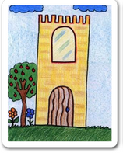
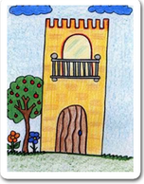
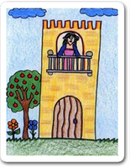
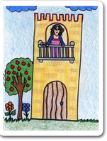
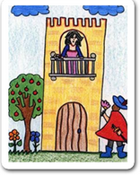
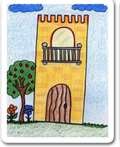
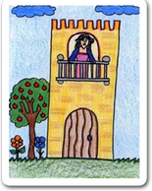
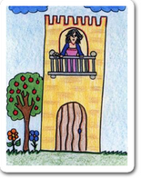
hablar
Practica el poema. ¡De memoria!
hablar
__ ______ tiene ____ ____, __ _____ tiene ___ _______, __ ______ tiene ____ ______, __ _____ ____ blanca ____. ha pasado un caballero y se ha llevado __ _____, con su _____ y su ________, con su _______ y su _______
su _______ y su _______ ___.
Notes:
Timing: 5 minutes (two slides – slides 2 and 4)
Aim: to practise spoken recall of the poems’s articles and nouns, and pronunciation of the full poem.
NB. There is an alternative task with more support. This could be done instead of this task or before this task (next slide).
Procedure:
1. Pupils do a choral read aloud, aided by the picture prompts. 2. Move to slide 4 for the answers and a further opportunity for read aloud.
Image attribution: Images by Colegio de Educación Infantil y Primaria Vista Alegre
Licensed under CC BY-SA 4.0
http://literaturalunalunera.blogspot.com/2014/03/la-plaza-tiene-una-torre.html

Slide 3
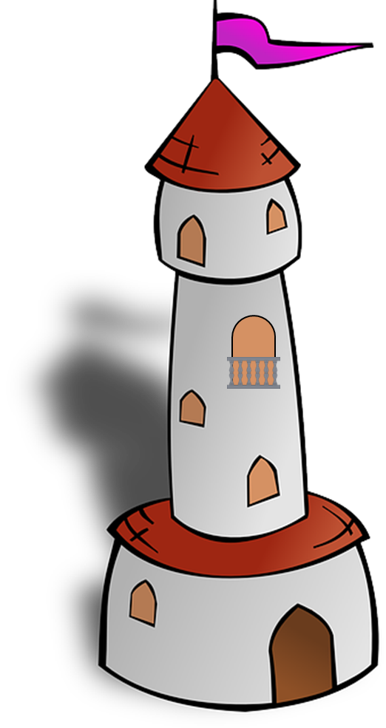
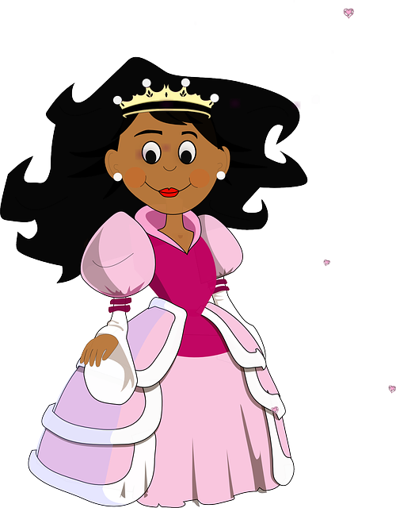
hablar
Practica el poema. ¡De memoria!
hablar
__ ______ tiene ____ ____, __ _____ tiene ___ _______, __ ______ tiene ____ ______, __ _____ ____ blanca ____. ha pasado un caballero y se ha llevado __ _____, con su _____ y su ________, con su _______ y su _______
su _______ y su _______ ___.
t _ r _ _
p _ _ z _
b _ _ c _ _
d _ _ _
f _ _ _
Notes:
Timing: 5 minutes (two slides, slides 3 and 4)
Aim: to practise spoken recall, using pictures to prompt retrieval of articles and nouns.
Procedure:
1. Pupils do a choral read aloud, aided by the picture prompts. 2. Move to the next slide for the answers and a further opportunity for read aloud.
Image attribution: Images by Colegio de Educación Infantil y Primaria Vista Alegre
Licensed under CC BY-SA 4.0
http://literaturalunalunera.blogspot.com/2014/03/la-plaza-tiene-una-torre.html

Slide 4
respuestas
Las respuestas
__ ______ tiene ____ ____, __ _____ tiene ___ _______, __ ______ tiene ____ ______, __ _____ ____ blanca ____. ha pasado un caballero y se ha llevado __ _____, con su _____ y su ________, con su _______ y su _______
su _______ y su _______ ___.
La plaza
una torre
hablar
la torre
un balcón
el balcón
una dama
escribir
La dama una
flor
la plaza
torre
balcón
balcón
dama
dama
blanca flor
Notes:
Procedure:
Pupils do a choral read aloud, prompted for each line by the animated images.

Slide 5
escribir
Escribe tu propio poema.
propio = own
escribir
La plaza tiene una torre, la torre tiene un balcón,
el balcón tiene una dama, la dama una blanca flor.
ha pasado un caballero
y se ha llevado la plaza, con su torre y su balcón,
con su balcón y su dama, su dama y su blanca flor.
personas | lugares | objetos | animales
amigo/a profesor/a madre padre persona abuelo/a niño/a | iglesia museo edificio escuela piscina hotel puente estadio restaurante isla bosque | barco guitarra árbol vestido libro | conejo gato caballo perro
Notes:
Timing: 5 minutes
Aim: to write their own version of the poem.
Procedure:
1. Pupils to write their own poem with the same structure / style.
There are easy and more challenging ways to do these variations on a theme. E.g. OR Choose two or three nouns (la plaza / torre / balcón)
OR Change everything except the essential structure
They can either…
use the list provided and/or a Knowledge Organiser.
OR
Use a dictionary to look up their own nouns
NB. This could be done as a collaborative writing exercise.
See next slide for more ideas.
propio [183]

Slide 6
escribir
Un ejemplo de una versión adaptada.
propio = own
escribir
Notes:
https://www.youtube.com/watch?v=VpvQxBlKDRc
Additional material that teachers could exploit to work with ‘La plaza tiene una torre’.

Slide 7
¡adiós!
verde

