Slide 1
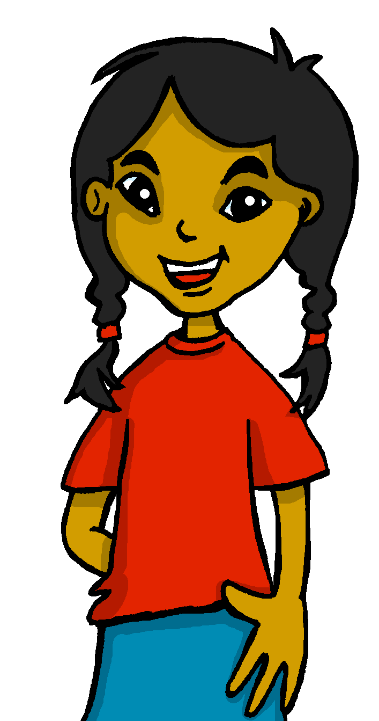
español, con Sofía

Slide 2
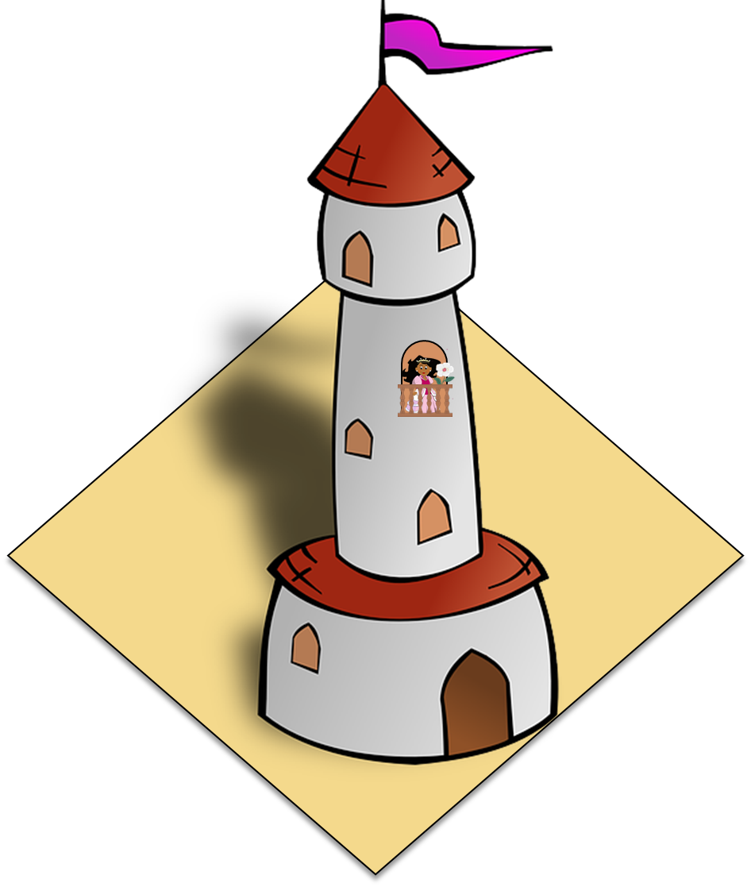
La plaza tiene una torre
Antonio Machado
verde
Notes:
Artwork by Steve Clarke. All additional pictures selected are available under a Creative Commons license, no attribution required.
The frequency rankings for words that occur in this PowerPoint which have been previously introduced in the resources are given in the SOW (excel document) and in the resources that first introduced and formally re-visited those words.
Phonics: SSC revision 3
Vocabulary (new words in bold): N/A
Revisit 1: persona [108] gente [137] dinero [364] tráfico [>5000]
Revisit 2: primo [1451] voy [ir 33] vas [ir 33] va [ir 33] estoy [estar 21] está [estar 21] estás [estar 21] calle [269] cine [952] estadio [2581] parque [1354] playa [1475] plaza [806] teatro [605] a [8] el [1] la [1]
Frequency of unknown words and cognates:
ha (haber) [13] balcón [3133] caballero [2056] torre [2138] voz [252] alegre [2081]
Source: Davies, M. & Davies, K. (2018). A frequency dictionary of Spanish: Core vocabulary for learners (2nd ed.). Routledge: London
For any other words that occur incidentally in this PowerPoint, frequency rankings will be provided in the notes field wherever possible.

Slide 3
pronunciar
Escucha. ¿Qué sonido(s) tienen las palabras?
SSC Repaso
(el) sonido – sound
pronunciar
[ca]
[co]
[h]
[ll]
[z]
[rr]
2 caballero
1 balcón
3 ha
2 caballero
4 plaza
5 torre
[1 minuto]
6 blanca
1
2
3
4
5
6
INICIO
Notes:
Timing: 4 minutes
Aim: to revisit some (terms 1-3) SSC [rr], [z], [ll], [ca], [co], [h].
Procedure:
Read the instruction in Spanish and clarify the meaning of ‘sonido’.
Ask pupils to write [rr], [z], [ll], [ca], [co], [h] and tell the the need to identify the key sound (or sounds) for each number.
NB. Only number 2 contains two of the sounds listed.
3. Click 1-6 to listen to the words.
4. Click to bring up answers.
5. Ask them to volunteer examples of other words they know which contain these SSCs. For example, you could also ask them to find an example of RR (torre). What other words can they think of that have this SSC? (Inglaterra, correcto ☺).
6. Click ‘inicio’ and ask them to work in pairs to a) pronounce the words and b) think of any other examples from their active vocabulary. This would also be a good opportunity to use the knowledge organisers.
Transcript: balcón caballero ha plaza torre blanca
Frequency of unknown words and cognates:
caballero [2056] balcón [3133] ha (haber) [13] torre [2138]
Source: Davies, M. & Davies, K. (2018). A frequency dictionary of Spanish: Core vocabulary for learners (2nd ed.). Routledge: London

Slide 4
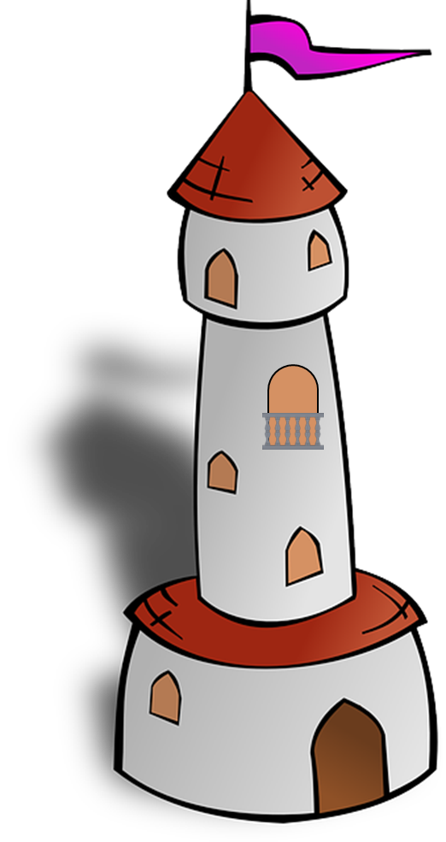
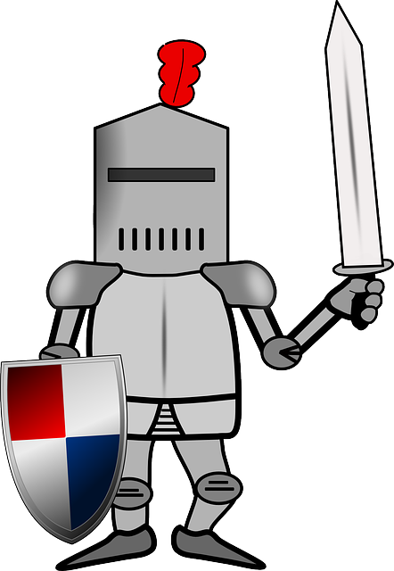
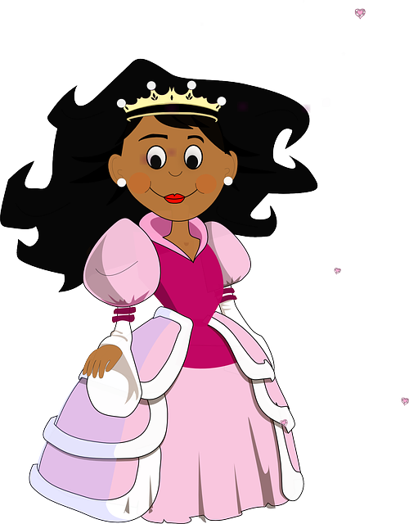
vocabulario
¿Qué palabra es?
l
z
a
a
p
l
a
e
l
b
a
c
ó
n
l
c
l
e
a
f
l
o
r
a
l
a
d
a
m
a
d
r
e
l
c
a
b
a
e
o
l
l
f
b
Un caballero es una persona que monta a caballo. 😉
Notes:
Timing: 4 minutes
Aim: to introduce vocabulary from with the poem.
Procedure: 1. words will appear letter by letter. Click for the first letter to appear. After that the rest of the word will appear automatically.
2. Pupils say the word out loud when they know which number it is and give the translation.
3. When the whole word has appeared click to show the correct picture. 4. If desired, click on the picture to hear the Spanish word.

Slide 5
leer
Lee el texto. ¿Qué es?
¿Es…
La plaza tiene una torre,
la torre tiene un balcón,
un artículo de una revista
una canción
una novela
un poema
una ecuación $(A=πr^{2}$)
El balcón tiene una dama,
La dama una blanca flor…
?
A
B
Es una ecuación.
¡Imposible!
Es una cancion.
¡Reacciona! 😃
Notes:
Timing: 2 minutes
Aim: Introductory slide to challenging text that is the focus of this lesson for pupils to anticipate what they might be about to work on.
Procedure:
Read the instruction.
Click to bring the question and types of texts.
Ask pupils to read aloud the first four lines of the text and then identify its type. ‘Artículo’, ‘novela’, ‘poema’ and ‘ecuación’ haven’t been taught in the scheme of work but should be recognisable as cognates.
Click to bring further instruction and model the interaction between pupils (speech bubbles A and B).
Teachers could prompt certain reasons why they may suggest a poem: frases cortas, repetición.
Frequency of unknown words and cognates:
artículo [458] novela [735] poema [1430] ecuación [4842]
Source: Davies, M. & Davies, K. (2018). A frequency dictionary of Spanish: Core vocabulary for learners (2nd ed.). Routledge: London

Slide 6
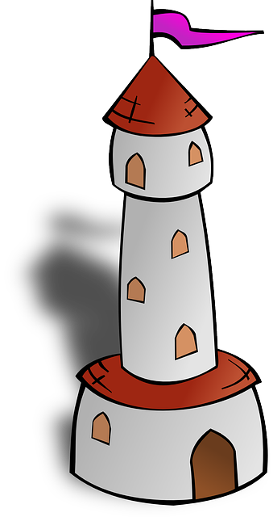
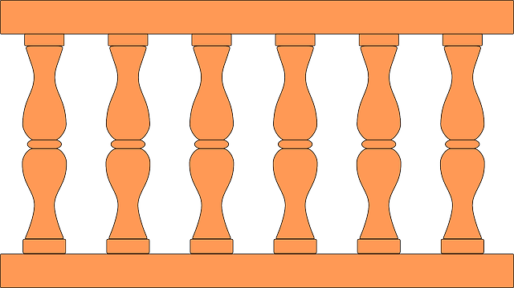
leer
Lee el texto. ¿Qué es?
La plaza tiene una torre,
la torre tiene un balcón,
El balcón tiene una dama,
La dama una blanca flor…
Notes:
Timing: 1 minute
Aim: slide to remind pupils of the use of ‘tiene’ . This begins to foster an approach to challenging texts of searching for words that are familiar.
Procedure:
1. Teachers elicit from pupils the meaning of ‘tiene’, which they first learnt in Term 1 of Y3/4 week 8. Since it was introduced, there have been several opportunities to revisit parts of ‘TENER’ in the scheme of work.
2. Teachers ask pupils why they think ‘tiene’ is missing from line 4 of the poem (i.e. to maintain the rhythm/flow), and where it would have gone, if the writer had included it.
Notes Images are animated to support the meaning.

Slide 7
escuchar
Escucha. Organiza las 5 partes del poema.
La plaza tiene una torre, la torre tiene un balcón,
A
Order
Part
el balcón tiene una dama, la dama una blanca flor.
#1
C
B
#2
E
ha pasado un caballero -¡ quién sabe por qué pasó !-,
A
C
#3
#4
D
y se ha llevado la plaza, con su torre y su balcón,
D
#5
B
con su balcón y su dama,
su dama y su blanca flor.
E
Ahora busca el vocabulario 🔎
s/he has taken
he passed
s/he knows
his/her
s/he has passed
who
why
ha llevado
quién
por qué
pasó
sabe
su
ha pasado
Notes:
Timing: 7 minutes
Aim: listening activity to help pupils recognise SSCs and words.
Procedure:
Give pupils 2-3 minutes to practise the poem in full.
Next teachers click on the number buttons to play fragments of the poem. Pupils listen and write down the letter that the fragment corresponds to.
The answers can be checked item by item by clicking. This makes it less difficult than listening to all 5 parts and then checking answers.
Click to bring further instruction and bring up English words.
Give pupils 2-3 minutes with a partner to find the Spanish meanings for the seven English words.
Elicit Spanish responses chorally, prompting with the English, e.g., ‘who?’ ‘quién’, muy bien. ☺ Note: click on each English word to reveal the Spanish translation.
Transcript: 1. ha pasado un caballero -¡ quién sabe por qué pasó !-,
2. con su balcón y su dama,
su dama y su blanca flor.
3. La plaza tiene una torre, la torre tiene un balcón,
4. y se ha llevado la plaza, con su torre y su balcón,
5. el balcón tiene una dama, la dama una blanca flor.
Frequency of unknown words and cognates:
Organizar [1053]
Source: Davies, M. & Davies, K. (2018). A frequency dictionary of Spanish: Core vocabulary for learners (2nd ed.). Routledge: London

Slide 8
leer
Lee el poema. Escribe la letra en la tabla.
La plaza tiene una torre, la torre tiene un balcón,
A
What the pair of lines describes
el balcón tiene una dama, la dama una blanca flor.
B
Tells us that a man goes past
C
Tells us who is on the balcony
B
ha pasado un caballero -¡ quién sabe por qué pasó !-,
C
Tells us what happens as the man goes past.
D, E
y se ha llevado la plaza, con su torre y su balcón,
Tells us what the square has.
A
D
con su balcón y su dama, su dama y su blanca flor.
E
Notes:
Timing: 3 minutes
Aim: reading activity to begin to think more closely about the meaning of each couplet of the poem
Procedure:
Teachers click to reveal a couplet of the poem out of order. Pupils fill in the table with the letters of the couplet.
Answers are shown by clicking.
Notes:
The poem appears out of order so that pupils think more carefully about the meaning of different parts of the poem. This way, they can’t simply rely on a predictable order of events to complete the task.

Slide 9
leer
Con tu compañero/a, lee.
La plaza tiene una torre, la torre tiene un balcón,
el balcón tiene una dama, la dama una blanca flor.
ha pasado un caballero -¡ quién sabe por qué pasó !-,
y se ha llevado la plaza, con su torre y su balcón,
con su balcón y su dama, su dama y su blanca flor.
hablar
con voz alegre 😊
con voz triste 🙁
lento 🐌
[1 minuto]
rápido 🌠
en voz baja 🤫
con voz de abeja 🐝
(la) voz – voice
alegre – happy, lively
en voz baja - quietly
INICIO
Notes:
Timing: 5 minutes
Aim: to practise read aloud of new and known language, including different tones of voice.
Procedure:
Read the instruction and bring up the first animation: ‘con voz alegre’.
Pupils read the poem together (alternating lines) with each of the tones prompted (happy, sad, slow, fast, quietly, with a buzzing ‘bee’ voice).
NB. Teachers can set the parameters for this activity according to the time available. For example:
Teachers clarify the meaning of each tone and allow pupils to practise in pairs choosing one, two or three different tones.
Teachers allocate time (e.g., 1 minute) to practise each tone individually.
Teachers can allocate time to practise each of the different tones, and then allow pupils to take turns to read the text to each other. This time the speaker decides the tone in which they will narrate the poem. The partner listens and then asks the partner, e.g., ‘¿Estás feliz / alegre?’. Remind pupils of the need to use ‘estás’ to speak directly to ‘you’ (singular). ¿Eres una abeja? (This time ‘ser’ as they are asking about a permanent trait!).
Frequency of unknown words and cognates:
voz [252] alegre [2081]
Source: Davies, M. & Davies, K. (2018). A frequency dictionary of Spanish: Core vocabulary for learners (2nd ed.). Routledge: London

Slide 10
¡adiós!
verde

