Slide 1
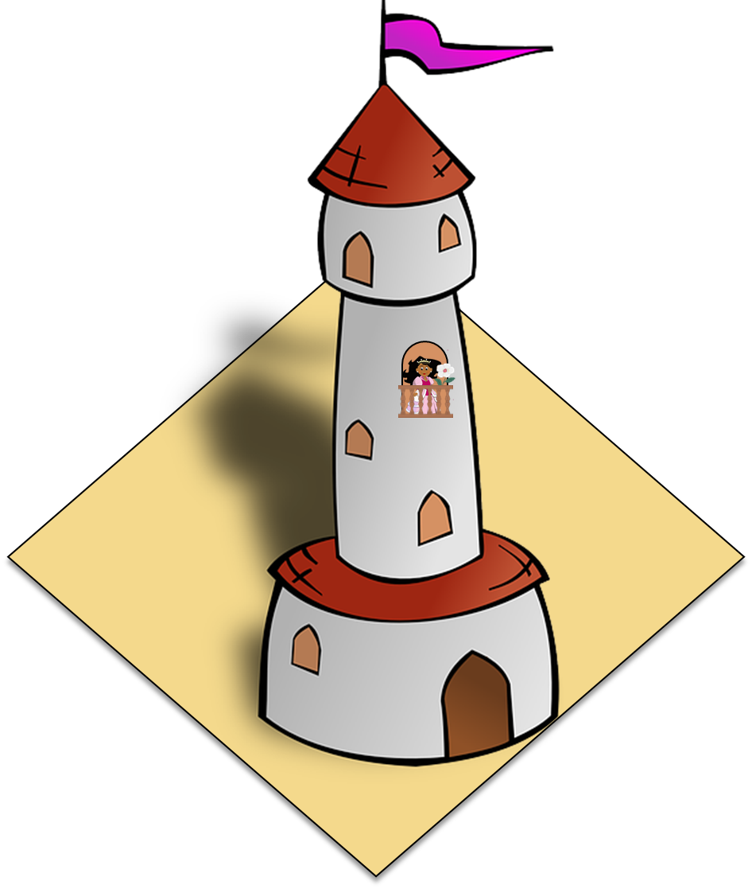
Saying what I and others like/dislike, and have to do
Antonio Machado
verde
Follow ups 1-5
Notes:
Artwork by Steve Clarke. All additional pictures selected are available under a Creative Commons license, no attribution required.
The frequency rankings for words that occur in this PowerPoint which have been previously introduced in the resources are given in the SOW (excel document) and in the resources that first introduced and formally re-visited those words.
Phonics: SSC revision 3
Vocabulary (new words in bold): N/A
Revisit 1: persona [108] gente [137] dinero [364] tráfico [>5000]
Revisit 2: primo [1451] voy [ir 33] vas [ir 33] va [ir 33] estoy [estar 21] está [estar 21] estás [estar 21] calle [269] cine [952] estadio [2581] parque [1354] playa [1475] plaza [806] teatro [605] a [8] el [1] la [1]
Frequency of unknown words and cognates:
ha (haber) [13] viajar [902] balcón [3133] biografía [4236] caballero [2056] interés [388] memoria [827] reflexión [1909] romance [4541] torre [2138] voz [252] alegre [2081]
Source: Davies, M. & Davies, K. (2018). A frequency dictionary of Spanish: Core vocabulary for learners (2nd ed.). Routledge: London
For any other words that occur incidentally in this PowerPoint, frequency rankings will be provided in the notes field wherever possible.
Frequency of unknown words:
empezar [175] encuesta [2077] sobre [62] Source: Davies, M. & Davies, K. (2018). A frequency dictionary of Spanish: Core vocabulary for learners (2nd ed.). Routledge: London
For any other words that occur incidentally in this PowerPoint, frequency rankings will be provided in the notes field wherever possible.

Slide 2
Follow up 1:
Con tu compañero/a, lee.
La plaza tiene una torre, la torre tiene un balcón,
el balcón tiene una dama, la dama una blanca flor.
ha pasado un caballero -¡ quién sabe por qué pasó !-,
y se ha llevado la plaza, con su torre y su balcón,
con su balcón y su dama, su dama y su blanca flor.
hablar
leer
con voz alegre 😊
con voz triste 🙁
lento 🐌
[1 minuto]
rápido 🌠
en voz baja 🤫
(la) voz – voice
alegre – happy, lively
en voz baja - quietly
INICIO
Notes:
Timing: 5 minutes
Aim: to practise read aloud of new and known language, including different tones of voice.
Procedure:
Read the instruction and bring up the first animation: ‘con voz alegre’.
Pupils read the poem together (alternating lines) with each of the tones prompted (happy, sad, slow, fast, quietly, with a buzzing ‘bee’ voice).
NB. Teachers can set the parameters for this activity according to the time available. For example:
Teachers clarify the meaning of each tone and allow pupils to practise in pairs choosing one, two or three different tones.
Teachers allocate time (e.g., 1 minute) to practise each tone individually.
Teachers can allocate time to practise each of the different tones, and then allow pupils to take turns to read the text to each other. This time the speaker decides the tone in which they will narrate the poem. The partner listens and then asks the partner, e.g., ‘¿Estás feliz / alegre?’. Remind pupils of the need to use ‘estás’ to speak directly to ‘you’ (singular). ¿Eres una abeja? (This time ‘ser’ as they are asking about a permanent trait!).
Frequency of unknown words and cognates:
voz [252] alegre [2081]
Source: Davies, M. & Davies, K. (2018). A frequency dictionary of Spanish: Core vocabulary for learners (2nd ed.). Routledge: London

Slide 3
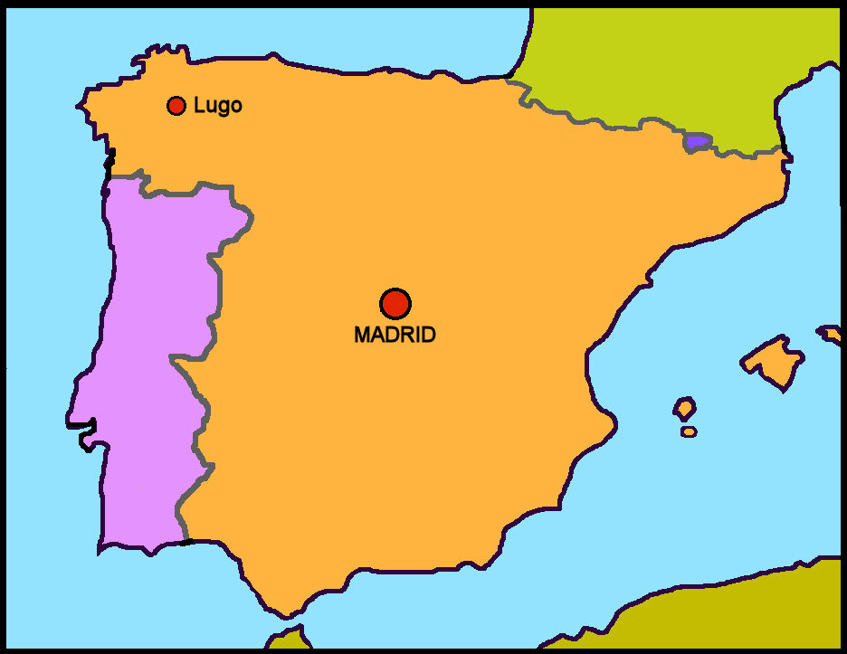
Follow up 2 [a] :
El autor*: Antonio Machado (1875-1913)
leer
Biografía
Es de Sevilla.
Estudia en Madrid.
Habla francés.
Viaja mucho a Francia.
Intereses
La memoria
La reflexión
El romance
Escribir
viajar – to travel, travelling
Notes:
Timing: 3 minutes
Aim: to introduce information about the author of the poem, using familiar language and some cognates.
Procedure:
Read the information and clarify the meaning of ‘autor’.
Teachers click to go through the slide. We can give details of his life in the present tense. Pupils can read aloud (whole class) to practise SSC knowledge.
Pupils could also be asked:
1/ where Sevilla and Madrid are (‘¿Dónde está…?) to elicit ‘Está en el sur’ or ‘Está en el centro’. Note: ‘centro’ has been taught as a phonics word.
2/ yes-no questions with raised intonation (e.g. ‘¿Valencia está en el norte?’). Encourage full answers here (‘No, está en el sur’).
Frequency of unknown words/cognates:
viajar [902] Biografía [4236] interés [388] memoria [827] reflexión [1909] romance [4541]

Slide 4
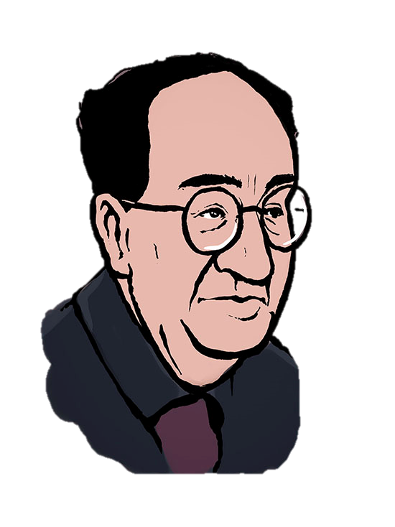
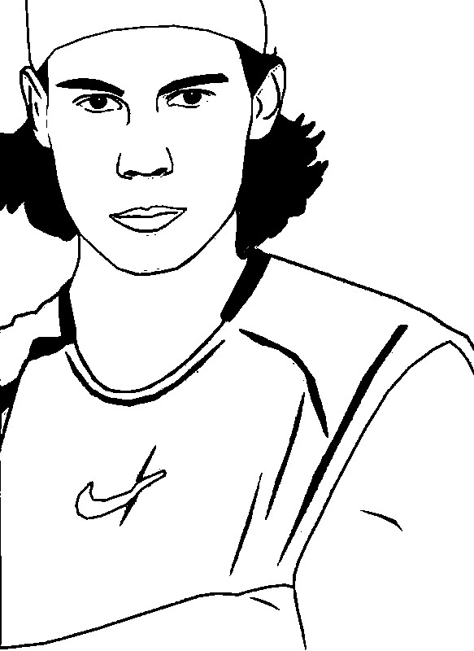
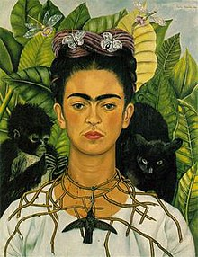
Follow up 2 [b]:
El autor*: Antonio Machado (1875-1913)
leer
¿Quién es Antonio Machado?
(el) autor – author (m.)
c
a
b
Notes:
Timing: 1 minute
Aim: A short activity to sustain the interest of the pupils in the text.
Procedure:
Ask pupils, e.g., ‘Es la persona en A?’. Elicit the correct answer (B).
Photo A too young (Rafal Nadal). Photo C is a woman (Frida Kahlo) and they are looking for a male author (el autor).
In B (the correct photo) he also seems calm and composed, which is in tune with the interests mentioned on the last slide.
Image sources:
A: Imagen courtesy of Xavi Sepúlveda, retrieved from https://www.cervantesvirtual.com/portales/antonio_machado/dibujos_y_caricaturas/imagen/2022_antonio_machado_xavi_sepulveda
A: Photo https://www.morningkids.net/dibujos-para-colorear-id-3030-tenis-rafael-nadal.html
B: Photo by Xavi Sepúlveda https://www.cervantesvirtual.com/portales/antonio_machado/dibujos_y_caricaturas/imagen/2022_antonio_machado_xavi_sepulveda/

Slide 5
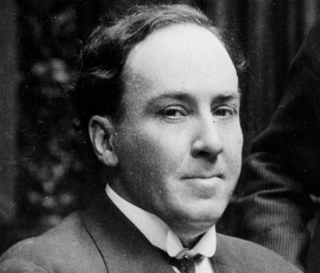
Follow up 2 [c]:
¿Cómo está Antonio Machado en la foto?
leer
a
b
Está…
serious
quiet
happy
pleased
Notes:
Timing: 1 minute
Aim: to revisit some adjectives with ‘estar’ for temporary state.
Procedure:
Ask pupils to translate the 3 phrases. Ask for other potential descriptions of how he looks, or doesn’t look.
Other adjectives previously taught in the Spanish scheme of work could be revisited here: contento [1949] elegante [2742] nervioso [1521] serio [856] tranquilo [1073]
Photo [A] by EFE, is licensed under CC BY-SA 4.0 and retrieved from http://www.spainisculture.com/en/artistas_creadores/antonio_machado.html
Photo [B]: Photo by Xavi Sepúlveda https://www.cervantesvirtual.com/portales/antonio_machado/dibujos_y_caricaturas/imagen/2022_antonio_machado_xavi_sepulveda/

Slide 6
Follow up 3 :
Escucha y practica el poema.
leer
Notes:
https://www.youtube.com/watch?v=Z6jD2xUiea4
Alternative version on YouTube (includes audio and text).

Slide 7
¡adiós!
verde

