Slide 1
español, con Sofía

Slide 2
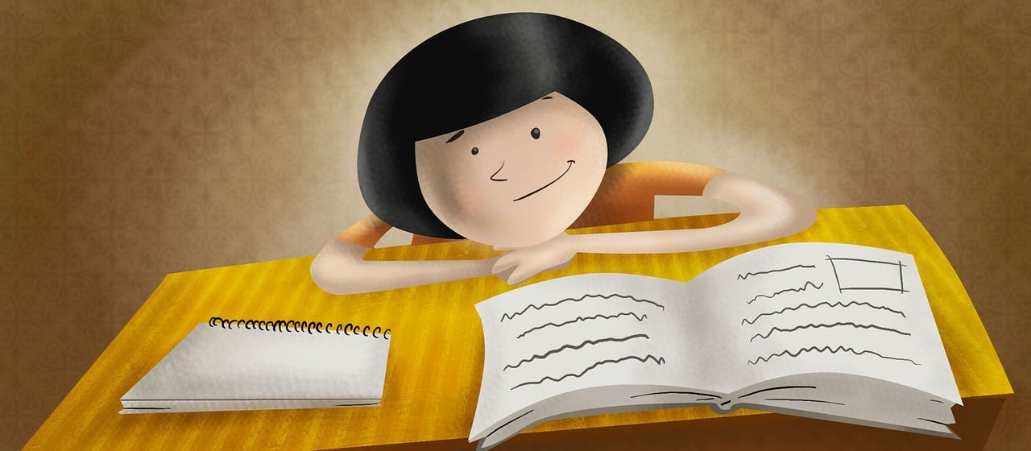
What do I know now?
verde
Vocabulary and grammar quiz
Notes:
Artwork by Steve Clarke. Pronoun pictures from LDP (www.ldpedagogy.org). All additional pictures selected from Pixabay and are
available under a Creative Commons license, no attribution required.
This lesson contains phonics read aloud and transcription assessments to check progress in SSC (sound-symbol correspondences) introduced and practised this year and in years 3 and 4.
Total marks available: 28 (14 read aloud, 14 transcription).

Slide 3
pronunciar
[ge]
[gi]
pronunciar
[inventiveness]
[to catch (a disease)]
ingenio
contagiar
Notes:
Phonics quiz
Timing: flexible during Week 11 Procedure:
Print out one set of these 14 phonics cards.
Working with one pupil at a time, elicit the pronunciation of each word.
Say: You have not learnt these words, but you have learnt how to read aloud these sounds, so just have a go at reading each word aloud.
Focus only on the accurate pronunciation of the target SSC and tolerate any other inaccuracies.
Use the pupil scoring sheet at the end of this presentation to assess SSC knowledge and give feedback.
Note: Whilst working with individual children, others can be doing the Easter activities at the end of this presentation.
3

Slide 4
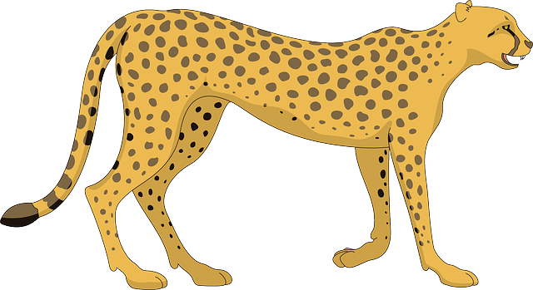
pronunciar
[gue]
[gui]
pronunciar
[cheetah]
[immediately]
guepardo
en seguida
Notes:
4

Slide 5
pronunciar
[ce]
[ci]
pronunciar
[hill]
[tiredness]
cerro
cansancio
Notes:
5

Slide 6
pronunciar
[z]
[j]
pronunciar
[to start]
[to weave]
comenzar
tejer
Notes:
6

Slide 7
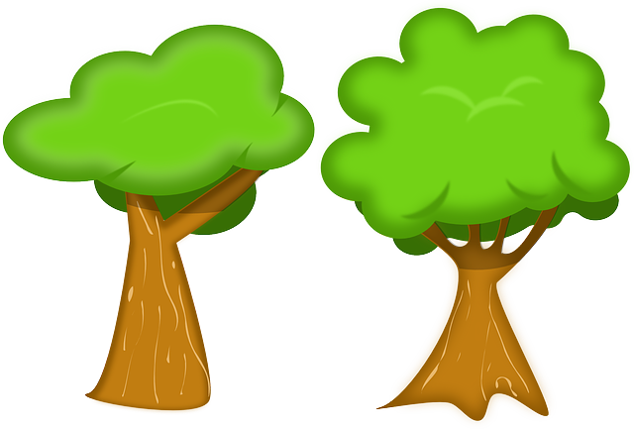
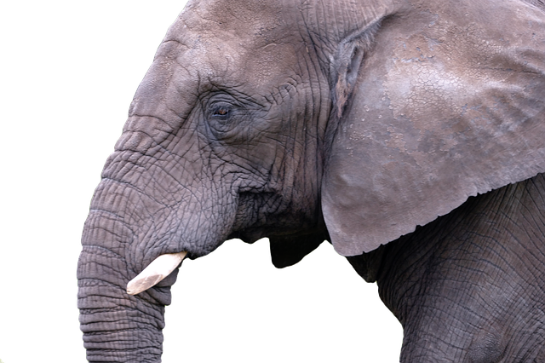
pronunciar
[r-/rr]
[Stress 1]
pronunciar
[wrinkled]
[trees]
arrugado
árboles
Notes:
7

Slide 8
pronunciar
[Stress 2]
[Stress 3]
pronunciar
[to crown]
[bottle]
coronar
frasco
Notes:
8

Slide 9
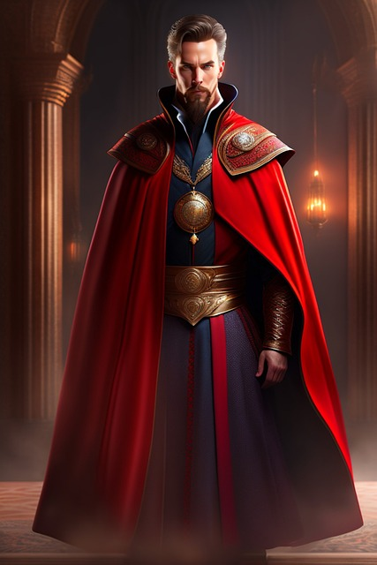
pronunciar
[ñ]
[v]
pronunciar
[strange]
[private]
extraño
privado
Notes:
9

Slide 10
pronunciar
Pupil name:
Pupil name:
SSC and word | px
ingenio
contagiar
guepardo
en seguida
cerro
cansancio
comenzar
tejer
arrugado
árboles
coronar
frasco
extraño
privado
SSC and word | px
ingenio
contagiar
guepardo
en seguida
cerro
cansancio
comenzar
tejer
arrugado
árboles
coronar
frasco
extraño
privado
Notes:
Pupil feedback and assessment sheet [14 points]
10

Slide 11
¡adiós!
verde

Slide 12
escuchar
escribir
1. Cecilia juega con la guitarra. [3]
1. Cecilia plays with the guitar.
2. Es juguetona y también valiente. [2]
2. She is playful and also brave.
3. La llama come hojas y ramas. [3]
3. The llama eats leaves and branches.
4. Emite gruñidos si es amenazada. [3]
4. It grunts if it is threatened.
5. La longevidad de este animal es de quince hasta treinta años. [3]
5. The life expectancy of this animal is from 15 – 30 years.
Notes:
Dictation answers and English sentence translations for information [14 points]
12

Slide 13
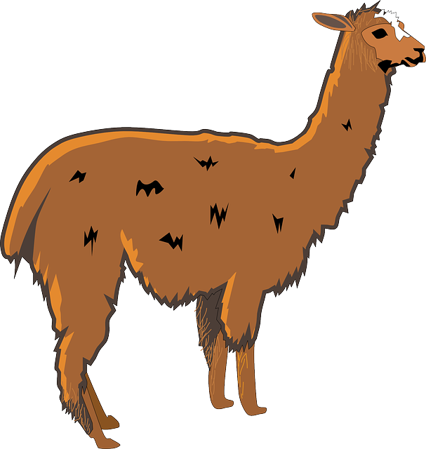
escuchar
escribir
escuchar
escribir
1. _ _cilia _uega con la _ _ _tarra. [3]
1. _ _cilia _uega con la _ _ _tarra. [3]
2. Es ju_ _ _tona y también _aliente. [2]
2. Es ju_ _ _tona y también _aliente. [2]
3. La _ _ama come _ojas y _amas. [3]
3. La _ _ama come _ojas y _amas. [3]
4. Emite gru_idos si es amena_ada. [3]
4. Emite gru_idos si es amena_ada. [3]
5. La lon_ _vidad de este animal es de _ _ _nce hasta tr_ _nta años. [3]
5. La lon_ _vidad de este animal es de _ _ _nce hasta tr_ _nta años. [3]
to
to
Notes:
Dictation [14 points]
13

