Slide 1


español, con Sofía

Slide 2


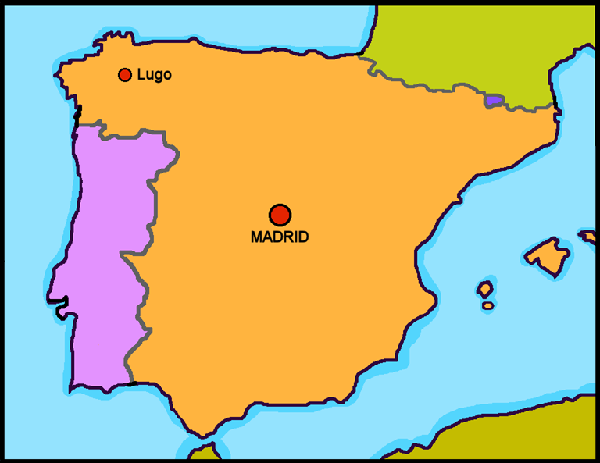


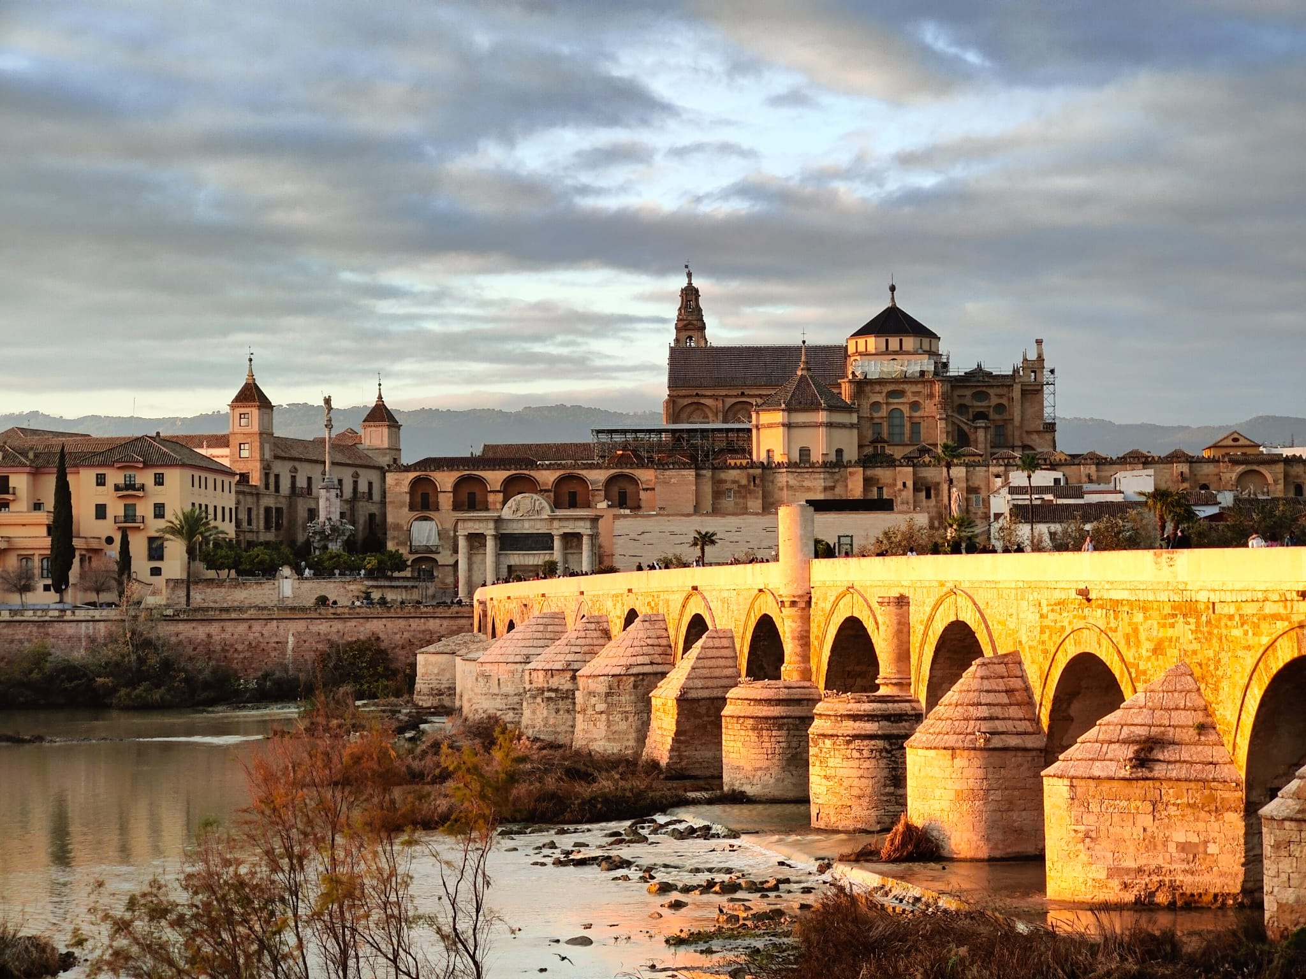
Saying where you are going and what there is there
verde
ir [to go]: voy & vas
SSC: [r] [rr]
Notes:
Artwork by Steve Clarke. All additional pictures selected are available under a Creative Commons license, no attribution required.
The frequency rankings for words that occur in this PowerPoint which have been previously introduced in the resources are given in the SOW (excel document) and in the resources that first introduced and formally re-visited those words.
Phonics: revisit [r] and [rr]
Source: parar [706] correr [343] Cluster: caro [2179] carro [1857] cerro [2560] pera [>5000] perra [888]
Vocabulary (new words in bold): primo [1451] voy [ir 33] vas [ir 33] va [ir 33] estoy [estar 21] está [estar 21] estás [estar 21] calle [269] cine [952] estadio [2581] mercado [487] parque [1354] playa [1475] plaza [806] teatro [605] a [8] el [1] la [1]
Revisit 1: bicicleta [3684] cama [609] camisa [1873]cuaderno [3301] cuarto [653] gato [1728] habitación [1069] hermano [333] hermana [3409] idea [247] libro [230] mochila [>5000] oso [4449] perro [888] tía [1205] tío [988] vestido [1697]dónde [161] qué [50]
Revisit 2: celebrar [886] mandar [588] carrera [481] España [N/A] tarjeta [1958] villancico [>5000] común [742] especial [436] típico [1934] pero [30] en1 [5]
Revisit other –ar verbs: cantar [717] comprar [361] escuchar [281] preparar [570]
Glossed: intruso [>5000] preposición [>5000] ropa [782] viaje [519] porque [40]
Source: Davies, M. & Davies, K. (2018). A frequency dictionary of Spanish: Core vocabulary for learners (2nd ed.). Routledge: London
For any other words that occur incidentally in this PowerPoint, frequency rankings will be provided in the notes field wherever possible.

Slide 3


[r]
parar
pronunciar
Notes:
Timing: 1 minute
Aim: To revisit SSC [r]
Procedure:
To recap and elicit the pronunciation of the individual SSC [r]
Click to bring the picture & get students to repeat (with gesture, if using).
Gesture suggestion: hold one hand up, palm open and facing away, to signal ‘stop’.
Frequency:
parar [706]
Source: Davies, M. & Davies, K. (2018). A frequency dictionary of Spanish: Core vocabulary for learners (2nd ed.). Routledge: London

Slide 4
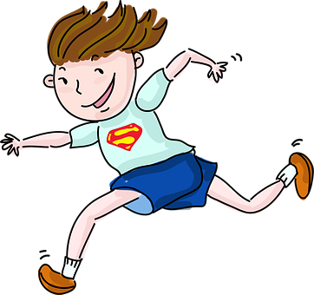
[rr]
correr
pronunciar
Notes:
Timing: 1 minute
Aim: To revisit SSC [rr]
Procedure:
To recap and elicit the pronunciation of the individual SSC [rr]
Click to bring the picture & get students to repeat (with gesture, if using).
Gesture suggestion: Using index and middle fingers to be ‘legs’ mime a fast running movement, moving the hand from right to left across the body.
Frequency:
correr [343]
Source: Davies, M. & Davies, K. (2018). A frequency dictionary of Spanish: Core vocabulary for learners (2nd ed.). Routledge: London

Slide 5

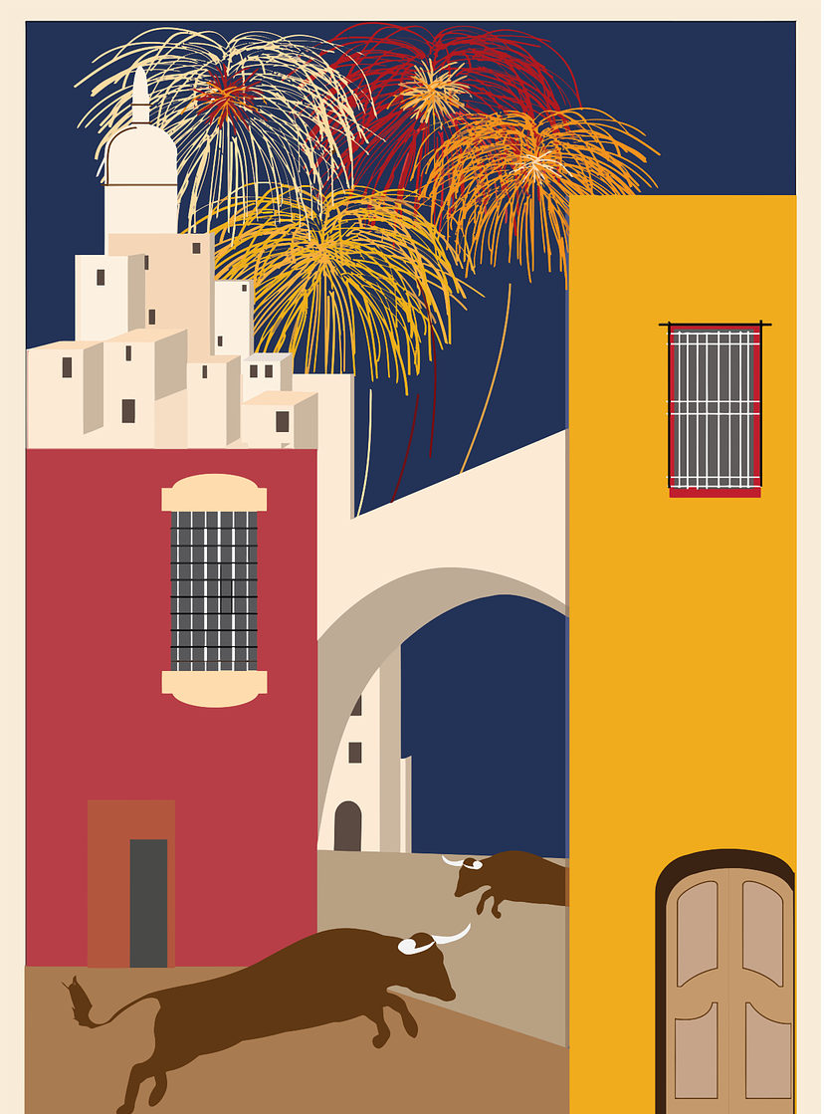


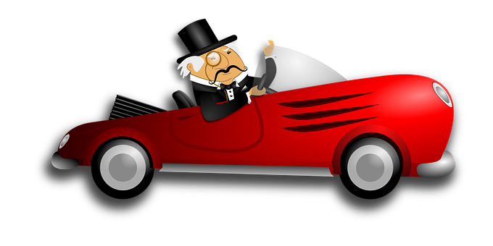





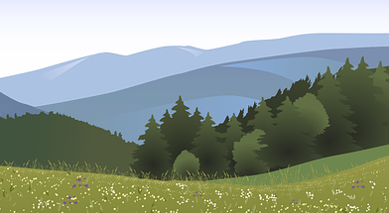
pronunciar
¡A practicar!
In many countries in Latin America, carro means car. In those countries, this would be un carro caro!
pero
perro
caro
carro
🤔
45
segundos
expensive
pera
perra
cero
cerro
INICIO
Notes:
Timing: 2 minutes
Aim: to practise reading aloud [r] [rr].
Procedure:
Pupils to apply SSC knowledge and pronounce the following minimal pairs (words differing by one phoneme only).
Click to bring up the first pair of words. Elicit choral repetition.
Click to bring up the 2nd pair of words. Elicit choral repetition.
Bring up the culture callout about the meaning of ‘carro’ in Latin America.
Click to bring up the 3rd pair of words.
Click on the timer (20 seconds) for pupils to practise saying the words again.
If required, click on individual words to hear them pronounced.
Frequency of unknown words and cognates:
Cerro [2560]
Source: Davies, M. & Davies, K. (2018). A frequency dictionary of Spanish: Core vocabulary for learners (2nd ed.). Routledge: London

Slide 6



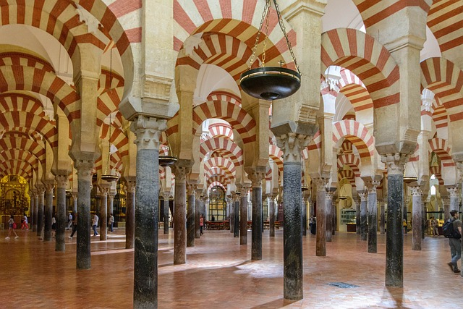

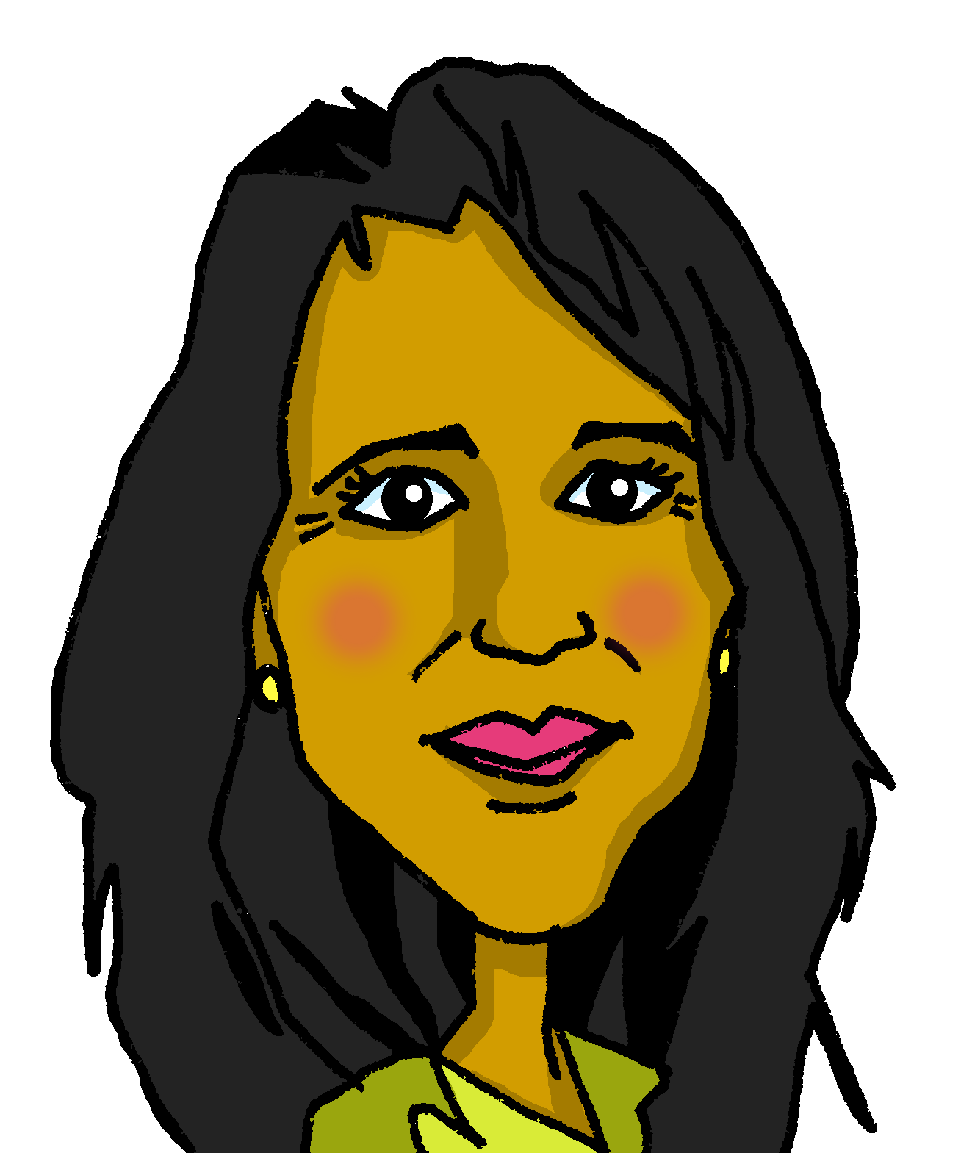
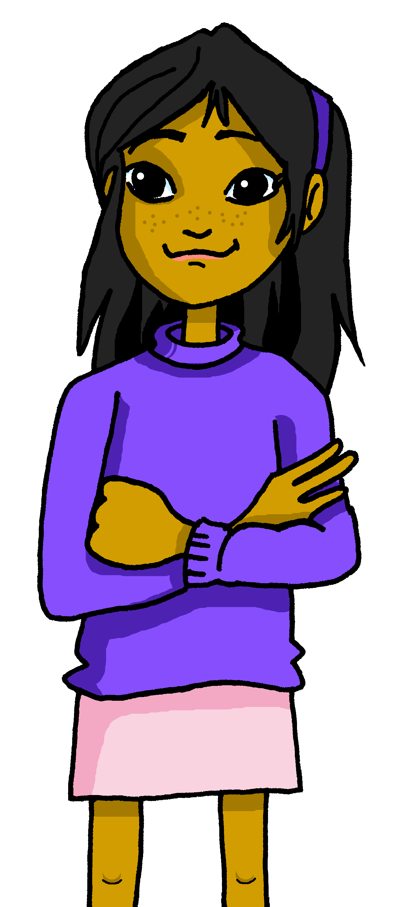
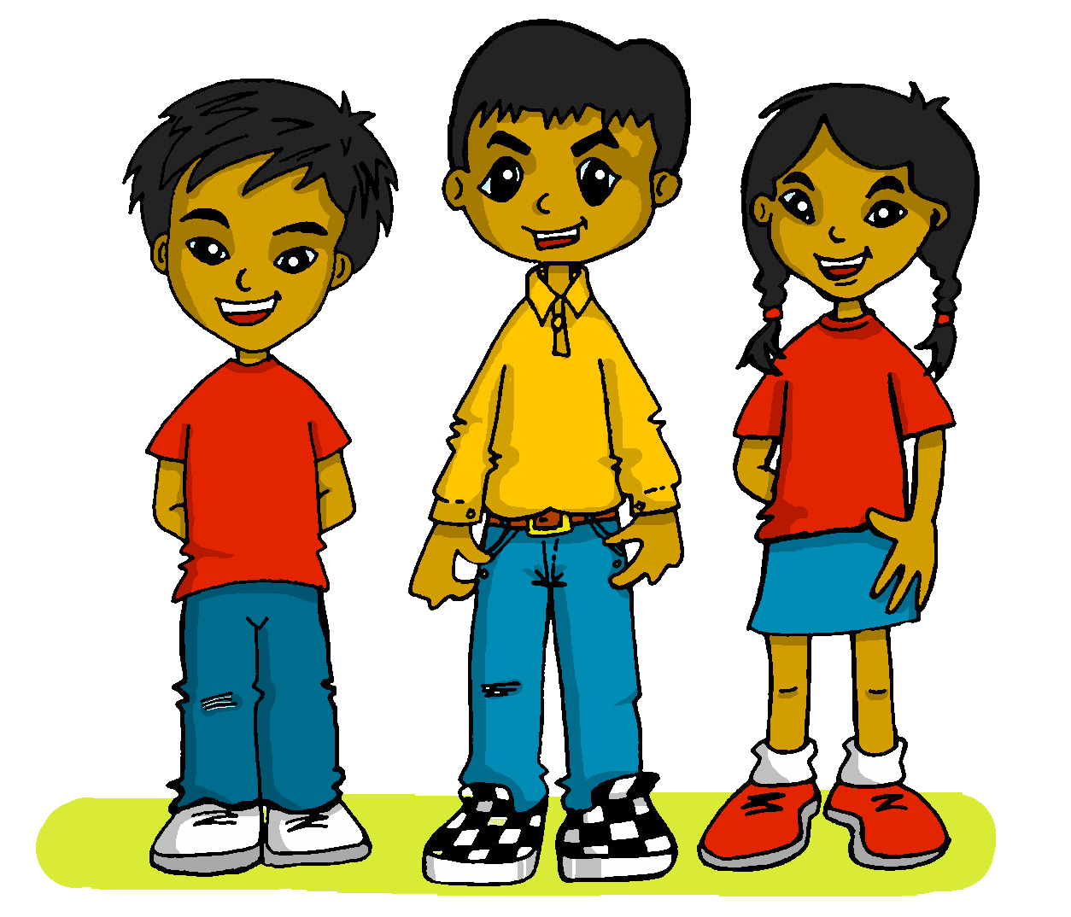
Leer y hablar
Córdoba
el viaje = trip / journey
El viaje a ______________
1
Voy al ______ de España con mi mamá, papá y Sofía.
La _________ es histórica y grande.
El primo Luis está ______.
escuchar
leer
sur
2
ciudad
allí
3
Bilbao
Barcelona
La Mezquita-Catedral
Cáceres
Valencia
¿Qué ciudad es?
El Puente Romano
Córdoba
el primo
Notes:
Timing: 3 minutes
Aim: to introduce the context of the lesson (Córdoba) through transcription of 3 key items of vocabulary introduced in week 8.
Procedure:
1. Pupils write 1-3.
2. Click to listen to each sentence. Pupils write in the missing word.
3. Click to correct answers.
4. Click to bring up question ¿Qué ciudad es? Teachers can refer back to the sentences and the map… Está en el sur ¿Es Bilbao? No! No es Bilbao. Está en el sur…. Etc.
5. Click to bring up ‘Córdoba’.
6. Click to bring up two pictures of 2 iconic places in Córdoba: El Puente Romano & La Mezquita-Cátedral.
7. Click to bring up ‘el primo’ to formally introduce the word. Click through animations to establish meaning
Frequency of unknown words and cognates:
viaje [519]
Source: Davies, M. & Davies, K. (2018). A frequency dictionary of Spanish: Core vocabulary for learners (2nd ed.). Routledge: London

Slide 7

hablar
¿Cuál es el intruso*?
(el) intruso = intruder
porque = because
(la) ropa = clothes
E
cine | estadio | playa | mercado
parque | playa | montaña | teatro
profesora | primo | mamá | hermano
voy | ir | vas | va
estoy | estar | está | va
plaza | vestido | sombrero | camisa
histórica | bonito | enorme | blanco
1
2
leer
3
4
5
6
porque* es femenino.
porque* no es una forma de ‘estar’
porque es masculino y femenino
porque* está en la calle.
porque* es un infinitivo
¿Cuántos nombres hay en total?
porque no es ropa*
¿Cuántos adjetivos hay en total?
porque* no es familia
¿Cuántos verbos hay en total?
¡Hay 4 adjetivos!
¡Hay 16 nombres!
¡Hay 8 verbos!
Notes:
Timing: 5 minutes [2 slides]
Aim: to recap previously introduced vocabulary.
Procedure:
Part 1
Read the instruction in Spanish. Check understanding of ‘intruso’.
Tell students they need to figure out which word is the odd one out. There could be a range of reasons (gender, number, grammatical category, etc.). Do the example with them (they are all masculine nouns apart from ‘playa’).
Click to bring up speech bubble with the reason in Spanish, and check understanding.
Repeat with 1-6.
Part 2:
Click to bring the question on grammatical categories. Ensure meaning of ‘nombres’ is clear.
Elicit answer from students.
Repeat x2 (adjectives and verbs). Elicit numbers in Spanish.
Frequency of unknown words and cognates:
instruso [] ropa [782] porque [40]
Source: Davies, M. & Davies, K. (2018). A frequency dictionary of Spanish: Core vocabulary for learners (2nd ed.). Routledge: London

Slide 8
hablar
¿Cómo se dice en español?
E
cine | estadio | playa | mercado
parque | playa | montaña | teatro
profesora | primo | mamá | hermano
voy | ir | vas | va
estoy | estar | está | va
plaza | vestido | sombrero | camisa
histórica | bonito | enorme | blanco
1
2
leer
3
4
5
6
theatre
to be, being
S/he, it is (state, location)
pretty
square
s/he, it goes
cousin
beach
Notes:
Part 3
Clarify the meaning of the question – How do you say in Spanish?
Click to bring the first English word (theatre) and elicit Spanish word from students (teatro).
Repeat x7

Slide 9


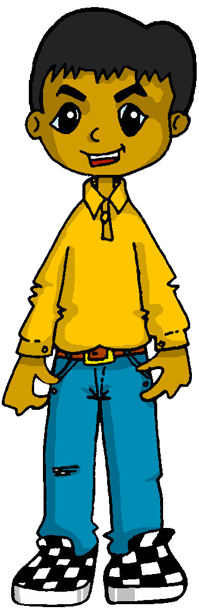
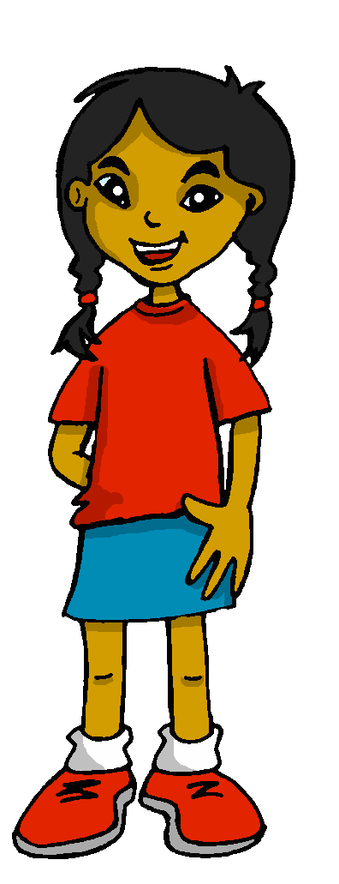

Using the verb ‘ir’
[ir: I go vs. you go]
We have learned that the verb ‘ir’ is irregular:
voy
vas.
To say ‘I go’, we use _____.
To say ‘you go’, we use _____.
I
you
Voy con papá.
Vas con mi primo.
I go with dad.
You go with my cousin.
Notes:
Timing: 3 minutes
Aim: to introduce 1st and 2nd person singular of ‘ir’
Procedure:
Read the grammar explanation on irregular verb ir.
Elicit English translation for the Spanish examples provided.

Slide 10
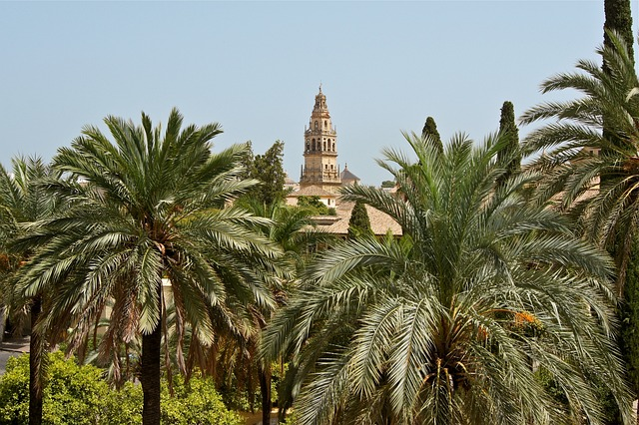


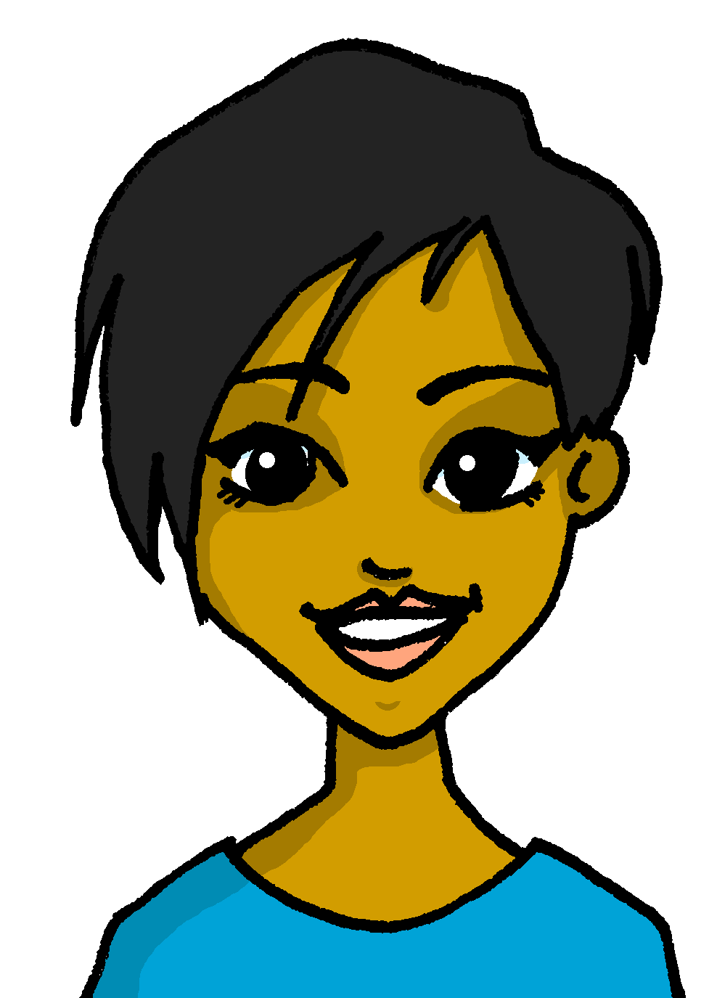

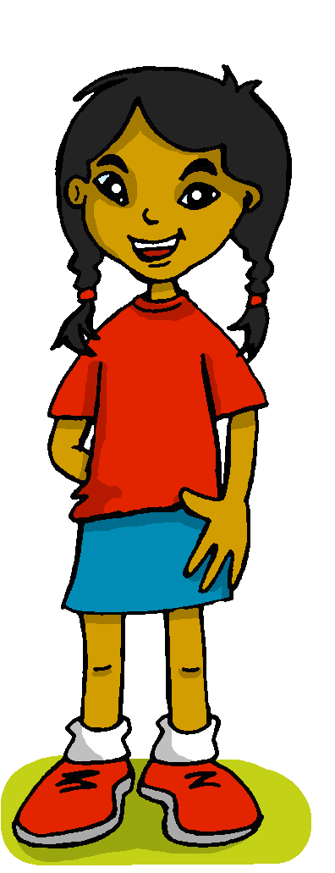

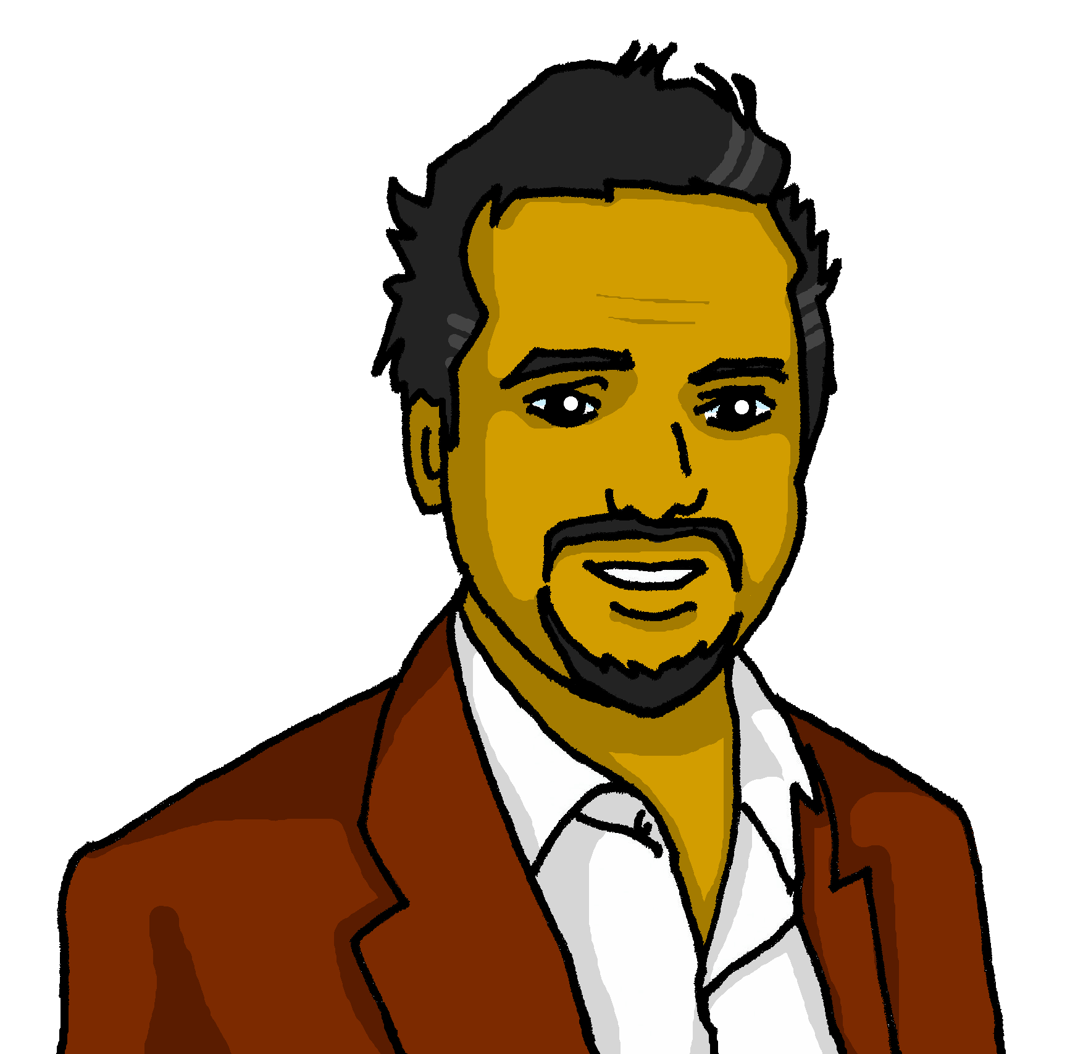
escuchar
Las actividades en Córdoba
¿Dónde va? ¿Con quién? Escribe 📝
¿Quién es? Marca .✅
Sofía habla con Luis.
 | Sofía (I) | Luis (you)
¿dónde? 📝
¿quién? 📝
E
al puente
1
a la plaza
2
al mercado
3
al teatro
4
al río
[grandad]
5
al museo
Notes:
Timing: 5 minutes
Aim: to practise aural identification of 1st and 2nd person singular of ‘ir’; transcription of key vocabulary (places in town).
Procedure:
1. Ensure pupils are clear about the task. Sofía talks to Luis about what she or he is going in Códoba (and with whom).
2. Click to play the example. Ask pupils to tick Sofía (I) or ‘Luis’ (you)
3. Click to reveal the answer.
4. Play 1-5 and pupils to complete.
5. Click to reveal answers.
Transcript:
[E] Voy al puente con el tío.
[1] Vas a la plaza con la abuela.
[2] Voy al mercado con mi hermano.
[3] Voy al teatro con mamá.
[4] Vas al río con el abuelo.
[5] Vas al museo con la tía.

Slide 11
Using ir with al, a la [1/2]
[to go, going to the]
Remember, the verb ‘ir’ is often followed by ‘a’ (to) to say where someone goes.
Vas a la costa.
You go to the coast.
Remember that a + el becomes ‘al’.
Vas al cine.
You go to the cinema.
Notes:
Timing: 4 minutes [2 slides]
Aim: to recap ‘ir’ and to the (including the contraction ‘al’)
Procedure:
Read the grammar explanation on ir & ‘to the’
Elicit English translation for the Spanish examples provided.

Slide 12
Using ir & estar; en & al, a la [2/2]
[to go & to be (location)| in; to the]
The verb ‘estar’ means ‘to be’ when describing location.
Estás en el cine.
Estás en la costa.
You are at the cinema.
You are on the coast.
After estar, ‘en’ can mean ‘on’, ‘at’ or ‘in’.
Just choose the meaning that sounds right in each sentence.
ir
We generally use ‘a’ with the verb _______.
estar
We generally use ‘en’ with the verb ________.
Notes:
Timing: 4 minutes [slide 2/2]
Aim: to reintroduce ‘estar’ and ‘en’ to prepare for a contrast with ‘ir’ and ‘to the’
Procedure:
Read the grammar explanation about ‘estar’ and ‘en’.
Elicit English translations for the Spanish examples provided.

Slide 13
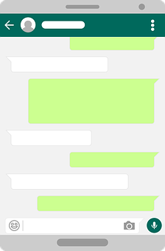

leer
Luis manda mensajes a Sofía.
¿Qué mensaje es?
¿Qué preposición es?
¿Es ‘en’, ‘al’, o ‘ a la’?
||/\
la preposición = preposition
/||/\
/|||
||||\
E
Luis
Estoy en el hotel.
 | Are you| am I on | to the bridge?
 | Do you go| Do I go in | to the church?
 | I am I You are in | to the hotel.
 | Do you go| Do I go in | to the streets in the centre?
 | I am | You are in | to the market.
 | Am I | are you in | to the museum with grandad?
[4]
||/\
/||/\
/|||
1
||||\
Sofía
¿Vas a la iglesia?
||/\
/||/\
/|||
||||\
[1]
2
¿Estás en el
museo con el abuelo?
Luis
||/\
/||/\
/|||
3
||||\
[E]
Sofía
¿Vas a las
calles del centro?
4
Luis
[3]
||/\
/||/\
/|||
||||\
¿Estás en el puente?
5
||/\
Sofía
[5]
/||/\
/|||
||||\
Voy al mercado.
[2]
Notes:
Timing: 8 minutes
Aim: to practise identification of missing pronouns from the verbs they are used with.
Procedure:
Read the title and click to explain the context of the task.
Click to bring further instructions in Spanish. Teachers can ask further questions re the contraction “al”. Elicit examples of masculine nouns (hotel, museo; mercado, puente).
Do [E] with them to model the task, drawing their attention to the verb (Está). Is it en, al or a la?
Pupils complete 1-5.
Click through the animations to make the ‘cracks’ disappear and show the correct preposition.
Teachers can play the texts for further listening practice, if they wish, or pupils can read the texts aloud in pairs.
NB: The next slide includes an activity to focus on comprehension.
Part 2
Aim: to practise written comprehension of correct person of estar & ir, prepositions and places in town.
Read and clarify the instruction (pupils to match the sentences with the messages E-5 and decide the correct translation of the preposition.
Do the first sentence with them.
Pupils complete sentences 2-5.
Click to bring up answers and further instructions.
Next, pupils decide on the correct translation of the verb, identifying the person (subject) of the sentence.
Pupils to do E-5.
Elicit answers from pupils, click to bring up answers.
Frequency of unknown words and cognates:
preposición [>5000]
Source: Davies, M. & Davies, K. (2018). A frequency dictionary of Spanish: Core vocabulary for learners (2nd ed.). Routledge: London

Slide 14
¡adiós!
verde

