Slide 1


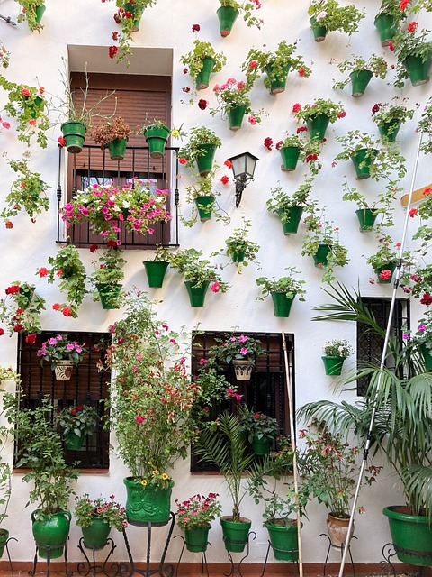

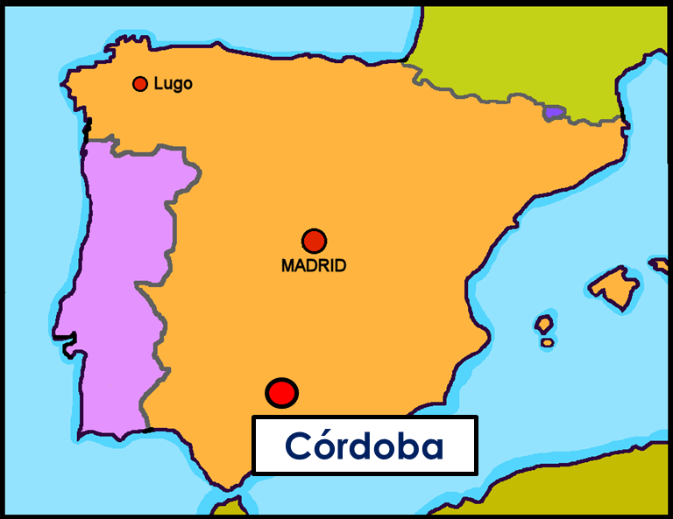
Saying what I and others do
verde
Follow ups 1-5
Notes:
Artwork by Steve Clarke. All additional pictures selected are available under a Creative Commons license, no attribution required.
The frequency rankings for words that occur in this PowerPoint which have been previously introduced in the resources are given in the SOW (excel document) and in the resources that first introduced and formally re-visited those words.
Phonics: Source: parar [706] correr [343] Cluster: caro [2179] carro [1857] cerro [2560] pera [>5000] perra [888]
Vocabulary (new words in bold): primo [1451] voy [ir 33] vas [ir 33] va [ir 33] estoy [estar 21] está [estar 21] estás [estar 21] calle [269] cine [952] estadio [2581] mercado [487] parque [1354] playa [1475] plaza [806] teatro [605] a [8] el [1] la [1]
Revisit 1: bicicleta [3684] cama [609] camisa [1873]cuaderno [3301] cuarto [653] gato [1728] habitación [1069] hermano [333] hermana [3409] idea [247] libro [230] mochila [>5000] oso [4449] perro [888] tía [1205] tío [988] vestido [1697]dónde [161] qué [50]
Revisit 2: celebrar [886] mandar [588] carrera [481] España [N/A] tarjeta [1958] villancico [>5000] común [742] especial [436] tipíco [1934] pero [30] en1 [5]
Revisit other –ar verbs: cantar [717] comprar [361] escuchar [281] preparar [570]
Glossed words:
practicar [1595] concurso [2186] patio [1197] sonido [1040] trabalenguas [>5000] decorada [4553]
Source: Davies, M. & Davies, K. (2018). A frequency dictionary of Spanish: Core vocabulary for learners (2nd ed.). Routledge: London
For any other words that occur incidentally in this PowerPoint, frequency rankings will be provided in the notes field wherever possible.

Slide 2




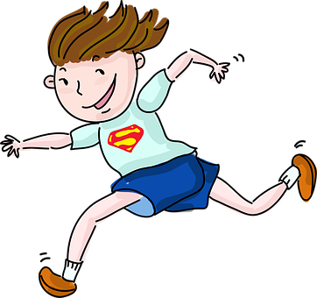
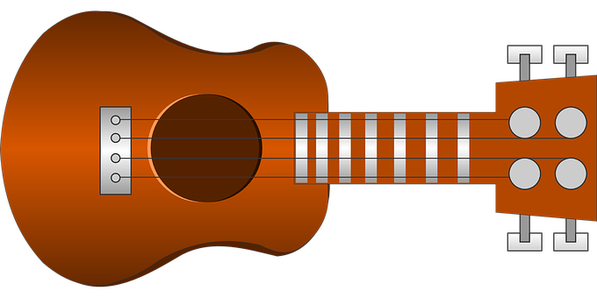
Follow up 1
[r] [rr]
A Escucha. ¿Qué sonido* es?
pronunciar
Marca
 | r | rr
E
moreno
1
perro
corre
2
[s/he]
3
guitarra
terrible
4
😡
5
tarea
(el) sonido = sound
Notes:
Timing: 5 minutes (2 slides)
Aim: to develop phonological awareness of [r] [rr]
Procedure:
Click to bring up the instruction.
Click to bring up table and do example together (E).
Students tick and/or write the correct sound [r] or [rr].
Click to reveal answers and elicit pupils’ pronunciation of each word.
Transcript Part A:
[EJ] moreno
[1] perro
[2] corre
[3] guitarra
[4] terrible
[5] tarea
Frequency of unknown words and cognates:
sonido [1040]
Source: Davies, M. & Davies, K. (2018). A frequency dictionary of Spanish: Core vocabulary for learners (2nd ed.). Routledge: London

Slide 3





Follow up 1
[r] [rr]
B ¡Practica el trabalenguas!
pronunciar
En la calle de Carretas
te atrapará el rabo
(In Carretas St.)
(will catch your tail)
hay un perrito parado
pero es tarde,
(There is a dog standing)
(but it’s late)
¡Corre Corre!
y el perro
(Run! Run!)
(and the dog)
Gruñe el Señor Morgado
llora llora
(Mr Morgado groans)
(cries cries)
Si no la carreta
por su rabo!
(otherwise the cart)
(for its tail)
practicar = to practise, practising
(el) trabalenguas = tonguetwister
Notes:
[2/2]
Procedure:
Click to bring up Part B and read instructions.
Click to bring up and listen to each sentence of the poem.
Allow pupils to practise in pairs.
Practise one more time as a whole class.
Transcript Part B:
En la calle Carretas
Hay un perrito parado
¡Corre corre!
Gruñe el señor Morgado
Sino la carreta
Tea atrapará el rabo.
Pero ya es tarde,
Y el perro
llora llora
Por su rabo
Frequency of unknown words and cognates:
practicar [1595] trabalenguas [>5000]
Source: Davies, M. & Davies, K. (2018). A frequency dictionary of Spanish: Core vocabulary for learners (2nd ed.). Routledge: London

Slide 4




Follow up 2:
Escribe en inglés 📝: Can you get at least 15 points?
 | el villancico | la tarjeta | común
 | la carrera | España | cantar
 | preparar | celebrar | mandar
 | la bicicleta | la camisa | la tía
 | el hermano | ¿dónde? | ¿qué?
 | el primo | estoy | la playa
 | va | vas | estás
(the) xmas carol
(the) card
common
vocabulario
(the) race
Spain
to sing, singing
x3
to prepare
to celebrate
to send, sending
(the) bicycle
(the) shirt
(the) aunt
x2
Where?
(the) brother
What?
(the) cousin (m)
I am (location, state)
(the) beach
x1
s/he goes
You go
You are (location, state)
Notes:
Timing: 5 minutes
Aim: to practise written comprehension (this slide) and production (next slide) of vocabulary from this week and this week’s revisited sets.
Procedure:
1. Give pupils a blank grid. They fill in the English meanings of any of the words they know, trying to reach 15 points in total.
Note:
The most recently learnt and practised words are pink, words from the first revisit are green and those from the second revisit are blue, thus more points are awarded for them, to recognise that memories fade and more effort (heavy lifting!) is needed to retrieve them.

Slide 5


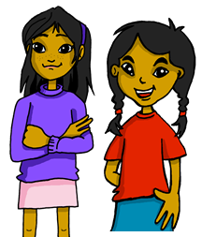

Using the verb ‘ir’
[ir:- you go, s/he goes]
We have learned that the verb ‘ir’ (to go) is irregular:
vas
va
To say ‘you go’, use ‘____’.
To say ‘s/he goes’, use ‘____’.
You
S/he
Vas al cine por la tarde.
Va a la playa con papá.
You go to the cinema in the afternoon.
She goes to the beach with dad.
⚠ Remember to use correct words(s) for ‘to the’.
Notes:
Timing: 3 minutes
Aim: to introduce 1st and 2nd person singular of ‘ir’
Procedure:
Read the grammar explanation on irregular verb ir.
Elicit English translation for the Spanish examples provided.

Slide 6
Using the verb ‘estar’
[Estar:- you are, s/he is (location)]
We have learned that the verb ‘estar’ (to be, location) is often followed by the preposition ‘en’.
You
S/he
Estás en el cine.
Está en la habitación.
You are at the cinema.
She is in the room.
⚠ You decide the best translation for en - on, at, in - depending on the context.
Notes:
Timing: 3 minutes
Aim: to introduce 1st and 2nd person singular of ‘ir’
Procedure:
Read the grammar explanation on irregular verb ir.
Elicit English translation for the Spanish examples provided.

Slide 7

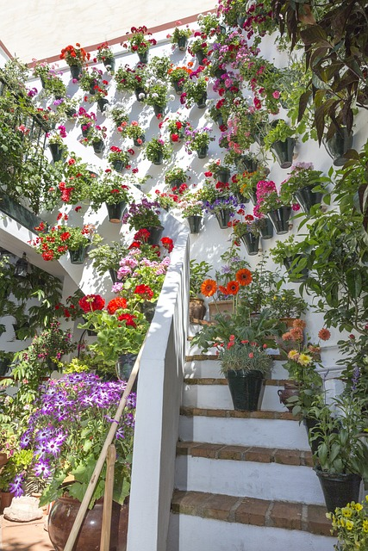


Follow up 3:
(el) patio = courtyard
decoradas = decorated
(el) concurso = competition
(la) flor = flower
Lee las frases.
leer
After ‘estoy’, ‘estás’ and ‘está’, we often use the preposition ___.
en
A
a la
After ‘voy’, ‘vas’ and ‘va’, we use _______ before
feminine nouns, and ____ before masculine nouns.
al
B Lee. ¿Qué verbo es’?
C Escribe las frases en inglés 📝 .
 | Va al estadio con mi papá.
 | Estás en la habitación del hotel.
 | Está en la iglesia de Córdoba.
 | Vas a la calle con flores.
 | Va al mercado famoso de la ciudad.
 | Estás en el puente histórico.
E
S/he goes to the stadium with my dad.
1
You are in the hotel room.
2
S/he is in the Córdoba church.
3
You go to the street with flowers.
4
En mayo es el festival de los
patios* de Córdoba. Muchas calles están decoradas* con flores y hay un concurso*.
S/he goes to the famous market in the city.
5
You are on the historical bridge.
Notes:
Timing: 10 minutes
Aim: to practise written comprehension of the verbs ir and estar in 2nd and 3rd person singular
Procedure:
Click to present the recap of verbs and the prepositions they are most often followed by.
Click to bring up Part B.
Pupils write 1-5 and the missing verbs.
Click to reveal answers.
Click to bring up Part C.
Pupils translate the sentences.
Click to bring up answers.
Frequency of unknown words and cognates:
concurso [2186] patio [1197] decorada [4553]
Source: Davies, M. & Davies, K. (2018). A frequency dictionary of Spanish: Core vocabulary for learners (2nd ed.). Routledge: London

Slide 8

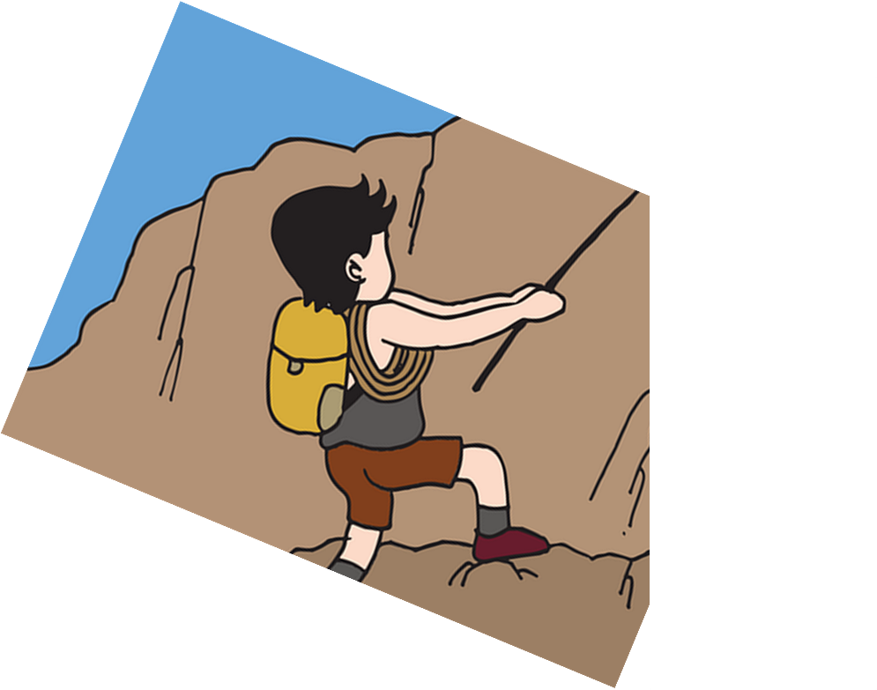
Follow up 4:
Habla en español [1/6]
Traduce 🗣
I go to the museum with my cousin (m).
leer
hablar
mi papá
mi primo
mi hermana
5
con
de
por
4
teatro
montaña
museo
playa
3
a la
al
en el
2
voy
vas
va
estoy
1
Notes:
Timing: 5 minutes [6 slides]
Aim: to use correct forms of estar / ir, and the correct preposition.
Procedure:
Tell students they need to use the words, starting from the bottom, to climb up the mountain (so that they translate the sentence!).
Ask students to work in pairs to practise first.
Click to trigger the timer (15 seconds per sentence).
Ask a volunteer from a pair to say the Spanish sentence out loud – next slide reveals the answer.
Repeat with the next 5 sentences (there are 6 in total).

Slide 9
Follow up 4:
Habla en español [2/6]
Traduce 🗣
You are in the historical square.
leer
hablar
5
históricas
histórica
histórico
4
plaza
centro
mercado
mar
3
a la
en la
en el
2
vas
estoy
estás
está
1
Notes:
[2/6]

Slide 10
Follow up 4:
Habla en español [3/6]
Traduce 🗣
I am in the big market.
leer
hablar
5
grande
grandes
pequeño
4
ciudad
mercado
puente
playa
3
en el
al
en la
2
vas
estoy
estás
va
1
Notes:
[3/6]

Slide 11
Follow up 4:
Habla en español [4/6]
Traduce 🗣
You go to the street with my parents.
leer
hablar
padres
madre
tío
mis
mi
5
con
por
4
mercado
cine
clase
calle
3
a la
en el
al
2
vas
estoy
va
está
1
Notes:
[4/6]

Slide 12
Follow up 4:
Habla en español [5/6]
Traduce 🗣
She is in the city of Córdoba with my cousin (m).
leer
hablar
mi primo
mi abuelo
mi profesor
con
de
por
5
Córdoba
4
con
por
de
centro
casa
pueblo
ciudad
3
al
a la
en la
2
vas
estás
voy
está
1
Notes:
[5/6]

Slide 13
Follow up 4:
Habla en español [6/6]
Traduce 🗣
She goes to the famous theatre alone.
leer
hablar
5
solo
sola
solos
4
famosa
perfecto
famoso
bosque
isla
teatro
casa
3
al
en el
a la
2
estoy
va
vas
estás
1
Notes:
[6/6]

Slide 14

Follow up 5:

Escribe las frases.
 | She goes ____ ______ river ____ Córdoba.
 | ____ al ________ en Córdoba.
 | _____ _____ in ________ square ___ ____ morning.
 | Está ____ ____ plaza por la ___________.
 | I am ____ the market ______ _____ grandma.
 | ________ en ___ _________ con mi _____________.
 | Do you go ____ the __________ theatre?
 | _______ _______ ___________ famoso?
 | You are in ____ ___________ with _____ magazine.
 | _______ _____ la habitación ______ una ___________.
to the
in
E
escribir
E
Va
cine
1
She is
the
in the
1
en la
mañana
2
in
with my
2
Estoy
el mercado
hermano
3
to
famous
3
Vas
al
teatro
the room
a
4
4
Estás en
con
revista
Notes:
Timing: 5 minutes
Aim: written production and comprehension of estar, ir and the correct preposition.
Procedure:
Pupils to use the parts of the sentence in Spanish / English to write down the whole sentence in Spanish and English.
Click to correct.
If desired, click on the numbers to hear the sentences.

Slide 15
Follow up [extra]:
Escribe en español 📝: Can you get at least 15 points?
 | to send, sending | (the) card | common
 | but | to buy, buying | typical
 | (the) race | to sing, singing | to listen, listening
 | (the) bear | to celebrate, celebrating | (the) aunt
 | (the) room | (the) sister | (the) bed
 | (the) cousin (f) | (the) square | s/he is (state, location)
 | you go | (the) market | I am (state, location)
mandar
la tarjeta
común
vocabulario
pero
comprar
típico
x3
la carrera
cantar
escuchar
el oso
celebrar
la tía
x2
la habitación
la hermana
la cama
la prima
la plaza
está
x1
vas
el mercado
estoy
Notes:
Timing: 5 minutes
Aim: to practise written comprehension (this slide) and production (next slide) of vocabulary from this week and this week’s revisited sets.
Procedure:
1. Give pupils a blank grid. They fill in the Spanish meanings of any of the words they know, trying to reach 15 points in total.
Note:
The most recently learnt and practised words are pink, words from the first revisit are green and those from the second revisit are blue, thus more points are awarded for them, to recognise that memories fade and more effort (heavy lifting!) is needed to retrieve them.

Slide 16
¡adiós!
verde

Slide 17
Handout: Follow up 2
Escribe en inglés 📝: Can you get at least 15 points?
 | el villancico | la tarjeta | común
 | la carrera | España | cantar
 | preparar | celebrar | mandar
 | la bicicleta | la camisa | la tía
 | el hermano | ¿dónde? | ¿qué?
 | el primo | estoy | la playa
 | va | vas | estás
vocabulario
x3
x2
x1
Notes:
Timing: 5 minutes
Aim: to practise written comprehension (this slide) and production (next slide) of vocabulary from this week and this week’s revisited sets.
Procedure:
1. Give pupils a blank grid. They fill in the English meanings of any of the words they know, trying to reach 15 points in total.
Note:
The most recently learnt and practised words are pink, words from the first revisit are green and those from the second revisit are blue, thus more points are awarded for them, to recognise that memories fade and more effort (heavy lifting!) is needed to retrieve them.

Slide 18
Handout: Follow up [extra]
Escribe en español 📝: Can you get at least 15 points?
 | to send, sending | (the) card | common
 | but | to buy, buying | typical
 | (the) race | to sing, singing | to listen, listening
 | (the) bear | to celebrate, celebrating | (the) aunt
 | (the) room | (the) sister | (the) bed
 | (the) cousin (f) | (the) square | s/he is (state, location)
 | you go | (the) market | I am (state, location)
vocabulario
x3
x2
x1
Notes:
Timing: 5 minutes
Aim: to practise written comprehension (this slide) and production (next slide) of vocabulary from this week and this week’s revisited sets.
Procedure:
1. Give pupils a blank grid. They fill in the Spanish meanings of any of the words they know, trying to reach 15 points in total.
Note:
The most recently learnt and practised words are pink, words from the first revisit are green and those from the second revisit are blue, thus more points are awarded for them, to recognise that memories fade and more effort (heavy lifting!) is needed to retrieve them.

