Slide 1


español, con Sofía

Slide 2





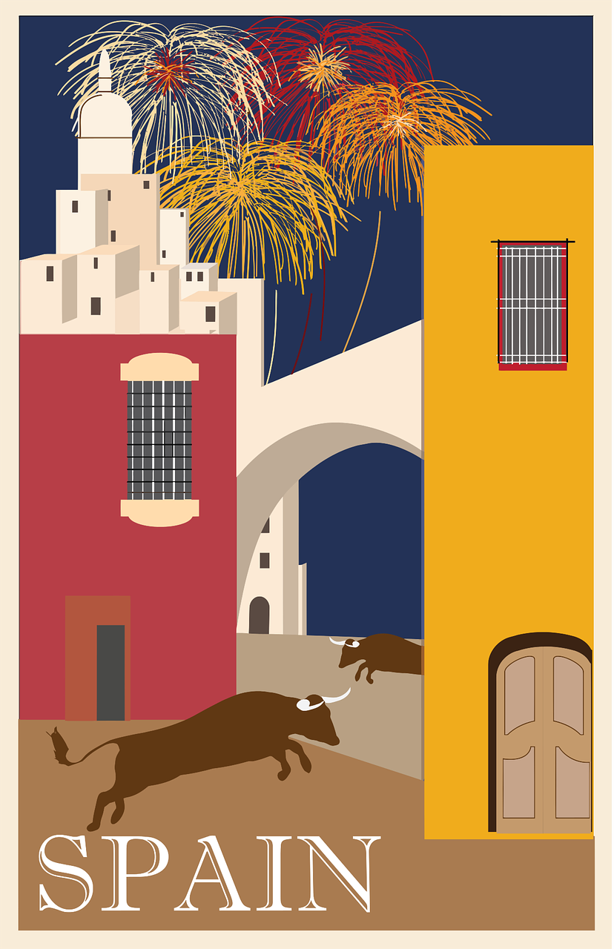

Saying where you are going and what there is there
verde
ir [to go]: voy & va
Contractions (al vs. a la)
SSC: [b] [v]
e r
P ú
Notes:
Artwork by Steve Clarke. All additional pictures selected are available under a Creative Commons license, no attribution required.
The frequency rankings for words that occur in this PowerPoint which have been previously introduced in the resources are given in the SOW (excel document) and in the resources that first introduced and formally re-visited those words.
Phonics: revisit SSC [b] and [v]
Vocabulary (new words in bold): voy [ir 33] vas [ir 33] va [ir 33] bosque [1444] campo [342] isla [810] lago [2151] montaña [1464] playa [1475] río [496] a [8] el [1] la [1]
Revisit 1: jugar [356] amigo [210] amiga [1172] ajedrez [4970] carta [627] cuerda [2116] escondite [>5000] fútbol [1471] habitación [1069] hermano [333] hermana [3409] línea [476] tenis [4856] pelota [2270] solo [181] con [14] en [5]
Revisit 2: tiene [8] cantante [2105] cara [337] gafas [>5000] nariz [1570] ojo [169] pelo [873] profesor / profesora [501] azul [811] corto [1055] grande [66] gris [1751] largo [300] moreno [3304] negro [307] pequeño [202] rubio [2861] redondo [2470] verde [812] los / las [1]
Glossed:
capital [581] costa [775] excursión [4699] provincia [1095] región [545] selva [2768] sierra [2569] viaje [519] amazónico [>5000] casi [166] cubierto [3775]
Source: Davies, M. & Davies, K. (2018). A frequency dictionary of Spanish: Core vocabulary for learners (2nd ed.). Routledge: London
For any other words that occur incidentally in this PowerPoint, frequency rankings will be provided in the notes field wherever possible.

Slide 3

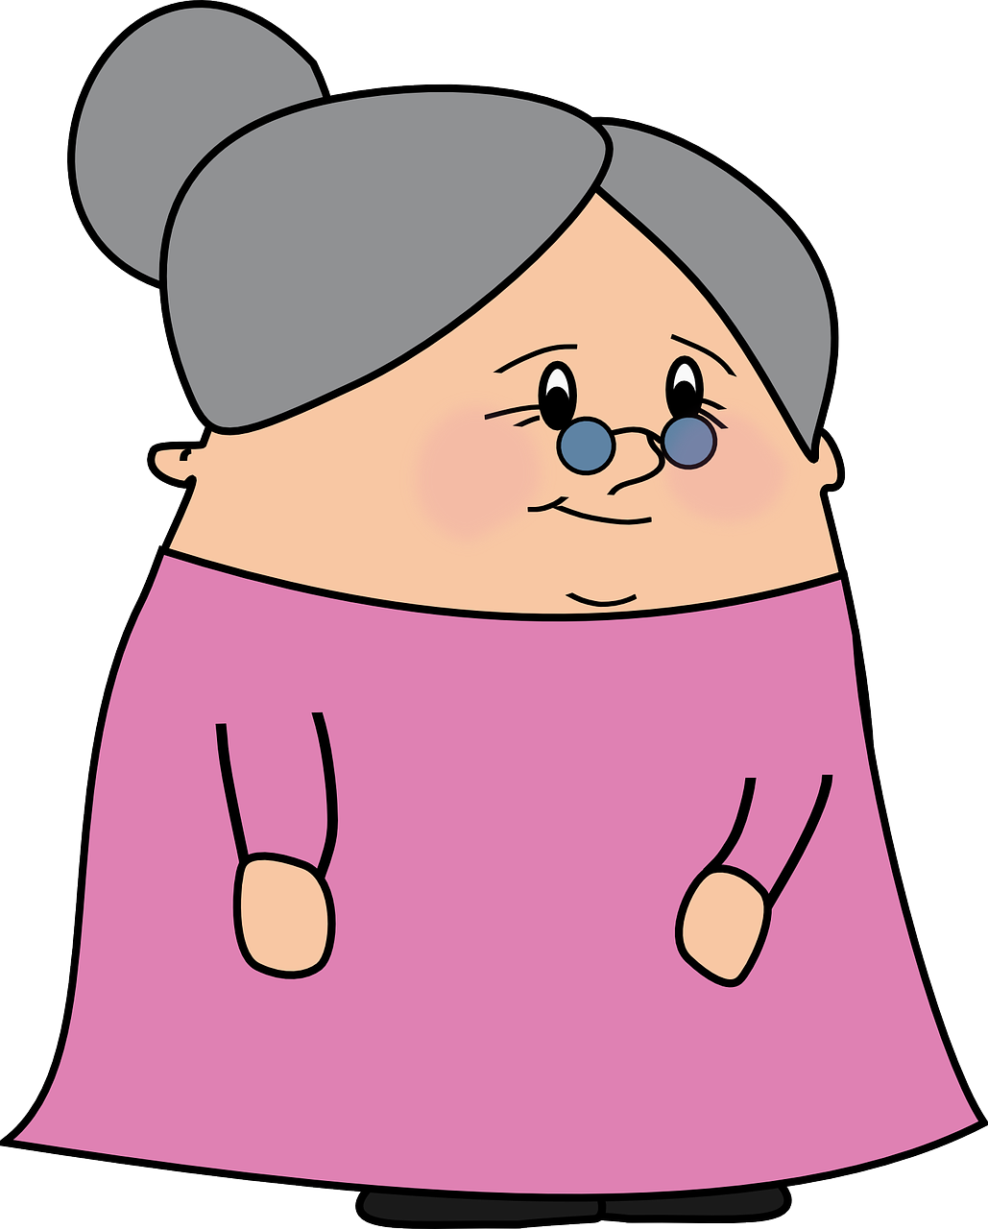
[b]
abuela
pronunciar
Notes:
Timing: 1 minute
Aim: To revisit SSC [b]
Procedure:
To recap and elicit the pronunciation of the individual SSC [b]
Click to bring the picture & get students to repeat (with gesture, if using).
Gesture suggestion: Spanish sign language for ‘abuela’ can be viewed here as a possible gesture:
https://www.youtube.com/watch?v=cxOcDkvKaJY

Slide 4



[v]
ver
Notice [v] has the same sound as [b] ☺.
pronunciar
Notes:
Timing: 1 minute
Aim: To revisit SSC [v]
Procedure:
To recap and elicit the pronunciation of the individual SSC [v]
Click to bring the picture & get students to repeat (with gesture, if using).
Gesture suggestion: point index and middle fingers of right hand towards the eyes and then away from the face to point forwards, gesturing ‘seeing you, looking at you’.

Slide 5

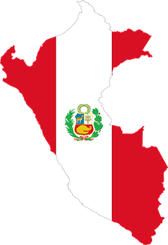
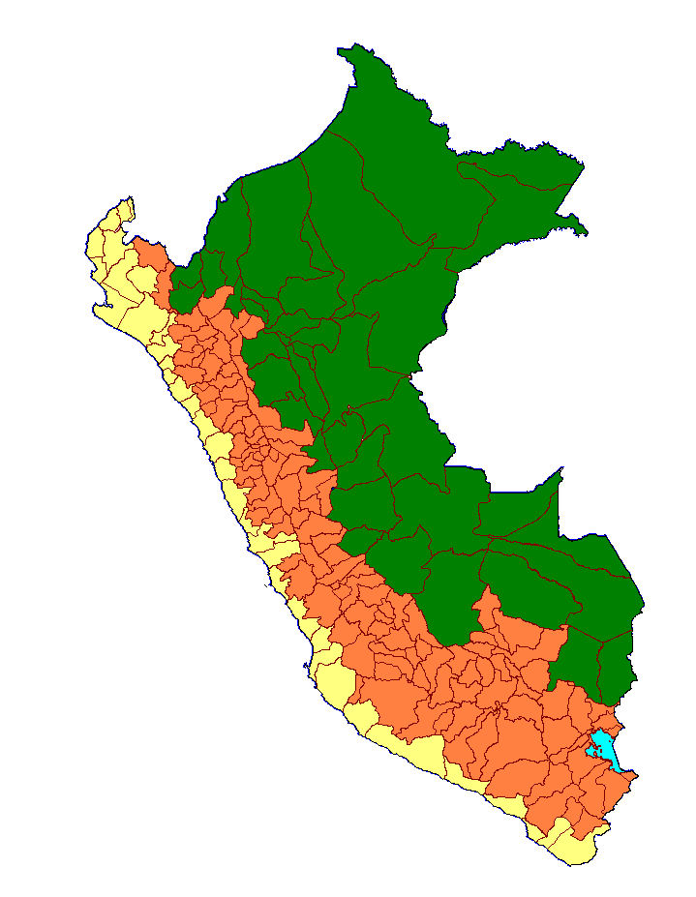
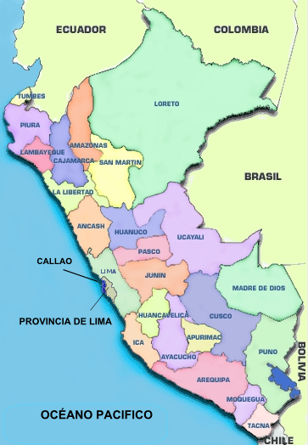
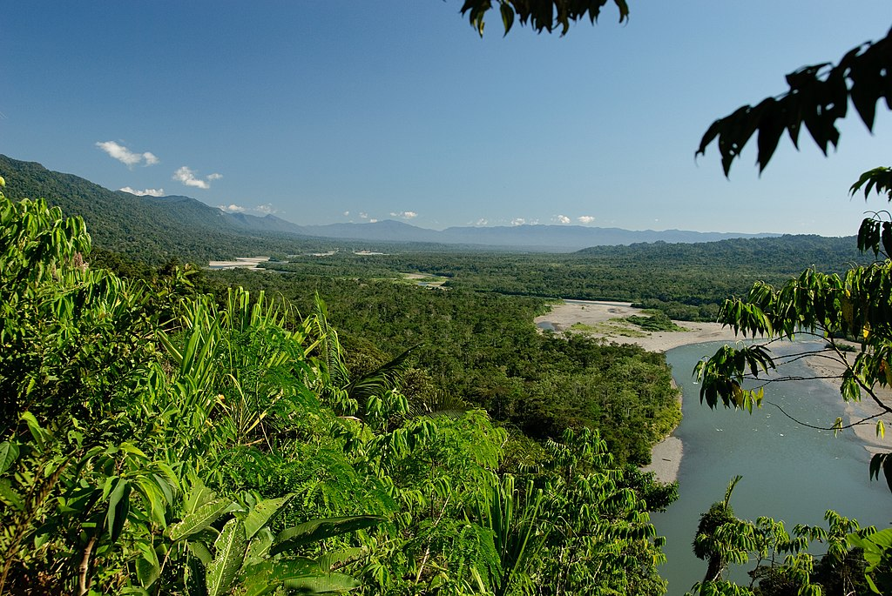
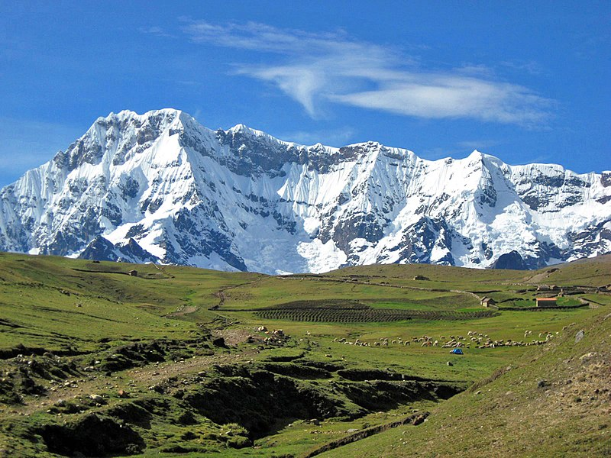
pronunciar
Lee la información sobre Perú con tu compañero/a.
La Sierra
1
En Perú hay 25 provincias.
5
Perú tiene selva.
3
Vichayito
es una playa muy famosa en Piura.
60
segundos
4
Perú tiene sierra.
El Nevado de Ausangate
6
La Libertad tiene costa y sierra.
(la) provincia = province
(la) costa = coast
(la) selva = tropical rain forest
(la) sierra = mountain range
2
Perú tiene costa*.
INICIO
Notes:
Timing: 3 minutes
Aim: to practise reading aloud [b] [v] with unknown vocabulary re landscape in Perú; to set the cultural focus of this lesson.
Procedure:
Pupils practise (chorally) reading all the info, starting from 1.
Start the timer.
Click on each number to listen to and check the sentences 1-6.
Frequency of unknown words and cognates:
costa [775] provincia [1095] selva [2768] sierra [2569]
Source: Davies, M. & Davies, K. (2018). A frequency dictionary of Spanish: Core vocabulary for learners (2nd ed.). Routledge: London
Pictures attributions:
Map 1: De I, JohnManuel, CC BY 2.5, https://commons.wikimedia.org/w/index.php?curid=2309301
El Nevado de Ausangate: De Edubucher - Trabajo propio, CC BY-SA 3.0, https://commons.wikimedia.org/w/index.php?curid=16939428Map: By AgainErick at the English Wikipedia, CC BY-SA 3.0, https://commons.wikimedia.org/w/index.php?curid=9474392
Selva: By Corey Spruit - Flickr: Manu National Park-71, CC BY 2.0, https://commons.wikimedia.org/w/index.php?curid=25786829
Ceviche: By Ledelboy Luis Delboy (Don Lucho) - self-made. Originally published in http://donlucho.com, CC BY-SA 3.0, https://commons.wikimedia.org/w/index.php?curid=4360252

Slide 6

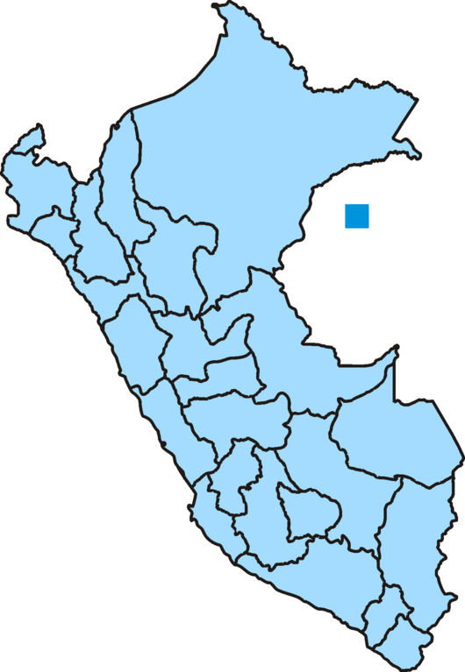
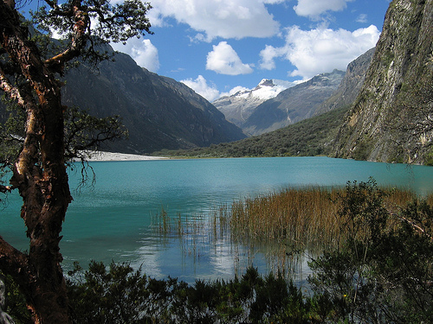

Leer y hablar
¿Dónde está la ciudad?
[1/4]
Piura
Remember! La ciudad means city.☺
_ _ _ _ _ está en el norte.
leer
hablar
1
Iquitos
_ _ _ _ _ _ _ está en el norte.
el norte
2
Trujillo
_ _ _ _ _ _ _ _ está en el norte.
el oeste
el este
3
Iquitos
el sur
4
En el norte está el lago de Llanganuco.
Piura
Pucallpa
Trujillo
Cusco
Lima
Puno
Arequipa
Notes:
Timing: 5 minutes (4 slides)
Aim: to present new items of vocabulary (lake, forest, island) in the context of the lesson.
Procedure:
1, Teacher reads the question in SP.
Pupils locate the three cities in the north. Picture is provided to clarify meaning. Teachers could ask ¿Puno está en el norte? ¡No..! Puno no está el norte… ¿y Piura? Before bringing up the support on the slide.
Teacher elicits full sentences from students.
3. In number 4, teachers elicit meaning of ‘lago’ from pupils.
Picture attribution:
De daniel_sandoval - Llanganuco_lagunas_1_ancash, Dominio público, https://commons.wikimedia.org/w/index.php?curid=8689595

Slide 7
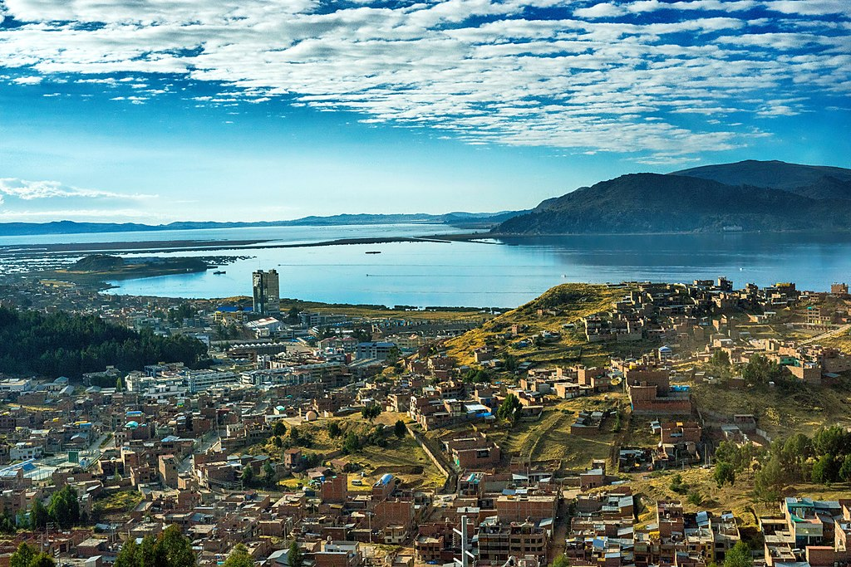
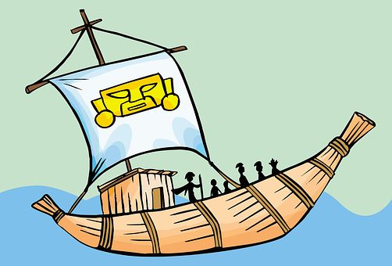
Leer y hablar
¿Dónde está la ciudad?
[2/4]
_ _ _ _ está en el sur.
1
Puno
leer
hablar
Arequipa
_ _ _ _ _ _ _ _ está en el sur.
el norte
2
_ _ _ _ _ está en el sur.
Cusco
el oeste
el este
3
Iquitos
el sur
4
El lago de Titicaca está en Puno.
Piura
Pucallpa
Trujillo
Cusco
Lima
Puno
Un barco típico del lago.
Arequipa
Notes:
Procedure:
1, Teacher reads the question in SP.
Pupils locate the three cities in the south. Picture is provided to clarify meaning. Teachers could ask ¿Piura está en el sur? ¡No..! Puno no está el sur… ¿y Puno? Before bringing up the support on the slide.
Teacher elicits full sentences from students.
3. In number 4, teachers elicit meaning of ‘lago’ from pupils.
Picture attribution:
De Tydence Davis from Las Vegas - Puno cityscape, CC BY 2.0, https://commons.wikimedia.org/w/index.php?curid=63223100

Slide 8
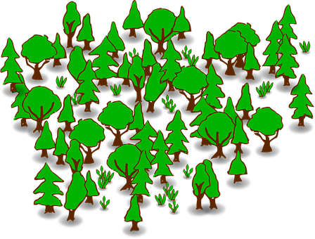
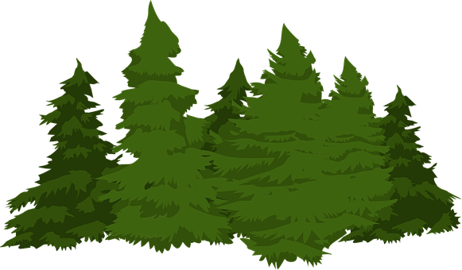
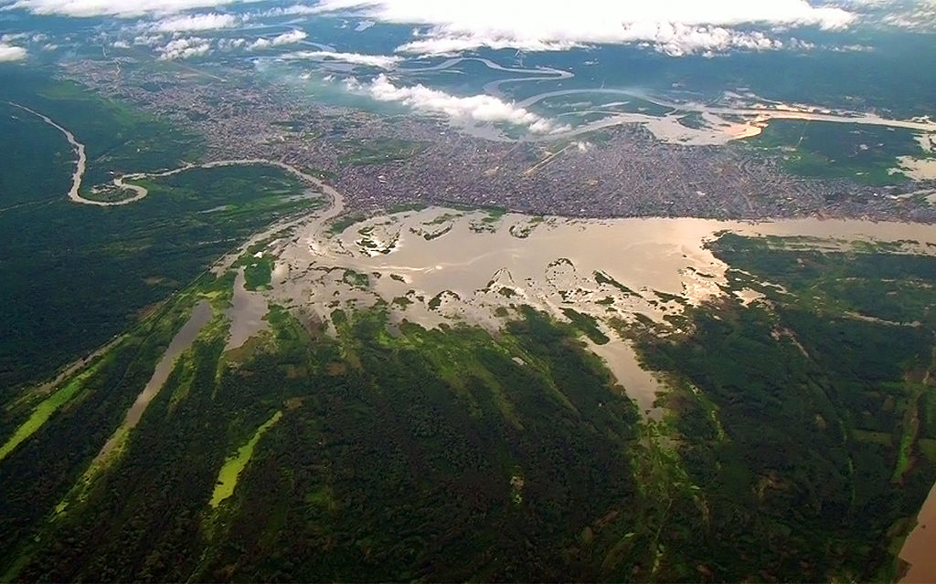
Leer y hablar
amazónico = Amazonian
casi = nearly
cubierto = covered
¿Dónde está la ciudad?
[3/4]
leer
hablar
Iquitos
1
_ _ _ _ _ _ _ está en el este.
Puno
el norte
_ _ _ _ está en el este.
2
el oeste
el este
3
Perú tiene muchos bosques.
Iquitos
Iquitos es la capital de la región de Loreto, donde está el bosque tropical amazónico*.
el sur
Piura
Pucallpa
Trujillo
‘País de bosques’. Casi* el 60% de Perú está cubierto* de bosques.
Cusco
Lima
Puno
Arequipa
Notes:
Procedure:
1, Teacher reads the question in SP.
Pupils locate cities in the east. Picture is provided to clarify meaning. Teachers could ask ¿Iquitos está en el oeste? ¡No..! Iquitos no está ien el oeste… ¿e Puno? Before bringing up the support on the slide.
Teacher elicits full sentences from students.
3. In number 3, teachers elicit meaning of ‘bosque’ from pupils.
Frequency of unknown words and cognates:
capital [581] región [545] amazónico [>5000] casi [166] cubierto [3775]
Source: Davies, M. & Davies, K. (2018). A frequency dictionary of Spanish: Core vocabulary for learners (2nd ed.). Routledge: London
Picture attribution:
De Percy Meza - Trabajo propio, CC BY-SA 4.0, https://commons.wikimedia.org/w/index.php?curid=44759960

Slide 9
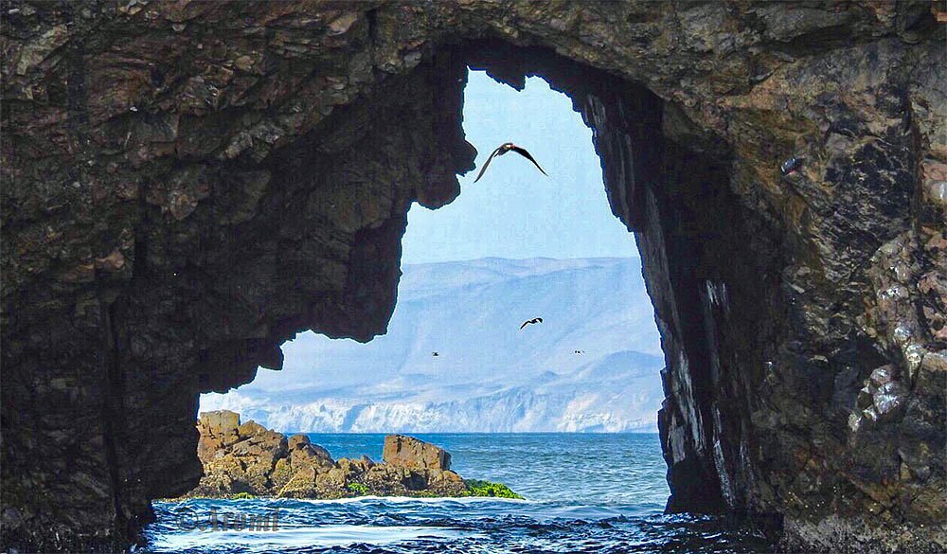

Leer y hablar
¿Dónde está la ciudad?
[4/4]
_ _ _ _ está en el oeste.
1
Lima
leer
hablar
Paracas
_ _ _ _ _ _ _ está en el oeste.
el norte
2
el oeste
el este
3
Las islas Ballestas están en el este, cerca* de Paracas.
Iquitos
el sur
Piura
Pucallpa
Cusco
Lima
Puno
Paracas
Notes:
Procedure:
1, Teacher reads the question in SP.
Pupils locate the three cities in the west. Picture is provided to clarify meaning. Teachers could ask ¿Puno está en el oeste? ¡No..! Puno no está el oeste… ¿y Lima? Before bringing up the support on the slide.
Teacher elicits full sentences from students.
3. In number 3, teachers elicit meaning of ‘isla’ from pupils.
Picture attribution:
https://www.tripadvisor.es/Attraction_Review-g445063-d4732462-Reviews-Islas_Ballestas-Paracas_Ica_Region.html

Slide 10


Using the verb ‘ir’
[ir: I go vs. s/he goes]
Some verbs do not follow regular patterns.
The verb ‘ir’ (to go) is an irregular verb.
va
voy
To say ‘s/he goes’, we use _____.
To say ‘I go’, we use _______.
s/he, it
I
Voy con mamá.
Va con una amiga.
S/he goes with a (female) friend.
I go with mum.
Quique va con una amiga.
Quique goes with a (female) friend.
Notes:
Timing: 3 minutes
Aim: to introduce 1st and 3rd person singular of ‘ir’.
Procedure:
Read the grammar explanation on irregular verb ir.
Elicit English translation for the Spanish examples provided.

Slide 11
Using ‘al’ & ‘a la’
[to the]
The Spanish word ‘a’ means ‘to’:
This is because it’s much easier to say ‘al’ than ‘a el’. Try it 😊!
Voy a Burgos.
I go to Burgos.
To mean ‘to the’ before a singular feminine noun, use ‘a la’.
To mean ‘to the’ before a singular masculine noun, use a + el → al.
Voy a la playa.
Voy al bosque.
I go to the beach.
I go to the forest.
Notes:
Timing: 3 minutes
Aim: to introduce contraction ‘al’.
Procedure:
Read the grammar explanation on ‘to the’.
Elicit English translation for the Spanish examples provided.

Slide 12


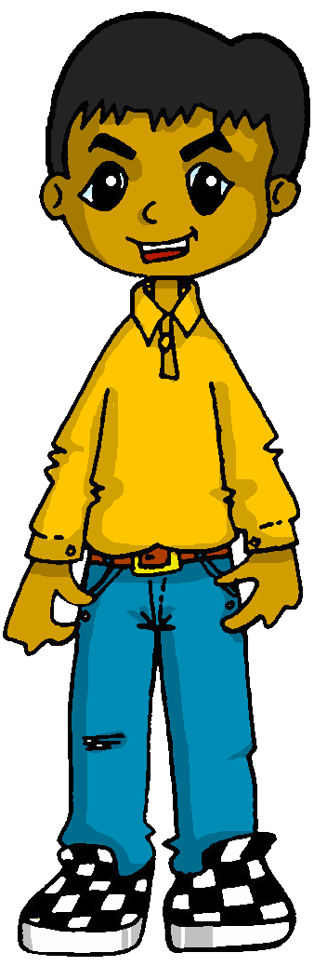

escuchar
La excursión* con la escuela.
¿Quién es? Marca ✅.
Escribe en español 📝.
Voy de excursion y Luis también va.
 | Sofía (I) | Luis (he)
Información extra
E
en julio
1
a la montaña
2
con mis padres
3
a la ciudad
4
con los abuelos
5
en agosto
(la) excursión = trip
Notes:
Timing: 5 minutes (2 slides)
Aim: to practise aural identification of 1st and 3rd person singular based on the verb form..
Part 1
Procedure:
1. Ensure pupils are clear about the task. Point out Sofía’s speech bubble with ‘voy’ (I go) and Luis va (he goes).
2. Click to play the example. Ask pupils to tick Sofía (I) or ‘Luis’ (he)
3. Click to reveal the answer.
4. Play 1-5 and pupils complete.
5. Click to reveal answers.
6. Click to listen to each sentence again. This time pupils write down any extra information, in Spanish.
7. Click to reveal the additional information.
Transcript:
[E] Voy en julio.
[1] Va a la montaña
[2] Voy con mis padres.
[3] Va a la ciudad.
[4] Va con los abuelos.
[5] Va en agosto.
Frequency of unknown words and cognates:
viaje [519]
Source: Davies, M. & Davies, K. (2018). A frequency dictionary of Spanish: Core vocabulary for learners (2nd ed.). Routledge: London

Slide 13


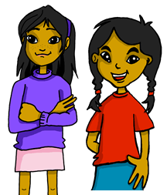
leer
El viaje de Luis y Sofía: Sofía escribe.
el viaje = trip / journey
Sofía escribe pero ¡hay un problema con el chocolate!
Es “al” o “a la”?
¿Qué frase es? Escribe el número 📝.
¿Quién es?
E
Va al bosque.
 | I go | he goes to the mountain.
 | I go | he goes to the lake.
 | I go | he goes to the beach.
 | I go | he goes to the island.
 | I go | he goes to the river.
 | I go | he goes to the forest.
[5]
1
Va a la playa.
[4]
2
Voy a la isla.
[1]
3
Voy al río.
[2]
4
Va al lago.
[3]
5
Voy a la montaña.
[E]
Notes:
Timing: 10 minutes
Aim: To identify the use of ‘al’ and ‘a la’.
This activity is structured in three parts. In Part 1 students decide if they need al or a la by looking at looking at the noun. Part 2 revisits vocabulary. Part 3 revisits 1st and 3rd person singular of ir.
Procedure:
Part 1
1. Teachers to set the context of the task
2. Do [E] with pupils. Draw their attention to the noun (bosque). Is it masculine or feminine?. It’s el bosque, therefore it’s a masculine noun.
3. Click to bring up answers.
Pupils do 1-5.
Elicit answers from pupils and click to bring up answers.
If desired, click on the audio buttons to hear the full sentences.
Part 2
Click to bring up instructions and English translations.
Pupils to match up the English translations with Spanish sentences (E to 5).
Elicit answers from pupils and click to bring up correct numbers
Part 3
Click to bring up instructions & reveal sentences in full. (Check pupils understand the question - who is it? Luis? Or Sofia?).
Draw their attention to the verb (Voy/ va).
Pupils can write the verb & English translation for each number (NB. Some pupils might benefit from a having a paper copy of the task).
Elicit verb & English translation from pupils & and click to bring up answers.
Frequency of unknown words and cognates:
viaje [519]
Source: Davies, M. & Davies, K. (2018). A frequency dictionary of Spanish: Core vocabulary for learners (2nd ed.). Routledge: London

Slide 14
¡adiós!
verde

