Slide 1





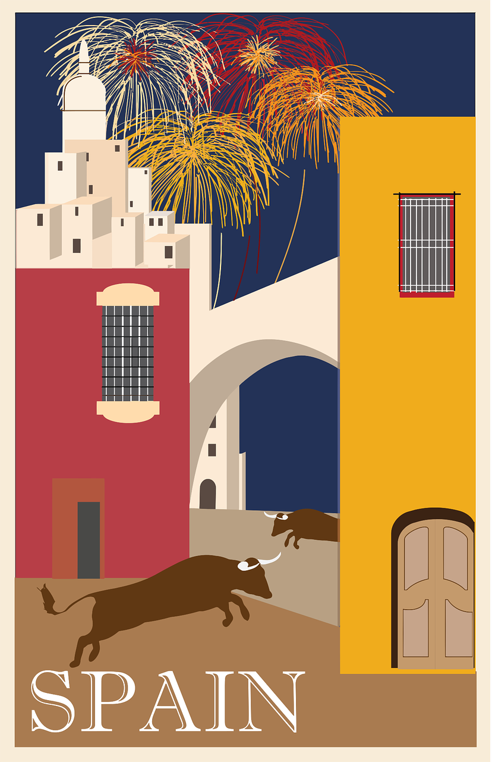

Saying what I and others do
verde
e r
P ú
Follow ups 1-5
Notes:
Artwork by Steve Clarke. All additional pictures selected are available under a Creative Commons license, no attribution required.
The frequency rankings for words that occur in this PowerPoint which have been previously introduced in the resources are given in the SOW (excel document) and in the resources that first introduced and formally re-visited those words.
Phonics: revisit SSC [b] and [v]
Vocabulary (new words in bold): voy [ir 33] vas [ir 33] va [ir 33] bosque [1444] campo [342] isla [810] lago [2151] montaña [1464] playa [1475] río [496] a [8] el [1] la [1]
Revisit 1: jugar [356] amigo [210] amiga [1172] ajedrez [4970] carta [627] cuerda [2116] escondite [>5000] fútbol [1471] habitación [1069] hermano [333] hermana [3409] línea [476] tenis [4856] pelota [2270] solo [181] con [14] en [5]
Revisit 2: tiene [8] cantante [2105] cara [337] gafas [>5000] nariz [1570] ojo [169] pelo [873] profesor / profesora [501] azul [811] corto [1055] grande [66] gris [1751] largo [300] moreno [3304] negro [307] pequeño [202] rubio [2861] redondo [2470] verde [812] los / las [1]
Glossed words:
costa [775] excursión [4669] selva [2768] sierra [2569] valle [1658] vegetación [3672] hermoso [980]
Source: Davies, M. & Davies, K. (2018). A frequency dictionary of Spanish: Core vocabulary for learners (2nd ed.). Routledge: London
For any other words that occur incidentally in this PowerPoint, frequency rankings will be provided in the notes field wherever possible.

Slide 2



Follow up 1:
[A] Escribe 📝.
pronunciar
palabras
 | verde |  | vestido
 | árbol |  | trabajar
 | también |  | bonito
 | verdad |  | veintidós
 | rubio |  | nervioso
[C] ¿Qué significan las palabras?
E
5
dress to work, working
22 blond
pretty truth
tree green
nervous also, too
1
6
5
6
2
7
8
4
3
8
7
3
4
9
1
E
9
2
[B] Practica con tu compañero/a.
Remember, [b] and [v] sound the same in Spanish 😊.
Notes:
Timing: 7 minutes
Aim: to practise SSC [b] and [v] and revisit vocabulary.
NB. These are all words previously introduced in Verde terms 1 & 2 so far.
Procedure:
Pupils to write the missing letter (or the entire word if they turn away from the board to listen and write).
Click to bring up answers.
Click to bring up part B. Pupils practise the words. Remind pupils that b and v have the same sound in Spanish.
Click to bring up part C instructions. Pupils to match Spanish words with English translations. Encourage pupils to practise in pairs saying the Spanish word and the English translation rather than just saying the number.
Elicit number (and Spanish word) when going through answers. E.g. cinco – el vestido.
Transcript:
Ejemplo: verde
1. árbol
2. también
3. verdad
4. rubio
5. vestido
6. trabajar
7. bonito
8. veintidós
9 nervioso.

Slide 3

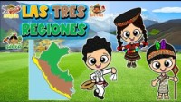

Follow up 2:
Escucha la canción y lee la lista.
escuchar
¿Está en en el vídeo de Perú o no?
playas
❌
islas
❌
lagos
montañas
❌
restaurantes
❌
ríos
hermosa = beautiful
(la) costa = coast
(la) selva = forest
(la) sierra = mountains / mountain range
(el) valle = valley
vegetación = vegetation
Notes:
Timing: 5 minutes
Aim: to practise listening and joining in with a song about the geography of Peru; to read a list of known words and decide if these are represented in the video, or not.
Procedure:
Pupils listen to the song and watch the video.
They read the list of Spanish nouns and decide if these appear in the video.
Click to correct.
Replay the song and invite pupils to join in with the repeated lines and phrases.
Video attribution:
With many thanks to Mercedes Edith: https://www.youtube.com/watch?v=zsvm4EtyRvQ&ab_channel=MercedesEdith
Word frequency of unknown words and cognates used (1 is the most frequent word in Spanish):
costa [775] selva [2768] sierra [2569] valle [1658] vegetación [3672] hermoso [980]
Source: Davies, M. and Davies, K. (2018). A frequency dictionary of Spanish: Core vocabulary for learners (2nd ed.). Routledge: London

Slide 4

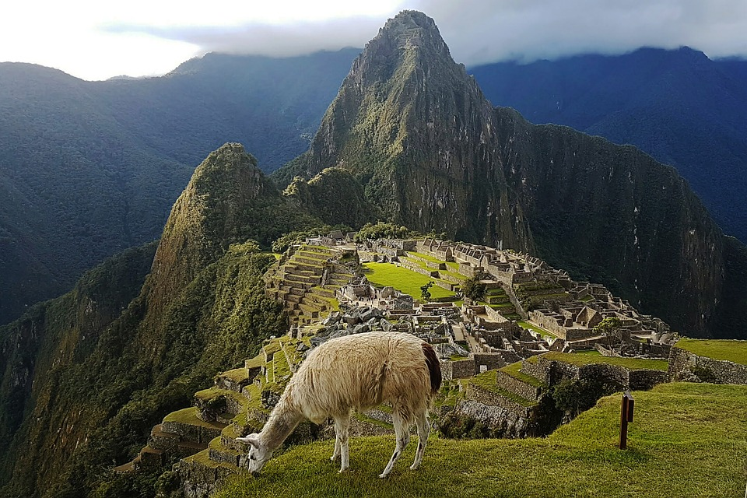
Follow up 3:
excursión = trip
Luis va de excursión* a Cusco y manda unos mensajes a Sofía.
Cusco es una ciudad en el sur de Perú.
Después va a Machu Picchu.
También va al lago Titicaca en Puno.
Es una excursión muy divertida.
1
leer
2
3
3
5
Machu Picchu es una ciudadela Inca.
lake
he goes
to the
to
after
city
he sends
South
el lago
va
al
a
después
la ciudad
manda
el sur
Notes:
Timing: 10 minutes
Aim: written comprehension of some previously taught vocabulary within a longer text; to introduce the context for the remaining activities.
Procedure:
Part 1 [6 minutes]
Give pupils 2-3 minutes to read the sentences with a partner and find the Spanish meanings for the eight English words.
Pupils could be asked to read the text aloud in pairs, taking it in turns to read alternate sentences.
Click the audio buttons to hear each sentence, if desired.
Click on each English word to reveal the Spanish translation.
NB. Some pupils might benefit from a bit of teacher’s input on the Inca civilization. The Inca Empire was the last empire in pre-Columbian America.
Part 2 (next slide)
Frequency of unknown words and cognates:
excursión [4699]
Source: Davies, M. & Davies, K. (2018). A frequency dictionary of Spanish: Core vocabulary for learners (2nd ed.). Routledge: London

Slide 5
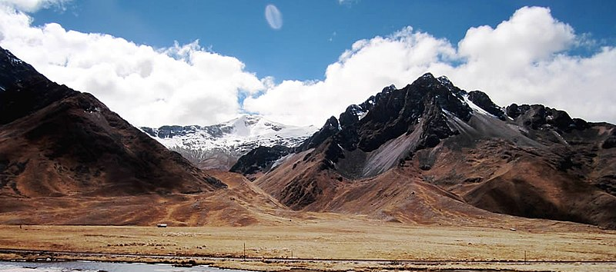

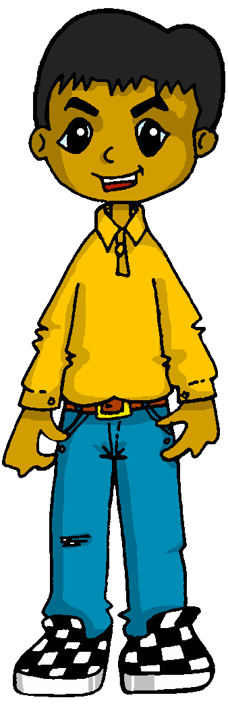
Follow up 4
[1/5]
excursión = trip
Sofía habla de la excursión de Luis y de ella.
Lee el mensaje.
Leer y hablar
Completa la frase con las palabras correctas.
20
montaña
Va al ____________.
a la
S
Cordillera La Raya: Los Andes
I
s/he
0
INICIO
Notes:
Timing: 5 minutes [1/5]
Aim: written comprehension of 1st and 3rd person singular and contractions; oral production of vocabulary.
Procedure:
Pupils work in pairs to read the sentence aloud, choosing the correct translation for ‘to the’ and the correct word for the gap (draw their attention to the picture to elicit this).
Click on ‘inicio’ to start the timer (25 seconds in total)
Elicit answer from pupils & click to bring up answers.
Click further to bring up further questions. Is Sofía talking about herself or about Luis?
Frequency of unknown words and cognates:
excursión [4669]
Source: Davies, M. & Davies, K. (2018). A frequency dictionary of Spanish: Core vocabulary for learners (2nd ed.). Routledge: London
Picture attribution:
De David Stanley from Nanaimo, Canada - La Raya Pass, CC BY 2.0, https://commons.wikimedia.org/w/index.php?curid=24200185

Slide 6
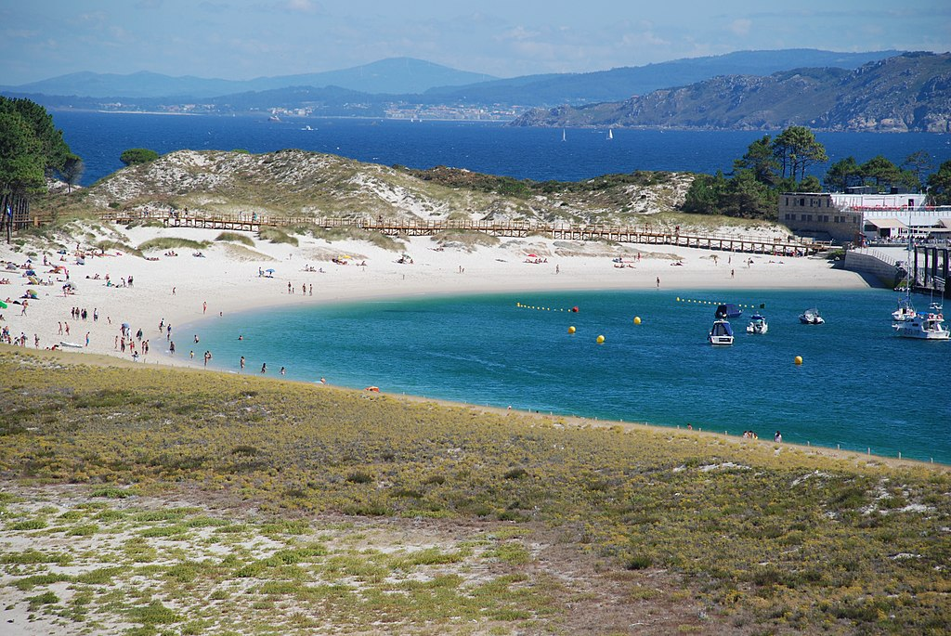
Follow up 4
[2/5]
excursión = trip
Lee el mensaje.
Leer y hablar
Completa la frase con las palabras correctas.
20
playa
Voy al ______.
a la
S
Playa de Rodas
P_ _ _ _ de Rodas
I
s/he
0
INICIO
Notes:
[2/5]
Picture attribution:
De Julio Aquino, CC BY 3.0, https://commons.wikimedia.org/w/index.php?curid=52977777

Slide 7
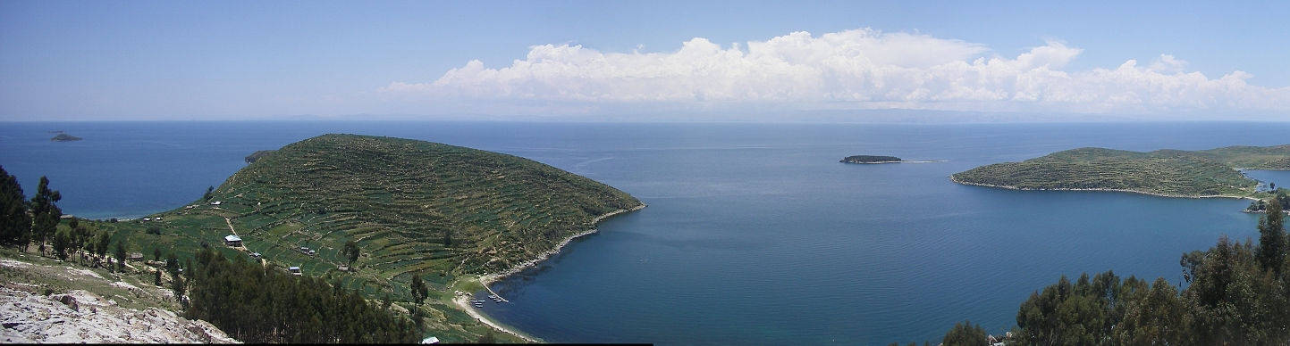
Follow up 4
[3/5]
excursión = trip
Lee el mensaje.
Leer y hablar
Completa la frase con las palabras correctas.
20
lago
Voy al ______.
a la
Tititcaca
S
El lago Titicaca está en
Perú y Bolivia.
I
s/he
0
INICIO
Notes:
[3/5]
Picture attribution:
De Diego Delso, CC BY-SA 4.0, https://commons.wikimedia.org/w/index.php?curid=46447305

Slide 8
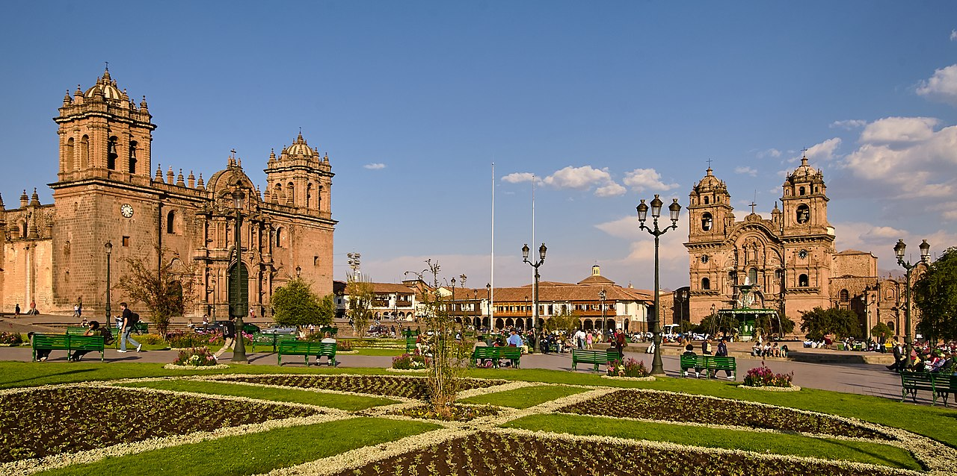
Follow up 4
[4/5]
excursión = trip
Lee el mensaje.
Leer y hablar
Completa la frase con las palabras correctas.
20
plaza
Va al ______ de Armas.
a la
S
P _ _ _ _ de Armas
Plaza de Armas
I
s/he
0
INICIO
Notes:
[4/5]
Picture attribution:
De Diego Delso, CC BY-SA 4.0, https://commons.wikimedia.org/w/index.php?curid=46447305

Slide 9
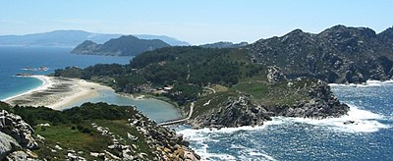
Follow up 4
[5/5]
excursión = trip
Lee el mensaje.
Leer y hablar
Completa la frase con las palabras correctas.
20
isla
Va al ______ de Monteagudo.
a la
S
_ _ _ _ Monteagudo
Isla Monteagudo
I
s/he
0
INICIO
Notes:
[5/5]
Picture attribution:
Public Domain, https://en.wikipedia.org/w/index.php?curid=4252779

Slide 10

Follow up 5:
El ordenador tiene un problema. 😨.
Quique escribe a Luis.
Leer y hablar
Lee el mensaje con tu compañero/a.
¡[Hello] Luis! Estoy en [home] [with] mamá [in] mi [room]. El [Friday] [I go] de excursión con [my] clase. Mi profesora [has] el pelo [short] y [black] . [I go] [to the] isla de Monteagudo. Es una [island] muy [pretty]. Sofía [goes] con el señor Valero. [She goes] [to the] [forest].
Hola
casa
con
en
habitación.
viernes
voy
mi
tiene
largo
negro
Voy
a la
isla
bonita
va
Va
al
bosque
Notes:
Timing: 5 minutes
Aim: oral practice of the key grammatical features of week 6 (ir, al/a la)
Procedure:
Teacher to read the context and ensure this is clear.
Pupils to read the message aloud in pairs. Some words are jumbled, some others are in English.
Elicit answers from pupils and click to bring up answers.
Click to bring up part 2 of the task to check understanding. Pupils can say the English words for the items mentioned in the e-mail aloud (animations appear on click from left to right, in the order they are mentioned in the text).

Slide 11

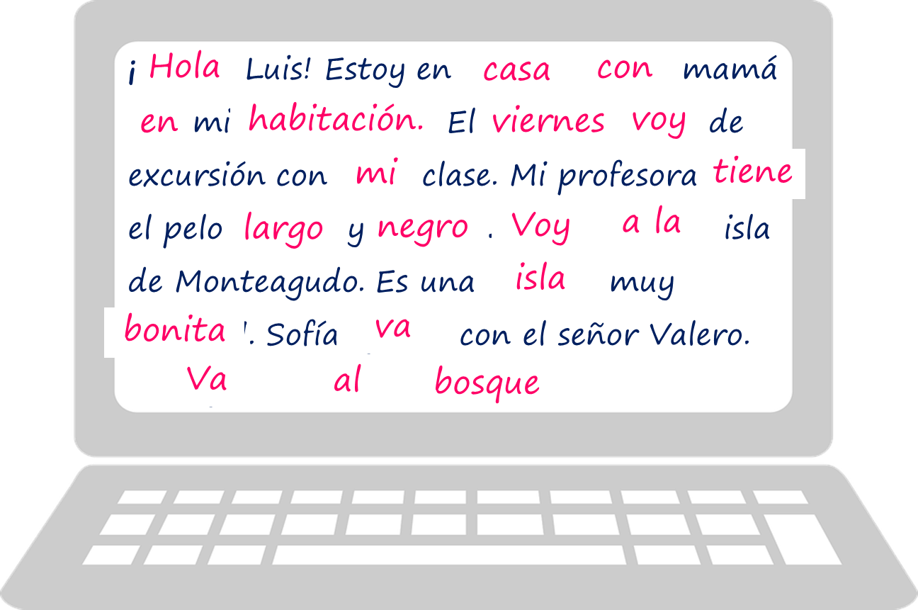
Follow up 5
Escribe el mensaje en inglés.
escribir
Hello, Luis!
I’m at home with my mum,
in my room.
On Friday I’m going on
My teacher has
a trip with my class.
long, black hair.
I’m going to the island
of Monteagudo.
It is a very pretty island.
Sofía is going with Mr Valero.
She is going to the forest.
Notes:
Timing: 6 minutes
Aim: written comprehension of the key grammatical features of week 6 (ir, to the) & previously introduced vocabulary.
Procedure:
Pupils to read the message again and translate it into English.
Click to bring up answers (each sentence at a time)

Slide 12
¡adiós!
verde

