Slide 1


español, con Sofía

Slide 2

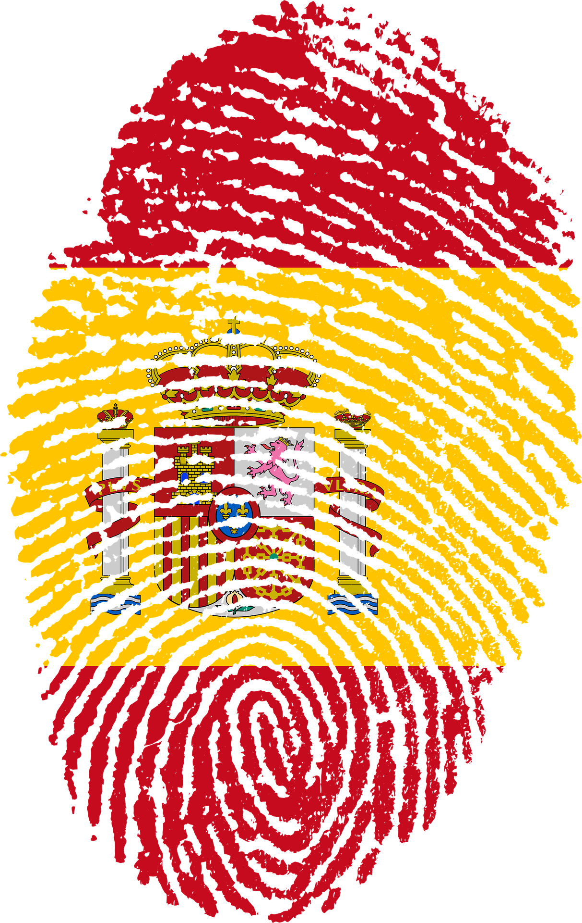



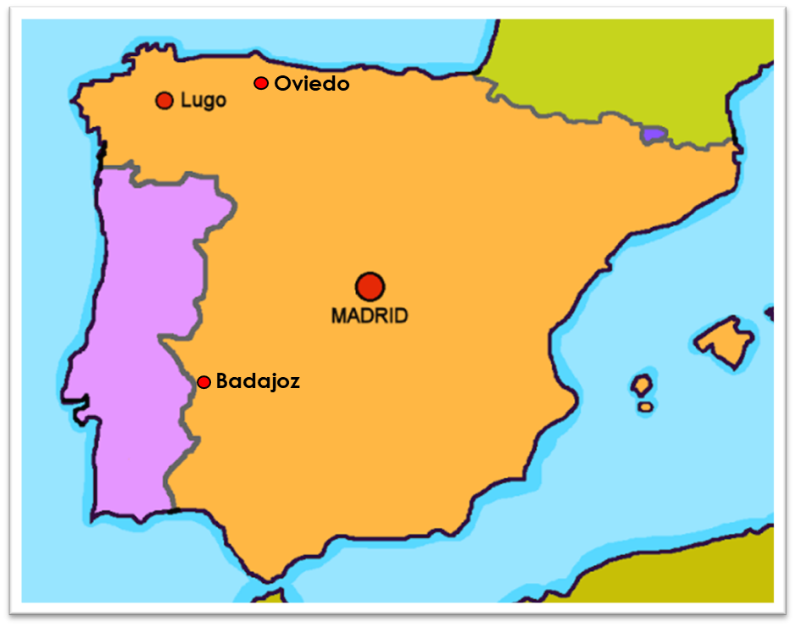

Saying where you are going and what there is there
Extremadura
verde
numbers 1-31
hay, no hay
unos, unas
SSC: [n] [ñ]
Notes:
Artwork by Steve Clarke. All additional pictures selected are available under a Creative Commons license, no attribution required.
The frequency rankings for words that occur in this PowerPoint which have been previously introduced in the resources are given in the SOW (excel document) and in the resources that first introduced and formally re-visited those words.
Phonics: Revisit [n] and [ñ]
Vocabulary (new words in bold*): hay [13] dos [64] tres [134] cuatro [241] cinco [284] seis [438] siete [603] ocho [641] nueve [991] diez [449] once [1701] doce [1138] trece [2700] catorce [2411] quince[1215] dieciséis [3373] diecisiete [3400] dieciocho [2730] diecinueve [4232] veinte [819] veintiuno [819/425] veintidós, veintitrés, veinticuatro, veinticinco, veintiséis, veintisiete, veintiocho, veintinueve, treinta [830] treinta y uno [830/4/425]
Revisit 1: fin [182] restaurante [2636] ruido [1034] nunca [158]: aprender [428] beber [1085] comer [37] comprender [434] hacer [26] leer [209] responder (a) [464] ver [38] a menudo [958] a veces [vez 59] normalmente [1696]siempre [96]
Revisit 2: tienen [8] tenemos [8] cine [952] edificio [857] aquí [130] de12 [2] delante [1742] detrás [2044] dónde [161] en1 [6] entre [63]
Glossed words:
adivinar [2201] escribir [198] ] carnaval [4114] desfile [4514] disfraz [>5000] espacio [451] mariposa [3359] oeste [2416] pájaro [1607]
región [545] ritmo [1277] tambor [3826] tema [240] infantil [1706] que [3]
Source: Davies, M. & Davies, K. (2018). A frequency dictionary of Spanish: Core vocabulary for learners (2nd ed.). Routledge: London
For any other words that occur incidentally in this PowerPoint, frequency rankings will be provided in the notes field wherever possible.

Slide 3




pronunciar
mano
[n]
[ñ]
español
¡hola!
Notes:
Timing: 1 minute
Aim: To revisit SSC [n] [ñ]
Procedure:
To recap and elicit the pronunciation of the individual SSC [n] [ñ]
Click to bring the picture & get students to repeat (with gesture, if using).
Gesture suggestion : handshake
Gesture suggestion: mouthe the words ‘hola’ and make a talking gesture with your hand (like a puppet is talking)
Frequency of unknown words:
mano [135]
Source: Davies, M. & Davies, K. (2018). A frequency dictionary of Spanish: Core vocabulary for learners (2nd ed.). Routledge: London

Slide 4






pronunciar
¡A practicar!
escribir = to write, writing
adivinar = to guess
Escribe cinco palabras en secreto. 📝
Tu compañero/a adivina*.
45
segundos
pequeño
piña
cañón
señora
suena
🎶
mañana
niño
ñu
español
mano
pequeña
sueño
😴
INICIO
Notes:
Timing: 4 minutes
Aim: to practise reading aloud [n] [ñ] with some previously taught vocabulary & unknown word (pictures provided to support meaning).
Procedure:
Read the explanation and ensure pupils understand the task.
Start the timer.
Pupils try to guess their partner’s 5 words by saying them aloud, before the 45 seconds is up.
Swap roles and repeat the game.
Frequency of unknown words and cognates:
adivinar [2201] escribir [198] cañón [>4015] niño [173] ñu [>5000] piña [5000] secreto [1490] suena (sonar) [949] sueño [460]
Source: Davies, M. & Davies, K. (2018). A frequency dictionary of Spanish: Core vocabulary for learners (2nd ed.). Routledge: London

Slide 5







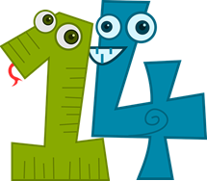

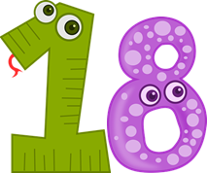



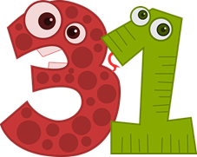
Leer y hablar
Lee los números en el orden correcto.
veintiuno
dieciocho
leer
hablar
catorce
nueve
diez
treinta
doce
60
segundos
treinta y uno
siete
once
dieciséis
veintitrés
cinco
- - - - - - - - - - - - - - - - - - - - - - - - - - - - - - -
INICIO
Notes:
Timing: 3 minutes
Aim: to practise written recognition and correct pronunciation of 13 numbers between 1-31.
Procedure:
Teacher reads the instruction in Spanish and ensures pupil understanding.
Pupils work in pairs to say the numbers in order (1-31). They have one minute.
Click to trigger the timer (60 seconds)
To bring up answers, each number / word disappears on click, and the correct answer appears.

Slide 6
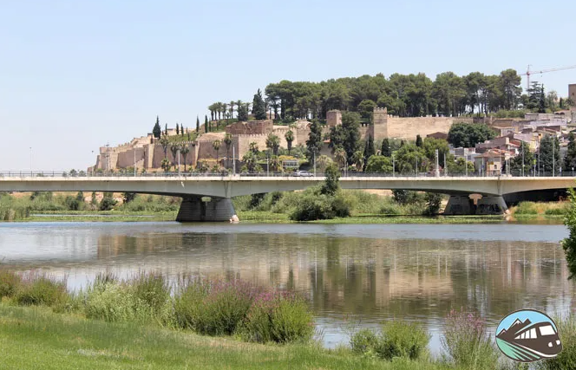
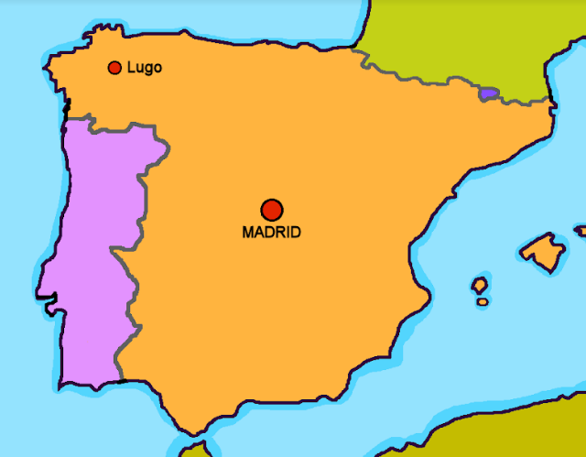
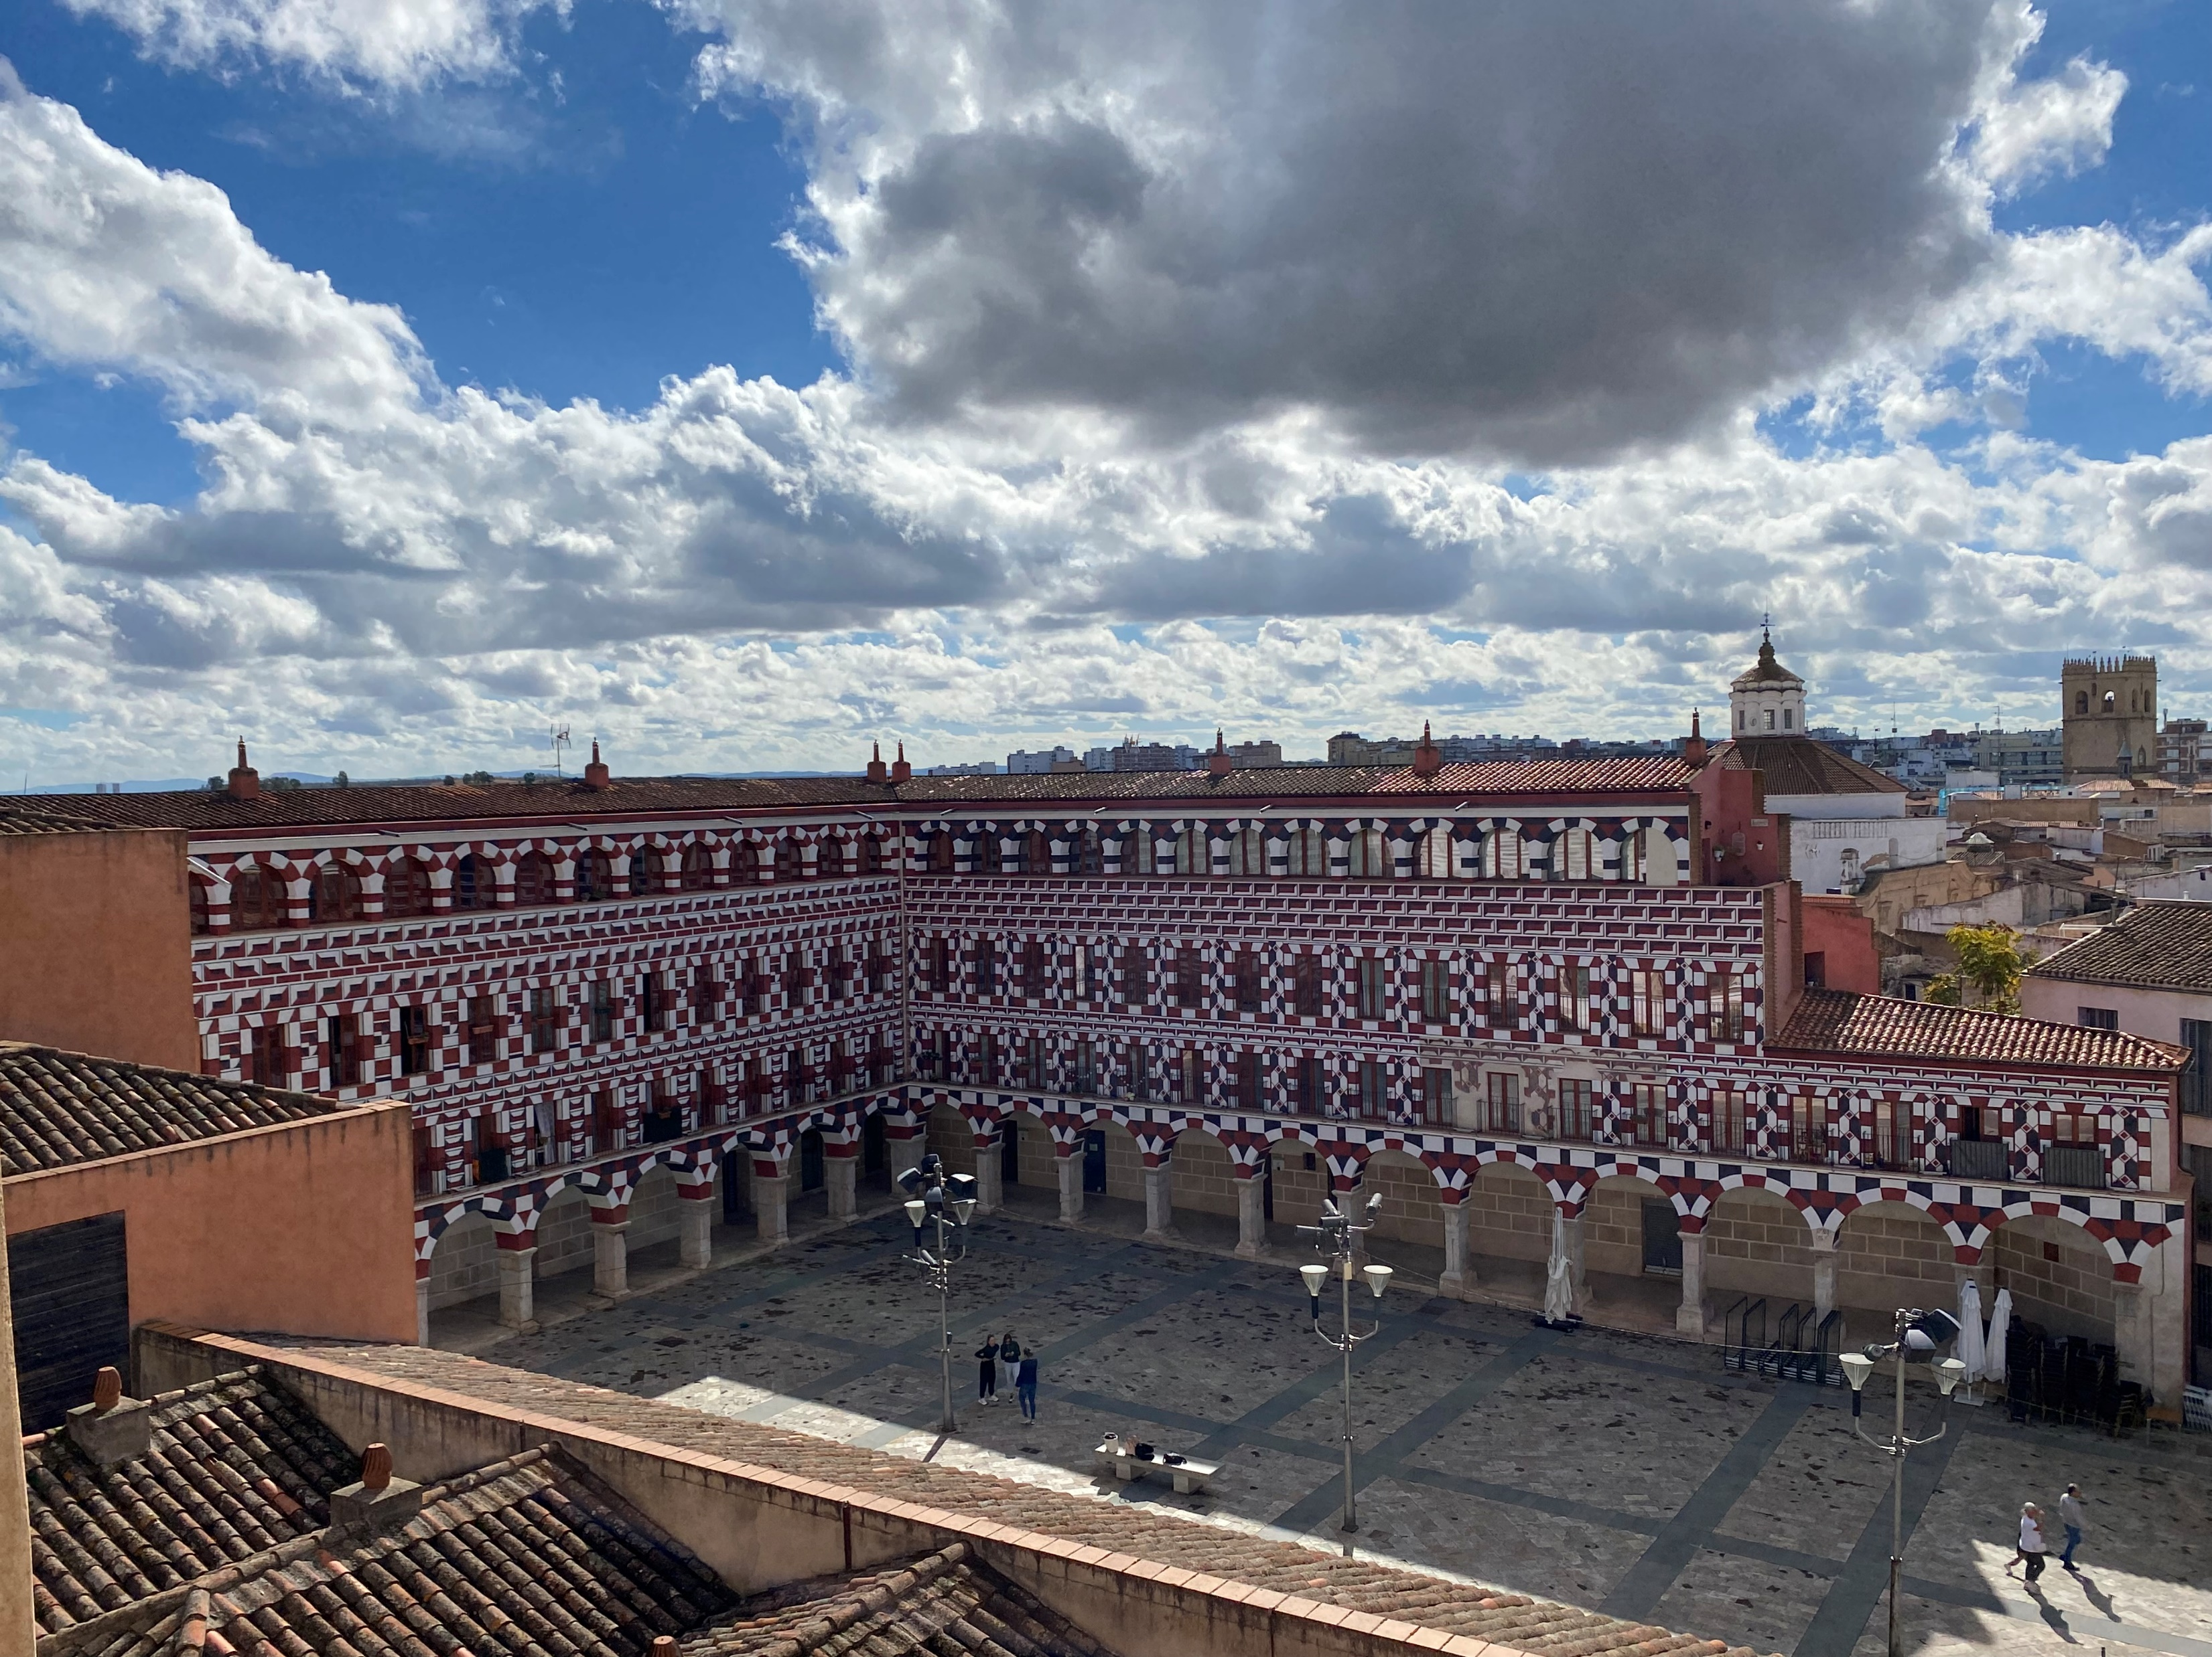
leer
⚠ Remember to use es (SER) to talk about permanent traits; Badajoz is a city.
Badajoz
(el) oeste = west
(la) región = region
Badajoz es una ciudad en el oeste de España, en la región* de Extremadura.
Oviedo
Alcazaba de Badajoz
Badajoz
La Plaza Alta
La Concordia
Notes:
Timing: 1 minute
Aim: To locate Badajoz geographically on a map and introduce its carnival.
Procedure:
1. Click to present the new information.
2. Elicit English meanings from pupils, orally.
3. Click for callout about use of SER.
Frequency of unknown words and cognates:
oeste [2416] región [545]
Source: Davies, M. & Davies, K. (2018). A frequency dictionary of Spanish: Core vocabulary for learners (2nd ed.). Routledge: London
Photo 1 from:
https://www.rutasporespana.es/blog/2016/11/que-ver-hacer-badajoz/
Many thanks to José, Adrián and Alicia.

Slide 7

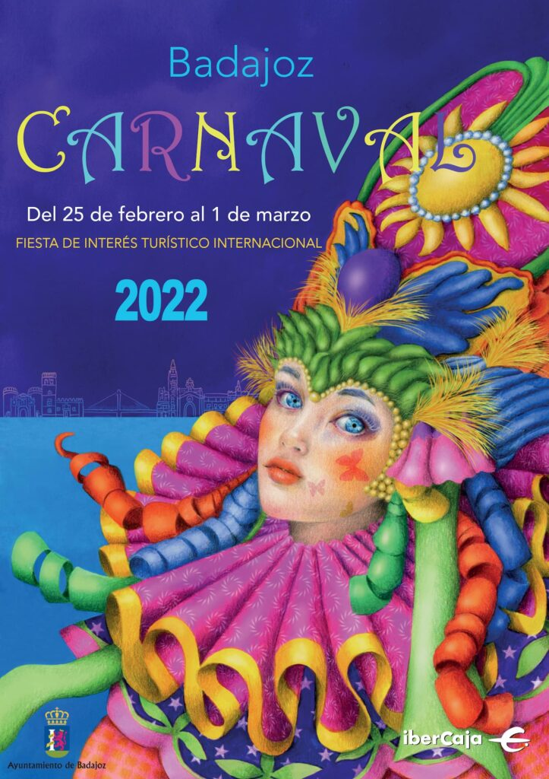
escuchar
Escucha y completa los espacios*.
(el) espacio = space
En Badajoz, [E] ______ un carnaval* muy famoso en febrero. Cada [1] ______ tiene un tema* y [2] ______ disfraces* de muchos [3] ______. Hay una banda con
[4] ____________ también. En las
[5] ____________ hay muchas personas que* [6] ___________ la fiesta: bailan y cantan al ritmo* de la música.
hay
E
1
grupo
2
llevan
3
colores
4
instrumentos
5
calles
celebran
6
(la) carnaval = carnival
(el) tema = theme
disfraces = costumes
que = who, that, which
(el) ritmo = rhythm
Notes:
Timing: 10 minutes (2 slides)
Aim: to practise transcription of previously taught vocabulary; to introduce pupils to a city in Spain.
Procedure:
1. Explain that pupils are going to learn a bit about Badajoz and its Carnival.
2. They number E, 1-6 in their books.
3. Click to listen to the example. Allow pupils time to write the missing word.
4. Click to reveal and check the answer.
5. Continue with items 1-6, and check answers.
Transcript:
En Badajoz, hay un carnaval muy Famoso en febrero.
Cada grupo tiene un tema y
lleva disfraces
de muchos colores.
Hay una banda con instrumentos también.
En las calles hay muchas personas
que celebrant la festa: bailan y canta al ritmo de la música.
Photo from:
https://carnavaldebadajoz.org/2022/02/21/programa-oficial-del-carnaval-de-badajoz-2022/
Frequency of unknown words and cognates:
carnaval [4114] disfraz [>5000] espacio [451] ritmo [1277] tema [240] que [3]
Source: Davies, M. & Davies, K. (2018). A frequency dictionary of Spanish: Core vocabulary for learners (2nd ed.). Routledge: London

Slide 8
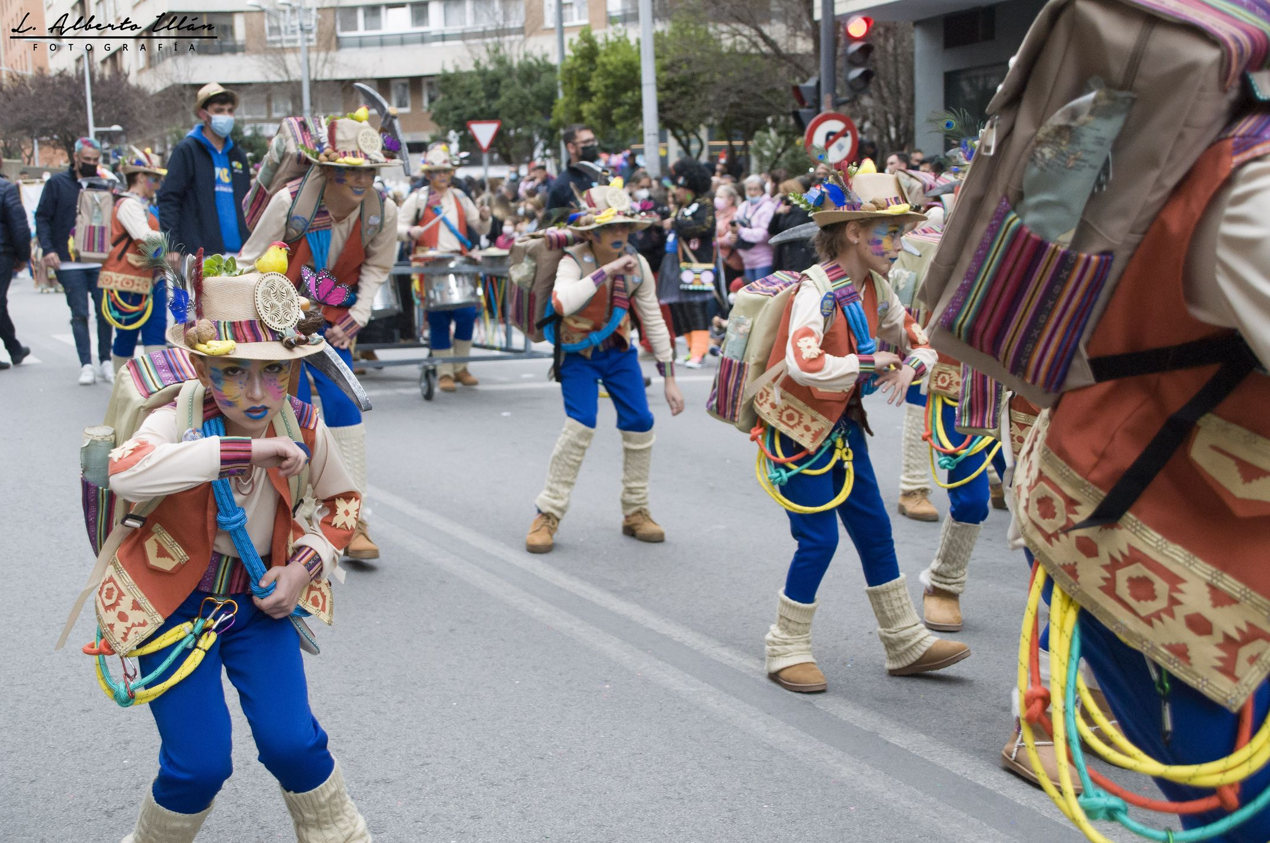
leer
Busca el vocabulario 🔎.
a band
they sing
each
instruments
many
una banda
cantan
cada
instrumentos
muchas
En Badajoz, hay un carnaval muy famoso en febrero. Cada grupo tiene un tema y lleva disfraces de muchos colores. Hay una banda con instrumentos también.
En las calles hay muchas personas que celebran la festa: bailan y cantan al ritmo de la música.
(la) carmaval =
(el) tema = theme
disfraces = costumes
que = who, that, which
(el) ritmo = rhythm
they dance
there is/are
too
famous
bailan
hay
también
famoso
Notes:
Aim: To practise written comprehension of previously taught vocabulary within a longer text.
Procedure:
Give pupils 2-3 minutes with a partner to find the Spanish meanings for the nine English words.
Elicit Spanish responses chorally, prompting with the English, e.g., ‘very?’ ‘muy’, muy bien. ☺
Note: click on each English word to reveal the Spanish translation.
Further questions can be asked to draw out linguistic and content knowledge of the text, as appropriate: for example, ‘¿por qué famoso y no famosa?,
‘¿qué es Famoso en el texto?
Ask pupils to identify any plural nouns in the text (instrumentos, personas).
Pupils could be asked to read the text aloud in pairs, taking it in turns to read alternate sentences. There are a few unknown words in the text, and a variety of words that were taught some time ago.
Click the audio player to hear the full text, if desired.
Transcript:
En Badajoz, hay un carnaval muy Famoso en febrero. Cada grupo tiene un tema y lleva disfraces de muchos colores. Hay una banda con instrumentos también. En las calles hay muchas personas que celebran la festa: bailan y cantan al ritmo de la música.
Frequency of unknown words and cognates:
carnaval [4114] disfraz [>5000] ritmo [1277] tema [240] que [3]
Source: Davies, M. & Davies, K. (2018). A frequency dictionary of Spanish: Core vocabulary for learners (2nd ed.). Routledge: London

Slide 9


Hay
⚠ Remember that un/una means a/an and one.
To say how many of something there are, use hay + number or + unos/unas (some):
Hay un pueblo aquí.
Hay una fiesta importante allí.
There is a town here.
There is an important festival there.
Hay unos pueblos en Extremadura.
Hay unas fiestas importantes allí.
There are some towns in Extremadura.
There are some important festivals there.
⚠ Plurals: add –s to nouns ending in a vowel.
Hay muchos pueblos en España.
There are many/lots of cities in Spain.
Notes:
Timing: 2 minutes
Aim: to reintroduce negation with ‘no’ together with ‘hay’
Procedure:
1. Click to bring up each new part of the explanation.
2. Interactive elicitation: Try to elicit the English meaning in each of the example sentences.

Slide 10
Adjectives following the noun
We know many adjectives follow the noun:
un pueblo pequeño
una ciudad famosa
Remember that adjectives that end in ‘o’ change to an ‘a’ when the noun being described is feminine.
⚠ Remember: Adjectives that end in -e can describe a feminine or masculine noun.
a small town
a famous city
⚠ Plurals: add –es to nouns ending in a consonant.
When we describe more than one
person or animal, we add an ‘s’ after‘o’, ‘a’ and ‘e’:
unos pueblos pequeños
unas ciudades famosas
some small towns
some famous cities
unos pueblos importantes
unas fiestas importantes
some important towns
some important festivals
Notes:
Timing: 3 minutes
Aim: to revisit post-nominal adjective agreement.
Procedure:
Read the grammar explanation on post-nominal adjective agreement.
Elicit English translations for the Spanish examples provided.
Speech bubble 1 flags up the gender agreement.
Speech bubble 2 reminds students about gender agreement of adjectives ending in –e.
Speech bubble 3 reminds pupils about plural nouns ending in consonants.

Slide 11
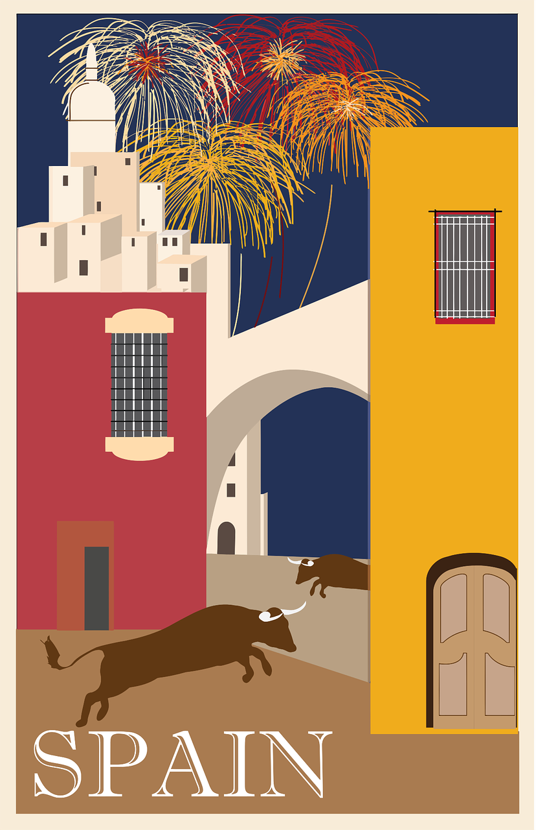

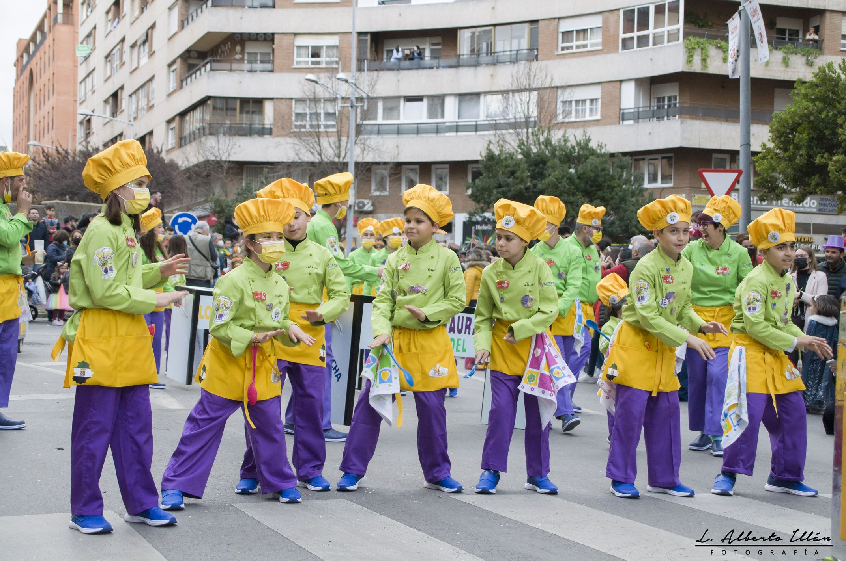
leer
¿Qué hay en la foto?
[1/3]
hablar
El desfile* infantil* es solo para niños.
trece
En la foto hay _______ personas con disfraces*.
catorce
catorce
quince
Llevan sombreros ________ .
amarillos
verdes
amarillos
amarillas
(el) desfile = parade
infantil = of children
Notes:
Timing: 3 minutes [slide 1/3[
Aim: to practise written recognition of plural adjectival agreement and comprehension of revisited vocabulary in sentences; to find out more about the Badajoz festival.
Procedure:
Ask the question ‘¿Qué hay en la foto?’
2. Read the first sentence aloud with pupils and elicit the correct word for the gap, orally.
3. Click to confirm.
4. Continue with the remainder of the sentences, over three slides.
5. Elicit English meanings orally from pupils, too.
Frequency of unknown words and cognates:
desfile [4514] infantil [1706]
Source: Davies, M. & Davies, K. (2018). A frequency dictionary of Spanish: Core vocabulary for learners (2nd ed.). Routledge: London
Image attribution:
https://www.carnavalbadajoz.es/multimedia-fotos/

Slide 12
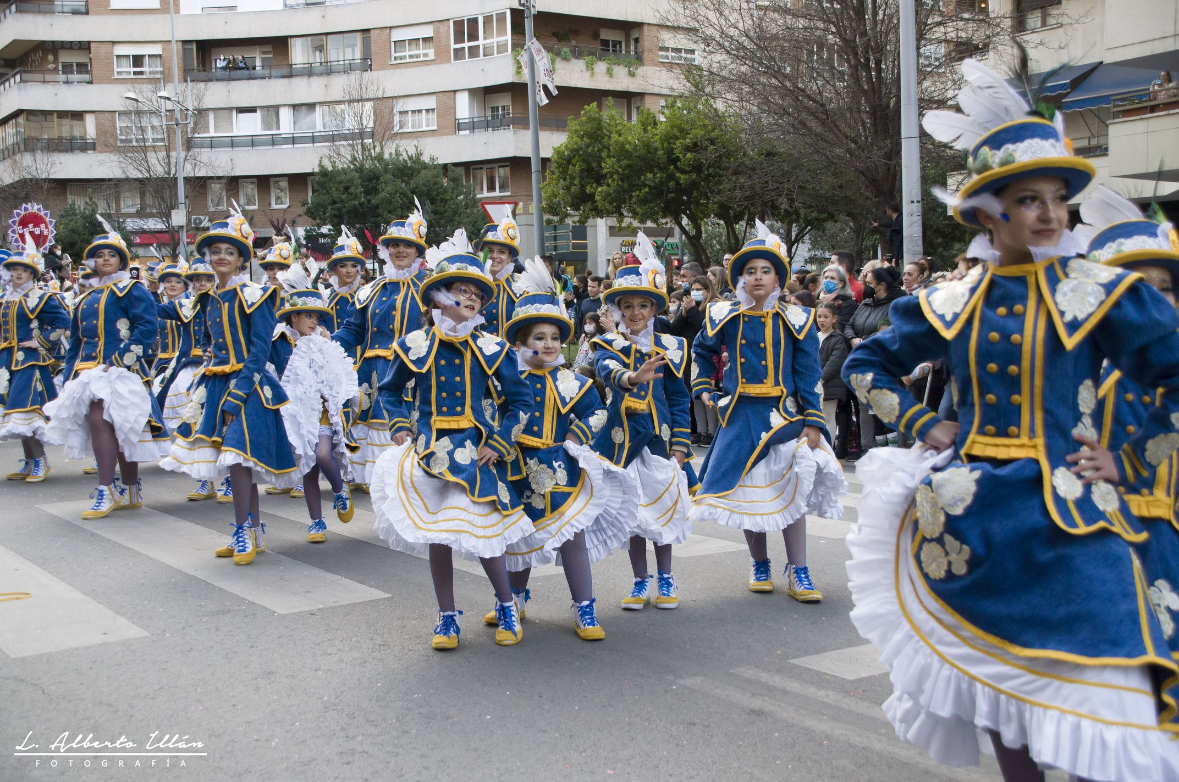
leer
¿Qué hay en la foto?
[2/3]
hablar
En la foto hay ________ sombreros _______.
dieciocho
azules
veinte
blancos
diecinueve
azules
dieciocho
verdes
Notes:
Timing: 3 minutes [slide 2/3[
Aim: to practise written recognition of plural adjectival agreement and comprehension of revisited vocabulary in sentences; to find out more about the Badajoz festival.
Procedure:
Ask the question ‘¿Qué hay en la foto?’
2. Read the first sentence aloud with pupils with pupils and elicit the correct word for the gap, orally.
3. Click to confirm.
4. Continue with the remainder of the sentences, over three slides.
5. Elicit English meanings orally from pupils, too.
Image attribution:
https://www.carnavalbadajoz.es/multimedia-fotos/

Slide 13
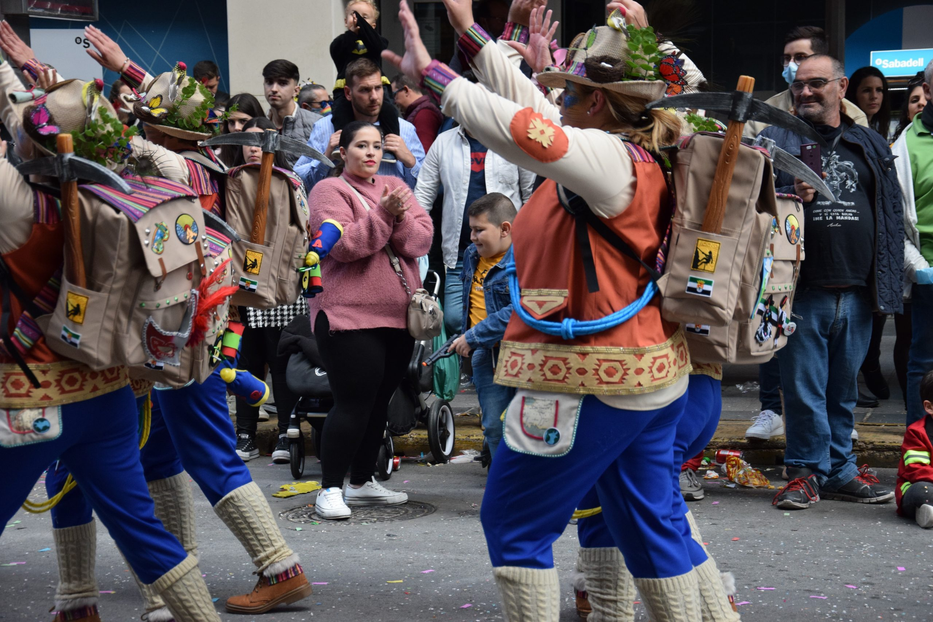
leer
¿Qué hay en la foto?
[3/3]
hablar
En la foto hay ________ mochilas __________.
cinco
grandes
cinco
negras
cuatro
grande
tres
grandes
Notes:
Timing: 3 minutes [slide 3/3]
Aim: to practise written recognition of plural adjectival agreement and comprehension of revisited vocabulary in sentences; to find out more about the Badajoz festival.
Procedure:
Ask the question ‘¿Qué hay en la foto?’
2. Read the first sentence aloud with pupils with pupils and elicit the correct word for the gap, orally.
3. Click to confirm.
4. Continue with the remainder of the sentences, over three slides.
5. Elicit English meanings orally from pupils, too.
Image attribution:
Image from http://elestribillo.es/vas-como-quieres

Slide 14
Using the negative ‘no’
In Spanish, to say there isn’t or there aren’t, put ‘no’ before the verb hay. This makes a negative.
⚠ It is also possible to omit the article: No hay playa en Oviedo.
No hay una playa en Badajoz.
There isn’t a beach in Badajoz.
No hay playas en Badajoz.
There aren’t any beaches in Badajoz.
⚠ There’s no Spanish word for ‘any’ in plural sentences.
Notes:
Timing: 2 minutes
Aim: to reintroduce negation with ‘no’ together with ‘hay’
Procedure:
1. Click to bring up each new part of the explanation.
2. Interactive elicitation of the English meaning in each of the example sentences.

Slide 15

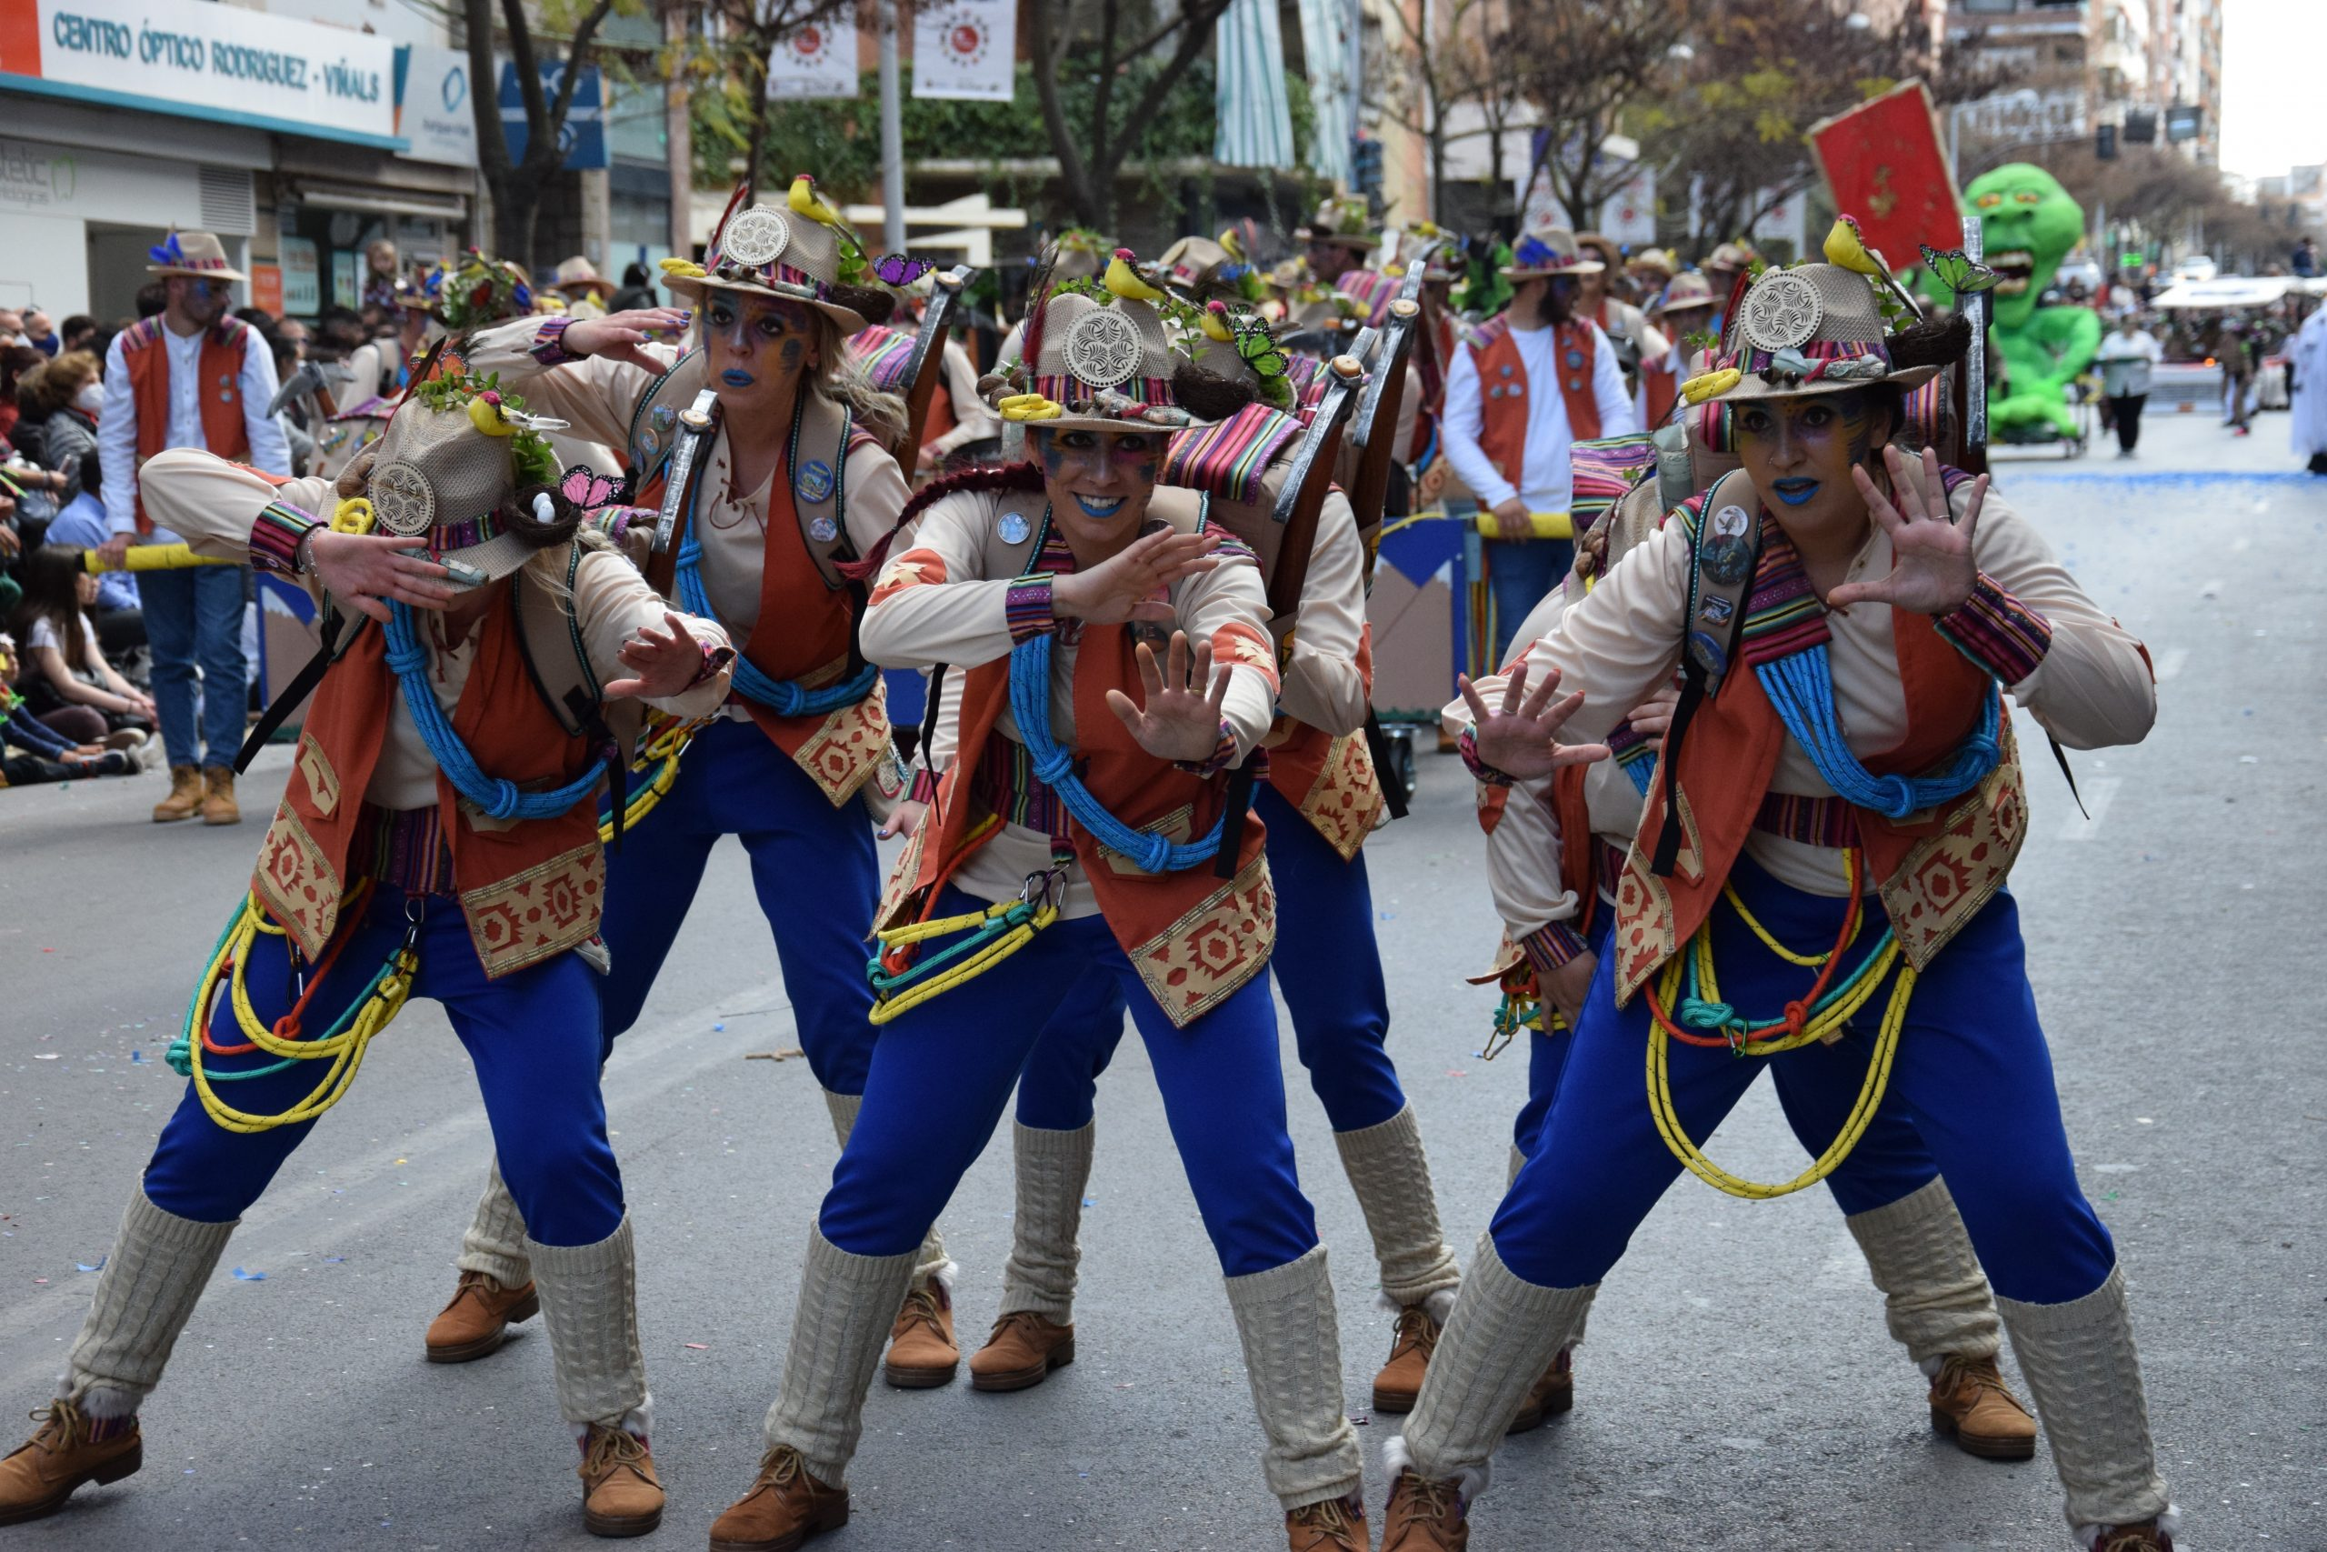
leer
¿Es correcto o incorrecto?
[1/4]
hablar
En la foto no hay animales.
¡Es incorrecto!
Hay pájaros* 🐦 y mariposas*. 🦋
Notes:
Timing: 3 minutes (four slides)
Aim: to practise written comprehension of hay and no hay in short sentences about the Badajoz festival.
Procedure:
1. Ask the question ¿Es correcto o incorrecto?
2. Elicit the response ‘es incorrecto’ and click to confirm.
3. Click to obscure the ‘no’ and elicit a repetition of the correct sentence from pupils.
4. Continue for slices 2-4.
Image attribution:
Image from http://elestribillo.es/vas-como-quieres
Frequency of unknown words and cognates:
pájaro [1607] mariposa [3359]
Source: Davies, M. & Davies, K. (2018). A frequency dictionary of Spanish: Core vocabulary for learners (2nd ed.). Routledge: London

Slide 16
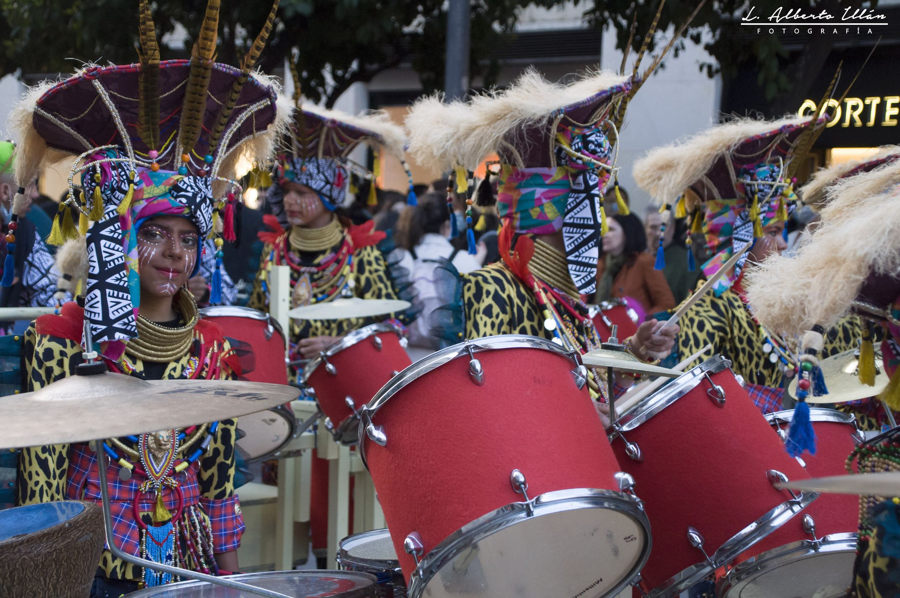
leer
¿Qué hay en la foto?
[3/4]
En la foto hay guitarras.
hablar
no
¡Es incorrecto!
¡Hay tambores* 🥁!
Notes:
Timing: 3 minutes [slide 2/3]
Aim: to practise written recognition of plural adjectival agreement and comprehension of revisited vocabulary in sentences; to find out more about the Badajoz festival.
Procedure:
Ask the question ‘¿Qué hay en la foto?’
2. Read the first sentence aloud with pupils with pupils and elicit the correct word for the gap, orally.
3. Click to confirm.
4. Continue with the remainder of the sentences, over three slides.
5. Elicit English meanings orally from pupils, too.
Frequency of unknown words and cognates:
tambor [3826]
Source: Davies, M. & Davies, K. (2018). A frequency dictionary of Spanish: Core vocabulary for learners (2nd ed.). Routledge: London
Image attribution:
https://www.carnavalbadajoz.es/multimedia-fotos/

Slide 17
leer
¿Es correcto o incorrecto?
[4/4]
hablar
En la foto no hay una niña con gafas.
¡Es incorrecto!
Notes:
Timing: 3 minutes [3/4]
Aim: to practise written comprehension of hay and no hay in short sentences about the Badajoz festival.
Procedure:
1. Ask the question ¿Es correcto o incorrecto?
2. Elicit the response ‘es incorrecto’ and click to confirm.
3. Click to obscure the ‘no’ and elicit a repetition of the correct sentence from pupils.
4. Continue for slices 2-4.
Image attribution:
https://www.carnavalbadajoz.es/multimedia-fotos/

Slide 18

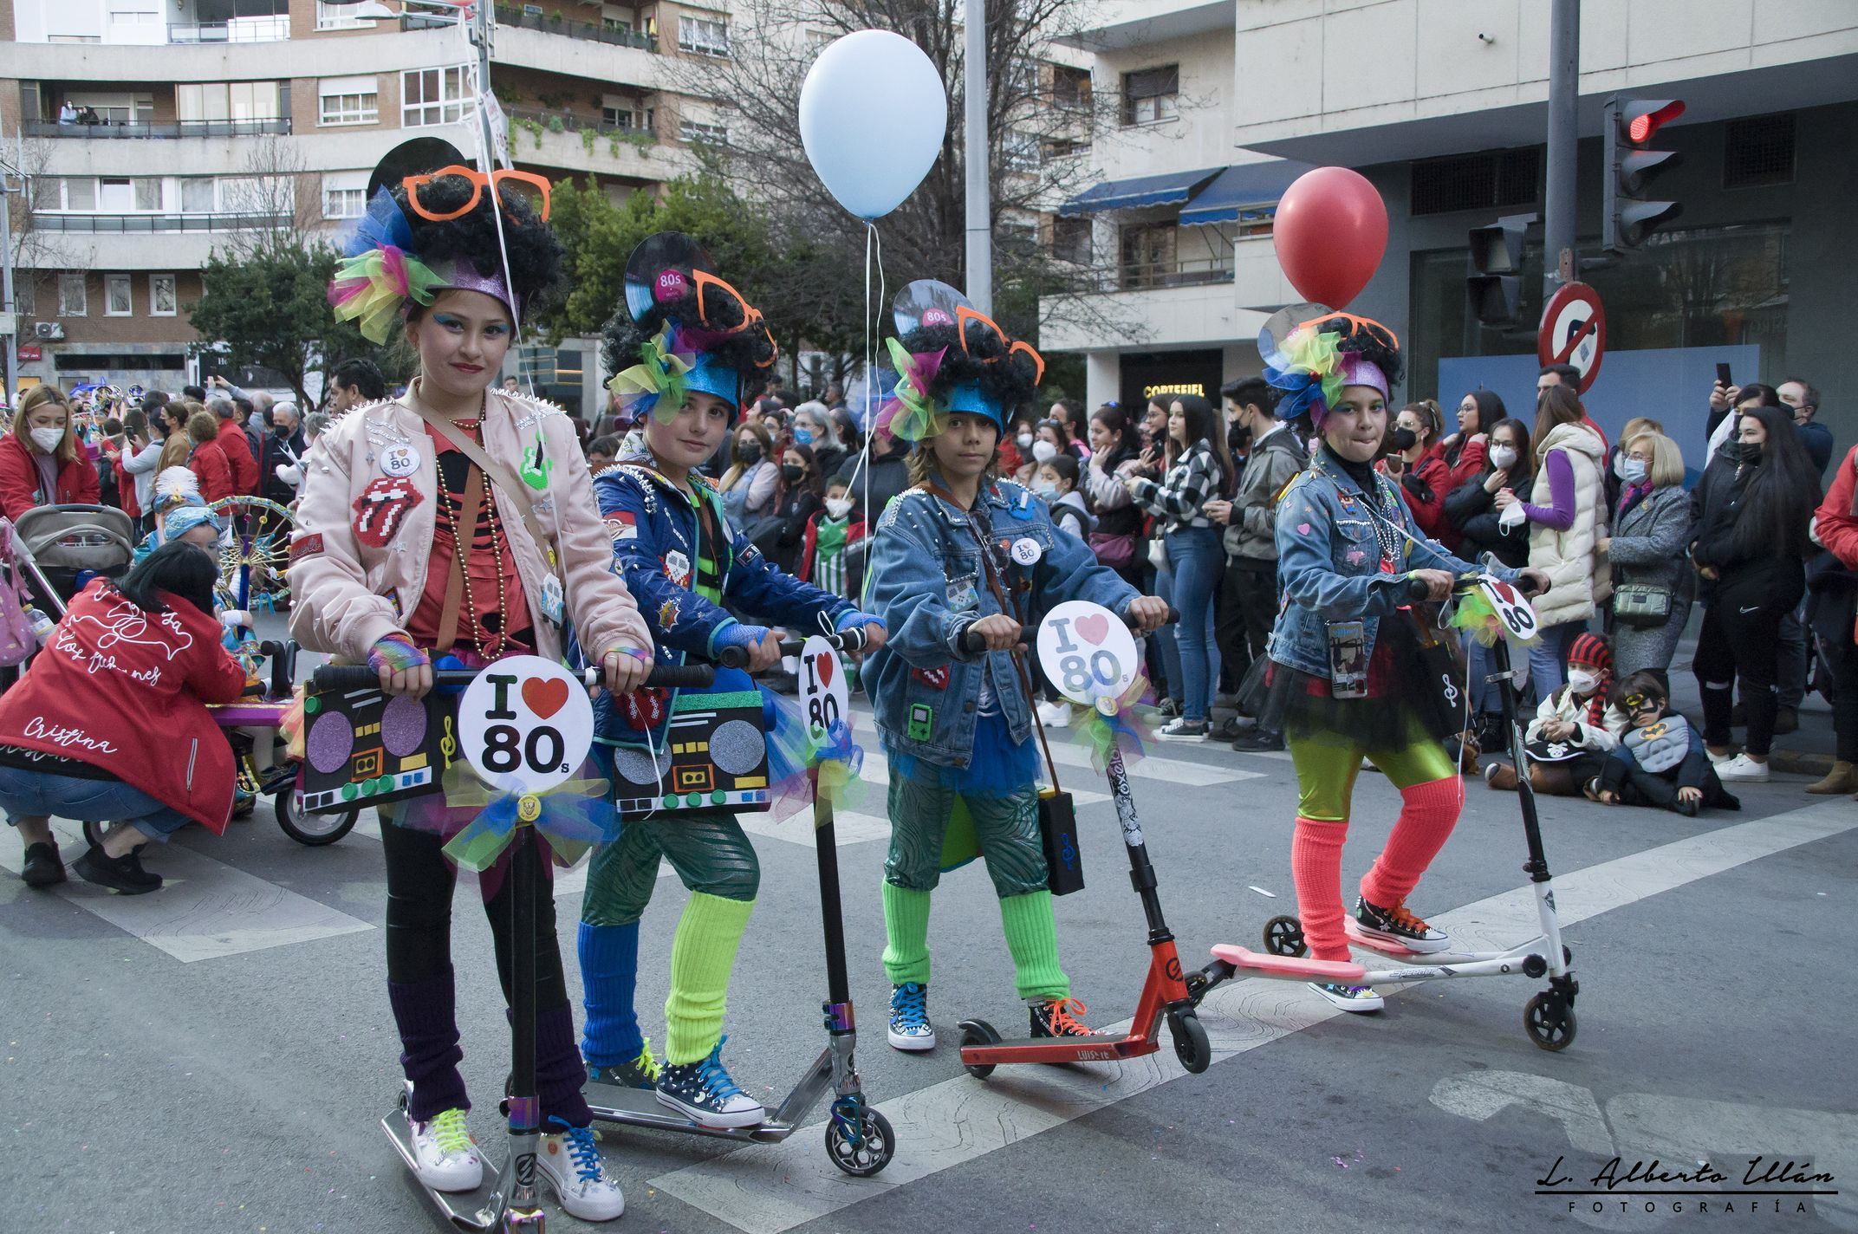
leer
¿Qué hay en la foto?
[4/4]
hablar
En la foto hay cuatro niñas que tienen gafas naranjas en la cabeza.
¡Es correcto!
Notes:
Timing: 3 minutes [slide 4/4]
Aim: to practise written recognition of plural adjectival agreement and comprehension of revisited vocabulary in sentences; to find out more about the Badajoz festival.
Procedure:
Ask the question ‘¿Qué hay en la foto?’
2. Read the first sentence aloud with pupils with pupils and elicit the correct word for the gap, orally.
3. Click to confirm.
4. Continue with the remainder of the sentences, over three slides.
5. Elicit English meanings orally from pupils, too.
Image attribution:
https://www.carnavalbadajoz.es/multimedia-fotos/

Slide 19
¡adiós!
verde

