Slide 1





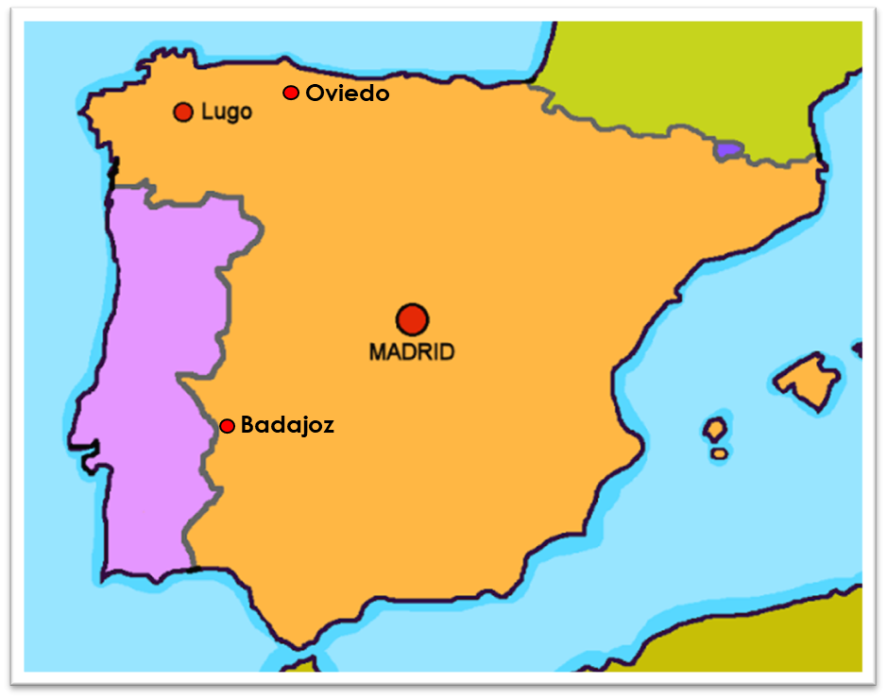
Saying what I and others do
verde
Extremadura
Follow ups 1-5
Notes:
Artwork by Steve Clarke. All additional pictures selected are available under a Creative Commons license, no attribution required.
The frequency rankings for words that occur in this PowerPoint which have been previously introduced in the resources are given in the SOW (excel document) and in the resources that first introduced and formally re-visited those words.
Phonics: Revisit [n] and [ñ]
Vocabulary (new words in bold*): hay [13] dos [64] tres [134] cuatro [241] cinco [284] seis [438] siete [603] ocho [641] nueve [991] diez [449] once [1701] doce [1138] trece [2700] catorce [2411] quince[1215] dieciséis [3373] diecisiete [3400] dieciocho [2730] diecinueve [4232] veinte [819] veintiuno [819/425] veintidós, veintitrés, veinticuatro, veinticinco, veintiséis, veintisiete, veintiocho, veintinueve, treinta [830] treinta y uno [830/4/425]
Revisit 1: fin [182] restaurante [2636] ruido [1034] nunca [158]: aprender [428] beber [1085] comer [37] comprender [434] hacer [26] leer [209] responder (a) [464] ver [38] a menudo [958] a veces [vez 59] normalmente [1696]siempre [96]
Revisit 2: tienen [8] tenemos [8] cine [952] edificio [857] aquí [130] de12 [2] delante [1742] detrás [2044] dónde [161] en1 [6] entre [63]
Glossed words:
alcazaba [>5000] mapa [2314] punto [189] zona [359]
Source: Davies, M. & Davies, K. (2018). A frequency dictionary of Spanish: Core vocabulary for learners (2nd ed.). Routledge: London
For any other words that occur incidentally in this PowerPoint, frequency rankings will be provided in the notes field wherever possible.

Slide 2


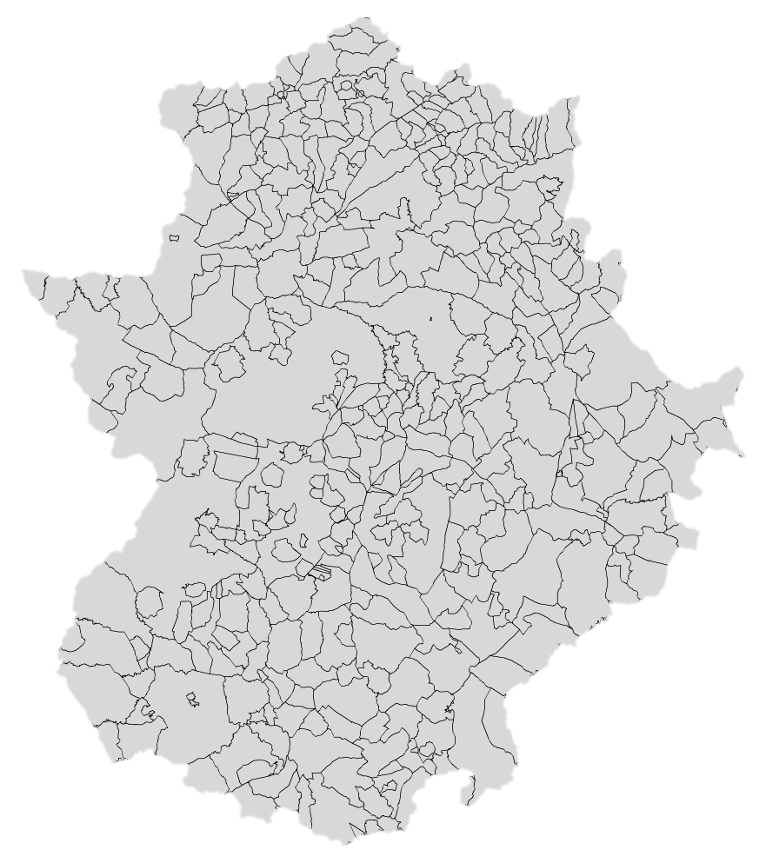

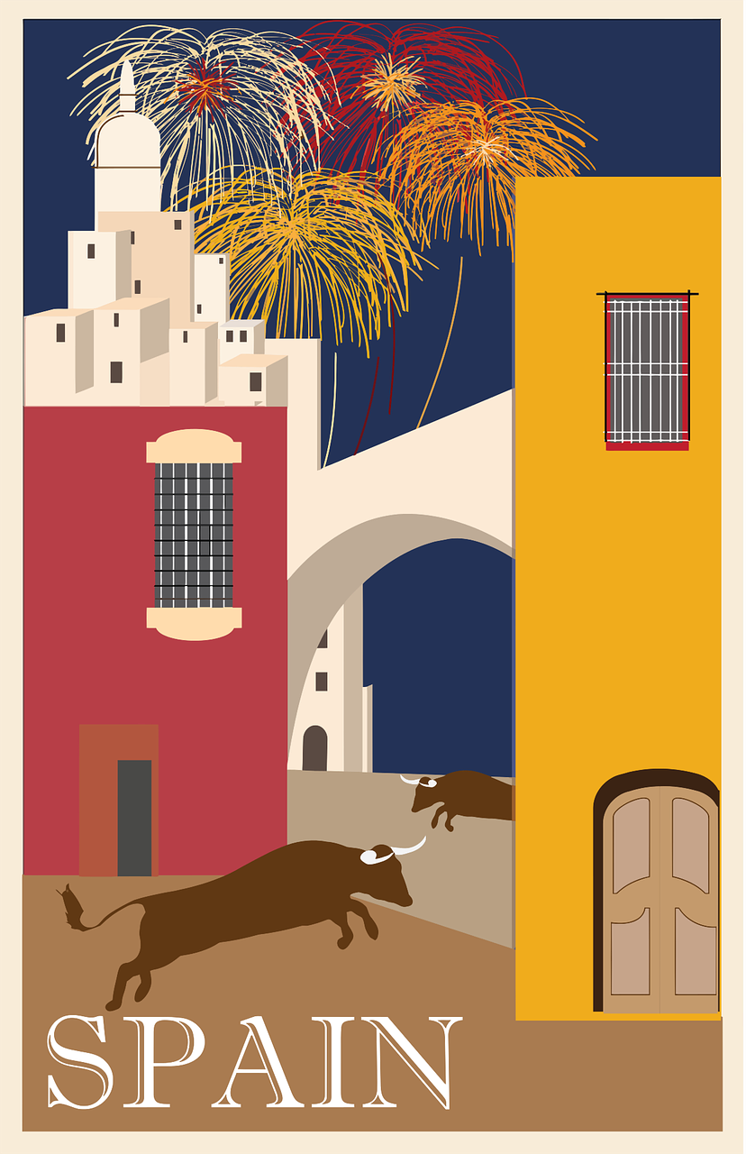

Follow up 1:
El mapa de Extremadura
Escucha y escribe. ¿Es [n] o [ñ]? 📝.
21
21
escuchar
13
13
1
Ba ñ os
2
34
3
_
4
Aceitu n a
40
_
36
36
19
Ca ñ amero
3
22
2
_
4
20
8
17
7
9
5
Ca ñ averal
5
_
10
24
15
24
6
23
25
26
12
27
11
14
X
28
30
35
29
31
18
18
33
35
41
1
Don Be ni to
6
Olive n za
_
_
38
39
39
(el) mapa = map
37
E
Campi ñ a Sur
_
Notes:
Timing: 5 minutes
Aim: to practise transcription of [n] and [ñ] with towns and village names and areas in Extremadura.
Procedure:
Pupils listen to each word and write [n] or [ñ].
Click to reveal the letter and elicit pronunciation of the full place name from pupils.
Elicit also the number for each place name.
If desired, click on the number to hear the audio.
Click each audio button to listen.
Differentiation:
Pupils could turn away from the board and transcribe the whole place name. They have learnt all the SSC previously.
Transcript 1:
E. Campiña Sur
1. Don Benito
2. Cañamero
3. Baños
4. Aceituna
5. Cañaveral
6. Olivenza
Transcript 2:
treinta y nueve
treinta y cinco
veinticuatro
veintiuno
trece
treinta y seis
dieciocho
Picture attribution:
CC BY-SA 3.0, https://commons.wikimedia.org/w/index.php?curid=66513
Word frequency of unknown words and cognates used (1 is the most frequent word in Spanish):
mapa [2314]
Source: Davies, M. and Davies, K. (2018). A frequency dictionary of Spanish: Core vocabulary for learners (2nd ed.). Routledge: London

Slide 3


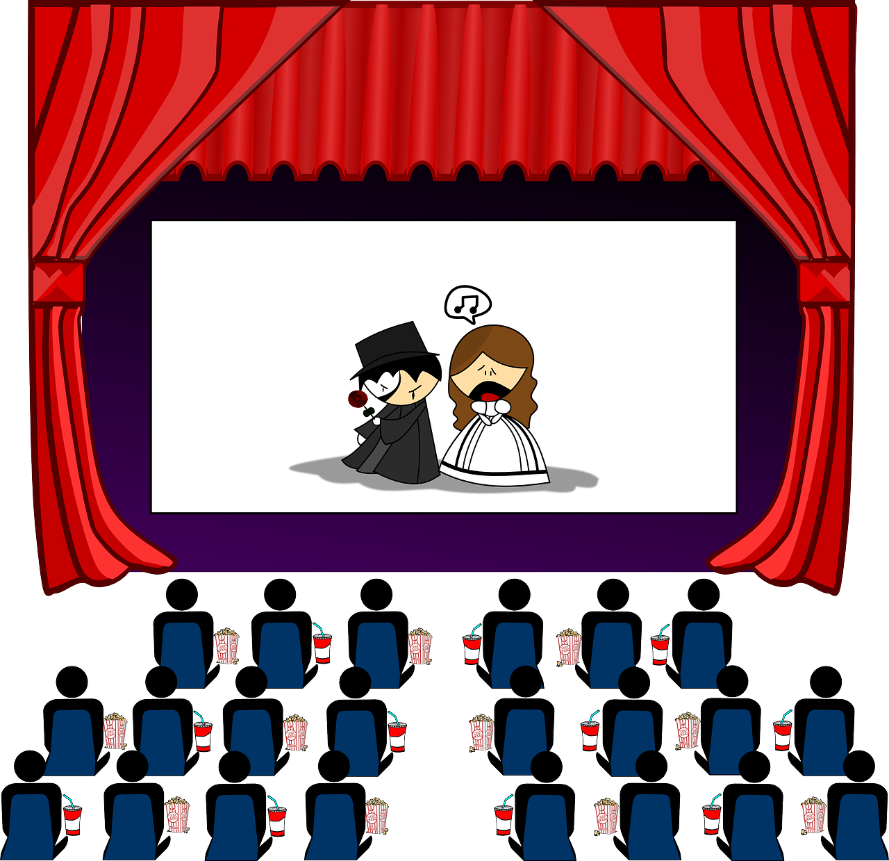


Follow up 2: : ¿Cuántos hay? ¿Cuántas hay? [1/6]
Escucha la frase y escribe el número correcto y el objeto en inglés 📝.
escuchar
E
Notes:
Timing: 5 minutes
Aim: to practise aural comprehension of numbers and previously taught vocabulary that we are revisiting this week.
Procedure:
Click to listen to the sentence.
Pupils write the number (in digits) and the item in English. (e.g. 13 cinemas)
Click to highlight the number answer and reveal the noun.
Repeat for the follow 5 sentences.
Differentiation:
For more challenge in terms of comprehension remove the number options (or in a mixed proficiency class, some pupils can turn away from the board).
For additional transcription practice, ask pupils to transcribe the sentence and then translate it.
Transcription:
Hay tres cines.

Slide 4






Follow up 2: : ¿Cuántos hay? ¿Cuántas hay? [2/6]
Escucha la frase y escribe el número correcto y el objeto en inglés 📝.
escuchar
1
Notes:
Transcription:
Hay unos edificios.

Slide 5





Follow up 2: : ¿Cuántos hay? ¿Cuántas hay? [3/6]
Escucha la frase y escribe el número correcto y el objeto en inglés 📝.
escuchar
2
Notes:
Transcription:
Hay veintidós museos.

Slide 6


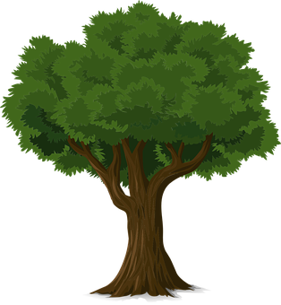


Follow up 2: : ¿Cuántos hay? ¿Cuántas hay? [4/6]
Escucha la frase y escribe el número correcto y el objeto en inglés 📝.
escuchar
3
Notes:
Transcription:
Hay veinticinco árboles.

Slide 7



Follow up 2: : ¿Cuántos hay? ¿Cuántas hay? [5/6]
Escucha la frase y escribe el número correcto y el objeto en inglés 📝.
escuchar
4
Notes:
Transcription:
Hay treinta y una iglesias.

Slide 8



Follow up 2: : ¿Cuántos hay? ¿Cuántas hay? [6/6]
Escucha la frase y escribe el número correcto y el objeto en inglés 📝.
escuchar
5
Notes:
Transcription:
Hay unas escuelas.

Slide 9

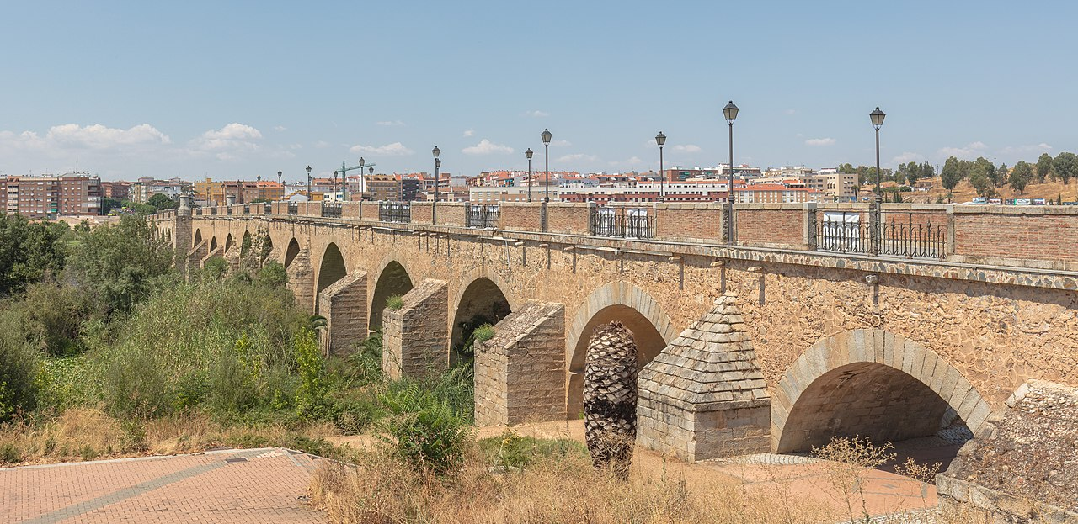

Follow up 3:
Hay y tiene
[there is, there are | s/he, it has
Remember: to say ‘there is’ and ‘there are’, use ______.
hay
Sentences with hay often start with en:
En Badajoz hay unos puentes bonitos.
In Badajoz there are some pretty bridges.
Puente Las Palmas
tiene
Use _______ to mean ‘s/he, it has’:
Badajoz tiene unos puentes históricos.
Badajoz has some historical bridges.
Sentences with tiene don’t usually start with en.
Notes:
Timing: 10 minutes (2 slides)
Aim: to revisit hay and tiene and remind them that en is often used to start sentences with hay.
Procedure:
Click to present the information.
Elicit English translations for the Spanish examples provided.
Picture attribution:
De Diego Delso, CC BY-SA 4.0, https://commons.wikimedia.org/w/index.php?curid=93179349

Slide 10

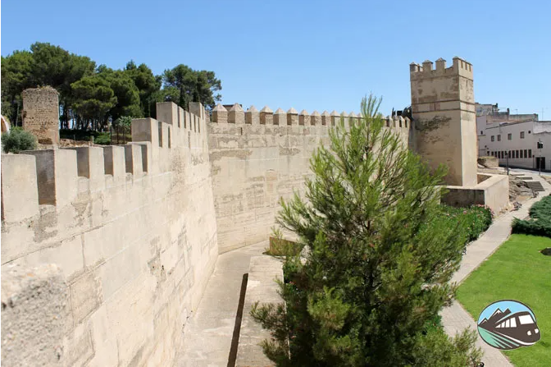

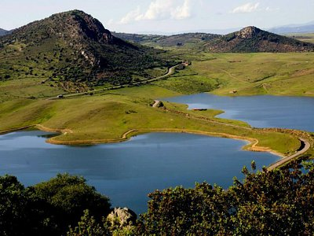
Follow up 3:
Badajoz
(la) zona = area
(la) alcazaba = kasbah, fortress
la más = the most
Lee las frases ¿Es hay o tiene? Marca ✅.
Escribe en inglés 📝.
leer
1. En Badajoz | Tiene | hay | unas Iglesias en el centro de la ciudad.
2. Badajoz | hay | tiene | una alcazaba (fuerte*) muy importante.
3. En la ciudad no | hay | tiene | playas.
4. En la region | tiene | hay | una zona de montañas, la Siberia Extremeña.
Badajoz | tiene | hay | unas fiestas importantes en febrero, el carnaval.
6. La zona | hay | tiene | temperaturas muy altas.
1
some churches in the centre of the city
2
an important fortress.
3
beaches.
4
an area of mountains, the Extremadura Siberia.
La Alcazaba de Badajoz es la más *grande de Europa.
La Siberia Extremeña
5
some important celebrations in February, the Carnival.
6
very high temperatures
Notes:
Timing: 10 minutes (2 slides)
Aim: to practise written comprehension of affirmative and negative sentences with hay and tiene and previously taught vocabulary; to learn more about Badajoz.
Procedure:
Ensure that pupils understand the task. Remind them to look out for the presence of ‘en’ at the start.
First pupils read the sentence and select the correct verb.
Then they translate the 2nd part of the sentence into English.
When feeding back, elicit the full Spanish sentence from pupils and the English translation, orally.
Note that sentences 3 and 6 are negative!
Click the audio buttons to hear the full sentences, if required.
Answers:
1. In Oviedo there are some museums in the centre of the city / city centre.
2. Oviedo has some pretty green spaces, too.
3. In the city there aren’t any beaches.
4. In the region there are some mountains, the Peaks of Europe.
5. Ovideo has some important celebrations on the 21st September.
6. The area doesn’t have very low temperatures.
Picture attribution:
José Luis Filpo Cabana, CC BY 3.0 via Wikimedia Commons
Word frequency of unknown words and cognates used (1 is the most frequent word in Spanish):
zona [359] alcazaba [>5000]
Source: Davies, M. and Davies, K. (2018). A frequency dictionary of Spanish: Core vocabulary for learners (2nd ed.). Routledge: London

Slide 11


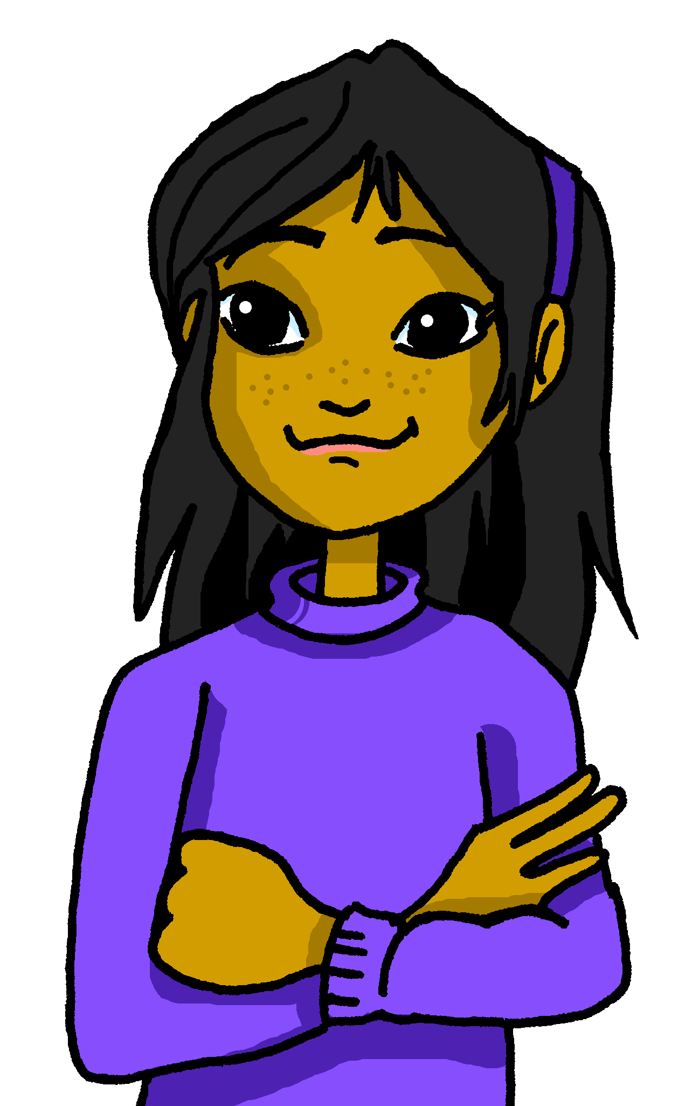


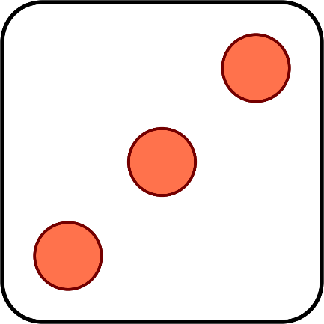
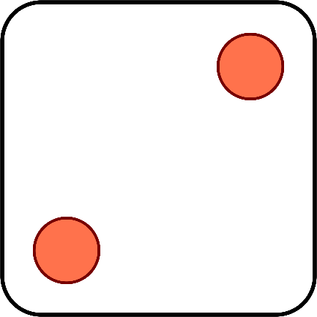


Follow up 4a:
Sofía y Ángela inventan un juego divertido.
¿Cuántos puntos* tienen en total? Habla en español.
hablar
catorce
trece
quince
dieciséis
diecisiete
dieciocho
veintitrés
veintiuno
el punto = point
Notes:
Timing: 2 minutes
Aim: to practise oral recall of numbers.
Procedure:
1. Click to ‘roll’ the dice Sofía and Elena.
2. Students say the total shown on the two dice in Spanish.
3. Click again to move on to the next number.
Word frequency of unknown words and cognates used (1 is the most frequent word in Spanish):
punto [189]
Source: Davies, M. and Davies, K. (2018). A frequency dictionary of Spanish: Core vocabulary for learners (2nd ed.). Routledge: London

Slide 12










Follow up 4b:
¿Qué número es?
Persona A: Lee el número.
Persona B: Lee el número.
escuchar
Persona A:
Persona B:
Escucha y escribe el número.
1
veinticinco
25
6
veintinueve
29
pronunciar
2
treinta
30
7
treinta y uno
31
3
veintisiete
27
8
veinticuatro
24
4
veintidós
22
9
veintiséis
26
5
veintiocho
28
10
veintitrés
23
Notes:
Time: 5 minutes
Aim: to practise reading aloud, understanding and transcribing cardinal numbers (22 -31).
Procedure:
1. Explain the task to pupils, using the Spanish instructions.
2. Pupil B turns away from the board with a pen and something to write on. They will just write the digits this time.
3. Click to bring up the first set of numbers. Pupil A reads the numbers slowly and carefully, one by one, repeating as necessary.
4. Pupil B writes down the 5 numbers, then turns back to face the board.
5. Teacher elicits numbers in Spanish from pupils chorally for additional read aloud practice, and click to reveal the number answers.
6. Pupils swap roles.
7. Repeat steps 2 – 5 with the 2nd set of numbers.
8. If required, teachers can click the number buttons to hear the numbers said by a native speaker.
Transcript:
veinticinco
treinta
veintisiete
veintidós
veintiocho
veintinueve
treinta y uno
veinticuatro
veintiséis
veintitrés

Slide 13




Follow up: 5
Escribe en inglés 📝.
Can you get at least 15 points?
 | delante (de) | el edificio | tienen
 | hacer | a menudo | tenemos
 | el fin | el ruido | nunca
 | hay | beber | comprender
 | veintinueve | veinticuatro | veintiséis
 | treinta | once | doce
in front (of)
(the) building
they have
vocabulario
x3
to do, make
often
we have
(the) end
(the) noise
never
x2
to understand
there is/ are
to drink, drinking
twenty-nine
twenty-four
twenty-six
x1
thirty
eleven
twelve
Notes:
Timing: 5 minutes
Aim: to practise written production of vocabulary from this week and this week’s revisited sets.
Procedure:
1. Give pupils a blank grid. They fill in the English meanings of any of the words they know, trying to reach 15 points in total.
Note:
The most recently learnt and practised words are pink, words from the first revisit are green and those from the second revisit are blue, thus more points are awarded for them, to recognise that memories fade and more effort (heavy lifting!) is needed to retrieve them.

Slide 14
Follow up: 5
Escribe en español 📝.
Can you get at least 15 points?
 | they have | (the) building | (the) cinema
 | opposite | where? | we have
 | sometimes | (the) end | (the) noise
 | to do, make | to see, watch | often
 | eighteen | twenty-seven | fifteen
 | thirty-one | eleven | twelve
tienen
el edificio
el cine
vocabulario
x3
¿dónde?
tenemos
delante
a veces
el fin
el ruido
x2
hacer
ver
a menudo
dieciocho
veintisiete
quince
x1
treinta y uno
once
doce
Notes:
Timing: 5 minutes
Aim: to practise written production of vocabulary from this week and this week’s revisited sets.
Procedure:
1. Give pupils a blank grid. They fill in the Spanish meanings of any of the words they know, trying to reach 15 points in total.
Note:
The most recently learnt and practised words are pink, words from the first revisit are green and those from the second revisit are blue, thus more points are awarded for them, to recognise that memories fade and more effort (heavy lifting!) is needed to retrieve them.

Slide 15
¡adiós!
verde

Slide 16
Follow up: 5
Escribe en inglés 📝.
Can you get at least 15 points?
 | delante (de) | el edificio | tienen
 | hacer | a menudo | tenemos
 | el fin | el ruido | nunca
 | hay | beber | comprender
 | veintinueve | veinticuatro | veintiséis
 | treinta | once | doce
vocabulario
x3
x2
x1
Notes:
HANDOUT

Slide 17
Follow up: 5
Escribe en español 📝.
Can you get at least 15 points?
 | they have | (the) building | (the) cinema
 | in front (of) | Where? | we have
 | sometimes | (the) end | (the) noise
 | to do, make | to see, watch | often
 | eighteen | twenty-seven | fifteen
 | thirty-one | eleven | twelve
vocabulario
x3
x2
x1
Notes:
HANDOUT

