Slide 1


español, con Sofía

Slide 2

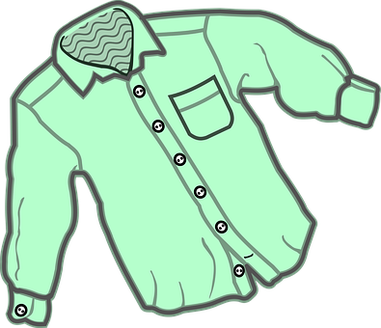
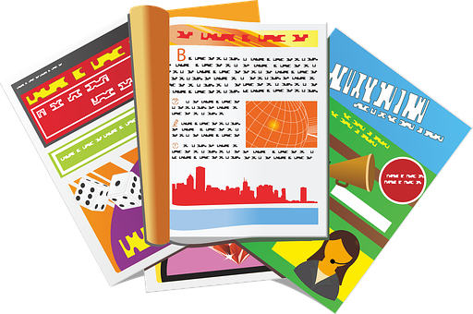
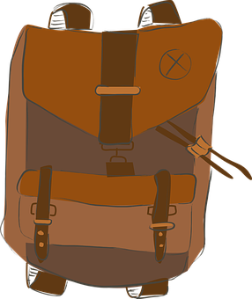
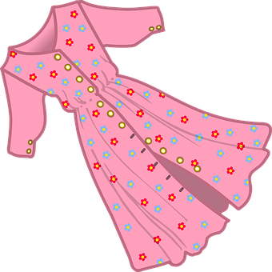

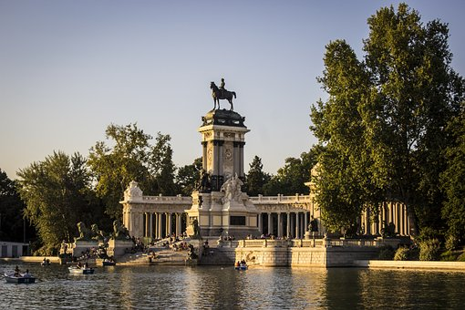
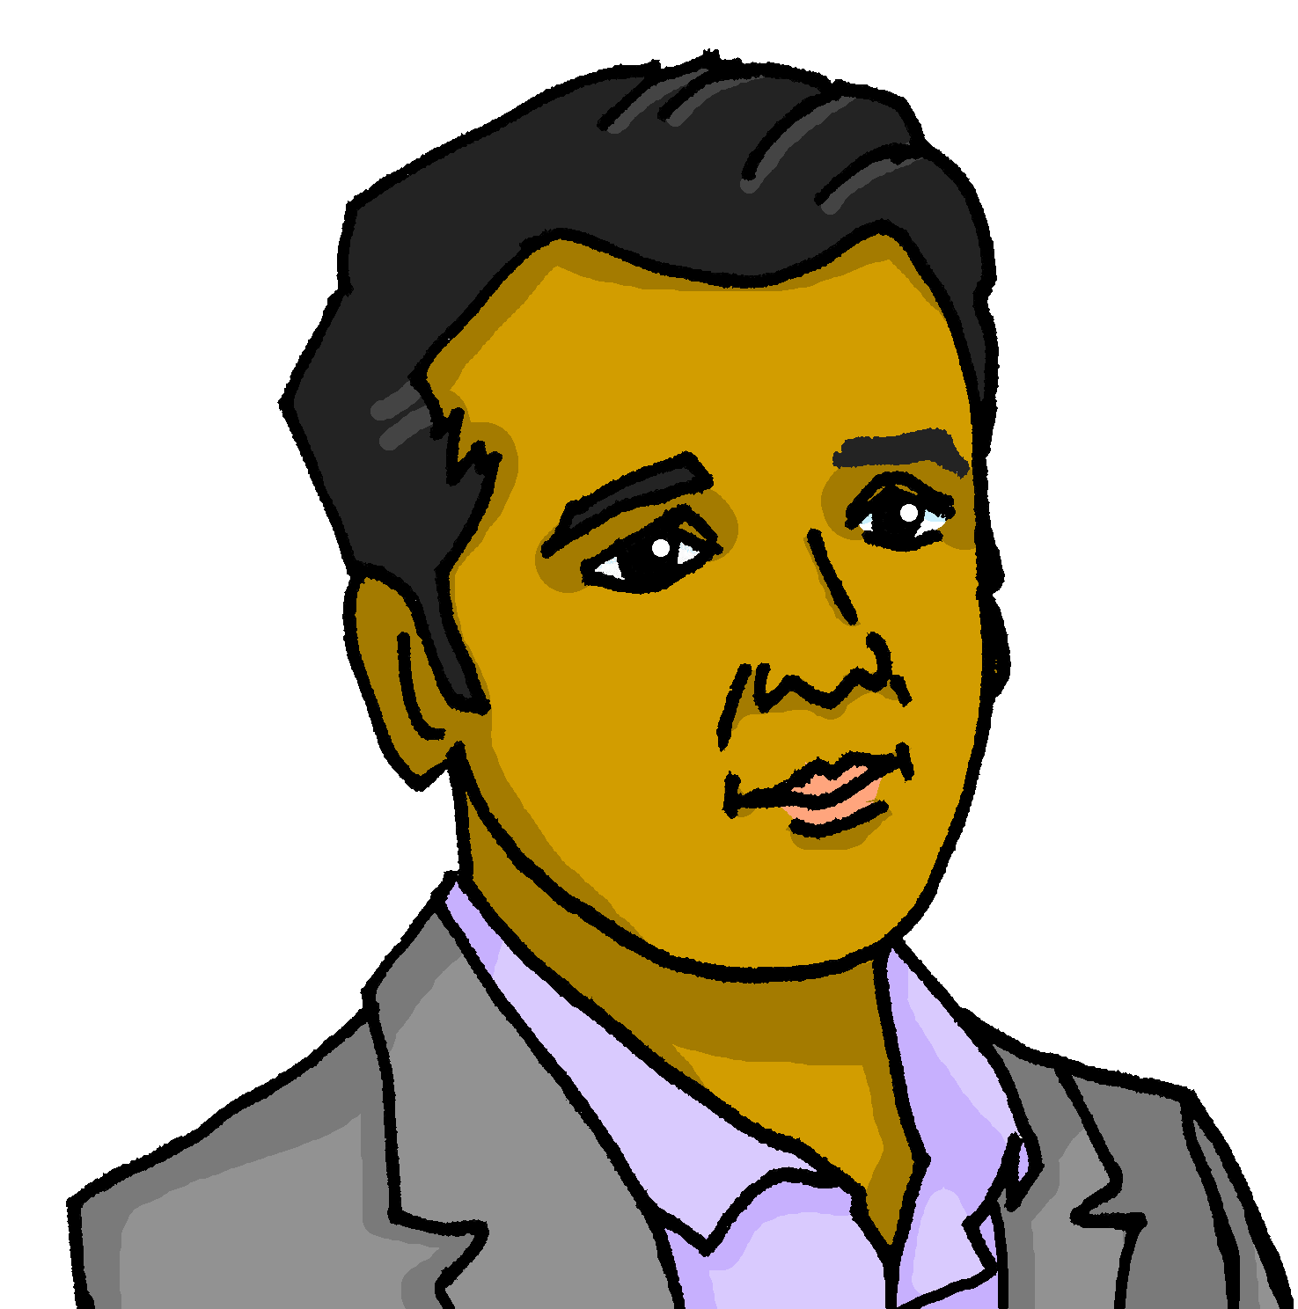
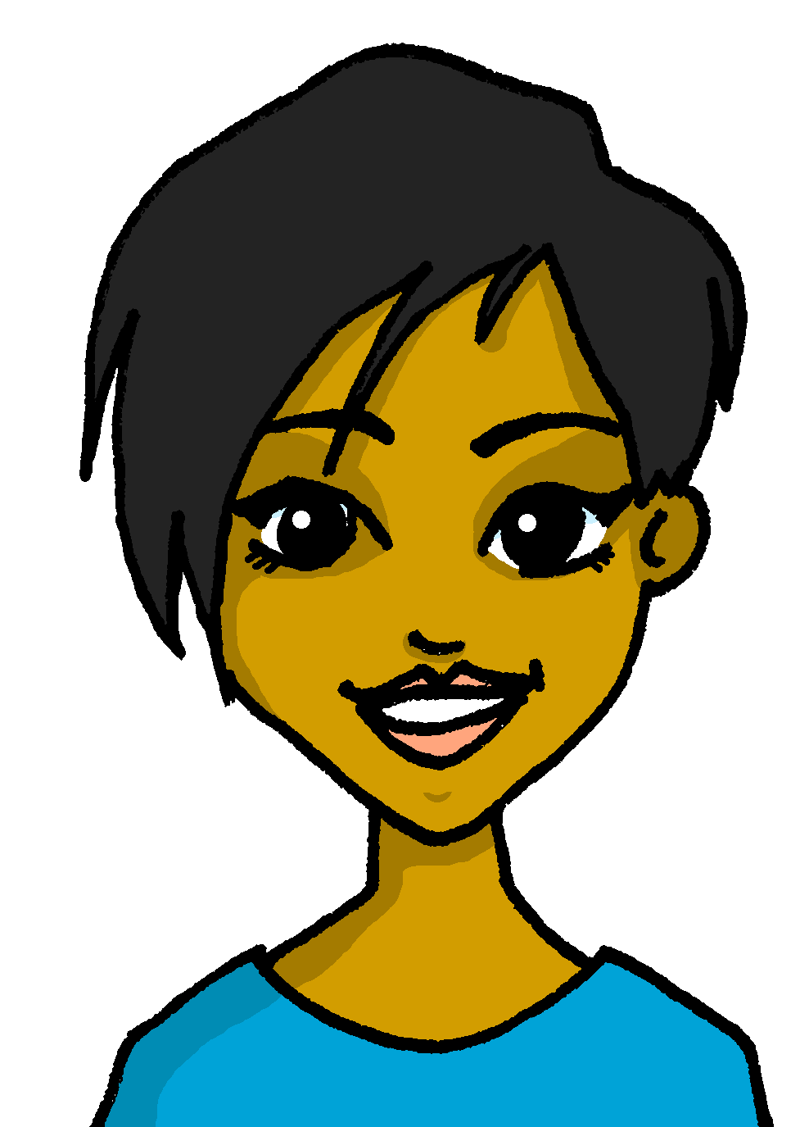
Saying what I and others do
Un viaje a Madrid
Tener: 1st and 2nd persons singular
Plural possessives (my, your)
SSC: [que] [qui]
verde
Jorge y Antonella
Notes:
Artwork by Steve Clarke. All additional pictures selected are available under a Creative Commons license, no attribution required.
The frequency rankings for words that occur in this PowerPoint which have been previously introduced in the resources are given in the SOW (excel document) and in the resources that first introduced and formally re-visited those words.
Phonics: revisit [que] [qui] paquete [2325] equipo [373]
Vocabulary (new words in bold): bicicleta [3684] cama [609] camisa [1873]cuaderno [3301] cuarto [653] gato [1728] habitación [1069] hermano [333] hermana [3409] idea [247] libro [230] mochila [>5000] oso [4449] perro [888] tía [1205] tío [988] vestido [1697]dónde [161] qué [50]
Revisit 1: a menudo [958] aprender [428] beber [1085] comer [347] [347] correr [343] hacer [26] leer [209]
Revisit 2: tienen [8] calle [269] cine [952] escuela [424] hotel [1163] iglesia [437] museo [1114] parque [1354] piscina [4604] plaza [806] puente [1715] universidad [387] enorme [631] histórico [830] solo [181] de12
For any other words that occur incidentally in this PowerPoint, frequency rankings will be provided in the notes field wherever possible.
Frequency of unknown words:
nota [1141] novela [735]
Source: Davies, M. and Davies, K. (2018). A frequency dictionary of Spanish: Core vocabulary for learners (2nd ed.). Routledge: London

Slide 3

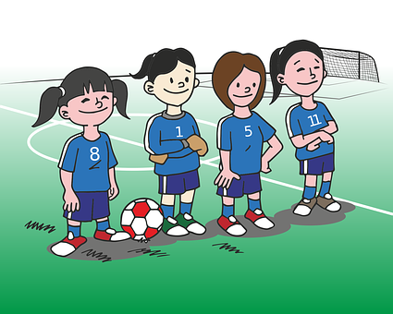

pronunciar
[qui]
equipo
[que]
paquete
Notes:
Timing: 1 minute
Aim: To revisit SSC [qui] [que]
Procedure:
To recap and elicit the pronunciation of the individual SSC [qui] [que]
Click to bring the picture & get students to repeat (with gesture, if using).
Gesture suggestion : handshake
Gesture suggestion : with both hands, draw the shape of a rectangle in 3 moves (top, sides, bottom).

Slide 4



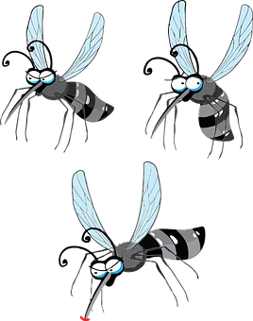


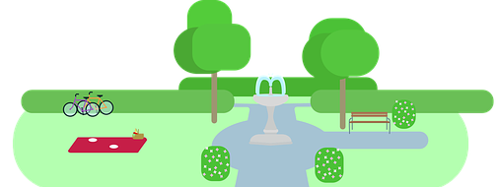

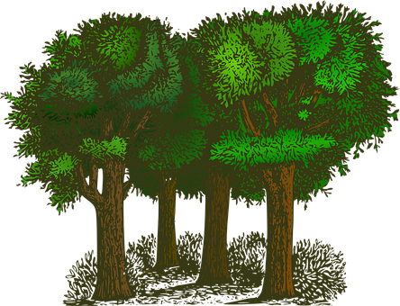


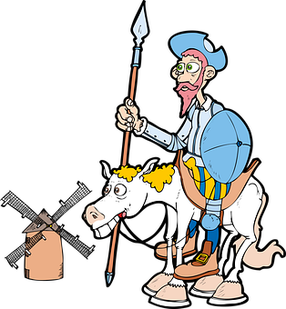
escuchar
(la) novela = novel
Escucha. ¿Es ‘que’ o ‘qui’?
escuchar
qui
qui
que
Qui
1
A Pa____to le picó un mos ____ to en un estan ____ de ____to.
Pa____ come ____so en un par____ de ____quén.
El ____jote está en el bos_____ con Sancho y su caballo.
[Paquito was bitten by a mosquito in a pond in Quito.]
2
qui
que
que
Que
[Paqui eats cheese in a park in Quequén]
3
Qui
que
[Quixote is in the forest with Sancho and his horse]
El Quijote es una novela* de Miguel de Cervantes.
Notes:
Timing: 4 minutes
Aim: to recognise ‘qui’ ‘que’,
Procedure:
Read the instruction and do the example [E] with pupils. Pupils to write the correct SSCs [qui] [que]
Go through answers by eliciting the Spanish word from pupils, and click to bring up answers.
Give pupils 1 minute to work in pairs to practise pronunciation.
Transcript:
E Paquito | mosquito | estanque | Quitp
1 Paqui | queso | parque | Quequén
2 Quijote | bosque
Frequency of unknown words:
novela [735]
Source: Davies, M. and Davies, K. (2018). A frequency dictionary of Spanish: Core vocabulary for learners (2nd ed.). Routledge: London

Slide 5

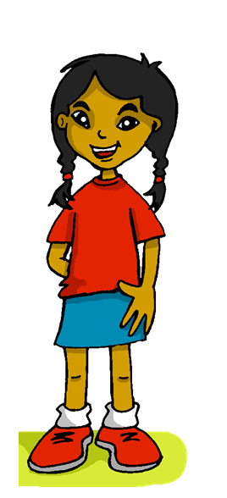
leer
Lee el texto y busca el vocabulario.
así que = and so, therefore
El tío Jorge está de vacaciones en España y la tía Antonella está con él. El fin de semana, mamá, papá, Quique y yo vamos a ir a Madrid así que* hoy preparo mi mochila para el viaje: un vestido y una camisa.
a shirt
una camisa
trip
el viaje
my
uncle
on holidays
dress
backpack
aunt
today
mi
el tío
de vacaciones
un vestido
mi mochila
la tía
hoy
Notes:
Timing: 5 minutes
Aim: to set the scene for this week’s lesson; to practise written comprehension of previously taught vocabulary and this week’s new words.
Procedure:
Pupils read the text aloud with teacher support, as needed.
Click on Sofía to hear an audio version of the text, if desired.
3. Pupils focus on the English words and identify the Spanish words from the bold words in the text. Pupils can volunteer answers in any click – teacher clicks on the English word and the Spanish translation appears.
4. Teachers elicit an oral translation of the text from the class to establish the context of this week’s lesson.
Frequency of unknown words:
así que []
Source: Davies, M. & Davies, K. (2018). A frequency dictionary of Spanish: Core vocabulary for learners (2nd ed.). Routledge: London

Slide 6


Talking about possessions in singular and plural
[my]
To say ‘my’ in Spanish before a singular or uncountable noun, use _____.
mi
⚠ It does not matter whether the nouns are masculine or feminine.
Tengo una cámara en mi mochila.
I have a camera in my bag.
mis
To say ‘my’ in Spanish before a plural noun, use _____.
En mi mochila tengo mis libros.
In my room I have my books.
Notes:
Timing: 2 minutes
Aim: to reintroduce s ‘mi/mis’ and ‘tu/tus’.
Procedure:
Click to go through the explanation and examples.

Slide 7







leer
¿Qué tiene Sofía en la bolsa?
¿Se menciona? Marca ✅ o ❌.
Lee las frases y marca.
 | mi | regalo | conejos
 | mis | lápices | cosas
 | mi | bicicletas | cuaderno
 | mi | cartas | vestido
 | mis | camisas | botella
 | mi | revistas | hermano
E
1
2
3
4
5
Notes:
Timing: 4 minutes
Aim: to practise written recognition of singular and plural nouns and connect them with the correct possessive adjective ‘mi’ or ‘mis’.
Part 1
Procedure:
Pupils write the noun that can follow the possessive adjective.
Click to correct OR click the audio button for a listen and check.
Part 2
Procedure:
Pupils decide for each picture shown whether the item was mentioned in Part 1 or not (i.e. in the list at all).
Click to correct.

Slide 8
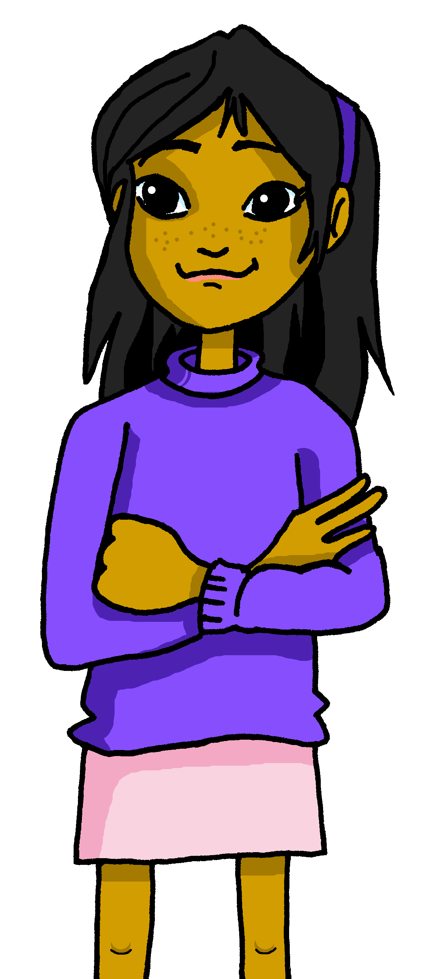
Asking about possession: tener
[I have; you have; do you have?]
We have already seen the verb tener means ‘to have’.
⚠ To change a statement into a question, simply raise your voice at the end.
I
You (singular)
To mean ‘I have’, use ‘tengo’.
To mean ‘you have’, use ‘tienes’.
¿?
Tengo una idea.
Tienes una pregunta, Elena.
I have an idea.
You have a question, Elena.
¿Tienes una pregunta, Elena?
Do you have a question, Elena?
Notes:
Timing: 2 minutes
Aim: to revisit 1st and 2nd person singsular of ‘tener’, including revisiting raised intonation for question formation.
Procedure:
Read the grammar explanation on tener (to have).
Elicit English translations for the Spanish examples provided.

Slide 9

escuchar
¿Dónde están las cosas de Sofía?
Sofía habla. Quique tiene las cosas de Sofía en la mochila.
¿Quién es? Marca ✅
¿Qué es? Marca ✅ y escribe en inglés .
¿Es una pregunta o una respuesta?
Sofía | Quique
¿?
mi | mis | ¿Qué?
E
?
magazines
1
.
glasses
2
.
(favourite) shirt
?
3
bottle
4
?
computer
5
.
games
Notes:
Timing: 6 minutes
Aim: listening activity to practise distinguishing between the meanings of the 1st and 2nd person singular of tener in the present, including statements and questions; mi and mis
Procedure:
Part 1
Click to bring instructions.
Pupils first idefintfiy the person of the verb ‘I’ / ‘you’, and then whether it’s a statement or a question.
Do [E] with them.
Part 2
Click to bring further instructions. Pupils to listen again and identify whether they hear ‘mi’ or ‘mis’ and write down the lexical item / object mentioned.
Transcript
E. ¿Tienes mis revistas?
Tengo mis gafas.
Tengo mi camisa favorita.
¿Tienes mi botella?
¿Tienes mi ordenador?
Tengo mis juegos.

Slide 10
Talking about possessions in singular and plural
[your]
To say ‘your’ in Spanish before a singular or uncountable noun, use _____.
tu
⚠ It does not matter whether the nouns are masculine or feminine.
¿Tienes una camisa en tu bolsa?
Do you have a shirt in your bag?
tus
To say ‘your’ in Spanish before a plural noun, use _____.
¿Tienes tus camisas en tu bolsa?
Do you have your shirts in your bag?
Notes:
Timing: 2 minutes
Aim: to reintroduce ’‘tu/tus’.
Procedure:
Click to go through the explanation and examples.

Slide 11


leer
En clase: Quique escribe notas a Sofía.
notas* = notes
Escribe en inglés 📝 .
¿Es ‘mi’, ‘mis’, ‘tu’ o ‘tus’?
E
1
shirts
 | ____ have my ____________ in your ____________ .
 | ___ _____ have your ________ in my _______ ?
 | _____ ______ your ________ in your _____ .
 | ____ _____ have my ________ for the uncle in your __________ ?
 | ____ _______ your ______ in my _______________ .
 | ____ _______ my ______ _________ in your ______ .
Tienes mi información en tu teléfono.
¿Tengo mis camisas en mi bolsa.
You
E
phone
3
1
Do
I
shirts
bag
¿Tienes mis regalos para el tío en tu bolsa?
2
You
things
have
Tienes tus cosas en tu mochila.
2
bag
Do
you
presents
3
bag
5
I have
fruit
Tienes mi música favorita en tu teléfono.
4
4
bag
Tengo tu fruta en mi mochila.
You have
favourite music
5
phone
Notes:
Timing: 6 minutes
Aim: to bring together various grammar features and vocabulary (tener: 1st and 2nd person singular; possessives ‘my’ and ‘your’)
Procedure:
Read the title & click to explain the context of the task
Click to bring further instructions in Spanish.
Pupils complete 1-5.
Click through the animations to bring up answers.
E. Tienes mi Información en tu teléfono.
¿Tengo mis camisas en mi bolsa?
Tienes tus cosas en tu mochila.
¿Tienes mis regalos para el tío en tu bolsa?
Tengo tu fruta en mi mochila.
Tienes mi música favorita en tu teléfono.
Frequency of unknown words:
nota [1141]
Source: Davies, M. and Davies, K. (2018). A frequency dictionary of Spanish: Core vocabulary for learners (2nd ed.). Routledge: London

Slide 12
¡adiós!
verde

