Slide 1

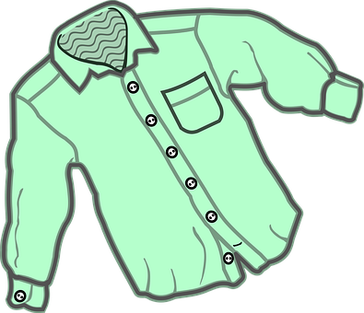
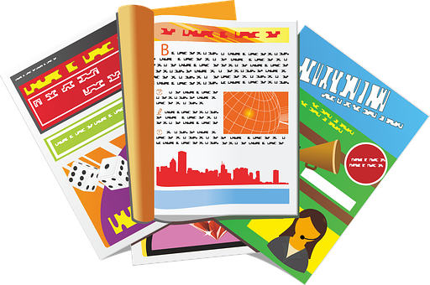
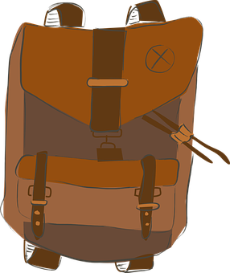
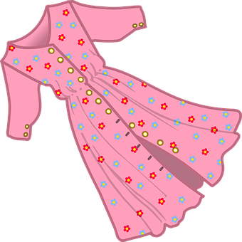

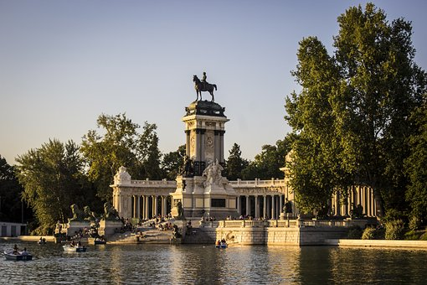
Saying what I and others do
Un viaje a Madrid
verde
Jorge y Antonella
Follow ups 1-5
Notes:
Artwork by Steve Clarke. All additional pictures selected are available under a Creative Commons license, no attribution required.
The frequency rankings for words that occur in this PowerPoint which have been previously introduced in the resources are given in the SOW (excel document) and in the resources that first introduced and formally re-visited those words.
Phonics: revisit [que] [qui] paquete [2325] equipo [373]
Vocabulary (new words in bold): bicicleta [3684] cama [609] camisa [1873]cuaderno [3301] cuarto [653] gato [1728] habitación [1069] hermano [333] hermana [3409] idea [247] libro [230] mochila [>5000] oso [4449] perro [888] tía [1205] tío [988] vestido [1697]dónde [161] qué [50]
Revisit 1: a menudo [958] aprender [428] beber [1085] comer [347] [347] correr [343] hacer [26] leer [209]
Revisit 2: tienen [8] calle [269] cine [952] escuela [424] hotel [1163] iglesia [437] museo [1114] parque [1354] piscina [4604] plaza [806] puente [1715] universidad [387] enorme [631] histórico [830] solo [181] de12
For any other words that occur incidentally in this PowerPoint, frequency rankings will be provided in the notes field wherever possible.
Frequency of unknown words:
observar [556] mencionar [1102] para [16] porque [40]
Source: Davies, M. and Davies, K. (2018). A frequency dictionary of Spanish: Core vocabulary for learners (2nd ed.). Routledge: London

Slide 2


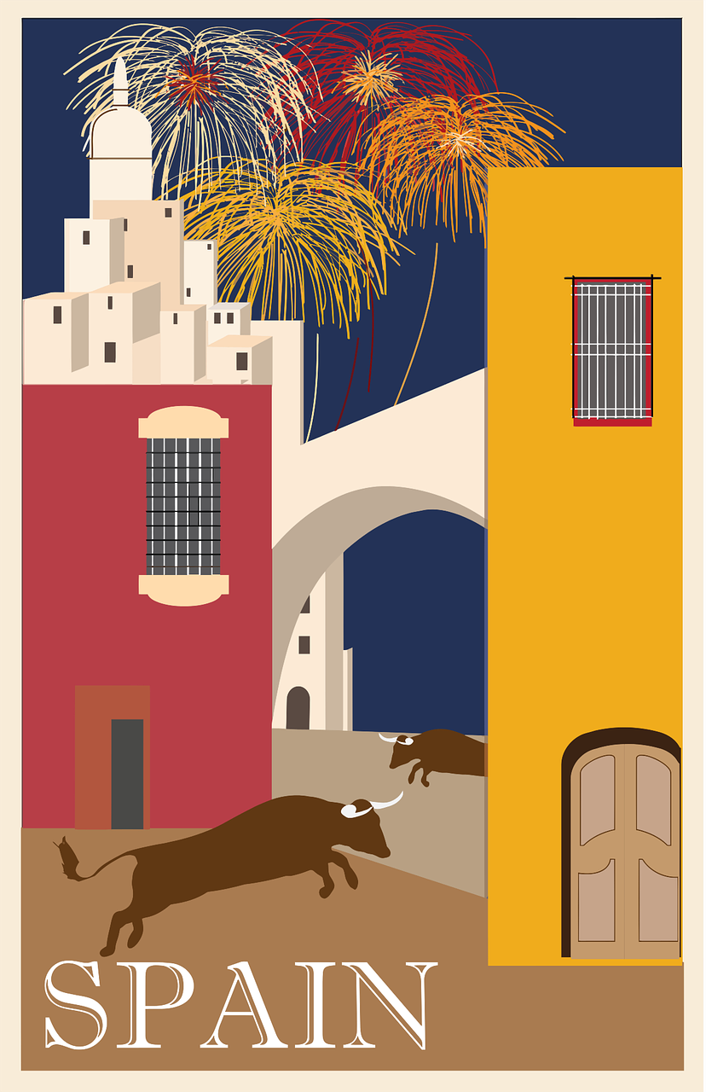

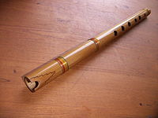
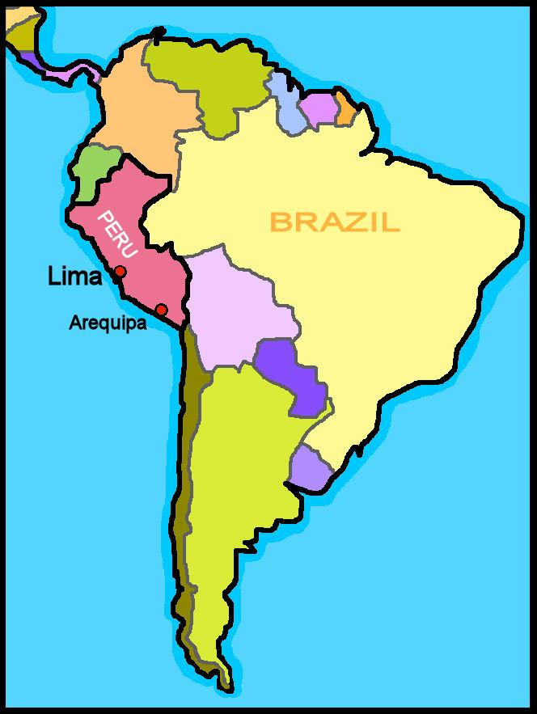
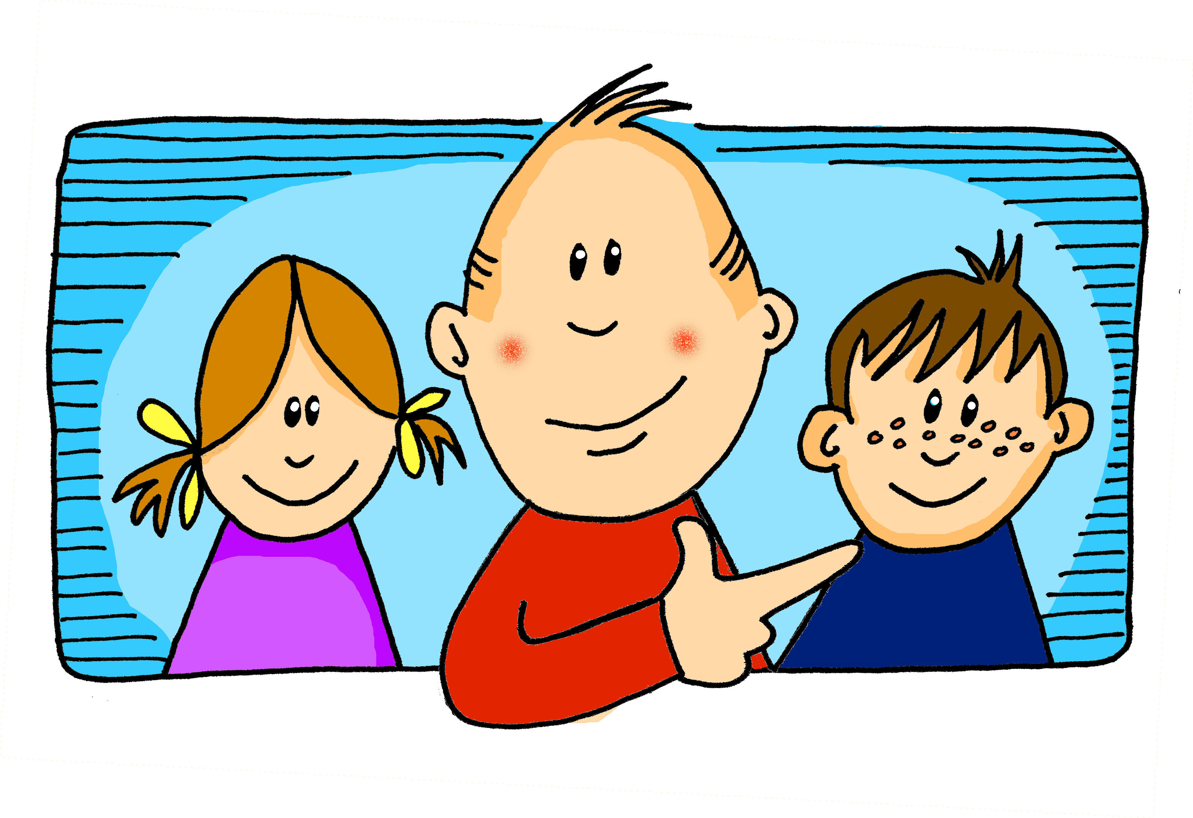




Follow up 1:
[A] Escucha y escribe el orden. ¿Es A B o B A? 📝.
escuchar
 | A|B B|A | A | B
cepo
quepo
1
A|B
[trap]
[I fit in]
quitar
citar
la quena
2
B|A
[to take off]
[to make a date]
dice
dique
3
B|A
[dock]
[says]
cena
quena
4
B|A
5
maqueta
maceta
A|B
[sketch]
6
cien
quién
B|A
Notes:
Timing: 5-6 minutes (two slides)
Aim: to practise que/qui in contrast with ci/ce
Procedure:
Pupils listen to each pair of words and decide which order they are spoken in A|B or B|A.
They write 1-6 and A|B or B|A.
Click each audio button to listen.
Click to reveal the correct order.
Frequency of unknown words:
ceja [3700] cena [2542] cepo [>5000] cien, ciento [440] citar [1440] dice, decir [31] dique [>5000] maceta [>5000] maqueta [>5000] quena [>5000] queja [1942] quepo, caber [1187] queso [3187] quitar [668]
Source: Davies, M. and Davies, K. (2018). A frequency dictionary of Spanish: Core vocabulary for learners (2nd ed.). Routledge: London

Slide 3
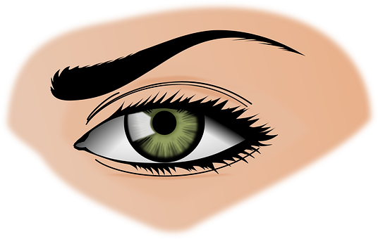

Follow up 1:
[B] Escucha a tu compañero/a y escribe 📝.
escuchar
cien
quién
dice
[says]
maceta
la quena
quena
citar
[to make a date]
ceja
queja
queso
[complaint]
dique
cena
quitar
[to take off]
Notes:
Aim: to practise que/qui in contrast with ci/ce
Procedure:
Partner A sits with their back to the board whilst partner B reads aloud 3 words. Partner A writes the words.
Pupils check their spellings.
Partner then swap roles.
Teachers should circulate to listen to students’ pronunciation and praise/correct as necessary.
Frequency of unknown words:
ceja [3700] cena [2542] cepo [>5000] cien, ciento [440] citar [1440] dice, decir [31] dique [>5000] maceta [>5000] maqueta [>5000] quena [>5000] queja [1942] quepo, caber [1187] queso [3187] quitar [668]
Source: Davies, M. and Davies, K. (2018). A frequency dictionary of Spanish: Core vocabulary for learners (2nd ed.). Routledge: London

Slide 4




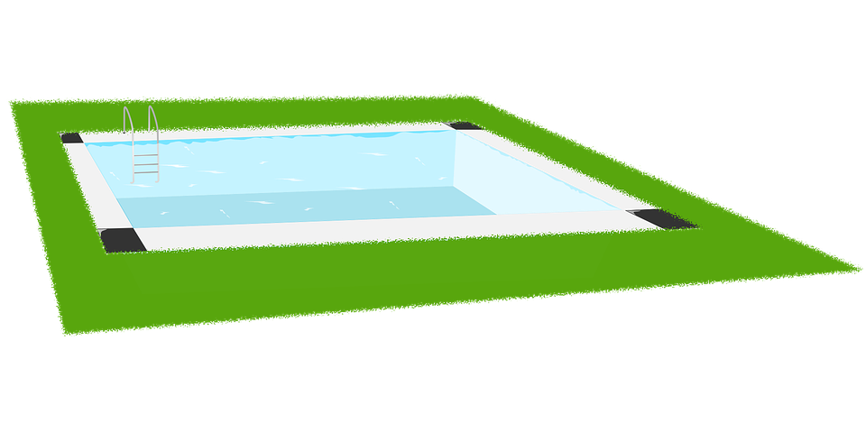

Follow up 2:
[A] Escribe “a/an” & “some” 📝.
¿Qué número es?
vocabulario
 | indefinite (a/an) | indefinite (some)
 | ____ piscina | ____ piscinas
 | ____ escuela | ____ escuelas
 | ____ vestido | ____ vestidos
 | ____ camisa | ____ camisas
 | ____ plaza | ____ plazas
 | ___ universidad | ____ universidades
 | ____ museo | ____ museos
E
una
unas
2
1
1
una
unas
4
E
E
E
2
un
unos
una
unas
E
3
E
E
una
6
4
unas
5
una
unas
6
un
unos
3
E
5
E
Notes:
Timing: 5 minutes
Aim: to use the indefinite article (singular and plural) in written production, connecting words with meaning.
Procedure:
Part A
Pupils write down the correct form of the indefinite article (masculine / feminine, singular / plural).
Click to listen and check.
Part 2 (connecting words with meaning)
Click to bring up instructions and pictures.
Teacher to elicit the Spanish word for the picture.

Slide 5

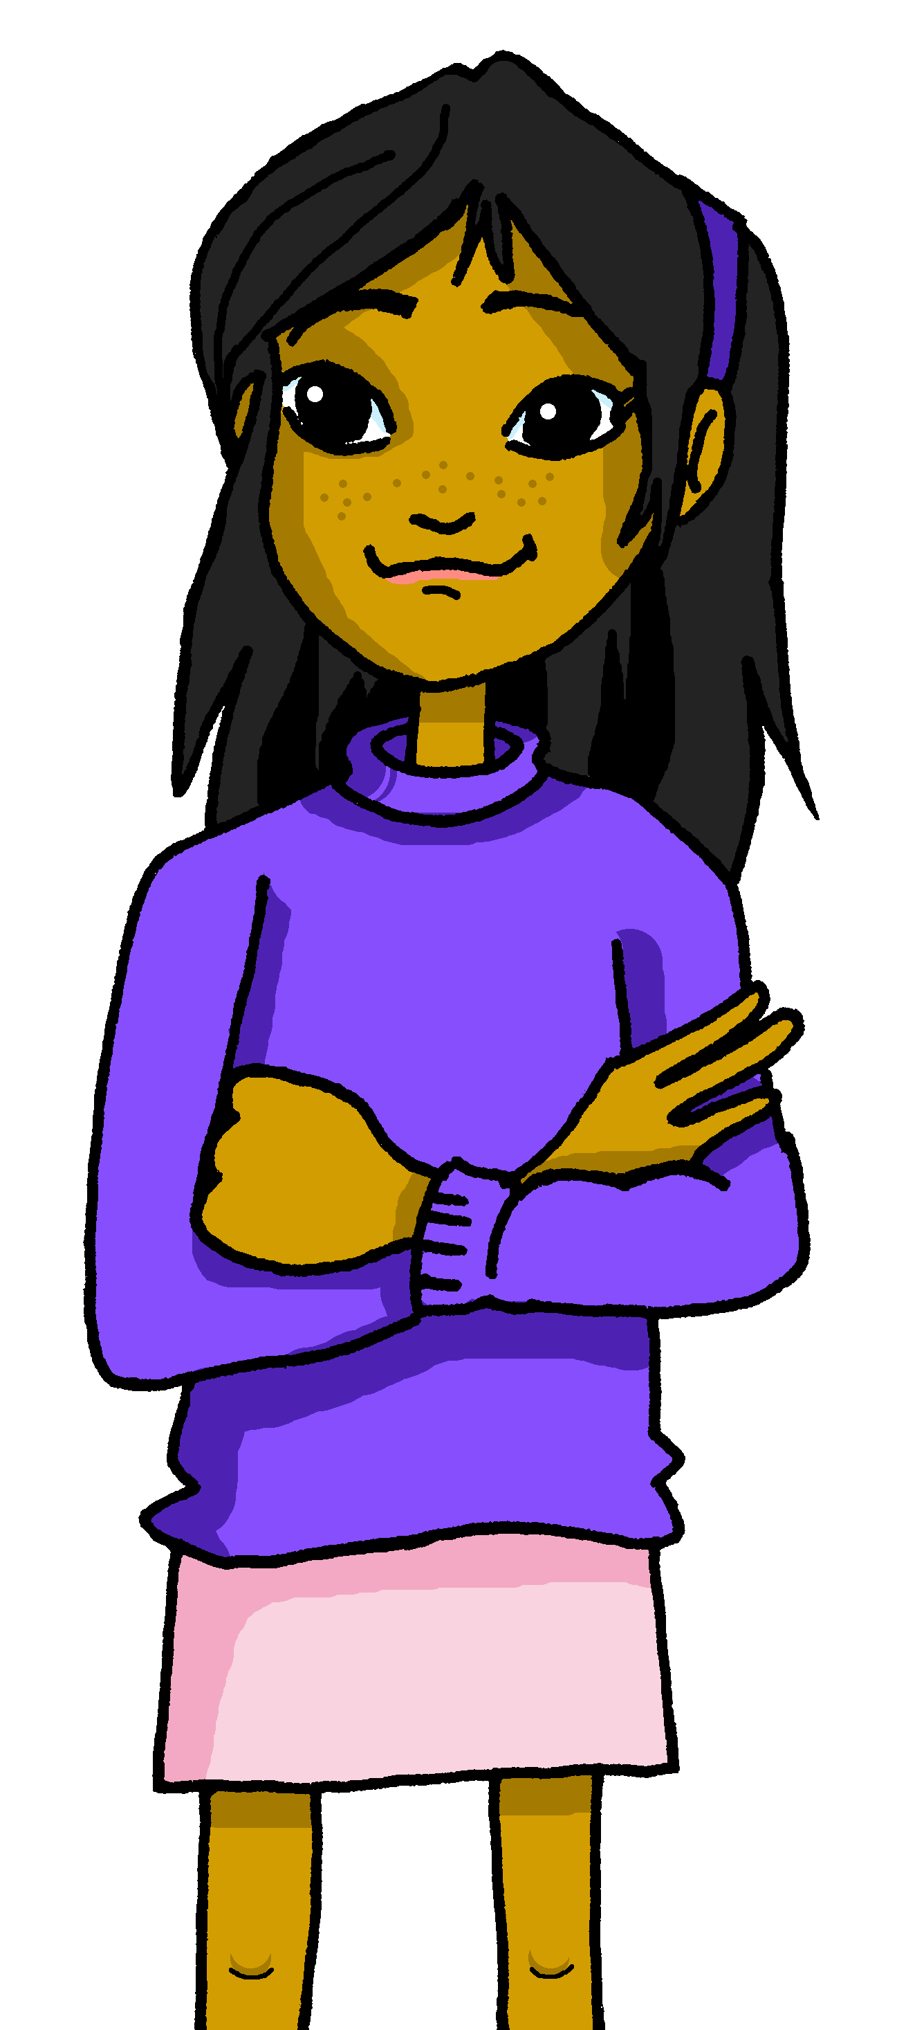


Follow up 3:
Asking about possession: tener
[I have; you have; do you have?; negative ‘no’]
We have already seen the verb tener means ‘to have’.
To say ‘I don’t’ have’, simply put ‘no’ before the verb. This makes a negative.
¿?
I
You (singular)
No tengo un vestido.
¿Tienes un vestido, Elena?
I don’t have a dress.
Do you have a dress, Elena?
This works with any person of the verb
No, no tengo un vestido.
No, I don’t have a dress.
Notes:
Timing: 8 minutes (2 slides)
Aim: to revisit 1st and 2nd person singular of ‘tener’, including revisiting raised intonation for question formation and negation.
Procedure:
Read the grammar explanation on tener (to have).
Elicit English translation for the Spanish examples provided.

Slide 6

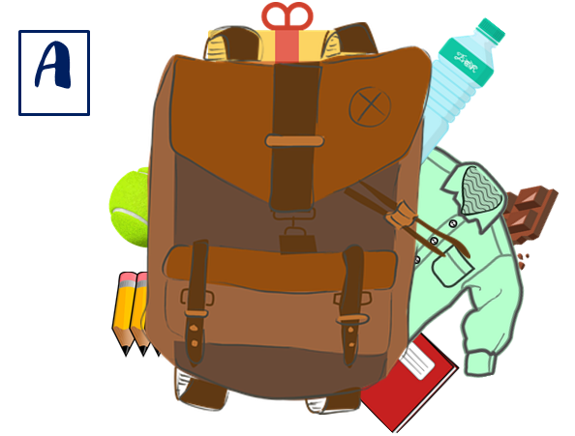

Follow up 3:
Pregunta y adivina la foto de tu compañero/a.
escuchar
hablar
Sí, tengo [some; a/an] [_____] en [my] bolsa.
60
¿Tienes [some; a/an] [_____] en [your] bolsa?
No, no tengo [some; a/an] [_____] en [my] bolsa.
S
0
A
INICIO
Notes:
Timing: 8 minutes
Aim: to use ‘tengo’ and ‘tienes’ in oral production, together with negation; indefinite articles.
Procedure:
Ask pupils to choose one picture (A, B or C), in secret.
Pupils take turns to find out their partner’s picture by asking ‘do you have ….?.
3. Click to bring up speech bubbles and model the dialogue. Insist on pupils answering in full sentences in order to practise negation with ‘tengo’.

Slide 7


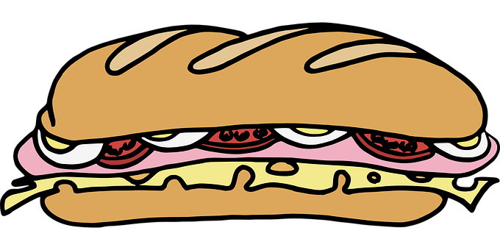


Follow up 4:
El ordenador tiene un problema 😨.
Observa 👀 las imágenes. ¿Qué es diferente?
Lee el texto con tu compañero/a.
Leer y hablar
Preparo mi mochila para* visitar a la
[aunt] Antonella y el [uncle] Jorge. [I have] un [v_ _t_ d_ ] azul y un [s_ _ br_ _ o] rojo. En [my][m_c_ _ l_ ] [I have] [my] [l_ b_ _ s] porque* amo leer. También [I have] [my] [b_t_ll_] [and] [some] [b_c_ _ d _ ll _ _] .
¿[Q_ _][do you have] en [your] [b_ l _ _], Luis?
tía
tío
Tengo
vestido
sombrero
mi
mochila
tengo
mis
libros
tengo
mi
botella
y
unos
bocadillos
Qué
tienes
tu
bolsa
mencionar = to mention, mentioning
para = in order to
porque = because
observar = to observe, observing
Notes:
Timing: 6 minutes
Aim: oral practice of the key grammatical features of week 6 (tener, possessive adjectives).
Procedure:
Teacher to read the context and ensure this is clear.
Pupils to read the message aloud in pairs. Some words have gaps, some others are in English.
Elicit answers from pupils and click to bring up answers.
Click to listen to the full message, if desired.
Click to bring part 2 of the task to check understanding. Pupils can say the English words for the items mentioned in the e-mail aloud and identify which two items are different (animations appear on click from bottom to top, in the order they are mentioned in the text).
Frequency of unknown words:
observar [556] mencionar [1102] para [16] porque [40]
Source: Davies, M. and Davies, K. (2018). A frequency dictionary of Spanish: Core vocabulary for learners (2nd ed.). Routledge: London

Slide 8



Follow up 5:
Escribe en inglés 📝.
Can you get at least 15 points?
 | la iglesia | la calle | histórico
 | de | el puente | solo
 | ¿dónde? | a menudo | el cine
 | aprender | beber | comer
 | el tío | tienes | tengo
 | la camisa | el vestido | la tía
church
street
historical
vocabulario
x3
of, from
bridge
only, alone
Where?
often
cinema
x2
to learn, learning
to drink, drinking
to eat, eating
uncle
You have
I have
x1
shirt
dress
aunt
Notes:
Timing: 5 minutes
Aim: to practise written production of vocabulary from this week and this week’s revisited sets.
Procedure:
1. Give pupils a blank grid. They fill in the English meanings of any of the words they know, trying to reach 15 points in total.
Note:
The most recently learnt and practised words are pink, words from the first revisit are green and those from the second revisit are blue, thus more points are awarded for them, to recognise that memories fade and more effort (heavy lifting!) is needed to retrieve them.

Slide 9
Follow up extra:
Escribe en español 📝.
Can you get at least 15 points?
 | church | street | bridge
 | only, alone | historical (f) | of, from
 | to drink, drinking | Where? | cinema
 | to learn, learning | to eat, eating | often
 | You have | dress | aunt
 | shirt | I have | uncle
la iglesia
la calle
el puente
vocabulario
x3
solo
histórica
de
beber
¿dónde?
el cine
x2
aprender
comer
a menudo
tienes
el vestido
la tía
x1
la camisa
tengo
el tío
Notes:
Timing: 5 minutes
Aim: to practise written production of vocabulary from this week and this week’s revisited sets.
Procedure:
1. Give pupils a blank grid. They fill in the Spanish meanings of any of the words they know, trying to reach 15 points in total.
Note:
The most recently learnt and practised words are pink, words from the first revisit are green and those from the second revisit are blue, thus more points are awarded for them, to recognise that memories fade and more effort (heavy lifting!) is needed to retrieve them.

Slide 10




Handout Follow up 3
✂
|
|
|
|
|
|
|
|
|
|
|
|
|
|
|
|
|
|
|
|
|
|
|
✂
|
|
|
|
|
|
|
|
|
|
|
|
|
A
B
C
D
Notes:
Timing: 8 minutes
Aim: to use ‘tengo’ and ‘tienes’ in oral production, together with negation; indefinite articles.
Procedure:
Ask pupils to choose one picture (A, B or C), in secret.
Pupils take turns to find out their partner’s picture by asking ‘do you have ….?.
3. Click to bring up speech bubbles and model the dialogue. Insist on pupils answering in full sentences in order to practise negation with ‘tengo’.

Slide 11
Follow up 5
Escribe en inglés 📝.
Can you get at least 15 points?
 | la iglesia | la calle | histórico
 | de | el puente | solo
 | ¿dónde? | a menudo | el cine
 | aprender | beber | comer
 | el tío | tienes | tengo
 | la camisa | el vestido | la tía
vocabulario
x3
x2
x1
Notes:
HANDOUT

Slide 12
Follow up extra
Follow up extra
Escribe en español 📝.
Can you get at least 15 points?
 | church | street | bridge
 | only, alone | historical (f) | of, from
 | to drink, drinking | Where? | cinema
 | to learn, learning | to eat, eating | often
 | You have | dress | aunt
 | shirt | I have | uncle
vocabulario
x3
x2
x1
Notes:
HANDOUT

