Slide 1
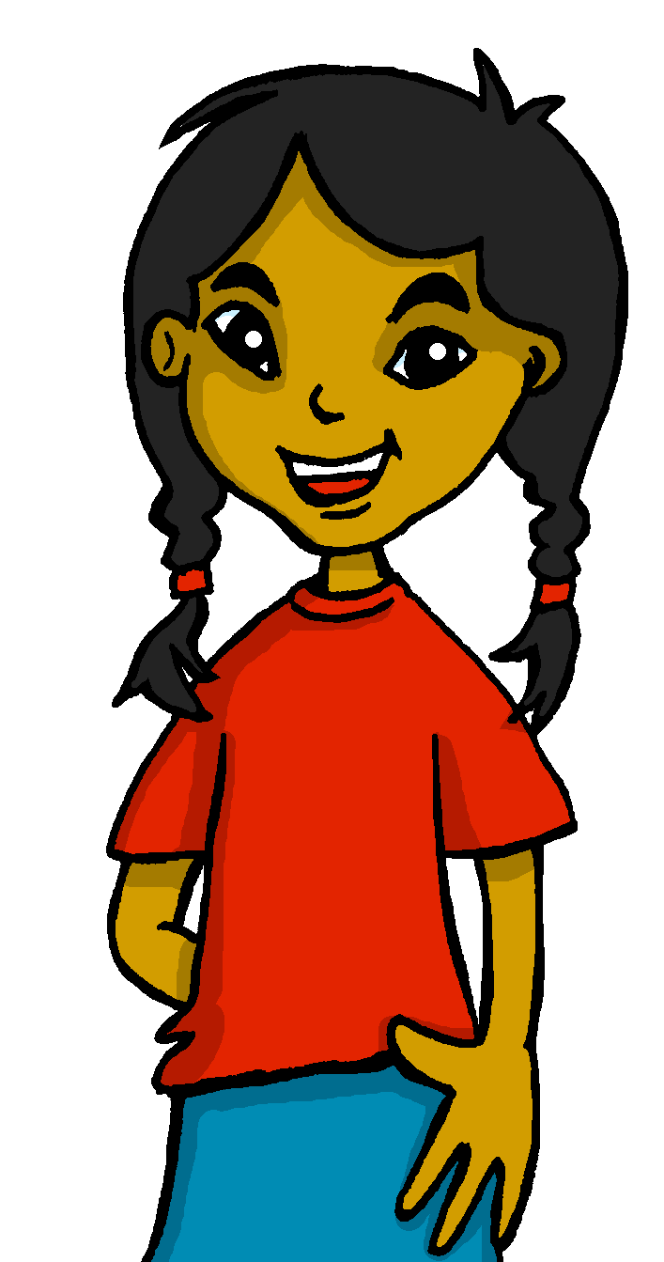
español, con Sofía

Slide 2
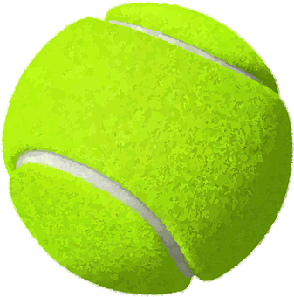
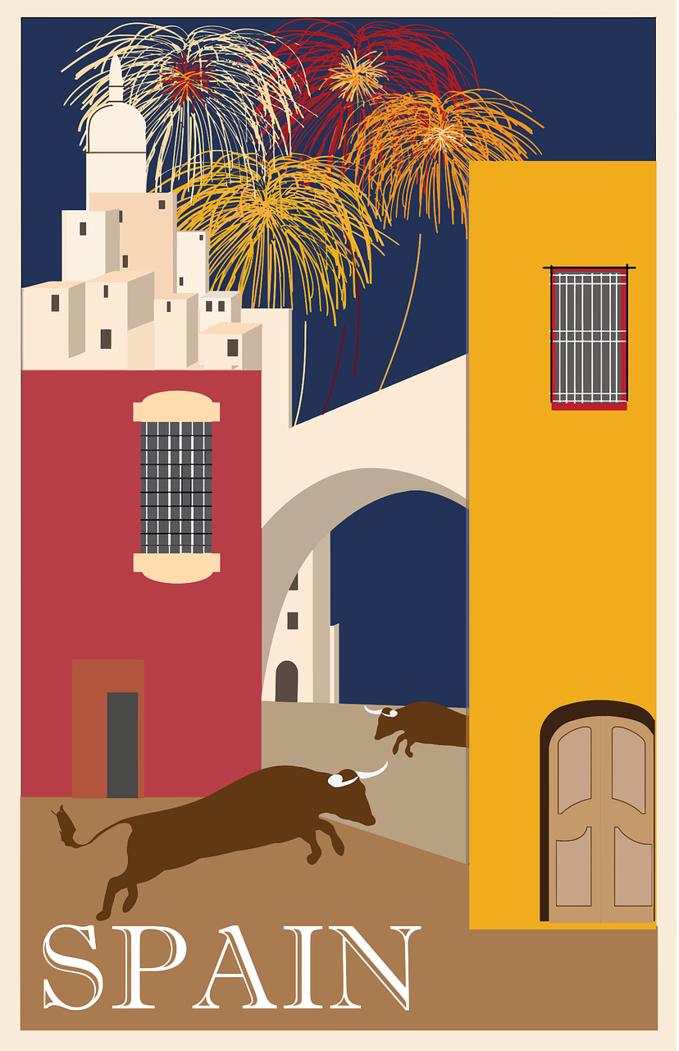
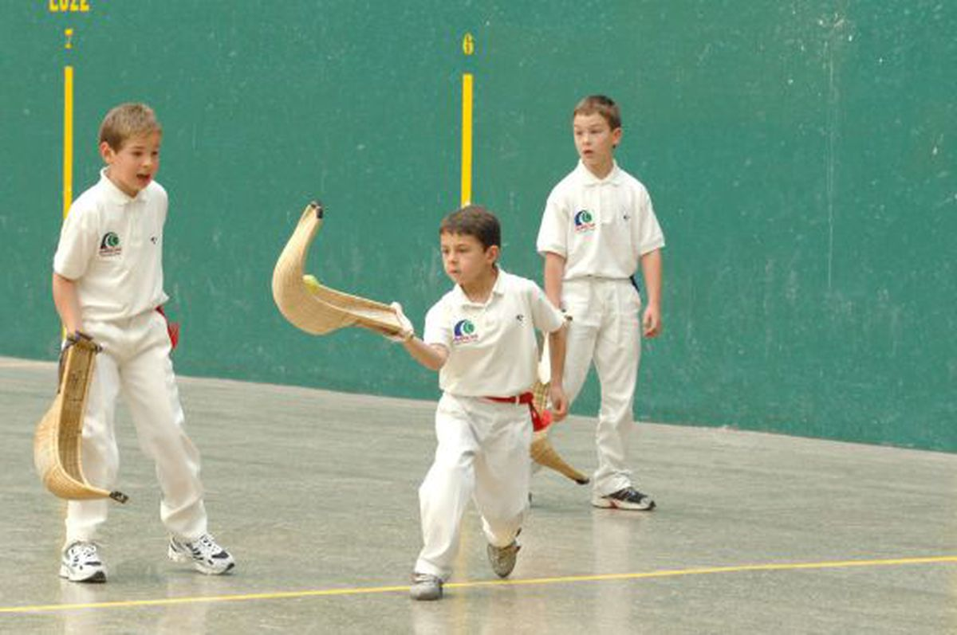
Saying what others and I do
El tiempo libre
verde
-ar verbs: I, s/he, they
SSC: Stress 3
Notes:
Artwork by Steve Clarke. All additional pictures selected are available under a Creative Commons license, no attribution required.
The frequency rankings for words that occur in this PowerPoint which have been previously introduced in the resources are given in the SOW (excel document) and in the resources that first introduced and formally re-visited those words.
For any other words that occur incidentally in this PowerPoint, frequency rankings will be provided in the notes field wherever possible.
Phonics: Stress 3
Vocabulary (new words in bold): jugar [356] amigo [210] amiga [1172] carta [627] cuerda [2116] escondite [>5000] fútbol [1471] habitación [1069] hermano [333] hermana [3409] línea [476] tenis [4856] pelota [2270] solo [181] con [14] en [5]
Revisit 1: beber [1085] aula [3501] bocadillo [>5000] chocolate [3408] comida [906] compañero / compañera [551] ejercicio [1162] español [262] patio [1197] profesor / profesora [501] salón [1722] tarea [995] caliente [1810] en [5] previously revisited –er verbs: aprender [428] comer [347] hacer [26] leer [209]
Revisit 2: tienes [tener 19] tiene [tener 19] árbol [748] calle [269] escuela [424] estadio [2581] hotel [1163] iglesia [437] mentira [1673] museo [1114] parque [1354] piscina [4604] puente [1715] plaza [806] universidad [387] verdad [176] allí [197] aquí [130] blanco [372] bonito [891] perfecto [1115] grande [66] alto [231] verde [812] unos, unas [>5000]
Glossed: activo [1278]
Source: Davies, M. & Davies, K. (2018). A frequency dictionary of Spanish: Core vocabulary for learners (2nd ed.). Routledge: London

Slide 3
pronunciar
Stress 2
We have learned to stress the penultimate syllable (second to last) for any word ending in a vowel, ‘n’ or ‘s’, where there is no written accent.
pasado
[past]
nunca
[never]
orden
[order]
casas
[houses]
Stress 3
For all other words, stress the final syllable.
calor
profesional
feroz
verdad
[truth]
[heat]
[ferocious]
Notes:
Timing: 2 minutes
Aim: to recap one rule of stress without written accents and introduce the other.
Procedure:
Read the explanation.
Introduce the example words to exemplify the rule.
amor [283] feroz [4988] profesional [682]

Slide 4
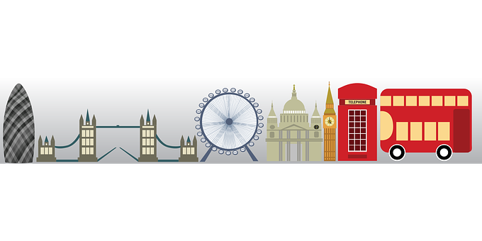
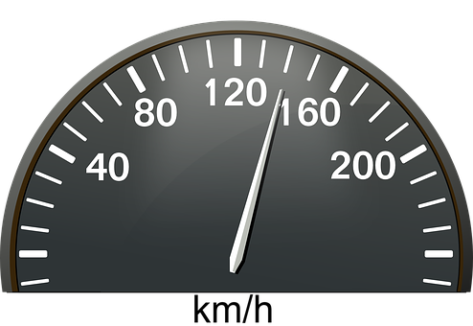
pronunciar
Pronuncia en parejas.
jugar
vencer
bocadillo
verdad
60
actividad
responder
pregunta
beber
aprender
tenemos
capital
feroz
♥
veloz
♥
calor
amor
amabilidad
0
INICIO
Notes:
Timing: 3 minutes
Aim: to practise Stress 2 and Stress 3 pronunciation
Procedure:
Pupils work in pairs to pronounce as many Stress 2 words as they can in 60 seconds.
Click on ‘inicio’ to start the timer.
Pupils then practise pronunciation of stress 3 words in pairs.
Pupils could do this activity as a competitive game, in which the listening pupil checks the speaking pupils’ pronunciation, and if s/he selects and says a word from the wrong category, s/he is sent back to the beginning to start again.
Click to highlight 12 words from this week’s revisiting sets and elicit English meanings.
Alternatively, or additionally, prompt students to recall the Spanish by prompting with English meanings of these 12 words. E.g. ¿Cómo se dice ‘question’ en español?
NB. Most of these words have been previously taught and are being revisited this week.
veloz [4521] amor [283] capital [581] calor [945] amabilidad [>5000]

Slide 5
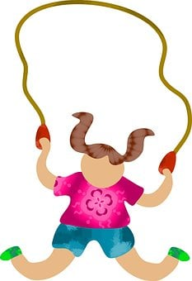
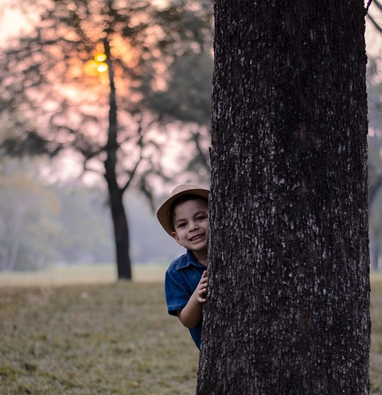
vocabulario
Escucha, repite y aprende 📢.
_ _ c_ _ rd_
el fútbol
_ _ e_ c_ _ d_ t _
la cuerda
_ _ f_ _ _ o _
_ _ t_ _ _ s
el escondite
el tenis
la cuerda
el fútbol
el escondite
el tenis
[tennis]
[rope]
[football]
[hide and seek]
Notes:
Timing: 5 minutes (one slide)
Aim: to introduce key vocabulary for this week.
Procedure: 1.Teacher introduces items one by one (word, then picture and English) and pupils practise pronunciation aloud.
Alternatively, pupils work in pairs, reading the Spanish words out loud and looking at the English meanings (1 minute). 2. Then the teacher removes the English words and pictures (one by one) and pupils try to recall the English orally (chorally), looking at the Spanish (1 minute). 3. Teacher removes Spanish word and elicits Spanish from pupils. (The word is replaced with a gapped version).
NB. Further rounds of learning can be facilitated by one pupil turning away from the board, and his/her partner asking him/her the meanings (‘Cómo se dice X en español?’). This activity can work from L2 → L1 or L1 → L2.

Slide 6
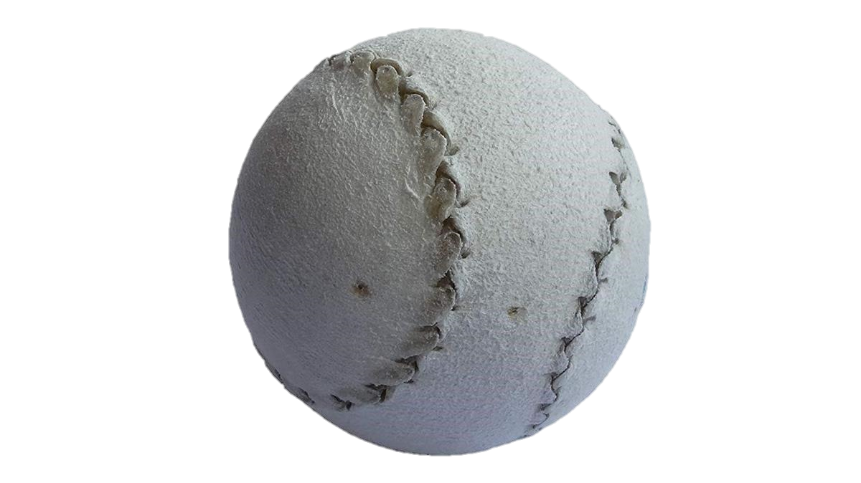
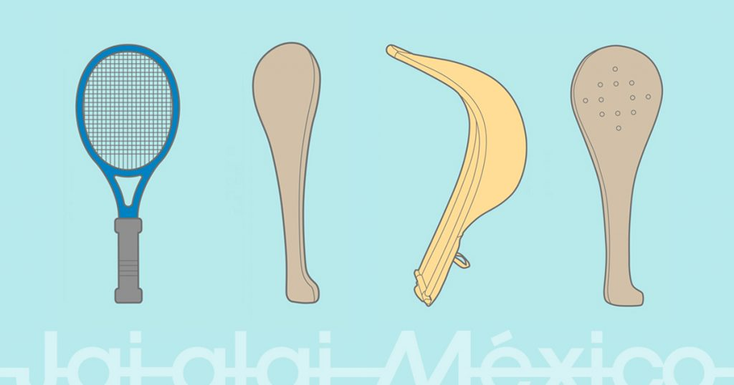
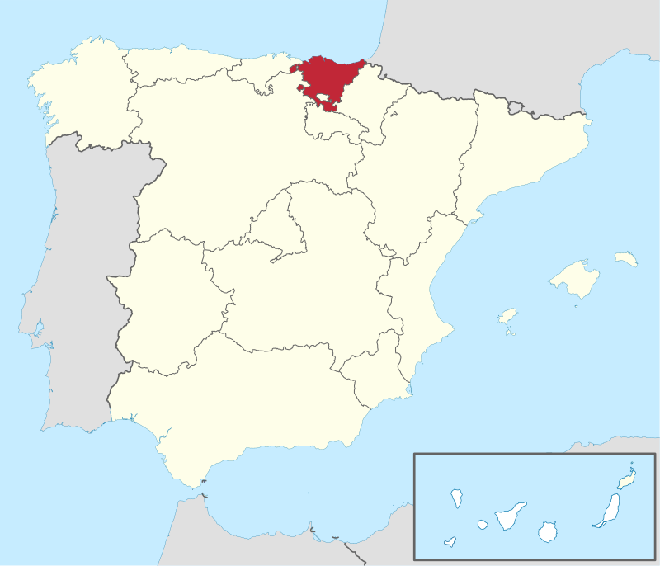
leer
Lee el texto y busca el vocabulario.
activa = active (f)
rackets
s/he loves
popular
a paddle
raquetas
ama
popular
una paleta
Sofía es muy activa* y ama el deporte. En clase aprende sobre deportes típicos en España, por ejemplo, la pelota vasca en el País Vasco. Necesitas una pelota pequeña y una paleta, la mano o raquetas diferentes. Es muy popular en México también.
s/he learns
too
hand
for example
aprende
también
la mano
por ejemplo
Notes:
Timing: 5 minutes
Aim: to set the scene for this week’s lesson and introduce pupils to a traditional sport from the Basque Country; to practise written comprehension of previously taught vocabulary and recognition of cognates/near-cognates.
Procedure:
Pupils read the text aloud with teacher support, as needed.
Click on Sofía to hear an audio version of the text, if desired.
3. Pupils focus on the English words and identify the Spanish words from the bold words in the text. Pupils can volunteer answers in any click – teacher clicks on the English word and the Spanish translation appears.
4. Teachers elicit an oral translation of the text from the class to establish the context of this week’s lesson.
activo [1278]
Children playing pelota vasca: https://elpais.com/ccaa/2015/11/30/paisvasco/1448887844_697093.html#?prm=copy_link
Rackets: https://frontonmexico.com.mx/mundial-absoluto-de-pelota-vasca-barcelona-2018/
Map: De TUBS - Esta imagen vectorial incluye elementos que han sido tomados o adaptados de esta:, CC BY-SA 3.0, https://commons.wikimedia.org/w/index.php?curid=14520652

Slide 7
Using ‘al’ & ‘a la’
[to the]
The verb ‘jugar’ is always followed by the preposition ‘a’ (‘to’).
Juego a la pelota.
Juego a las cartas
I play ball.
I play cards.
‘Juego a las cartas ’ literally translates as ‘I play to the cards’.
When the noun is singular and masculine, a + el becomes al.
Note how ‘al’ (to the) is not needed in English, but you do in Spanish!
Juego al tenis.
Juego al escondite.
I play tennis.
I play hide and seek.
Notes:
Timing: 3 minutes
Aim: to introduce the use of the preposition ‘a’ after ‘jugar’, and the contraction ‘al’.
Procedure:
Read the grammar explanation on ‘to the’.
Elicit English translation for the Spanish examples provided.

Slide 8
[1/5]
Lee las frases ¿Qué palabra es?
E
leer
hablar
Juego ____ fútbol.
a la
a las
al
Notes:
Timing: 3 minutes
Aim: to identify the correct preposition and article or contraction.
Procedure:
Introduce the task.
Click to bring the sentence, and focus pupils attention to gender of the noun (fútbol = masculine).
Give pupils 20-30 seconds to read the sentence aloud in pairs and decide the correct word for the gap.
Elicit response from pupils.
There are 5 sentences in total, including the example.

Slide 9
[2/5]
Lee las frases ¿Qué palabra es?
1
leer
hablar
Juego ____ cuerda.
a la
a las
al
Notes:
[2/5]

Slide 10
[3/5]
Lee las frases ¿Qué palabra es?
2
leer
hablar
Juego ____ escondite.
a la
al
a los
Notes:
[3/5]

Slide 11
[4/5]
Lee las frases ¿Qué palabra es?
3
leer
hablar
Juego ____ pelota.
a las
al
a la
Notes:
[4/5]

Slide 12
[5/5]
Lee las frases ¿Qué palabra es?
4
leer
hablar
Juego ____ tenis.
al
a las
a la
Notes:
[5/5]

Slide 13
Knowing who does what
[–ar verbs: ‘S/he,it’ vs. ‘they’]
Some verbs do not follow the general rules.
To mean ‘S/he, it’ with a verb, we remove –ar and add -a.
To mean ‘they’ with a verb, we remove –ar and add –an.
The verb ‘jugar’ is an example of a verb that does not follow the rules. Notice that ‘jug’ (jugar) changes to ‘jueg’.
S/he, it
they
Juega en el parque.
Juegan en el patio.
S/he plays in the park.
They play in the playground.
Notes:
Timing: 3 minutes
Aim: to introduce 3rd person plural for–ar verbs and revisit 3rd person singular.
Procedure:
Click through the animations to present the new information.
Elicit English translations for the Spanish examples provided.

Slide 14
escuchar
Escucha. ¿Quién es?
¿Es Quique (he) o Ángela y Rubén (they)?
Marca
Escribe 📝 en inglés.
 | Quique | A & R
información extra
E
football
1
in the room
2
in the park
3
hide and seek
4
in the afternoon
5
skipping
Notes:
Timing: 5 minutes
Aim: to practise aural identification of 3rd person singular and plural based on the verb ending; aural recognition of vocabulary.
Part 1
Procedure:
1. Ensure pupils are clear about the task.
2. Click to play the example. Ask pupils to tick Quique (he) or ‘A&R’ (they).
3. Click to reveal the answer.
4. Play 1-5 and pupils complete.
5. Click to reveal answers.
Part 2
1. Listen one more time and ask pupils to write any extra details in English.
Transcript:
E. Juega al fútbol.
1. Juega en la habitación.
2. Juegan en el parque.
3. Juegan al escondite.
4. Juega por la tarde.
5. Juegan a la cuerda.

Slide 15
¡adiós!
verde

