Slide 1






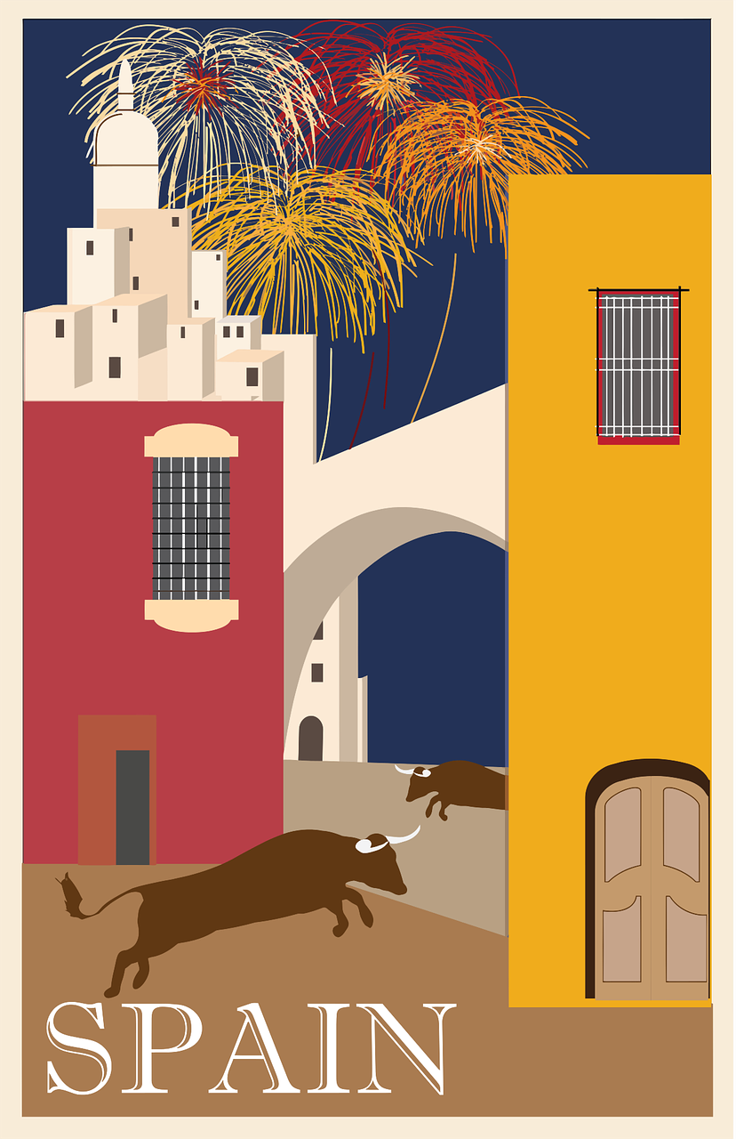

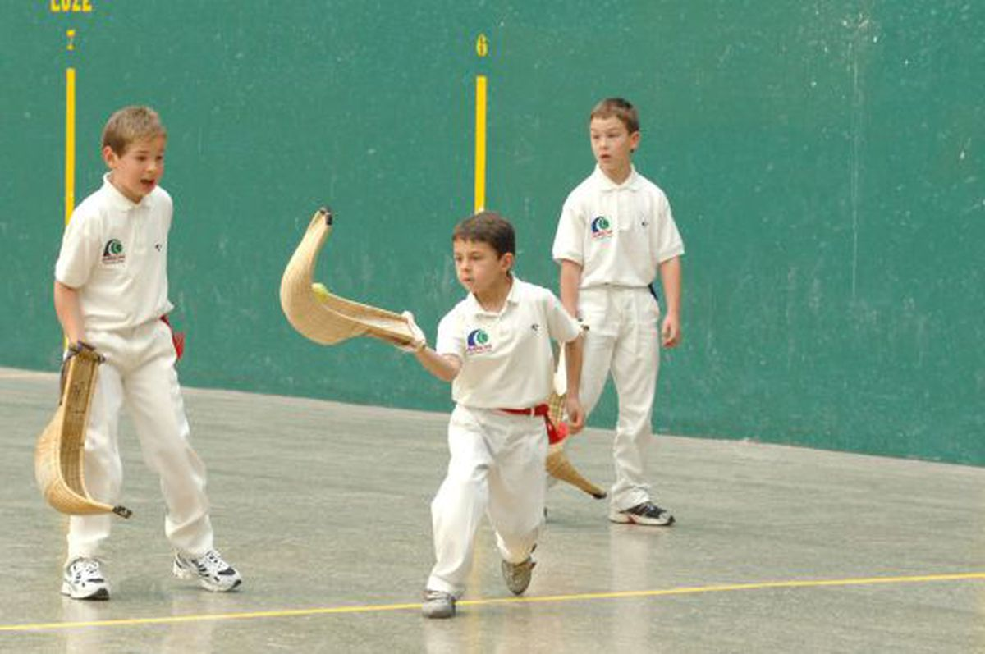
Saying what I and others do
El tiempo libre
verde
Follow ups 1-5
Notes:
Artwork by Steve Clarke. All additional pictures selected are available under a Creative Commons license, no attribution required.
The frequency rankings for words that occur in this PowerPoint which have been previously introduced in the resources are given in the SOW (excel document) and in the resources that first introduced and formally re-visited those words.
For any other words that occur incidentally in this PowerPoint, frequency rankings will be provided in the notes field wherever possible.
Phonics: Stress 3
Vocabulary (new words in bold): jugar [356] amigo [210] amiga [1172] carta [627] cuerda [2116] escondite [>5000] fútbol [1471] habitación [1069] hermano [333] hermana [3409] línea [476] tenis [4856] pelota [2270] solo [181] con [14] en [5]
Revisit 1: beber [1085] aula [3501] bocadillo [>5000] chocolate [3408] comida [906] compañero / compañera [551] ejercicio [1162] español [262] patio [1197] profesor / profesora [501] salón [1722] tarea [995] caliente [1810] en [5] previously revisited –er verbs: aprender [428] comer [347] hacer [26] leer [209]
Revisit 2: tienes [tener 19] tiene [tener 19] árbol [748] calle [269] escuela [424] estadio [2581] hotel [1163] iglesia [437] mentira [1673] museo [1114] parque [1354] piscina [4604] puente [1715] plaza [806] universidad [387] verdad [176] allí [197] aquí [130] blanco [372] bonito [891] perfecto [1115] grande [66] alto [231] verde [812] unos, unas [>5000]
juntos [149] conmigo [1256]
Source: Davies, M. & Davies, K. (2018). A frequency dictionary of Spanish: Core vocabulary for learners (2nd ed.). Routledge: London

Slide 2











Follow up 1:
[Stress]
¿Qué equipos son de España?
¿Qué equipo es de Argentina?
¿Qué equipo es de Colombia?
Leemos.
¿Qué equipos son de México?
pronunciar
60
Levante
Real Madrid
Barcelona
Osasuna
0
Guadalajara
Nacional
Monterrey
Boca Juniors
INICIO
Notes:
Timing: 2-3 minutes
Aim: to practise oral production of and distinction between stress patterns 2 and 3, in the context of Latin American countries.
Procedure:
Click to highlight the syllabification of each country and elicit the pronunciation from pupils, chorally.
Bring up the instruction to work in pairs and click the timer.
Pupils should work together to try to pronounce each country accurately, paying attention to the two different stress patterns.
Click again to remove all the visual syllabification support and repeat the task.
Further questions could be asked: ¿Qué equipos son de España? (Levante, Real Madrid, Barcelona, Osasuna). ¿Qué equipo
Levante: Von unknown - Diese Vektordatei stammt aus dem Archiv der VFLnet unter http://www.vflnet.com., Logo, https://de.wikipedia.org/w/index.php?curid=3954281
Madrid: By The logo is from the following website: https://www.realmadrid.com/, Fair use, https://en.wikipedia.org/w/index.php?curid=35239667
Atlético: By http://www.atleticodemadrid.com/, Fair use, https://en.wikipedia.org/w/index.php?curid=55146701
Osasuna: By The logo is from the following website: http://www.osasuna.es/ http://www.osasuna.es/dev/, Fair use, https://en.wikipedia.org/w/index.php?curid=37651412
Barcelona: By http://www.fcbarcelona.com/, Fair use, https://en.wikipedia.org/w/index.php?curid=17178745
Guadalajara: By The logo is from the following website: http://www.vflnet.com, Fair use, https://en.wikipedia.org/w/index.php?curid=43123716
Atlético Nacional: By CamiloBer04 - Own work, versión mejorada por Wikialien, Public Domain, https://commons.wikimedia.org/w/index.php?curid=40813953
Monterrey: By Club Deportivo Monterrey A.C. (Club de Fútbol Monterrey) - https://www.rayados.com/, Public Domain, https://commons.wikimedia.org/w/index.php?curid=92260949
Boca Juniors: De Diegotóteles - https://www.bocajuniors.com.ar/el-club/escudo, CC0, https://commons.wikimedia.org/w/index.php?curid=115936541

Slide 3




Follow up 2:

Escribe en inglés.
Can you get at least 15 points?
 | tienes | la iglesia | allí
 | hacer | unos | bonita
 | la mentira | el bocadillo | la verdad
 | el aula | el salón | caliente
 | beber | la tarea | la compañera
 | la cuerda | el escondite | pelota
 | el fútbol | el tenis | jugar
(the) church
vocabulario
you have
there
to do, make
some (m)
pretty (f)
x3
(the) lie, false
(the) sandwich
(the) truth
x2
(the) classroom
(the) hall
hot
to drink, drinking
(the) task
(the) partner (f)
(the) rope
(the) hide and seek
(the) ball
x1
(the) football
(the) tennis
to play, playing
Notes:
Timing: 5 minutes
Aim: to practise written comprehension (this slide) of vocabulary from this week and this week’s revisited sets.
Procedure:
Give pupils a blank grid. They fill in the English meanings of any of the words they know, trying to reach 15 points in total.
Note:
The most recently learnt and practised words are pink, words from the first revisit are green and those from the second revisit are blue, thus more points are awarded for them, to recognise that memories fade and more effort (heavy lifting!) is needed to retrieve them.

Slide 4


Follow up 3:
Knowing who does what
Using the verb ‘jugar’
[–ar verbs: ‘I’,‘s/he’ & ‘they’]
Some verbs do not follow the general rules.
The verb ‘jugar’ is an example of this.
‘jug’ changes to ‘jueg’
☺ Use the same endings as for all –ar verbs
I
S/he, it
they
juego
juega
juegan
I play
s/he plays
They play
Notes:
Timing: 10 minutes in total (3 slides) - grammar info (3 minutes) + reading task (2 slides, 7 minutes)
Aim: to revisit singular persons in the present tense for –ar verbs with jugar
Procedure:
Click through the animations to present the information.
Elicit English translations for the Spanish examples provided.

Slide 5



Follow up 3:
Lee:¿Es Quique, Max & Krina o los tres?
juntos = together (m., pl.)
conmigo = with me
Completa el diagrama en español 📝 .
leer
E
Juega a la pelota vasca en la calle.
1
Juega al tenis por la mañana.
2
Juegan a la cuerda juntos.
los tres
Max + Krina
‘they’
Quique
‘He’
‘He + they’
3
Juegan al escondite en el aula.
pelota vasca
escondite
cuerda
4
Juega a las cartas solo.
tenis
cartas
5
Juega a la cuerda conmigo.
6
Juegan a las cartas en línea.
Notes:
Timing: 7 minutes (2 slides)
Aim: to practise written understanding of ‘jugar’ in 3rd person singular and plural.
Procedure:
Read the task title in Spanish and click to bring up further instructions.
Click x1 to bring up Venn diagram and instruction, then draw pupils attention to the sentences. Was Sofía writing about Quique (he plays) or Max and Krina (they play)? Are there activities they all play? (he plays+ they play)
3. Ask pupils to draw the diagram (or a table) and write down the Spanish words in the correct.
4. Go through answers together, answers are animated in groups (first Quique, then ‘Max and Krina’, lastly ‘los tres’).
Part 2 – next slide
1. Go Through the questions to elicit answers from pupils.
juntos [149] conmigo [1256]

Slide 6
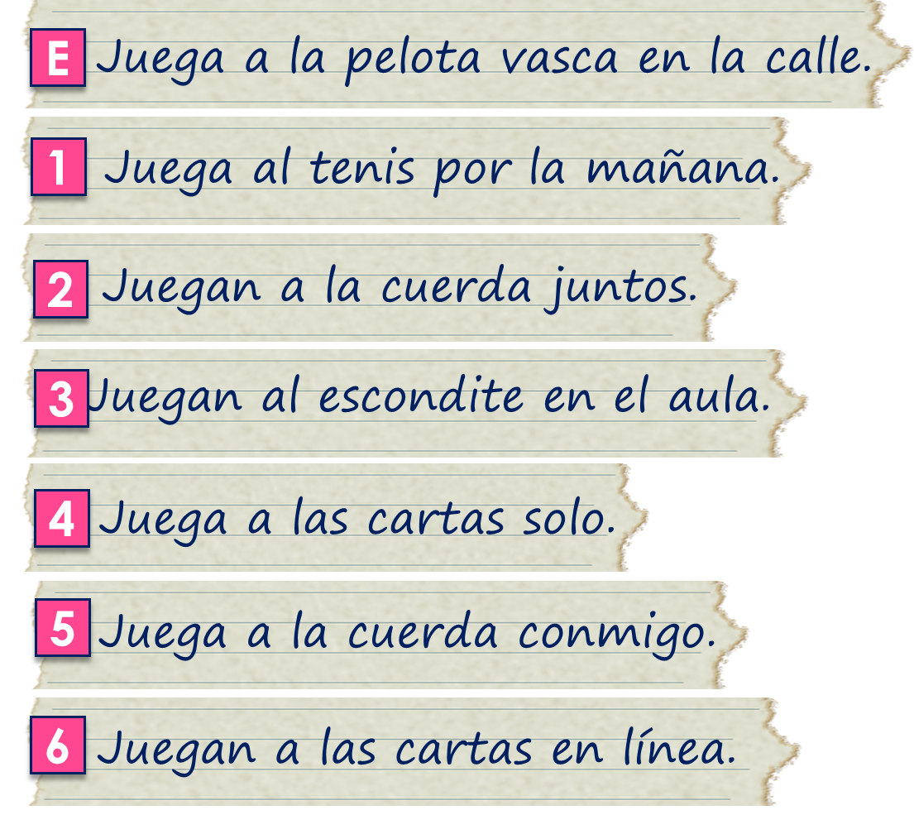
Follow up 3:
juntos = together (m., pl.)
conmigo = with me
Lee y responde en inglés.
leer
[A] Where does Quique play pelota vasca?
[B] How do Max and Krina play cards?
[C] How does Quique play cards?
[D] Where do Max and Krina play hide and seek?
[E] When does Quique play tennis?
[F] With whom does Quique play skipping?
[G] With whom do Max and Krina play skipping?
in the street
E
online
1
alone
2
in the classroom
3
in the morning
4
with me (Sofía)
5
together
6
Notes:
Timing: 5 minutes
Aim: to practise written understanding of a range of vocabulary in connection with 3rd person singular and plural of jugar.
Procedure:
Part 2
1. Go Through the questions to elicit answers from pupils. Answers are animated.
juntos [149] conmigo [1256]

Slide 7


Follow up 4:
[1/6]
Trabajamos en grupos de 3.
escribir
hablar
¿A qué juega Quique?
Quique plays football with (female) friends.
escuchar
Persona A pregunta.
Personas B y C responden.
B
⬇
C
⬇
B
⬇
C
⬇
B
⬇
C
⬇
Quique juega al fútbol con amigas.
Persona A escribe.
📝
Notes:
Timing: 5 minutes
Aim: to brings together all the revision from the lesson into a final production activity.
Procedure:
1. Teachers could use this slide to model the requirements of the task. Start by organizing pupils in groups of 3 and telling them whether they are A B or C as this will be important when modelling the task.
2. Here students work in groups of three. The person writing starts the dialogue off by asking the question in the speech bubble.
3. The other two people speaking take it in turns to say alternate words of the answer in Spanish. Sentences are then compared at the end as a whole class (or after each city if preferred).
4. The words for this example’s answers are revealed by clicking on each box.
5. Suggested order:
1: Persons B&C speak (B says the first word of the response), and person A writes down the Spanish.
2: Person A&C speak (A says the first word of the response), and person B writes down the Spanish.
3: Person A&B speak (B says the first word of the response), and person C writes down the Spanish.
4: Persons B&C speak (B says the first word of the response), and person A writes down the Spanish.
5: Person A&C speak (A says the first word of the response), and person B writes down the Spanish.
6: Person A&B speak (B says the first word of the response), and person C writes down the Spanish
(Teachers can be less prescriptive if students can work out for themselves how to take turns!)
Click on the yellow box to hear the Spanish audio.
Notes:
The person writing cannot interrupt if s/he spots a mistake. However, teachers should allow one minute for reflection on the sentences as a group of three, before the answers are revealed. Teachers could consider asking students to undertake the speaking without reference to their exercise books/vocab books and then in the reflection time allowing access to reference materials to allow for successful edits.
responder []

Slide 8
Follow up 4:
[2/6]
Trabajamos en grupos de 3.
escribir
hablar
¿A qué juega?
She plays cards in the room.
escuchar
Persona B pregunta.
Personas A y C responden.
A
⬇
C
⬇
A
⬇
C
⬇
A
⬇
C
⬇
A
⬇
Juega a las cartas en la habitación.
📝
Persona B escribe.
Notes:
[2/6]
Person A&C speak (A says the first word of the response), and person B writes down the Spanish.

Slide 9
Follow up 4:
[3/6]
Trabajamos en grupos de 3.
escribir
hablar
¿A qué juegas?
I play tennis with my brother.
escuchar
Persona C pregunta.
Personas A y B responden.
B
⬇
A
⬇
B
⬇
A
⬇
B
⬇
A
⬇
Juego al fútbol con mi hermano.
📝
Persona C escribe.
Notes:
[3/6]
3: Person A&B speak (B says the first word of the response), and person C writes down the Spanish.

Slide 10
Follow up 4:
[4/6]
Trabajamos en grupos de 3.
escribir
hablar
¿A qué juegan?
They play skipping in the square.
escuchar
Persona A pregunta.
Personas B y C responden.
B
⬇
C
⬇
B
⬇
C
⬇
B
⬇
C
⬇
B
⬇
Juegan a la cuerda en la plaza.
Persona A escribe.
📝
Notes:
[4/6]
4: Persons B&C speak (B says the first word of the response), and person A writes down the Spanish.

Slide 11
Follow up 4:
[5/6]
Trabajamos en grupos de 3.
escribir
hablar
¿A qué juegas?
I play football alone .
escuchar
Persona B pregunta.
Personas A y C responden.
A
⬇
C
⬇
A
⬇
C
⬇
Juego al fútbol solo.
Persona B escribe.
📝
Notes:
[5/6]
5: Person A&C speak (A says the first word of the response), and person B writes down the Spanish.

Slide 12
Follow up 4:
[6/6]
Trabajamos en grupos de 3.
escribir
hablar
¿A qué juegan?
Rubén and Ángela play hide and seek in the park.
escuchar
Persona C pregunta.
Personas B y C responden.
B
⬇
A
⬇
B
⬇
A
⬇
B
⬇
A
⬇
B
⬇
A
⬇
B
⬇
Rubén y Ángela juegan al escondite en el parque.
Persona A escribe.
📝
Notes:
[6/6]
6: Person A&B speak (B says the first word of the response), and person C writes down the Spanish.

Slide 13
Follow up 5:

Escribe en español.
Can you get at least 15 points?
 | pretty (f) | church | there
 | school | square | some (f)
 | here | big | s/he has
 | to learn, learning | to read, reading | task
 | food | teacher (f) | partner (m)
 | to play, playing | ball | rope
 | tennis | football | hide and seek
la iglesia
allí
vocabulario
bonita
la escuela
la plaza
unas
x3
aquí
grande
tiene
x2
aprender
leer
la tarea
la comida
la profesora
el compañero
jugar
la pelota
la cuerda
x1
el escondite
el tenis
el fútbol
Notes:
Timing: 5 minutes
Aim: to practise written production of vocabulary from this week and this week’s revisited sets.
Procedure:
1. Give pupils a blank grid. They fill in the Spanish meanings of any of the words they know, trying to reach 15 points in total.
Note:
The most recently learnt and practised words are pink, words from the first revisit are green and those from the second revisit are blue, thus more points are awarded for them, to recognise that memories fade and more effort (heavy lifting!) is needed to retrieve them.

