Slide 1


español, con Sofía

Slide 2

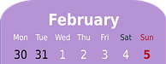

Saying what others and I do
El fin de semana
entre semana
verde
-er verbs: I, you, s/he, we
negation
SSC: Stress 2
Notes:
Artwork by Steve Clarke. All additional pictures selected are available under a Creative Commons license, no attribution required.
The frequency rankings for words that occur in this PowerPoint which have been previously introduced in the resources are given in the SOW (excel document) and in the resources that first introduced and formally re-visited those words.
For any other words that occur incidentally in this PowerPoint, frequency rankings will be provided in the notes field wherever possible.
Phonics: Stress 2
Vocabulary (new words in bold): fin [182] restaurante [2636] ruido [1034] nunca [158]: aprender [428] beber [1085] comer [37] comprender [434] hacer [26] leer [209] responder (a) [464] ver [38] a menudo [958] a veces [vez 59] normalmente [1696]siempre [96]
Revisit 1: celebrar [886] mandar [588] carrera [481] España [N/A] tarjeta [1958] villancico [>5000] común [742] especial [436] tipíco [1934] pero [30] en1 [5]
Revisit other –ar verbs: cantar [717] comprar [361] escuchar [281] preparar [570]
Revisit 2: tener [19] tengo [tener 19] tiene [tener 19] compañero / compañera [551] escuela [424] hotel [1163] piscina [4604] puente [1715] bastante [308] muy [43] un [6] una [6] re-use adjectives: bonito [891] diferente [293] divertido [2465] fuerte [435] grande [66] importante [171] independiente [1177] inteligente [2167] lento [1569] normal [1000] pequeño [202] perfecto [1115] pesado [2166] serio [856]
Glossed: pizarra [>5000]
Source: Davies, M. & Davies, K. (2018). A frequency dictionary of Spanish: Core vocabulary for learners (2nd ed.). Routledge: London

Slide 3

pronunciar
Stress 2
Where there is no written accent, stress the penultimate
(second to last) syllable for any word ending in a vowel, ‘n’ or ‘s’.
pasado
[past]
nunca
[never]
orden
[order]
sabemos
[we know]
Notes:
Timing: 2 minutes
Aim: to explain the rule of stress and written accents: 2. Where there is no written accent, stress the penultimate
(second to last) syllable for any word ending in a vowel, ‘n’ or ‘s’.
Procedure:
Read the explanation.
Introduce the example words to exemplify the rule.

Slide 4

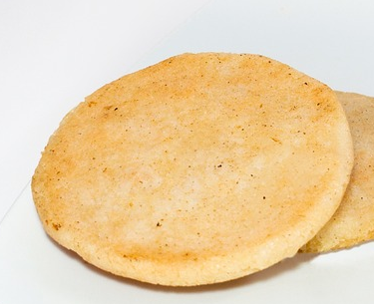
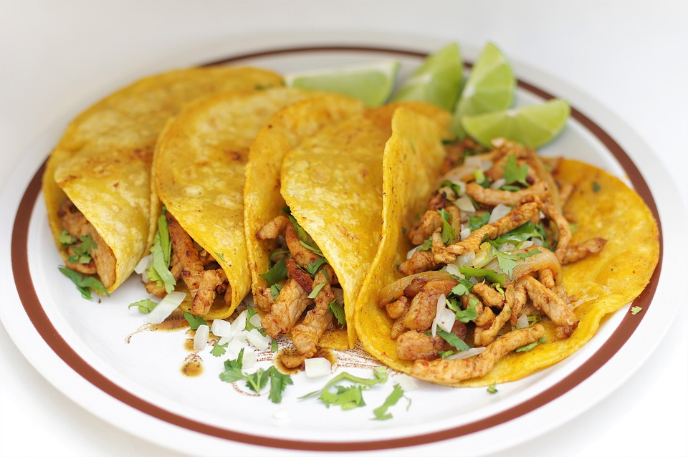
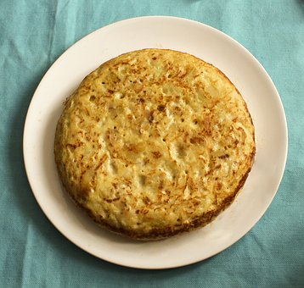
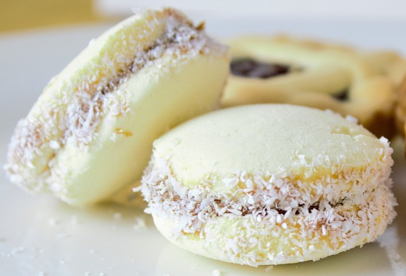

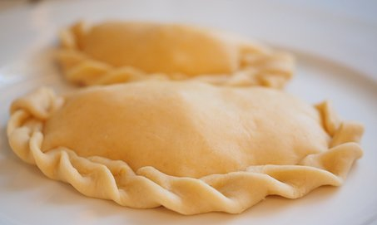
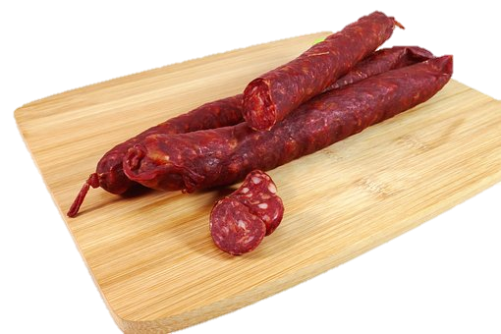
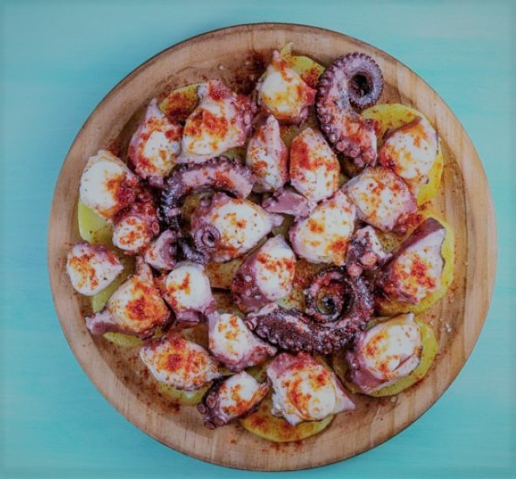
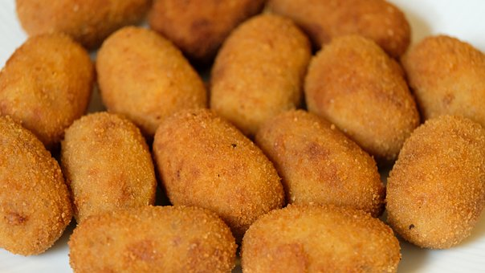
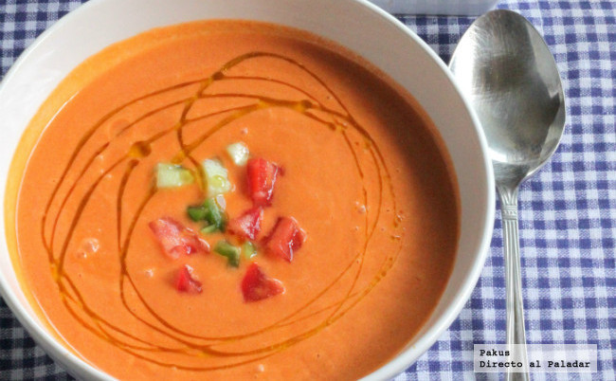
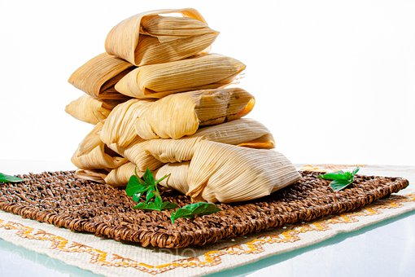
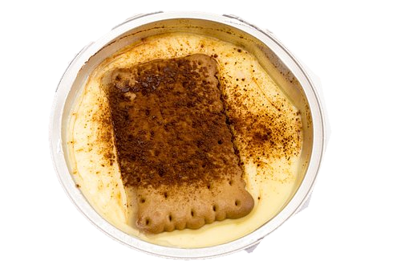
pronunciar
Pronuncia en parejas.
60
arepas
tortilla española
calamares
chorizo
gazpacho
natillas
tacos
alfajores
empanadas
pulpo (a la gallega)
croquetas
tamales
0
INICIO
Notes:
Timing: 3 minutes
Aim: to practise Stress rule 2 with unknown words (food from around Spanish speaking countries).
Procedure:
Pupils work in pairs to pronounce as many words as they can in 60 seconds.
Click on ‘inicio’ to start timer.
Click on the pictures to hear the Spanish audio.
Gazpacho picture downloaded from: https://www.directoalpaladar.com/recetas-de-sopas-y-cremas/receta-de-gazpacho-andaluz-tradicional
Pulpo picture downloaded from: https://dietamediterranea.com/pulpo-a-la-gallega/

Slide 5


Knowing who does what
[–er verbs: ‘S/he,it’ vs. ‘we’]
To mean ‘S/he, it’ with a verb, we remove –er and add -e.
To mean ‘we’ with a verb, we remove –er and add –emos.
S/he, it
we
Come en casa.
Comemos en un restaurante.
S/he eats at home.
We eat at a restaurant.
Notes:
Timing: 3 minutes
Aim: to reintroduce 3rd person singular for–er verbs and introduce 1st plural.
Procedure:
Click through the animations to present the new information.
Elicit English translations for the Spanish examples provided.

Slide 6



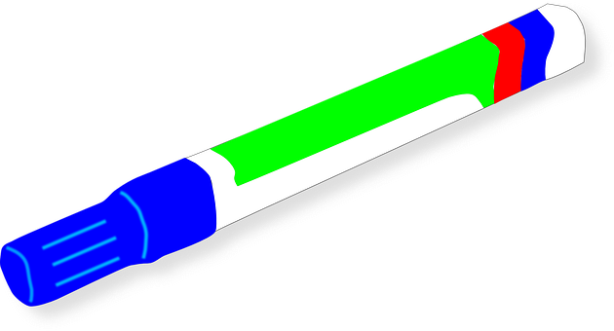

leer
Sofía escribe en la pizarra [Ejemplo]
la pizarra = board
¿Quién es?
Is she talking about what she does with Ángela or what someone else does?
Siempre lee con la abuela.
Marca.
Sofía & Ángela (we) | Someone else (s/he, it)
Notes:
Timing: 8 minutes (part 1 – 5 minutes / part 2 – 3 minutes)
Aim: to practise written comprehension of 1st person plural and 3rd person singular.
[Part 1] [1/5]
Procedure:
Read the title and click to explain the context of the task.
Click to bring up further instructions in Spanish.
Do [1/5] with them to model the task and draw their attention to the verb (bebe). Does it refer to Sofía & Ángela (we) or someone else (s/he)?
Click to bring up the answer.
Repeat with items 2-5.
NB. Meaning will be checked in Part 2 of this task.
pizarra [>5000]

Slide 7
leer
Sofía escribe en la pizarra [1/5]
la pizarra = board
nunca = never
¿Quién es?
Is she talking about what she does with Ángela or what someone else does?
Nunca* ve a su profesora.
Marca.
Sofía & Ángela (we) | Someone else (s/he, it)
Notes:
Timing: 8 minutes (part 1 – 5 minutes / part 2 – 3 minutes)
Aim: to practise written comprehension of 1st person plural and 3rd person singular.
[Part 1] [1/5]
Procedure:
Read the title and click to explain the context of the task.
Click to bring up further instructions in Spanish.
Do [1/5] with them to model the task and draw their attention to the verb (bebe). Does it refer to Sofía & Ángela (we) or someone else (s/he)?
Click to bring up the answer.
Repeat with items 2-5.
NB. Meaning will be checked in Part 2 of this task.

Slide 8
leer
Sofía escribe en la pizarra [2/5]
la pizarra = board
¿Quién es?
Is she talking about what she does with Ángela or what someone else does?
Respondemos a mensajes.
Marca.
Sofía & Ángela (we) | Someone else (s/he, it)
Notes:
Timing: 8 minutes (part 1 – 5 minutes / part 2 – 3 minutes)
Aim: to practise written comprehension of 1st person plural and 3rd person singular.
[Part 1] [2/5]
Procedure:
Read the title and click to explain the context of the task.
Click to bring up further instructions in Spanish.
Do [1/5] with them to model the task and draw their attention to the verb (bebe). Does it refer to Sofía & Ángela (we) or someone else (s/he)?
Click to bring up the answer.
Repeat with items 2-5.
NB. Meaning will be checked in Part 2 of this task.

Slide 9
leer
Sofía escribe en la pizarra [3/5]
la pizarra = board
¿Quién es?
Is she talking about what she does with Ángela or what someone else does?
Vemos una película en el cine.
Marca.
Sofía & Ángela (we) | Someone else (s/he, it)
Notes:
Timing: 8 minutes (part 1 – 5 minutes / part 2 – 3 minutes)
Aim: to practise written comprehension of 1st person plural and 3rd person singular.
[Part 1] [3/5]
Procedure:
Read the title and click to explain the context of the task.
Click to bring up further instructions in Spanish.
Do [1/5] with them to model the task and draw their attention to the verb (bebe). Does it refer to Sofía & Ángela (we) or someone else (s/he)?
Click to bring up the answer.
Repeat with items 2-5.
NB. Meaning will be checked in Part 2 of this task.

Slide 10
leer
Sofía escribe en la pizarra [4/5]
la pizarra = board
¿Quién es?
Is she talking about what she does with Ángela or what someone else does?
Come en un restaurante español.
Marca.
Sofía & Ángela (we) | Someone else (s/he, it)
Notes:
Timing: 8 minutes (part 1 – 5 minutes / part 2 – 3 minutes)
Aim: to practise written comprehension of 1st person plural and 3rd person singular.
[Part 1] [4/5]
Procedure:
Read the title and click to explain the context of the task.
Click to bring up further instructions in Spanish.
Do [1/5] with them to model the task and draw their attention to the verb (bebe). Does it refer to Sofía & Ángela (we) or someone else (s/he)?
Click to bring up the answer.
Repeat with items 2-5.
NB. Meaning will be checked in Part 2 of this task.

Slide 11
leer
Sofía escribe en la pizarra [5/5]
la pizarra = board
¿Quién es?
Is she talking about what she does with Ángela or what someone else does?
Hacemos ruido por la mañana.
Marca.
Sofía & Ángela (we) | Someone else (s/he, it)
Notes:
Timing: 8 minutes (part 1 – 5 minutes / part 2 – 3 minutes)
Aim: to practise written comprehension of 1st person plural and 3rd person singular.
[Part 1] [5/5]
Procedure:
Read the title and click to explain the context of the task.
Click to bring up further instructions in Spanish.
Do [1/5] with them to model the task and draw their attention to the verb (bebe). Does it refer to Sofía & Ángela (we) or someone else (s/he)?
Click to bring up the answer.
Repeat with items 2-5.
NB. Meaning will be checked in Part 2 of this task.

Slide 12
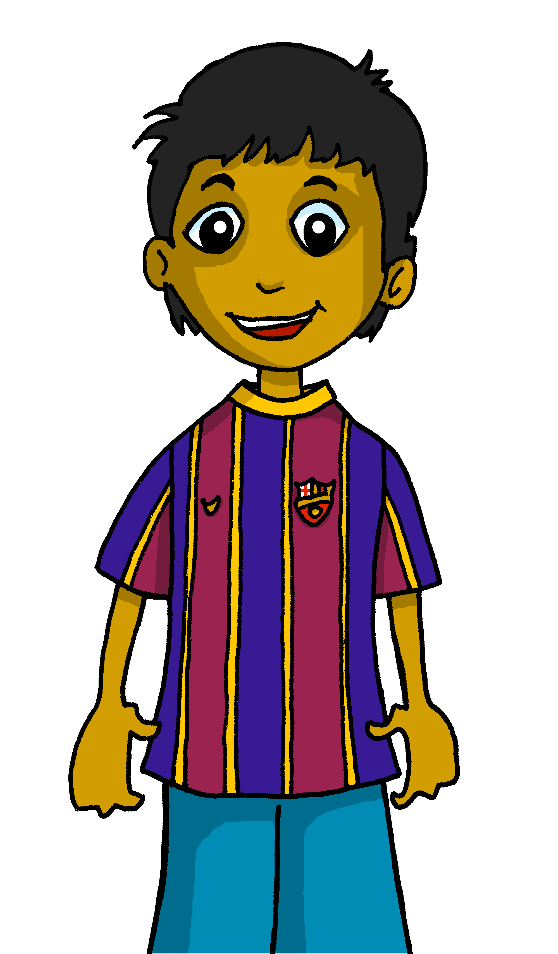

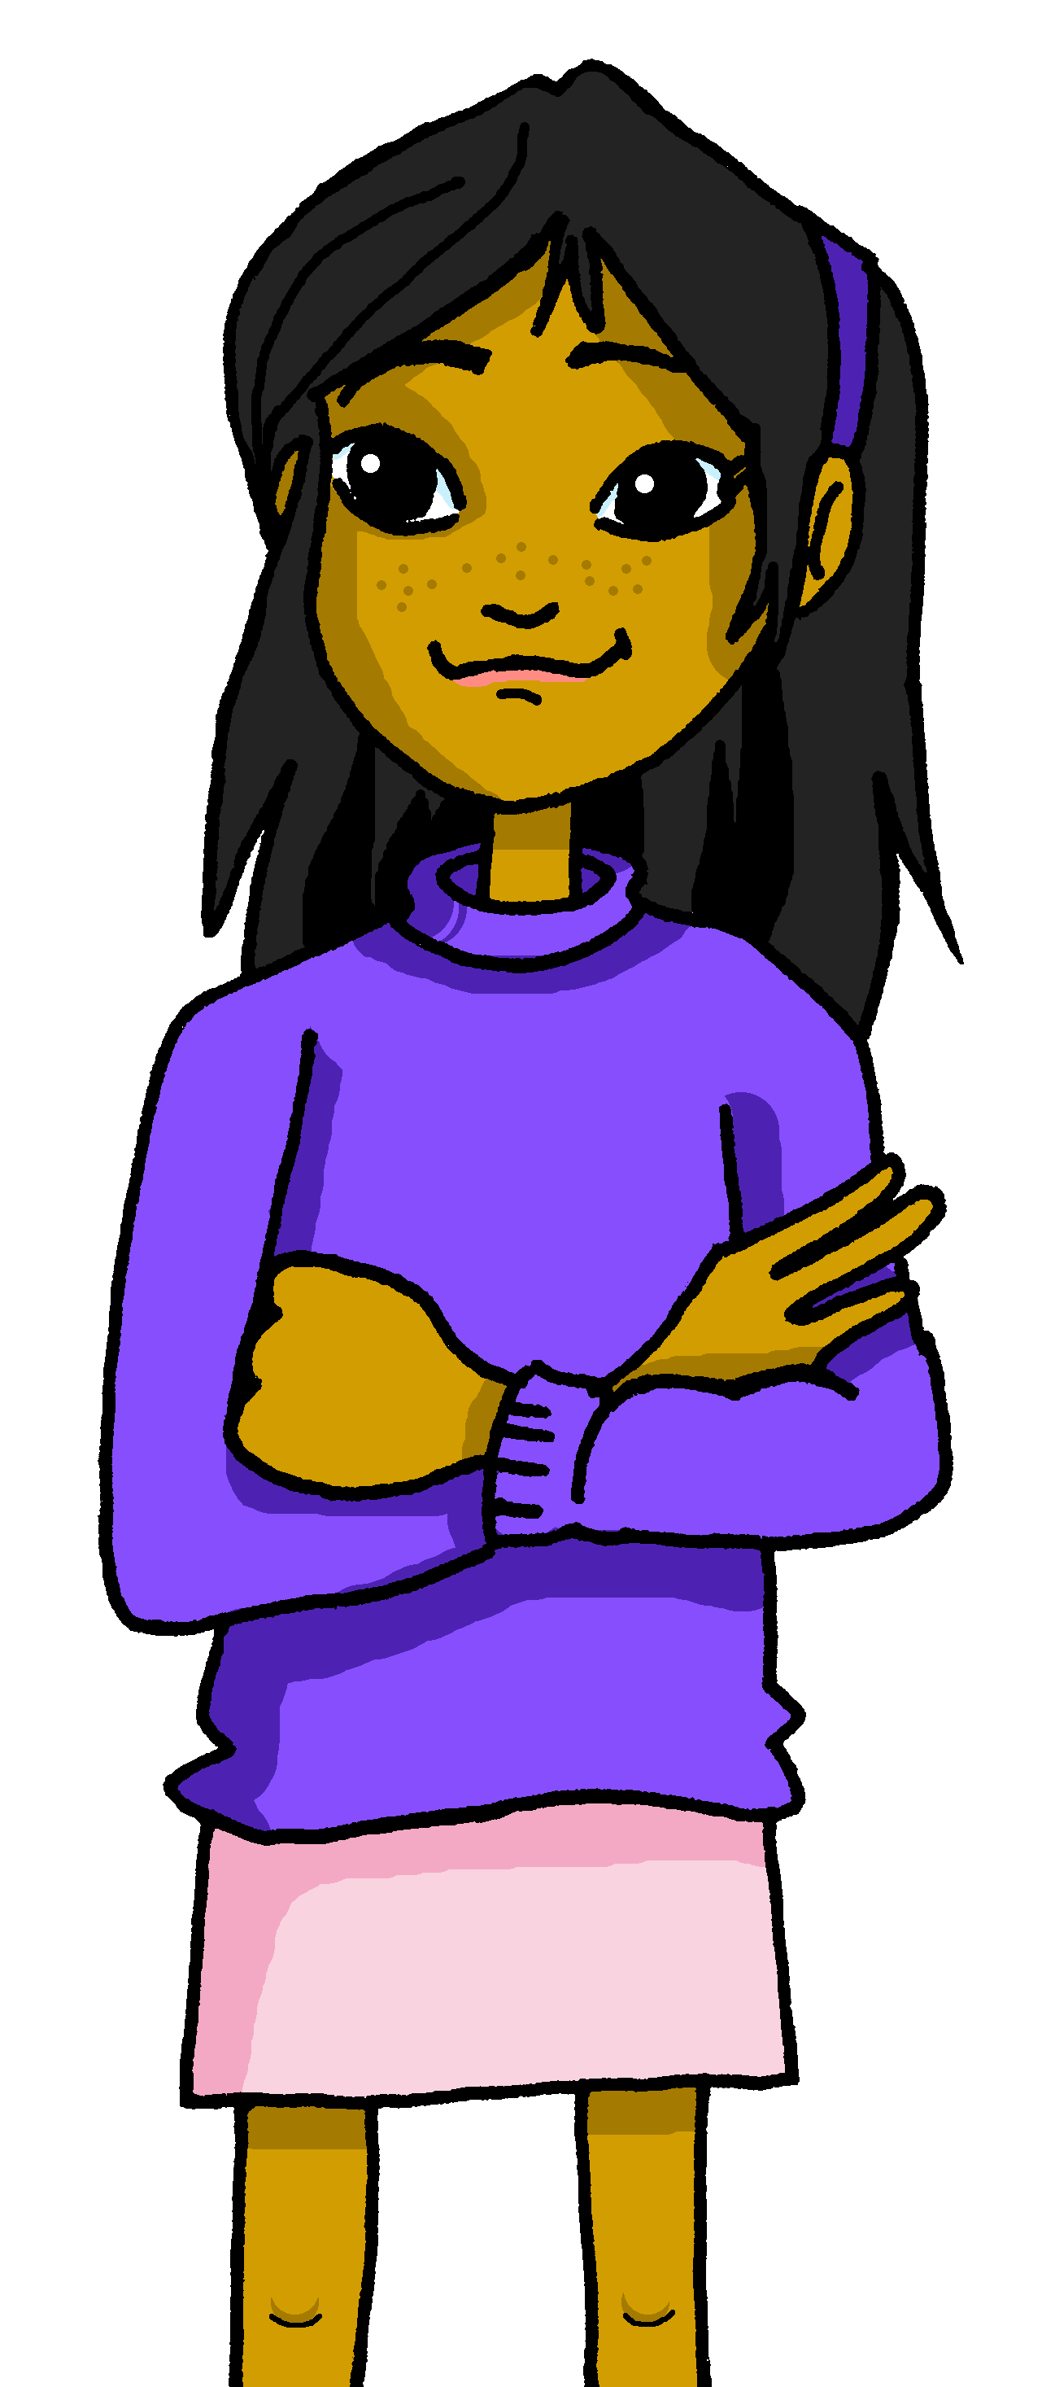









leer
Lee otra vez. ¿Qué imagen es?
Siempre lee con la abuela.
Nunca ve a su profesora.
Respondemos a mensajes.
Vemos una película en el cine.
Come en un restaurante español.
Hacemos ruido por la mañana.
‘nunca’ (never) goes before the verb.
[d]
E
[a]
[b]
[c]
1
[a]
[f]
[he sees]
[he eats]
[we make]
2
[e]
3
[b]
4
5
[c]
[d]
[e]
[f]
[he reads]
[we see]
[we answer]
Notes:
Timing: 5 minutes
Aim: to practise written comprehension of 1st person plural and 3rd person singular.
[Part 2]
Procedure:
Read the title and click to explain the context of the task.
Do [1] to model the task.
Click to bring up the answer.
Repeat with 2-5.
When going through the answers, encourage pupils to translate the whole sentence.
Translation of these sentences should reinforce understanding of 1st person plural, 3rd person singular and new/revisited vocabulary.

Slide 13


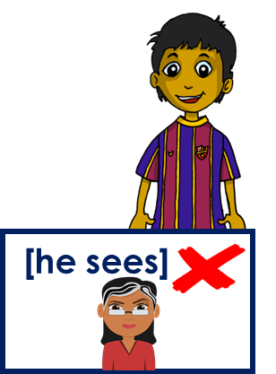
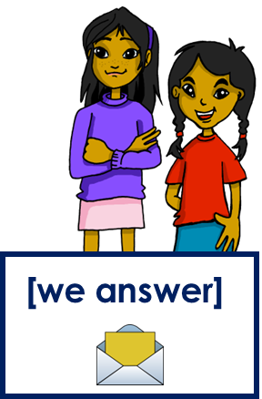



leer
¿Es entre semana?
¿o es el fin de semana?
Siempre lee con la abuela.
Nunca ve a su profesora.
Respondemos a mensajes.
Vemos una película en el cine.
Come en un restaurante español.
Hacemos ruido por la mañana.
E
hablar
1
2
3
Nunca ve a su profesora entre semana.
4
Siempre lee con la abuela entre semana.
5
¡Es imposible!
¡Es posible!
Notes:
Timing: 3 minutes
Aim: to practise written comprehension of 1st person plural and 3rd person singular.
[Part 2]
Procedure:
Read the title and click to explain the context of the task.
Do [1] to model the task.
Click to bring up the answer.
Repeat with 2-5.
When going through the answers, encourage pupils to translate the whole sentence.
Translation of these sentences should reinforce understanding of 1st person plural, 3rd person singular and new/revisited vocabulary.

Slide 14




Using the negative ‘no’
[no]
In Spanish, to say what you or others don’t do, put ‘no’ before the verb. This makes a negative.
No lee las noticias en el teléfono.
No leemos las noticias en el ordenador.
S/he doesn’t read the news on the phone.
We don’t read the news on the computer.
This works for any verb and any person (e.g., I, you, s/he, we).
Notes:
Timing: 3 minutes
Aim: to introduce the negative ‘no’, drawing on pupils’ knowledge of 1st person plural and 3rd person singular.
Procedure:
Click through the animations to present the new information.
Elicit English translations for the Spanish examples provided.

Slide 15


escuchar
Escucha: ¿La frase es positiva o negativa?
¿Quién es? Marca ✅.
Marca. ✅
positiva | negativa
verbo | s/he | we
información extra
ve
E
films (on the PC)
1
lee
the news (often)
2
respondemos
letters
3
bebe
milk (is allergic)
4
hace
exercise (in the park)
5
aprendemos
(new) words
Notes:
Timing: 7 minutes
Aim: listening activity to practise distinguishing between negative and positive statements, and 3rd person singular and 1st person plural forms of ‘-er’ verbs in the present.
Procedure:
Click to bring instructions.
Pupils first identify whether it’s a negative or affirmative statement and then the person of the verb ‘she’ / ‘you’.
Do [E] with them to model the task.
Complete items 1-5 and then click to correct.
Transcript
E. No ve películas en el ordenador.
A menudo lee las notícias.
No respondemos a cartas.
No bebe leche. ¡Es alérgico!
No hace ejercicio en el parque.
Aprendemos palabras nuevas.

Slide 16
¡adiós!
verde

