Slide 1

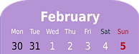

Saying what I and others do
El fin de semana
entre semana
verde
Follow ups 1-5
Notes:
Artwork by Steve Clarke. All additional pictures selected are available under a Creative Commons license, no attribution required.
The frequency rankings for words that occur in this PowerPoint which have been previously introduced in the resources are given in the SOW (excel document) and in the resources that first introduced and formally re-visited those words.
For any other words that occur incidentally in this PowerPoint, frequency rankings will be provided in the notes field wherever possible.
Phonics: Stress 2
Vocabulary (new words in bold): fin [182] restaurante [2636] ruido [1034] nunca [158]: aprender [428] beber [1085] comer [37] comprender [434] hacer [26] leer [209] responder (a) [464] ver [38] a menudo [958] a veces [vez 59] normalmente [1696]siempre [96]
Revisit 1: celebrar [886] mandar [588] carrera [481] España [N/A] tarjeta [1958] villancico [>5000] común [742] especial [436] tipíco [1934] pero [30] en1 [5]
Revisit other –ar verbs: cantar [717] comprar [361] escuchar [281] preparar [570]
Revisit 2: tener [19] tengo [tener 19] tiene [tener 19] compañero / compañera [551] escuela [424] hotel [1163] piscina [4604] puente [1715] bastante [308] muy [43] un [6] una [6] re-use adjectives: bonito [891] diferente [293] divertido [2465] fuerte [435] grande [66] importante [171] independiente [1177] inteligente [2167] lento [1569] normal [1000] pequeño [202] perfecto [1115] pesado [2166] serio [856]
su [12]
Source: Davies, M. & Davies, K. (2018). A frequency dictionary of Spanish: Core vocabulary for learners (2nd ed.). Routledge: London

Slide 2



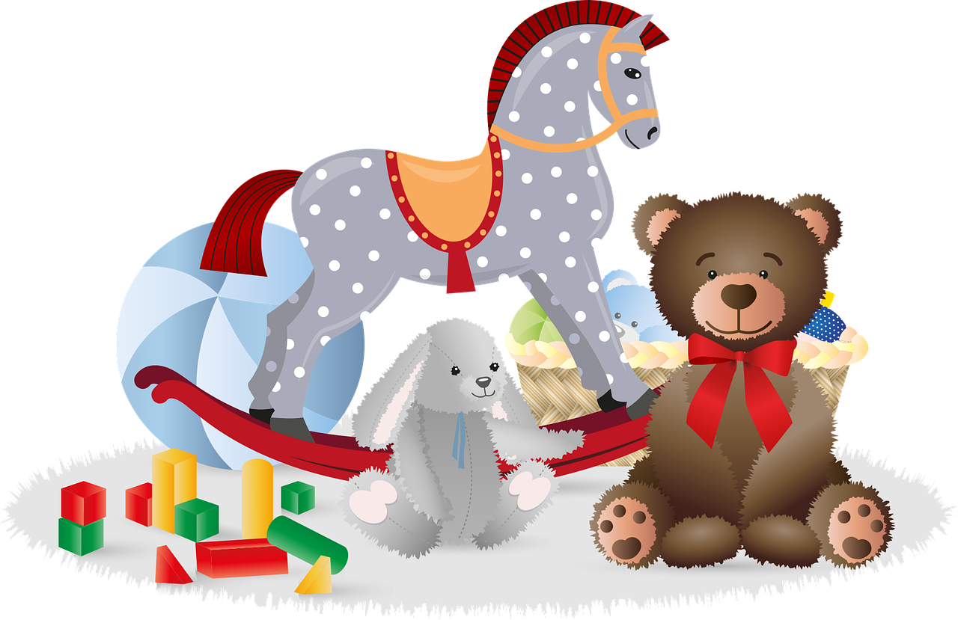
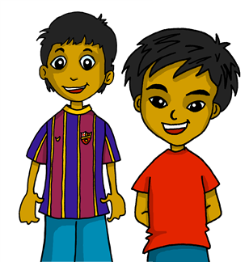




Follow up 1:
[Stress 2]
[A] Escucha y ordena las sílabas.
pronunciar
Where’s the stress?
Colorea la sílaba en rojo.
60
Where there is no written accent, stress the penultimate (second to last) syllable for any word ending in a vowel, ‘n’ or ‘s’.
ves
ti
ves
dos
E
ti
dos
gue
te
ju
1
ju
gue
te
es
pe
ran
2
ran
pe
es
tra
ba
ba
mos
tra
ja
ja
3
mos
[we]
ro
di
di
ne
4
ne
ro
0
5
to
ces
lon
lon
ba
to
ba
ces
[B] Practica con tu compañero/a.
INICIO
Notes:
Timing: 3 minutes
Aim: to practise stress rule 2.
Procedure:
Part A
1. Click to listen to each word.
2. Pupils write the words, putting the syllables in the correct order.
3. Pupils then colour (or underline/circle etc.) the syllable that is stressed.
Note: they will have heard the stress, but might not have paid full attention as they were writing. However, they can apply the rule to the written forms and then listen again to check, if needed.
Part B
1. Pupils practise the pronunciation of the words.
2. Click ‘inicio’ to start a 12-second timer.
Transcript:
E. vestidos
1. juguete
2. esperan
3. trabajamos
4. dinero
5. baloncesto
baloncesto [>5000] dinero [364] vestido [1697] will be introduced formally later on in term 3.
trabajar [174] esperar [157]
juguete [3163] is used as a source word for [gue]

Slide 3




Follow up 2:

Escribe en inglés: Can you get at least 15 points?
 | el puente | bastante | la piscina
 | la escuela | la compañera | el compañero
 | la carrera | especial | la tarjeta
 | común | mandar | celebrar
 | comer | comprender | hacer
 | nunca | aprender | a veces
 | el fin | el restaurante | el ruido
vocabulario
(the) bridge
quite
(the) swimming pool
x3
(the) school
(the) partner (f)
(the) partner (m)
(the) race
special
(the) card
x2
common
to send, sending
to celebrate
to eat, eating
to understand
to make, do
never
to learn, learning
sometimes
x1
(the) end
(the) restaurant
(the) noise
Notes:
Timing: 5 minutes
Aim: to practise written comprehension of vocabulary for this week and previous weeks.
Procedure:
1. Pupils need to write the English for as many words as possible, aiming to get at least 15 points (but more if possible).
2. Click for English answers.

Slide 4



Follow up 3:
Knowing who does what & negative ‘no’
[–er verbs: ‘I’,‘s/he,it’ & ‘we’| no ]
Remember, to mean ‘I’, ‘s/he,it’ or ‘we’ with a verb, the verb ending changes.
I
S/he, it
we
No como en casa.
Como en casa.
Come en el parque.
No come en el parque.
Comemos en clase.
No comemos en clase.
I eat at home.
S/he eats in the park.
We eat in class.
We don’t eat in the class.
I don’t eat at home.
She doesn’t eat in the park.
To say what you or others don’t do, put ‘no’ before the verb. This makes a negative.
Notes:
Timing: 3 minutes
Aim: to revisit the negative ‘no’, drawing on pupils’ knowledge of 1st and 3rd person singular and 1st person plural.
Procedure:
Click through the animations to present the new information.
Elicit English translations for the Spanish examples provided.

Slide 5




Follow up 3:
ella = she
su = his/her
Sofía habla sobre ella*, Max y Krina.
escuchar
leer
Escucha y completa el texto.
El fin de semana [1] __________ muchas cosas. Por ejemplo, [2] __________ chocolate caliente por la mañana porque es un día especial y a veces [3] __________ en un restaurante. T También [4] ______ ejercicio en el parque.
[5] _______ un amigo de Inglaterra. Su* nombre es Max. E Entre semana [6] _______ muchas actividades y su amiga Krina [7] ________ deporte. A menudo [8] ________ un lilbro por la tarde también.
hacemos
bebemos
cenamos
hago
Tengo
hace
hace
lee
Notes:
Timing: 10 minutes (two slides)
Aim: to practise transcription of key verbs in the 1st person plural and 3rd person singular.
Procedure:
1. Pupils write 1-8.
2. Click to listen to each sentence. Pupils write in the missing verb.
3. Click to correct answers.
4. Move to the next slide for a comprehension task.
su [12]

Slide 6

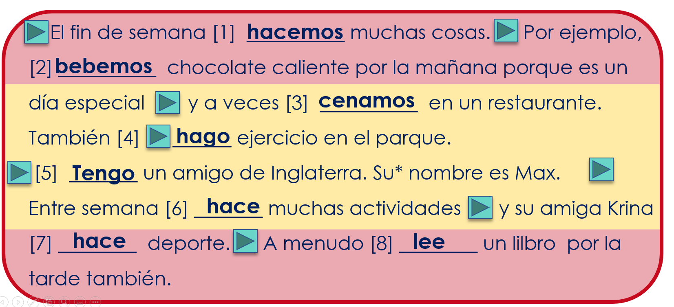
Follow up 3:
Lee ¿Quién es?
Escribe S [I], S&Q [we], K [she] o M [he] 📝.
leer
su = his/her
Who….
does lots of things at the weekend?
reads a book in the afternoon?
has a friend from England?
eat in a restaurant?
S&Q [we]
S&Q [we]
drinks hot chocolate in the morning?
does lots of things during the week?
does sport?
does exercise in the park?
K [she]
M [he]
S [I]
K [she]
S&Q [we]
S [I]
Notes:
[2/2]
Aim: to practise written comprehension of the text, understanding the difference between ‘I’, ‘s/he’ and ‘we’ verb forms.
Procedure:
1. Pupils read the text again.
2. They write 1-7 and the name or names that answer each question.
3. Click to correct.
su [12]

Slide 7

Follow up 4:
¡Habla!
hablar
Say the Spanish sentence. [1/6]
S
15
She replies to a message in the morning.
Responde a un mensaje por la mañana.
mensaje
responde
por
un
a
mañana
la
0
INICIO
Notes:
[2/2]
Aim: to practise written comprehension of the text, understanding the difference between ‘I’, ‘s/he’ and ‘we’ verb forms.
Procedure:
1. Pupils read the text again.
2. They write 1-7 and the name or names that answer each question.
3. Click to correct.

Slide 8
Follow up 4:
¡Habla!
hablar
Say the Spanish sentence. [2/6]
S
15
We eat fruit in the afternoon.
Comemos fruta por la tarde.
por
comemos
tarde
fruta
la
0
INICIO
Notes:
[2/2]
Aim: to practise written comprehension of the text, understanding the difference between ‘I’, ‘s/he’ and ‘we’ verb forms.
Procedure:
1. Pupils read the text again.
2. They write 1-7 and the name or names that answer each question.
3. Click to correct.

Slide 9
Follow up 4:
¡Habla!
hablar
Say the Spanish sentence. [3/6]
S
15
We don’t make noise in the morning.
No hacemos ruido por la mañana.
por
no
ruido
hacemos
mañana
la
0
INICIO
Notes:
[2/2]
Aim: to practise written comprehension of the text, understanding the difference between ‘I’, ‘s/he’ and ‘we’ verb forms.
Procedure:
1. Pupils read the text again.
2. They write 1-7 and the name or names that answer each question.
3. Click to correct.

Slide 10
Follow up 4:
¡Habla!
hablar
Say the Spanish sentence. [4/6]
S
15
I don’t drink hot chocolate in the week.
No bebo chocolate caliente entre semana.
bebo
chocolate
semana
caliente
entre
no
0
INICIO
Notes:
[2/2]
Aim: to practise written comprehension of the text, understanding the difference between ‘I’, ‘s/he’ and ‘we’ verb forms.
Procedure:
1. Pupils read the text again.
2. They write 1-7 and the name or names that answer each question.
3. Click to correct.

Slide 11
Follow up 4:
¡Habla!
hablar
Say the Spanish sentence. [5/6]
S
15
He eats at home in the week.
Come en casa entre semana.
en
casa
come
semana
entre
0
INICIO
Notes:
[2/2]
Aim: to practise written comprehension of the text, understanding the difference between ‘I’, ‘s/he’ and ‘we’ verb forms.
Procedure:
1. Pupils read the text again.
2. They write 1-7 and the name or names that answer each question.
3. Click to correct.

Slide 12
Follow up 4:
¡Habla!
hablar
Say the Spanish sentence. [6/6]
S
15
He doesn’t run on the weekend.
No corre el fin de semana.
el
semana
corre
no
fin
de
0
INICIO
Notes:
[2/2]
Aim: to practise written comprehension of the text, understanding the difference between ‘I’, ‘s/he’ and ‘we’ verb forms.
Procedure:
1. Pupils read the text again.
2. They write 1-7 and the name or names that answer each question.
3. Click to correct.

Slide 13
Follow up 5:
Escribe en español: Can you get at least 15 points?

 | (the) partner (m) | (the) swimming pool | (the) partner (f)
 | (the) bridge | (the) school | quite
 | to celebrate | (the) race | to send, sending
 | special | (the) card | common
 | to understand | to eat, eating | sometimes
 | never | to learn, learning | to do, make
 | end | restaurant | noise
el compañero
la piscina
la compañera
x3
el puente
la escuela
bastante
celebrar
la carrera
mandar
x2
especial
la tarjeta
común
comprender
comer
a veces
nunca
aprender
hacer
x1
el fin
el restaurante
el ruido
Notes:
Timing: 5 minutes
Aim: to practise written production of vocabulary from this week and this week’s revisited sets.
Procedure:
1. Give pupils a blank grid. They fill in the Spanish meanings of any of the words they know, trying to reach 15 points in total.
Note:
The most recently learnt and practised words are pink, words from the first revisit are green and those from the second revisit are blue, thus more points are awarded for them, to recognise that memories fade and more effort (heavy lifting!) is needed to retrieve them.

Slide 14
Handout follow up 5
Follow up 5:

Escribe en español: Can you get at least 15 points?
 | (the) partner (m) | (the) swimming pool | (the) partner (f)
 | (the) bridge | (the) school | quite
 | to celebrate | (the) race | to send, sending
 | special | (the) card | common
 | to understand | to eat, eating | sometimes
 | never | to learn, learning | to do, make
 | end | restaurant | noise
x3
x2
x1
Notes:
Timing: 5 minutes
Aim: to practise written production of vocabulary from this week and this week’s revisited sets.
Procedure:
1. Give pupils a blank grid. They fill in the Spanish meanings of any of the words they know, trying to reach 15 points in total.
Note:
The most recently learnt and practised words are pink, words from the first revisit are green and those from the second revisit are blue, thus more points are awarded for them, to recognise that memories fade and more effort (heavy lifting!) is needed to retrieve them.

Slide 15
Follow up 2:
Follow up 2:

Escribe en inglés: Can you get at least 15 points?
 | tiene | pesada | típico
 | lento | mandar | bonita
 | a menudo | a veces | la tarjeta
 | leer | mandar | ver
 | comer | comprender | hacer
 | nunca | aprender | beber
 | el fin | el restaurante | el ruido
vocabulario
x3
x2
x1
Notes:
Timing: 5 minutes
Aim: to practise written comprehension of vocabulary for this week and previous weeks.
Procedure:
1. Pupils need to write the English for as many words as possible, aiming to get at least 15 points (but more if possible).
2. Click for English answers.

