Slide 1
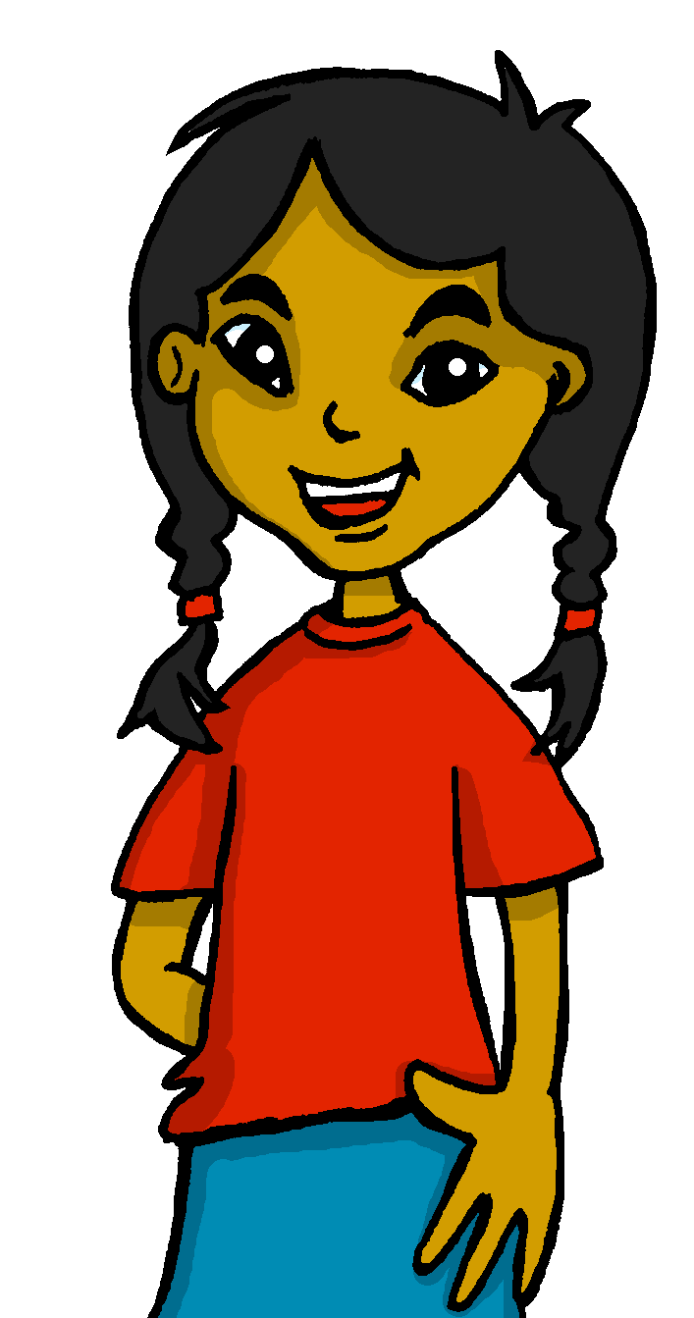
español, con Sofía

Slide 2
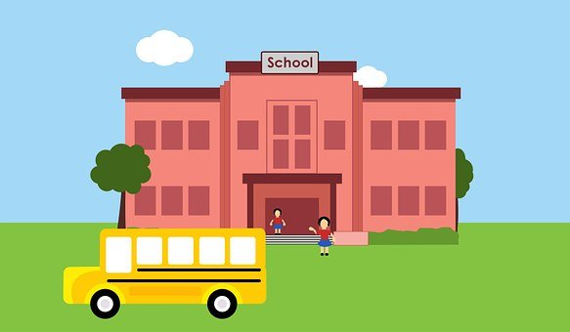
Saying what I and others do
En el colegio
verde
-ER verbs: we & s/he, it
SSC: [ga] [go] [gu]
Notes:
Artwork by Steve Clarke. All additional pictures selected are available under a Creative Commons license, no attribution required.
The frequency rankings for words that occur in this PowerPoint which have been previously introduced in the resources are given in the SOW (excel document) and in the resources that first introduced and formally re-visited those words.
For any other words that occur incidentally in this PowerPoint, frequency rankings will be provided in the notes field wherever possible.
Phonics: [ga] [go] [gu] Source: ganar [295] goma [4437] gusano [4217] Cluster: jugar [356] regalar [1420] fuego [884] enemigo [1066] figura [632] pregunta [507]
Vocabulary (new words in bold): beber [1085] aula [3501] bocadillo [>5000] chocolate [3408] comida [906] compañero / compañera [551] ejercicio [1162] español [262] patio [1197] profesor / profesora [501] salón [1722] tarea [995] caliente [1810] en [5] previously revisited –er verbs: aprender [428] comer [347] hacer [26] leer [209]
Revisit 1: tienen [8] tenemos [8] cine [952] edificio [857] aquí [130] de12 [2] delante [1742] detrás [2044] dónde [161] en1 [6] entre [63]
Revisit 2: están [21] son [7] cómodo [2237] importante [171] hoy [167] siempre [96] también [49] y [4]
Glossed: adivinar [2201] pagar [377] algo [110] gusto [890] segundo [223] agua [204] juntos [149]
Source: Davies, M. & Davies, K. (2018). A frequency dictionary of Spanish: Core vocabulary for learners (2nd ed.). Routledge: London

Slide 3
[ga]
ganar
pronunciar
[go]
lago
[gu]
gusano
Notes:
Timing: 1 minute
Aim: To revisit SSC [ga] [go] [gu]
Procedure:
To recap and elicit the pronunciation of the individual SSC [ga] [go] [gu]
Click to bring the picture & get students to repeat (with gesture, if using).
Gesture suggestion for ganar: lift your fist up in two goes.
Gesture suggestion for lago: rowing – two movements
Gesture suggestion for gusano: with index finger, lift up and down three times.

Slide 4
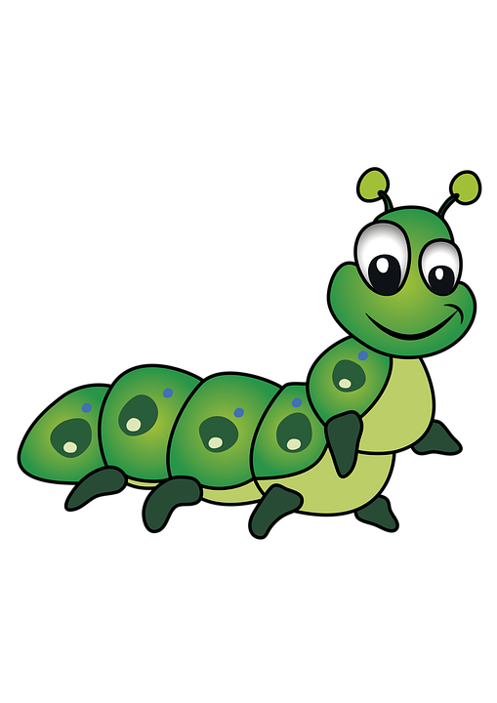
¡A practicar!
adivinar = to guess
[ga][go][gu]
pronunciar
Escribe cinco palabras en secreto. Tu compañero/a adivina*.
45 segundos
domingo
segundo
oruga
gusano
gorila
gol
pagar
algo
[something]
gusto
goma
ganar
juego
[taste]
INICIO
Notes:
Timing: 5 minutes
Aim: to practise reading aloud [ga] [go] [gu] with cognates, previously taught vocabulary and new words. Pictures provided to clarify meaning with new words.
Procedure:
Read the explanation and ensure pupils understand the task.
Start the timer.
Pupils try to guess their partner’s 5 words by saying them aloud, before the 45 seconds is up.
Swap roles and repeat the game.
adivinar [2201] pagar [377] algo [110] gusto [890] segundo [223]

Slide 5
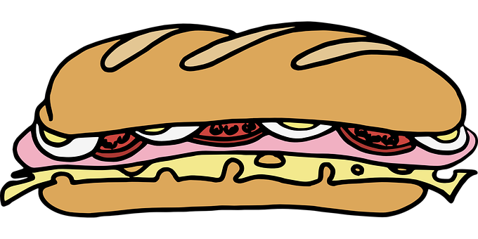
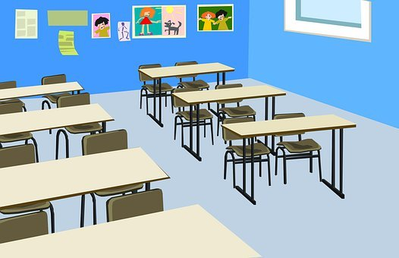
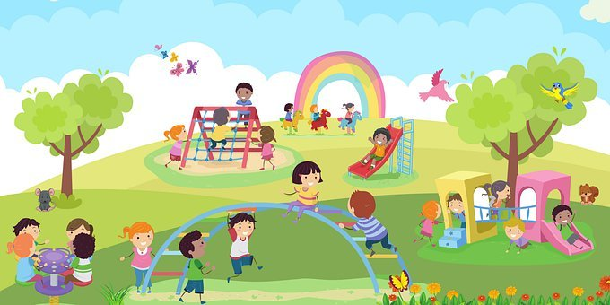
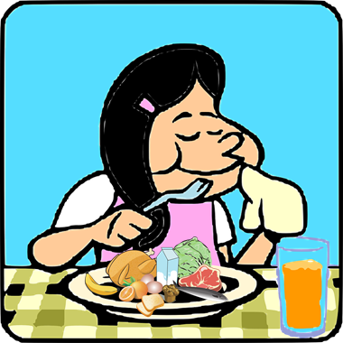
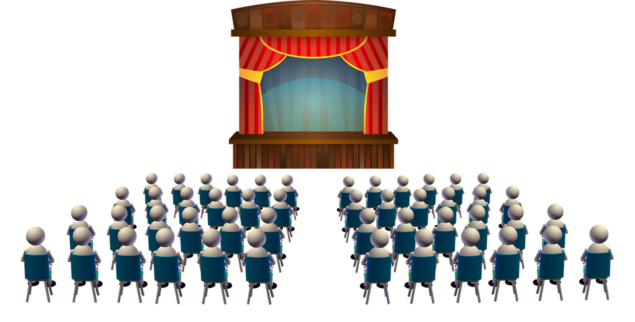
vocabulario
¿Cómo es en español?
el bocadillo
caliente
beber
la tarea
hot
to do, make; doing, making
task
el aula
hot
to eat, eating
el patio
classroom
playground
to drink, drinking
hall
sandwich
chocolate
el chocolate
comer
el salón
hacer
Notes:
Timing: 5-7 minutes (2 slides)
Aim: to present and practise written comprehension and read aloud of three items of previously taught vocabulary that we revisit this week and the seven new words.
Procedure: 1. Click for an English item. Elicit pronunciation of the Spanish from pupils.
2. Click to cover the Spanish word with a picture.
3. Continue with the remaining items.
Round 2 (next slide)
Procedure:
1. Parts of the Spanish words are missing and pupils try to recall them orally (again, chorally), looking at the pictures / English (1 minute).
2. Click on the pictures or English prompt to remove the hints and reveal each Spanish word.

Slide 6
vocabulario
¿Cómo es en español?
👏
c _ l_ _ n_ _
beber
la
tarea
e_ b_ c_d_ll_
b_ _ e _
l_
t_ t _ _
el bocadillo
caliente
e_
_ _l_
el
aula
el
patio
e_ a_l_
e_
p _ t_ _
e_
c_ _c_ _ at_
el
chocolate
comer
c _ m _ _
e_ s_ _ ó _
h_ _ e _
el salón
hacer
Notes:
Round 2
Procedure:
1. Parts of the Spanish words are missing and pupils try to recall them orally (again, chorally), looking at the pictures / English (1 minute).
2. Click on the pictures or English prompt to remove the hints and reveal each Spanish word.

Slide 7
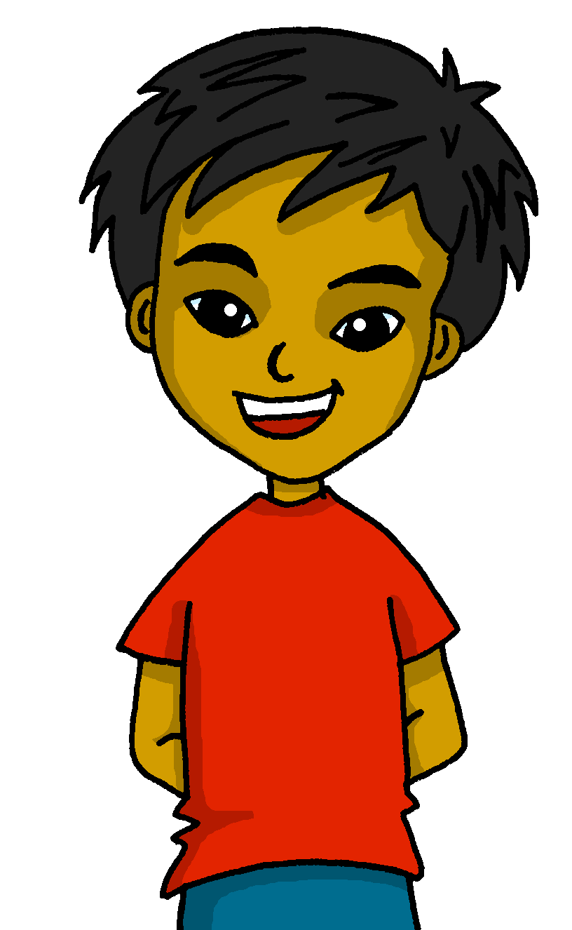
Knowing who does what
[–er verbs: ‘S/he, it’ and ‘we’]
Remember that some Spanish infinitives end in –er.
To mean ‘S/he, it’ with a verb, we remove –er and add -e.
To mean ‘we’ with a verb, we remove –er and add –emos.
beber
⚠ We don’t need pronouns because the verb ending tells us who is doing the action.
Compara.
S/he, it
Bebe un chocolate caliente.
we
S/he drinks a hot chocolate.
Bebemos coca cola.
Luis bebe un chocolate caliente.
We drink coca cola.
Luis drinks a hot chocolate.
Notes:
Timing: 3 minutes
Aim: to reintroduce 3rd person singular for–er verbs and introduce 1st plural.
Procedure:
Click through the animations to present the new information.
Elicit English translations for the Spanish examples provided.
agua [204]

Slide 8
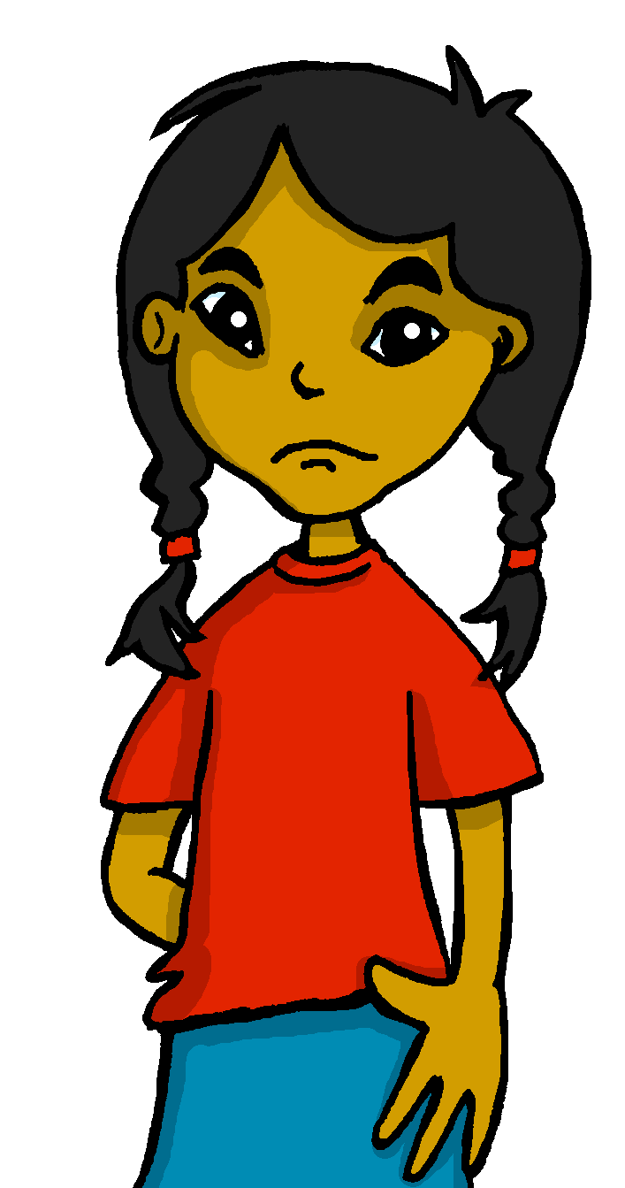
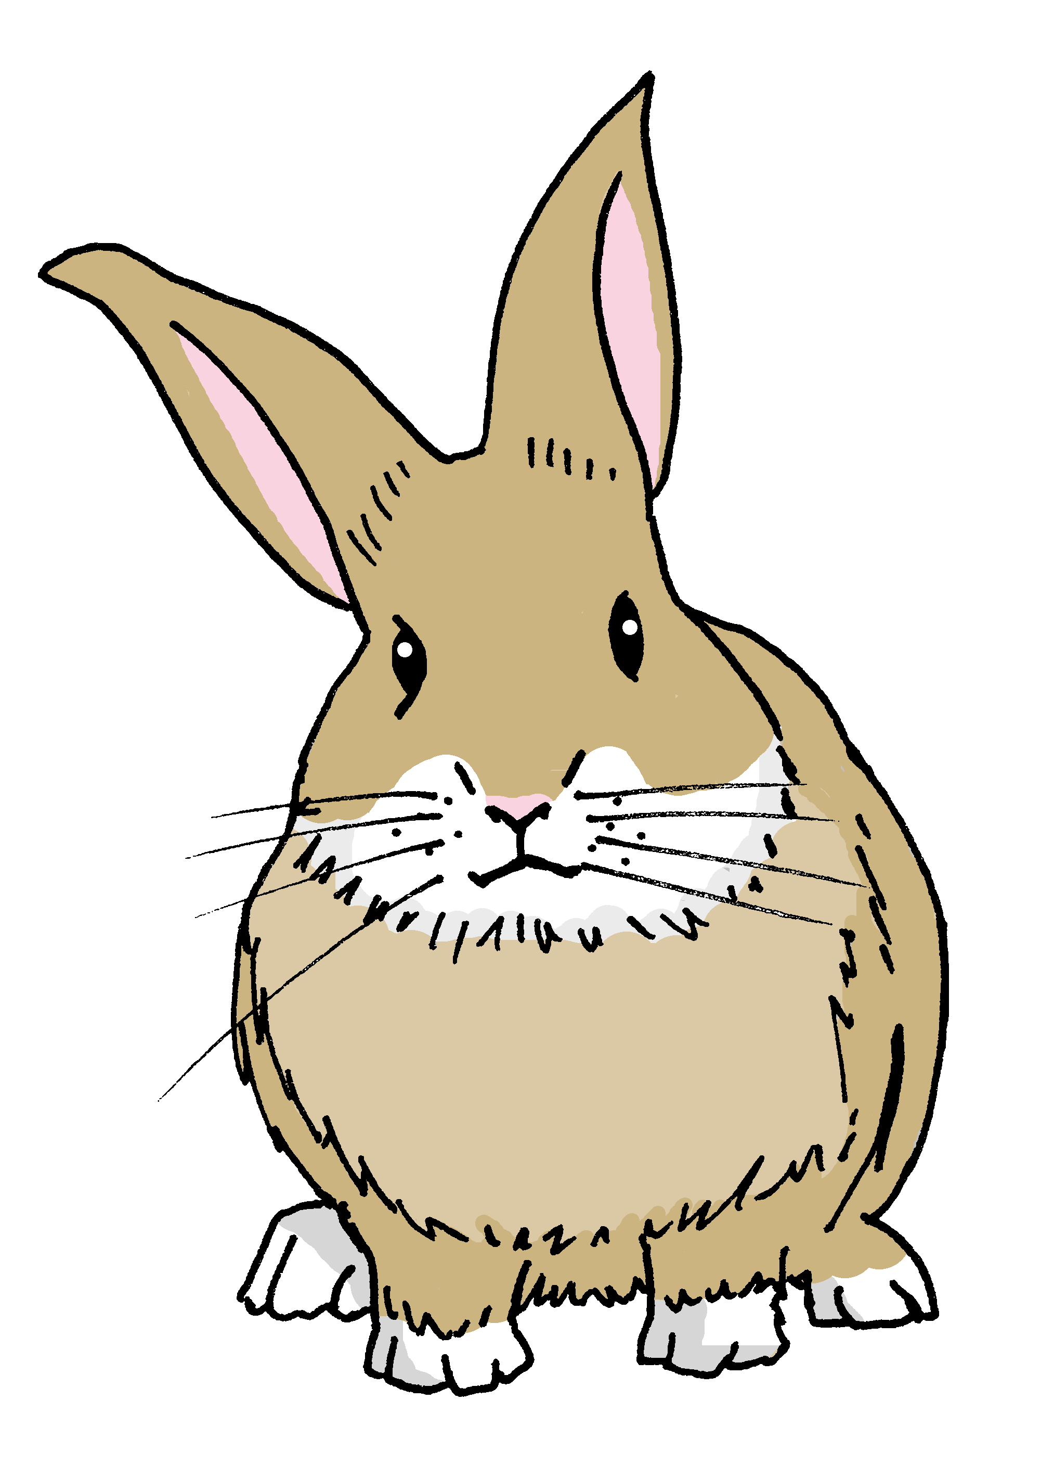
leer
Agua 💧 en los deberes* de Sofía.
¡Pancho!
¡Lo siento!
Pancho has spilled water all over Sofia’s English homework.
Lee las frases y marca .
E
Aprendemos inglés.
Sheeppms
We learn English.
1
Hacemos la tarea juntos.
Q & S (we) | Luis (he)
eems
We do the task together.
2
Bebe un chocolate caliente.
eemoms
He drinks a hot chocolate.
3
Aprende idiomas.
eemoms
He learns languages.
4
Leemos en el aula.
eemms
We read in the classroom.
juntos = together
Notes:
Timing: 7 minutes
Aim: to practise written comprehension of key –1st person plural and 3rd person singular of -er verbs.
Procedure:
Read the title & click to explain the context of the task.
Click to bring further instructions in Spanish. Is Sofia talking about Quique and herself, or about Luis? Clarify that Q & s refers to Quique and Sofía (they go to school together = we form of the verb).
Do [E] with them to model the task and draw their attention to the verb.
Pupils complete 1-4.
Click through the animations to bring up answers.
If desired, click on the green buttons to hear the sentences pronounced.
E. Aprendemos inglés.
Hacemos la tarea juntos.
Bebe un chocolate caliente.
Aprendemos idiomas.
Leemos en el aula.
juntos [149]

Slide 9
escuchar
Escucha a Sofía.
Marca ✅ la opción correcta y escribe el verbo.
s/he ; we | verbo | completa la frase
s/he
we
s/he
we
s/he
we
s/he
we
s/he
we
s/he
we
E
come
comida
1
hace
la tarea
2
bebemos
en el aula
3
comemos
un bocadillo
4
bebe
en el patio
5
lee
un libro
Notes:
Timing: 8 minutes
Aim: to practise distinguishing aurally between the meanings of the 1st person plural and 3rd person singular ‘-er’ verbs in the present.
Procedure:
Click the number button to play the recording.
Students first need to write or circle s/he or we, and then write the correct form of the verb they heard in Spanish. They then transcribe the rest of the sentence. They may want to listen twice to each item.
Click to show the answers one by one for each question in order.
Ask students to translate the sentences into English orally. Feedback can be given here on anything that is unclear.
Transcript
E. Come comida.
Hace la tarea.
Bebemos en el aula.
Comemos un bocadillo
Bebe en el patio.
Lee un libro.
Note: all words not taught this lesson were previously taught in Y3/4. However, if you are using this SOW for the first time, pupils may have vocabulary gaps. Reassure them to do their best as they transcribe and then clarify meanings with them during feedback.

Slide 10
¡adiós!
verde

