Slide 1


español, con Sofía

Slide 2



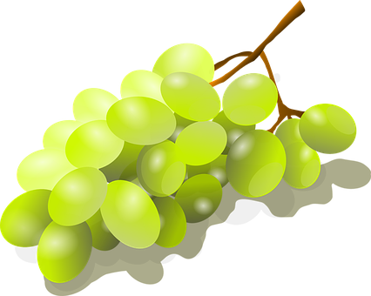
Saying what I and others do
Nochevieja
verde
-AR verbs: we & they
connecting sentences
SSC: [l] [ll]
Notes:
Artwork by Steve Clarke. All additional pictures selected are available under a Creative Commons license, no attribution required.
The frequency rankings for words that occur in this PowerPoint which have been previously introduced in the resources are given in the SOW (excel document) and in the resources that first introduced and formally re-visited those words.
Phonics: revisit [l] and [ll]
Vocabulary (new words in bold): celebrar [886] mandar [588] carrera [481] España [N/A] tarjeta [1958] común [742] especial [436] típico [1934] pero [30] en1 [5]
Revisit other –ar verbs: cantar [717] comprar [361] escuchar [281] preparar [570]
Revisit 1: tienen [8] calle [269] cine [952] escuela [424] hotel [1163] iglesia [437] museo [1114] parque [1354] piscina [4604] plaza [806] puente [1715] universidad [387] enorme [631] solo [181]
Revisit 2: cuál [445] día [65] espectáculo [1622] exposición [1317] fecha [756] lunes [1370] martes [3101] miércoles [1816] jueves [1650] viernes [1259] sábado [1179] domingo [693]
Source: Davies, M. & Davies, K. (2018). A frequency dictionary of Spanish: Core vocabulary for learners (2nd ed.). Routledge: London
For any other words that occur incidentally in this PowerPoint, frequency rankings will be provided in the notes field wherever possible.
glossed: caer [251] comparar [1597] cuidado [1822] su [22] correctamente [4173]

Slide 3


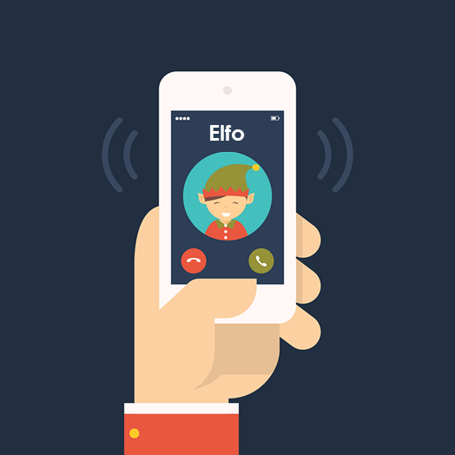
[l]
libro
pronunciar
[ll]
llamar
Notes:
Timing: 1 minute
Aim: to revisit SSC [l] and [ll].
Procedure:
To recap and elicit the pronunciation of the individual SSC [ll] [l]
Click to bring the picture and get students to repeat (with gesture, if using).
Gesture suggestions:
libro: use two hands to pretend to open a book
llamar: with your right hand, pretend to answer the phone, then repeat with the left hand. Two gestures = two syllables of the word.

Slide 4


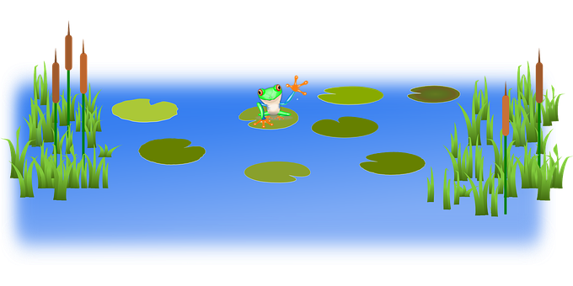
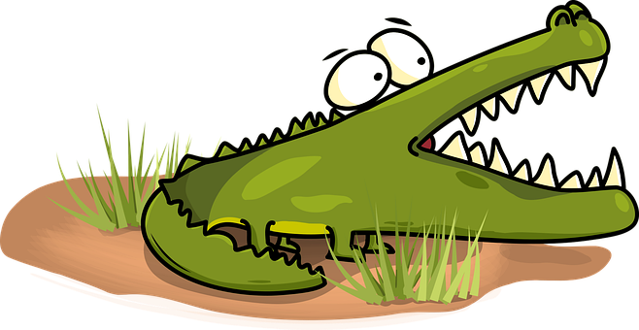



hablar
[ll]
¡Cuidado con el cocodrilo!
cuidado = be careful correctamente = correctly
caer = to fall
[l]
Pronuncia las palabras correctamente para no caer al agua.
Turno 1: Persona A
Turno 2: Persona B
llamar
color
lavar
calle
amarillo
letra
vale
collar
estrella
paella
ella
cuchillo
valle
Notes:
Timing: 3 minutes
Aim: to practise knowledge of [l] [ll] to known and unknown words.
Procedure:
Click to bring up the instruction.
Pupils work in pairs to practise pronunciation. They can choose where to start and have one minute to pronounce all the words correctly (silent h) to avoid being eaten by the crocodile.
Divide the class in A & B and click to indicate it’s ‘persona A’’s turn.
Click to bring up Persona B’s turn.
cuidado [1822] correctamente [4173] caer [251]

Slide 5

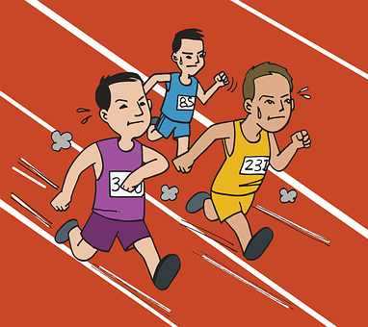


vocabulario
Vocabulario
mandar
la carrera
m_ _d_ _
la c_rr_ra
la tarjeta
la t_ _j_t_
la carrera
la tarjeta
celebrar
c_l_b_ _r
mandar
celebrar
[race]
[card]
[to send, sending]
[to celebrate, celebrating]
común
c_ _ ú _
especial
común
especial
_s_ _c_ _ l
[common]
[special]
Notes:
Timing: 3 minutes (one slide)
Aim: to introduce key vocabulary for the context of comparing countries and customs – New Year’s eve.
Procedure:
Teacher introduces items one by one (word, picture, English) and pupils practise pronunciation aloud.
2. Then the teacher removes the English words and/or pictures (one by one) and pupils try to recall the English orally (chorally), looking at the Spanish (1 minute).
3. Then the Spanish meanings are removed (all together) and replaced by hints. Pupils try to recall them orally (again, chorally), looking at the English (1 minute). Elicit Spanish from pupils – click to make answers appear.
4. Further rounds of learning can be facilitated by one pupil turning away from the board, and his/her partner asking him/her the meanings (‘Cómo se dice X en español?’). This activity can work from L2 → L1 or L1 → L2.

Slide 6


Knowing who does what
⚠ We don’t need pronouns because the verb ending tells us who is doing the action.
[–ar verbs: Singular forms vs. ‘we’]
In Spanish, the words for ‘I’ and ‘S/he, it’ (pronouns) are often unnecessary.
To mean ‘I’, ‘you’, ‘s/he,it’ with a verb, the verb ending changes.
Compara:
mandar
mando
mandas
manda
I send
You send
S/he, it sends
we
To mean ‘we’ with a verb, we remove –ar and add -amos.
Mandamos mensajes a la familia.
We send messages to family.
Notes:
Timing: 3 minutes
Aim: to introduce 1st person plural (we-form) for –ar verbs, building on the singular forms of –ar verbs.
Procedure:
Click through the animations to present the new information.
Elicit English translations for the Spanish examples provided.

Slide 7


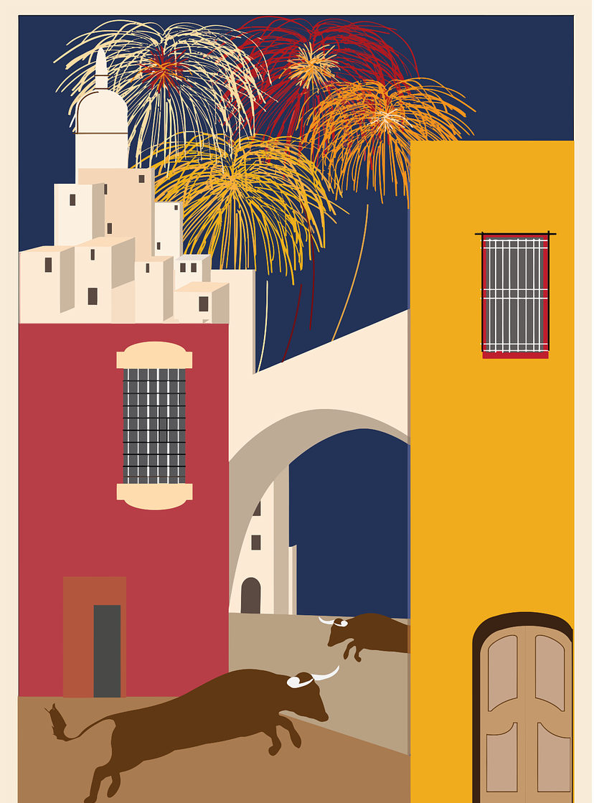

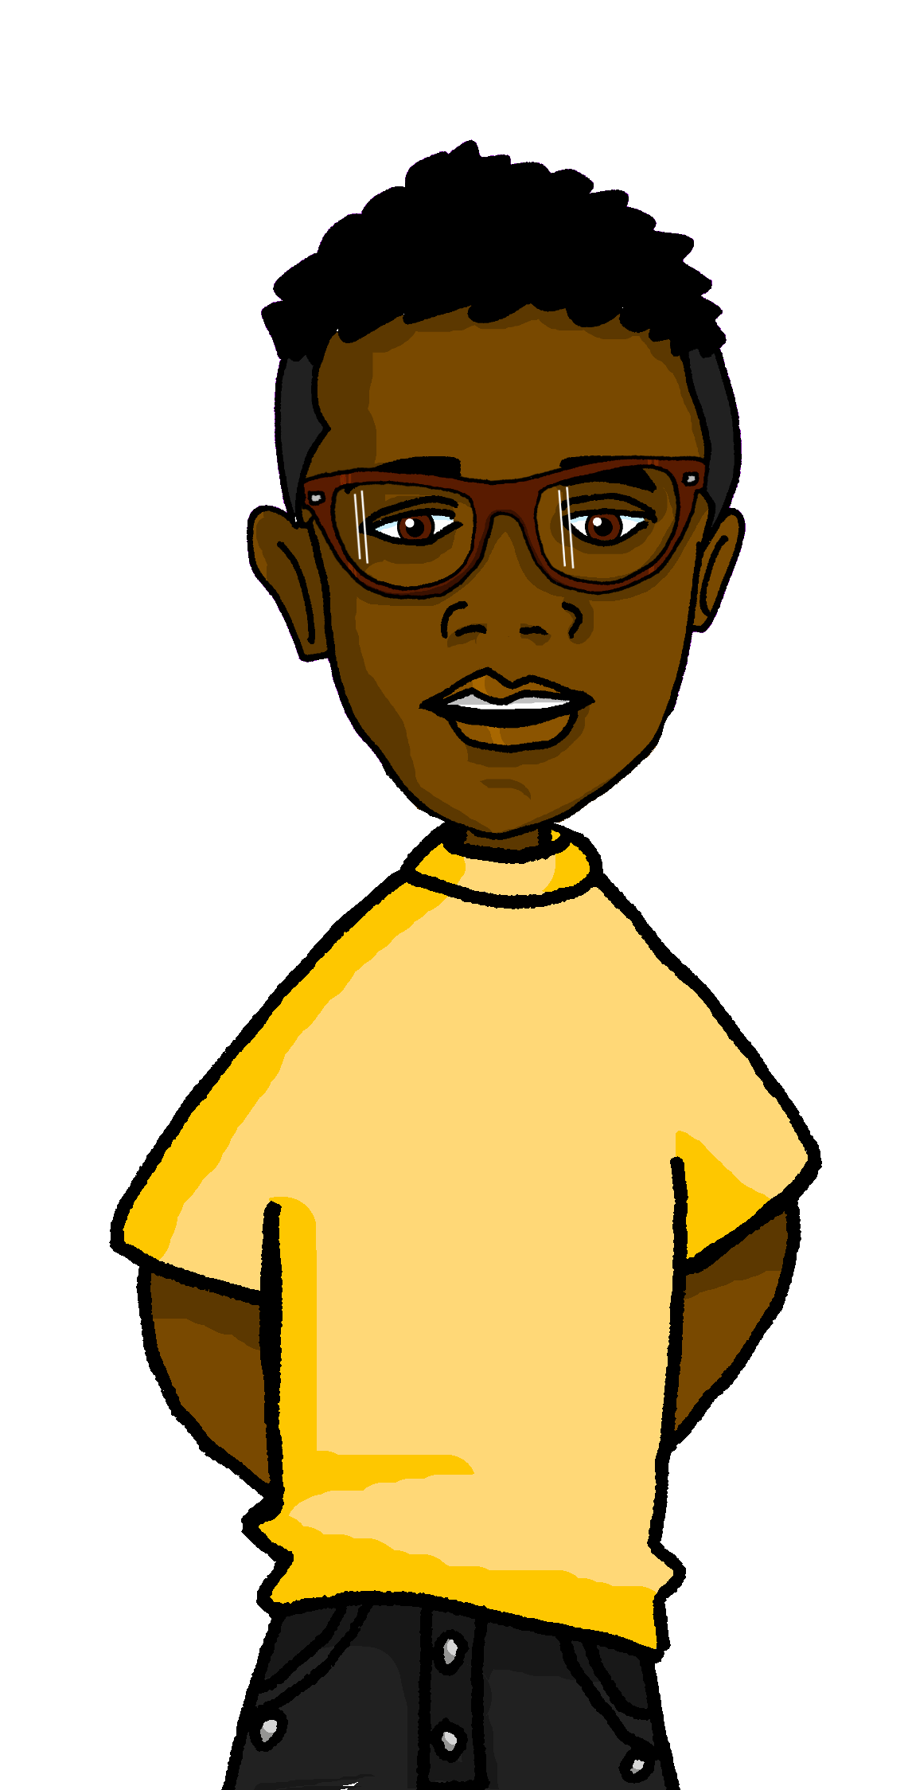
leer
La Nochevieja en España
La Nochevieja es el día treinta y uno de diciembre.
Es un día especial porque celebramos el fin del año.
Es común comer doce uvas a medianoche.
1
2
3
to eat
because
grapes
end
New Year’s eve
year
midnight
comer
porque
uvas
fin
Nochevieja
año
medianoche
Sofía told me all about the tradition. Las doce uvas de la suerte, "the twelve grapes of luck") is a Spanish tradition that consists of eating a grape with each of the twelve clock bell chimes (las campanadas) at midnight of December 31 to welcome the New Year. It is broadcast on TV all over Spain.
¡Muy bien, Max! En Perú es típico comer doce uvas pasas*. Son más pequeñas.
uvas pasas = raisins
Notes:
Timing: 4 minutes
Aim: to introduce some further information about New Year’s eve in Spain and the tradition of the striking of the Clock.
Procedure:
Give pupils 2-3 minutes with a partner to find the Spanish meanings for the seven English words.
Elicit Spanish responses chorally, prompting with the English, e.g., ‘Nochevieja?’ ‘New Year’s eve’, muy bien. ☺ Encourage pupils to tell you how they worked it out and /or whether they can work out the literal translation of the word (old night). They have previously learned ‘Viejo/a’ and ‘noche’ is the source word for the SSC [ch].
Note: click on each English word to reveal the Spanish translation.
2. Click the audio player to hear the full text, if desired.
3. Click to bring up Max who gives more details re the twelve grapes’ tradition.
4. Click to bring up Sofía.
Further information on NYE:
On this day, family or friends usually get together for a big dinner and then have the twelve grapes. In many towns and villages people go to a central square or an iconic place where there is a large clock, to eat the grapes together and share the last minutes of the old year
One place in Spain is especially famous for this tradition: Puerta del Sol, the central square in Madrid. All the major TV networks broadcast the the striking of the clock from Puerta del Sol, in Madrid. Thousands of people gather every New Year’s Eve below the clock to celebrate the arrival of the new year, transforming the square into a huge shared party.
Teachers can play the following video: https://www.youtube.com/watch?v=iyWENjv7_5Q&ab_channel=Ra%C3%BAlAlgar

Slide 8



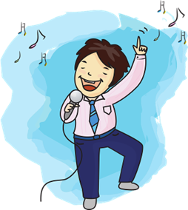
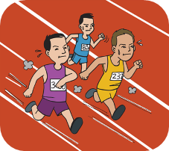
escuchar
Sofía habla de la Nochevieja en casa y compara con Max.
Escucha y marca ✅.
Escucha otra vez y escribe 📝.
Sofía y su familia | Max
el verbo
información extra
E
preparamos
special food
1
participamos
in a race
2
manda
messages
3
canta
songs
4
celebramos
with friends
5
prepara
a party
su = his/her
Notes:
Timing: 7 minutes
Aim: to practise aural comprehension of ‘3rd person singular ’ & ‘1st person plural’.
Procedure:
Pupils write 1-5 in their books Sofía & su familia and Max.
Click to listen to the example. Pupils decide whether Sofía is talking about her and her family (we), or Max (he).
Click to listen again. Pupils transcribe the verb in Spanish and any additional detail in English.
Complete the task with items 1-6, listening once for the verb forms.
Click to correct for number.
Listen again to allow time for pupils to transcribe the verbs and write any additional details in English.
Click to reveal answers.
Transcript:
E. Preparamos comida especial.
Participamos en una carrera.
Manda mensajes.
Canta canciones.
Celebramos con amigos.
Prepara una fiesta.
comparar [1597] su [22]

Slide 9
Knowing who does what
[–ar verbs: ‘we’ versus ‘they’]
To mean ‘we’ with a verb, we remove –ar and add -amos.
To mean ‘they’ with a verb, we remove –ar and add –an.
Ejemplo: celebrar
we
they
Celebramos con amigos.
Celebran con familiares.
We celebrate with friends.
They celebrate with relatives.
Notes:
Timing: 3 minutes
Aim: to introduce 3rd person plural for –ar verbs and revisit 1st person plural.
Procedure:
Click through the animations to present the new information.
Elicit English translations for the Spanish examples provided.

Slide 10
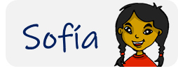
leer
Sofía manda mensajes a Rubén.
las campanadas = bell chimes
los fuegos artificiales = fireworks
She’s telling him about her conversation with Max.
Lee las frases y decide quién es.
Marca ✅
E
3
Visitamos a familiares.
Preparan comida especial.
Sofía y su familia (we) | Max y su familia (they)
1
4
E
Escuchamos las campanadas*.
1
Mandan tarjetas.
2
3
2
5
4
Celebran con fuegos artificiales.
Paseamos por la playa.
5
Notes:
Timing: 6 minutes
Aim: to practise written comprehension of key –ar verbs in the 1st and 3rd persons plural.
Procedure:
Read the title & click to explain the context of the task.
Click to bring further instructions in Spanish.
Do [E] with them to model the task and draw their attention to the verb (llevan). Is it Sofía talking about Krina & her family (they) or is she talking about herself and her own family (we)?
Pupils complete 1-5.
Click through the animations to bring up answers. If desired, click on the numbered buttons to hear sentence audio.
Ask pupils to translate the verbs into English.

Slide 11
¡adiós!
verde

