Slide 1



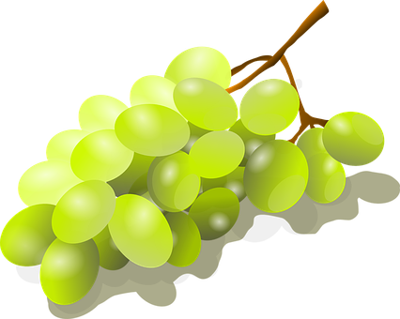
Describing me and others
Nochevieja
verde
Follow ups 1-5
Notes:
Artwork by Steve Clarke. All additional pictures selected are available under a Creative Commons license, no attribution required.
The frequency rankings for words that occur in this PowerPoint which have been previously introduced in the resources are given in the SOW (excel document) and in the resources that first introduced and formally re-visited those words.
Phonics: revisit [l] and [ll]
Vocabulary (new words in bold): celebrar [886] mandar [588] carrera [481] España [N/A] tarjeta [1958] común [742] especial [436] típico [1934] pero [30] en1 [5]
Revisit other –ar verbs: cantar [717] comprar [361] escuchar [281] preparar [570]
Revisit 1: tienen [8] calle [269] cine [952] escuela [424] hotel [1163] iglesia [437] museo [1114] parque [1354] piscina [4604] plaza [806] puente [1715] universidad [387] enorme [631] solo [181]
Revisit 2: cuál [445] día [65] espectáculo [1622] exposición [1317] fecha [756] lunes [1370] martes [3101] miércoles [1816] jueves [1650] viernes [1259] sábado [1179] domingo [693]
Source: Davies, M. & Davies, K. (2018). A frequency dictionary of Spanish: Core vocabulary for learners (2nd ed.). Routledge: London
For any other words that occur incidentally in this PowerPoint, frequency rankings will be provided in the notes field wherever possible.
glossed: investigar [1571] sobre [62]

Slide 2



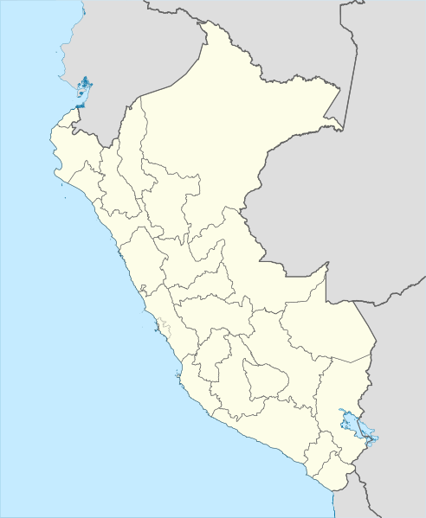
Follow up 1:
[l]
Escucha: ¿Quién visita? ¿Qué ciudad?
 | ¿Quién? |  | visita visitan |  | ciudad
 | Lola y Luna Coldo |  | visita |  | Truji __ o
 | Malú y Lorna Kala |  | visitan |  | Ju __ iaca
 | Mirella Milena y Mirella |  | visitan |  | __ ima
 | Lluis y Lluvia Luis |  | visita |  | Ta __ ara
 | Lorca y Llorent Lorente |  | visitan |  | Qui __ abamba
 | Luz y Lorena Luna |  | visita |  | I __ o
pronunciar
Escribe [l] o [ll]
E
E
……
ll
1
l
1
……
2
……
L
2
[3]
3
……
l
[E]
3
4
……
ll
[2]
[4]
4
[1]
5
5
……
l
[5]
Notes:
Timing: 5 minutes
Aim: to apply knowledge of the SSC [l] and [ll].
Procedure:
Teacher explains the scenario. People are visiting different cities in Peru.
Click to listen. First pupils need to identify whether the sentence refers to one or more people. They write the name or names.
They then write the corresponding form of ‘visita/’visitan’
Click to listen again and pupils transcribe the city.
Elicit answers orally from pupils.
Click to reveal written answers.
Pupil A practises pronouncing sentence 1. Partner B translates into English.
Click for another set of audio buttons to listen and check full sentences.
Transcript 1:
E. visita Trujillo
visitan Juliaca.
visitan Lima.
visita Talara.
visitan Quillabamba.
visita Ilo.
Transcript 2:
E. Coldo visita Trujillo.
Malú y Lorna visitan Juliaca.
Milena y Mirella visitan Lima.
Luis visita Talara.
Lorca y Llorent visitan Quillabamba.
Luna visita Ilo.
Picture by https://goo.gl/maps/k2zJDKCe4H2kMF7Q9, CC BY-SA 3.0, https://commons.wikimedia.org/w/index.php?curid=8241575

Slide 3




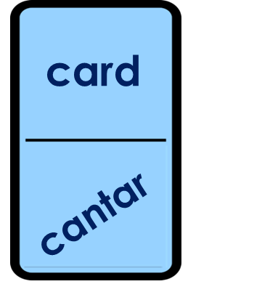
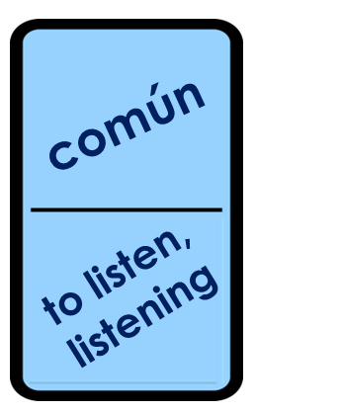
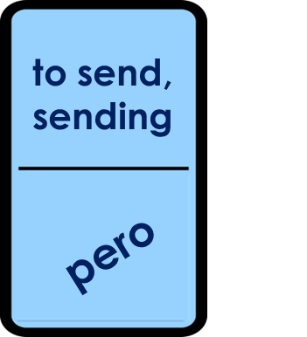
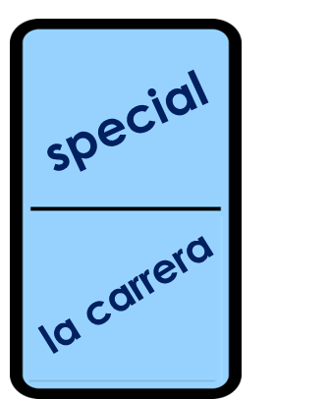
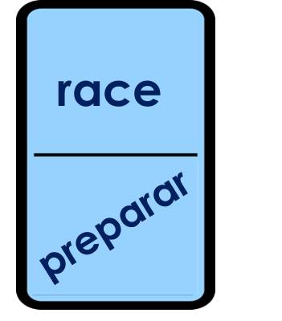
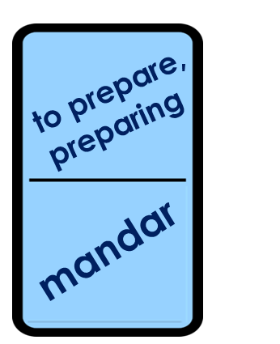
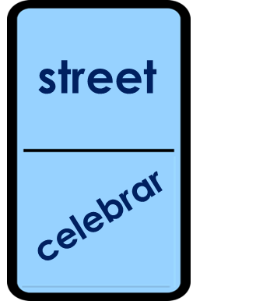

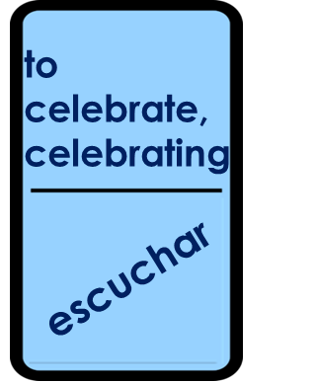
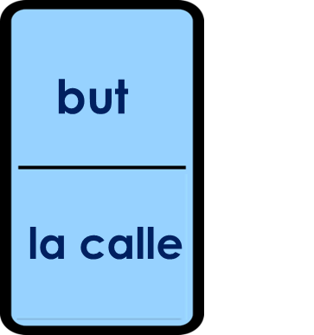
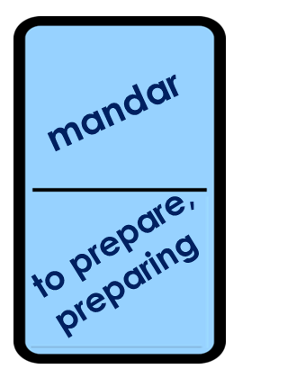
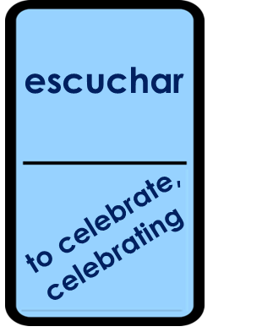


Follow up 2:
Completa el domino 🗣.
vocabulario
1 minuto
0
INICIO
Notes:
Timing: 5 minutes
Aim: to practise written comprehension and spoken pronunciation of vocabulary.
Procedure:
Starting from the play button, pupils work in pairs to complete the domino orally.
NB. Give pupils 2-3 minutes to complete in orally in pairs. Teachers can do several whole-class rounds. Challenge pupils to complete it in less than one minute.

Slide 4





Follow up 3:
?
Escucha. Sofía habla sobre* una persona.
escuchar
Escribe la descripción en inglés .
_____________________.
E
Today is Thursday 26th March.
1
It’s my grandma Valeria’s birthday.
_______
____________.
2
_____________________.
Valeria is from Perú.
___ _____ ________ _____ ______.
3
She has short, black hair.
4
She has black eyes.
_____ _______ ________ _________.
5
She has a round face.
_____ ______ ____ ______ ________.
6
In New Year’s Eve she sends messages.
_____ ______ ________.
______
______.
they prepare special food.
7
___________
At home
sobre = about
Notes:
Timing: 7 minutes
Aim: to practise aural comprehension of a wide variety of vocabulary from this and revisited weeks.
Procedure:
Click to listen to the example. Pupils complete the sentence in English.
For items 2 and 3, pupils can either turn away from the board and try to write the whole sentence, or use the written support on the board.
After each item, click to reveal the answers.
For items 4 – 8, pupils listen and translate the full sentence.
Click to reveal the answer each time.
The final click reveals Valeria, Sofía’s grandma.
Transcript:
Ej. Hoy es jueves veintiseis de marzo.
1. Es el cumpleaños de mi abuela, Valeria.
2. Valeria es de Perú.
3. Tiene el pelo corto y negro.
4. Tiene los ojos negros.
5. Tiene la cara redonda.
6. En Nochevieja, manda mensajes.
7. En casa, preparan comida especial.
sobre [62]

Slide 5

Follow up 4:
Conjunctions: connecting sentences with ‘también’ and ‘pero’.
Note: to mean ‘we’ with a verb, we remove –ar and add -amos.
‘también’ means also and too.
Ejemplo:
En Nochevieja preparamos comida especial y también celebramos con amigos.
En Nochevieja preparamos comida especial y celebramos con amigos también.
también can follow y or go to the end of the sentence.
Remember: to mean ‘they’ with a verb, we remove –ar and add -an.
‘pero’ means but
Ejemplo:
En España bailamos pero en Inglaterra escuchan música.
Notes:
Timing: 3 minutes
Aim: to revisit conjunctions ‘también’ and ‘pero’ in connecting sentences with 1st and 3rd person plural.
Procedure:
Click through the animations to present the new information.
Elicit English translations for the Spanish examples provided.

Slide 6



Follow up 4:
Sofía investiga* sobre* España e Inglaterra.
For her homework, she is recording what she’s found out, but her script is all mixed up!
Can you help her?
investiga = s/he researches
sobre = about
e = and (when the next word start with ‘i’ or ‘hi’
Habla en español [1/3]
hablar
 | We prepare the grapes and also we celebrate.
las doce uvas
1a
y
celebramos
también
preparan
preparamos
las uvas
1b
Preparamos
las uvas
y
también
celebramos.
preparan
La palabra extra es ______________
they prepare
En inglés significa ______________
Notes:
Timing: 5 minutes [1/4]
Aim: to practise oral production of the 1st and 3rd person plural for –ar verbs and connecting setences with ‘pero’ and ‘también’.
Procedure:
1. Pupils use the words to translate the sentence into Spanish – there is one extra word per sentence.
2. Click to reveal the correct sentence.
3. Click to bring ‘la palabra extra es’ & elicit Spanish and English for the extra word.
4. Click the audio buttons to hear the correct sentence
(Note: 1b has a version with también after the 2nd verb – this is also possible in other sentences but the written answer we provide here has (y) también after the 1st verb.
investigar [1571] sobre [62]

Slide 7
Follow up 4:
Habla en español [2/3]
hablar
 | We only send messages but in England they send cards.
2a
bailamos
pero
mandamos
mensajes
mandan
en Inglaterra
solo
tarjetas
Solo
mandamos
mensajes
pero
en Inglaterra
mandan
tarjetas.
Start by translating ‘only’
bailamos
La palabra extra es ______________
We dance
En inglés significa ______________
Notes:
Timing: 5 minutes [1/4]
Aim: to practise oral production of the 1st and 3rd person plural for –ar verbs and connecting setences with ‘pero’ and ‘también’.
Procedure:
1. Pupils use the words to translate the sentence into Spanish – there is one extra word per sentence.
2. Click to reveal the correct sentence.
3. Click to bring ‘la palabra extra es’ & elicit Spanish and English for the extra word.
4. Click the audio buttons to hear the correct sentence

Slide 8
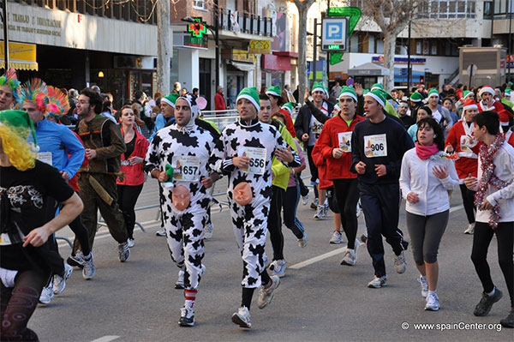
Follow up 4:
Habla en español [3/3]
hablar
 | We participate in a race and we sing too.
3a
en
y
también
participan
participamos
cantamos
una carrera
3b
Participamos
en
una carrera
y
cantamos
también.
La palabra extra es
______________
‘La carrera de San Silvestre’ es común el 31 de diciembre en ciudades importantes de España y Latinoamérica. Es una carrera de 10 km. Algunas personas llevan disfraces*’.
participan
En inglés significa
______________
They participate
disfraces = costumes
Notes:
Timing: 5 minutes
Aim: to practise oral production of the 1st and 3rd person plural for –ar verbs and connecting setences with ‘pero’ and ‘también’.
Procedure:
1. Pupils use the words to translate the sentence into Spanish – there is one extra word per sentence.
2. Click to reveal the correct sentence.
3. Click to bring ‘la palabra extra es’ & elicit Spanish and English for the extra word.
4. Click the audio buttons to hear the correct sentence
(Note: 3b has a version with (y) también before the 2nd verb – this is also possible. Here the written answer we provide has también after the 2nd verb.
Picture from: https://www.cmdsport.com/running/actualidad-running/las-mejores-carreras-san-silvestre-de-espana/

Slide 9

Follow up 5:
Reescribe en español 📝.
⚠ Don’t forget capital letters and full stops!
escribir
[we celebrate] Nochevieja [with] [family] [and] en
Inglaterra [they cebrate] [with family] y amigos [too]. ________________ __________________________________________________________________
En Nochevieja [we prepare] las doce uvas y [also] [we listen to] música.
____________________________________________________________
3. [They send] [cards] [but] [here] [we send] mensajes.
_____________________________________________________________
[Here] [we participate] en [a race] [but] allí [they walk] por [the beach] o el campo.
________________________________________________________________________
1
Celebramos la Nochevieja
con la familia y en Inglaterra celebran con la familia y amigos también.
2
En Nochevieja preparamos las doce uvas y también escuchamos música.
3
Mandan tarjetas pero aquí mandamos mensajes.
4
Aquí participamos en una carrera pero allí caminan por la playa o el campo.
Notes:
Timing: 10 minutes
Aim: to use the correct 1st and 3rd person plural as well as conjunctions ‘también’ and ‘pero’ in written production; written production of a vocabulary from this and revisited weeks.
Procedure:
Teachers to draw pupils’ attention to the instruction. Some bits of these sentences are yet to be translated so they need to rewrite the whole sentence and translate it in full into Spanish.
Some pupils might benefit from revisiting 1st and 3rd person plural endings. This might be something that teachers can do when modelling the task.
Answer to individual sentences appear on click.

