Slide 1

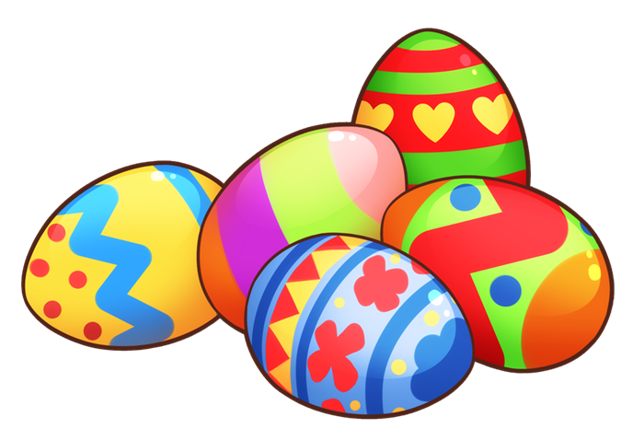
Saying where you are going and what there is there
¡Felices Pascuas!
verde
Phonics
Easter activity
Notes:
Artwork by Steve Clarke. Pronoun pictures from NCELP (www.ncelp.org). All additional pictures selected from Pixabay and are
available under a Creative Commons license, no attribution required.
This lesson contains phonics assessments to check progress in the SSCs (sound-spelling correspondences) introduced and practised this year so far, and in previous years.
The ratio of old to new language in the quiz is very approximately 50:50.
ave [2086] boda [2473] lana [3685] llamada [1324] figura [632] fatiga [4609] gota [2391] después [116] fantasma [2514] portal [3333] bloque [2685] quieto [3030] Puno [n/a] puño [3060] cartera [3062] carreta [4024]
1

Slide 2

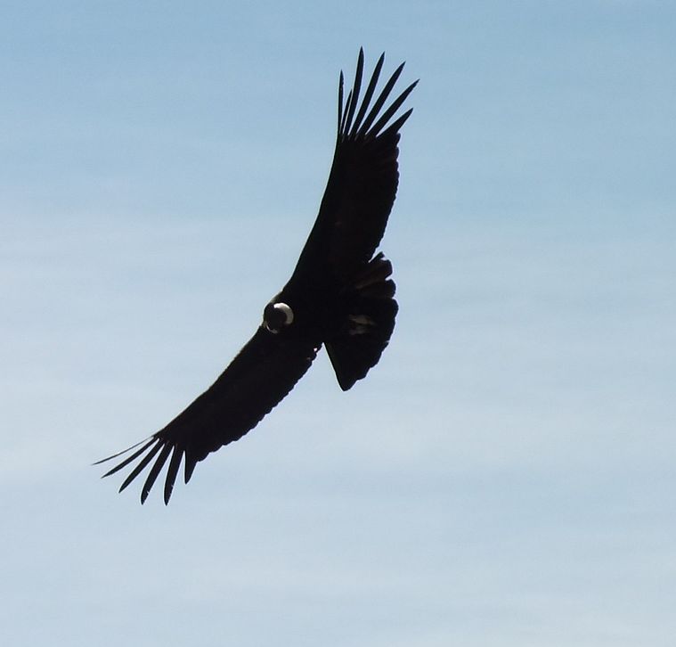
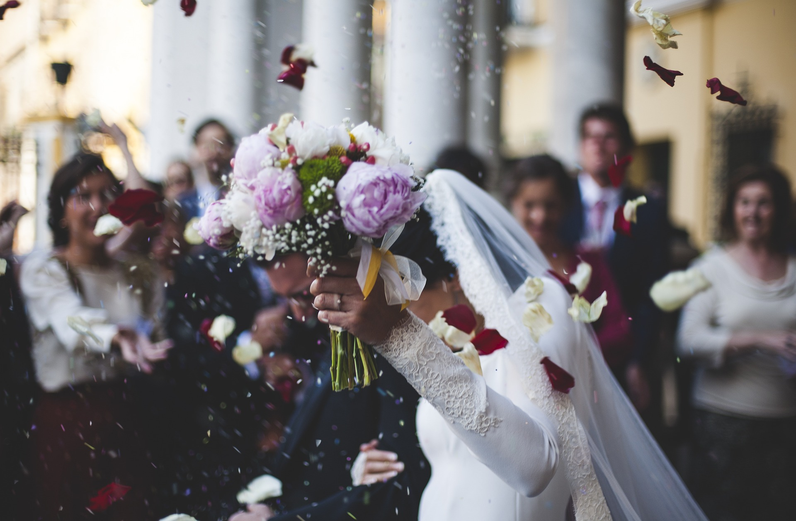
pronunciar
[v]
[b]
pronunciar
[wedding]
ave
boda
Notes:
Phonics quiz
Timing: flexible during Week 11
Procedure:
Print out one set of these 16 phonics cards.
Working with one pupil at a time, elicit the pronunciation of each word.
Say: You have not learnt these words, but you have learnt how to read aloud these sounds, so just have a go at reading each word aloud.
Focus only on the accurate pronunciation of the target SSC and tolerate any other inaccuracies.
Use the pupil scoring sheet at the end of this presentation to assess SSC knowledge and give feedback.
Note: Whilst working with individual children, others can be doing the Easter activities at the end of this presentation.
2

Slide 3
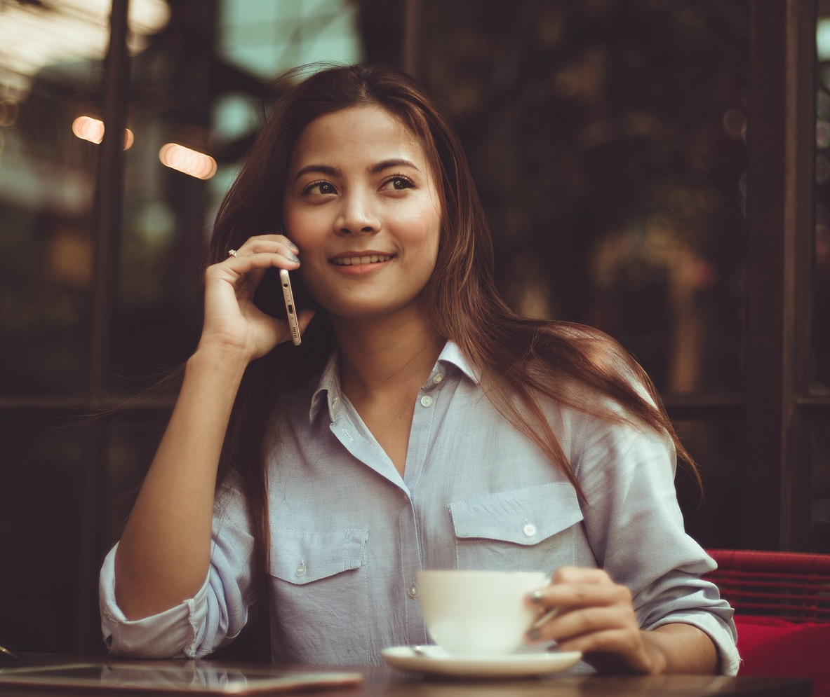
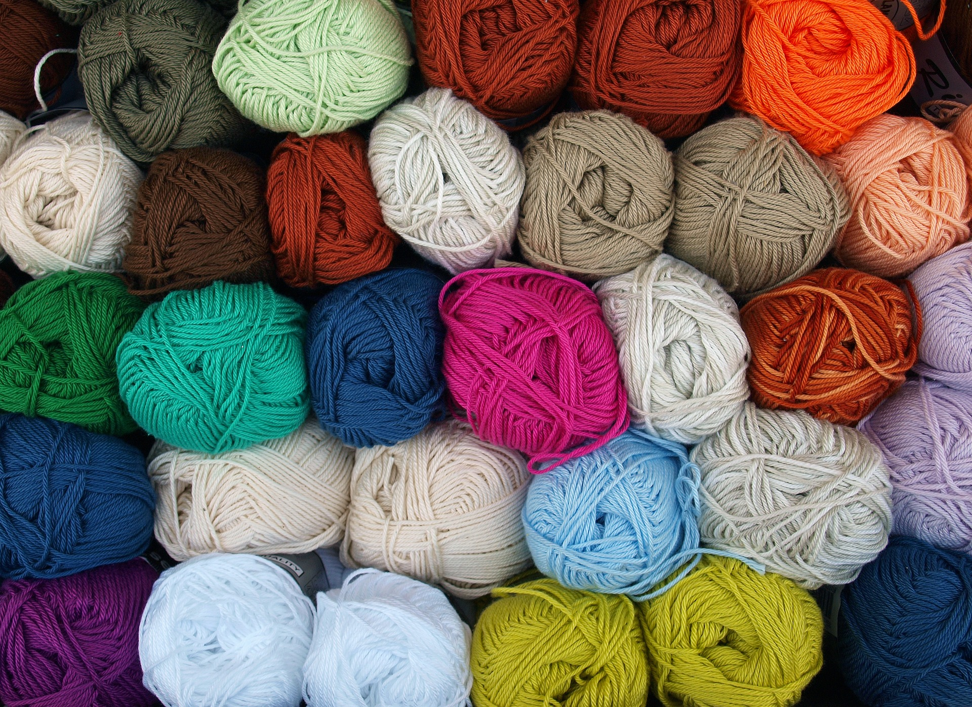
pronunciar
[l]
[ll]
pronunciar
[call]
lana
llamada
Notes:
3

Slide 4
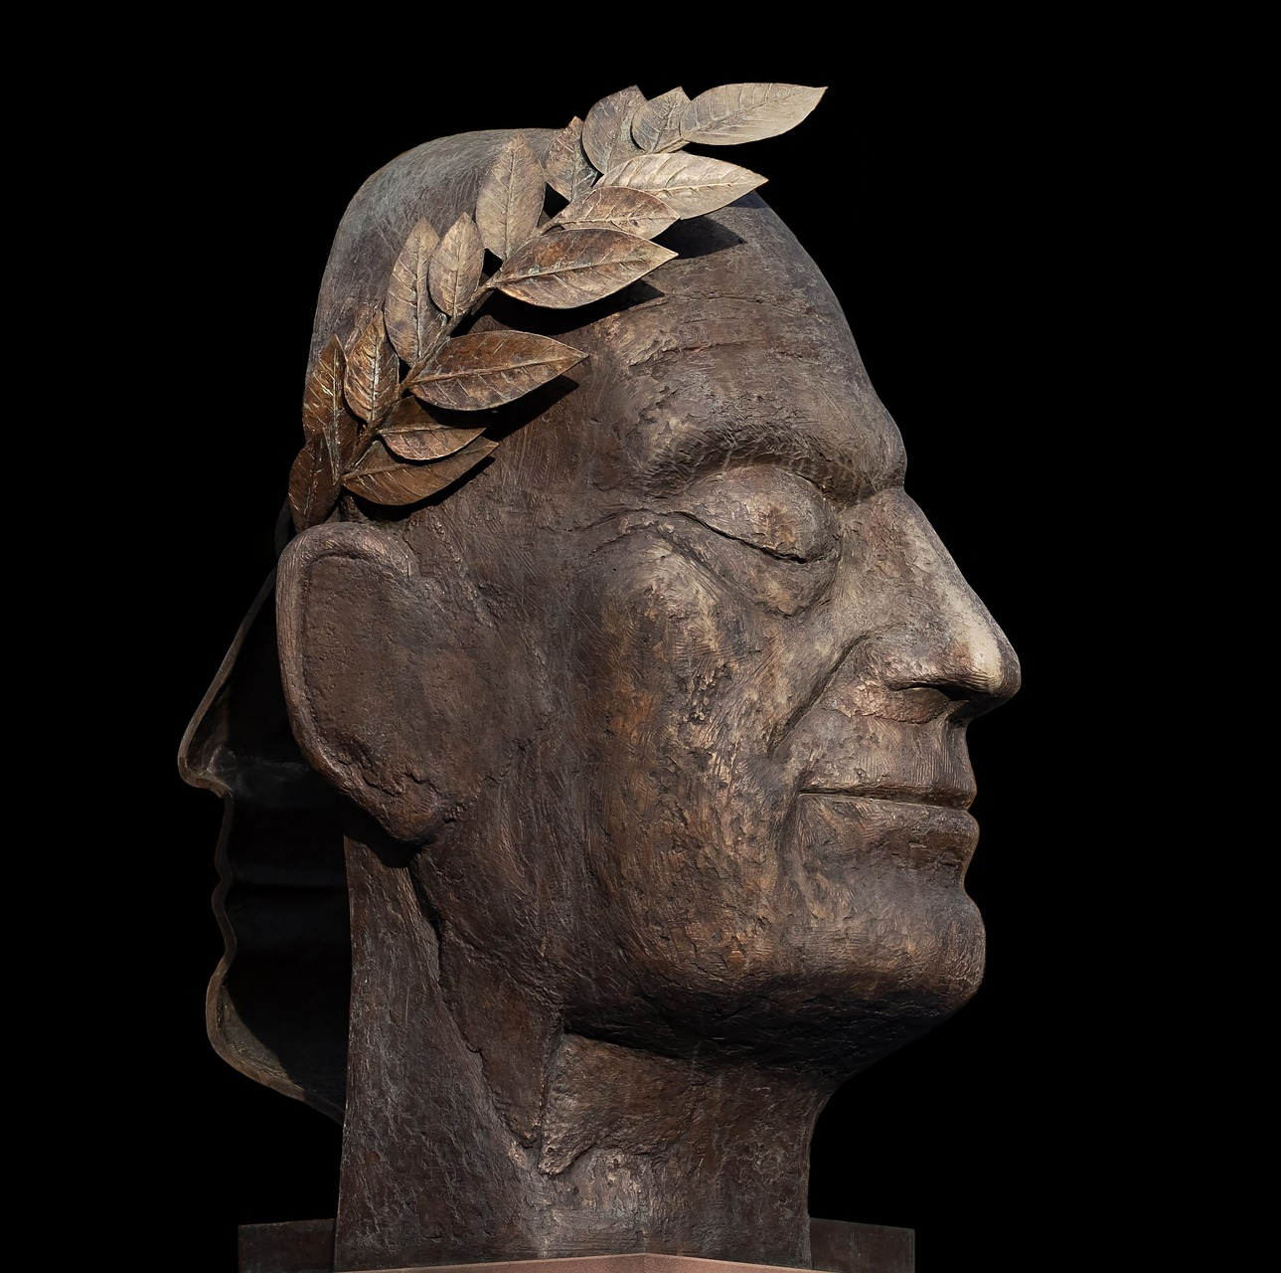
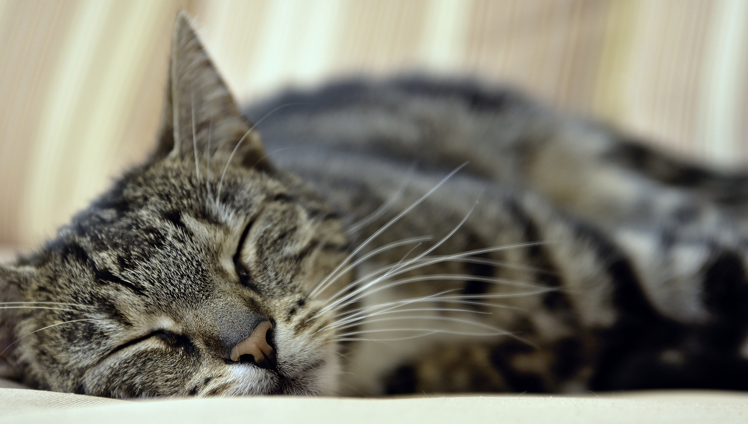
pronunciar
[gu]
[ga]
pronunciar
figura
fatiga
Notes:
4

Slide 5


pronunciar
[go]
[Stress 1]
pronunciar
[drop(let)]
gota
después
Notes:
5

Slide 6
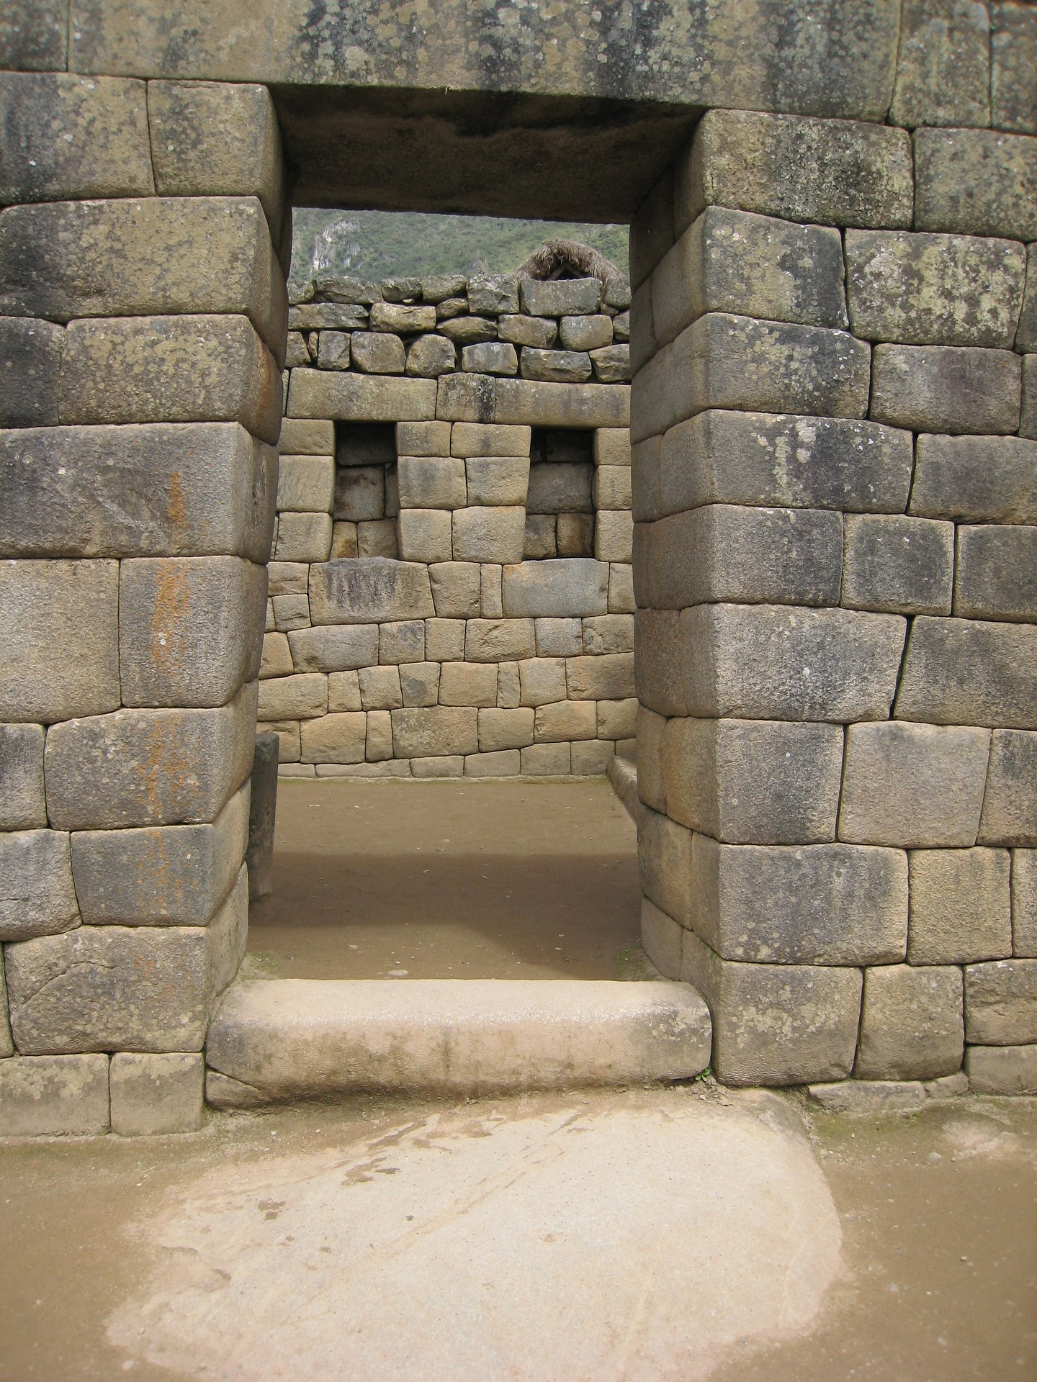
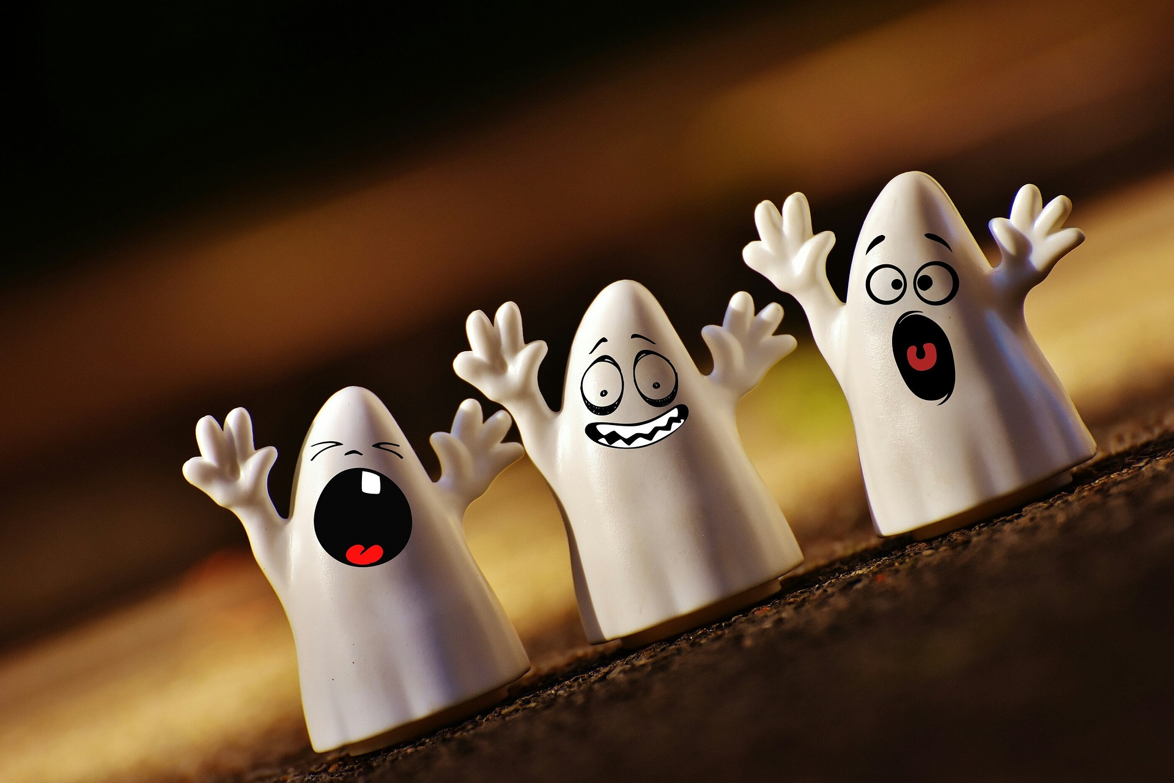
pronunciar
[Stress 2]
[Stress 3]
pronunciar
[ghost]
fantasma
portal
Notes:
6

Slide 7
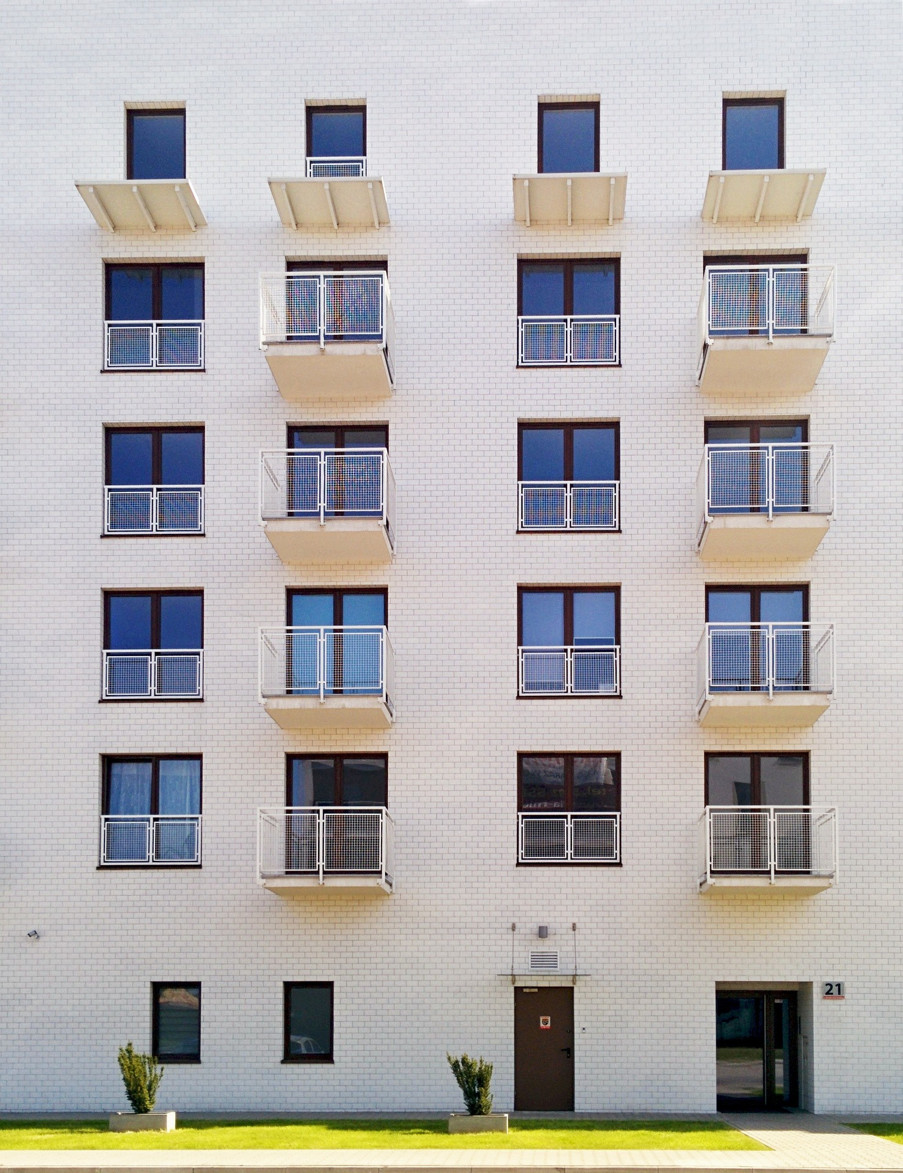
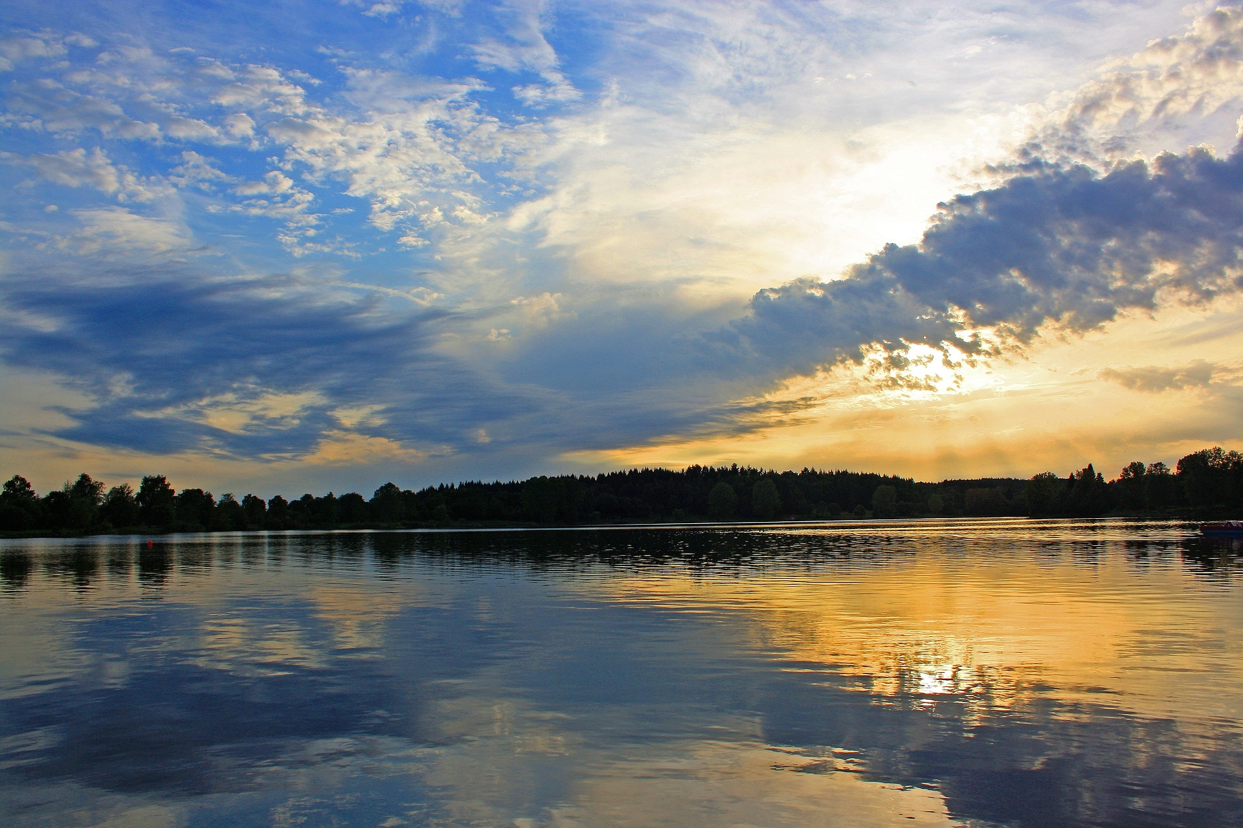
pronunciar
[que]
[qui]
pronunciar
bloque
quieto
Notes:
7

Slide 8

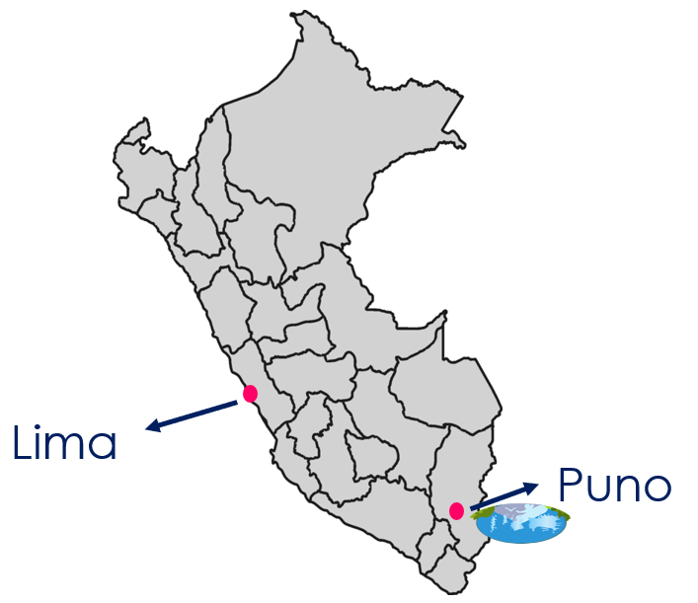
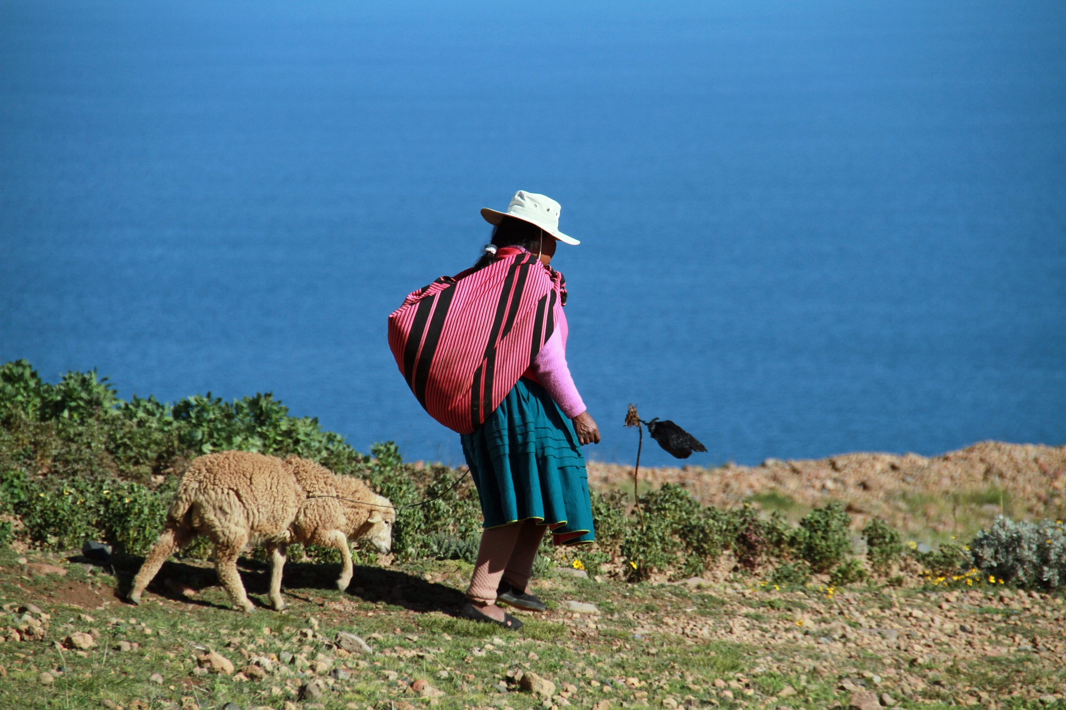
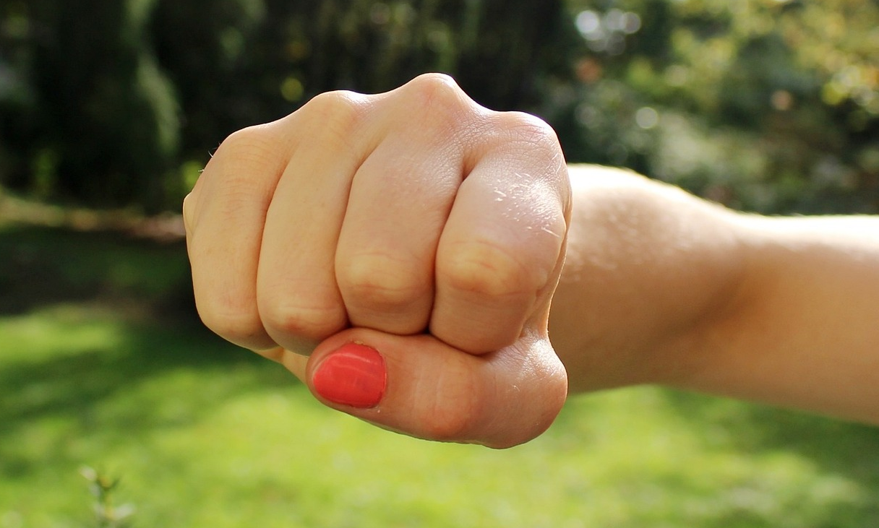

pronunciar
[n]
[ñ]
pronunciar
[fist]
Puno
puño
Notes:
8

Slide 9
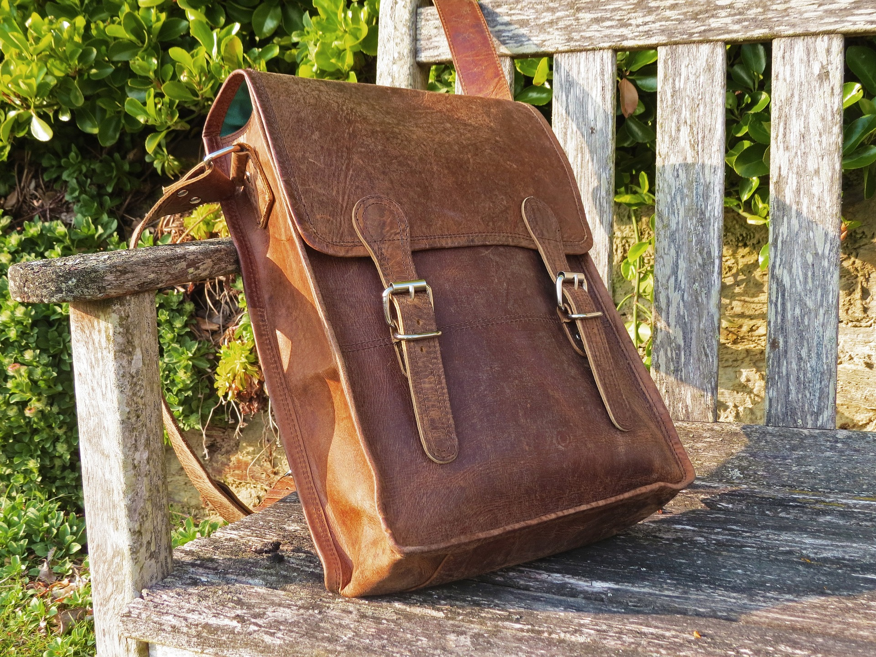
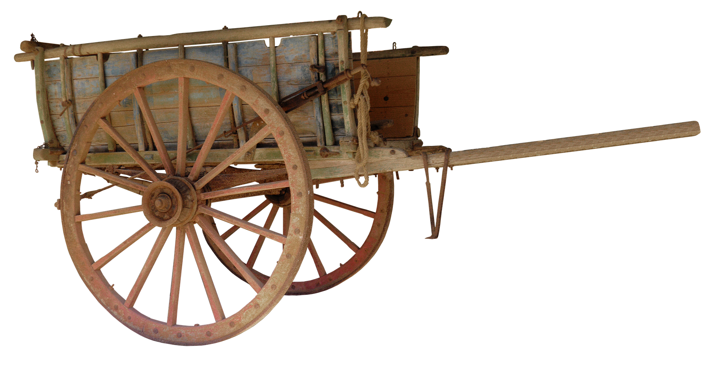
pronunciar
[r]
[rr]
pronunciar
cartera
carreta
Notes:
9

Slide 10
pronunciar
Pupil name:
Pupil name:
SSC and word | px
ave
boda
lana
llamada
figura
fatiga
gota
después
fantasma
portal
bloque
quieto
Puno
Puño
cartera
carreta
SSC and word | px
ave
boda
lana
llamada
figura
fatiga
gota
después
fantasma
portal
bloque
quieto
Puno
Puño
cartera
carreta
Notes:
Pupil feedback and assessment sheet [16 points]
10

Slide 11
pronunciar
pronunciar
1. Ina celebra las vacaciones. [2]
1. Ina celebra las vacaciones. [2]
2. Hay un zorro en mi jardín. [2]
2. Hay un zorro en mi jardín. [2]
3. Marco va al hospital. [2]
3. Marco va al hospital. [2]
4. La gallina corre. [2]
4. La gallina corre. [2]
5. El genio calcula matemáticas. [2]
5. El genio calcula matemáticas. [2]
6. Esta es una bandera nacional. [2]
6. Esta es una bandera nacional. [2]
Notes:
Optional additional sentence read aloud [12 points]
11

Slide 12

pronunciar
Teacher audio version
SSC and word | px
ave
boda
lana
llamada
figura
fatiga
gota
después
fantasma
portal
bloque
quieto
Puno
Puño
cartera
carreta
pronunciar
1. Ina celebra las vacaciones. [2]
2. Hay un zorro en mi jardín. [2]
3. Marco va al hospital. [2]
4. La gallina corre. [2]
5. El genio calcula matemáticas. [2]
6. Esta es una bandera nacional. [2]
Notes:
Teacher audio version
12

