Slide 1


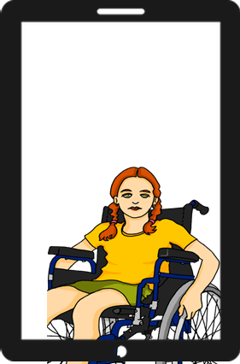
Describing me and others
verde
Follow ups 1-5
Notes:
Artwork by Steve Clarke. All additional pictures selected are available under a Creative Commons license, no attribution required.
The frequency rankings for words that occur in this PowerPoint which have been previously introduced in the resources are given in the SOW (excel document) and in the resources that first introduced and formally re-visited those words.
Phonics: cama [609] contar [172] cucaracha [>5000]
Vocabulary: tienes [tener 19] tiene [tener 19] árbol [748] calle [269] mentira [1673] universidad [387] verdad [176] cada [107] unos, unas [>5000] re-use noun: estadio [2581] iglesia [437] museo [1114] parque [1354] plaza [806] and adjectives: azul [811] bonito [891] divertido [2465] diferente [293] fuerte [435] grande [66] importante [171] independiente [1177] inteligente [2167] inútil [1753] lento [1569] normal [1000] pequeño [202] perfecto [1115] pesado [2166] serio [856] rojo [534] útil [3951] verde [812]
Revisit 1: están [21] son [7] cómodo [2237] importante [171] hoy [167] siempre [96] también [49] y [4]
Revisit 2: estar [21] estoy [21] estás [21] ser [7] soy [7] eres [7] quién [289] amigo(a) [210] profesor(a) [501] contento [1949] divertido [2465] elegante [2742] enfermo [1092] increíble [1642] inteligente [2167] lento [1569] perfecto [1115] pesado [2166] preparado [2092] rápido [870] serio [856] triste [1370] ¡Buenos días! [103/65] ¡Buenas tardes! [103/392] hola [1245]
Glossed: traducir [2037]
For any other words that occur incidentally in this PowerPoint, frequency rankings will be provided in the notes field wherever possible.
lugar [144]
Source: Davies, M. & Davies, K. (2018). A frequency dictionary of Spanish: Core vocabulary for learners (2nd ed.). Routledge: London

Slide 2


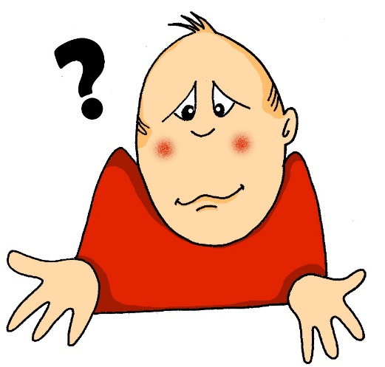




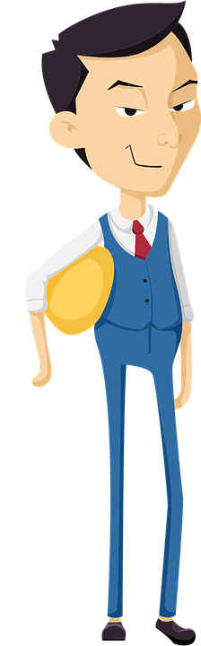




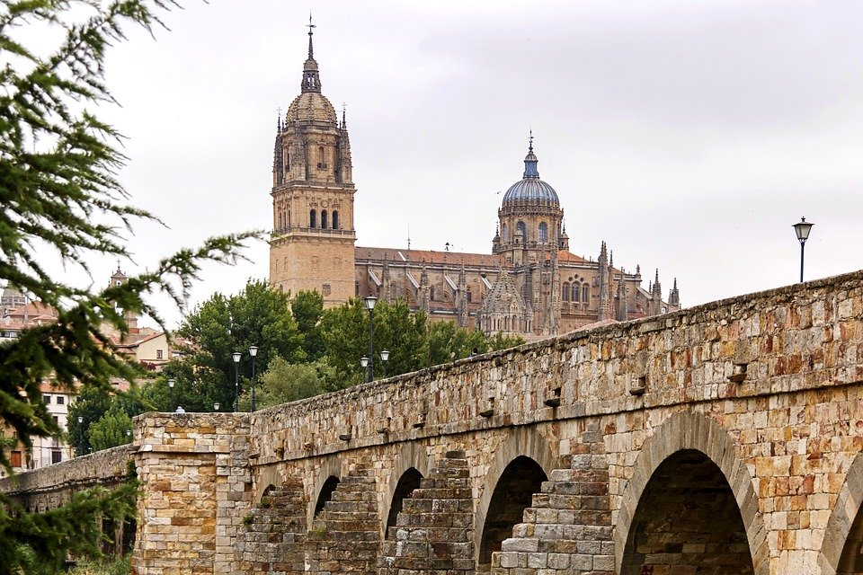
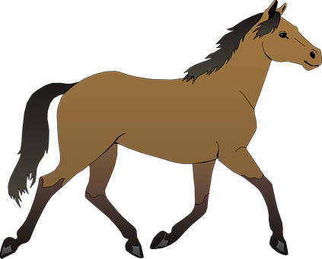

Follow up 1:
Escribe 5 palabras en secreto.
Pronuncia en parejas.
Tu compañero/a adivina.
pronunciar
5
cuaderno
60
1
¿Cómo?
6
cansado
10
contar
2
Colombia
7
Marco
11
contento
3
cucaracha
8
cámara
12
Salamanca
4
caballo
9
cama
0
INICIO
Notes:
Timing: 5 minutes
Aim: to apply knowledge of the SSC [ca] [co] and [cu] to the oral production of mostly unknown words.
Procedure:
Part 1
Pupils work in pairs to pronounce as many words as they can in 60 seconds.
Click on ‘inicio’ to start timer.
Click to bring up animations (image covering syllables [co] [co] and [cu] and give pupils 60 more seconds to pronounce these words, using [co] [co] and [cu] when it corresponds. NB. The majority of these words are revisited from rojo / amarillo; we have also included proper nouns (Colombia, Salamanca and Marco).
Part 2
Each pupils secretly writes down 5 of the words.
Start the timer. Pupil A tries to say all of Pupil B’s words within the 30 seconds.
Swap roles and start the timer again.
Several rounds of the activity can be completed.
If required, click on the blue splats to hear the audio for each word.
Source: Davies, M. & Davies, K. (2018). A frequency dictionary of Spanish: Core vocabulary for learners (2nd ed.). Routledge: London

Slide 3



Follow up 2:
B Escucha
A Escucha. Does it mention ‘I have’ or “s/he, it has’??
escuchar
¿Cómo es?
¿Qué describe?
Escribe el número en la tabla.
Escribe en inglés
2
adjetivo | ¿Qué?
E
4
curious
sister
1
3
5
different
male partner
I have | S/he, it has
fun
school
1
E
(quite) small
hotel
2
4
3
(quite) annoying
female partner
5
(very) able
female teacher
Notes:
Timing: 5 minutes
Aim: to practise listening out for ‘tengo’ & ‘tiene’ and process the person of the verb they refer to. Then, to practise aural recognition of postnominal adjectives and vocabulary.
Procedure:
Explain instructions to students.
Ask pupils to write ‘I have’ / ‘s/he has’.
3. Do the example with them and click to bring answer.
5. Do 1-5. They should identify whether they hear ‘I have’ or ‘s/he has and the correct adjective. Some students might also write down the object / person / animal.
7. Go through answers 1-5 (use of tener & adjective).
8. Play one more time. This time students listen out for the object & description (adjective) and write it down in English.
Transcript:
E. Tiene una hermana curiosa
Tengo un compañero diferente.
Tiene una escuela divertida.
Tiene un hotel bastante pequeño.
Tengo una compañera bastante pesada.
Tiene una profesora muy capaz.

Slide 4



Follow up 3:
Escucha.
Sofía habla con el abuelo.
¿Es una pregunta?
Marca
escuchar
I have
You have
She has
Escribe en inglés
Sofía | El abuelo | Krina
?
descripción
lugar
E
pretty
churches
1
interesting
museums
2
small
park
3
(very) important
universities
4
incredible
trees
5
different
streets
Notes:
Timing: 7 minutes
Aim: to practise differentiating aurally between ‘tengo’, ‘tienes’ & ‘tiene’ and connect the verbs forms with their meaning. In addition, to recognise questions and statements from the intonation. Finally, pupils will practise aural comprehension of nouns and adjectives from this and previous weeks.
Procedure:
Part 1
Read the instruction in Spanish from the board.
Click to bring up speech bubbles and elicit translations from pupils. This will provide support when doing the activity.
Click to bring up further instruction (Marca).
Tell them that they will hear Sofía talking about what she has, talking to her grandad Miguel or talking about Krina. Tell pupils they need to pay attention to whether they hear “tengo”, ‘tienes’ or “tiene”. They can write the verb down for support or tick directly.
5. Click to bring up further instructions and clarify. They need to pay attention to whether it’s a statement or a question.
6. Do the example with them.
7. Ask pupils to write 1-5 in their books.
8. Do 1-5 and click to provide feedback.
Part 2
9. Click x3 to bring up the instructions and the table. Pupils need now to concentrate understanding the vocabulary.
10. Play all items again.
11. Go through answers 1-6.
Note: the table is in the English word order of adjective + noun. Pupils will hear these words in Spanish (noun + adjectives). The structure of the task supports pupils but also makes the syntax difference more salient. Teachers can draw their pupils’ attention to this, too.
Transcript:
Ej. ¿Tienes unas iglesias bonitas?
Tiene unos museos interesantes.
Tengo un parque pequeño.
Tiene unas universidades muy importantes.
¿Tiene unos árboles increíbles?
Tienes unas calles diferentes.

Slide 5

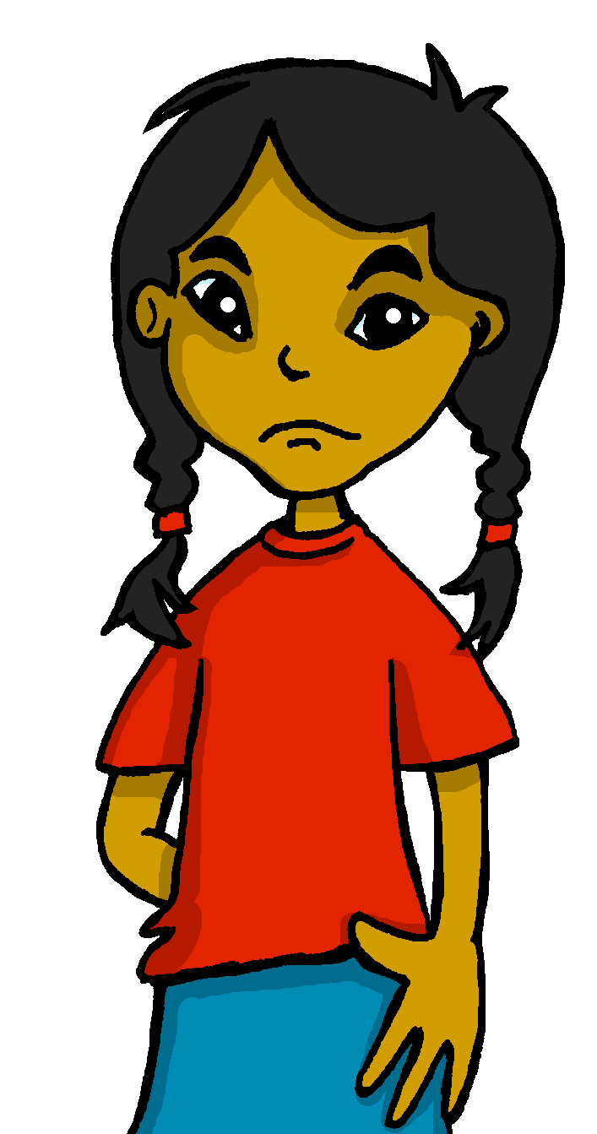


Gender & number agreement on adjectives
Remember that in Spanish all nouns are either masculine or feminine.
⚠ Don’t forget!
This is grammatical, not biological gender.
Preguntas (questions) are feminine, not female!
We also know that:
when we describe more than one masculine noun, the adjective ends in –os.
when we describe more than one feminine noun, the adjective ends in –as.
Cambridge tiene unas iglesias y son muy viejas.
Lugo tiene unos museos y son nuevos.
Lugo has some museums and they are new.
Cambridge has some churches and they are very old.
Notes:
Use before Follow up 4 and/or 5.
Timing: 1 minute
Aim: to revisit regular adjectival agreement (gender and number) in order use the masculine and feminine plural form of regular adjectives ending in –o, when describing any noun.
Procedure:
Click to present the information in stages.
Elicit English translation for the Spanish examples provided.

Slide 6
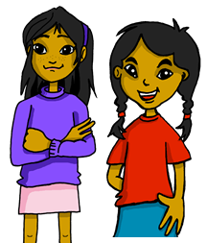



Follow up 4:
¿Qué tiene Sofíá? ¿Qué tiene Krina? ¿cómo es? o ¿cómo son?
Lee la lista de Sofía.
leer
1
¿Quién? | ¿Qué? | ¿Cómo?
Krina (She) | estadio plaza | perfect
Sofía (I) | montañas puentes | pretty
Krina (She) | árboles calles | big
Krina (She) | calles parques | old
Sofía (I) | cuaderno cuadernos | important
Sofía (I) | puentes plaza | new
Tiene una plaza. Es perfecta.
2
Tengo unas montañas
y una playa. Son bonitas.
3
Tiene unos árboles.
Son grandes.
4
Tiene unas calles.
Son viejas.
5
Tengo un cuaderno.
Es importante.
6
Tengo unos puentes.
Son nuevos.
Notes:
Timing: 4 minutes
Aim: to identify nouns from the indefinite articles; to understand new and previously taught nouns and adjectives (in singular and plural forms). To practise written comprehension of two parts of the verb tener (tengo, tiene) and connect these to their meaning.
Procedure:
Read the scenario with pupils. They should understand that Sofía is writing a list of what she has in her town (tengo – I have) and what Krina has (tiene – she has). She has smudged some of his writing, though. Can they still work out who has what, and what it is like?
Do the first one with pupils. They work out ‘quién’ by looking at the part of tener, they work out ‘qué’ by looking at the article, they work out ‘cómo’ by understanding the adjective. Click to work through the task in small steps, highlighting in pink the relevant parts of the sentence.
Pupils write 1 – 6 and complete the tasks.
Click to correct.

Slide 7
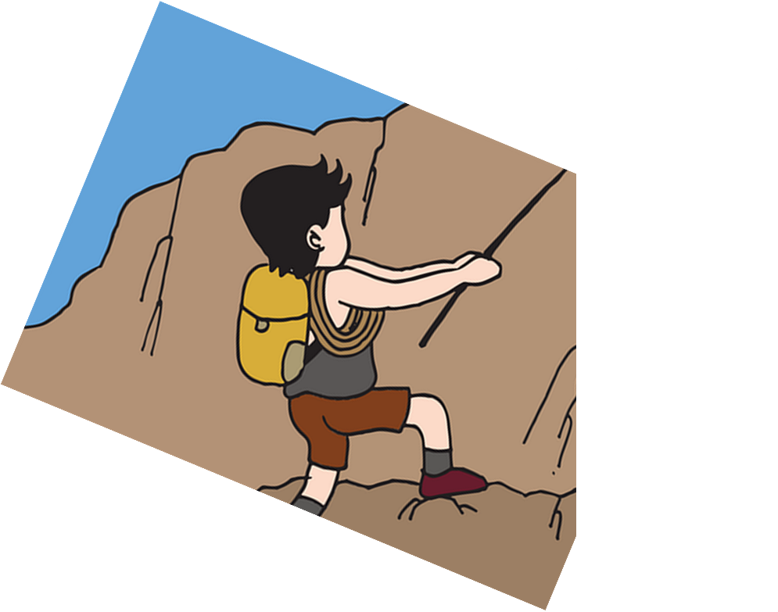
Follow up 5:
[1/4]
Traduce la frase.
Lugo has some museums.
hablar
Lugo tiene unos museos.
5
4
estadio
museo
mesas
museos
3
un
una
unos
unas
2
tengo
tiene
tienes
1
traduce = translate
Notes:
Timing: 5 minutes
Aim: to use the correct form of the adjective in oral production.
Procedure:
Tell students they need to use the words, starting from the bottom, to climb up the mountain (And translate the sentence!).
Ask students to work in pairs to practise first.
Click to trigger the timer (6 seconds per sentence).
Ask a volunteer from a pair to say the Spanish sentence out loud – next slide reveals the answer.
Repeat with the next 3 sentences (there are 4 in total).
traducir [2037]

Slide 8
Follow up 5:
[2/4]
Traduce la frase.
⚠ Remember to raise your voice at the end to mark this is a question.
Does it have a church and some trees?
hablar
calles?
plazas?
árboles?
estadios?
un
una
unos
unas
¿Tiene una iglesia y unos árboles?
5
y
pero
también
4
calle
iglesia
parque
museo
3
un
una
unos
unas
2
¿Tiene
¿Tienes
¿Tengo
1
traduce = translate
Notes:
Timing: 5 minutes
Aim: to use the correct form of the adjective in oral production.
Procedure:
Tell students they need to use the words, starting from the bottom, to climb up the mountain (And translate the sentence!).
Ask students to work in pairs to practise first.
Click to trigger the timer (6 seconds per sentence).
Ask a volunteer from a pair to say the Spanish sentence out loud – next slide reveals the answer.
Repeat with the next 3 sentences (there are 4 in total).
traducir [2037]

Slide 9
Follow up 5:
[3/4]
Traduce la frase.
You have some important streets in your city.
hablar
tu ciudad
mi ciudad
en
con
Tienes algunas calles importantes en tu ciudad.
5
útil
importante
diferentes
importantes
4
plaza
calles
palabras
estadios
3
un
una
algunos
algunas
2
Tienes
Tiene
Tengo
1
traduce = translate
Notes:
Timing: 5 minutes
Aim: to use the correct form of the adjective in oral production.
Procedure:
Tell students they need to use the words, starting from the bottom, to climb up the mountain (And translate the sentence!).
Ask students to work in pairs to practise first.
Click to trigger the timer (6 seconds per sentence).
Ask a volunteer from a pair to say the Spanish sentence out loud – next slide reveals the answer.
Repeat with the next 3 sentences (there are 4 in total).
traducir [2037]

Slide 10
Follow up 5:
[4/4]
Traduce la frase.
I have a small university but some pretty parks.
bonito
bonitas
hablar
bonitos
árboles
parque
puentes
parques
unos
unas
un
una
Tengo una universidad pequeña pero unos parques bonitos.
5
y
pero
también
4
grande
pequeño
pequeña
útil
hotel
escuela
universidad
plaza
3
unos
unas
2
un
una
Tienes
Tengo
Tiene
1
traduce = translate
Notes:
Timing: 5 minutes
Aim: to use the correct form of the adjective in oral production.
Procedure:
Tell students they need to use the words, starting from the bottom, to climb up the mountain (And translate the sentence!).
Ask students to work in pairs to practise first.
Click to trigger the timer (6 seconds per sentence).
Ask a volunteer from a pair to say the Spanish sentence out loud – next slide reveals the answer.
Repeat with the next 3 sentences (there are 4 in total).
traducir [2037]

Slide 11




Follow up [extra]:
Escribe en inglés: Can you get at least 15 points?
 | ¿quién? | preparada | Buenos días
 | divertida | triste | Buenas tardes
 | importante | son | siempre
 | cómodas | hoy | están
 | la mentira | la calle | el árbol
 | la verdad | la universidad | también
vocabulario
who?
ready (f)
Good day/morning
x3
fun, funny (f)
sad (m/f)
Good afternoon
important (m/f)
they are (trait)
always
x2
comfortable (fpl)
today
they are (state)
(the) lie
(the) street
(the) tree
x1
(the) truth
(the) uni
also, too
Notes:
Timing: 5 minutes
Aim: to practise written comprehension of vocabulary for this week and previous weeks.
Procedure:
1. Pupils need to write the English for as many words as possible, aiming to get at least 15 points (but more if possible).
2. Click for English answers.

Slide 12
Follow up [extra]:
Escribe en español: Can you get at least 15 points?
 | sad (m/f) | fun, funny (mpl) | Good afternoon
 | prepared (f) | who? | Good day/morning
 | comfortable (fpl) | they are (trait) | they are (state)
 | today | always | important (mfpl)
 | (the) truth | (the) uni | also, too
 | (the) tree | (the) street | (the) lie
vocabulario
triste
divertidos
Buenas tardes
x3
preparada
¿quién?
Buenos días
cómodas
son
están
x2
hoy
siempre
importantes
la verdad
la universidad
también
x1
el árbol
la calle
la mentira
Notes:
Timing: 6 minutes
Aim: to practise written production of vocabulary for this week and previous weeks.
Procedure:
1. Pupils need to write the Spanish for as many words as possible, aiming to get at least 15 points (but more if possible).
2. Click for Spanish answers.

Slide 13
Handout Follow up extra 1
Follow up [extra] A:
Escribe en inglés: Can you get at least 15 points?
 | ¿quién? | preparada | Buenos días
 | divertida | triste | Buenas tardes
 | importante | son | siempre
 | cómodas | hoy | están
 | la mentira | la calle | el árbol
 | la verdad | la universidad | también
vocabulario
x3
x2
x1
Notes:
Timing: 5 minutes
Aim: to practise written comprehension of vocabulary for this week and previous weeks.
Procedure:
1. Pupils need to write the English for as many words as possible, aiming to get at least 15 points (but more if possible).
2. Click for English answers.

Slide 14
Handout Follow up extra 1
Follow up [extra] B:
Escribe en español: Can you get at least 15 points?
 | sad (m/f) | fun, funny (mpl) | Good afternoon
 | prepared (f) | who? | Good day/morning
 | comfortable (fpl) | they are (trait) | they are (state)
 | today | always | important (mfpl)
 | (the) truth | (the) uni | also, too
 | (the) tree | (the) street | (the) lie
vocabulario
x3
x2
x1
Notes:
Timing: 6 minutes
Aim: to practise written production of vocabulary for this week and previous weeks.
Procedure:
1. Pupils need to write the Spanish for as many words as possible, aiming to get at least 15 points (but more if possible).
2. Click for Spanish answers.

