Slide 1

Describing me and others
verde
Follow ups 1-5
Notes:
Artwork by Steve Clarke. All additional pictures selected are available under a Creative Commons license, no attribution required.
The frequency rankings for words that occur in this PowerPoint which have been previously introduced in the resources are given in the SOW (excel document) and in the resources that first introduced and formally re-visited those words.
- vocabulary: hay [13] cuántos/cuántas [580] bolígrafo [>5000] camiseta [4130] cuaderno [3301] deporte [1489] mochila [>5000] capaz [645] difícil [374] esencial [1872] fácil [584] útil [3951] Recycle nouns and adjectives from previous years: amarillo [1381] divertido[2465] fuerte [435] lento [1569] pequeño [202]
- SSC: Strong and weak vowels revisited: leer [209] aceite [2101] aire [401] boina [>5000] idea [247] oeste [2416] puente [1715] antiguo [446] feo [2373]
For any other words that occur incidentally in this PowerPoint, frequency rankings will be provided in the notes field wherever possible.
Source: Davies, M. & Davies, K. (2018). A frequency dictionary of Spanish: Core vocabulary for learners (2nd ed.). Routledge: London

Slide 2



Follow up 1:
[i] [o] [u]
[e]
[a]
Escucha y repite.
pronunciar
Abeja es con ‘a’
Mi abuela dice ‘a’
Oso es con ‘o’
Olivia dice ‘o’
60
Elefante es con ‘e’
Emilio dice ‘e’
Uña es con ‘u’
Ustedes dicen ‘u’
Isla es con ‘i’
Isabel dice ‘i’
repite = repeat
dice = s/he says
ustedes = you pl. (formal)
0
INICIO
Notes:
Timing: 6 minutes (2 slides)
Aim: to revisit all the vowels and develop phonological confidence
Procedure:
1. Pupils read the texts aloud in pairs
2. Click on the play button to listen to each line
3. Move to next slide to play the video and encourage pupils to join,
NB. The meaning for abeja, isla, oso and uña is clear when watching the video (next slide).
repite [] dice [] ustedes []
https://www.youtube.com/watch?v=LYV0hoqOVXk&ab_channel=123Andr%C3%A9s
© 123 Andrés. All rights reserved.

Slide 3


Follow up 1:
[i] [o] [u]
[e]
[a]
Escucha y canta.
pronunciar
repite = repeat
dice = s/he says
ustedes = you pl. (formal)
Notes:
Timing: 6 minutes
Aim: to revisit all the vowels and develop phonological confidence
Procedure:
1. Pupils read the texts aloud in pairs
2. Click on the play button to listen to each line
3. Move to next slide to play the video and encourage pupils to join,
Procedure:
With a partner, pronounce each set of four lines.
Then listen to the verse.
Then repeat in pairs again.
Repeat for all six verses.
https://www.youtube.com/watch?v=LYV0hoqOVXk&ab_channel=123Andr%C3%A9s
© 123 Andrés. All rights reserved.

Slide 4


Follow up 2:
B Escucha
A Escucha. Does it mention ‘I have’ or “s/he, it has’??
escuchar
¿Cómo es?
¿Qué describe?
Escribe el número en la tabla.
Escribe en inglés
2
adjetivo | ¿Qué?
E
4
positive
sister
1
3
5
strong
male partner
I have | S/he, it has
big
school
1
E
(quite) small
hotel
2
4
3
(quite) annoying
female partner
5
(very) able
female teacher
Notes:
Timing: 5 minutes
Aim: to practise listening out for ‘tengo’ & ‘tiene’ and process the person of the verb they refer to. Then, to practise aural recognition of postnominal adjectives and vocabulary.
Procedure:
Explain instructions to students.
Ask pupils to write ‘I have’ / ‘s/he has’.
3. Do the example with them and click to bring answer.
5. Do 1-5. They should identify whether they hear ‘I have’ or ‘s/he has and the correct adjective. Some students might also write down the object / person / animal.
7. Go through answers 1-5 (use of tener & adjective).
8. Play one more time. This time students listen out for the object & description (adjective) and write it down in English.
Transcript:
E. Tiene una hermana positiva
Tengo un compañero fuerte.
Tiene una escuela grande.
Tiene un hotel bastante pequeño.
Tengo una compañera bastante pesada.
Tiene una profesora muy capaz.

Slide 5
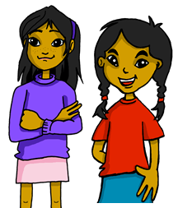


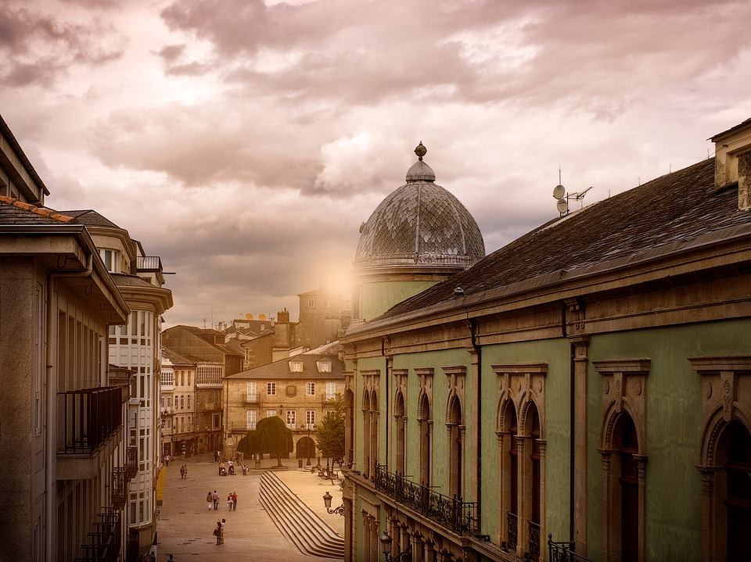
Follow up 3:
Lee la carta de Sofía.
¿Qué es incorrecto? Reescribe.
escribir
o
Tengo una amiga divertida .
un hermano
I have a fun brother.
Tiene una piscina pequeña.
Tiene
una escuela
I have a small school.
Tiene
Tengo un parque grande.
bonito.
She has a pretty park.
o.
Tengo una profesora preparada.
un profesor
I have a prepared (male) teacher.
Lugo tiene un hotel importante .
un puente
interesante
Lugo has an interesting bridge.
Notes:
Timing: 6-8 minutes
Aim: to use the correct postnominal adjective agreement in guided written production.
Procedure:
Read the title and the instruction in Spanish from the board.
Click to bring further instruction.
Read the first sentence in Spanish, and the English sentence. Ask students to identify what’s incorrect in the Spanish sentence. Elicit the Spanish word for “brother” & draw their attention to the gender & how that would affect the ending of the adjective “divertida”.
Students complete sentences 1-4 in their books (there are 2 mistakes per sentence).

Slide 6
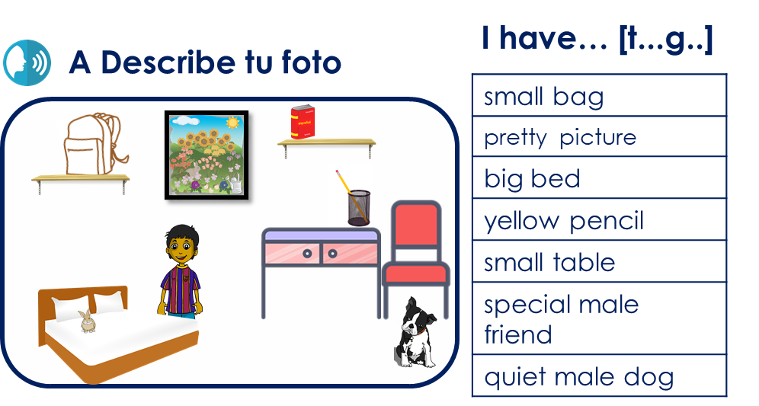
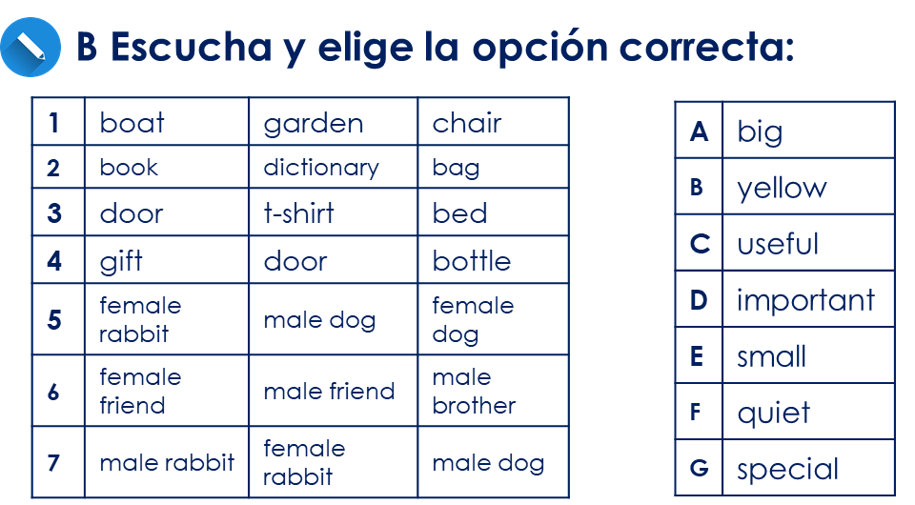
Follow up 4
En parejas
escribir
hablar
A Lee las frases a tu compañero/a y describe tu foto.
B Escucha la descripción de tu compañero/a.
Read your sentences in this order.
Tengo
una mochila
pequeña
Remember: In Spanish, adjectives often follow the noun.
Notes:
Timing: 5-8 minutes
Aim: oral production of tengo, adjectival agreement & post-nominal position of adjectives. Part B of the activity focuses on aural comprehension of the same set of taught features.
1.

Slide 7

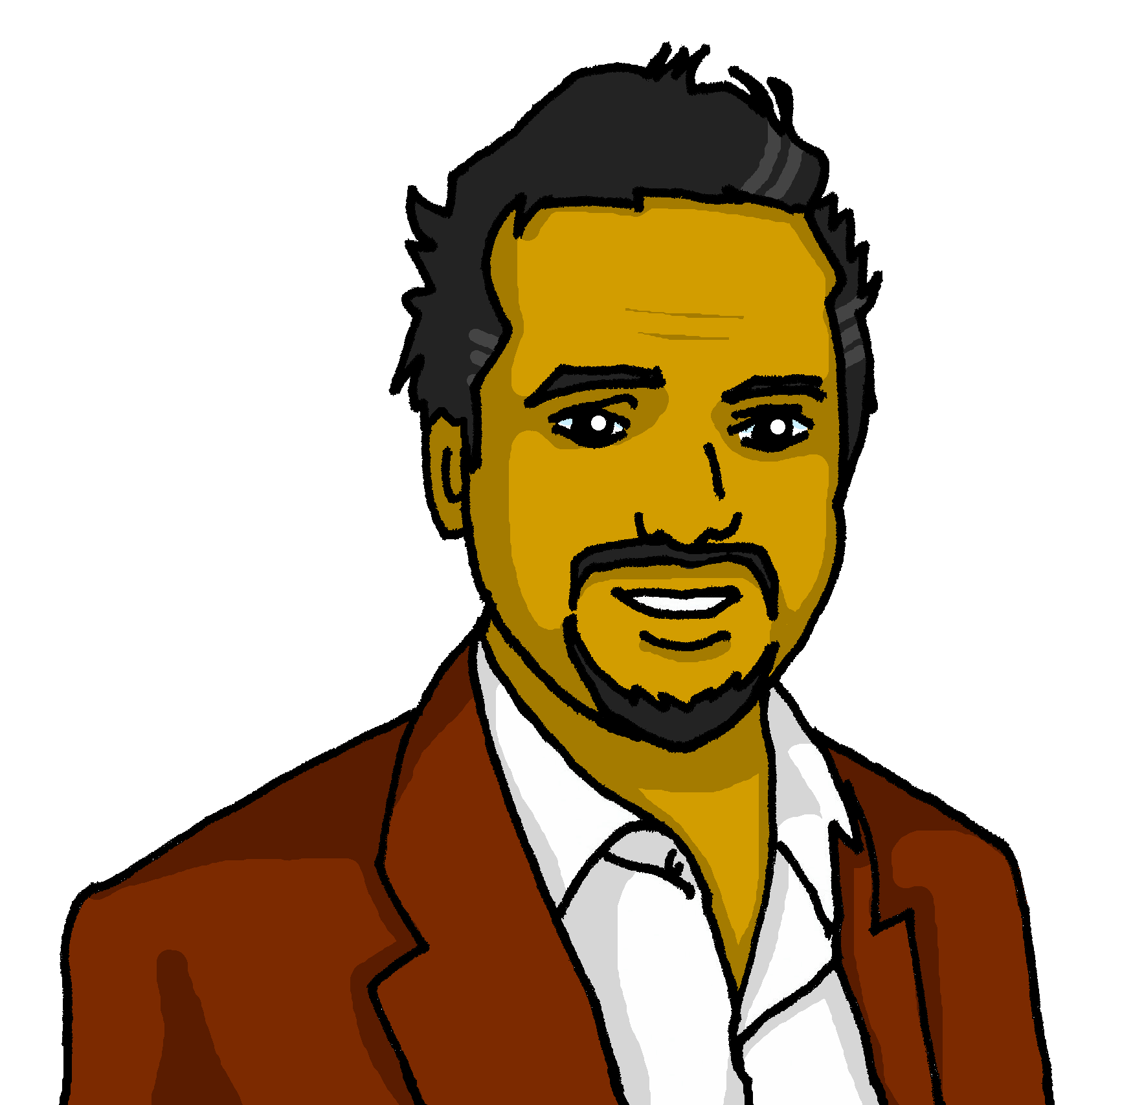

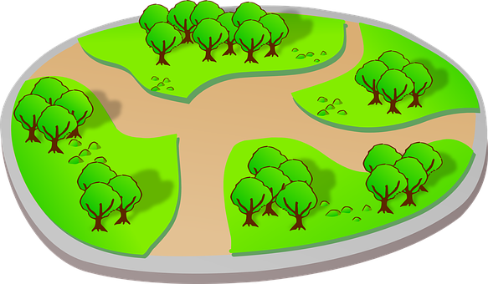

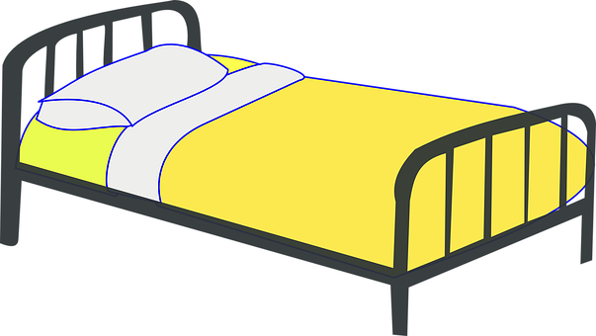



ANSWERS
Persona A
Persona B
A Describe tu foto
B Escucha y elige la opción correcta:
|
|
|
|
|
|
|
|
|
|
|
|
|
|
1 | boat | table | pool
2 | book | pencil | bag
3 | door | pencil | bed
4 | t-shirt | door | bottle
5 | church | park | museum
6 | brother | sister | father
7 | table | plant | bed
A | big
B | yellow
C | fun
D | interesting
E | important
F | small
G | essential
I have… [t..g..]
a small table
an important book
a yellow pencil
a big t-shirt
a fun park
a interesting dad
an essential bed
Notes:
ANSWERS
Transcript:
Tengo una mesa pequeña.
Tengo un libro importante.
Tengo un lápiz amarillo.
Tengo una camiseta grande.
Tengo un parque divertido.
Tengo un padre interesante.
Tengo una cama esencial.

Slide 8
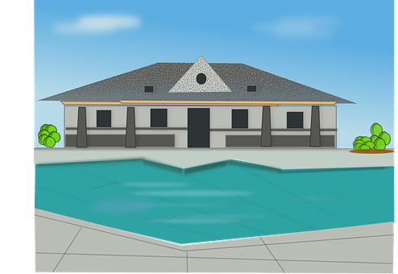
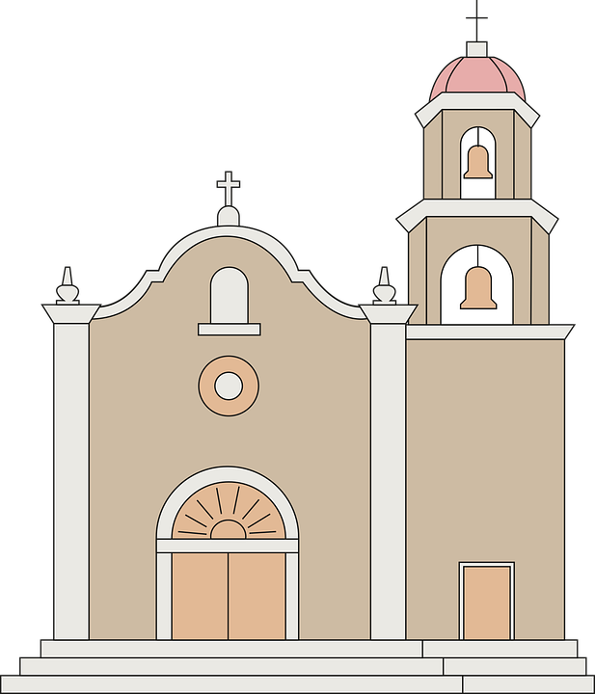
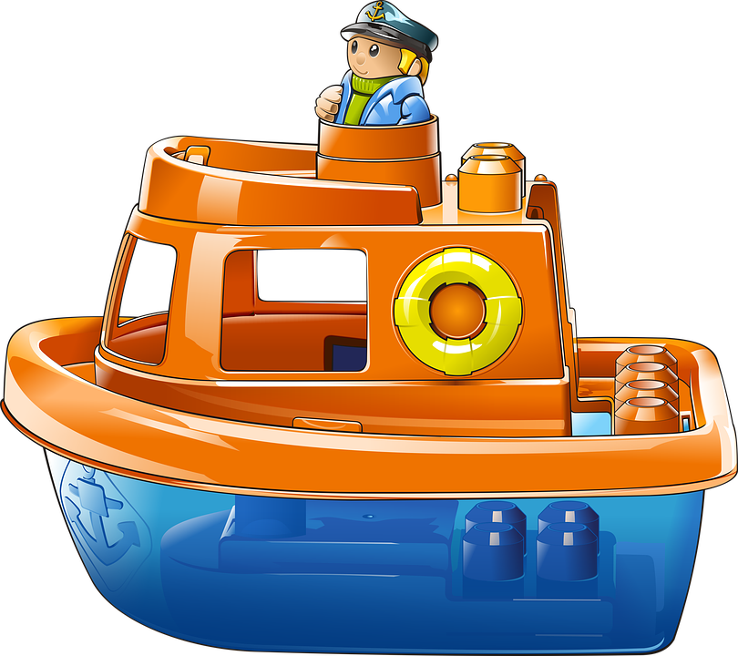


ANSWERS
Persona B
Persona A
A Describe tu foto
B Escucha y elige la opción correcta:
|
|
|
|
|
|
|
|
|
|
|
|
|
|
1 | museum | garden | church
2 | bag | book | sheet
3 | bed | Door | ruler
4 | friend (m) | friend (f) | sister
5 | pool | hotel | horse
6 | instrument | thing | boat
7 | plant | message | boat
A | happy
B | new
C | old
D | important
E | small
F | odd
G | fun
I have… [t..g..]
an important church
an old bag
a small bed
a happy friend (f)
a fun pool
an odd instrument
a new boat
Notes:
ANSWERS
Transcript:
Tengo una iglesia importante.
Tengo una bolsa vieja.
Tengo una cama pequeña.
Tengo una amiga feliz.
Tengo una piscina divertida.
Tengo un instrumento raro.
Tengo un barco nuevo.

Slide 9
Follow up 5
Amo Lugo ❤. Es una ciudad perfecta.
Escribe las frases en el diario.
escribir
objeto | descripción | Who/ What?
bridge | new | Lugo
swimming pool | (quite) small | Lugo
church | important | Lugo
school | fun | Lugo
male partner | (too) annoying | I
Fecha:
Lugo tiene un puente nuevo.
Tiene una piscina bastante pequeña.
Tiene una iglesia importante.
Tiene una escuela divertida.
Tengo un compañero demasiado pesado.
Notes:
Timing: 5-8 minutes
Aim: to practise written production of ‘tengo’ and ‘tiene’; correct position and form of adjectives, and other vocabulary.
Procedure:
Click to present the task.
Pupils write Sofía’s diary entry in Spanish, using the prompts in the table.
Click to provide written versions of the answers.

Slide 10




Follow up Extra
Escribe en inglés: Can you get at least 15 points?
 | el domingo | el jueves | el martes
 | el lunes | el viernes | el miércoles
 | el espectáculo | ¿cuándo? | la exposición
 | la fecha | el sábado | el día
 | el puente | ¿cuál? | el compañero
 | la escuela | la compañera | muy
 | la piscina | bastante | el hotel
vocabulario
Sunday
Thursday
Tuesday
x3
Monday
Friday
Wednesday
(the) show
when?
(the) exhibition
x2
(the) date
(the) Saturday
(the) day
(the) bridge
which?
(the) male partner
(the) school
(the) female partner
very
x1
(the)swimming pool
quite
(the) hotel
Notes:
Timing: 5 minutes
Aim: to practise written comprehension of vocabulary for this week and previous weeks.
Procedure:
1. Pupils need to write the English for as many words as possible, aiming to get at least 15 points (but more if possible).
2. Click for English answers.

Slide 11
Follow up Extra:
Escribe en español: Can you get at least 15 points?
 | (the) Friday | (the) Monday | (the) Wednesday
 | (the) Tuesday | (the) Sunday | (the) Thursday
 | (the) show | (the) Saturday | (the) day
 | when? | (the) party | (the) exhibition
 | very | (the) bridge | which?
 | (the) partner (m) | (the) school | (the) partner (f)
 | (the) hotel | (the) swimming pool | quite
el viernes
el lunes
el miércoles
vocabulario
x3
el martes
el domingo
el jueves
el espectáculo
el sábado
el día
x2
¿cuándo?
la fiesta
la exposición
muy
el puente
¿cuál?
el compañero
la escuela
la compañera
x1
el hotel
la piscina
bastante
Notes:
Timing: 6 minutes
Aim: to practise written production of vocabulary for this week and previous weeks.
Procedure:
1. Pupils need to write the Spanish for as many words as possible, aiming to get at least 15 points (but more if possible).
2. Click for Spanish answers.

Slide 12
to print
Persona A
Persona B
I have… [t..g..]
1 Describe tu foto
1 Escucha y elige la opción correcta:
|
|
|
|
|
|
|
|
|
|
|
|
|
|
a small table
an important book
a yellow pencil
a big t-shirt
a fun park
a interesting dad
an essential bed
1 | boat | table | pool
2 | book | pencil | bag
3 | door | dog | bed
4 | t-shirt | door | bottle
5 | church | park | museum
6 | brother | sister | father
7 | table | plant | bed
A | big
B | yellow
C | fun
D | interesting
E | small
F | strong
G | essential
2 Escucha y elige la opción correcta:
I have… [t..g..]
2 Describe tu foto
1 | museum | garden | church
2 | bag | book | sheet
3 | bed | door | ruler
4 | friend (m) | friend (f) | sister
5 | pool | hotel | horse
6 | instrument | thing | boat
7 | plant | message | boat
A | happy
B | new
C | old
D | important
E | small
F | odd
G | fun
an important church
an old bag
a small bed
a happy friend (f)
a fun pool
an odd instrument
a new boat
Notes:
HANDOUT

Slide 13
Handout Follow up 5a
Follow up Extra:
Escribe en inglés: Can you get at least 15 points?
 | el domingo | el jueves | el martes
 | el lunes | el viernes | el miércoles
 | el espectáculo | ¿cuándo? | la exposición
 | la fecha | el sábado | el día
 | el puente | ¿cuál? | el compañero
 | la escuela | la compañera | muy
 | la piscina | bastante | el hotel
vocabulario
x3
x2
x1
Notes:
Timing: 5 minutes
Aim: to practise written comprehension of vocabulary for this week and previous weeks.
Procedure:
1. Pupils need to write the English for as many words as possible, aiming to get at least 15 points (but more if possible).
2. Click for English answers.

Slide 14
Handout Follow up 5b:
Follow up Extra:
Escribe en español: Can you get at least 15 points?
 | (the) Friday | (the) Monday | (the) Wednesday
 | (the) Tuesday | (the) Sunday | (the) Thursday
 | (the) show | (the) Saturday | (the) day
 | when? | (the) party | (the) exhibition
 | very | (the) bridge | which?
 | (the) partner (m) | (the) school | (the) partner (f)
 | (the) hotel | (the) swimming pool | quite
vocabulario
x3
x2
x1
Notes:
Timing: 6 minutes
Aim: to practise written production of vocabulary for this week and previous weeks.
Procedure:
1. Pupils need to write the Spanish for as many words as possible, aiming to get at least 15 points (but more if possible).
2. Click for Spanish answers.

