Slide 1


español, con Quique

Slide 2

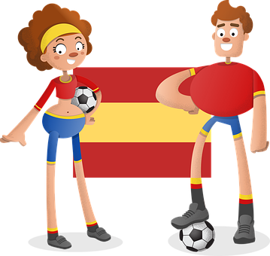


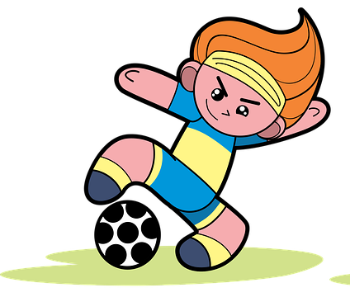

Describing me and others
verde
- Adjectives ending in -z & -l.
SSC: Strong & weak vowels [revisited]
Notes:
Artwork by Steve Clarke. All additional pictures selected are available under a Creative Commons license, no attribution required.
The frequency rankings for words that occur in this PowerPoint which have been previously introduced in the resources are given in the SOW (excel document) and in the resources that first introduced and formally re-visited those words.
Phonics: Strong and weak vowels revisited: leer [209] aceite [2101] aire [401] boina [>5000] idea [247] oeste [2416] puente [1715] antiguo [446] feo [2373]
Vocabulary: hay [13] cuántos/cuántas [580] bolígrafo [>5000] camiseta [4130] cuaderno [3301] deporte [1489] mochila [>5000] capaz [645] difícil [374] esencial [1872] fácil [584] útil [3951] Recycle nouns and adjectives from previous years: amarillo [1381] divertido[2465] fuerte [435] lento [1569] pequeño [202]
Revisit 1: concierto [1456] cumpleaños [3372] fiesta [796] mes [288] enero [1173] febrero [1419] marzo [1231] abril [1064] mayo [909] junio [1035] julio [659] septiembre [1150] octubre [1242] noviembre [1434] diciembre [1165] cuándo [138] de [2] trece [2700] catorce [2411] quince[1215] dieciséis [3373] diecisiete [3400] dieciocho [2730] diecinueve [4232] veinte [819] veintiuno [819/425] veintidós | veintitrés | veinticuatro | veinticinco |veintiseis |veintisiete|veintiocho |veintinueve | treinta [830] treinta y uno [830/4/425]
Revisit 2:
Glossed:
corregir [2351] describir [1272]
For any other words that occur incidentally in this PowerPoint, frequency rankings will be provided in the notes field wherever possible.
Source: Davies, M. & Davies, K. (2018). A frequency dictionary of Spanish: Core vocabulary for learners (2nd ed.). Routledge: London

Slide 3


pronunciar
Strong & weak vowels revisited
We know that in Spanish strong vowels are pronounced separately when they appear next to each other.
[a]
[o]
[e]
The strong vowels are ____, ____ and _____.
E
O
A
In contrast, weak vowels merge with [a], [e] and [o] (or with each other – iu | iu) to make a single syllable.
U
I
[i]
[u]
The weak vowels are _____ and _____.
Notes:
Timing: 2 minutes
Aim: to recap strong and weak vowels.
Procedure:
Click to present and elicit information.

Slide 4


hablar
El día de los deportes
Clasifica el vocabulario.
números | adjetivos | verbos | nombres
= noun
ocho
feliz
hay
los cuadernos
cinco
difícil
son
las pelotas
nueve
importante
los deportes
los hermanos
there is / are
sports
siblings
importante
nueve
los cuadernos
the exercise books
ocho
nine
they are
balls
happy
los deportes
feliz
hay
las pelotas
difícil
cinco
son
los hermanos
Notes:
Timing: 5 mins
Aim: to recap previously introduced vocabulary by being able to classify the words by their grammatical category.
Procedure:
Teacher reads the title of the activity (also the context of this lesson- Sports day) and elicits English translation from pupils.
Click to bring up Spanish instruction and read out loud. Draw pupils’ attention to the four categories (números, adjetivos, verbos and nombres). The first three are cognates. Elicit English translations and encourage pupils to anticipate the meaning of “nombres”. Click again and the translation appears (noun).
Pupils work in pairs to classify the nouns into the four categories.
Elicit answers from pupils (ocho – número). Answers are animated in columns from left to right.
Click for English cues to prompt meaning recall and pronunciation of the words.

Slide 5





pronunciar
La mochila del día de los deportes
la camiseta
las botellas
las hojas
los lápices
hojas
camiseta
En la bolsa hay una __________.
En la bolsa hay ______ lápices
En la bolsa hay _____ botellas.
tres
En la bolsa hay dos ________.
cinco
Notes:
Timing: 3 mins
Aim: to introduce key vocabulary for the context of the lesson (Sports day). ‘camiseta’ is a new item.
Procedure:
Teacher reads the title.
Click to bring the Spanish words for the different items and elicit repetition from students.
Click to bring full sentence ‘en la mochila hay…’. Students complete the sentence with the correct number per item.

Slide 6


pronunciar
¿Cuántos?
⚠ The question word ‘¿cuántos?’ agrees with the gender of the noun it describes.
How many?
¿Cuántos lápices hay?
[How many pencils are there?]
Rachel Hawkes / Emma Marsden
Notes:
Timing: 1 minute (two slides)
Aim: to introduce question words ¿cuántos? and ¿cuántas?
Procedure:
Pupils listen and repeat the key question word (include gesture if possible).
Display the word and get them to repeat one more time.
Elicit English meaning.
Reveal the sentence and elicit English translation from pupils.
Click to reveal speech bubble with reminder for agreement of this question word.
Repeat steps 1-5 with the following slide.
Gesture: mime the drawing of a five-bar tally with your index finger.

Slide 7

pronunciar
¿Cuántas?
⚠ The question word ‘¿cuántas?’ agrees with the gender of the noun it describes.
How many?
¿Cuántas camisetas hay?
[How many t-shirts are there?]
Rachel Hawkes / Emma Marsden
Notes:
Timing: 1 minute
Aim: To introduce question word ¿cuántas?
Procedure:
Pupils listen and repeat the key question word (include gesture if possible)
Display the word & get them to repeat one more time
Elicit English meaning
Reveal the sentence & elicit English translation from students
Click to reveal speech bubble with reminder for agreement of this question word.
Gesture: mime the drawing of a five-bar tally with your index finger.

Slide 8


hablar
[1/7]
os
¿Cuánt____ lápices hay?
Hay diez lápices.
Notes:
Timing: 3 minutes (5 slides)
Aim: to revisit agreement of the question words ‘cuántos’ and ‘cuántas’ and practise some numbers.
Procedure:
Read the question and model it with the two possible answers: cuántos or cuántas.
Elicit answer from pupils.
Click to bring up the correct ending ‘cuántos’
Click to bring up Quique’s answers. Make sure pupils are familiar with ‘hay’ as this was introduced in Y3/4.
Repeat with the next 5 slides / examples.

Slide 9
hablar
[2/7]
¿Cuánt____ camisetas hay?
as
Hay 2 camisetas.

Slide 10






hablar
[3/7]
as
¿Cuánt____ bolsas hay?
Hay 5 bolsas.

Slide 11



hablar
[4/7]
os
¿Cuánt____ libros hay?
Hay 23 libros.

Slide 12





hablar
[5/7]
as
¿Cuánt____ pelotas hay?
Hay 16 pelotas.

Slide 13

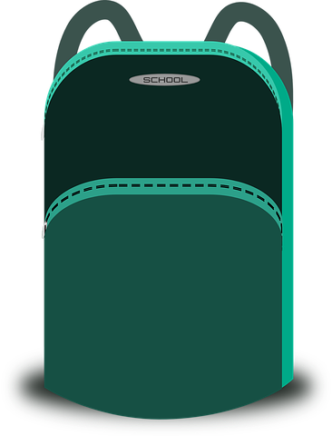
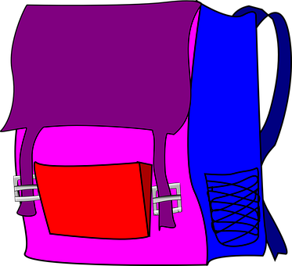
hablar
[6/7]
as
¿Cuánt____ mochilas hay?
Hay 5 mochilas.

Slide 14



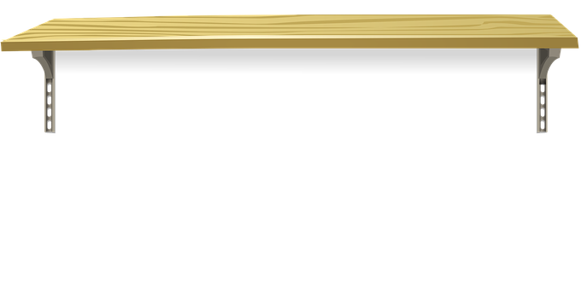
hablar
[7/7]
os
¿Cuánt____ cuadernos hay?
Hay 22 cuadernos.

Slide 15


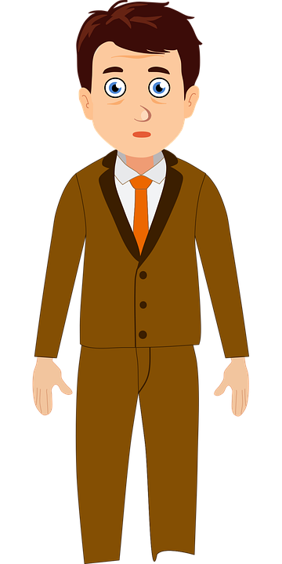
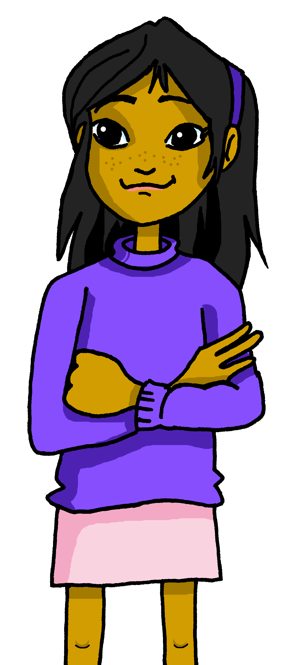
leer
El día de los deportes
Quique y Ángela son capaces.
Soy capaz.
Soy capaz.
Quique es capaz.
Ángela es capaz.
Notes:
Timing: 1 minute
Aim: to introduce ‘capaz’
Procedure:
Click to bring Quique and Sofía’s speech bubbles & elicit English meaning from students. Click x2 to bring the next two sentences & elicit meaning. This is a good opportunity to check whether they still remember “soy” & “es”.
Click to bring el señor Valero’s speech bubble & elicit meaning.
NB. We formally introduce the spelling change that occurs with adjectives that end in –z in the next slide.

Slide 16


leer
El día de los deportes
opinas = you think/ do you think
¿Qué opinas, Ángela?
¿Qué opinas de los deportes?
¿Qué opinas, Quique?
¡Son difíciles!
¡Son fáciles!
¡Es difícil!
¡Es fácil!
Notes:
Timing: 1 minute
Aim: to introduce ‘difícil’ and ‘fácil’
Procedure:
Click to bring up el señor Valero’s speech bubble & elicit meaning.
Click to bring up answers from Quique and Angela and check understanding.
Click to bring another question from Sr Valero –What do you think about sports? This is a good opportunity to check whether they still remember “soy” & “es”.
Click to bring up answers from Ángela first, then Quique.
NB. We formally introduce the spelling change that occurs with adjectives that end in –l in the next slide.

Slide 17


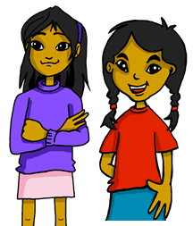

Number agreement on adjectives
Adjectives that end in –l, -s or -z can describe a female and male person, animal or noun.
When we describe more than one person, animal or any other noun, we add an –s if the adjective ends in –o, –a or –e.
When we describe more than one person, animal or noun and the adjective ends in –l or -s, we add –es.
Las botellas son esenciales.
The bottles are essential.
ending in -z
When the adjective (e.g., capaz) ends in –z, we change –z for –c and add –es.
Ángela y Sofía son capaces.
Ángela and Sofía are able.
Notes:
Timing: 2 minutes
Aim: to use the plural form of adjectives ending in consonant (-l, -s), including the spelling changes occurred in adjectives ending in –z.
Procedure:
Present the grammar explanation about adjective number agreement; text is animated to pace the delivery.
Elicit English translations for the Spanish examples provided.

Slide 18

leer
Lee. ¿Qué describe?
The answer might be both!
describe = (it) describes
 |  | adjetivo
Las camisetas | Los amigos | importantes
Los juegos | Las actividades | fáciles
Las fiestas | Los museos | divertidos
Quique y Rubén | Sofía y Ángela | fuertes
Los chicos | Las chicas | capaces
Los profesores | Las profesoras | lentas
Los libros | Las botellas | esenciales
Ej
1
2
3
4
5
6
Notes:
Timing: 5 minutes
Aim: to practise written comprehension of plural forms of adjectives that end in –o, –e and consonants.
Procedure:
Read the instructions in Spanish.
Read the adjective from the example (útiles) and the two possible options “las camisetas” & “los amigos”. Does it describe “las camisetas”, “los amigos” or could it be both? How do we know? It can be both because it ends in –es.
3. Students do 1-5 in their books.
4. Go through answers together.
describir [1272]

Slide 19


escuchar
Escucha y marca la opción correcta.
Escribe
add -s | adds -es
adjetivo
E
difíciles
1
fáciles
2
divertidos
Remember!
capaz also changes z→ c.
fuertes
3
capaces
4
5
importantes
esenciales
6
Notes:
Timing: 5 minutes
Aim: to practise aural comprehension of plural adjectives and knowledge of different rules of formation.
Procedure:
Read the instructions in Spanish. Click to bring up instruction for the challenge (escribe).
Do the example with them.
Pupils write 1-6 in their books.
Click to play items 1-6 and pupils write –s or –es.
Click to listen again and pupils transcribe the singular form of the adjective. (Note – they could transcribe first what they hear and then remove the ending).
4. Click to bring up answers. Elicit English meaning of each adjective when going through answers.
N.B Draw students’ attention to ‘fuertes’. It ends in –e so just adds –s for plural.
Transcript:
Ej. Son difíciles.
Son muy fáciles.
Son divertidos.
Son fuertes.
Son capaces.
Son importantes.
Son esenciales.

Slide 20



hablar
✍
Turno 1
Lee, escucha y escribe. .
Persona B
escribir
corrige = correct
1 Lee las frases a tu compañero/a.
En mi mochila hay cuatro pelotas. Son amarillas. Hay seis cuadernos. Son pequeños. También hay tres diccionarios. Son grandes. En mi mochila hay dos bolígrafos. Son azules.
Persona A
1 Corrige las diferencias:
En mi mochila hay dos pelotas. Son lentas. Hay seis camisetas. Son azules. También hay tres bolígrafos. Son útiles. En mi mochila hay dos botellas. Son esenciales.
Notes:
Timing: 5 minutes
Aim:
ii) to develop fluency in decoding by reading aloud
iii) to listen attentively, noting differences in the original text.
Procedure:
1. Divide the class in A & B before modelling the task.
2. Click through animations to model the task (Pupil B starts reading and pupil A starts writing)
3. Pupil B reads his/her text. 2 to their partner A
2. Pupil A follows along with the original and makes a note of any substituted words s/he hears (on his/her copy of the sheet – text 1)
3. Swap roles – Click to show “turno 2” and model further if necessary (A reads text to B, B makes annotation in their text)
4. Pupils draw what’s in the school bag based on the text 1.
corrige [2351]

Slide 21

hablar
✍
Turno 2
Lee, escucha y escribe. .
Persona A
escribir
corrige = correct
2 Lee las frases a tu compañero/a.
En mi mochila hay dos camisetas. Son amarillas. Hay cinco pelotas. Son grandes. También hay ocho cuadernos. Son divertidos. En mi mochila hay dos botellas. Son esenciales.
Persona B
2 Corrige las diferencias:
Persona A & B
En mi mochila hay dos botellas. Son azules. Hay cuatro pelotas. Son pequeñas. También hay cinco cuadernos. Son útiles. En mi mochila hay dos bolígrafos. Son esenciales.
3. Dibuja la bolsa.
Notes:
Timing: 5 minutes
Aim:
ii) to develop fluency in decoding by reading aloud
iii) to listen attentively, noting differences in the original text.
Procedure:
1. Divide the class in A & B before modelling the task.
2. Click through animations to model the task (Pupil B starts reading and pupil A starts writing)
3. Pupil B reads his/her text. 2 to their partner A
2. Pupil A follows along with the original and makes a note of any substituted words s/he hears (on his/her copy of the sheet – text 1)
3. Swap roles – Click to show “turno 2” and model further if necessary (A reads text to B, B makes annotation in their text)
4. Pupils draw what’s in the school bag based on the text 1.
corrige [2351]

Slide 22
¡adiós!
verde

Slide 23
to print
Persona A
Persona B
1 Corrige las diferencias:
1 Lee las frases a tu compañero/a.
|
|
|
|
|
|
|
|
|
|
|
|
|
|
En mi mochila hay cuatro pelotas. Son amarillas. Hay seis cuadernos. Son pequeños. También hay tres diccionarios. Son grandes. En mi mochila hay dos bolígrafos. Son azules.
En mi mochila hay dos pelotas. Son lentas. Hay seis camisetas. Son azules. También hay tres bolígrafos. Son útiles. En mi mochila hay dos botellas. Son esenciales.
2 Lee las frases a tu compañero/a.
2 Corrige las diferencias:
En mi mochila hay dos camisetas. Son amarillas. Hay cinco pelotas. Son grandes. También hay ocho cuadernos. Son divertidos. En mi mochila hay dos botellas. Son esenciales.
En mi mochila hay dos botellas. Son azules. Hay cuatro pelotas. Son pequeñas. También hay cinco cuadernos. Son útiles. En mi mochila hay dos bolígrafos. Son esenciales.

