Slide 1

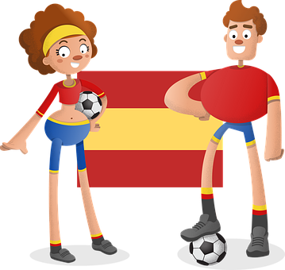



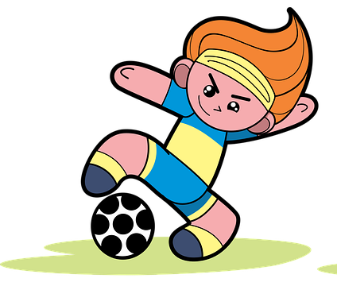
Describing me and others
verde
Follow ups 1-5
Notes:
Artwork by Steve Clarke. All additional pictures selected are available under a Creative Commons license, no attribution required.
The frequency rankings for words that occur in this PowerPoint which have been previously introduced in the resources are given in the SOW (excel document) and in the resources that first introduced and formally re-visited those words.
Phonics: Strong and weak vowels revisited: leer [209] aceite [2101] aire [401] boina [>5000] idea [247] oeste [2416] puente [1715] antiguo [446] feo [2373]
Vocabulary: hay [13] cuántos/cuántas [580] bolígrafo [>5000] camiseta [4130] cuaderno [3301] deporte [1489] mochila [>5000] capaz [645] difícil [374] esencial [1872] fácil [584]
Revisit 1: concierto [1456] cumpleaños [3372] fiesta [796] mes [288] enero [1173] febrero [1419] marzo [1231] abril [1064] mayo [909] junio [1035] julio [659] septiembre [1150] octubre [1242] noviembre [1434] diciembre [1165] cuándo [138] de [2] trece [2700] catorce [2411] quince[1215] dieciséis [3373] diecisiete [3400] dieciocho [2730] diecinueve [4232] veinte [819] veintiuno [819/425] veintidós | veintitrés | veinticuatro | veinticinco |veintiseis |veintisiete|veintiocho |veintinueve | treinta [830] treinta y uno [830/4/425]
Revisit 2:
For any other words that occur incidentally in this PowerPoint, frequency rankings will be provided in the notes field wherever possible.
Source: Davies, M. & Davies, K. (2018). A frequency dictionary of Spanish: Core vocabulary for learners (2nd ed.). Routledge: London

Slide 2








Follow up 1
[Strong & weak vowels]
✍
Strong vowels
A Escucha y escribe.
a e o
pronunciar
Weak vowel
u i
r_ _ na
_ _ re
Luis
Ec_ _dor
reina
aire
L_ _ s
Ecuador
B Colour in blue the words in which the vowels fall in separate syllables, and in green the words in which the vowels merge together.
v_ _rnes
viernes
pas_ _
C_ _ nca
paseo
Cuenca
p_ _sa
pausa
cac_ _
cacao
tar_ _
tarea
Ner_ _
Nerea
Ed_ _rdo
Eduardo
Bilb_ _
Bilbao
Practica con tu compañero/a.
Notes:
Timing: 5 minutes
Aim: to practise listening out for pairs of strong and weak vowels in words and to successfully transcribe them.
Part A
Students listen and write the strong + strong or strong + weak / weak + weak vowel combination.
Teacher reveals the answers for each word, one by one.
Part B
Students colour in blue the words in which vowels fall in separate syllables and green in the vowels merge together. Alternatively, they can circle them or underline them.
The teacher shows the answers.
Part C
Students practise pronouncing the words, reading each one aloud.
Transcript
Ecuador
Reina
Aire
Luis
Pausa
Paseo
Cuenca
Viernes
Cacao
Bilbao
Nerea
Eduardo
Tarea

Slide 3

Follow up 2:
C Escucha. Use the correct words to write the sentences. ¡Hay palabras extra!
A Escucha
escuchar
tres
‘there is / are’ is number ________.
hoy
lápices
en
hay
la
mesa
son
1
2
3
1
En la mesa hay lápices.
los
niñas
en
las
hay
fuertes
son
dos
‘they are’ is number ________.
2
Las niñas son fuertes.
1
2
3
D Escucha. Use the words to translate what you hear.
things
they are
bag
pens
B When we use ‘hay’, we need the preposition “en” before the place.
t-shirts
in
1
big
essential
there are
the
and
‘son’ is often followed by an adjective.
In the bag there are things and they are essential.
Notes:
Timing: 5 minutes
Aim: to practise aural comprehension of ‘son’ and ‘hay’ and revisit adjectives from week 2-7, connecting sound with meaning.
Procedure:
(Part A) Click to listen. Students write down the number that corresponds with ‘there is/are’ and ‘they are.
(Part B) Read the information on ‘hay’ and ‘son’.
(Part C). Students listen to 1-2 and write the sentences, selecting from the options given (there are additional words that are not needed).
(Part D) Students listen to 1 and use the words to translate what they hear.
Transcript:
Part A
es
son
Hay
-
está
son
ahora
Part C
En la mesa hay lápices
2. Las niñas son fuertes.
Part D
En la bolsa hay cosas y son esenciales.

Slide 4



Follow up 3:
Clasifica las palabras.
tranquilo
elegante
leer
divertido
imposible
feliz
difícil
negativo
increíble
curioso
pesado
capaz
- es
feliz
-o
-a
difícil
divertido
capaz
tranquilo
negativo
curioso
- s
imposible
pesado
elegante
increíble
-os
-as
Write down the plural form of
‘feliz’ & ‘capaz’.
felices
capaces
Notes:
Timing: 5 minutes
Aim: to recap adjective agreements
Procedure:
Teachers ask students to write the adjectives down in two columns depending on whether the ending will change ‘o/a/os/as’ or ‘es’. As an alternative, this exercise could be done orally.
Notes:
The shapes offer a visual representation of the possible endings. Elicit the responses from the students as to when to use the different endings and therefore which type of adjective will go in each box.

Slide 5

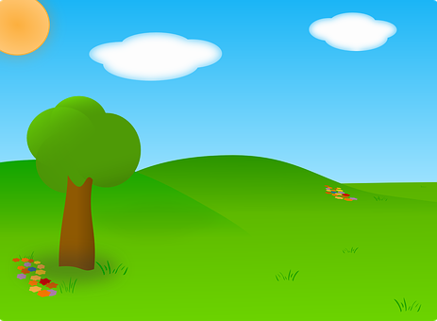
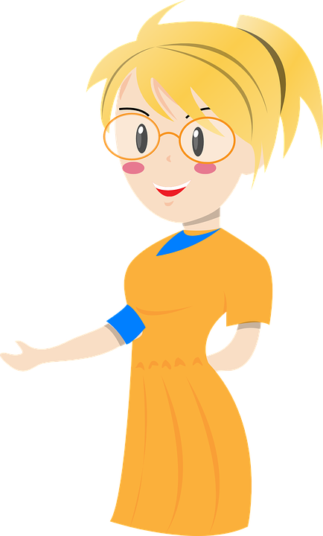
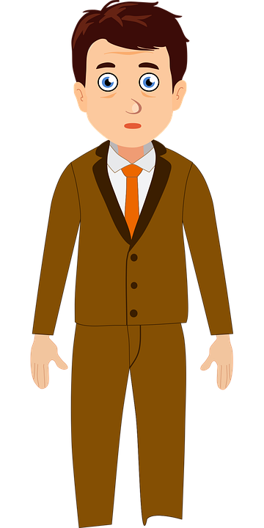

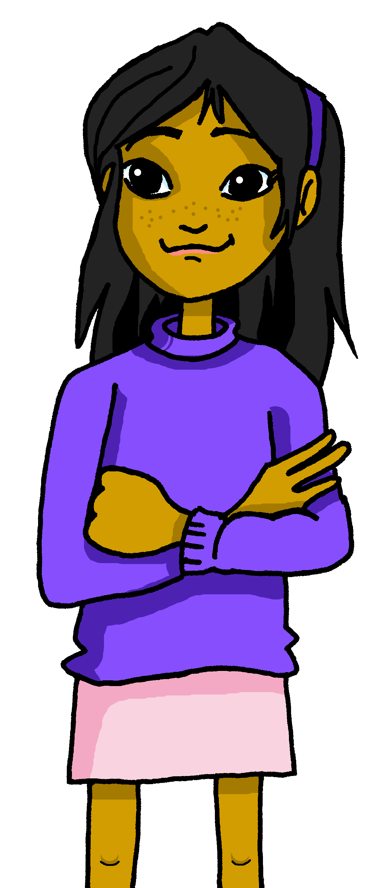












Follow up 4a:
¿Qué imagen es?
Escribe el adjetivo en inglés
Escucha y escribe el objeto.
1
2 camisetas
escuchar
A
yellow
B
2
able
2 niños
essential
3
3 botellas
4
5 pelotas
important
small
5
2 cuadernos
C
D
Notes:
Timing: 5 minutes [2 slides for 4a and 4b]
Aim: to practise aural comprehension of numbers, nouns and adjectives from this week in a longer context.
Procedure:
Read the instructions in Spanish.
Tell students they need to identify the photo that is going to be described. You might want to recap some of the key nouns introduced in the lesson (botella, camiseta, pelota, mochila, cuaderno) as well as “niños” & “profesores” and write the 5 objects mentioned.
Click on each number button to play each of the sentences.
Click to bring up answers.
Part 2
1. Pupils listen x1 and note down the adjective use to describe each item, in English.
2. Click to bring up instruction and ask pupils to identify the photo being described.
3. Click to make A, C and D disappear.
Transcript
Hay dos camisetas. Son amarillas.
Hay dos niños. Son capaces.
Hay tres botellas. Son esenciales.
Hay cinco pelotas. Son increíbles.
Hay dos cuadernos. Son pequeños.

Slide 6

Follow up 4b:
¿Qué imagen es?
Escribe el adjetivo en inglés
Escucha y escribe el objeto.
1
3 bolsas
white
escuchar
A
B
2
8 pelotas
incredible
3
2 personas
strong
4
4 cuadernos
yellow
4 botellas
healthy
5
C
D
Notes:
Timing: 5 minutes [2 slides]
Aim: to practise aural comprehension of numbers, nouns and adjectives from this week in a longer context.
Procedure:
Read the instructions in Spanish.
Tell students they need to identify the photo that is going to be described. You might want to recap some of the key nouns introduced in the lesson (botella, camiseta, pelota, mochila, cuaderno) as well as “niños” & “profesores” and write the 5 objects mentioned.
Click on each number button to play each of the sentences.
Click to bring up answers.
Part 2
1. Pupils listen x1 and note down the adjective use to describe each item, in English.
2. Click to bring up instruction and ask pupils to identify the photo being described.
3. Click to make B, C and D disappear.
Transcript
Hay tres bolsas. Son blancas.
Hay ocho pelotas. Son increíbles.
Hay dos personas. Son fuertes.
Hay cuatro cuadernos. Son amarillos.
Hay cuatro botellas. Son sanas.

Slide 7


Follow up 4:
Escribe frases.
Use ‘hay’, ‘son’ and the correct ending for the adjectives.
Choose A or B.
escribir
A
blue, important, strong, perfect
B
able, yellow, essential, easy
Hay 2 profesores.
Son fuertes.
Hay 2 niños.
Son capaces.
Hay 4 botellas.
Son importantes.
Hay 2 camisetas.
Son amarillas.
Hay 2 camisetas.
Son azules.
Hay 4 botellas.
Son esenciales.
Hay 6 pelotas.
Son perfectas.
Hay 6 pelotas.
Son fáciles.
Notes:
Timing: 5 minutes
Aim: written production ‘son’ and ‘hay and known adjectives, including the use of correct adjectival agreement.
Procedure:
Pupils select an altar picture (A or B) to describe.
They write two short sentences for each item, saying how many of it there are and what they are like, selecting one of the four adjectives each time.
Remind pupils to think about the form/spelling of the adjective and its connection to the noun.
Click to check answers.

Slide 8




Follow up 5a :
Escribe en inglés: Can you get at least 15 points?
 | tener lugar | típicas | acompañar
 | el lugar | la música | famosos
 | treinta y cinco | el concierto | la fiesta
 | trece | veintisiete | diecinueve
 | capaces | difíciles | ¿cuántas?
 | fácil | capaz | ¿cuántos?
to take place
typical (fpl)
to accompany
x3
(the) place
(the) music
famous (mpl)
35
(the) concert
(the) party
x2
13
27
19
able (m/fpl)
difficult (m/fpl
How many? (fpl)
x1
easy (m/f)
able (m/f)
How many? (mpl)
Notes:
Timing: 5 minutes
Aim: to practise written comprehension of vocabulary for this week and previous weeks.
Procedure:
1. Pupils need to write the English for as many words as possible, aiming to get at least 15 points (but more if possible).
2. Click for English answers.

Slide 9
Follow up 5b :
Escribe en español: Can you get at least 15 points?
 | typical (mpl) | (the) music | (the) place
 | to accompany | to take place | famous (fpl)
 | 13 | 18 | 21
 | (the) concert | (the) party | 31
 | difficult (mfpl) | easy (m/f) | how many? (mpl)
 | able (m/f) | able (mfpl) | how many? (fpl)
típicos
la música
el lugar
x3
acompañar
tener lugar
famosas
trece
dieciocho
veintiuno
x2
el concierto
la fiesta
treinta y uno
difíciles
fácil
¿Cuántos?
x1
capaz
capaces
¿Cuántas?
Notes:
Timing: 6 minutes
Aim: to practise written production of vocabulary for this week and previous weeks.
Procedure:
1. Pupils need to write the Spanish for as many words as possible, aiming to get at least 15 points (but more if possible).
2. Click for Spanish answers.

Slide 10
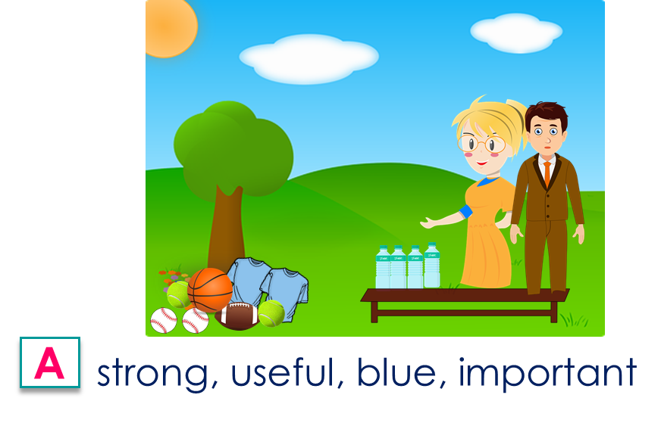
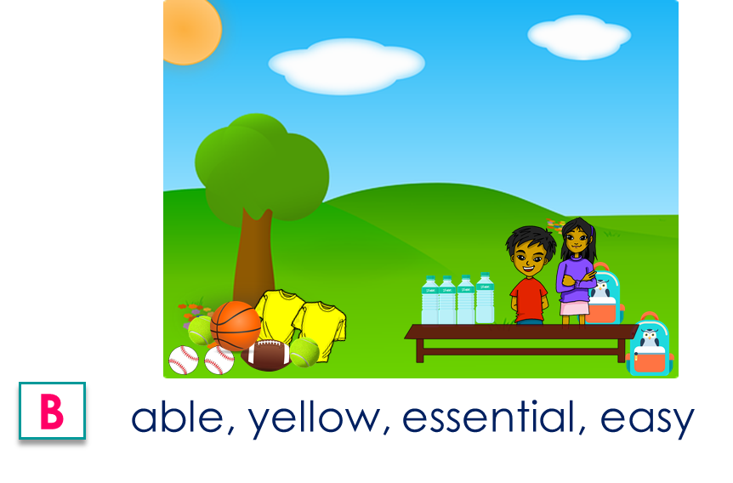


to print
1 Escribe frases. Use ‘hay’, ‘son’ and the correct ending for the adjectives.
1 Escribe frases. Use ‘hay’, ‘son’ and the correct ending for the adjectives.
|
|
|
|
|
|
|
|
|
|
|
|
|
|
1
2
3
4
1
2
3
4
2 Design and describe your own picture.
2 Design and describe your own picture.

Slide 11
Handout Follow up 5a
Escribe en inglés: Can you get at least 15 points?
Follow up 5a:
 | tener lugar | típicas | acompañar
 | el lugar | la música | famosos
 | treinta y cinco | el concierto | la fiesta
 | trece | veintisiete | diecinueve
 | capaces | difíciles | ¿cuántas?
 | fácil | capaz | ¿cuántos?
x3
x2
x1
Notes:
Handout Follow up 5a

Slide 12
Handout Follow up 5b :
Escribe en español: Can you get at least 15 points?
Follow up 5b:
 | typical (mpl) | (the) music | (the) place
 | to accompany | to take place | famous (fpl)
 | 13 | 18 | 21
 | (the) concert | (the) party | 31
 | difficult (mfpl) | easy (m/f) | how many? (mpl)
 | able (m/f) | able (mfpl) | how many? (fpl)
x3
x2
x1
Notes:
Handout Follow up 5b

