Slide 1
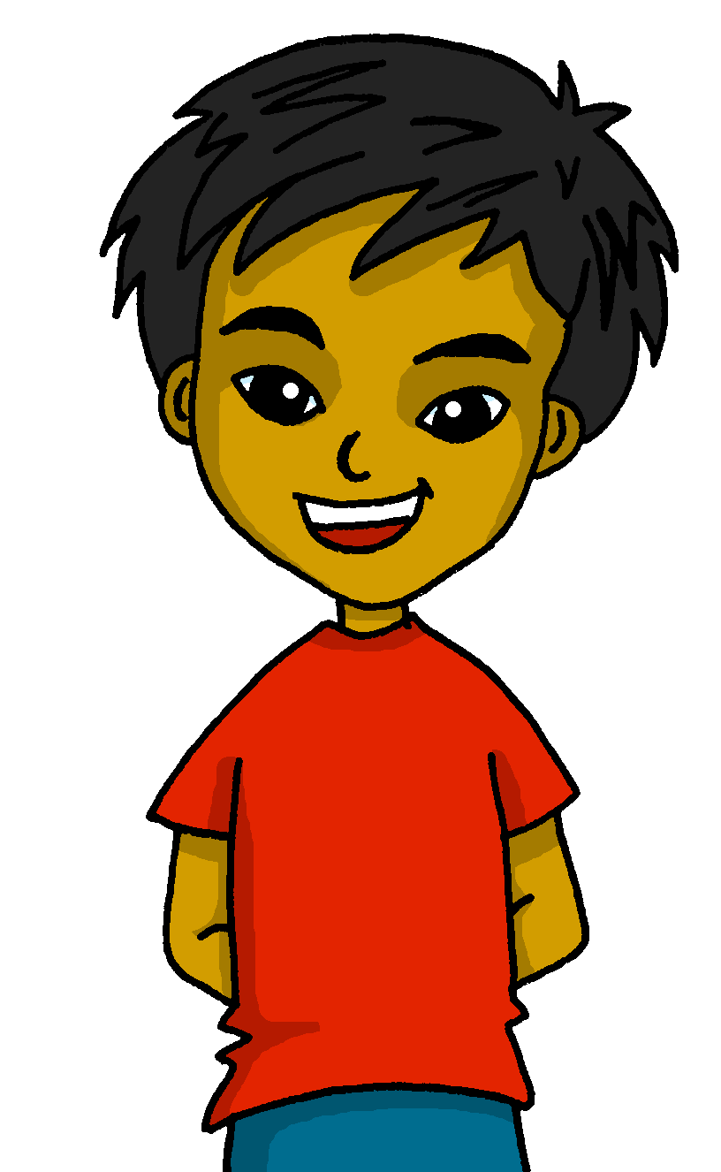
español, con Quique

Slide 2
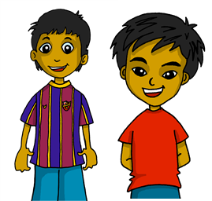
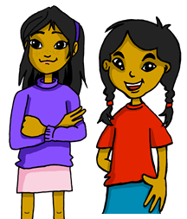
Describing me and others
- To be [permanent & temporary]: son / están
- SSC: Weak vowel [i]
verde
Notes:
Artwork by Steve Clarke. All additional pictures selected are available under a Creative Commons license, no attribution required.
The frequency rankings for words that occur in this PowerPoint which have been previously introduced in NCELP resources are given in the NCELP SOW and in the resources that first introduced and formally re-visited those words.
SSC: Weak vowel [i]: aceite [2101] aire [401] boina [>5000]
vocabulary: están [21] son [7] hoy [167] normalmente [1696] pero [30]
Revisit 1: somos [ser, 7] estamos [estar, 21] amable [2707] curioso [1811] enfermo [1092] imposible [1418] nervioso [1521] sano [1961]
Revisit 2: y [4] a menudo [958] en¹ [5] + months
For any other words that occur incidentally in this PowerPoint, frequency rankings will be provided in the notes field wherever possible.
Source: Davies, M. & Davies, K. (2018). A frequency dictionary of Spanish: Core vocabulary for learners (2nd ed.). Routledge: London

Slide 3
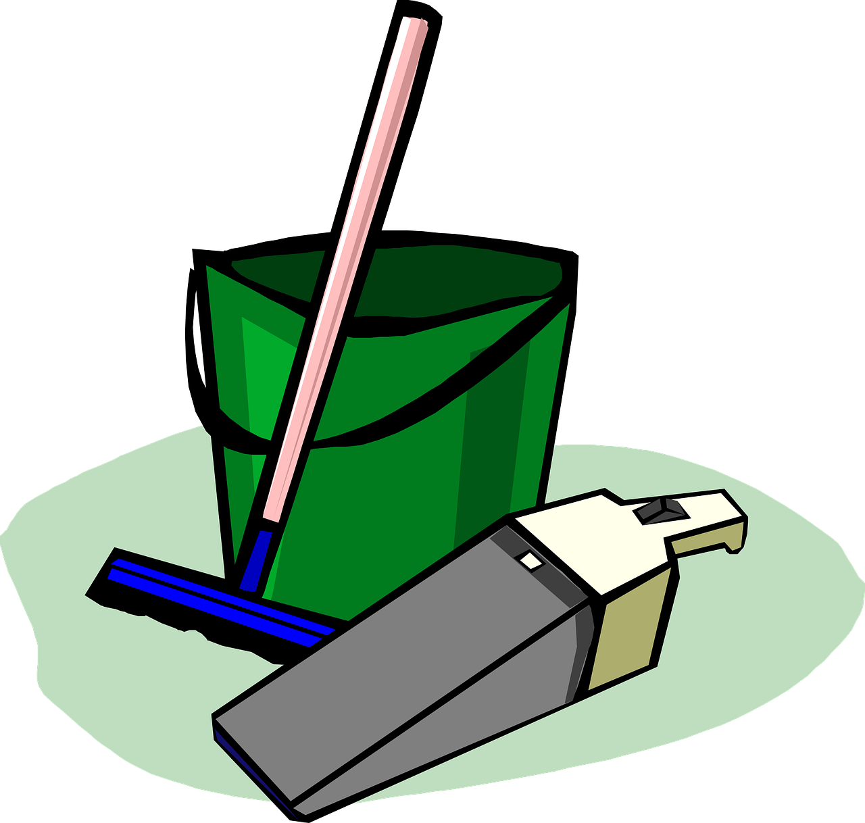
pronunciar
Weak vowel [i]
[u]
We know that the vowel ____ merges with [a], [e] and [o] to make a single syllable. This makes it a ‘weak’ vowel.
[i]
The same happens with _____.
a, e, o
a, e, o = strong vowels
Escucha unos ejemplos:
A
E
O
aceite
ciencia
I
U
aire
limpiar
i, u = weak vowels
boina
junio
Notes:
Timing: 2 minutes
Aim: to recap the ‘weak’ vowel [u] and introduce the ‘weak’ vowel [i], which attaches to a strong vowel to create a diphthong, where one vowel ‘glides’ into another.
Procedure:
Click through the animations to present the new information.
Teacher models pronunciation and/or plays audio.
Pupils say the six words in chorus.
Teacher clarifies meanings of the six words, as necessary.

Slide 4
son | están
ser
3rd person plural [they are]
In Spanish there are two verbs for ‘to be, being’
ser
estar
We use ser to describe
____________________
We use estar to describe ______________________ and __________.
permanent traits.
temporary states / moods
location
To say ‘they are’ with a permanent attribute, say ‘son’.
To say ‘they are’ with a location or to describe a temporary state, say ‘están’.
Notes:
Timing: 4 minutes (two slides)
Aim: to present the 3rd person plural of to be for estar (for location / mood / temporary states) and ser (permanent traits) building on pupils’ understanding of the different uses of ser and estar.
Procedure:
Click to present the information. Elicit answers from pupils. This will give you an idea of how confident they are with this.
Click to bring up the definition for “ser” and elicit the answer from pupils.
Click to bring up the statement for “estar” and elicit the different uses from pupils.
Click to introduce “son”
Click to introduce “están”.

Slide 5
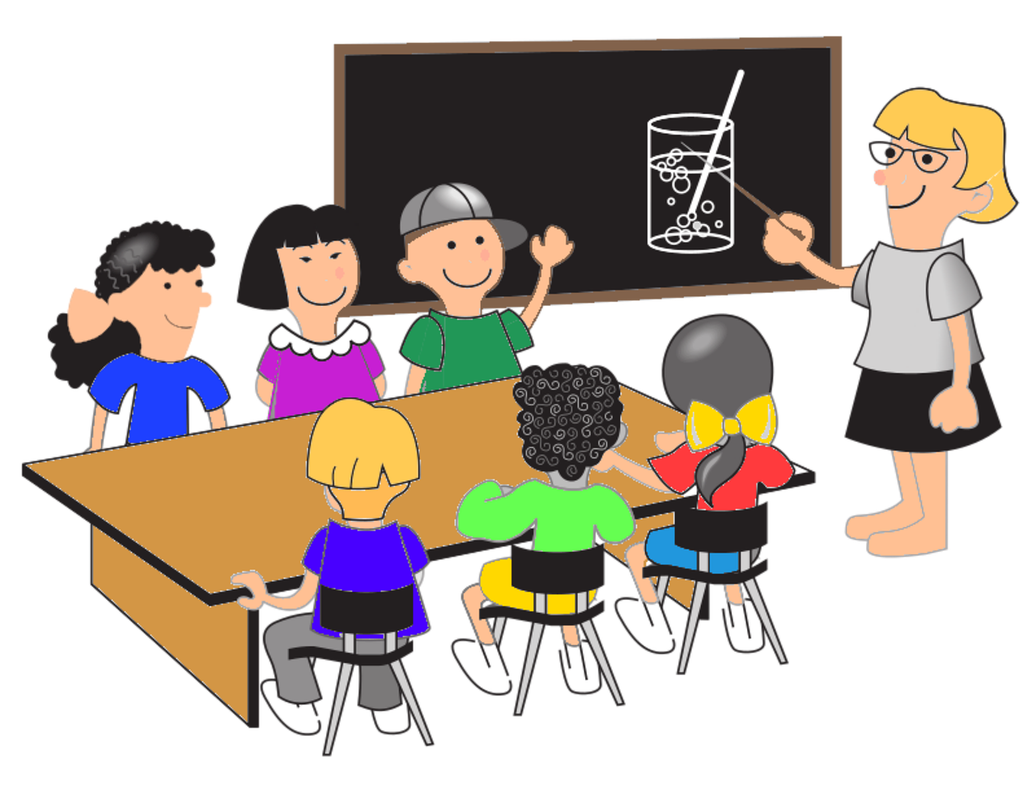
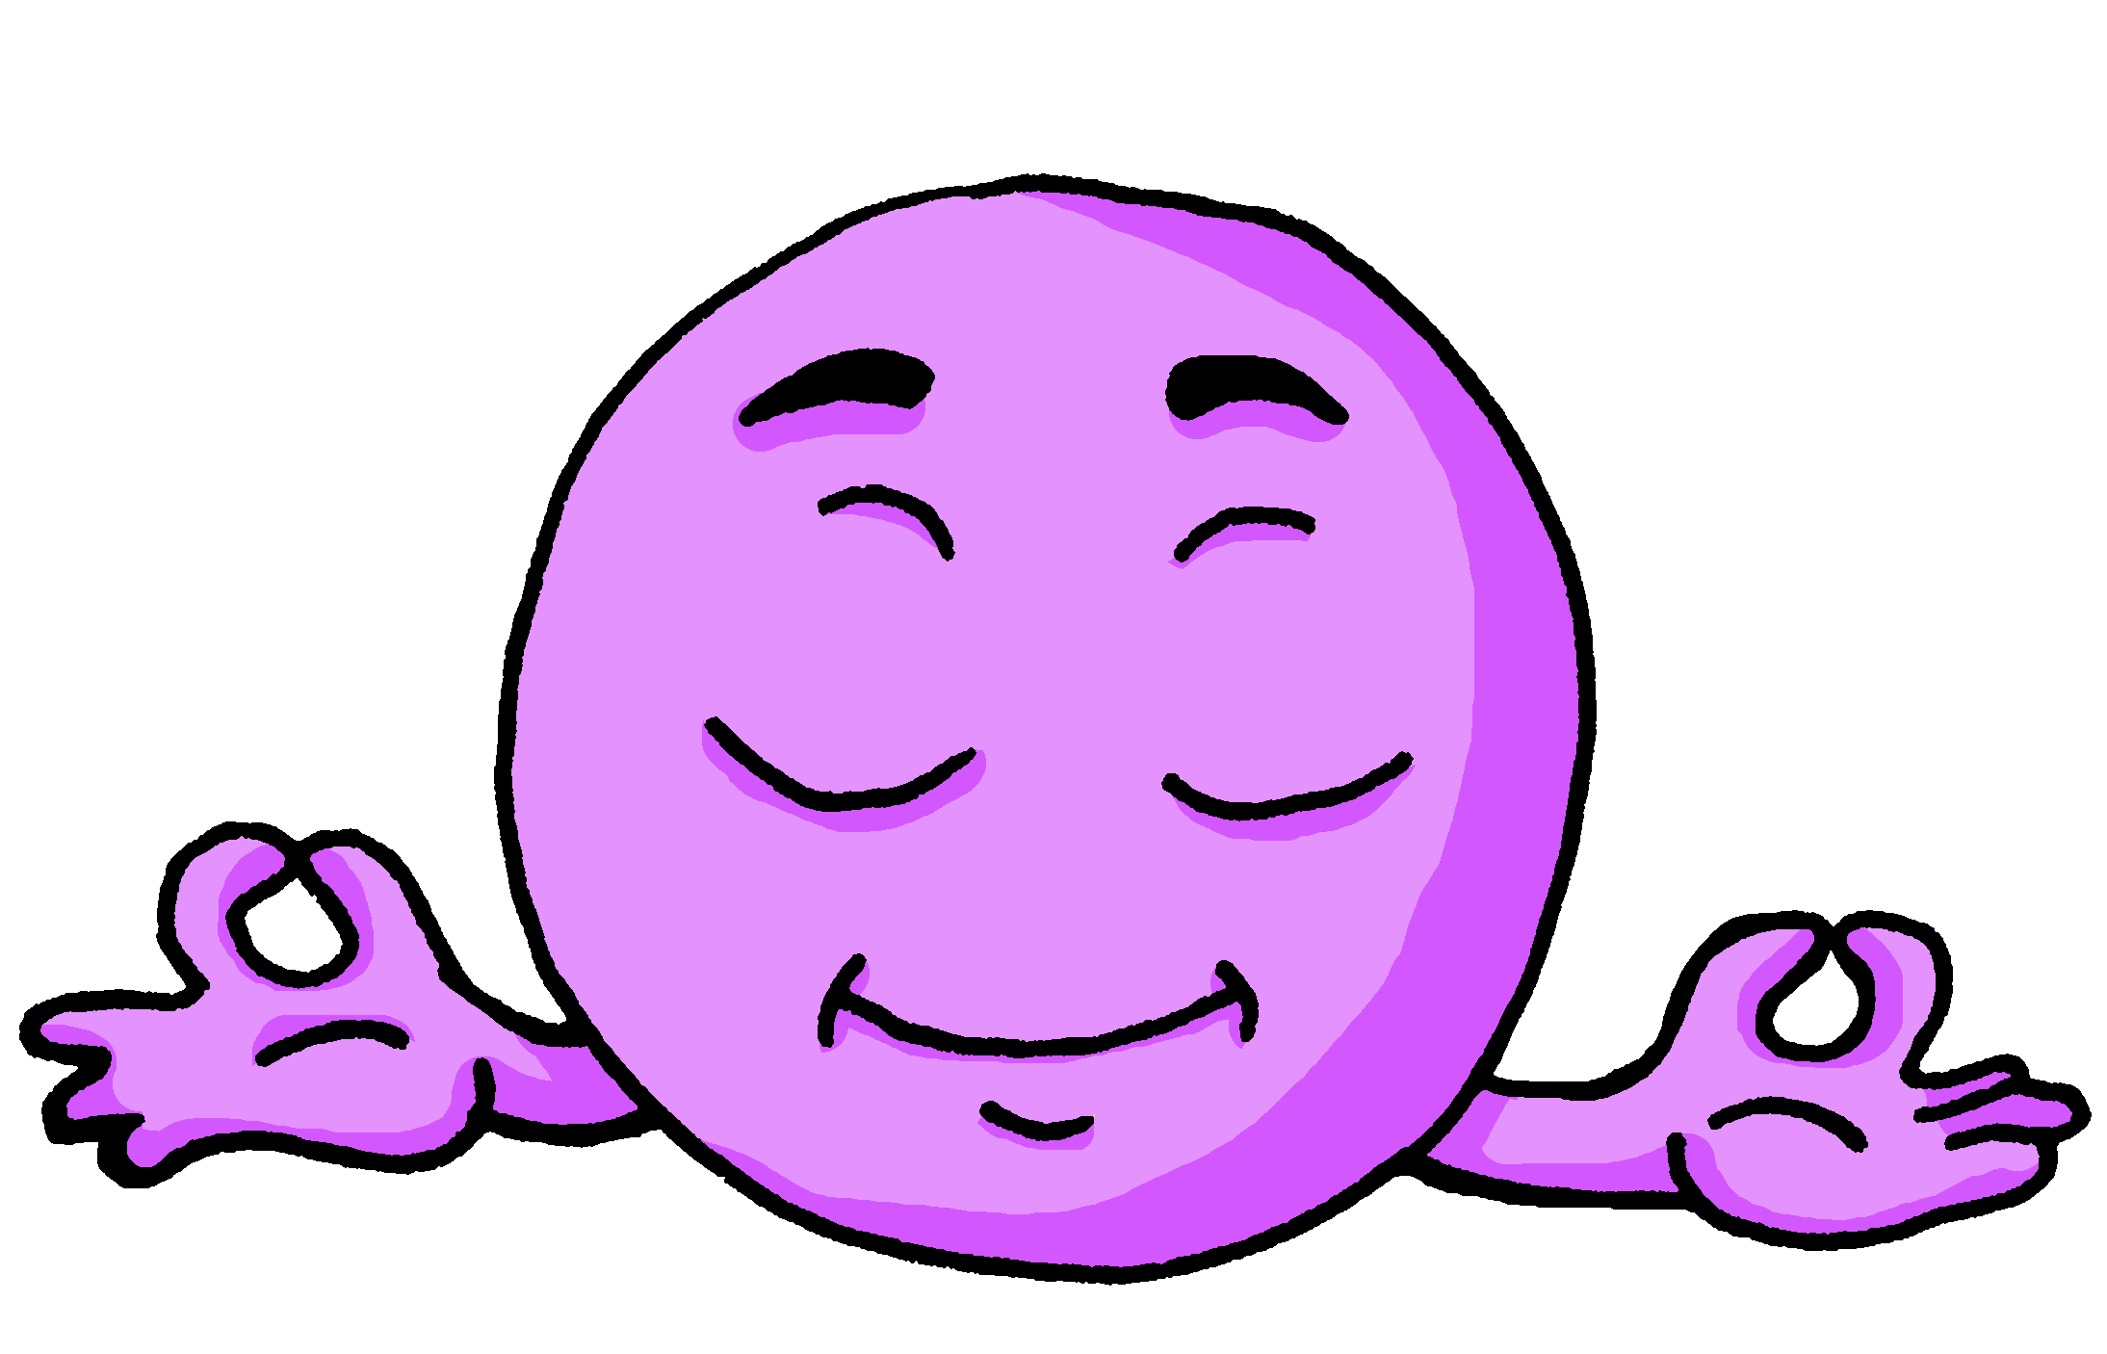
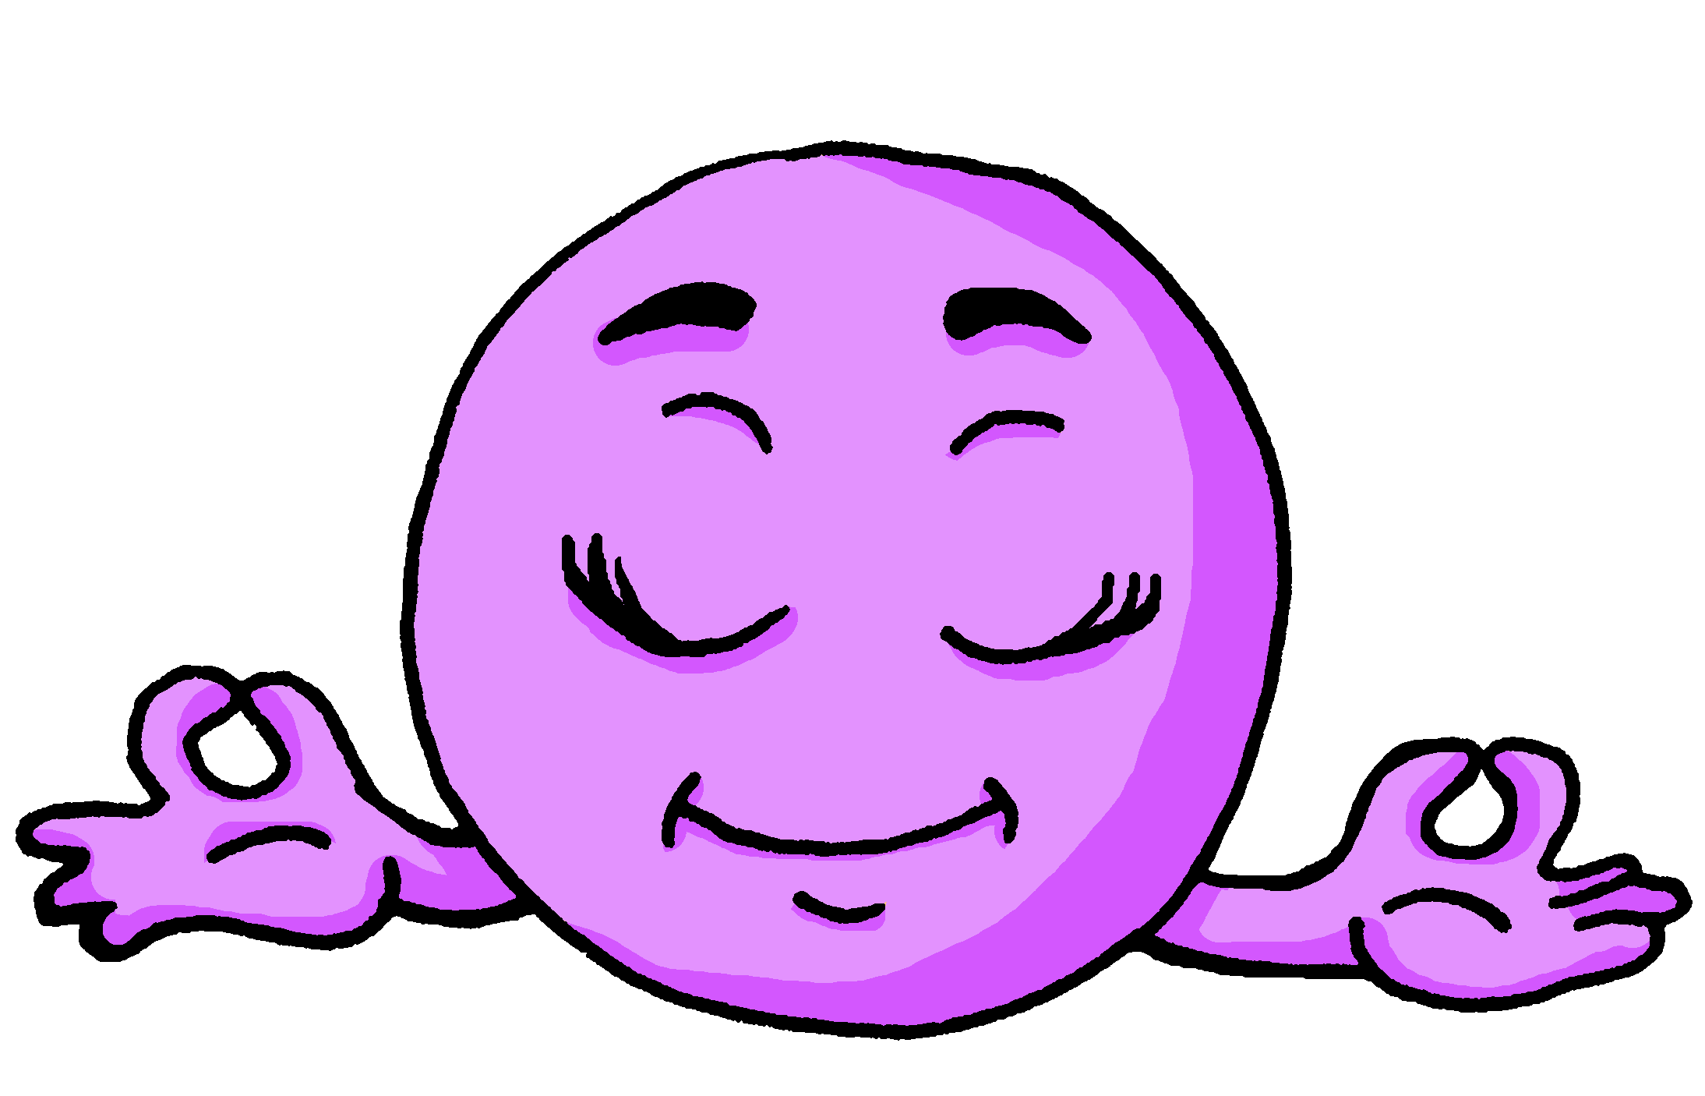
son | están
Compara:
Están en clase.
Son tranquilos.
They are in class.
They are calm.
location
permanent trait
⚠ They are calm in general.
Están tranquilos hoy.
They are calm today.
temporary state / mood
⚠ It’s not their natural state; they’re feeling calm today!
Notes:
[2/2]
Procedure: Read the examples out loud, eliciting English meaning (and correct use) from pupils.

Slide 6
escuchar
Escucha a Quique: ¿Cómo describe?
Escucha el verbo: ¿today / location or all the time?
Marca
 | today / location | all the time
EJ
1
2
3
4
5
extra info
E
important (to me)
1
in class
2
fast and also calm
3
(too) tired
4
nervous
5
(my) friends
Notes:
Timing: 6 minutes
Aim: to practise listening out for the verbs ‘son’ & ‘están’ and process the meaning of the two verbs.
Procedure:
1. Ask pupils to write 1-5 in their books.
2. Read the instruction in Spanish from the board.
3. Tell them that they will hear Quique talking about his friends. They need to identify they correct use of ‘to be’. Is it today or all the time?
4. Do the example with them. Elicit extra info if possible.
5. Do 1-5. The first time they listen they identify the correct use of ‘to be’. The second time, encourage students to write down any extra information.
Script
E. Son importantes para mí.
1. Están en clase.
2. Son rápidos y también tranquilos.
3. Están demasiado cansados.
4. Están nerviosos.
5. Son mis amigos.
Note: i) we omit temporal adverbs to avoid giving additional cues; pupils must focus on the verb form and connect it to its use/meaning. ii) each adjective could be used with either verb ser or estar.

Slide 7
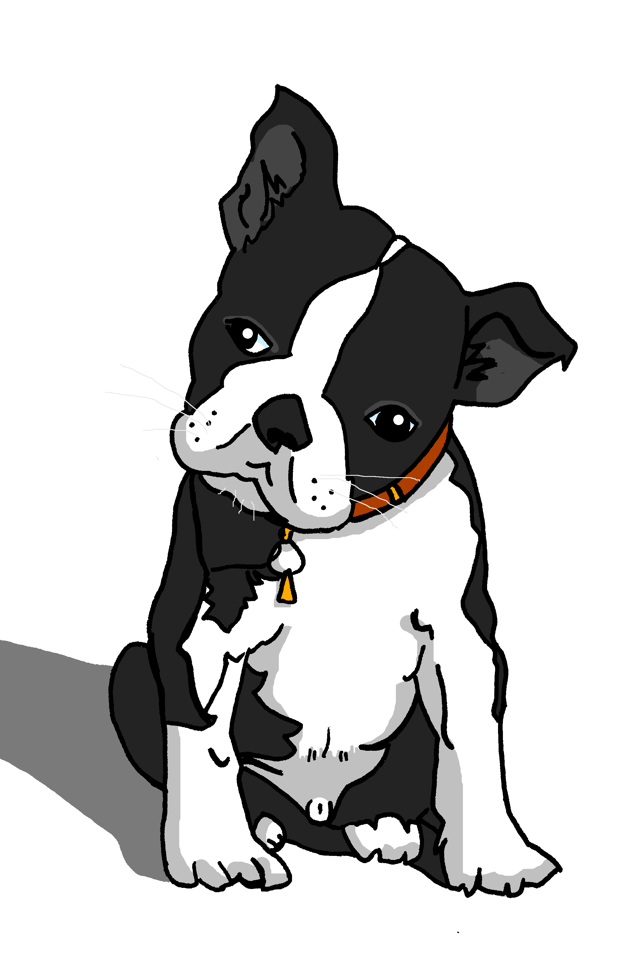
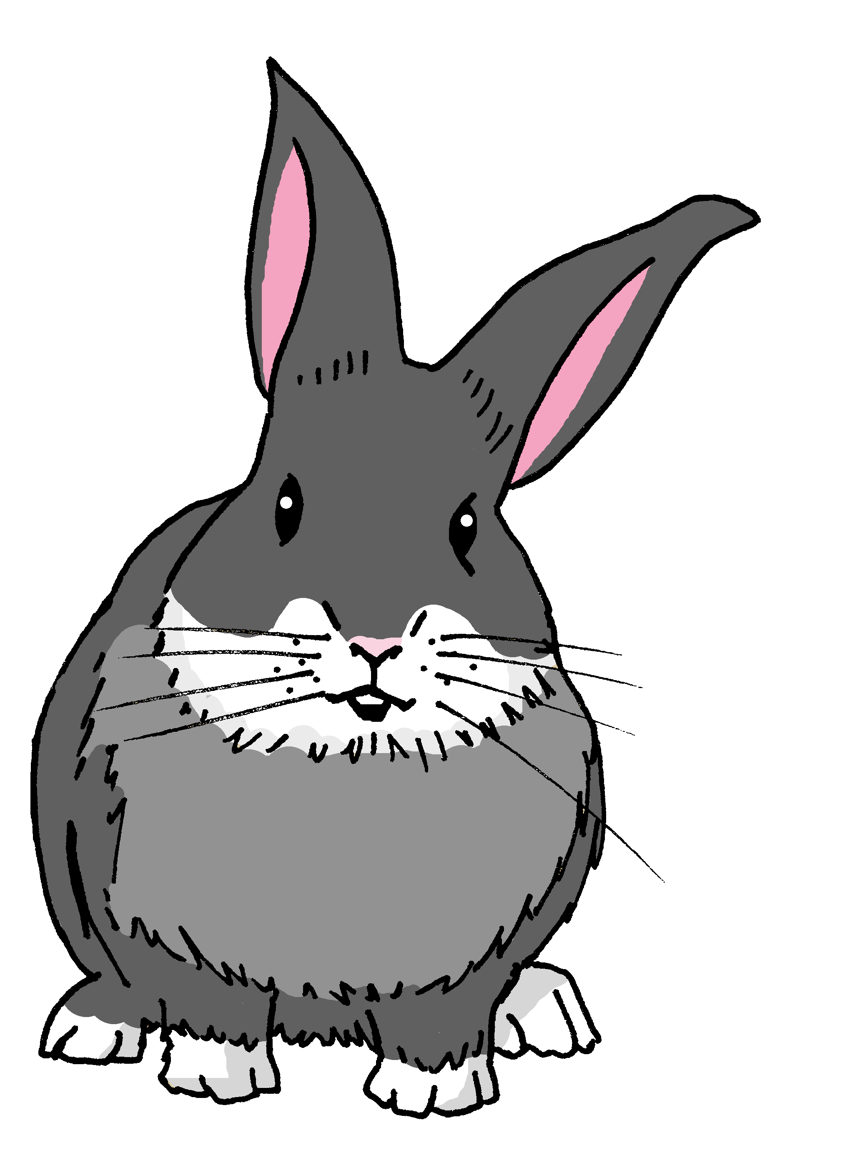
Gender & number agreement on adjectives
In Spanish, we already know that adjectives that end in ‘o’ change to an ‘___’ when the person or animal being described is female.
a
Santi está activo.
Manchita está activa.
When an adjective ends in –e, it can describe a female and male person or animal.
Santi es inteligente.
Manchita es inteligente.
Santi is intelligent.
Manchita is intelligent.
When we describe more than one person or animal, we add an___.
–s
Notes:
Timing: 2 minutes
Aim: to use the masculine and feminine plural form of regular adjectives ending in –o, -a and -e when describing people and animals.
Procedure:
Read the grammar explanation on gender and number agreement on adjectives
Elicit English translation for the Spanish examples provided.

Slide 8
leer
Lee: ¿Quién? Quique describe a sus amigos.
¡Ay ay ay! He’s spilled hot chocolate on it so we can’t see who he’s describing. Sofía & Eva or Rubén & Santi? or could it be either (los dos)?
Marca
Marca
¡extra!
Sofía & Eva | Rubén y Santi | los dos
always | today
Sofía y Eva están tranquilas.
inglés
Rubén y Santi son lentos.
Rubén y Santi están tristes.
calm
Sofía y Eva están cansadas.
slow
sad
Sofía y Eva son inteligentes.
tired
Rubén y Santi son amables.
intelligent
kind
Notes:
Timing: 10 minutes
Part 1
Aim: Topractise their understanding of regular adjectival agreement. Receptive practice of masculine and feminine plural form of regular adjectives ending in –o, -a and –e.
Procedure:
Read the task title in Spanish & click to trigger the English.
2. Click x3 to bring the table, Spanish instructions (marca) and challenge task (extra).
3. Ask students to tick the people each sentence refers to (Sofía & Eva, Rubén & Santi or ‘los dos’ = could be both because it ends in -e). Encourage them to write down the English meaning of the adjectives.
5. The answers are animated – click x2 to bring the adjective and the tick, then click again to reveal the name in the diary. Click one more time for the English translation.
Note: whilst it says ‘los dos’ for 3, 5, 6 we have assigned names to the diary. Ensure that pupils are clear that tristes, inteligentes and amables could apply to male or female persons.

Slide 9
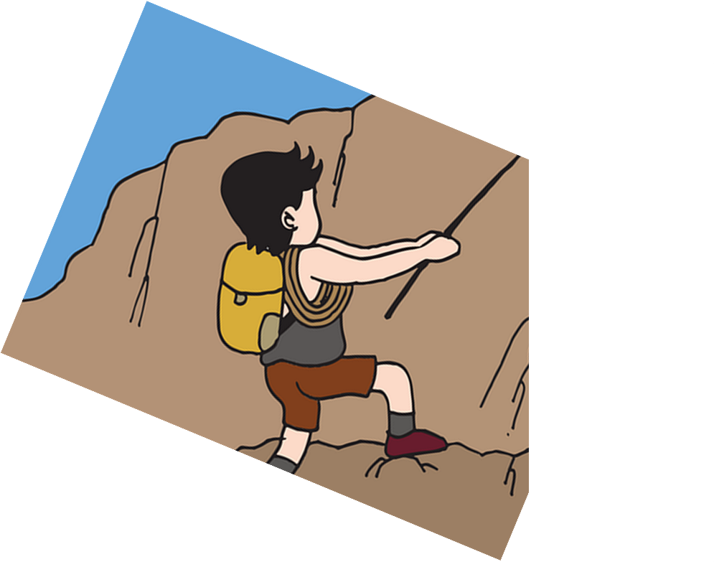
hablar
Traduce 🗣 [1/4]
They are my friends and they are positive.
positivos
negativo
positivas
5
están
estamos
son
4
y
pero
demasiado
también
3
mi familia
mis profesores
mi amigo
mis amigas
2
están
estamos
son
1
Notes:
Timing: 5 minutes
Aim: to use “son”, “están” and the correct masculine and feminine plural form of regular adjectives in guided oral production.
Procedure:
Tell pupils they need to use the words, starting from the bottom, to climb up the mountain (so that they translate the sentence!).
Ask pupils to work in pairs to practise first.
Click to trigger the timer (15 seconds per sentence).
Ask a volunteer from a pair to say the Spanish sentence out loud – next slide reveals the answer.
Repeat with the next 3 sentences (there are 4 in total).

Slide 10
hablar
Respuesta ✅
They are my friends and they are positive.
Son mis amigas y son positivas.
positivos
negativo
positivas
están
estamos
son
y
pero
demasiado
también
mi familia
mis profesores
mi amigo
mis amigas
están
estamos
son
Notes:
Note: Click on the speaking icon top right to hear the full sentences in Spanish.

Slide 11
hablar
Traduce 🗣 [2/4]
They are always ready on Tuesday.
jueves
martes
lunes
5
en
el
la
4
preparadas
amables
preparados
cansados
3
siempre
nunca
hoy
normalmente
2
están
estamos
son
1

Slide 12
hablar
Respuesta ✅
They are always ready on Tuesday.
Están siempre preparados el martes.
jueves
martes
lunes
en
el
la
preparadas
amables
preparados
cansados
siempre
nunca
hoy
normalmente
están
estamos
son
Notes:
Note: Click on the speaking icon top right to hear the full sentences in Spanish.

Slide 13
hablar
Traduce 🗣 [3/4]
Normally they are very kind but today they are too negative.
tristes
serios
negativos
negativas
demasiado
muy
un poco
son
somos
es
están
5
siempre
normalmente
hoy
4
pero
y
también
amable
amables
contentos
contentas
3
muy
un poco
demasiado
2
son
somos
es
están
siempre
normalmente
hoy
1

Slide 14
hablar
Respuesta ✅
Normalmente son muy amables pero hoy están demasiado negativas.
Normally they are very kind but today they are too negative.
tristes
serios
negativos
negativas
demasiado
muy
un poco
son
somos
es
están
siempre
normalmente
hoy
pero
y
también
amable
amables
contentos
contentas
muy
un poco
demasiado
son
somos
es
están
siempre
normalmente
hoy
Notes:
Note: Click on the speaking icon top right to hear the full sentences in Spanish.

Slide 15
hablar
Traduce 🗣 [4/4]
They are my friends and they are in class today.
siempre
hoy
lunes
septiembre
en casa
en clase
de casa
5
somos
estamos
son
están
4
y
pero
también
3
mis amigas
mis padres
mis amigos
mis hermanos
2
somos
estamos
son
están
1

Slide 16
hablar
Respuesta ✅
Son mis amigos y están en clase hoy.
They are my friends and they are in class today.
siempre
hoy
lunes
septiembre
en casa
en clase
de casa
somos
estamos
son
están
y
pero
también
mis amigas
mis padres
mis amigos
mis hermanos
somos
estamos
son
están
Notes:
Note: Click on the speaking icon top right to hear the full sentences in Spanish.

Slide 17
¡adiós!
verde

