Slide 1
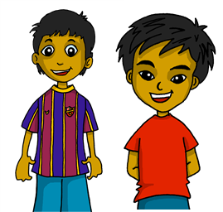
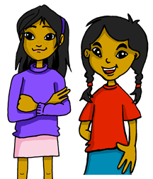
Describing me and others
verde
Follow ups 1-5
Notes:
Artwork by Steve Clarke. All additional pictures selected are available under a Creative Commons license, no attribution required.
The frequency rankings for words that occur in this PowerPoint which have been previously introduced in NCELP resources are given in the NCELP SOW and in the resources that first introduced and formally re-visited those words.
SSC: Weak vowel [i]: aceite [2101] aire [401] boina [>5000]
vocabulary: están [21] son [7] hoy [167] normalmente [1696] pero [30]
Revisit 1: somos [ser, 7] estamos [estar, 21] amable [2707] curioso [1811] enfermo [1092] imposible [1418] nervioso [1521] sano [1961]
Revisit 2: y [4] a menudo [958] en¹ [5] + months
For any other words that occur incidentally in this PowerPoint, frequency rankings will be provided in the notes field wherever possible.
Source: Davies, M. & Davies, K. (2018). A frequency dictionary of Spanish: Core vocabulary for learners (2nd ed.). Routledge: London

Slide 2
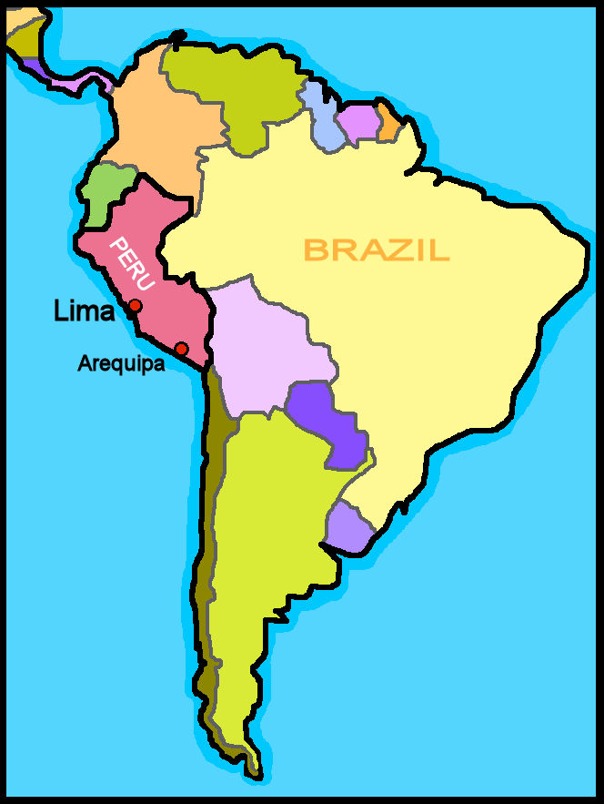
Follow up 1:
(el) país = country
Weak vowel [i]
A Practica en pareja.
B Clasifica las palabras.
Santiago de Compostela
En España
Ciudad de Méjico
Santiago de Compostela
Valencia
Valencia
Santiago de Chile
Oviedo
Oviedo
Murcia
Colombia
En Latinonamérica
Murcia
Ciudad de Méjico
Buenos Aires
Santiago de Chile
⚠ Remember [u] is also a weak vowel
Colombia
C ¿Cuál es el país*?
Buenos Aires
Notes:
Timing: 5 mins
Aim: to practise weak vowel [i]
Procedure:
Teacher reads the instruction and students work in pairs to pronounce the words.
Read the speech bubble to remind students about the other weak vowel [u]
Once students have practised pronouncing the words in pairs, get students to listen and repeat.
Click to bring Part B.
Encourage students to classify the places
Click to bring answers (one at a time).
Click to bring C and ask students to identify the country in the list [Colombia]

Slide 3
ser | estar
ser
[to be, being]
Remember that in Spanish there are two verbs for ‘to be, being’:
ser
estar
We use ser to describe
____________________
We use estar to describe _________________________ and __________.
permanent traits.
temporary states / moods
location
To say ‘we are’ for permanent traits, use __________.
To say ‘we are’ for location or state, use ___________.
somos
estamos
To say ‘they are’ for permanent traits, use _________.
To say ‘they are’ for location or state, use ___________.
son
están
Notes:
COMPLETE THIS SLIDE BEFORE FOLLOW UP 2.
Timing: 1 minute
Aim: to recap the 1st and 3rd person plural forms of estar (for mood / temporary state) and ser (permanent traits).
Procedure:
Click to present the explanation.
Elicit English and Spanish from pupils.

Slide 4
Follow up 2:
Escucha.
We or they? In general or today? Write the English adjective.
escuchar
 | we | they | in general | today | description?
 |  |  |  |  | positive
 |  |  |  |  | sad
 |  |  |  |  | sick, ill
 |  |  |  |  | annoying
 |  |  |  |  | pleased
 |  |  |  |  | funny
 |  |  |  |  | ready
E
1
2
3
4
5
6
Notes:
Timing: 5 minutes
Aim: to practise aural comprehension of 1st and 3rd person plural forms of ser and estar and revisited adjectives.
Procedure:
Complete the example with the class.
Pupils write 1-6 and the table headings.
Click to listen to each item.
Click to check answers.
Transcript:
EJ. Somos positivos. 1. Están tristes. 2. Estamos enfermos. 3.Son pesados. 4. Están contentas. 5. Somos divertidas.
6. Estamos preparados.

Slide 5
Follow up 3:
Combina las palabras y escribe frases.
 | A | B | C
1 | Los | en | hoy.
2 | Ángela está | es | son amables.
3 | El uniforme | amigos siempre | importantes.
4 | Quique y Rubén están | son | muy cómodo.
5 | Los amigos | seria | el parque.
leer
1.
2.
3.
4.
5.
Los amigos siempre son amables.
Ángela está seria hoy.
El uniforme es muy cómodo.
Rubén y Quique están en el parque.
Los amigos son importantes.
Notes:
Timing: 5 minutes
Aim: to practise written comprehension of vocabulary and structures from this week and revisited weeks.
Procedure:
Pupils write five sentences using one element from each column. (They should use all the options but only once).
Click to check answers.

Slide 6
Follow up 4:
Completa las frases con las palabras necesarias.
escribir
son
Mis amigos [are] siempre [intelligent] .
Mis hermanas [are] [ready] hoy.
Ángela y Sofía [are] en casa y [they are] [ill] .
Quique y Rubén [are] amigos y [they are] muy [creative] pero hoy [are] demasiado [negative] .
inteligentes
están
preparadas
están
están
enfermas.
son
son
creativos
están
negativos
Notes:
Timing: 5 minutes
Aim: to practise written production of the two translations of ‘they are’ and adjectives and their correct agreement.
Procedure:
Pupils write the missing words (or full sentences, as instructed).
Click for written answers.

Slide 7
Follow up 5a:
Escribe en inglés: Can you get at least 15 points?
 | then | a menudo | contestar
 | estudiar | la cocina | trabajar
 | somos | sanos | estamos
 | amables | enfermas | curiosa
 | están | hoy | siempre
 | pero | también | son
 | normalmente | y | demasiado
luego
often
to answer
x3
to study
(the) kitchen
to work, working
we are (trait)
healthy (mpl)
we are (state)
x2
nice, kind (mfpl)
ill, sick (mpl)
curious (f)
they are (state)
today
always
but
also
they are (trait)
x1
normally
and
too (much)
Notes:
Timing: 5 minutes
Aim: to practise written comprehension of vocabulary for this week and previous weeks.
Procedure:
1. Pupils need to write the English for as many words as possible, aiming to get at least 15 points (but more if possible).
2. Click for English answers.

Slide 8
Follow up 5b:
Escribe en español: Can you get at least 15 points?
 | to answer | to study | to work
 | often | then | (the) kitchen
 | we are (state) | nice, kind (mfpl) | ill (mpl)
 | we are (trait) | nervous (mpl) | healthy (fpl)
 | comfortable (m) | important (mfpl) | but
 | they are (state) | always | they are (trait)
 | too (much) | also | and
contestar
estudiar
trabajar
x3
a menudo
luego
la cocina
estamos
amables
enfermos
x2
somos
nerviosos
sanas
cómodo
importantes
pero
están
siempre
son
x1
demasiado
también
y
Notes:
Timing: 6 minutes
Aim: to practise written production of vocabulary for this week and previous weeks.
Procedure:
1. Pupils need to write the Spanish for as many words as possible, aiming to get at least 15 points (but more if possible).
2. Click for Spanish answers.

Slide 9
Handout follow up 5a
Follow up 5a:
Escribe en inglés: Can you get at least 15 points?
 | then | a menudo | contestar
 | estudiar | la cocina | trabajar
 | somos | sanos | estamos
 | amables | enfermas | curiosa
 | están | hoy | siempre
 | pero | también | son
 | normalmente | y | demasiado
x3
x2
x1
Notes:
Timing: 5 minutes
Aim: to practise written comprehension of vocabulary for this week and previous weeks.
Procedure:
1. Pupils need to write the English for as many words as possible, aiming to get at least 15 points (but more if possible).
2. Click for English answers.

Slide 10
Handout follow up 5b
Follow up 5b:
Escribe en inglés: Can you get at least 15 points?
 | to answer | to study | to work
 | often | then | (the) kitchen
 | we are (state) | nice, kind (mfpl) | ill (mpl)
 | we are (trait) | nervous (mpl) | healthy (fpl)
 | comfortable (m) | important (mfpl) | but
 | they are (state) | always | they are (trait)
 | too (much) | also | and
x3
x2
x1
Notes:
Timing: 6 minutes
Aim: to practise written production of vocabulary for this week and previous weeks.
Procedure:
1. Pupils need to write the Spanish for as many words as possible, aiming to get at least 15 points (but more if possible).
2. Click for Spanish answers.

