Slide 1


español, con Quique

Slide 2


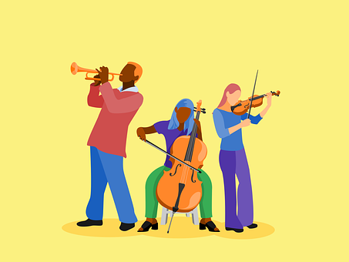

Describing me and others
verde
- “It is”: es + dates
- SSC: Strong vowels
Notes:
Artwork by Steve Clarke. All additional pictures selected are available under a Creative Commons license, no attribution required.
The frequency rankings for words that occur in this PowerPoint which have been previously introduced in NCELP resources are given in the NCELP SOW and in the resources that first introduced and formally re-visited those words.
Phonics: idea [247] oeste [2416] leer [209] feo [2373]
Vocabulary: concierto [1456] fiesta [796] mes [288] enero [1173] febrero [1419] marzo [1231] abril [1064] mayo [909] junio [1035] julio [659] septiembre [1150] octubre [1242] noviembre [1434] diciembre [1165] cuándo [138] de [2] trece [2700] catorce [2411] quince[1215] dieciséis [3373] diecisiete [3400] dieciocho [2730] diecinueve [4232] veinte [819] veintiuno [819/425] veintidós | veintitrés | veinticuatro | veinticinco |veintiseis |veintisiete|veintiocho |veintinueve | treinta [830] treinta y uno [830/4/425]
Revisit 1: estar [21] estoy [21] estás [21] ser [7] soy [7] eres [7] quién [289] amigo(a) [210] profesor(a) [501] contento [1949] divertido [2465] elegante [2742] enfermo [1092] increíble [1642] inteligente [2167] lento [1569] perfecto [1115] pesado [2166] preparado [2092] rápido [870] serio [856] triste [1370] ¡Buenos días! [103/65] ¡Buenas tardes! [103/392] hola [1245]
Revisit 2: calor [1852] frío [1307] miedo [755] sueño [460]
For any other words that occur incidentally in this PowerPoint, frequency rankings will be provided in the notes field wherever possible.
Source: Davies, M. & Davies, K. (2018). A frequency dictionary of Spanish: Core vocabulary for learners (2nd ed.). Routledge: London

Slide 3

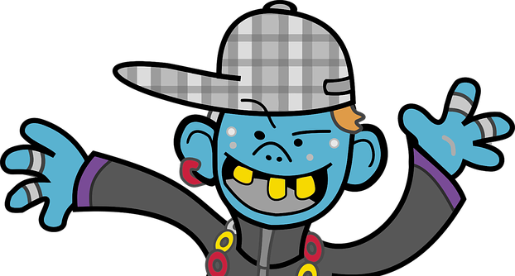





pronunciar
Strong vowels [a] [e] [o]
When they appear next to each other, the Spanish vowels [a], [e] and [o] are pronounced separately.
This is why we call them ‘strong’ vowels!
a, e, o
feo
Escucha unos ejemplos:
leer
⚠ Spanish vowels are usually short and open!
oeste
idea
Notes:
Timing: 2 minutes
Aim: to introduce the idea of ‘strong’ vowels and their pronunciation. Generally, Spanish vowels are very much more ‘open-mouthed’ than English vowels. The word ‘i-de-a’ is a good example for this as you get a very physically obvious dropping down of the jaw as you pronounce through the word.
Procedure:
Teacher clicks through animations to present the new information.
Teacher models pronunciation and/or plays audio.
Pupils say the four words in chorus, opening their mouth fully and pronouncing the strong vowels separately.
Transcript:
feo
leer
oeste
idea

Slide 4




Los números 13-15
Spanish numbers 13 – 15 are as follows:
trece
thirteen
catorce
fourteen
quince
fifteen
Notes:
Time: 3 minutes (two slides)
Aim: to present the key knowledge needed for the formation of numbers 13 - 19.
Procedure:
1. Teachers present the new information. It is animated to allow for a paced, interactive delivery.
2. Elicit the Spanish for numbers 13 – 15 again. Audio has been added to these numbers (digits) to allow for listen and check.
Transcript:
trece
catorce
quince

Slide 5




Los números 16-19
Spanish numbers 16-19 follow a clear pattern.
Use the combination “dieci“ + the number (6, 7, 8, 9).
16 = dieci + seis (which contracts to one word as “dieciséis”).
17 →
dieci + siete
diecisiete
18 →
dieci + ocho
dieciocho
⚠ Remember, if the final syllable is stressed and the word ends in a vowel or ‘n’ or ‘s’, there is an accent on the final vowel.
dieci + nueve
diecinueve
19 →
Notes:
Procedure:
1. Teachers present the new information. It is animated to allow for a paced, interactive delivery.
2. Elicit the Spanish for numbers 16 - 19. Audio has been added to these numbers to allow for listen and check.
Note: Speech bubble reminds pupils about rules for accents (we add an accent on the last syllable when it is stressed and the word ends in –n, -s or vowel).
Transcript:
dieciséis
diecisiete
dieciocho
diecinueve

Slide 6











escuchar
¿Qué número es?
Escucha y escribe el número y la palabra.
escuchar
E
13
trece
5
18
dieciocho
1
10
diez
6
14
catorce
2
12
doce
7
19
diecinueve
3
16
dieciséis
8
11
once
4
15
quince
9
17
diecisiete
Notes:
Time: 5 minutes
Aim: to practise understanding and transcribing cardinal numbers (10 -19)
Procedure:
1. Do the example with pupils. Click E to list. Pupils write the number in digits and letters. Click to check the answer.
2. Complete items 1-9, then click to check.
3. In feedback, teachers can ask for the number in Spanish. This has been included in the answers to provide pupils with support when giving the number.
Transcript:
Ej. trece
1. diez
2. doce
3. dieciséis
4. quince
5. dieciocho
6. catorce
7. diecinueve
8. once
9. diecisiete

Slide 7
Los números 21- 31
The numbers from 21 to 29 use a combination of veinti- and a number from 1-9, all in one word.
veinticinco
veintitrés
25 →
veintiuno
23 →
21 →
veinticuatro
veintiséis
veintidós
24 →
22 →
26 →
⚠ Remember, if the final syllable is stressed and the word ends in a vowel or ‘n’ or ‘s’, there is an accent on the final vowel.
For numbers from 31 to 39, use treinta + y + a number from 1-9, in three separate words.
32 →
treinta y dos
treinta y tres
treinta y uno
33 →
31 →
Notes:
Time: 3 minutes
Aim: to present the key knowledge needed for the formation of numbers 20-31.
Procedure:
1. Teachers present the new information. It is animated to allow for a paced, interactive delivery.
2. Elicit the Spanish for numbers 21- 26.
3. Explain the rule for 31 to 39 and how this differs from twenties.
Notes:
i) the rule for 31 + is explained but pupils will only be expected to understand and produce 31.
ii) Speech bubble reminds pupils about rules for accents (we add an accent on the last syllable when it is stressed and the word ends in –n, -s or vowel).

Slide 8










escuchar
¿Qué número es?
Persona A: Lee el número.
Persona B: Lee el número.
pronunciar
escuchar
Persona B:
Persona A:
Escucha y escribe el número.
1
veinticinco
25
6
veintidós
22
2
treinta y uno
31
7
treinta
30
3
veintinueve
29
8
veinticuatro
24
4
veintiséis
26
9
veintisiete
27
5
veintiocho
28
10
veintitrés
23
Notes:
Time: 5 minutes
Aim: to practise reading aloud, understanding and transcribing cardinal numbers (22 -31).
Procedure:
1. Explain the task to pupils, using the Spanish instructions.
2. Pupil B turns away from the board with a pen and something to write on. They will just write the digits this time.
3. Click to bring up the first set of numbers. Pupil A reads the numbers slowly and carefully, one by one, repeating as necessary.
4. Pupil B writes down the 5 numbers, then turns back to face the board.
5. Teacher elicits numbers in Spanish from pupils chorally for additional read aloud practice, and click to reveal the number answers.
6. Pupils swap roles.
7. Repeat steps 2 – 5 with the 2nd set of numbers.
8. If required, teachers can click the number buttons to hear the numbers said by a native speaker.
Transcript:
Veinticinco
treinta y uno
Veintinueve
Veintiséis
Veintiocho
Veintidós
Treinta
Veinticuatro
Veintisiete
veintitrés

Slide 9
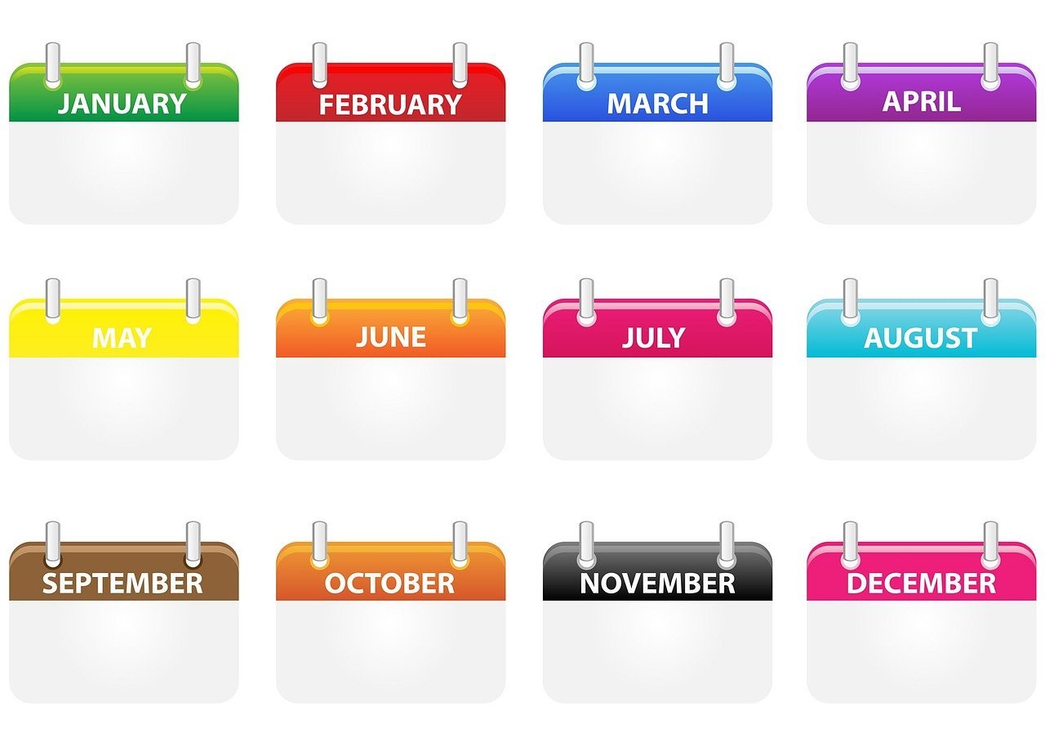
Los meses del año
hablar
enero
febrero
marzo
abril
12
mayo
S
junio
julio
agosto
septiembre
octubre
noviembre
diciembre
0
INICIO
Notes:
Time: 5 minutes (two slides)
Aim: to revisit months of the year.
Procedure:
1. In pairs and alternating, pupils need to say the months in chronological order as quickly as possible and before the 12 seconds elapse.
2. They should have 2-3 attempts, to improve their spoken performance each time.
3. Pupil A then secretly selects 3 months (making a note that s/he can show his partner). Pupil B needs to try to say his/her partner’s 3 months correctly, within the 12 second time limit. S/he will need to say as many months as s/he can, but will naturally opt to say them out of order to try to match his/her partner’s choices.
4. Pupils then swap roles to play again.
5. Click on the words to hear them spoken by a native speaker, if desired.

Slide 10





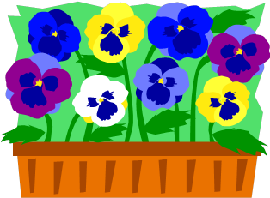
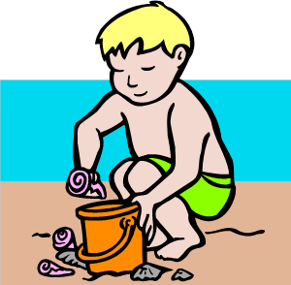






Los meses del año
escribir
60
e _ _ r _
_ e _ r _ r o
m _ r _ o
_ _ r _ l
_ a _ o
e n e r o
f e b r e r o
m a r z o
a b r i l
m a y o
S
j u n i o
_ _ l _o
a _ _ s t _
_ _ n _ o
j u l i o
a g o s t o
_ _ p t _ e m b _ _
s e p t i e m b r e
0
o c t u b r e
n o v i e m b r e
d i c i e m b r e
o _ t _ b _ _
_ o _ _ e m b _ _
d _ c _ _ m b r e
INICIO
Notes:
Aim: to revisit months of the year.
Procedure:
1. Pupils need to write the months in order, filling in the missing letters, within the 60 second time limit.
2. Teacher starts the timer.
3. Click to show the full words for pupils to check their answers.

Slide 11
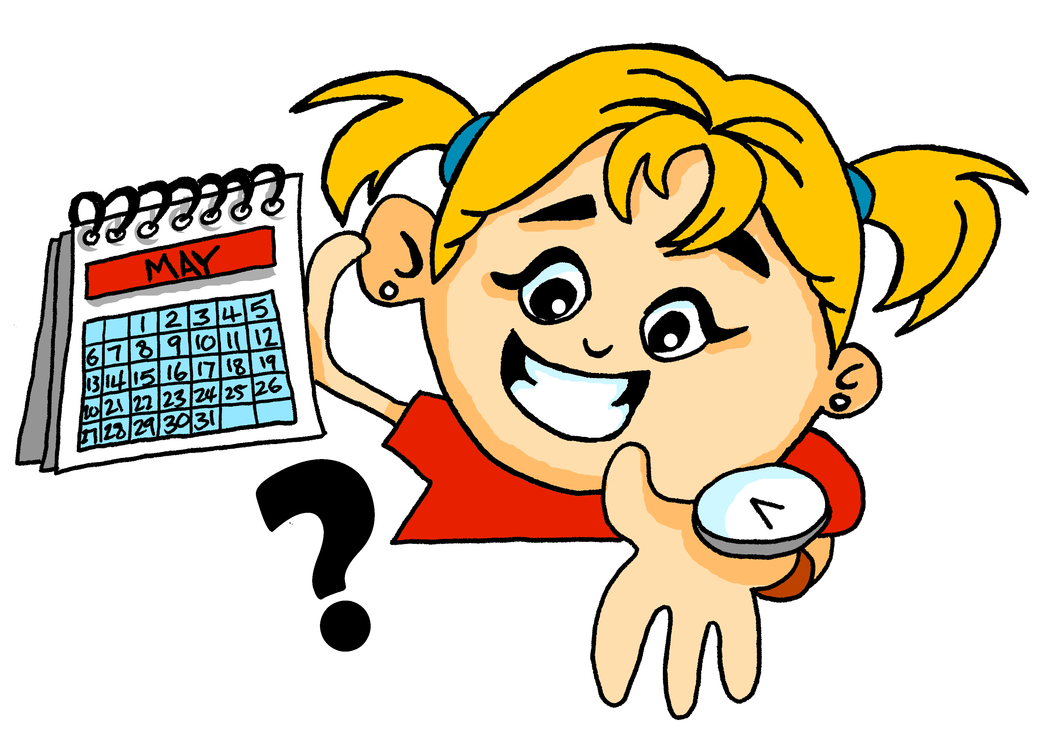

pronunciar
¿Cuándo?
when?
¿Cuándo es el concierto?
[When is the concert?]
¿Cuándo es la fiesta?
[When is the party?]
Rachel Hawkes / Emma Marsden
Notes:
Timing: 1 minute
Aim: To revisit question word ¿cuándo?
Procedure:
Pupils listen and repeat the key question word (include gesture if possible)
Display the word & get them to repeat one more time
Elicit English meaning
Reveal the sentence & elicit English translation from students
Gesture: turn to look at left wrist where a watch might be worn and tap it twice, in time with the two syllables of cuán-do.

Slide 12






escuchar
Un anuncio en la radio
Escucha y escribe: ¿Cuándo es el concierto?
escuchar
Maná
Serrat
Juanes
To talk about dates, use the cardinal number i.e 21 rather than 21st.
el 17 de diciembre
el 24 de marzo
el 19 de octubre
____
____
____
Rosalía
Camilo
el 30 de julio
el 22 de agosto
____
____
Estopa
Amaral
el 28 de febrero
el 16 de mayo
____
____
Notes:
Time: 6 minutes
Aim: To practise understanding cardinal numbers in dates.
Procedure:
1. Students listen to the date given for each concert, and write down the number.
Click on the balloons to hear the audio..
2. In feedback, teachers can ask: “Qué concierto es el X de X?”’ to elicit the names from students, and allow them another opportunity to hear and understand the dates one more time.
Note: these are bands and singer from the Hispanic world.
Transcript:
[Maná] El concierto de Maná es el 17 de diciembre
[Serrat] El concierto de Serrat es el 24 de marzo
[Juanes] El concierto de Juanes es el 19 de octubre
[Rosalía] El concierto de Rosalía es el 30 de julio
[Camilo] El concierto de Camilo es el 22 de agosto
[Estopa] El concierto de Estopa es el 28 de febrero
[Amaral] El concierto de Amaral es el 16 de mayo

Slide 13
¡adiós!
verde

