Slide 1
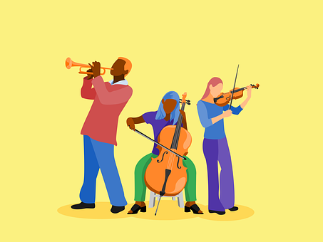
Saying what I and others have
verde
Follow ups 1-5
Notes:
Artwork by Steve Clarke. All additional pictures selected are available under a Creative Commons license, no attribution required.
The frequency rankings for words that occur in this PowerPoint which have been previously introduced in NCELP resources are given in the NCELP SOW and in the resources that first introduced and formally re-visited those words.
Phonics: idea [247] oeste [2416] leer [209] feo [2373]
Vocabulary: concierto [1456] fiesta [796] mes [288] enero [1173] febrero [1419] marzo [1231] abril [1064] mayo [909] junio [1035] julio [659] septiembre [1150] octubre [1242] noviembre [1434] diciembre [1165] cuándo [138] de [2] trece [2700] catorce [2411] quince[1215] dieciséis [3373] diecisiete [3400] dieciocho [2730] diecinueve [4232] veinte [819] veintiuno [819/425] veintidós | veintitrés | veinticuatro | veinticinco |veintiseis |veintisiete|veintiocho |veintinueve | treinta [830] treinta y uno [830/4/425]
Revisit 1: estar [21] estoy [21] estás [21] ser [7] soy [7] eres [7] quién [289] amigo(a) [210] profesor(a) [501] contento [1949] divertido [2465] elegante [2742] enfermo [1092] increíble [1642] inteligente [2167] lento [1569] perfecto [1115] pesado [2166] preparado [2092] rápido [870] serio [856] triste [1370] ¡Buenos días! [103/65] ¡Buenas tardes! [103/392] hola [1245]
Revisit 2: calor [1852] frío [1307] miedo [755] sueño [460]
For any other words that occur incidentally in this PowerPoint, frequency rankings will be provided in the notes field wherever possible.
Source: Davies, M. & Davies, K. (2018). A frequency dictionary of Spanish: Core vocabulary for learners (2nd ed.). Routledge: London

Slide 2
Follow up 1
Strong vowels [a] [e] [o]

A Escucha. Completa las palabras con [a] [o] [e].
B Separa las sílabas.
pronunciar
[E] Pirineo
[1] poema
[2] canoa
[3] Paella
[4] creer
[5] leer
60
[EJ]
eo
mus_ _
[1]
ea
t _ _ tro
[2]
cac_ _
ao
[3]
ae
tr_ _ r
[4]
eo
recr_ _
[5]
f _ _
ea
0
C Practica con tu compañero.
INICIO
Notes:
Timing: 5 min.
Aim: to practise listening out for pairs of strong vowels in words and to successfully transcribe them.
Procedure:
Part A
Students listen and write the strong vowel combination
The teacher shows the answers for each word, one by one.
(Part B) Students separate the words into syllables.
The teacher shows the answers for each word, one by one. If desired, click on the numbers to hear each word pronounced.
(Part C) Students practise pronouncing the words, reading each one aloud. Click ‘Inicio’ to start timer.
Notes: Students have encountered ‘leer’, museo and ‘feo’ formally. ‘ ‘teatro’ (605) will be introduced in the Summer term. ‘cacao’ (>5000), ‘traer’ (341), ‘recreo’ (>5000), ‘canoa’ (>5000) and ‘creer’ (83) are only used for the purpose of this activity.
Transcript A:
EJ. museo
teatro
cacao
traer
recreo
fea
Transcript B:
EJ. Pirineo 1. poema 2. canoa 3. Paella 4. creer 5. leer
Source: Davies, M. & Davies, K. (2018). A frequency dictionary of Spanish: Core vocabulary for learners (2nd ed.). Routledge: London

Slide 3
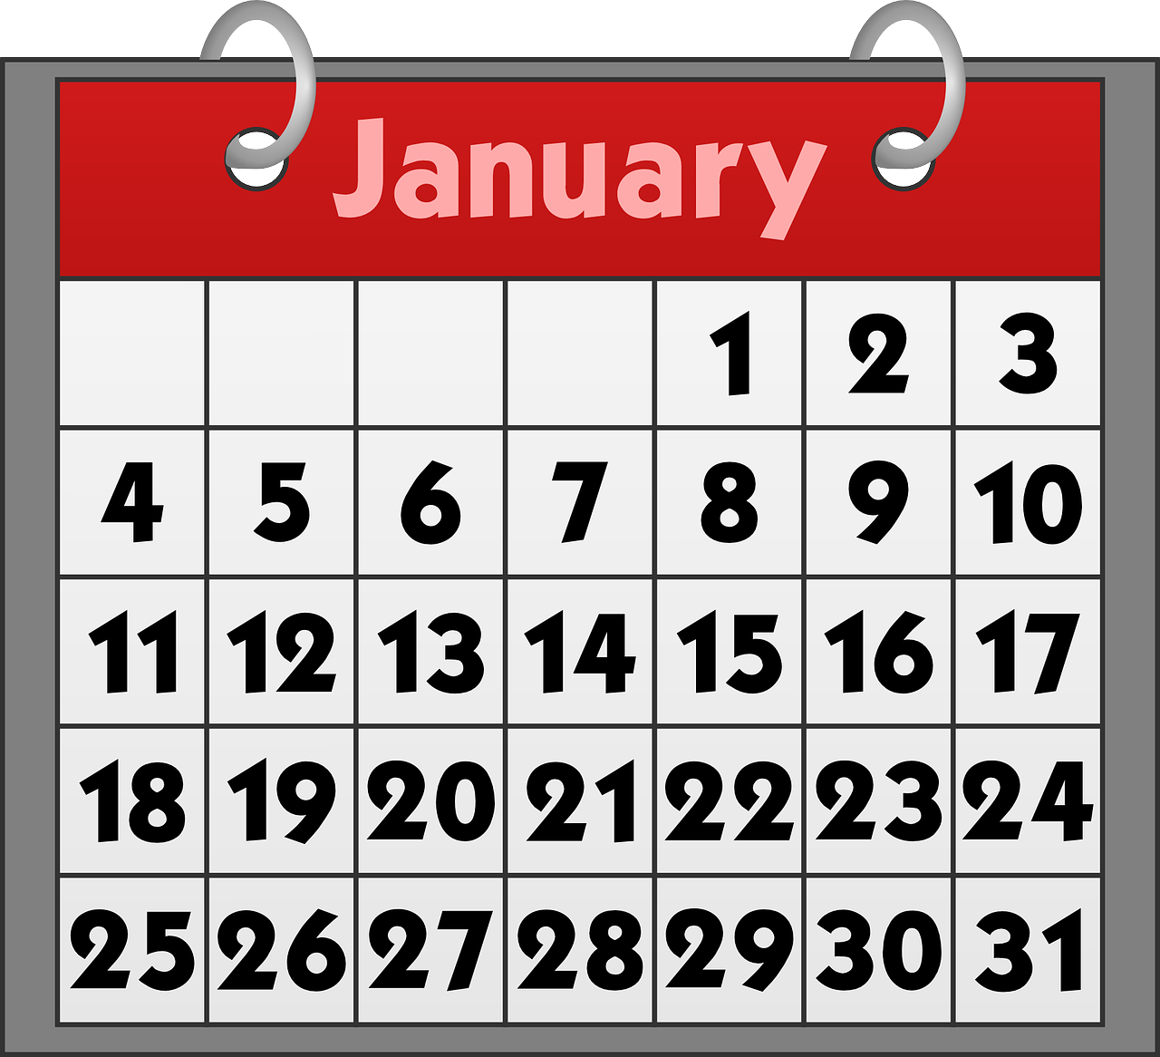
Follow up 2: Using ‘el’ with dates
[on the]
We use the definite article ‘el’ to mean ‘on the’ with specific dates.
Por ejemplo:
La fiesta es el 17 de enero.
The party is on the 17th of January.
To say today’s date, don’t use ‘el’.
October
Hoy es 24 de octubre.
Today is the 24th of October.
Notes:
Do this recap slide before Follow up 2
Time: 6-8 minutes (two slides) Aim: to learn the use of “el” with the meaning of “on the” with dates.
Procedure: 1. Teachers present the new information. It is animated to allow for a paced, interactive delivery. 2. Elicit the English translation from the examples.

Slide 4
Follow up 2
¿Qué día es?
Is it a birthday or today’s date?.
escuchar
escuchar
Escucha y decide. Luego, escribe el día y el mes.
La fiesta/ el concierto | hoy | día | mes
E
E
30
September
1
1
el concierto
18
July
2
2
14
February
3
3
29
April
4
4
la fiesta
15
August
5
5
9
November
6
6
el concierto
26
June
Notes:
Aim: to practise aural distinction of birthday dates with ‘el’ and other dates.
Procedure: 1. Explain to pupils that they will not hear the start of the sentence (hoy or el concierto/la fiesta) but need to listen out for the article ‘el’ to know whether the date is a concert/party date or today’s date.
2. Click to listen to the example. Pupils note down either cumpleaños or hoy.
3. Pupils listen again and write the date in digits and the month in English.
4. Click to reveal the example answers for both stages. (On the next click the pink audio buttons appear – these are for the listen and check step).
5. Complete steps 2 – 4 with items 1-6.
6. Use the pink set of audio buttons to listen and check answers with full sentence audio.
Transcript: EJ. [Hoy] es 30 de septiembre.
[El concierto] es el dieciocho de julio.
[Hoy] es catorce de febrero.
3. [Hoy] es veintinueve de abril.
4. [La fiesta] es el quince de agosto.
5. [Hoy] es nueve de noviembre.
6. [El concierto] es el veintiséis de junio.

Slide 5
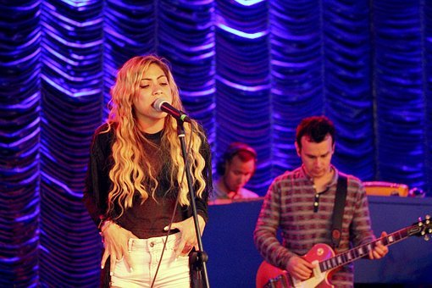
Follow up 3:
[1/6]
¿Cuándo es el concierto?
hablar
El concierto es el [__] de [____].
El concierto es el 28 de abril.
Notes:
Time: 5 minutes Aim: to ask and answer about concerts and parties in oral production.
Ask the question “¿cuándo es el concierto? and encourage pupils to answer in Spanish using the prompts.
Round 2 (next slide). Click to remove support and display clues for each word in the question and answer.

Slide 6
Follow up 3:
[2/6]
¿C….. e.. e.. c……to?
hablar
E.. c.… e.. e.. [_____] d.. [______]
El concierto es el 28 de abril.
Notes:
Time: 5 minutes Aim: to ask and answer about concerts and parties in oral production.
Ask the question “¿cuándo es el concierto? and encourage pupils to answer in Spanish using the prompts.
Round 2 (next slide). Click to remove support and display clues for each word in the question and answer.

Slide 7
Follow up 3:
[3/6]
¿Cuándo es el cumpleaños?
hablar
El cumpleaños es el [__] de [____].
El concierto es el 17 de enero.
January
17
Notes:
Time: 5 minutes Aim: to ask and answer about concerts and parties in oral production.
Ask the question “¿cuándo es el concierto? and encourage pupils to answer in Spanish using the prompts.
Round 2 (next slide). Click to remove support and display clues for each word in the question and answer.

Slide 8
Follow up 3:
[4/6]
¿C….. e.... e.... c……..?
hablar
E.. c.… e.. e.. [_____] d.. [______]
El concierto es el 17 de enero.
January
17
Notes:
Time: 5 minutes Aim: to ask and answer about concerts and parties in oral production.
Ask the question “¿cuándo es el cumpleaños? and encourage pupils to answer in Spanish using the prompts.
Round 2 (next slide). Click to remove support and display clues for each word in the question and answer.

Slide 9
Follow up 3:
[5/6]
¿C….. e.... e.... c……..?
hablar
e.. c.… e.. e.. [_____] d.. [______]
El concierto es el 21 de septiembre.
September
21
Notes:
Time: 5 minutes Aim: to ask and answer about concerts and parties in oral production.
Ask the question “¿cuándo es el concierto? and encourage pupils to answer in Spanish using the prompts.
Round 2 (next slide). Click to remove support and display clues for each word in the question and answer.

Slide 10
Follow up 3:
[6/6]
¿Cuándo es la fiesta?
¿C….. e.... l.... f……..?
hablar
l.. f.… e.. e.. [_____] d.. [______]
La fiesta es el [__] de [____].
February
25
Notes:
Time: 5 minutes Aim: to ask and answer about concerts and parties in oral production.
Ask the question “¿cuándo es la fiesta? and encourage pupils to answer in Spanish using the prompts.
Round 2 (next slide). Click to remove support and display clues for each word in the question and answer.

Slide 11
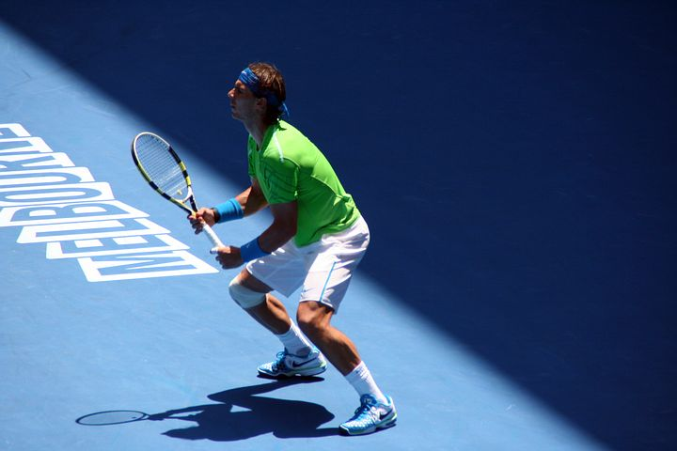
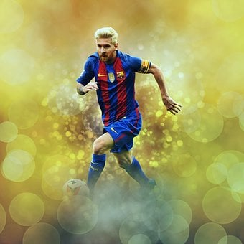
Follow up 4:
Lee las frases.
A Completa los espacios con la palabra correcta:
leer
estoy es soy de
Soy
¡Hola! Soy Rafael Nadal y soy tenista. _________ [1] de las Islas Baleares así que soy ______ [2] España. Ahora _______ [3] en Inglaterra para una fiesta. La fiesta _____ [4] el sábado dieciséis de marzo.
de
estoy
es
de estoy soy el
Soy
¡Hola! _____ [1] Lionel Messi y soy jugador de fútbol. Soy de Argentina pero ahora _______ [2] en España para un concierto. _____ [3] concierto es el viernes veintisiete _____ [4] mayo.
Estoy
El
de
Notes:
Timing: 10 minutes
Aim: to recognise the key vocabulary (adjectives) linked to the correct translation of “to be / being”.
Procedure:
Do the first gap with pupils. Encourage them to look at the surrounding words, to think about meaning but also about the difference between soy (ser) – to be, being (trait) and estoy (estar) – to be, being (location, state). Remind them that event dates use ser (the rule of thumb is that if you can substitute ‘takes, is taking place’ for ‘is’ then use ser)
Ask students to write 1-4 and the correct word.
Click the photo to hear the whole passage as a listen and check answers.
Click to reveal individual written answers.

Slide 12
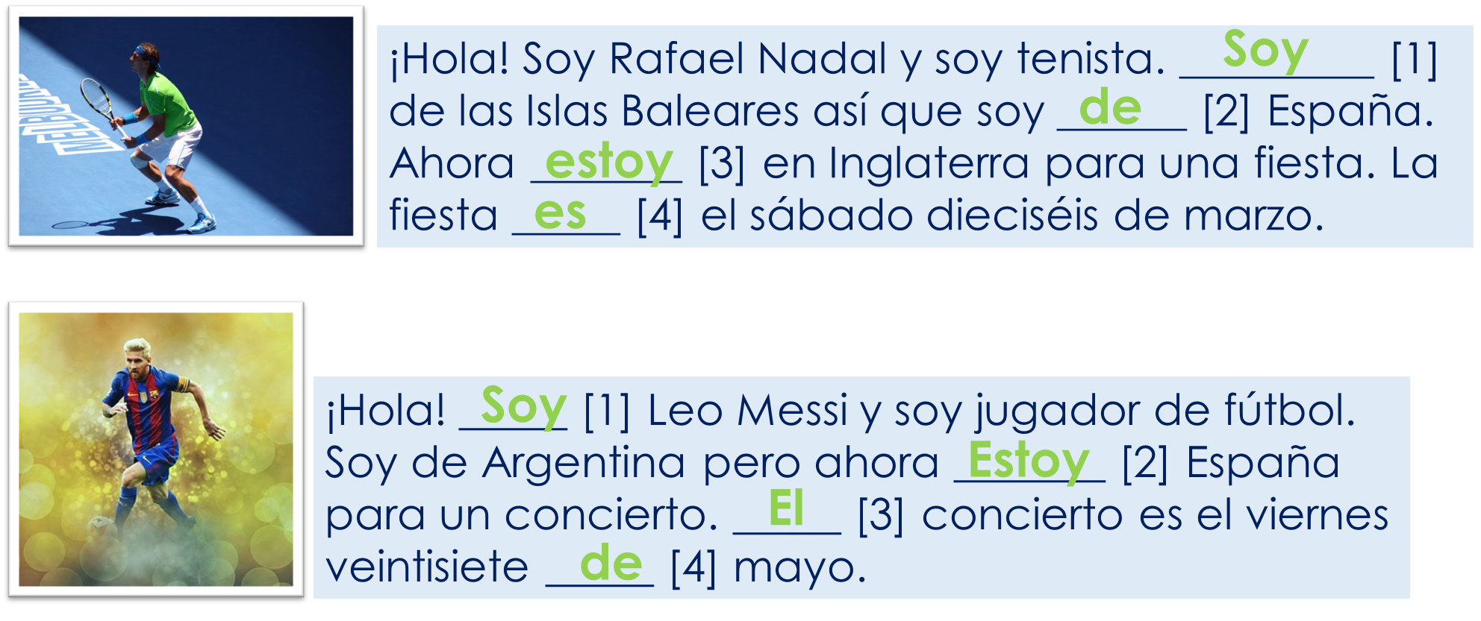
Follow up 4:
B Completa la tabla en inglés.
leer
 | Origin | Where he is now | Occasion | when
Rafael Nadal
Leo Messi
Spain
England
party
Saturday 17th March
Argentina
Spain
concert
Friday 27th May
Notes:
Timing: 5 minutes
Aim: to recognise the key vocabulary (adjectives) linked to the correct translation of “to be / being”.
Procedure:
Do the example with them. Draw their attention to the underlined adjectives & the verb that accompanies them (soy creativa y tranquila). Ask them if we use “soy” as “I am in general” or “I am (feeling) today”. Repeat with “estoy positiva”.
2. Ask students to write 1-4, and write down in general / today on top. Students to write the English translation under the right category.

Slide 13
Follow up 5:

Escribe las frases.
escribir
la es el fiesta de diecinueve julio
La fiesta es el diecinueve de julio.
Don’t forget capital letters and full stops!
El concierto es el catorce de enero.
concierto catorce el de es enero
⚠But remember that we don’t use capital letters with months in Spanish.
El cumpleaños es el veinticinco de noviembre.
veinticinco el cumpleaños de es noviembre el
el diciembre concierto de treinta es
El concierto es el treinta de diciembre.
Notes:
Timing: 8 minutes
Aim: to use “es” with dates (numbers and months) in guided written production.
Procedure:
Students to unjumble the words and write the dates for the party / concert / birthday.
Click to bring up answers

Slide 14
Follow up extra:
Escribe en inglés: Can you get at least 15 points?


 | el sueño | el frío | ¿quién?
 | el calor | el miedo | demasiado
 | somos | sano | seria
 | amable | diferente | estamos
 | diceisiete | marzo | treinta
 | la fiesta | el cumpleaños | el concierto
 | ¿cuándo? | diecinueve | veinticinco
(the) sleep, dream
(the) cold
Who?
vocabulario
vocabulario
x3
(the) heat, warmth
(the) fear
too (much)
We are (perm.)
healthy (m)
serious (f)
x2
nice, kind
different
We are (temp.)
17
March
30
(the) party
(the) birthday
(the) concert
x1
When?
19
25
Notes:
Timing: 6 minutes
Aim: to practise written comprehension of vocabulary from last week and this week.
Procedure: 1. Give pupils a blank grid. They fill in the English meanings of any of the words they know, trying to reach 15 points in total.
Note: The most recently learnt and practised words are pink, words from the previous week are green and those from two weeks ago are blue, thus more points are awarded for them, to recognise that memories fade and more effort (heavy lifting!) is needed to retrieve them.

Slide 15
Follow up extra:
Escribe en español: Can you get at least 15 points?

 | (the) cold | (the) fear | (the) sleep, dream
 | too (much) | who? | (the) heat, warmth
 | we are (state) | serious (f) | we are (trait)
 | different (m/f) | nice, kind (m/f) | healthy (f)
 | March | (the) concert | 17
 | 32 | 19 | 30
 | (the) party | When? | 25
el frío
el miedo
el sueño
vocabulario
x3
demasiado
¿Quién?
el calor
estamos
seria
somos
x2
diferente
amable
sana
marzo
el concierto
diecisiete
treinta y dos
diecinueve
treinta
x1
la fiesta
¿Cuándo?
veinticinco
Notes:
Timing: 6 minutes
Aim: to practise written production of vocabulary for this week and previous weeks.
Procedure:
1. Pupils need to write the Spanish for as many words as possible, aiming to get at least 15 points (but more if possible).
2. Click for Spanish answers.
Note: The most recently learnt and practised words are pink, words from the previous week are green and those from two weeks ago are blue, thus more points are awarded for them, to recognise that memories fade and more effort (heavy lifting!) is needed to retrieve them.

Slide 16
Handout: Follow up extra 1
Escribe en inglés: Can you get at least 15 points?

 | el sueño | el frío | ¿quién?
 | el calor | el miedo | demasiado
 | somos | sano | seria
 | amable | diferente | estamos
 | diceisiete | marzo | treinta
 | la fiesta | el cumpleaños | el concierto
 | ¿cuándo? | diecinueve | veinticinco
vocabulario
x3
too (much)
x2
x1

Slide 17
Handout: Follow up extra 2
Escribe en español: Can you get at least 15 points?

 | (the) cold | (the) fear | (the) sleep, dream
 | too (much) | who? | (the) heat, warmth
 | we are (state) | serious (f) | we are (trait)
 | different (m/f) | nice, kind (m/f) | healthy (f)
 | March | (the) concert | 17
 | 32 | 19 | 30
 | (the) party | When? | 25
vocabulario
x3
x2
x1

