Slide 1


español, con Quique

Slide 2

Describing me and others
azul
- To be [state and trait]:
somos vs. estamos
- SSC: consonant-vowel syllables
Notes:
Artwork by Steve Clarke. All additional pictures selected are available under a Creative Commons license, no attribution required.
The frequency rankings for words that occur in this PowerPoint which have been previously introduced in the resources are given in the SOW (excel document) and in the resources that first introduced and formally re-visited those words.
For any other words that occur incidentally in this PowerPoint, frequency rankings will be provided in the notes field wherever possible.
Phonics:
Revisit SSC: casa [106] dos [64] universo [1603] elefante (5000) idea (247)
Introduce syllabification: cho-co-la-te (3408) in-te-re-san-te (616)
Vocabulary (new words in bold): somos [ser, 7] estamos [estar, 21] amable [2707] curioso [1811] enfermo [1092] imposible [1418] nervioso [1521] sano [1961] y [4]
Revisit 1: -
Revisit 2: amar [700] odiar [2211] las [1] los [1] carta [627] lista [1189] mariposa [3359] mono [3835] museo [1114] parque [1354] película [543] tarjeta [1958] tarta [>5000] viernes [1259] lunes [1370] domingo [693]
Source: Davies, M. & Davies, K. (2018). A frequency dictionary of Spanish: Core vocabulary for learners (2nd ed.). Routledge: London

Slide 3






pronunciar
[o]
dos
[a]
casa
[u]
universo
[e]
elefante
[i]
idea
Notes:
Timing: 2 minutes
Aim: To practise SSC [a] [o] [u] [e] [i]
Procedure:
Click to trigger [o] and get pupils to repeat – this is also a great opportunity to check whether they remember the source word.
Click to trigger the word [dos] and source word and get pupils to repeat (elicit gesture if used).
Repeat the process with [a] [u] [e] [i]
Once all the source words are on display, click to trigger first picture [universo] – ask pupils to pronounce the word that matches the picture.
Repeat 4 more times to go through all the source words.
For further practice, pupils work in pairs. One pupil uses a gesture, the partners elicits the source word.

Slide 4




Syllables
pronunciar
In Spanish, syllables often come in consonant-vowel pairs.
Each syllable in a word is pronounced fully.
Escucha:
español
inglés
cho-co-la-te
Four clear, separate syllables
cho-co-late
Three syllables when you speak slowly.
Two syllables (‘choc–late’) normally!
in – te – re – san – te
Five clear, separate syllables
in – te – res – ting
Four clear, separate syllables
Three syllables (‘in-tres-ting’) normally!
Notes:
Timing: 2 minutes
Aim: to introduce Spanish syllabification and compare it with English ahead of the practice activity that follows.
Procedure:
Click through the animations to present the new information.
After escucha, click on volume buttons for español and inglés –this will allow pupils to hear the difference between Spanish and English.
Encourage pupils to practise saying the four words aloud to compare them.
For further practice, bring back dos, casa, universo and elefante and count the syllables together.
Dos – 1
Ca – sa – 2
I-de-a - 3
U –ni-ver-so – 4
E-le-fan-te - 4

Slide 5






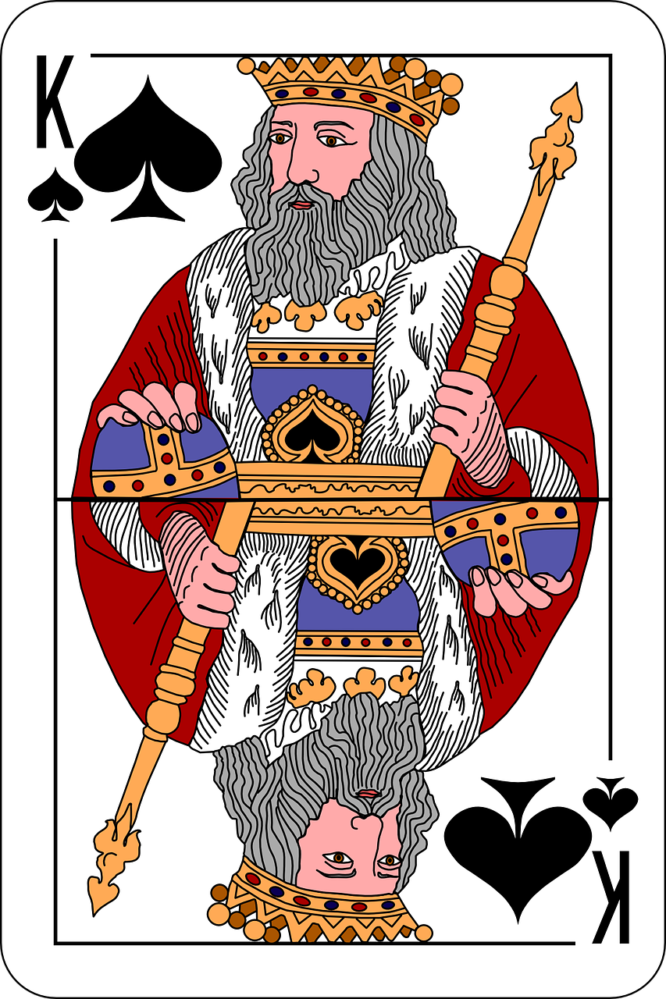

¿Qué son estas palabras?
Busca seis palabras (de dos sílabas) en español.
Pronuncia las palabras con tu compañero/a.
pronunciar
pe | car | nes | cho
nor | pla | cla | ra
tas | se | mu | te
60
1
much | north | class
plans | pear | cards
3
5
0
2
4
6
INICIO
Notes:
Timing: 5 minutes
Aim: to practise finding and pronouncing unknown two syllable Spanish words, which are near cognates with one syllable English words.
Procedure:
Explain the task; pupils work in pairs to find and pronounce all six two syllable Spanish words within one minute.
Click to start the timer.
When time has elapsed, elicit words from pupils.
Click to reveal the written forms.
Click on each number to hear each of the words said by a native speaker.
Transcript:
1. mucho
2. planes
3. norte
4. pera
5. clase
6. cartas
Vocabulary:
mucho [41] plan [625] norte [624] pera [>5000] clase [320] carta [627]
Source: Davies, M. & Davies, K. (2018). A frequency dictionary of Spanish: Core vocabulary for learners (2nd ed.). Routledge: London

Slide 6

somos | estamos
ser
1st person plural [we are]
In Spanish there are two verbs for ‘to be, being’:
ser
estar
We use ser to describe
____________________
We use estar to describe _________________________ and __________.
permanent traits.
temporary states / moods
location
To say ‘we are’ for a permanent trait,
use ‘somos’.
To say ‘we are’ for location or a temporary state,
use ‘estamos’.
Notes:
Timing: 2 minutes
Aim: to learn the 1st person plural of to be for estar (for mood / temporary state) and ser (permanent traits) building on their understanding of the different uses of ser and estar.
Procedure:
Read the grammar explanation on the two verbs for ‘to be’ and elicit the answers from pupils. This will give you an idea of how confident they are with this.
Click to bring up the definition for “ser” and elicit the right answer from pupils.
Click to bring up the statement for “estar” and elicit the different uses from pupils.
Click to introduce “estamos” and “somos”.

Slide 7



somos | estamos
Compare:
Estamos en casa.
Somos curiosos.
We are at home.
We are curious.
location
permanent trait
⚠ We are curious in general.
Estamos curiosos hoy.
We are curious today.
temporary state / mood
⚠ It’s not our natural state; we’re feeling curious today!
Notes:
Timing: 1 minute
Aim: to present examples of estamos and somos in short sentences.
Procedure:
Click to present the examples.
Elicit the English meaning (and correct use) from pupils.

Slide 8




leer
Lee: ¿Qué tienen en común*?
en común –
in common
Quique is writing in his diary about his friends and what he has in common with them.
¡Ay ay ay! He’s spilled hot chocolate on it! Is it “somos” or “estamos”?
What do they have in common?
Sofía y yo*
Rubén y yo
Sofía | Ángela | Rubén
1
Somos hermanos.
5
Siempre somos rápidos.
siblings
in class (together)
fast
(always)
2
Estamos en casa juntos.
Hoy estamos enfermos.
Ángela y yo
6
at home (together)
active (normally)
ill
(today)
3
Estamos en clase juntas.
4
Somos activos normalmente pero hoy estamos cansados.
tired
(today)
yo – I
juntos – together
Notes:
Timing: 10 minutes
Aim: to identify the use of ‘somos’ and ‘estamos’ at sentence level and connect these with meaning.
Procedure:
1. Read the text instructions in Spanish & click to trigger the English.
2. Read the first statement for Quique.
3. Decide if the statement needs “somos” or “estamos” based on the words before and after.
4. Do the first statement with them: X hermanos. Somos or estamos? Is it describing a temporary state or permanent trait? It’s a permanent trait so it’s “somos”.
5. Click to disappear the “hot chocolate mark”.
6. Elicit the meaning of ‘somos hermanos’ from pupils and click to reveal the first answer in the table.
7. Pupils complete steps 2 – 6 for the remaining statements. The statements are numbered for ease of reference during feedback.
8. Click to reveal answers.

Slide 9
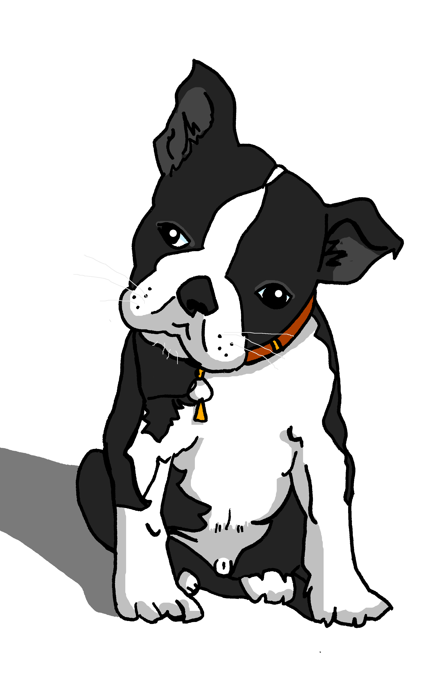
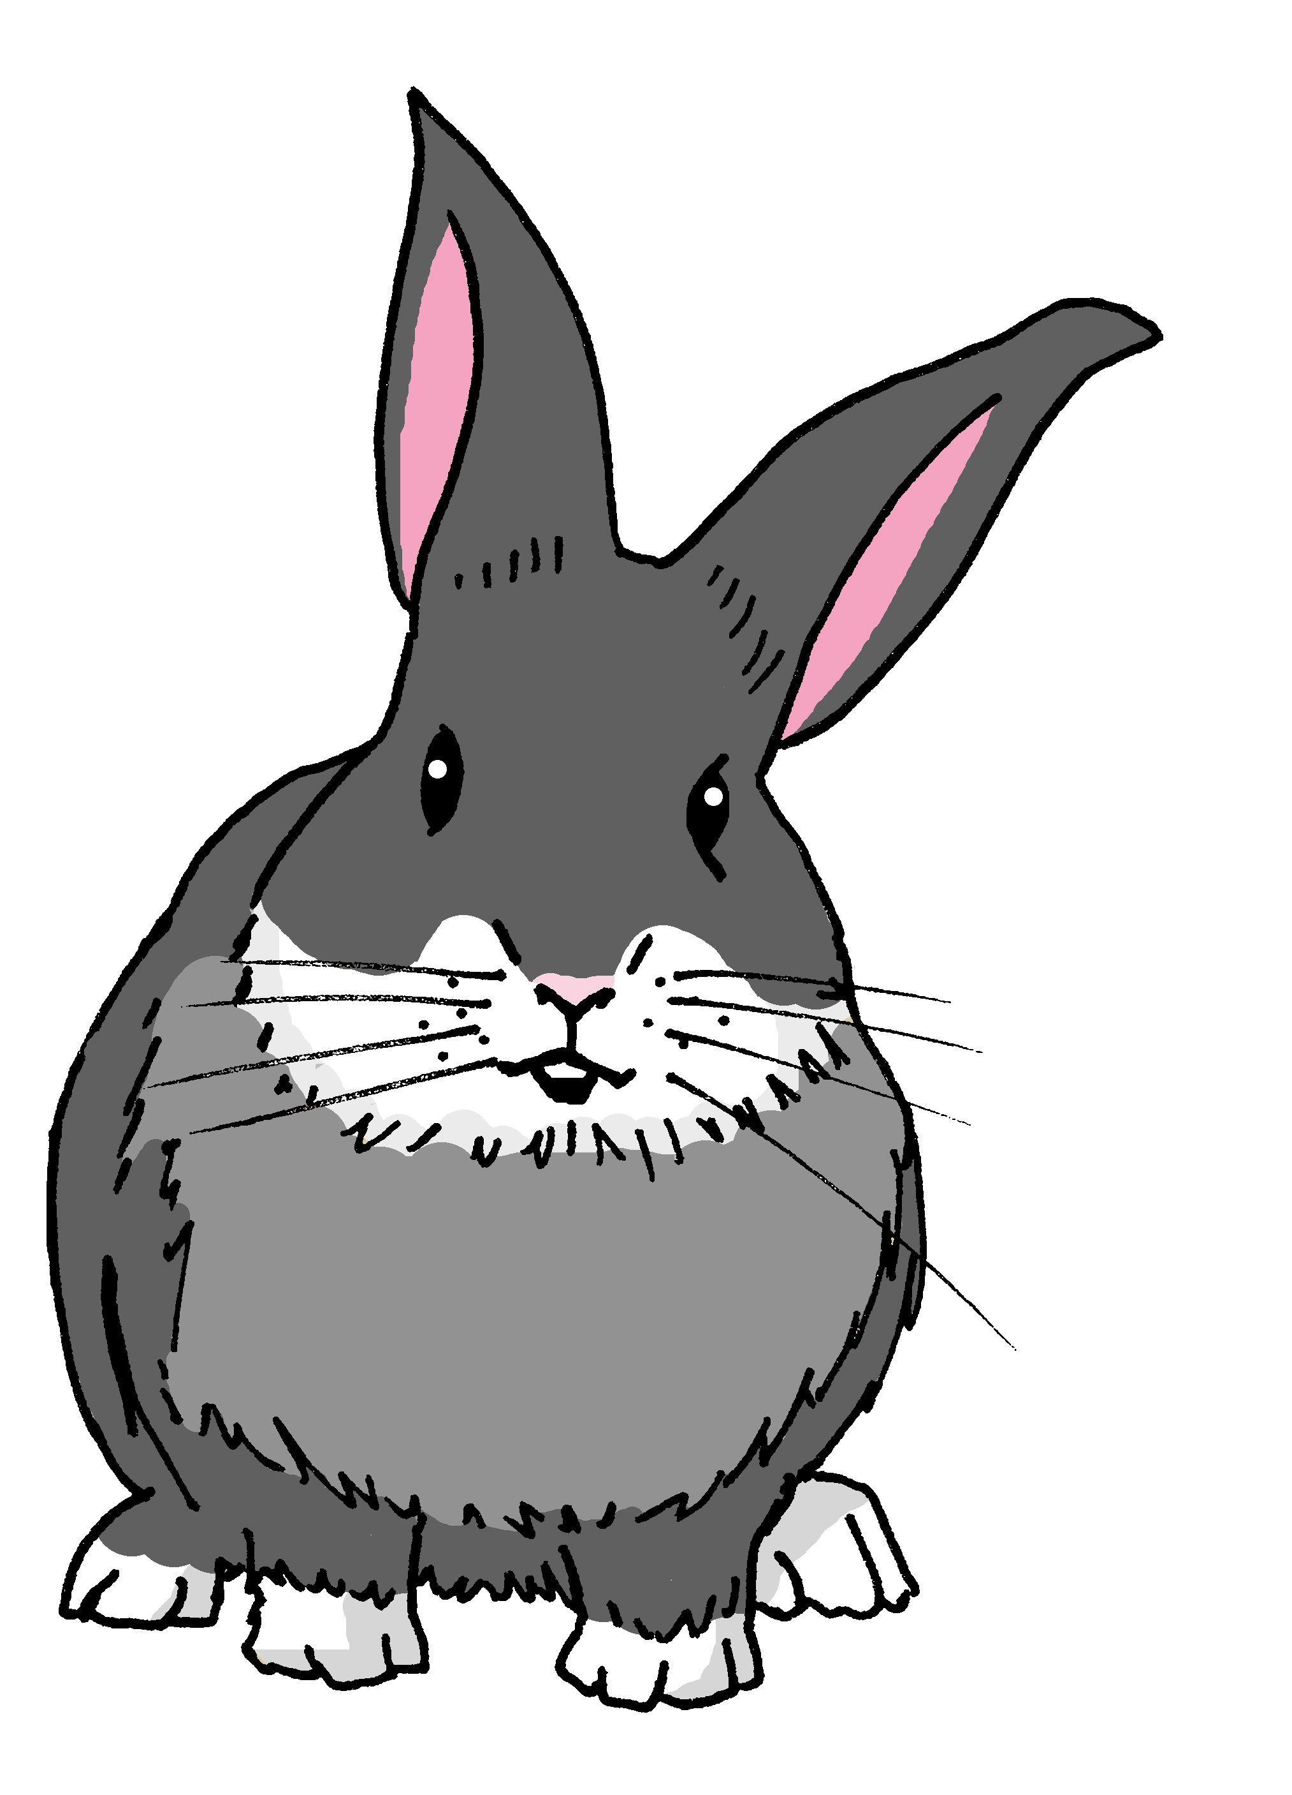
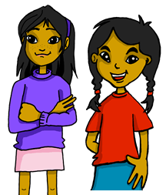
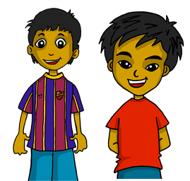
Gender & number agreement on adjectives
In Spanish we know that adjectives which end in ‘o’ change to end in ‘a’ when the noun described is feminine.
⚠ Names are called proper nouns.
Santi está activo.
Manchita está activa.
When we describe more than one masculine noun, the adjective ends in –os.
When we describe more than one feminine noun, the adjective ends in –as.
Estamos contentos.
Estamos contentas.
⚠ We is a pronoun, like I, you, s/he, it.
We are (feeling) happy.
We are (feeling) happy.
Notes:
Timing: 3 minutes
Aim: to revisit regular adjectival agreement (gender and number) in order to use the masculine and feminine plural form of regular adjectives ending in –o, when describing people and animals.
Procedure:
Click through the animations to present the grammar explanation about gender and number agreement on adjectives.
Elicit English translation for the Spanish examples provided.

Slide 10

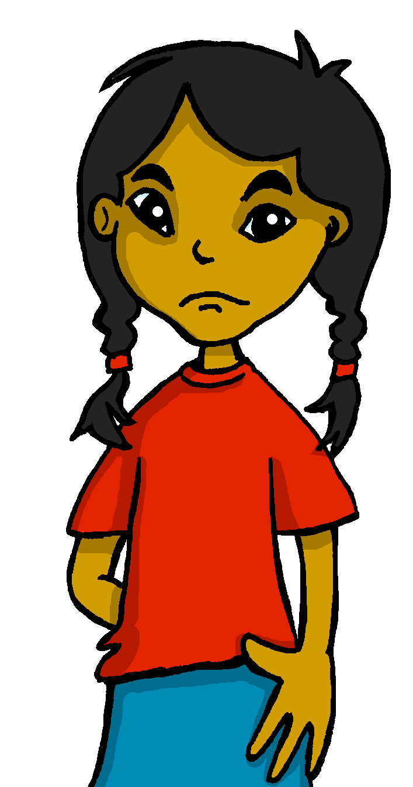


escuchar
Escucha la frase. ¿Quién habla?
1
leer
Estamos enfermas.
????
in general
today | location
Santi
Quique
Manchita
Sofía
Notes:
Timing: 5 minutes (five slides)
Aim: to practise aural comprehension of regular plural masculine and feminine adjective agreement; to practise written comprehension of the different meaning/use of estamos | somos.
Procedure:
Explain to pupils that they need to identify the speakers from the form of the adjective they hear.
Click to play the sentence.
Elicit the response from pupils (e.g. Quique y Santi OR Sofía y Manchita).
Click to show the sentence, with the callout pointing towards the speakers.
Click to bring up the possible meanings of the verb to be – in general OR today | location.
Elicit the correct meaning from students.
Click to confirm with a tick.
Repeat steps 2-7 with the next four slides.
Transcript:
Estamos enfermas.

Slide 11

escuchar
Escucha la frase. ¿Quién habla?
2
leer
Estamos curiosos.
????
in general
today | location
Santi
Quique
Manchita
Sofía
Notes:
[2/5]
Transcript:
Estamos curiosos.

Slide 12
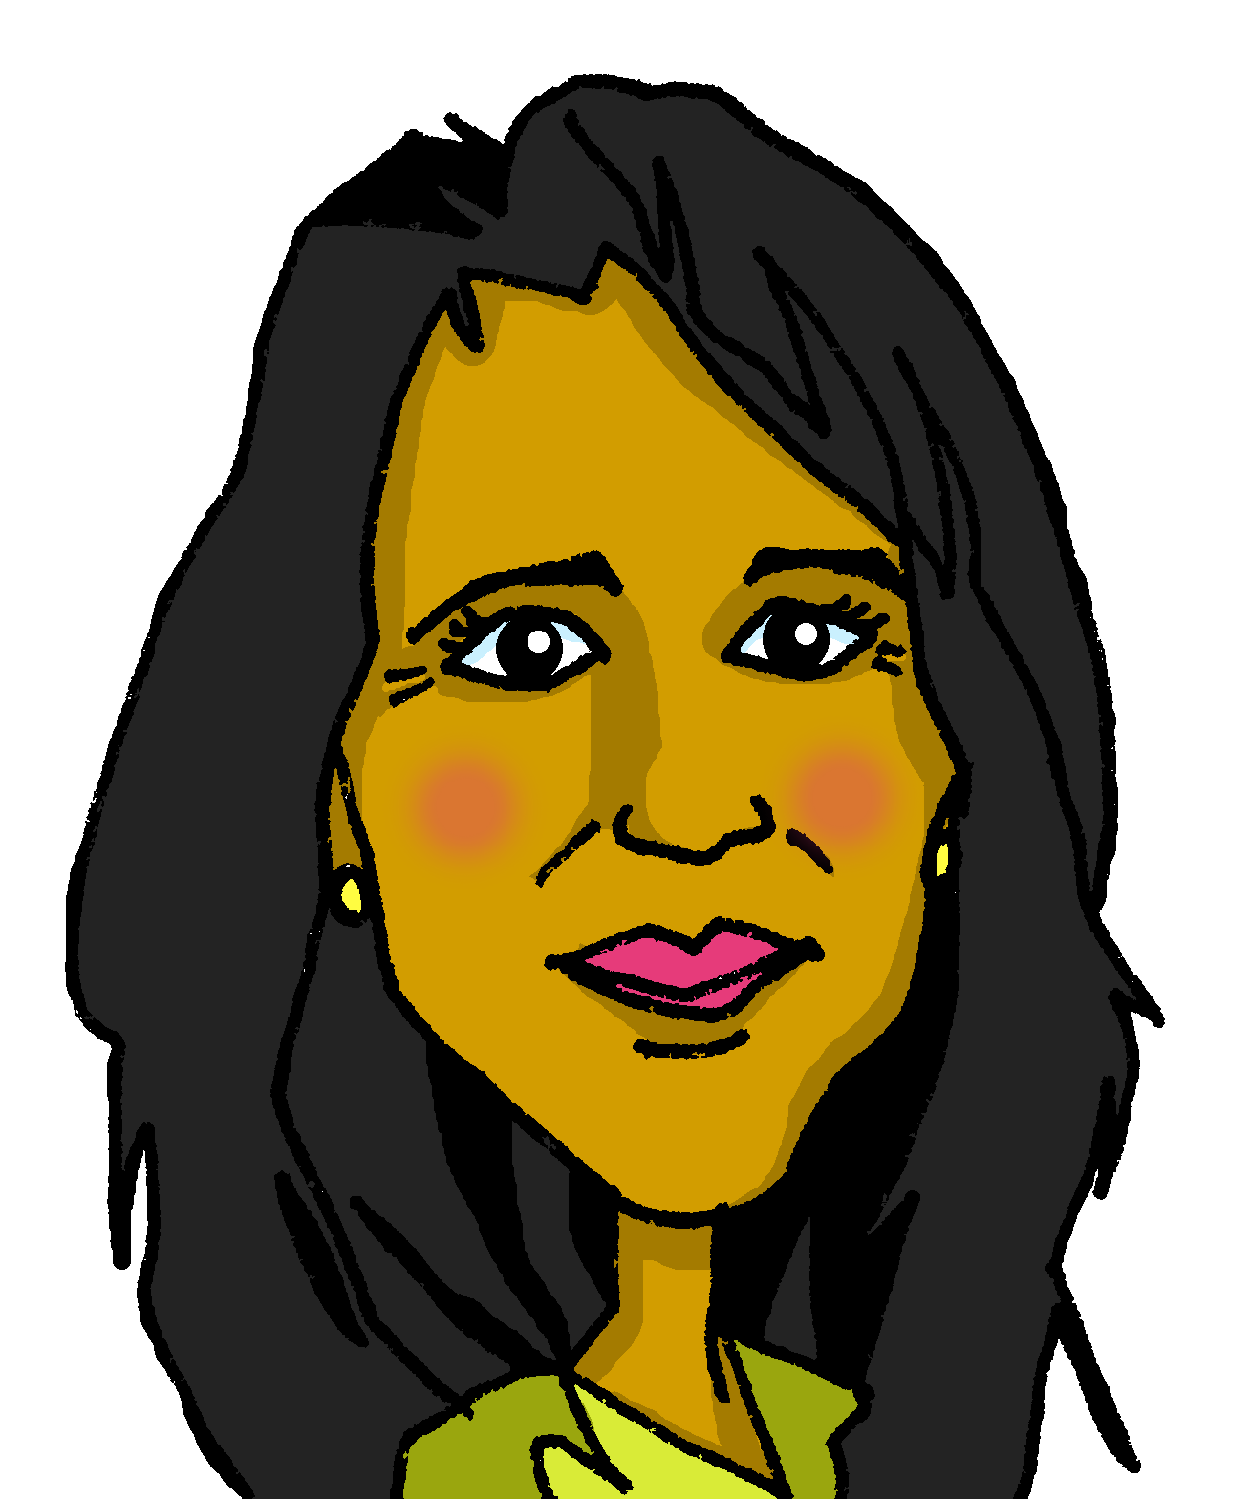
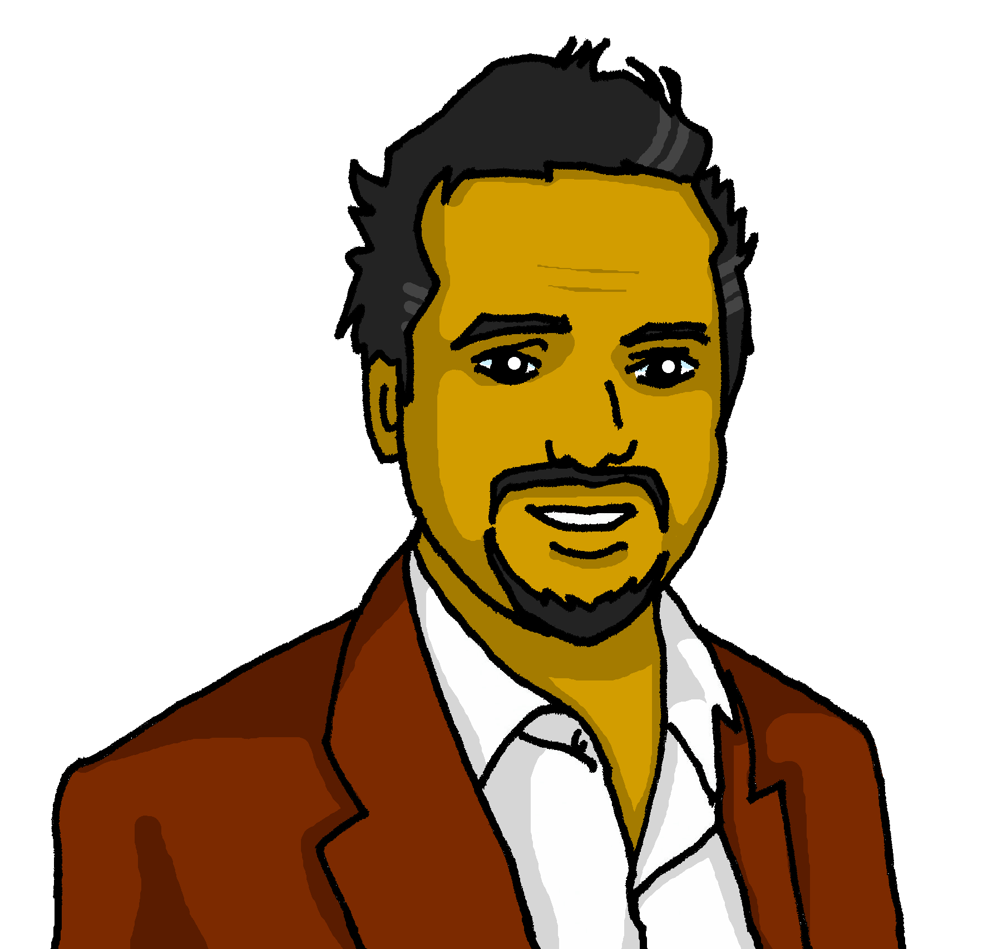
escuchar
Escucha la frase. ¿Quién habla?
3
leer
Somos sanas.
????
in general
today | location
Sofía
Elena
Pedro
Quique
Notes:
[3/5]
Transcript:
Somos sanas.

Slide 13
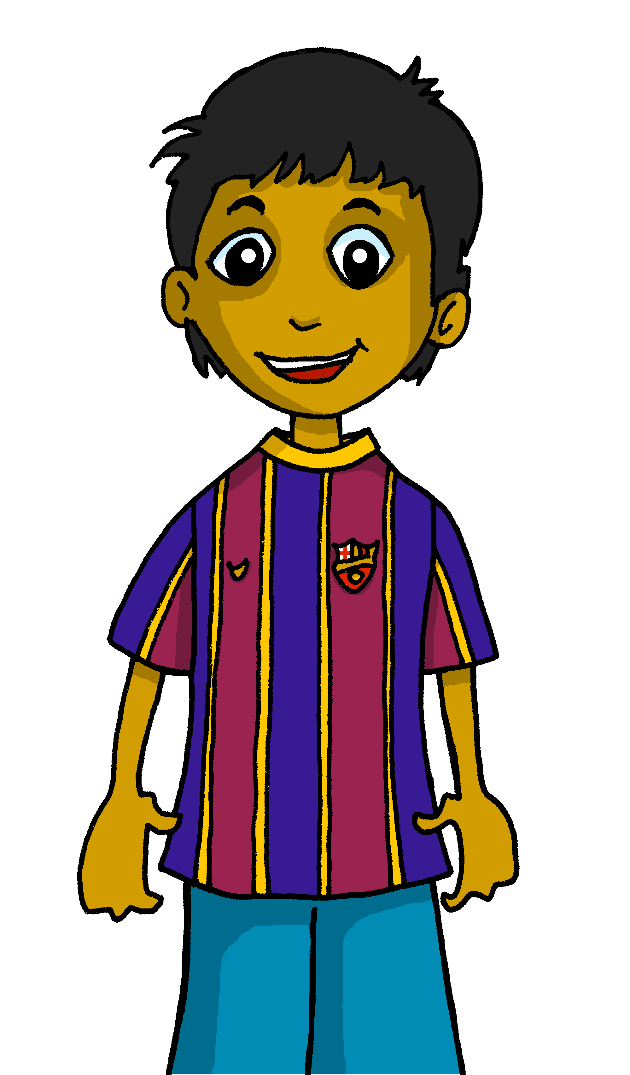
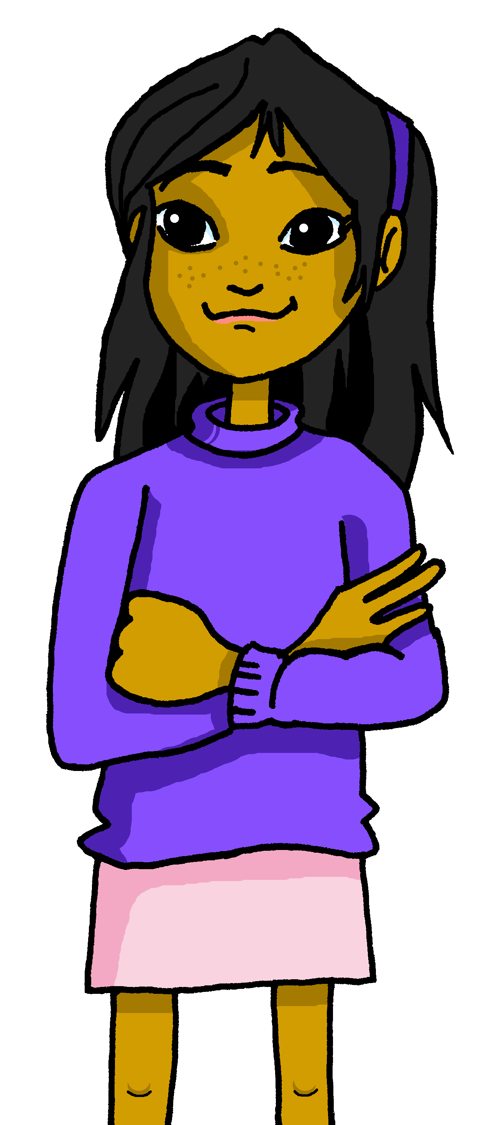
escuchar
Escucha la frase. ¿Quién habla?
4
leer
Estamos cansadas.
????
in general
today | location
Rubén
Quique
Ángela
Sofía
Notes:
[4/5]
Transcript:
Estamos cansadas.

Slide 14
escuchar
Escucha la frase. ¿Quién habla?
5
leer
Estamos nerviosos.
????
in general
today | location
Santi
Quique
Manchita
Sofía
Notes:
[5/5]
Transcript:
Estamos nerviosos.

Slide 15
¡adiós!
verde

