Slide 1
Describing me and others
verde
Follow ups 1-5
Notes:
Artwork by Steve Clarke. All additional pictures selected are available under a Creative Commons license, no attribution required.
The frequency rankings for words that occur in this PowerPoint which have been previously introduced in NCELP resources are given in the NCELP SOW and in the resources that first introduced and formally re-visited those words.
Phonics:
Revisit SSC: casa [106] dos [64] universo [1603] elefante (5000) idea (247) Introduce syllabification: cho-co-la-te (3408) in-te-re-san-te (616)
Vocabulary (new words in bold): somos [ser, 7] estamos [estar, 21] amable [2707] curioso [1811] enfermo [1092] imposible [1418] nervioso [1521] sano [1961] y [4]
Revisit 1: - Revisit 2: amar [700] odiar [2211] las [1] los [1] carta [627] lista [1189] mariposa [3359] mono [3835] museo [1114] parque [1354] película [543] tarjeta [1958] tarta [>5000] viernes [1259] lunes [1370] domingos [693]
For any other words that occur incidentally in this PowerPoint, frequency rankings will be provided in the notes field wherever possible.
Source: Davies, M. & Davies, K. (2018). A frequency dictionary of Spanish: Core vocabulary for learners (2nd ed.). Routledge: London

Slide 2
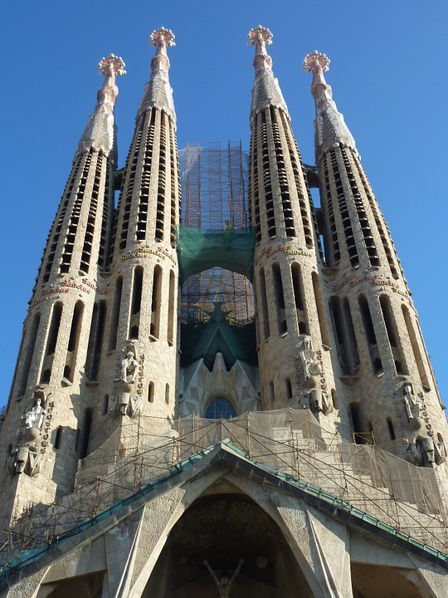
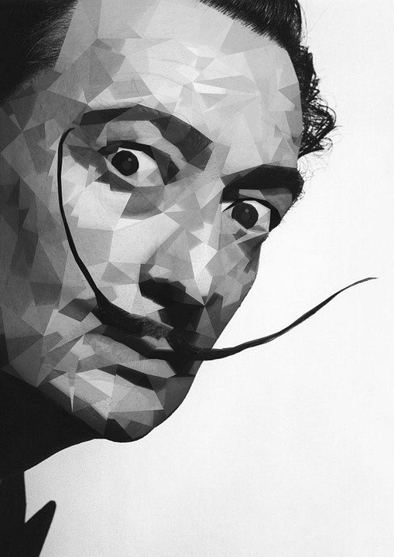
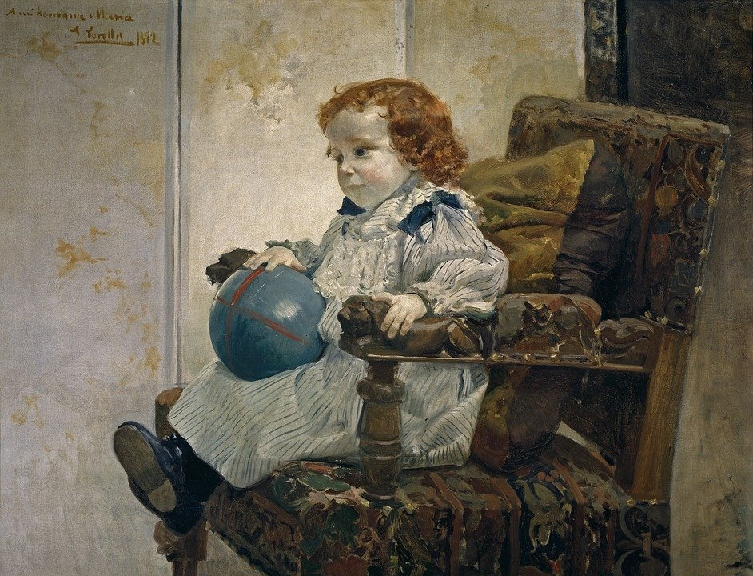
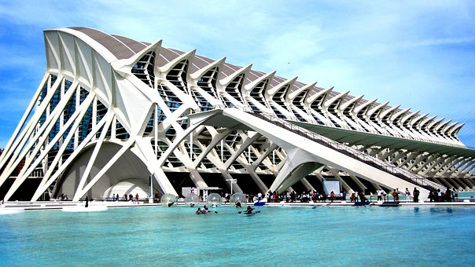
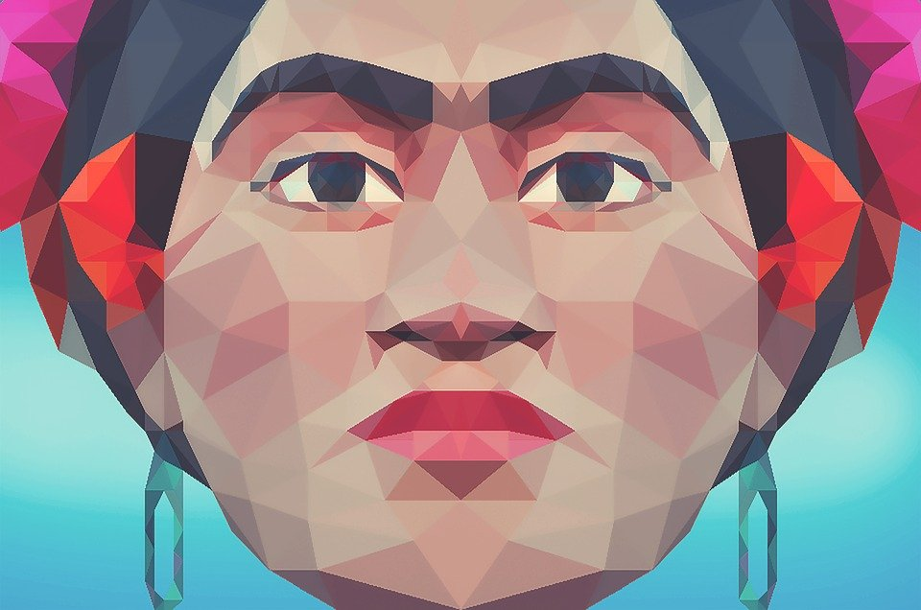
Follow up 1
Escucha.
¿Cuántas sílabas hay?
Antoni (Gaudí)
Salvador (Dalí)
(Pablo) Picasso
escuchar
2
Ej
4
1
2
2
3
3
4
2
5
3
4
Sorolla
Calatrava
Frida (Kahlo)
3
5
3
1
Ej
Notes:
Timing: 5 minutes
Aim: to practise aural syllabification and then transcription of names of Hispanic artists and architects.
Procedure:
Do the example with them (EJ – ejemplo).
Students listen to the single word Frida and write down the number of syllables in it.
Repeat with items 1 – 5.
Click to reveal number answers.
Play the audio again – this time pupils transcribe the names they hear.
Click to reveal written answers.
Transcript
Ej. Frida
1. Calatrava
2. Dalí
3. Sorolla
4. Antoni
5. Picasso

Slide 3
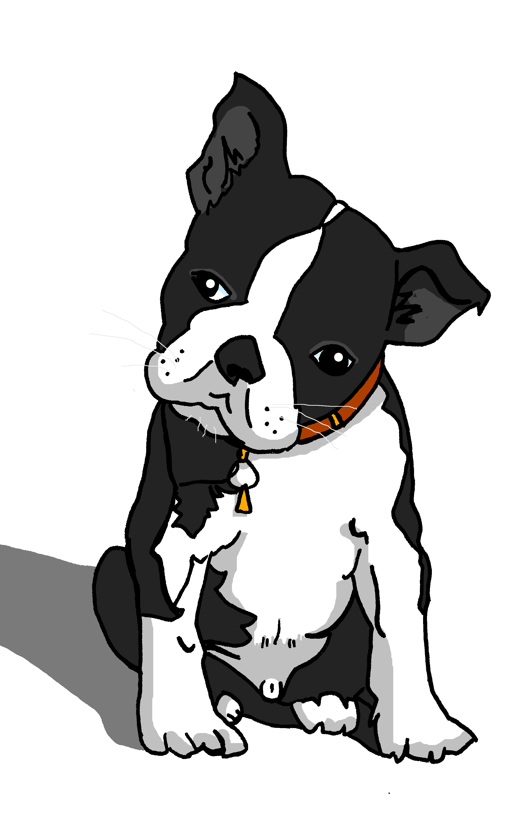
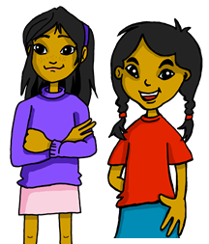
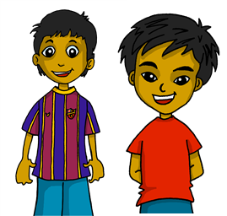
Follow up 2: Gender & number agreement on adjectives
In Spanish we know that adjectives which end in ‘o’ change to end in ‘a’ when the noun described is feminine.
⚠ Names are called proper nouns.
Santi está activo.
Manchita está activa.
When we describe more than one masculine noun, the adjective ends in –os.
When we describe more than one feminine noun, the adjective ends in –as.
Estamos contentos.
Estamos contentas.
⚠ We is a pronoun, like I, you, s/he, it.
We are (feeling) happy.
We are (feeling) happy.
Notes:
Timing: 10 minutes (three slides) Note: this slide is a quick reminder and is repeated from this week’s lesson.
Aim: to revisit regular adjectival agreement (gender and number) in order use the masculine and feminine plural form of regular adjectives ending in –o, when describing people and animals.
Procedure:
Read the grammar explanation on – Gender and number agreement on adjectives
Elicit English translation for the Spanish examples provided.

Slide 4
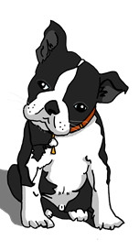
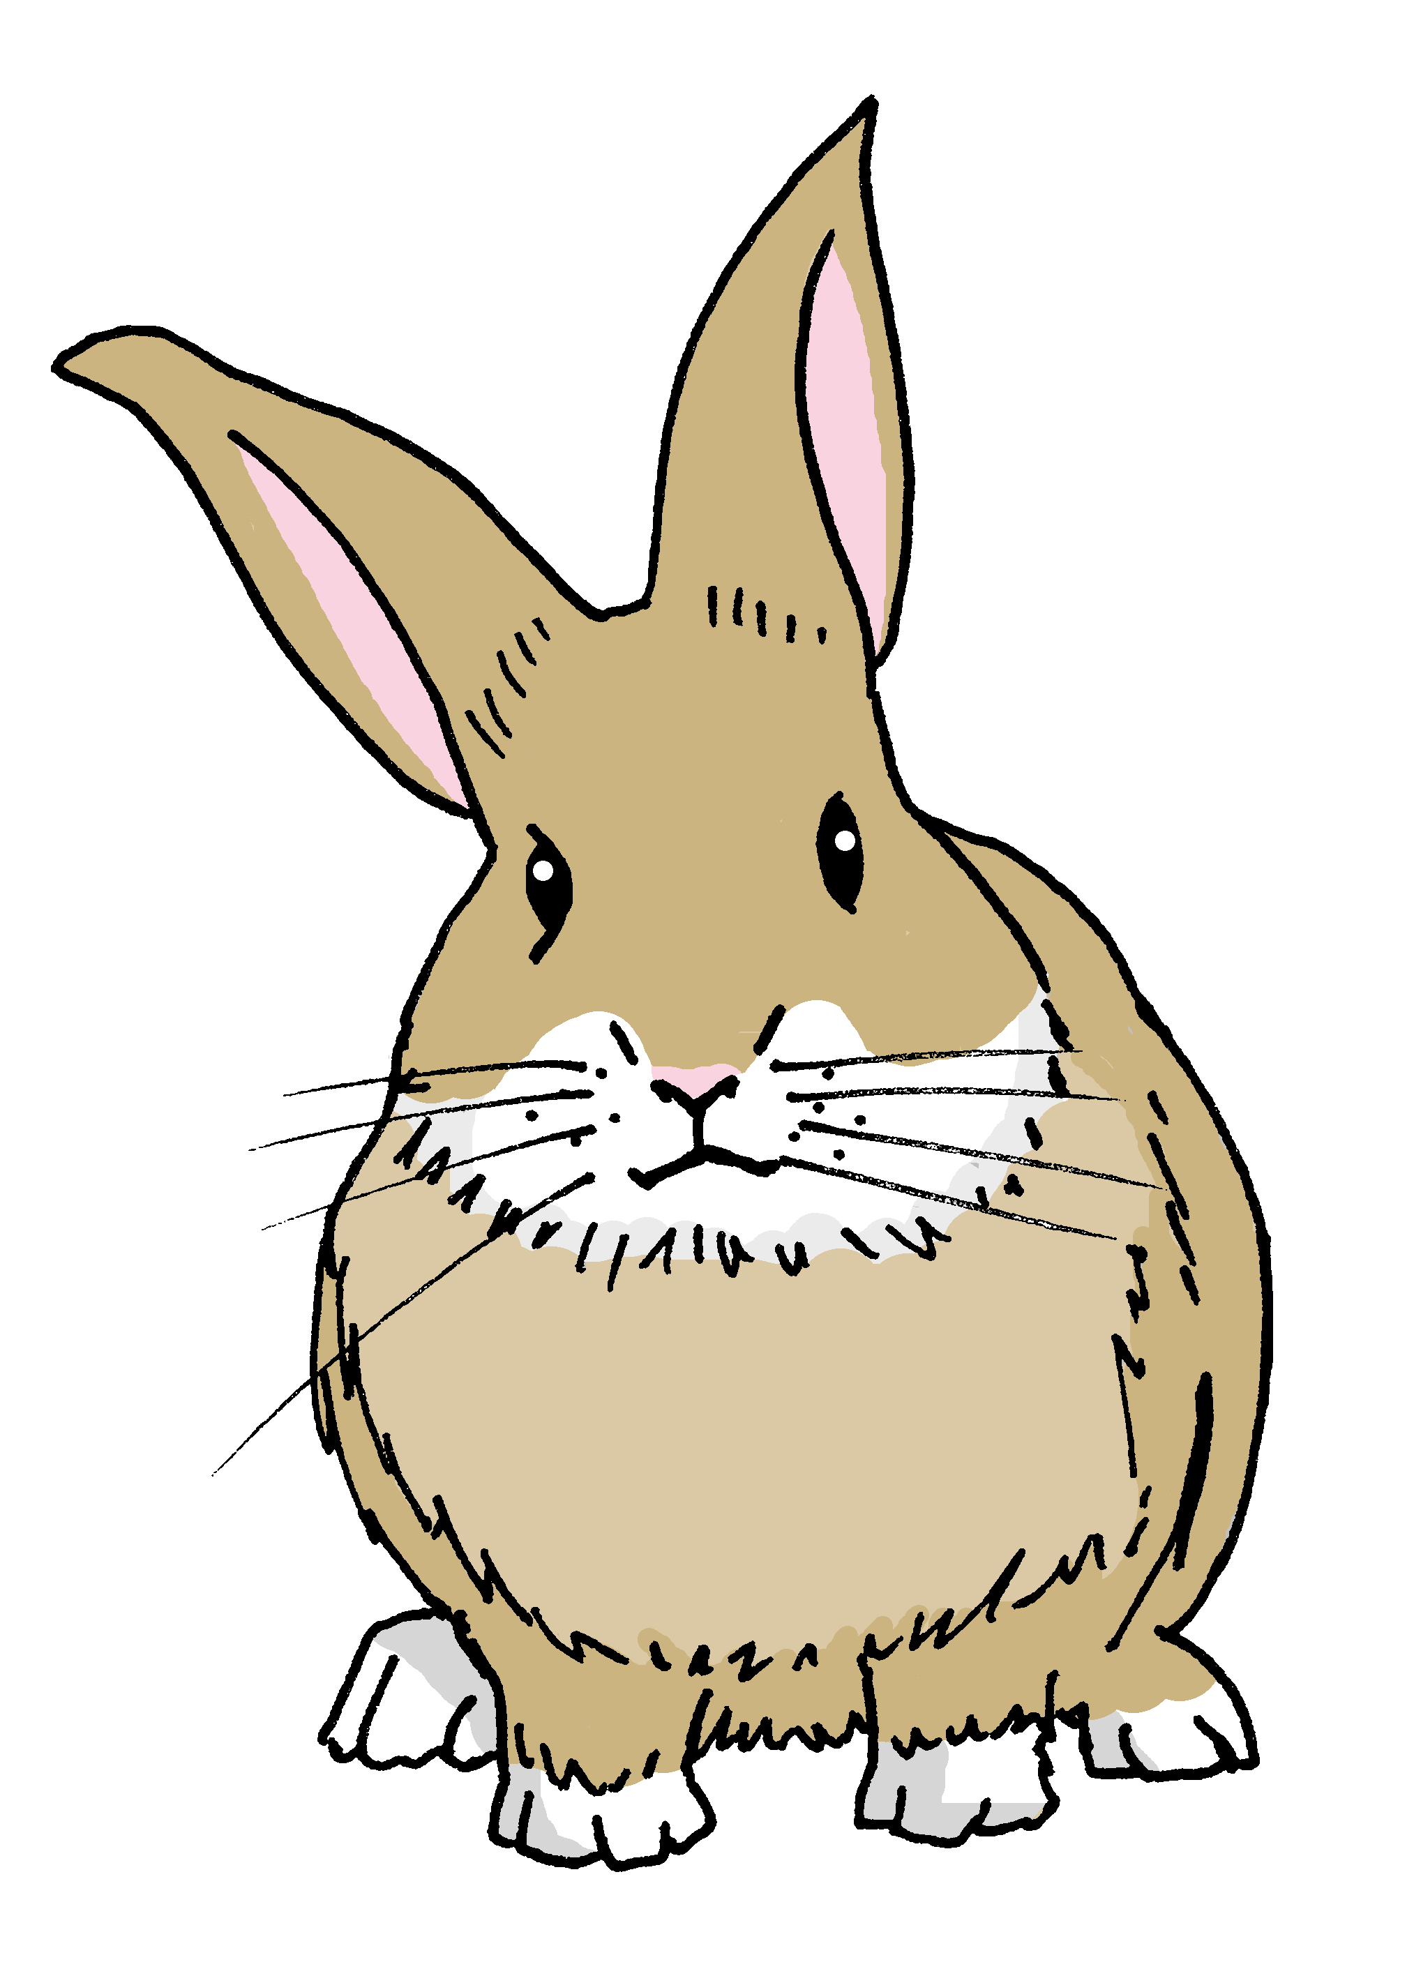
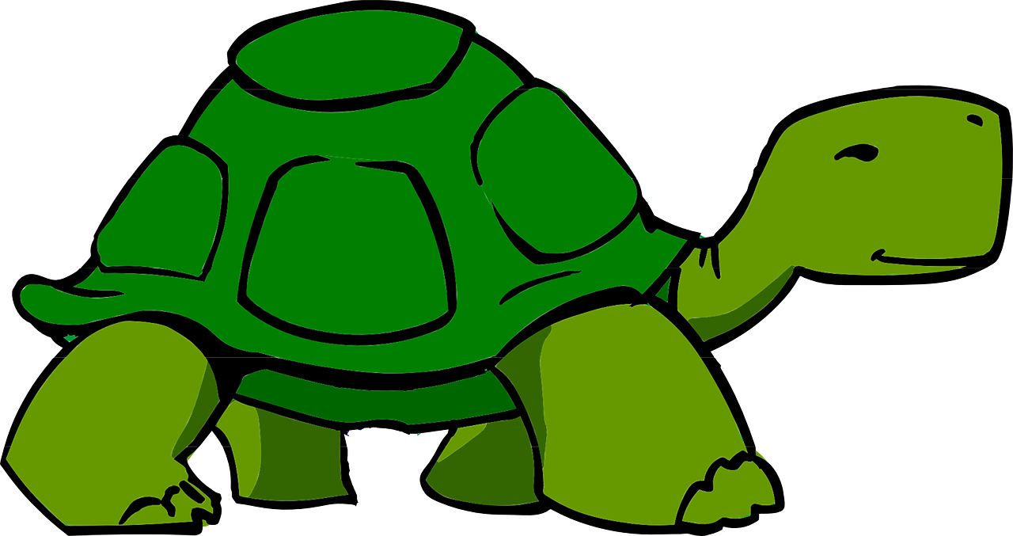
Gender & number agreement on adjectives
When an adjective ends in –e, it can describe a masculine or feminine noun.
Santi es inteligente.
Manchita es inteligente.
Santi is intelligent.
Manchita is intelligent.
To describe more than one noun with adjectives that end in -e, just add –s.
Somos importantes.
Somos importantes.
Pancho
Santi
Manchita
Irene
We are important.
We are important.
Notes:
Aim: to introduce the plural adjective agreement for number for adjectives ending in –e.
Procedure:
Click through the animations to present the information.
Elicit English translation for the Spanish examples provided.
Point out that with plural adjectives ending in –es, as with the singular form -e, you cannot tell from the adjective whether it refers to a masculine or feminine noun.

Slide 5
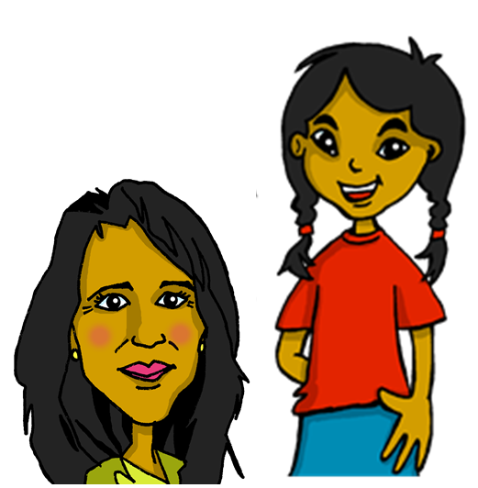
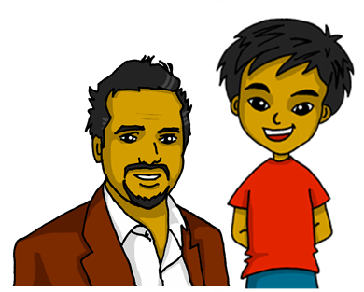
escuchar
Escucha. ¿Quién habla?
¿Sofía y Elena?, ¿Pedro y Quique? o ¿los dos?
escuchar
How do they describe themselves?
Marca
Sofía y Elena | Quique y Pedro | los dos
in general | today
Descripción en inglés
E
negative
1
healthy
2
nervous
3
impossible
4
ready
very kind
5
6
ill
Notes:
Timing: 8 minutes
Aimto practise noticing the gender and number of the person (people) described and process the meaning of the adjectives.
Procedure:
1. Ask pupils to write 1-6 in their books.
2. Read the instruction in Spanish from the board.
3. Tell them that they will hear Sofía and Elena, Pedro and Quique talking about themselves. They need to pay attention to the ending of the adjective and decide if this could apply to Sofía and Elena, Pedro and Quique or both. Remind them about –os /-as / -es.
4. Do the example with them.
5. The first time they listen, pupils tick the correct group (Sofía y Elena, Pedro y Quique or both). 6. Click to reveal answer tick.
7. The second time they listen, pupils need to identify the correct meaning of “we are” (estamos or somos), and the adjective in English. 8. click to reveal answers.
9. Complete 1-6. Challenge pupils to also write down the description (the adjective) in English. 10. Click to provide answers.
Note: there are no adverbs in this activity to compel pupils to focus attention on estamos | somos to identify the meaning of the verb.
Script
E. Estamos curiosas.
1. Somos sanos.
2. Estamos nerviosos.
3. Somos imposibles.
4. Estamos preparadas.
5. Somos muy amables.
6. Estamos enfermos.

Slide 6
Follow up 3:
Clasifica los adjetivos.
divertido
imposible
preparado
tranquilo
elegante
leer
cansado
increíble
sano
curioso
amable
diferente
enfermo
-o
-a
- es
divertido
preparado
tranquilo
cansado
imposible
elegante
curioso
increíble
sano
amable
-os
enfermo
-as
diferente
Notes:
Timing: 5 minutes
Aim: to recap adjective agreements.
Procedure:
Teachers ask pupils to write the adjectives down in two columns depending on whether the ending will change ‘o/a/os/as’ or ‘es’. As an alternative, this exercise could be done orally.
Notes:
The shapes offer a visual representation of the possible endings. Elicit the responses from the pupils as to when to use the different endings and therefore which type of adjective will go in each box.

Slide 7
Follow up 4:
Say each word in Spanish when you see the English.
sanas
amables
amable
las
estamos
we are (state)
y
kind (m/f, pl.)
the (m,pl.)
the (f, pl.)
impossible (m/f, pl.)
we are (trait)
healthy (f, pl.)
healthy (m, pl.)
kind (m/f)
to hate
¡Excelente!
and
to love
somos
odiar
sanos
los
imposibles
amar
Notes:
Timing: 10 minutes (two slides)
Aim: to practise written comprehension and spoken pronunciation of vocabulary for this week and the revisited weeks.
Procedure:
1. Click for English prompt. Pupils need to locate the correct Spanish word and pronounce it, chorally.
2. Click for target word to be highlighted. 3. Repeat for all 12 items.

Slide 8
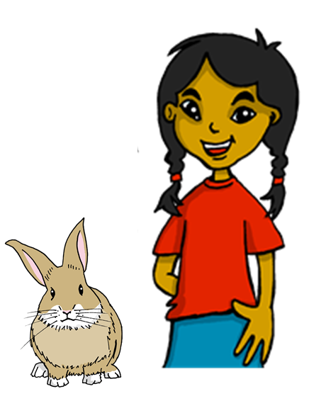
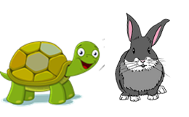
Follow up 5:

Escribe unas frases.
escribir
We are (feeling) ready now.
We are always different.
We are family.
We are always kind.
We are (feeling) curious today.
Estamos preparados ahora.
⚠ Spanish adverbs for now, always, today can usually go at the start, end or after the verb.
Siempre somos diferentes.
always =
s_ _mpr_
today = h_ y
family = f_m_l_a
Somos familia.
Siempre somos amables.
Estamos curiosas hoy.
Notes:
Timing: 10 minutes (two slides)
Aim: to produce full sentences using ‘somos’ and ‘estamos’, using the correct form of the adjective too.
Read the instructions in Spanish.
Ask pupils to complete translate the sentences into Spanish, using the correct verb (somos or estamos) and form of the adjective.
Always/ today and family are not new words; however, prompts are provided to support pupils.

Slide 9
Follow up 4:
Escribe en inglés: Can you get at least 15 points?
 | la fiesta | la persona | el color
 | tu | mi | preferido
 | increíbles | divertidos | rápida
 | triste | lentos | contentas
 | curiosas | amables | sanas
 | nerviosas | enfermos | imposible
 | estamos | y | somos
party
person
colour
x3
your
my
favourite (m, sg.)
unbelievable (m/f, pl.)
funny (m, pl.)
fast (f, sg.)
x2
sad (m/f, sg.)
happy (f, pl.)
slow (m, pl.)
curious (f, pl.)
kind (m/f, pl.)
healthy (f, pl.)
nervous (f, pl.)
ill (m, pl.)
impossible (m/f, sg.)
x1
we are (state)
we are (trait)
and
Notes:
HANDOUT

Slide 10
Follow up 5
Escribe en español: Can you get at least 15 points?
 | my | your | favourite (m, sg.)
 | colour | party | person
 | happy (f, pl.) | sad (m/f, sg.) | slow (m, sg.)
 | fast (f, sg.) | funny (m, pl.) | unbelievable (m/f, pl.)
 | and | we are (state) | we are (trait)
 | impossible (m/f, sg.) | ill (m, pl.) | nervous (f, pl.)
 | kind (m/f, pl.) | healthy (f, pl.) | curious (f, pl.)
mi
tu
preferido
x3
el color
la fiesta
la persona
contentas
triste
lento
x2
rápida
divertidos
increíbles
y
estamos
somos
imposible
enfermos
nerviosas
x1
amables
sanas
curiosas
Notes:
Aim: to practise written production of vocabulary for this week and previous weeks.
Procedure:
Pupils need to write the Spanish for as many words as possible, aiming to get at least 15 points (but more if possible).
Tell pupils to write the correct word for ‘the’ with all the nouns.
3. Click for Spanish answers.

Slide 11
Follow up 4:
Escribe en inglés: Can you get at least 15 points?
 | la fiesta | la persona | el color
 | tu | mi | preferido
 | increíbles | divertidos | rápida
 | triste | lentos | contentas
 | curiosas | amables | sanas
 | nerviosas | enfermos | imposible
 | estamos | y | somos
x3
x2
x1
Notes:
HANDOUT

Slide 12
Follow up 5
Escribe en español: Can you get at least 15 points?
 | my | your | favourite
 | colour | party | person
 | happy (f, pl.) | sad (m/f, sg.) | slow (m, sg.)
 | fast (f, sg.) | funny (m, pl.) | unbelievable (m/f, pl.)
 | and | we are (state) | we are (trait)
 | impossible (m/f, sg.) | ill (m, pl.) | nervous (f, pl.)
 | kind (m/f, pl.) | healthy (f, pl.) | curious (f, pl.)
x3
x2
x1
Notes:
HANDOUT

