Slide 1
Describing me and others
verde
Follow ups 1-5
Notes:
Artwork by Steve Clarke. All additional pictures selected are available under a Creative Commons license, no attribution required.
The frequency rankings for words that occur in this PowerPoint which have been previously introduced in NCELP resources are given in the NCELP SOW and in the resources that first introduced and formally re-visited those words.
Phonics:
Revisit SSC: [e] elefante [>5000] [i] idea [247]
Vocabulary (new words in bold): es [ser, 7] está [estar 21] amigo(a) [210] negativo [1804] perdido [1899] perfecto [1115] positivo [1188] preparado [2092] tranquilo [1093] mi [37] demasiado [494] hoy [167] normalmente [1696] pero [30]
Revisit 1: a menudo [958] en¹ [5] enero [1173] febrero [1419] marzo [1231] abril [1064] mayo [909] junio [1035] julio [659] agosto [931]septiembre [1150] octubre [1242] noviembre [1434] diciembre [1165] Revisit 2: crear [239] organizar [1053] preparar [570] aula [3501] lista [1189] fiesta [796] útil [3951]
Source: Davies, M. and Davies, K. (2018). A frequency dictionary of Spanish: Core vocabulary for learners (2nd ed.). Routledge: London

Slide 2
Follow up 1:
[e]
elefante
[i]
idea
Presento a mis amigos.
¿Cómo se escribe el nombre? ¿Con ‘e’, con ‘i’ o con los dos?
pronunciar
 |  | [e] | [i]
1 | Ariana
2 | Camilo
3 | Florencia
4 | Romina
5 | Josué
6 | Isidora
7 | Elías
8 | Malena
9 | Valentín
Notes:
Timing: 5 minutes
Aim: to practise aural comprehension of the SSC [e] and [i].
Procedure:
Click to bring up the instructions. Pupils write 1-9, and [e] [i] at the top.
Click on each audio symbol to listen to the names.
Pupils tick if they hear ‘e’ or ‘i’ or both.
Note: for additional challenge pupils can write the full name.
4. Click to bring up the answer ticks and reveal the written names.
Transcript 1. Ariana 2. Camilo 3. Florencia 4. Romina 5. Josué 6. Isidora 7. Elías 8. Malena 9. Valentín

Slide 3
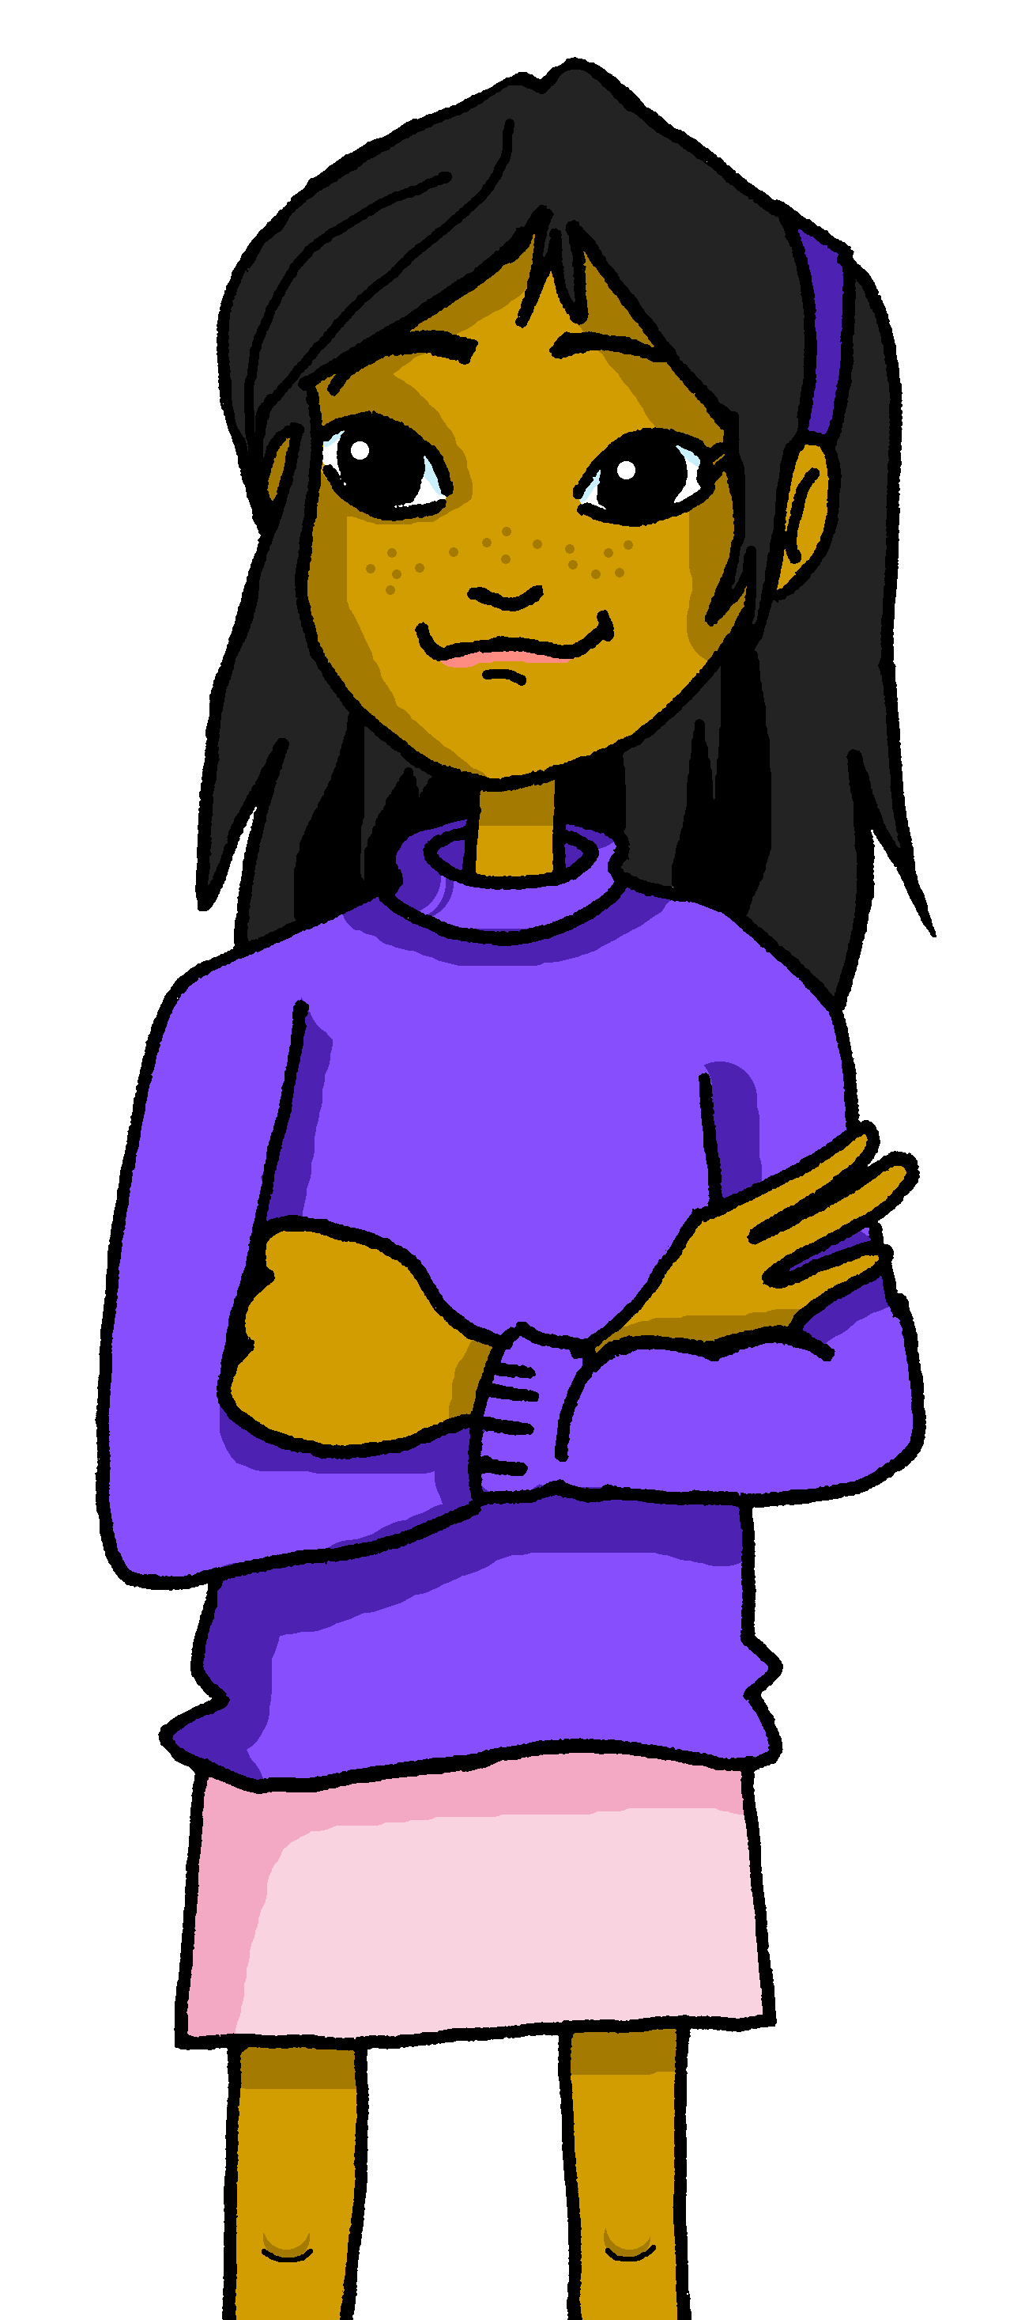
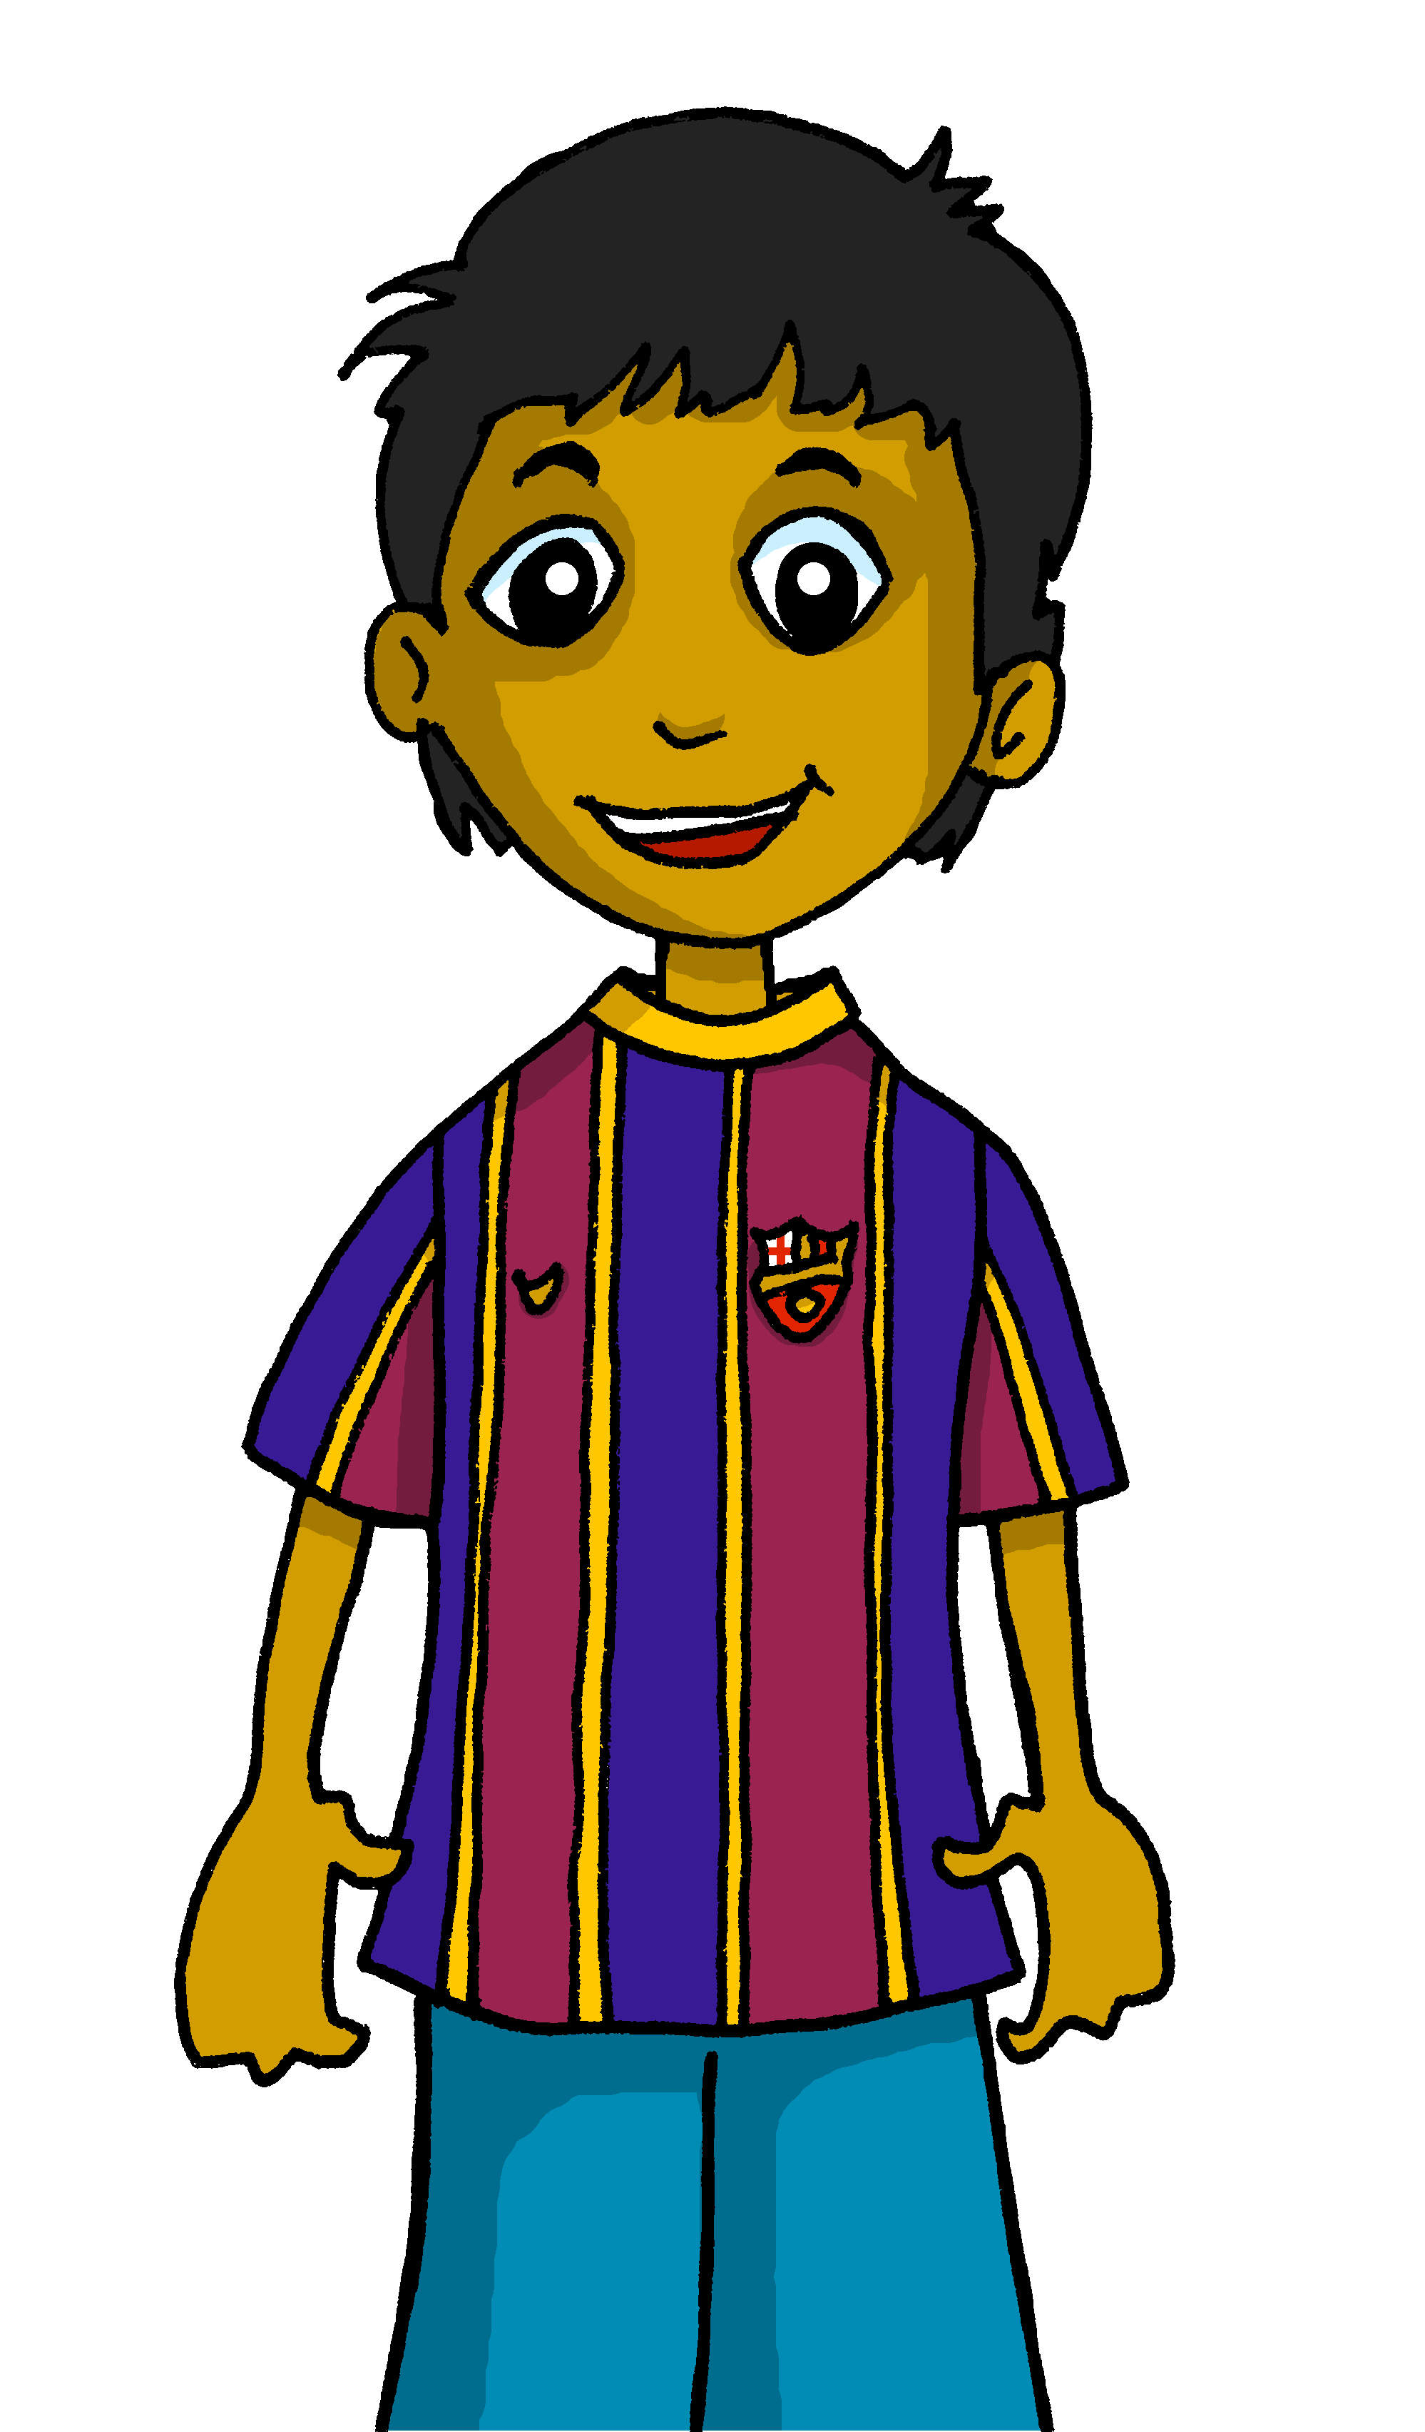
escuchar
Follow up 2: Escucha y escribe.
Es
1. _______ muy tranquilo.
3
I
s/he
Ángela
Rubén
2
1
in general
today | location
¡escribe!
Notes:
Timing: 5 minutes
Slide 1/5
Aim: to practise listening out for the verbs ‘estoy’, ‘soy’, ‘está’, ‘es’ and connecting them to person of the verb they refer to. To then practise processing the meaning of the two verbs.
Note: Pupils can choose to use the help on the board or write the sentence without looking – encourage pupils to choose their own level of challenge.
Procedure:
Read the instructions in Spanish. The following instructions apply to the next 5 slides.
Tell pupils this is a delayed dictation activity. They will hear a sentence played twice and they will have to retain that sentence in their working memory (picturing it in their heads!) for 3 seconds.
3. Once the time is up, they need to write the sentence.
4. Click to show the answer to the whole question.
5. Click again to bring up the different forms of the verb in (I, s/he). Elicit answer from pupils.
6. Click to bring up the possible uses of the verb (in general / today | location). Elicit answer from pupils.
Transcript:
Es muy tranquilo.

Slide 4
escuchar
Escucha y escribe
Está
2. _____ demasiado cansado hoy.
3
I
s/he
Ángela
Rubén
2
1
in general
today | location
¡escribe!
Notes:
Slide 2/5
Transcript:
2. Está demasiado cansado hoy.

Slide 5
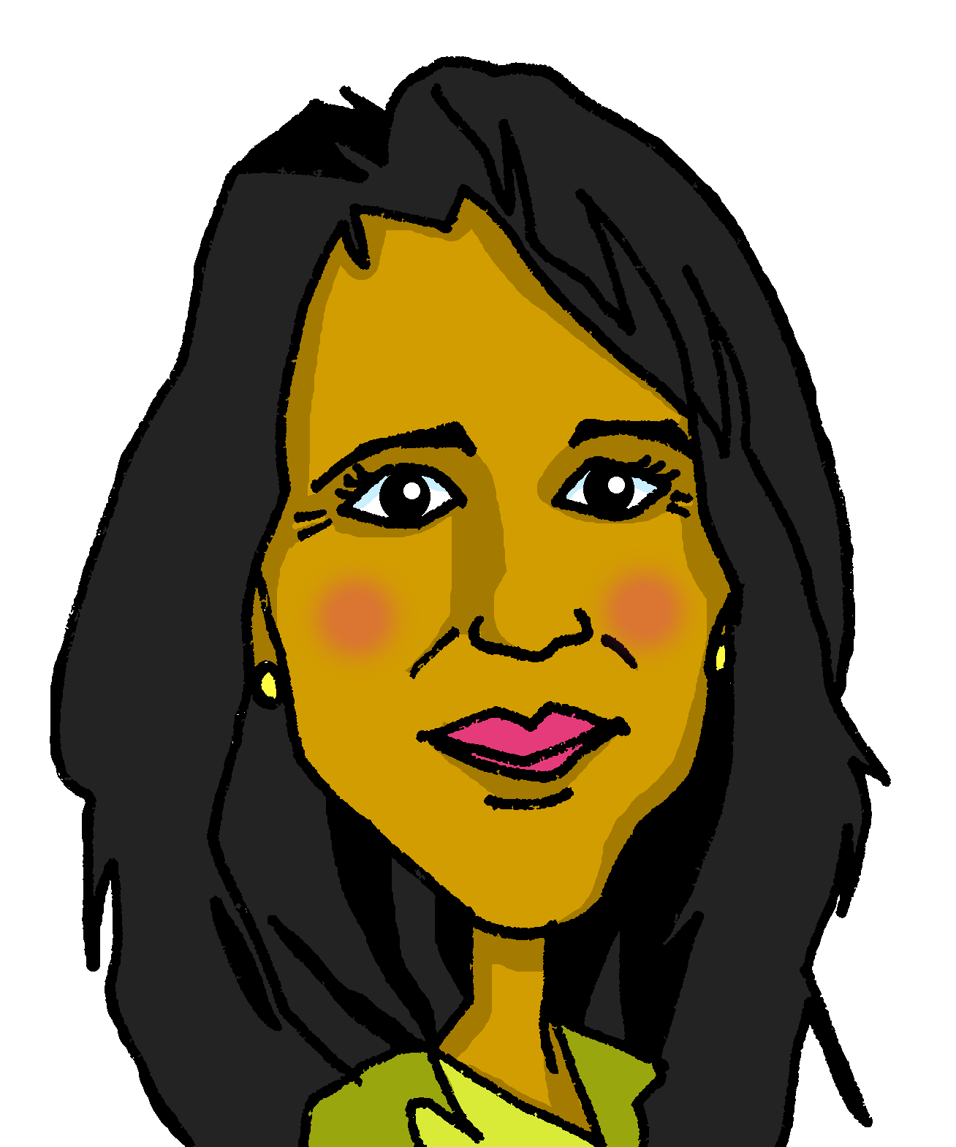
escuchar
Escucha y escribe
Es
3. ____ muy positivo.
3
I
s/he
Elena
Pedro
2
1
in general
today | location
¡escribe!
Notes:
(Slide 3/5)
Transcript:
3. Es muy positivo.

Slide 6
escuchar
Escucha y escribe
Estoy en clase.
Estoy
4. ________ en clase.
3
I
s/he
2
1
in general
today | location
¡escribe!
Notes:
(Slide 4/5)
Transcript:
4. Estoy en clase.

Slide 7
escuchar
Escucha y escribe.
Soy
5. ________ muy rápida.
3
I
s/he
Elena
Pedro
2
1
in general
today |location
¡escribe!
Notes:
(Slide 5/5)
Transcript:
5. Soy muy rápida.

Slide 8
Follow up 3: Habla en español.
Normally I am calm and positive. Today I am feeling lost.
hablar
tranquilo/a
nervioso/a
positivo/a
negativo/a
divertido/a
rápido/a
lento/a
pesado/a preparado/a
perdido/a
cansado/a
demasiado
y pero también
Hoy
Normalmente
Siempre
estoy | soy está | es
3
2
1
Normalmente soy tranquilo y positivo. Hoy estoy perdido.
Notes:
Timing: 5 minutes (three slides)
Aim: to use ser and estar (I am, s/he is) and adjectival agreement in guided oral production. Note: the layout of the words provides support with word order and prompts thinking about which forms of ser/estar are required, together with the the correct form of the adjective. We avoid separating the adverbs and matching them to ser/estar options as these are the choices we want to compel pupils to make themselves.
pupils to use the prompts to translate the sentences out loud in pairs within the 40 second time limit.
Draw their attention to the correct from of the adjectives. Make it clear that it is Pedro (a man) talking.
Click to trigger the timer.
Click to reveal the written answer.

Slide 9
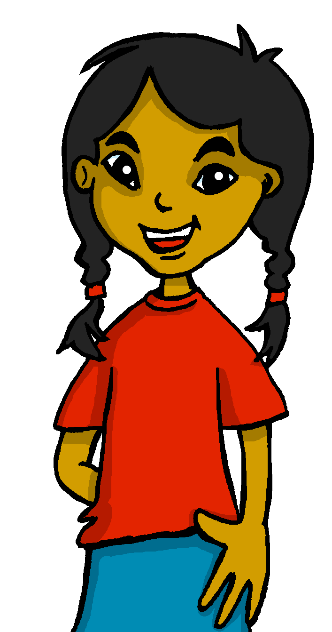
Follow up 3: Habla en español.
She is always funny but also annoying. Today she is feeling too tired.
hablar
tranquilo/a
nervioso/a
positivo/a
negativo/a
divertido/a
rápido/a
lento/a
pesado/a preparado/a
perdido/a
cansado/a
demasiado
y también pero
Hoy
Normalmente
Siempre
estoy | soy está | es
3
2
1
Siempre es divertida pero también pesada. Hoy está demasiado cansada.
Notes:
Timing: 5 minutes (three slides)
Aim: to use ser and estar (I am, s/he is) and adjectival agreement in guided oral production. Note: the layout of the words provides support with word order and prompts thinking about which forms of ser/estar are required, together with the the correct form of the adjective. We avoid separating the adverbs and matching them to ser/estar options as these are the choices we want to compel pupils to make themselves.
pupils to use the prompts to translate the sentences out loud in pairs within the 40 second time limit.
Draw their attention to the correct from of the adjectives. Make it clear that it is Pedro (a man) talking.
Click to trigger the timer.
Click to reveal the written answer.

Slide 10
Follow up 3:
Con tu compañero, habla en español.
Normally I am… today I am… s/he is always … today s/he is…
hablar
hablar
tranquilo/a
nervioso/a
positivo/a
negativo/a
divertido/a
rápido/a
lento/a
pesado/a preparado/a
perdido/a
cansado/a
y pero también
60
demasiado
Hoy
Normalmente
Siempre
estoy | soy está | es
S
0
INICIO
Notes:
SLIDE 3/3
Aim to practise spoken production of sentences with ser and estar (I am, s/he is) and correct adjectival agreement.
Pupils to work in pairs to describe themselves and someone else. Normally I am… today I am… s/he is always … today s/he is…
Click “inicio” to start timer.
Teachers can ask pupils to feedback to the class on what their partners said.

Slide 11
Follow up 4:

Completa las frases. Escribe en español
⚠ Use these words to make your sentences more interesting.
too
very
and
but
¿’soy’ or ‘estoy’? ¿’es’ or ‘está’?
escribir
escribir
Normally I am …
2. Today I am …
3. He is always…
4. Today he is …
very serious but positive.
Normalmente soy seria pero positiva.
tranquilo/a
nervioso/a
positivo/a
negativo/a
divertido/a
rápido/a
lento/a
pesado/a
preparado/a*
perdido/a*
cansado/a*
Notes:
Timing: 5 minutes
Aim: to produce full sentences using soy, estoy, es, está & and a range of adjectives to describe personality.
Read the instructions in Spanish.
Ask students to complete the sentences in English to describe themselves and someone else, then translate them into Spanish.
Show Sofía’s example.

Slide 12
vocabulario

Follow up 5 :
Escribe en inglés: Can you get at least 15 points?
 | crear | organizar | preparar
 | la lista | la fiesta | útil
 | mayo | agosto | enero
 | a menudo | en | marzo
 | estoy | negativo | está
 | pero | es | demasiado
 | siempre | también | soy
to believe
to organise
to prepare
x3
list
party
useful
May
August
January
x2
often
in
March
I am (state)
negative (m)
s/he, it is (state)
but
s/he, it is (trait)
too
x1
always
also
I am (trait)
Notes:
Timing: 5 minutes
Aim: to practise written comprehension of vocabulary from last week and this week.
Procedure: 1. Give pupils a blank grid. They fill in the English meanings of any of the words they know, trying to reach 15 points in total.
Note: The most recently learnt and practised words are pink, words from the previous week are green and those from two weeks ago are blue, thus more points are awarded for them, to recognise that memories fade and more effort (heavy lifting!) is needed to retrieve them.

Slide 13
vocabulario

Follow up 5 :
Escribe en español: Can you get at least 15 points?
 | to believe | to organise | to prepare
 | list | party | useful
 | May | August | January
 | often | in | March
 | I am (state) | negative (m) | s/he, it is (state)
 | but | s/he, it is (trait) | too
 | always | also | I am (trait)
crear
organizar
preparar
x3
la lista
la fiesta
útil
mayo
agosto
enero
x2
a menudo
en
marzo
estoy
negativo
está
pero
es
demasiado
x1
siempre
también
soy
Notes:
Timing: 5 minutes
Aim: to practise written production of vocabulary from this week and this week’s revisited sets.
Procedure: 1. Give pupils a blank grid. They fill in the Spanish meanings of any of the words they know, trying to reach 15 points in total.
Note: The most recently learnt and practised words are pink, words from the first revisit are green and those from the second revisit are blue, thus more points are awarded for them, to recognise that memories fade and more effort (heavy lifting!) is needed to retrieve them.

Slide 14
vocabulario

Follow up :
Escribe en inglés: Can you get at least 15 points?
 | crear | organizar | preparar
 | la lista | la fiesta | útil
 | mayo | agosto | enero
 | a menudo | en | marzo
 | estoy | negativo | está
 | pero | es | demasiado
 | siempre | también | soy
x3
x2
x1
Notes:
HANDOUT

Slide 15
vocabulario

Follow up 5 :
Escribe en español: Can you get at least 15 points?
 | to believe | to organise | to prepare
 | list | party | useful
 | May | August | January
 | often | in | March
 | I am (state) | negative (m) | s/he, it is (state)
 | but | s/he, it is (trait) | too
 | always | also | I am (trait)
x3
x2
x1
Notes:
HANDOUT

