Slide 1
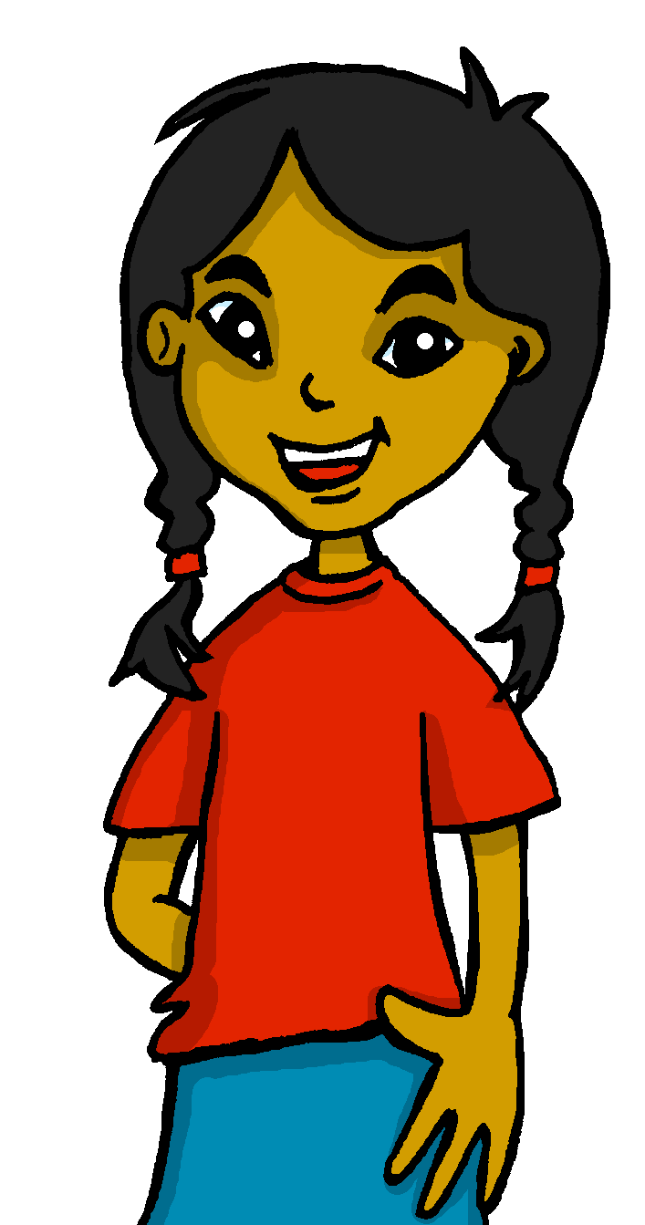
español, con Sofía

Slide 2
Saying what I and others have
verde
Autumn vocabulary and grammar quiz
A Christmas carol
Notes:
Artwork by Steve Clarke. Pronoun pictures from NCELP (www.ncelp.org). All additional pictures selected from Pixabay and are
available under a Creative Commons license, no attribution required.
This lesson contains vocabulary and grammar assessments to check progress in the words and structures introduced and practised in the first 12 weeks of this year’s course, as well as those from the previous two years. The ratio of old to new language in the quiz is very approximately 50:50.
Source: Davies, M. & Davies, K. (2018). A frequency dictionary of Spanish: Core vocabulary for learners (2nd ed.). Routledge: London

Slide 3
escuchar
Vocabulary
At home, Apo speaks Quechua, a language spoken by many people from Peru, Bolivia and Ecuador. He is learning Spanish at school, like you. Help Apo by answering the questions in this quiz.
A For each question, put a cross (x) under the English meaning that matches what you hear.
You will hear each Spanish word twice. Choose one correct answer only.
 | A | B | C | D
Ej. | 10 | 18 | 8 | 28
 | ☐ | ☐ | ☐ | ☐
1. | there is/are | to have | to be (trait) | to be (state, location)
 | ☐ | ☐ | ☐ | ☐
2. | date | happy | difficult | February
 | ☐ | ☐ | ☐ | ☐
3. | what | which | when | who
 | ☐ | ☐ | ☐ | ☐
1
2
3
4
Notes:
Timing: 20-25 minutes (all assessment slides)
Aim: to practise aural comprehension of vocabulary taught in weeks 1-12 of the course.
Procedure:
1. Click the audio buttons to play each item. (The words are recorded twice with a pause to allow pupils to process the information).
2. Pupils can either write 1C, etc.. or if they have the assessment on a print out they can put a X in the correct box.
3. After items 1-4, continue to the next slide to complete the remainder of the task.
Transcript:
1. dieciocho
2. ser
3. fecha
4. cuál ?

Slide 4
escuchar
Vocabulary
A For each question, put a cross (x) under the English meaning that matches what you hear.
You will hear each Spanish word twice. Choose one correct answer only.
 | A | B | C | D
4. | to play | to eat | to learn | to talk
 | ☐ | ☐ | ☐ | ☐
5. | 12 | 30 | 20 | 11
 | ☐ | ☐ | ☐ | ☐
6. | park | square | door | bridge
 | ☐ | ☐ | ☐ | ☐
 | exercise | exhibition | show | chair
 | ☐ | ☐ | ☐ | ☐
5
6
7
8
Notes:
Transcript:
1. dieciocho
2. ser
3. fecha
4. cuál ?
5. aprender
6. veinte
7. puente
8. exposición

Slide 5
escuchar
Vocabulary
B For each question, put a cross (x) under the type of word you hear. You will hear each Spanish word twice. Choose one correct answer only.
This word is a good example of …
 | A | B | C | D
 | a place ☐ | a person ☐ | a month ☐ | a greeting ☐
 | a day ☐ | a place ☐ | an animal ☐ | a part of the body ☐
 | a greeting ☐ | a question word ☐ | personality ☐ | a number ☐
 | a number ☐ | a position ☐ | a question word ☐ | a part of the body ☐
1
2
3
4
Notes:
Procedure:
1. Click the audio buttons to play each item. (The words are recorded twice with a pause to allow pupils to process the information).
2. Pupils can either write 1C, etc.. or if they have the assessment on a print out they can put a X in the correct box.
3. When complete, continue to the reading.
Transcript:
1. compañera
2. universidad
3. quince
4. entre
5. negro
6. amarillo
7. niña
8. detrás

Slide 6
escuchar
Vocabulary
B For each question, put a cross (x) under the type of word you hear. You will hear each Spanish word twice. Choose one correct answer only.
This word is a good example of …
 | A | B | C | D
 | personality description ☐ | a question word ☐ | a colour ☐ | a number ☐
 | a colour ☐ | a greeting ☐ | personality ☐ | a day ☐
 | a number ☐ | a person ☐ | a month ☐ | a day ☐
 | a greeting ☐ | a number ☐ | a question word ☐ | a month ☐
5
6
7
8
Notes:
Transcript:
1. compañera
2. universidad
3. quince
4. entre
5. negro
6. amarillo
7. niña
8. trece

Slide 7
leer
A Translate the underlined Spanish word(s) to complete each English sentence.
1. La profesora es rubia. The ________________ is ___________.
2. El cantante no es famoso. The ______________ ____ _____ famous.
3. Tiene una calle pequeña. It has a ___________ ___________ .
4. Es verdad o es mentira? Is it___________ or_____________?
5. ¡Es bastante débil! It’s ____________ ___________!
6. Está delante del cine. It is ____________ __________ ___________ .
7. Tiene una cocina? Does it have ________________________?.
8. Quique solo tiene hambre. Quique is _______ ______________.
9. No tiene gafas. He doesn’t have ___________.
10. Tiene los ojos negros. S/he has __________ ____________ .
Notes:
Aim: to practise written comprehension of previously taught vocabulary.
Procedure:
Ensure that the task is clear.
Pupils could write 1 – 10 and the individual English word meanings (or they could fill in if they have printed assessment sheets).

Slide 8
escribir
B Translate the underlined English words to complete the Spanish sentence.
1. Sofía is my favourite person. Sofía es mi ___________ __________. (write two words)
2. The tree is tall. El __________ es _____________. (write two words)
3. My classmate (m) is capable. Mi ______________es ____________. (write two words)
4. He has a round face. Tiene una __________ _______. (write two words)
5. He has short hair. Tiene el ________ _________. (write two words)
6. He is fun and also intelligent. Es divertido ___ ________ inteligente. (write two words)
7. My school has a pool. Mi _________ _________ una piscina. (write two words)
8. The building is behind. El _______________ está ____________. (write two words)
9. There are concerts , shows… Hay ____________, ________________... (write two words)
10. Yes, I am ten years old. ____, _________ __________ años. (write three words)
Notes:
Aim: to practise written production of previously taught vocabulary.
Procedure:
Ensure that the task is clear.
Pupils could write 1 – 10 and the individual English word meanings (or they could fill in if they have printed assessment sheets).

Slide 9
leer
Grammar
A Put a (X) next to the person the sentence is about.
1 | ☐ I ☐ you _{[singular]} ☐ s/he, it ☐ we ☐ they | Estás rápido. |  | 4 | ☐ I ☐ you _{[singular]} ☐ s/he, it ☐ we ☐ they | Somos fuertes.
2 | ☐ I ☐ you _{[singular]} ☐ s/he, it ☐ we ☐ they | Soy una chica. |  | 5 | ☐ I ☐ you _{[singular]} ☐ s/he, it ☐ we ☐ they | Tienen una respuesta.
3 | ☐ I ☐ you _{[singular]} ☐ s/he, it ☐ we ☐ they | Tengo frío. |  | 6 | ☐ I ☐ you _{[singular]} ☐ s/he, it ☐ we ☐ they | Están en la playa.
Notes:
Aim: to practise written recall of previously taught grammar.
Procedure:
Ensure that the task is clear.
Pupils could write the correct English pronouns (or they could fill in if they have printed assessment sheets).

Slide 10
leer
Grammar
Quechua doesn’t have gendered words for ‘a’ and ‘the’. Adjectives and verbs are also very different from Spanish. Help Apo with his Spanish grammar by answering the questions in this part of the quiz.
B Put a cross (x) next to the correct English meaning.
1. No está enfermo. | ☐ He is ill. | ☐ He is not ill.
2. Tiene una planta. | ☐ S/he has a plant. | ☐ S/he does not have a plant.
3. No necesita comida. | ☐ S/he needs food. | ☐ S/he does not need food.
4. No es negativa. | ☐ She is negative. | ☐ She is not negative.
C ESTAR or SER? Put a cross (x) next to the correct start of each sentence.
1. | ☐ Está… ☐ Es … | activo hoy.
2. | ☐ Son … ☐ Están … | en España.
3. | ☐ Están … ☐ Son … | positivos siempre.
Notes:
Aim: to practise written recall of previously taught grammar features.

Slide 11
leer
Grammar
D Write the words in each box in the correct order to make a question.
1. | hay cuántas iglesias | Correct order:_________________________________________
2. | la fecha es cuál | Correct order:_________________________________________
E Singular or plural? Put a cross (x) next to the correct start of each sentence.
1. | ☐ Es… ☐ Son … | elegantes.
2. | ☐ Está… ☐ Están … | diferente.
3. | ☐ Son … ☐ Es … | amables.
4. | ☐ Están … ☐ Está … | cómoda.
Notes:
Aim: to practise written recall of previously taught grammar features.

Slide 12
leer
Grammar
F Write the words in each box in the correct order.
1. | profesora estricta una | Correct order:_________________________________________
2. | problemas unos difíciles | Correct order:_________________________________________
escribir
G Write the Spanish for the English given in brackets. Use the clues to help you.
 |  | Clues
1. | ___________ elegante hoy. (I am) | to be = estar
2. | ___________ una pelota. (you have) | to have = tener
3. | ___________ imposibles. (they are) | to be = ser
4. | _______________ de Perú. (you are) | to be = ser
5. | _________ en Barcelona. (s/he, it is) | to be = estar
6. | __________ un amigo español. (we have) | to have = tener
Notes:
Aim: to practise written recall of previously taught grammar features.

Slide 13
escribir
H Write the Spanish article ‘a’ or ‘some’. The gender (and number) of the noun is provided.
1. | Es _______ puerta. (f)
2. | Hay ________ montañas. (fpl)
3. | Son ________ barcos. (mpl)
4. | Hay ________ animal. (m)
I Write the Spanish article ‘the’. The gender (and number) of the noun is provided.
1. | _____ regalo (m) fantástico.
2. | _____ cartas (fpl) bonitas.
3. | _____ hoteles (mpl) perfectos.
4. | _____ cámara (f) rara.
Notes:
Aim: to practise written recall of previously taught grammar features.

Slide 14
escuchar
Un villancico: ________ de _____________
A Escucha y ordena las frases.
A Escucha y completa el estribillo.
el villancico = Christmas carol
[estribillo] (chorus)
Notes:
Timing: flexible
Aim: to enjoy a traditional Spanish carol; to practise read aloud and pronunciation, including of some unknown words.
Procedure:
1. Click to listen to the carol, using the youtube link provided. 2. Pupils write in the number 25 in Spanish to fill the gaps. 3. They then listen to the lines of the verses and number them in the correct order. They may need to hear them multiple times to do this. 4. Click to correct.
Transcript:

Slide 15
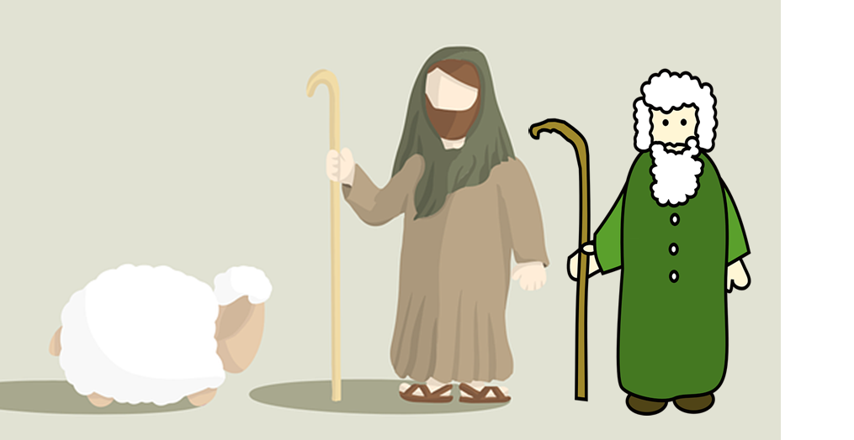
escuchar
Un villancico: ________ de _________
Veinticinco
diciembre
B ¿Cuál es el título del villancico?
C ¡Canta el villancico!
ha nacido = s/he is born venid = come!
parece = s/he looks like adorar = to worship
ha aparecido = s/he has appeared
Notes:
Aim: to enjoy a traditional Spanish carol; to practise read aloud and pronunciation, including of some unknown words.
Procedure: 1. Ask pupils for the title of the carol, in Spanish. 2. Play the song again for pupils to join in with.
Transcript:

Slide 16
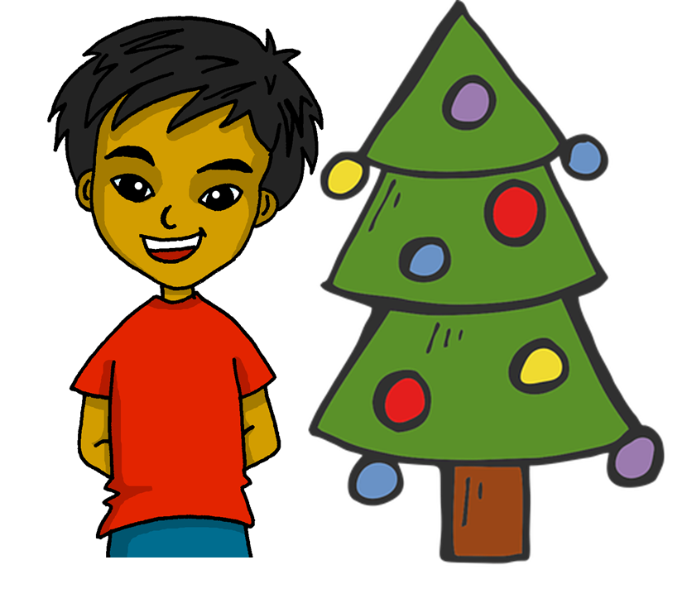
¡Feliz Navidad !
azul

Slide 17
escuchar
Vocabulary
At home, Apo speaks Quechua, a language spoken by many people from Peru, Bolivia and Ecuador. He is learning Spanish at school, like you. Help Apo by answering the questions in this quiz.
A For each question, put a cross (x) under the English meaning that matches what you hear.
You will hear each Spanish word twice. Choose one correct answer only.
 | A | B | C | D
Ej. | 10 | 18 | 8 | 28
 | ☐ | ☐ | ☐ | ☐
1. | there is/are | to have | to be (trait) | to be (state, location)
 | ☐ | ☐ | ☐ | ☐
2. | date | happy | difficult | February
 | ☐ | ☐ | ☐ | ☐
3. | what | which | when | who
 | ☐ | ☐ | ☐ | ☐
1
2
3
4
Notes:
ANSWERS

Slide 18
escuchar
Vocabulary
A For each question, put a cross (x) under the English meaning that matches what you hear.
You will hear each Spanish word twice. Choose one correct answer only.
 | A | B | C | D
4. | to play | to eat | to learn | to talk
 | ☐ | ☐ | ☐ | ☐
5. | 12 | 30 | 20 | 11
 | ☐ | ☐ | ☐ | ☐
6. | park | square | door | bridge
 | ☐ | ☐ | ☐ | ☐
 | exercise | exhibition | show | chair
 | ☐ | ☐ | ☐ | ☐
5
6
7
8
Notes:
ANSWERS

Slide 19
escuchar
Vocabulary
B For each question, put a cross (x) under the type of word you hear. You will hear each Spanish word twice. Choose one correct answer only.
This word is a good example of …
 | A | B | C | D
 | a place ☐ | a person ☐ | a month ☐ | a greeting ☐
 | a day ☐ | a place ☐ | an animal ☐ | a part of the body ☐
 | a greeting ☐ | a question word ☐ | personality ☐ | a number ☐
 | a number ☐ | a position ☐ | a question word ☐ | a part of the body ☐
1
2
3
4
Notes:
ANSWERS

Slide 20
escuchar
Vocabulary
B For each question, put a cross (x) under the type of word you hear. You will hear each Spanish word twice. Choose one correct answer only.
This word is a good example of …
 | A | B | C | D
 | personality description ☐ | a question word ☐ | a colour ☐ | a number ☐
 | a colour ☐ | a greeting ☐ | personality ☐ | a day ☐
 | a number ☐ | a person ☐ | a month ☐ | a day ☐
 | a greeting ☐ | a number ☐ | a question word ☐ | a month ☐
5
6
7
8
Notes:
ANSWERS

Slide 21
leer
A Translate the underlined Spanish word(s) to complete each English sentence.
1. La profesora es rubia. The _______________________ is ___________.
2. El cantante no es famoso. The ______________ _________ famous.
3. Tiene una calle pequeña. It has a ___________ ___________ .
4. Es verdad o es mentira? Is it___________ or_____________?
5. ¡Es bastante débil! It’s ____________ ___________!
6. Está delante del cine. It is ____________ __________ ___________ .
7. Tiene una cocina? Does it have ________________________?.
8. Quique solo tiene hambre. Quique is _______ ______________.
9. No tiene gafas. S/he doesn’t have ___________.
10. Tiene los ojos negros. S/he has __________ ____________ .
(female) teacher
blond
(male) singer
is not
small
street
true
false
quite
weak
in front of
the
cinema
a kitchen
only
hungry
glasses
black
eyes
Notes:
ANSWERS

Slide 22
escribir
B Translate the underlined English words to complete the Spanish sentence.
1. Sofía is my favourite person. Sofía es mi ___________ __________. (write two words)
2. The tree is tall. El __________ es _____________. (write two words)
3. My classmate (m) is capable. Mi ______________ es ____________. (write two words)
4. He has a round face. Tiene una __________ __________. (write two words)
5. He has short hair. Tiene el ________ _________. (write two words)
6. He is fun and also intelligent. Es divertido ___ __________ inteligente. (write two words)
7. My school has a pool. Mi _________ _________ una piscina. (write two words)
8. The building is behind. El _______________ está ____________. (write two words)
9. There are concerts , shows… Hay ____________, ________________... (write two words)
10. Yes, I am ten years old. ____, _________ __________ años. (write three words)
persona
favorita
árbol
alto
compañero
capaz
cara
redonda
pelo
corto
y
también
escuela
tiene
edificio
detrás
conciertos
espectáculos
Sí
tengo
diez
Notes:
ANSWERS

Slide 23
leer
Grammar
A Put a (X) next to the person the sentence is about.
1 | ☐ I ☐ you _{[singular]} ☐ s/he, it ☐ we ☐ they | Estás rápido. |  | 4 | ☐ I ☐ you _{[singular]} ☐ s/he, it ☐ we ☐ they | Somos fuertes.
2 | ☐ I ☐ you _{[singular]} ☐ s/he, it ☐ we ☐ they | Soy una chica. |  | 5 | ☐ I ☐ you _{[singular]} ☐ s/he, it ☐ we ☐ they | Tienen una respuesta.
3 | ☐ I ☐ you _{[singular]} ☐ s/he, it ☐ we ☐ they | Tengo frío. |  | 6 | ☐ I ☐ you _{[singular]} ☐ s/he, it ☐ we ☐ they | Están en la playa.
Notes:
ANSWERS

Slide 24
leer
Grammar
Quechua doesn’t have gendered words for ‘a’ and ‘the’. Adjectives and verbs are also very different from Spanish. Help Apo with his Spanish grammar by answering the questions in this part of the quiz.
B Put a cross (x) next to the correct English meaning.
1. No está enfermo. | ☐ He is ill. | ☐ He is not ill.
2. Tiene una planta. | ☐ S/he has a plant. | ☐ S/he does not have a plant.
3. No necesita comida. | ☐ S/he needs food. | ☐ S/he does not need food.
4. No es negativa. | ☐ She is negative. | ☐ She is not negative.
C ESTAR or SER? Put a cross (x) next to the correct start of each sentence.
1. | ☐ Está… ☐ Es … | activo hoy.
2. | ☐ Son … ☐ Están … | en España.
3. | ☐ Están … ☐ Son … | positivos siempre.
Notes:
ANSWERS

Slide 25
leer
Grammar
D Write the words in each box in the correct order to make a question.
1. | hay cuántas iglesias | Correct order:_________________________________________
2. | la fecha es cuál | Correct order:_________________________________________
¿Cuántas iglesias hay?
¿Cuál es la fecha?
E Singular or plural? Put a cross (x) next to the correct start of each sentence.
1. | ☐ Es… ☐ Son … | elegantes.
2. | ☐ Está… ☐ Están … | diferente.
3. | ☐ Son … ☐ Es … | amables.
4. | ☐ Están … ☐ Está … | cómoda.
Notes:
ANSWERS

Slide 26
leer
Grammar
F Write the words in each box in the correct order.
1. | domingo tranquilo un | Correct order:_________________________________________
2. | grandes unos pueblos | Correct order:_________________________________________
un domingo tranquilo
unos pueblos grandes
escribir
G Write the Spanish for the English given in brackets. Use the clues to help you.
 |  | Clues
1. | ___________ elegante hoy. (I am) | to be = estar
2. | ___________ una pelota. (you have) | to have = tener
3. | ___________ imposibles. (they are) | to be = ser
4. | _______________ de Perú. (you are) | to be = ser
5. | _________ en Barcelona. (s/he, it is) | to be = estar
6. | __________ un amigo español. (we have) | to have = tener
Soy
Tienes
Son
Eres
Está
Tenemos
Notes:
ANSWERS

Slide 27
escribir
H Write the Spanish article ‘a’ or ‘some’. The gender (and number) of the noun is provided.
una
1. | Es _______ puerta. (f)
2. | Hay ________ montañas. (fpl)
3. | Son ________ barcos. (mpl)
4. | Hay ________ animal. (m)
unas
unos
un
I Write the Spanish article ‘the’. The gender (and number) of the noun is provided.
El
1. | _____ regalo (m) fantástico.
2. | _____ cartas (fpl) bonitas.
3. | _____ hoteles (mpl) perfectos.
4. | _____ cámara (f) rara.
Las
Los
La
Notes:
ANSWERS

