Slide 1


español, con Sofía

Slide 2

Saying what I and others have
Singular & plural definite articles
Post-nominal adjectives
SSC: [ch]
verde
Notes:
Artwork by Steve Clarke. All additional pictures selected are available under a Creative Commons license, no attribution required.
The frequency rankings for words that occur in this PowerPoint which have been previously introduced in the resources are given in the SOW (excel document) and in the resources that first introduced and formally re-visited those words.
Phonics: Source: noche[164] Cluster: chocolate [3408] leche[1397] chino [1349]
Vocabulary: tiene [8] cantante [2105] cara [337] gafas [>5000] nariz [1570] ojo [169] pelo [873] profesor / profesora [501] azul [811] corto [1055] grande [66] gris [1751] largo [300] moreno [3304] negro [307] pequeño [202] rubio [2861] redondo [2470] verde [812] los / las [1]
Revisit 1: tienes [tener 19] tiene [tener 19] árbol [748] calle [269] escuela [424] estadio [2581] hotel [1163] iglesia [437] mentira [1673] museo [1114] parque [1354] piscina [4604] puente [1715] plaza [806] universidad [387] verdad [176] allí [197] aquí [130] blanco [372] bonito [891] perfecto [1115] grande [66] alto [231] verde [812] unos, unas [>5000]
Revisit 2: concierto [1456] cumpleaños [3372] fiesta [796] mes [288] enero [1173] febrero [1419] marzo [1231] abril [1064] mayo [909] junio [1035] julio [659] septiembre [1150] octubre [1242] noviembre [1434] diciembre [1165] cuándo [138] de [2] trece [2700] catorce [2411] quince[1215] dieciséis [3373] diecisiete [3400] dieciocho [2730] diecinueve [4232] veinte [819] veintiuno [819/425] veintidós | veintitrés | veinticuatro | veinticinco |veintiseis |veintisiete|veintiocho |veintinueve | treinta [830] treinta y uno [830/4/425]
For any other words that occur incidentally in this PowerPoint, frequency rankings will be provided in the notes field wherever possible.
Glossed words: comprobar [1301] artículo [458] pintor [1848]
Source: Davies, M. & Davies, K. (2018). A frequency dictionary of Spanish: Core vocabulary for learners (2nd ed.). Routledge: London

Slide 3


pronunciar
[ch]
noche
Notes:
Timing: 1 minute
Aim: To introduce SSC [ch]
Procedure
Introduce and elicit the pronunciation of the individual SSC [ch] and then the source word ‘noche’ (with gesture, if using).
Click to bring the picture & get students to repeat (with gesture, if using).

Slide 4

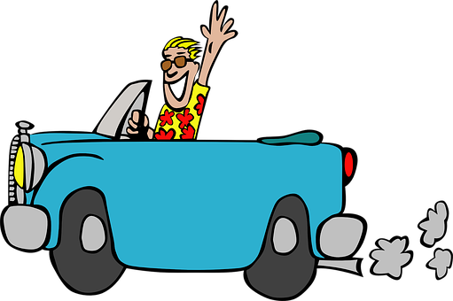


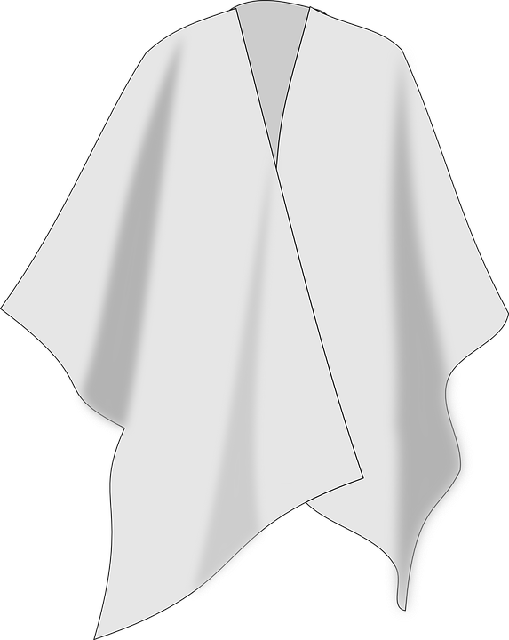
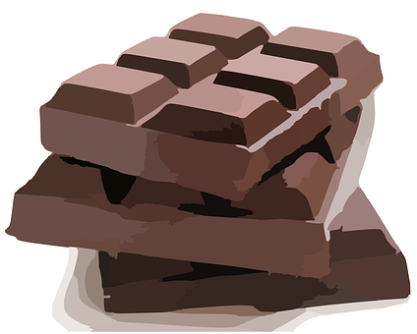

pronunciar
Pronuncia las palabras.
noche
leche
coche
1 minuto
Pancho
chino
chocolate
poncho
cuchara
Pocholo
INICIO
Notes:
Aim: to practise SSC [ch] in a read aloud task.
Timing: 2 minutes
Procedure:
1. Partner A writes down 5 of the words on the slide.
2. Partner B, without seeing A’s list, says all the words on the slide as quickly as possible, trying to match all of Partner A’s list before the 30 seconds is up. If s/he succeeds s/he has won the round, if not all five words have been said, Partner B wins the round.
Note: Partner A should listen very carefully to B’s pronunciation. S/he doesn’t need to cross a word off if it is a different form (m/f) of the chosen word.
3. Swap roles.
Note: this activity can be repeated a couple of times.

Slide 5

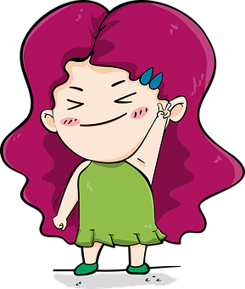



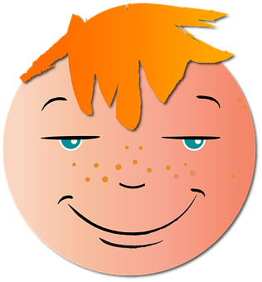


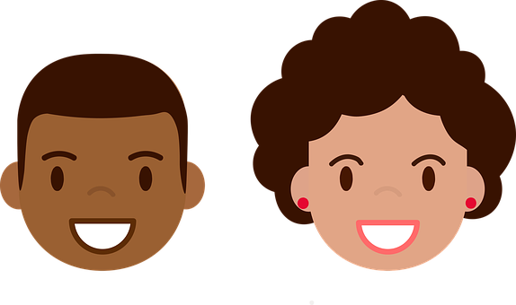
vocabulario
¿Cómo tiene… ?
el pelo
[hair]
corto
largo
negro
rubio
moreno
[short]
[long]
[black]
[blonde]
[dark, brown]
la cara
las gafas
redondo
grande
pequeño
[round]
[big]
[small]
Notes:
Timing: 5 minutes
Aim: presentation of new vocabulary items.
Procedure:
Click to reveal the Spanish word and picture. Say the word with pupils.
Elicit the English and click to reveal the written English meaning.
Click to make English and picture disappear and elicit pupil repetition of the word and English meaning.

Slide 6

Definite articles: singular & plural
This is grammatical, not biological gender! A house (una casa) is not female, it is a feminine noun.
[the]
In Spanish, things, as well as people and animals, are either masculine or feminine. We say that they have gender.
To say the before a singular noun, you use ‘el’ or ‘la’.
To say ‘the’ before a plural noun (more than one), use ‘los’ or ‘las’.
Masculine
Feminine
las
la
___ fiesta
the party
los
___ fiestas
the parties
el
___ amigos
___ amigo
the friends
the friend
the square
las
the squares
la
___ plaza
los
___ plazas
___ parques
___ parque
the parks
el
the park
el
los
___ compañero
___ compañeros
the partner
the (female) friend
the partners
las
the (female) friends
___ amiga
___ amigas
la
Notes:
Timing: 3 minutes
Aim: to revisit grammatical gender and singular and plural definite articles (el, la, los, las).
Procedure:
Read the grammar explanation on gender in Spanish.
Click to bring up examples of singular masculine and feminine nouns.
Elicit the definite article from pupils and the English meaning of each noun.
Click each time to reveal the answer.
Click to make examples of nouns with singular definite article disappear.
Click to bring up the explanation for “the” in the plural form.
Repeat as in steps 2-5.
Bear in mind that students following Rojo / Amarillo (lower KS2) Spanish SoW have already learnt singular nouns with their definite article in term 2, and plural definite articles in term 3, so this is revisiting.

Slide 7

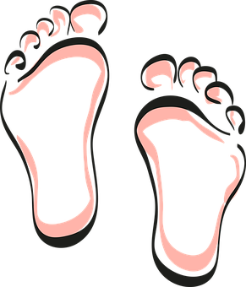
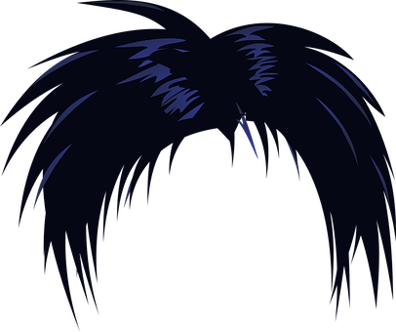
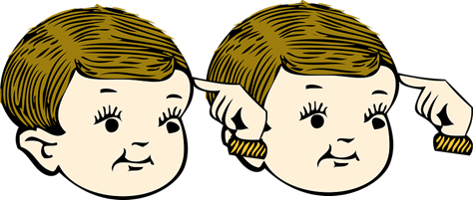

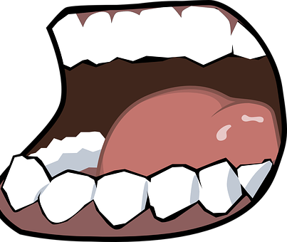


hablar
¿Qué artículo* es?
(el) artículo = article
- - -
[el]
[los]
- - -[ ]- - -
___ nariz
[the] nose
___ ojos
[the] eyes
___ cara
[the] face
___ pelo
[the] hair
___ cabezas
[the] heads
___ gafas
[the] glasses
___ boca
[the] mouth
___ pies
[the] feet
[la]
- - -
[las]
Notes:
Note: pies/los pies – awaiting audio
Timing: 5 minutes
Aim: to revisit vocabulary from Y3/4 and new vocabulary from this week.
Procedure:
Click for each word to appear with audio (without article).
Pupils say ‘el’, ‘la’, ‘los’, ‘las’, depending on the noun ending.
Click again for it to disappear into the corresponding pacperson’s mouth.
Transcript
1. nariz
2. cara
3. pelo
4. ojos
5. cabezas
6. gafas
7. boca
8. pies
1. La nariz
2. la cara
3. El pelo
4. Los ojos
5. Las cabezas
6. Las gafas
7. La boca
8. Los pies
artículo [458]

Slide 8

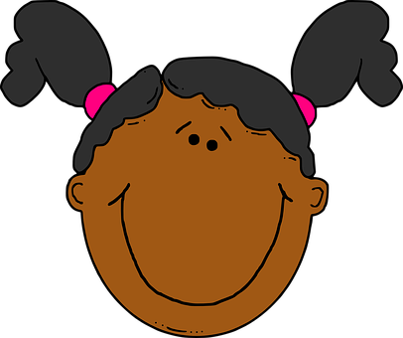
escuchar
Sofía describe unas personas.
Lee. ¿Qué describe Sofía?
Escucha. ¿Es ‘el, la, los o las’?
Marca la opción correcta.
 | el / la | cara | pelo
 | la / las | nariz | gafas
 | los / las | gafas | ojos
 | el / los | pelo | dedos
 | el / la | pelo | nariz
 | los / las | pies | cabezas
E
E
1
1
2
2
3
3
4
4
5
5
Notes:
Timing: 5 minutes
Aim: to practise aural recognition of definite articles (singular & plural) and their connection with the newly introduced vocabulary .
Procedure:
Read the title and click to bring up the instructions in Spanish.
Do the first part of the example (E). (Note: some learners will benefit from being able to circle the words on the sheet).
Click to listen. They only hear the definite article. Click to correct.
Listen to 1 – 4. Pupils note the definite article. Click to correct these.
Now draw their attention to the nouns – selecting the correct article will help them work out which noun is correct.
Give pupils a minute to select the correct noun to match their definite articles.
Now pupils listen and check. Click the pink audio buttons to hear the correct nouns (minus the adjectives for the moment).
Click to bring up answers.
Now elicit the English meanings for the correct nouns. ¿Cómo se dice ‘pelo’ en inglés?’ Click to provide a picture confirmation of meaning.
Note: the final stage (hearing and understanding the adjectives) is in a separate activity on slide 18.
Transcript 1
Ej. Tiene la [cara pequeña]
Tiene las [gafas negras]
Tiene los [ojos bonitos]
Tiene el [pelo moreno]
Tiene la [nariz roja]
Tienes los [pies] grandes
Transcript 2
Ej. Tiene la cara [pequeña]
Tiene las gafas [negras]
Tiene los ojos [bonitos]
Tiene el pelo [moreno]
Tiene la nariz [roja]
Tiene los pies [grandes]

Slide 9
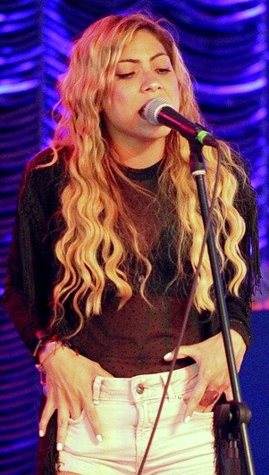


Adjectives following the noun.
We have already seen that many adjectives follow the noun.
Ejemplos:
Note: in Spanish we always use the definite article ‘the’ in these descriptions. In English, we leave it out or use ‘a’, e.g., has a small nose.
Shakira tiene el pelo bonito.
Shakira tiene el pelo bonito.
Shakira has pretty hair.
El cantante tiene las gafas amarillas.
El cantante tiene las gafas amarillas.
The singer has yellow glasses.
⚠ Remember: Adjectives agree (match) in gender and number with the noun they are describing.
Notes:
Timing: 2 minutes
Aim: to reintroduce post-nominal adjective agreement.
Procedure:
Read the grammar explanation on post-nominal adjective agreement (singular and plural form).
Elicit English translation for the Spanish examples provided.
Click to highlight another major cross-linguistic difference between English and Spanish, i.e., the fact that Spanish uses the definite article for physical description but English omits the article.

Slide 10
escuchar
Ahora el audio está bien 😉.
¿Cómo son las personas?
 | el / la | cara | pelo | has a small face
 | la / las | nariz | gafas | has black glasses
 | los / las | gafas | ojos | has pretty eyes
 | el / los | pelo | dedos | has brown hair
 | el / la | pelo | nariz | has a red nose
 | los / las | pies | cabezas | has big feet
E
_______
1
______
2
______
3
______
4
____
5
___
Notes:
Timing: 5 minutes
Aim: to practise aural comprehension of descriptive sentences with definite articles and postnominal adjectives.
Procedure:
Do the example [E]. The previous answers are fixed in place to remind pupils that they have listened to part of this information before. Now they listen to the whole sentence and complete the sentences in English. The gapped sentences provide support for comprehension and make the different syntax (word order) visually more concrete.
Click to correct the example.
Complete 1-4. Elicit answers from pupils and click to reveal written answers.
Transcript
Ej. Tiene la cara [pequeña]
Tiene las gafas [negras]
Tiene los ojos [bonitos]
Tiene el pelo [moreno]
Tiene la nariz [roja]
Tiene los pies [grandes]

Slide 11
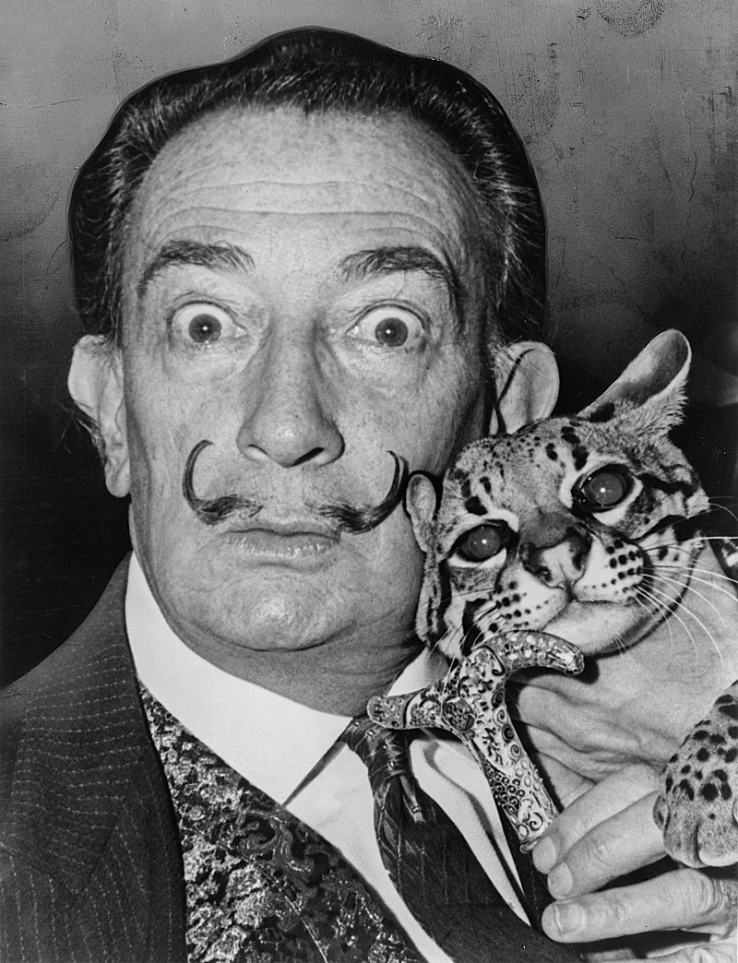
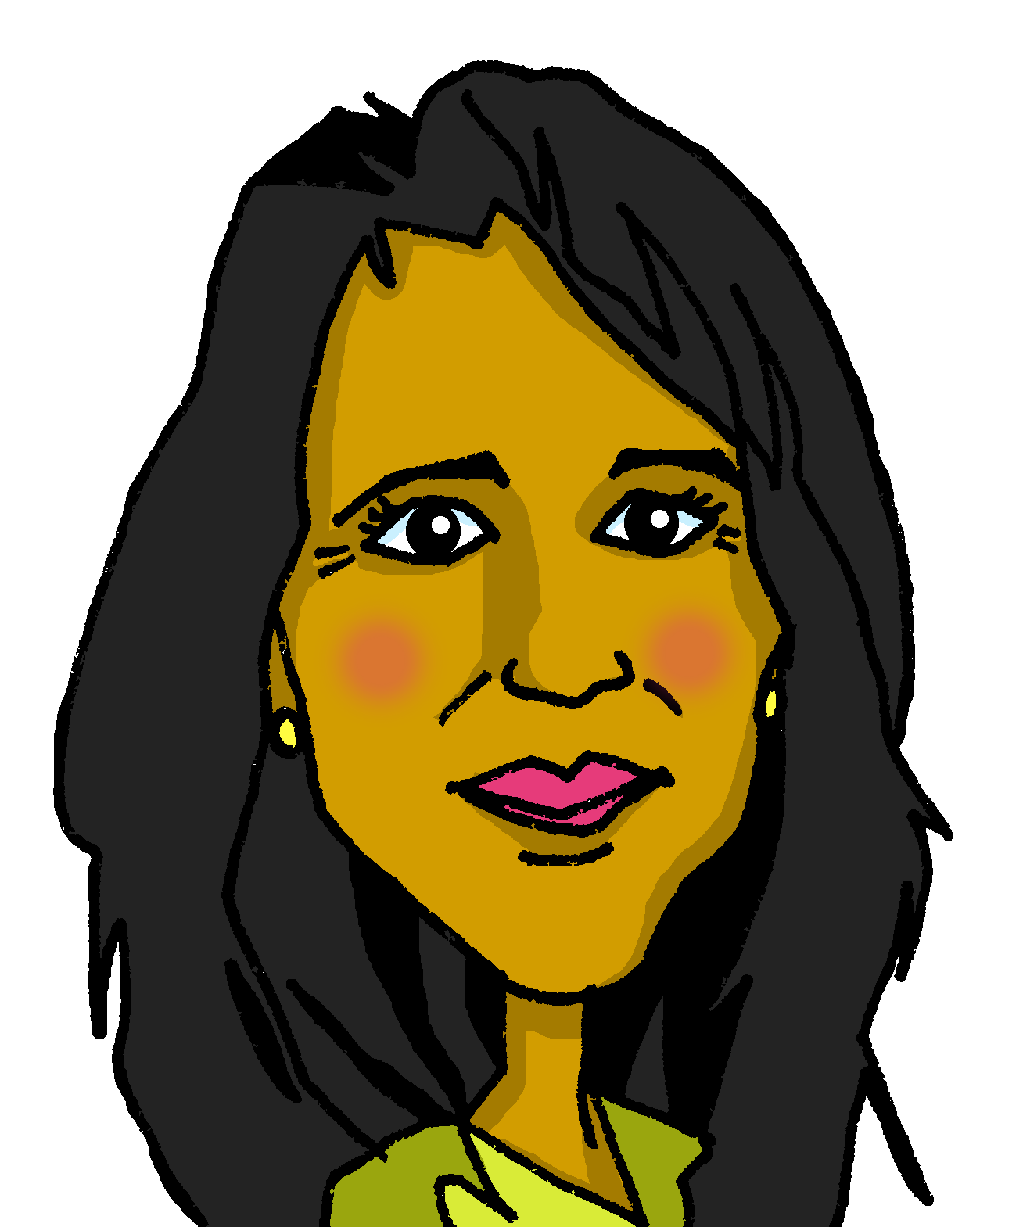
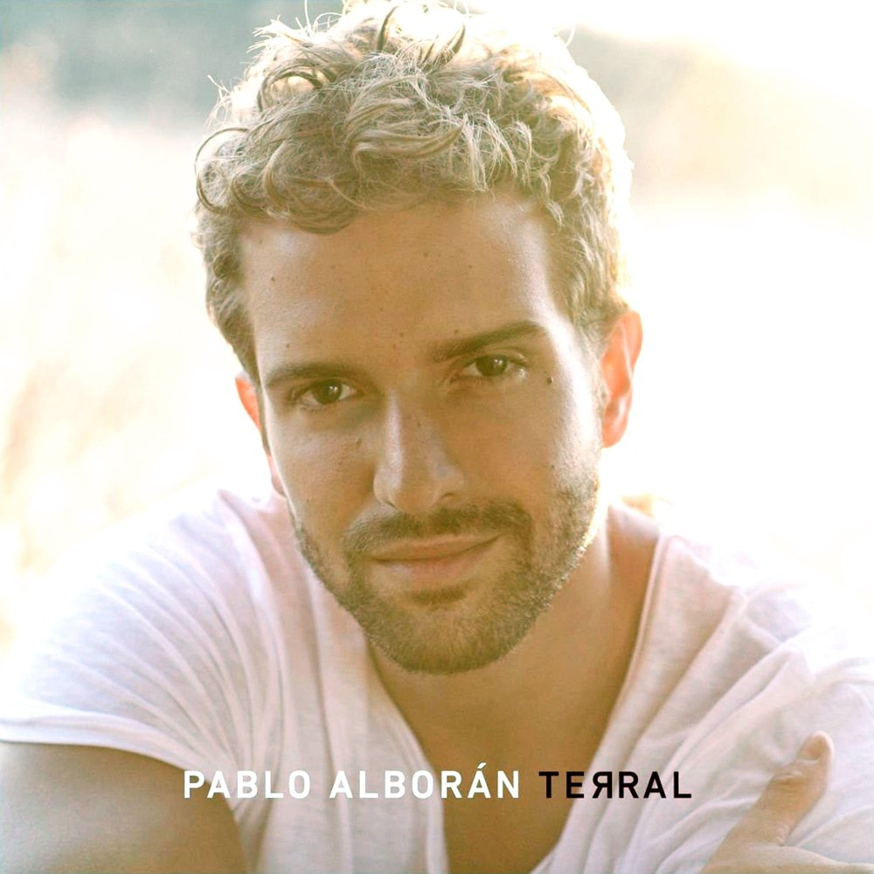
hablar
Lee las frases con tu compañero/a.
(el) pintor = painter
comprobar = to check, checking
Ahora escucha y comprueba* ✅.
1
La cantante Shakira tiene el pelo rubio | rubia | moreno | morena.
El cantante Pablo Alborán tiene el pelo corto | corta | largo | larga.
Elena tiene los ojos azul | azules | negro | negros.
El pintor* Salvador Dalí tiene los ojos
pequeño | pequeños | redondas | redondos.
2
3
4
Salvador Dalí
Pablo Alborán
Shakira
Elena
Notes:
Timing: 4 minutes (the 2nd (comprehension) part of this task is in the follow ups)
Aim: to correct adjectival form; to practise comprehension this week’s vocabulary in sentence form.
Procedure:
1. Pupils select the correct form of the adjective.
3. Click to correct answers.
4. If desired, click on the green buttons to hear the answers, too.
Transcript:
La cantante Shakira tiene el pelo rubio.
El cantante Pablo Alborán tien el pelo corto.
Elena tiene los ojos negros.
El pinto Salvador Dalí tiene los ojos redondos.
Note: the language in this task will be the focus of a comprehension task in the follow ups.
comprobar [1301] pintor [1848]
Pablo Alborán: https://www.last.fm/music/Pablo+Albor%C3%A1n/Terral/Pasos+de+cero
Dalí: De Roger Higgins, World Telegram staff photographer - Esta imagen está disponible en la División de Impresiones y Fotografías de la Biblioteca del Congreso de los Estados Unidos bajo el código digital cph.3c14985. Dominio público, https://commons.wikimedia.org/w/index.php?curid=1304063

Slide 12
¡adiós!
verde

